Slide 1
Chapter 3
Labor Productivity and Comparative Advantage: The Ricardian Model

Slide 2
Preview
Opportunity costs and comparative advantage
A one-factor Ricardian model
Production possibilities
Gains from trade
Wages and trade
Misconceptions about comparative advantage
Transportation costs and non-traded goods
Empirical evidence

Slide 3
Introduction
Theories of why trade occurs:
Differences across countries in labor, labor skills, physical capital, natural resources, and technology
Economies of scale (larger scale of production is more efficient)

Slide 4
Introduction (cont.)
Sources of differences across countries that lead to gains from trade:
The Ricardian model (Econ/Trade Chapter 3) examines differences in the productivity of labor (due to differences in technology) between countries.
The Heckscher-Ohlin model (Econ/Trade Chapter 4) examines differences in labor, labor skills, physical capital, land, or other factors of production between countries.

Slide 5
Comparative Advantage and Opportunity Cost
The Ricardian model uses the concepts of opportunity cost and comparative advantage.
The opportunity cost of producing something measures the cost of not being able to produce something else with the resources used.

Slide 6
Comparative Advantage and Opportunity Cost (cont.)
For example, a limited number of workers could produce either roses or computers.
The opportunity cost of producing computers is the amount of roses not produced.
The opportunity cost of producing roses is the amount of computers not produced.

Slide 7
Comparative Advantage and Opportunity Cost (cont.)
Suppose that in the United States 10 million roses could be produced with the same resources as 100,000 computers.
Suppose that in Colombia 10 million roses could be produced with the same resources as 30,000 computers.
Colombia has a lower opportunity cost of producing roses: has to stop producing fewer computers.

Slide 8
Comparative Advantage and Opportunity Cost (cont.)
A country has a comparative advantage in producing a good if the opportunity cost of producing that good is lower in the country than in other countries.
The United States has a comparative advantage in computer production.
Colombia has a comparative advantage in rose production.

Slide 9
Comparative Advantage and Opportunity Cost (cont.)
Suppose initially that Colombia produces computers and the United States produces roses, and that both countries want to consume computers and roses.
Can both countries be made better off?

Slide 10
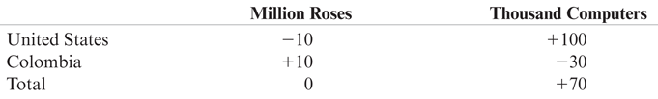
Table 3-1: Hypothetical Changes in Production

Slide 11
Comparative Advantage and Trade
When countries specialize in production in which they have a comparative advantage, more goods and services can be produced and consumed.
Have the United States stop growing roses and use those resources to make 100,000 computers instead. Have Colombia stop making 30,000 computers and grow roses instead.
If produce goods in which have a comparative advantage (the United States produces computers and Colombia roses), they could still consume the same 10 million roses, but could consume 100,000 – 30,000 = 70,000 more computers.

Slide 12
A One-Factor Ricardian Model
The simple example with roses and computers explains the intuition behind the Ricardian model.
We formalize these ideas by constructing a one-factor Ricardian model using the following assumptions:

Slide 13
A One-Factor Ricardian Model (cont.)
Labor is the only factor of production.
Labor productivity varies across countries due to differences in technology, but labor productivity in each country is constant.
The supply of labor in each country is constant.

Slide 14
A One-Factor Ricardian Model (cont.)
Two goods: wine and cheese.
Competition allows workers to be paid a wage equal to the value of what they produce, and allows them to work in the industry that pays the highest wage.
Two countries: home and foreign.

Slide 15
A One-Factor Ricardian Model (cont.)
A unit labor requirement indicates the constant number of hours of labor required to produce one unit of output.
a_{LC} is the unit labor requirement for cheese in the home country. For example, a_{LC} = 1 means that 1 hour of labor produces one pound of cheese in the home country.
a_{LW} is the unit labor requirement for wine in the home country. For example, a_{LW} = 2 means that 2 hours of labor produces one gallon of wine in the home country.
A high unit labor requirement means low labor productivity.

Slide 16
A One-Factor Ricardian Model (cont.)
Labor supply L indicates the total number of hours worked in the home country (a constant number).
Cheese production Q_{C} indicates how many pounds of cheese are produced.
Wine production Q_{W} indicates how many gallons of wine are produced.

Slide 17
Production Possibilities
The production possibility frontier (PPF) of an economy shows the maximum amount of a goods that can be produced for a fixed amount of resources.
The production possibility frontier of the home economy is:
a_{LC}Q_{C} + a_{LW}Q_{W} ≤ L
Total amount of labor resources
Labor required for each pound of cheese produced
Total pounds of cheese produced
Labor required for each gallon of wine produced
Total gallons of wine produced

Slide 18
Production Possibilities (cont.)
Maximum home cheese production is Q_{C} = L/a_{LC} when Q_{W} = 0.
Maximum home wine production is Q_{W} = L/a_{LW} when Q_{C} = 0.

Slide 19
Production Possibilities (cont.)
For example, suppose that the economy’s labor supply is 1,000 hours.
The PPF equation a_{LC}Q_{C} + a_{LW}Q_{W} ≤ L becomes Q_{C} + 2Q_{W} ≤ 1,000.
Maximum cheese production is 1,000 pounds.
Maximum wine production is 500 gallons.

Slide 20
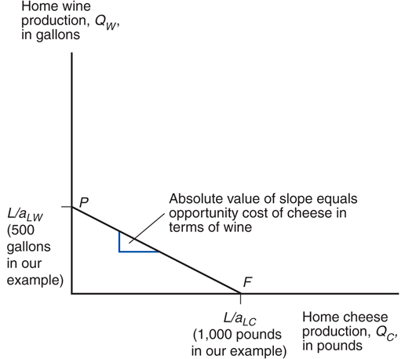
Fig. 3-1: Home’s Production Possibility Frontier

Slide 21
Production Possibilities (cont.)
The opportunity cost of cheese is how many gallons of wine Home must stop producing in order to make one more pound of cheese:
a_{LC} /a_{LW}
This cost is constant because the unit labor requirements are both constant.
The opportunity cost of cheese appears as the absolute value of the slope of the PPF.
Q_{W} = L/a_{LW} – (a_{LC} /a_{LW} )Q_{C}

Slide 22
Production Possibilities (cont.)
Producing an additional pound of cheese requires a_{LC} hours of labor.
Each hour devoted to cheese production could have been used instead to produce an amount of wine equal to
1 hour/(a_{LW} hours/gallon of wine)
= (1/a_{LW}) gallons of wine

Slide 23
Production Possibilities (cont.)
For example, if 1 hour of labor is moved to cheese production, that additional hour could have produced
1 hour/(2 hours/gallon of wine)
= ½ gallon of wine.
Opportunity cost of producing one pound of cheese is ½ gallon of wine not produced.

Slide 24
Relative Prices, Wages, and Supply
Let P_{C} be the price of cheese and P_{W} be the price of wine.
Due to competition,
hourly wages of cheese makers equal the value of the cheese produced in an hour: P_{C} /a_{LC}
hourly wages of wine makers equal the value of the wine produced in an hour: P_{W} /a_{LW}
Workers will choose to work in the industry that pays the higher wage.

Slide 25
Relative Prices, Wages, and Supply (cont.)
If the price of cheese relative to the price of wine exceeds the opportunity cost of producing cheese P_{C} /P_{W} > a_{LC} /a_{LW} ,
Then the wage in cheese will exceed the wage in wine w_{C} =P_{C} /a_{LC} > P_{W}/a_{LW} =w_{W}
So workers will make only cheese (the economy specializes in cheese production).

Slide 26
Relative Prices, Wages, and Supply (cont.)
If the price of cheese relative to the price of wine is less than the opportunity cost of producing cheese P_{C} /P_{W} < a_{LC} /a_{LW} ,
then the wage in cheese will be less than the wage in wine P_{C} /a_{LC} < P_{W}/a_{LW}
so workers will make only wine (the economy specializes in wine production).

Slide 27
Production, Prices, and Wages
If the price of cheese relative to the price of wine equals the opportunity cost of producing cheese P_{C} /P_{W} = a_{LC} /a_{LW} ,
then the wage in cheese equals the wage in wine P_{C} /a_{LC} = P_{W}/a_{LW}
so workers will be willing to make both wine and cheese.

Slide 28
Production, Prices, and Wages (cont.)
For example, suppose cheese sells for P_{C} = $4/pound and wine sells for P_{W} = $7/gallon.
Wage paid producing cheese is P_{C} /a_{LC} = ($4/pound)(1 pound/hour) = $4/hour.
Wage paid producing wine is P_{W} /a_{LW} = ($7/gallon)(1/2 gallon/hour) = $3.50/hour.
Workers would be willing to make only cheese (the relative price of cheese 4/7 exceeds the opportunity cost of cheese of ½).

Slide 29
Production, Prices, and Wages (cont.)
If the price of cheese drops to P_{C} = $3/pound:
Wage paid producing cheese drops to P_{C} /a_{LC} = ($3/pound)(1 pound/hour) = $3/hour.
Wage paid producing wine is still $3.50/hour if price of wine is still $7/gallon.
Now workers would be willing to make only wine (the relative price of cheese 3/7 is now less than the opportunity cost of cheese of ½).

Slide 30
Production, Prices, and Wages (cont.)
If the home country wants to consume both wine and cheese (in the absence of international trade), relative prices must adjust so that wages are equal in the wine and cheese industries.
If P_{C} /a_{LC} = P_{W} /a_{LW} workers will not care whether they work in the cheese industry or the wine industry, so that production of both goods can occur.
Production (and consumption) of both goods occurs when the relative price of a good equals the opportunity cost of producing that good:
P_{C} /P_{W} = a_{LC} /a_{LW}

Slide 31
Trade in the Ricardian Model
If the home country is more efficient in wine and cheese production, then it has an absolute advantage in all production:
its unit labor requirements for wine and cheese production are lower than those in the foreign country
a_{LC} < a*_{LC} and a_{LW} < a*_{LW}
where “*” notates foreign country variables

Slide 32
Trade in the Ricardian Model (cont.)
A country can be more efficient in producing both goods, but it will have a comparative advantage in only one good.
Even if a country is the most (or least) efficient producer of all goods, it still can benefit from trade.

Slide 33
Trade in the Ricardian Model (cont.)
Suppose that the home country has a comparative advantage in cheese production: its opportunity cost of producing cheese is lower than in the foreign country.
a_{LC} /a_{LW} < a*_{LC} /a*_{LW}
When the home country increases cheese production, it reduces wine production less than the foreign country would.

Slide 34
Trade in the Ricardian Model (cont.)
Since the slope of the PPF indicates the opportunity cost of cheese in terms of wine, Foreign’s PPF is steeper than Home’s.
To produce one pound of cheese, must stop producing more gallons of wine in Foreign than in Home.

Slide 35
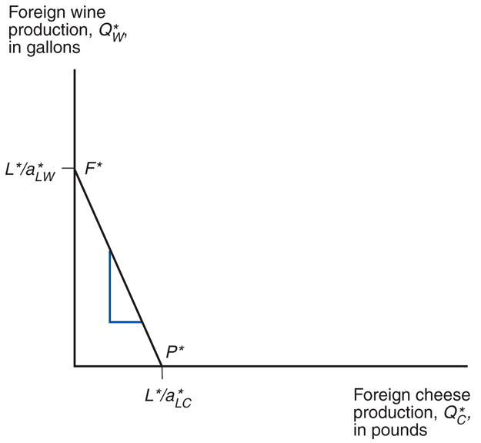
Fig. 3-2: Foreign’s Production Possibility Frontier

Slide 36
Trade in the Ricardian Model (cont.)
Before any trade occurs, the relative price of cheese to wine reflects the opportunity cost of cheese in terms of wine in each country.
In the absence of any trade, the relative price of cheese to wine will be higher in Foreign than in Home if Foreign has the higher opportunity cost of cheese.
It will be profitable to ship cheese from Home to Foreign (and wine from Foreign to Home) – where does the relative price of cheese to wine settle?

Slide 37
Trade in the Ricardian Model (cont.)
To see how all countries can benefit from trade, need to find relative prices when trade exists.
First calculate the world relative supply of cheese: the quantity of cheese supplied by all countries relative to the quantity of wine supplied by all countries
RS = (Q_{C} + Q*_{C} )/(Q_{W} + Q*_{W})

Slide 38
Relative Supply and Relative Demand
If the relative price of cheese falls below the opportunity cost of cheese in both countries P_{C} /P_{W} < a_{LC} /a_{LW} < a*_{LC} /a*_{LW,}
no cheese would be produced.
domestic and foreign workers would be willing to produce only wine (where wage is higher).

Slide 39
Relative Supply and Relative Demand (cont.)
When the relative price of cheese equals the opportunity cost in the home country P_{C} /P_{W} = a_{LC} /a_{LW} < a*_{LC} /a*_{LW} ,
domestic workers are indifferent about producing wine or cheese (wage when producing wine same as wage when producing cheese).
foreign workers produce only wine.

Slide 40
Relative Supply and Relative Demand (cont.)
When the relative price of cheese settles strictly in between the opportunity costs of cheese a_{LC} /a_{LW} < P_{c} /P_{W} < a*_{LC} /a*_{LW} ,
domestic workers produce only cheese (where their wages are higher).
foreign workers still produce only wine (where their wages are higher).
world relative supply of cheese equals Home’s maximum cheese production divided by Foreign’s maximum wine production (L / a_{LC} ) / (L*/ a*_{LW}).

Slide 41
Relative Supply and Relative Demand (cont.)
When the relative price of cheese equals the opportunity cost in the foreign country
a_{LC} /a_{LW} < P_{C} /P_{W} = a*_{LC} /a*_{LW} ,
foreign workers are indifferent about producing wine or cheese (wage when producing wine same as wage when producing cheese).
domestic workers produce only cheese.

Slide 42
Relative Supply and Relative Demand (cont.)
If the relative price of cheese rises above the opportunity cost of cheese in both countries
a_{LC} /a_{LW} < a*_{LC} /a*_{LW} < P_{C} /P_{W,}
no wine is produced.
home and foreign workers are willing to produce only cheese (where wage is higher).

Slide 43
Relative Supply and Relative Demand (cont.)
World relative supply is a step function:
First step at relative price of cheese equal to Home’s opportunity cost a_{LC} /a_{LW}, which equals 1/2 in the example.
Jumps when world relative supply of cheese equals Home’s maximum cheese production divided by Foreign’s maximum wine production (L / a_{LC} ) / (L*/ a*_{LW}), which equals 1 in the example.
Second step at relative price of cheese equal to Foreign’s opportunity cost a*_{LC} /a*_{LW}, which equals 2 in the example.

Slide 44
Relative Supply and Relative Demand (cont.)
Relative demand of cheese is the quantity of cheese demanded in all countries relative to the quantity of wine demanded in all countries.
As the price of cheese relative to the price of wine rises, consumers in all countries will tend to purchase less cheese and more wine so that the relative quantity demanded of cheese falls.
Case Study 3.1

Slide 45
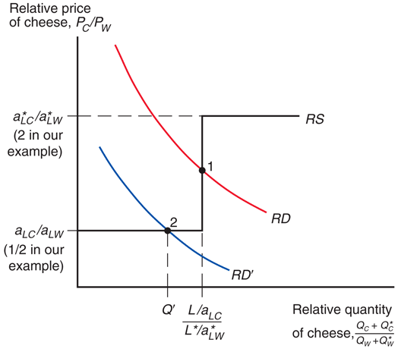
Fig. 3-3: World Relative Supply and Demand

Slide 46
Gains from Trade
Gains from trade come from specializing in the type of production which uses resources most efficiently, and using the income generated from that production to buy the goods and services that countries desire.
where “using resources most efficiently” means producing a good in which a country has a comparative advantage.

Slide 47
Gains from Trade (cont.)
Domestic workers earn a higher income from cheese production because the relative price of cheese increases with trade.
Foreign workers earn a higher income from wine production because the relative price of cheese decreases with trade (making cheese cheaper) and the relative price of wine increases with trade.

Slide 48
Gains from Trade (cont.)
Think of trade as an indirect method of production that converts cheese into wine or vice versa.
Without trade, a country has to allocate resources to produce all of the goods that it wants to consume.
With trade, a country can specialize its production and exchange for the mix of goods that it wants to consume.

Slide 49
Gains from Trade (cont.)
Consumption possibilities expand beyond the production possibility frontier when trade is allowed.
With trade, consumption in each country is expanded because world production is expanded when each country specializes in producing the good in which it has a comparative advantage.

Slide 50
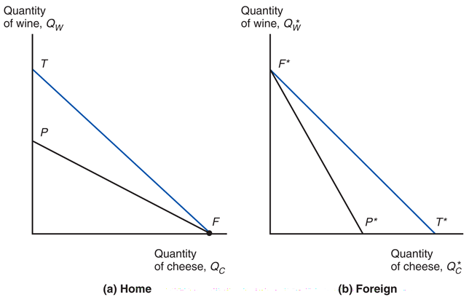
Fig. 3-4: Trade Expands Consumption Possibilities

Slide 51
A Numerical Example
Unit labor requirements for home and foreign countries
 | Cheese | Wine
Home | a_{LC} = 1 hour/lb | a_{LW} = 2 hours/gallon
Foreign | a*_{LC} = 6 hours/lb | a*_{LW} = 3 hours/gallon
What is the home country’s opportunity cost of producing cheese? a_{LC} /a_{LW} = ½, to produce one pound of cheese, stop producing ½ gallon of wine.

Slide 52
A Numerical Example (cont.)
The home country is more efficient in both industries, but has a comparative advantage only in cheese production.
1/2 = a_{LC} /a_{LW} < a*_{LC} /a*_{LW} = 2
The foreign country is less efficient in both industries, but has a comparative advantage in wine production.

Slide 53
A Numerical Example (cont.)
With trade, the equilibrium relative price of cheese to wine settles between the two opportunity costs of cheese.
Suppose that the intersection of RS and RD occurs at P_{C} /P_{W} = 1 so one pound of cheese trades for one gallon of wine.
Trade causes the relative price of cheese to rise in the home country and fall in foreign.

Slide 54
A Numerical Example (cont.)
With trade, the foreign country can buy one pound of cheese for P_{C} /P_{W} = one gallon of wine,
instead of stopping production of a*_{LC} /a*_{LW} = 2 gallons of wine to free up enough labor to produce one pound of cheese in the absence of trade.
Suppose L* = 3,000. The foreign country can trade its 1,000 gallons maximum production of wine for 1,000 pounds of cheese, instead of the 500 pounds of cheese it could produce itself.

Slide 55
A Numerical Example (cont.)
With trade, the home country can buy one gallon of wine for P_{W} /P_{C} = one pound of cheese,
instead of stopping production of a_{LW} /a_{LC} = two pounds of cheese to free up enough labor to produce one gallon of wine in the absence of trade.
The home country can trade its 1,000 pounds maximum production of cheese for 1,000 gallons of wine, instead of the 500 gallons of wine it could produce itself.
Case Study 3.2

Slide 56
Relative Wages
Relative wages are the wages of the home country relative to the wages in the foreign country.
Productivity (technological) differences determine relative wage differences across countries.
The home wage relative to the foreign wage will settle in between the ratio of how much better Home is at making cheese and how much better it is at making wine compared to Foreign.
Relative wages cause Home to have a cost advantage in only cheese and Foreign to have a cost advantage in only wine.

Slide 57
Relative Wages (cont.)
Suppose that P_{C} = $12/pound and P_{W} = $12/gallon.
Since domestic workers specialize in cheese production after trade, their hourly wages will be
P_{C}/a_{LC} = $12 /1= $12
Since foreign workers specialize in wine production after trade, their hourly wages will be
P_{W}/a*_{LW} = $12/3 = $4
The relative wage of domestic workers is therefore
$12/$4 = 3

Slide 58
Relative Wages (cont.)
The relative wage lies between the ratio of the productivities in each industry.
The home country is 6/1 = 6 times as productive in cheese production, but only 3/2 = 1.5 times as productive in wine production.
The home country has a wage 3 times higher than the foreign country.

Slide 59
Relative Wages (cont.)
These relationships imply that both countries have a cost advantage in production.
High wages can be offset by high productivity.
Low productivity can be offset by low wages.
In the home economy, producing one pound of cheese costs $12 (one worker paid $12/hr) but would have cost $24 (six paid $4/hr) in Foreign.
In the foreign economy, producing one gallon of wine costs $12 (three workers paid $4/hr) but would have cost $24 (two paid $12/hr) in Home.

Slide 60
Relative Wages (cont.)
Because foreign workers have a wage that is only 1/3 the wage of domestic workers, they are able to attain a cost advantage in wine production, despite low productivity.
Because domestic workers have a productivity that is 6 times that of foreign workers in cheese production, they are able to attain a cost advantage in cheese production, despite high wages.

Slide 61
Do Wages Reflect Productivity?
Do relative wages reflect relative productivities of the two countries?
Evidence shows that low wages are associated with low productivity.
Wage of most countries relative to the U.S. is similar to their productivity relative to the U.S.

Slide 62
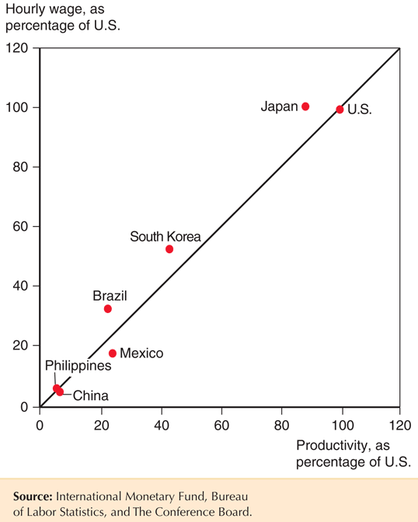
Productivity and Wages

Slide 63
Do Wages Reflect Productivity? (cont.)
Other evidence shows that wages rise as productivity rises.
As recently as 1975, wages in South Korea were only 5% of those of the United States.
As South Korea’s labor productivity rose (to about half of the U.S. level by 2007), so did its wages.

Slide 64
Misconceptions about Comparative Advantage
Free trade is beneficial only if a country is more productive than foreign countries.
But even an unproductive country benefits from free trade by avoiding the high costs for goods that it would otherwise have to produce domestically.
High costs derive from inefficient use of resources.
The benefits of free trade do not depend on absolute advantage, rather they depend on comparative advantage: specializing in industries that use resources most efficiently.

Slide 65
Misconceptions about Comparative Advantage (cont.)
Free trade with countries that pay low wages hurts high wage countries.
While trade may reduce wages for some workers, thereby affecting the distribution of income within a country, trade benefits consumers and other workers.
Consumers benefit because they can purchase goods more cheaply.
Producers/workers benefit by earning a higher income in the industries that use resources more efficiently, allowing them to earn higher prices and wages.

Slide 66
Misconceptions about Comparative Advantage (cont.)
Free trade exploits less productive countries whose workers make low wages.
While labor standards in some countries are less than exemplary compared to Western standards, they are so with or without trade.
Are high wages and safe labor practices alternatives to trade? Deeper poverty and exploitation may result without export production.
Consumers benefit from free trade by having access to cheaply (efficiently) produced goods.
Producers/workers benefit from having higher profits/wages—higher compared to the alternative.

Slide 67
Comparative Advantage with Many Goods
Suppose now there are N goods produced, indexed by i = 1,2,…N.
The home country’s unit labor requirement for good i is a_{Li}, and the corresponding foreign unit labor requirement is a*_{Li} .
Goods will be produced wherever cheapest to produce them.

Slide 68
Comparative Advantage with Many Goods (cont.)
Let w represent the wage rate in the home country and w* represent the wage rate in the foreign country.
If wa_{L1} < w*a*_{L1} then only the home country will produce good 1, since total wage payments are less there.
Or equivalently, if a*_{L1} /a_{L1} > w/w*, if the relative productivity of a country in producing a good is higher than the relative wage, then the good will be produced in that country.

Slide 69
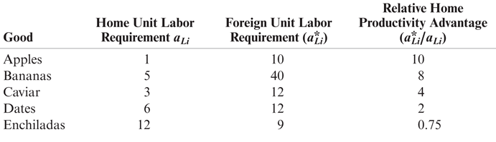
Table 3-2: Home and Foreign Unit Labor Requirements

Slide 70
Comparative Advantage with Many Goods (cont.)
Suppose there are 5 goods produced in the world: apples, bananas, caviar, dates, and enchiladas.
If w/w* = 3, the home country will produce apples, bananas, and caviar, while the foreign country will produce dates and enchiladas.
The relative productivities of the home country in producing apples, bananas, and caviar are higher than the relative wage.

Slide 71
Comparative Advantage with Many Goods (cont.)
If each country specializes in goods that use resources productively and trades the products for those that it wants to consume, then each benefits.
If a country tries to produce all goods for itself, resources are “wasted”.
The home country has high productivity in apples, bananas, and caviar that give it a cost advantage, despite its high wage.
The foreign country has low wages that give it a cost advantage, despite its low productivity in date production.

Slide 72
Comparative Advantage with Many Goods (cont.)
How is the relative wage determined?
By the relative supply of and relative (derived) demand for labor services.
The relative (derived) demand for home labor services falls when w/w* rises. As domestic labor services become more expensive relative to foreign labor services,
goods produced in the home country become more expensive, and demand for these goods and the labor services to produce them falls.
fewer goods will be produced in the home country, further reducing the demand for domestic labor services.

Slide 73
Comparative Advantage with Many Goods (cont.)
Suppose w/w* increases from 3 to 3.99:
The home country would produce apples, bananas, and caviar, but the demand for these goods and the labor to produce them would fall as the relative wage rises.
Suppose w/w* increases from 3.99 to 4.01:
Caviar is now too expensive to produce in the home country, so the caviar industry moves to the foreign country, causing a discrete (abrupt) drop in the demand for domestic labor services.
Consider similar effects as w/w* rises from 0.75 to 10.

Slide 74
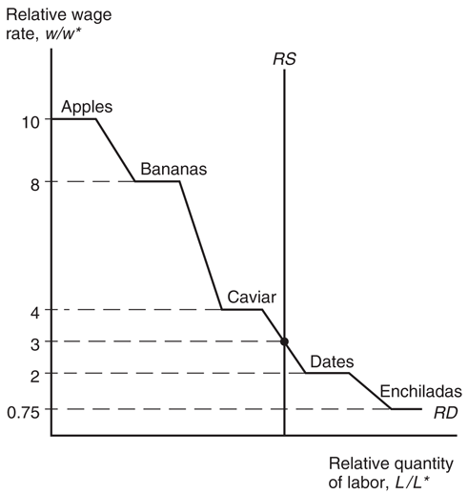
Fig. 3-5: Determination of Relative Wages
Notes:
Putting the relative supply curve and the relative demand curve together, we can determine the equilibrium relative quantity of labor demanded in each country, the equilibrium relative wage and the production that occurs in each country. In other words, the equilibrium relative wage, the equilibrium relative quantity of labor and comparative advantage depend on the relative size of each country (which determines the relative labor supply and the position of the RS curve) and the relative demand of the goods produced (which determines the shape and the position of the RD curve).

Slide 75
Comparative Advantage with Many Goods (cont.)
Finally, suppose that relative supply of labor is independent of w/w* and is fixed at an amount determined by the populations in the home and foreign countries.

Slide 76
Transportation Costs and Non-traded Goods
The Ricardian model predicts that countries completely specialize in production.
But this rarely happens for three main reasons:
More than one factor of production reduces the tendency of specialization (Econ/Trade Chapters 4-5).
Protectionism (Econ/Trade Chapters 9–12).
Transportation costs reduce or prevent trade, which may cause each country to produce the same good or service.

Slide 77
Transportation Costs and Non-traded Goods (cont.)
Nontraded goods and services (ex., haircuts and auto repairs) exist due to high transport costs.
Countries tend to spend a large fraction of national income on nontraded goods and services.
This fact has implications for the gravity model and for models that consider how income transfers across countries affect trade.

Slide 78
Empirical Evidence
Do countries export those goods in which their productivity is relatively high?
The ratio of U.S. to British exports in 1951 compared to the ratio of U.S. to British labor productivity in 26 manufacturing industries suggests yes.
At this time the U.S. had an absolute advantage in all 26 industries, yet the ratio of exports was low in the least productive sectors of the U.S.

Slide 79
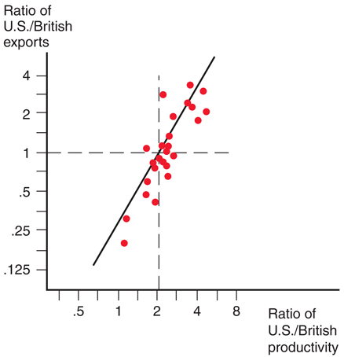
Fig. 3-6: Productivity and Exports

Slide 80
Empirical Evidence (cont.)
A very poor country like Bangladesh can have comparative advantage in clothing despite being less productive in clothing than other countries such as China because it is even less productive compared to China in other sectors.
Productivity (output per worker) in Bangladesh is only 28 percent of China’s on average.
In apparel, productivity in Bangladesh was about 77 percent of China’s, creating strong comparative advantage in apparel for Bangladesh.

Slide 81
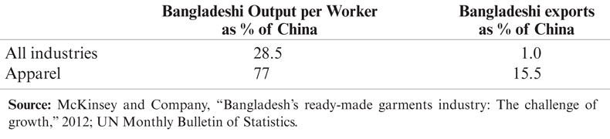
Table 3-3: Bangladesh versus China, 2011

Slide 82
Empirical Evidence (cont.)
The main implications of the Ricardian model are well supported by empirical evidence:
productivity differences play an important role in international trade
comparative advantage (not absolute advantage) matters for trade

Slide 83
Summary
Differences in the productivity of labor across countries generate comparative advantage.
A country has a comparative advantage in producing a good when its opportunity cost of producing that good is lower than in other countries.

Slide 84
Summary (cont.)
Countries export goods in which they have a comparative advantage - high productivity or low wages give countries a cost advantage.
With trade, the relative price settles in between what the relative prices were in each country before trade.

Slide 85
Summary (cont.)
Trade benefits all countries due to the relative price of the exported good rising: income for workers who produce exports rises, and imported goods become less expensive.
Empirical evidence supports trade based on comparative advantage, although transportation costs and other factors prevent complete specialization in production.

