Slide 1
Chapter 4
Specific Factors and Income Distribution

Slide 2
Chapter Organization
Introduction
The Specific Factors Model
International Trade in the Specific Factors Model
Income Distribution and the Gains from Trade
Political Economy of Trade: A Preliminary View
International Labor Mobility
Summary

Slide 3
Introduction
If trade is so good for the economy, why is there such opposition?
Two main reasons why international trade has strong effects on the distribution of income within a country:
Resources cannot move immediately or costlessly from one industry to another.
Industries differ in the factors of production they demand.

Slide 4
The Specific Factors Model
The specific factors model allows trade to affect income distribution.
Assumptions of the model:
Two goods, cloth and food.
Three factors of production: labor (L), capital (K) and land (T for terrain).
Perfect competition prevails in all markets.
Case Study 4.1

Slide 5
The Specific Factors Model (cont.)
Cloth produced using capital and labor (but not land).
Food produced using land and labor (but not capital).
Labor is a mobile factor that can move between sectors.
Land and capital are both specific factors used only in the production of one good.

Slide 6
The Specific Factors Model (cont.)
How much of each good does the economy produce?
The production function for cloth gives the quantity of cloth that can be produced given any input of capital and labor:
Q_{C} = Q_{C} (K, L_{C}) (4-1)
Q_{C} is the output of cloth
K is the capital stock
L_{C} is the labor force employed in cloth

Slide 7
The Specific Factors Model (cont.)
The production function for food gives the quantity of food that can be produced given any input of land and labor:
Q_{F} = Q_{F} (T, L_{F}) (4-2)
Q_{F} is the output of food
T is the supply of land
L_{F} is the labor force employed in food

Slide 8
Production Possibilities
How does the economy’s mix of output change as labor is shifted from one sector to the other?
When labor moves from food to cloth, food production falls while output of cloth rises.
Figure 4-1 illustrates the production function for cloth.

Slide 9
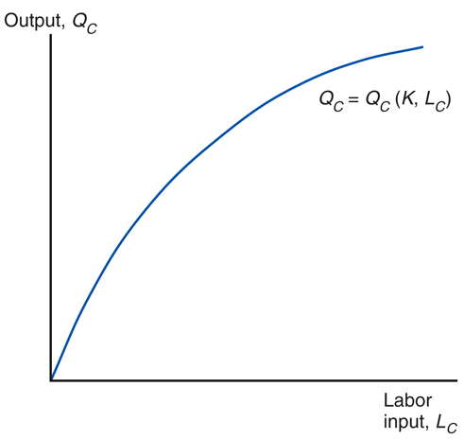
Fig. 4-1: The Production Function for Cloth

Slide 10
Production Possibilities (cont.)
The shape of the production function reflects the law of diminishing marginal returns.
Adding one worker to the production process (without increasing the amount of capital) means that each worker has less capital to work with.
Therefore, each additional unit of labor adds less output than the last.
Figure 4-2 shows the marginal product of labor, which is the increase in output that corresponds to an extra unit of labor.

Slide 11
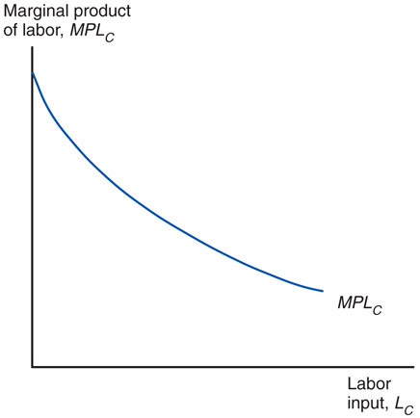
Fig. 4-2: The Marginal Product of Labor

Slide 12
Production Possibilities (cont.)
For the economy as a whole, the total labor employed in cloth and food must equal the total labor supply:
L_{C} + L_{F} = L (4-3)
Use these equations to derive the production possibilities frontier of the economy.

Slide 13
Production Possibilities (cont.)
Use a four-quadrant diagram to construct production possibilities frontier in Figure 4-3.
Lower left quadrant indicates the allocation of labor.
Lower right quadrant shows the production function for cloth from Figure 4-1.
Upper left quadrant shows the corresponding production function for food.
Upper right quadrant indicates the combinations of cloth and food that can be produced.

Slide 14
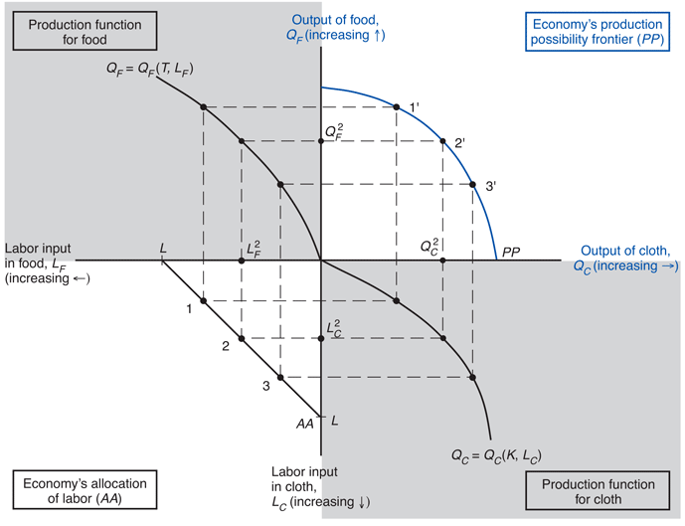
Fig. 4-3: The Production Possibility Frontier in the Specific Factors Model

Slide 15
Production Possibilities (cont.)
Why is the production possibilities frontier curved?
Diminishing returns to labor in each sector cause the opportunity cost to rise when an economy produces more of a good.
Opportunity cost of cloth in terms of food is the slope of the production possibilities frontier – the slope becomes steeper as an economy produces more cloth.

Slide 16
Production Possibilities (cont.)
Opportunity cost of producing one more yard of cloth is MPL_{F}/MPL_{C} pounds of food.
To produce one more yard of cloth, you need 1/MPL_{C} hours of labor.
To free up one hour of labor, you must reduce output of food by MPL_{F} pounds.
To produce less food and more cloth, employ less in food and more in cloth.
The marginal product of labor in food rises and the marginal product of labor in cloth falls, so MPL_{F}/MPL_{C} rises.

Slide 17
Prices, Wages, and Labor Allocation
How much labor is employed in each sector?
Need to look at supply and demand in the labor market.
Demand for labor:
In each sector, employers will maximize profits by demanding labor up to the point where the value produced by an additional hour equals the marginal cost of employing a worker for that hour.

Slide 18
Prices, Wages, and Labor Allocation (cont.)
The demand curve for labor in the cloth sector:
MPL_{C} x P_{C} = w (4-4)
The wage equals the value of the marginal product of labor in manufacturing.
The demand curve for labor in the food sector:
MPL_{F} x P_{F} = w (4-5)
The wage equals the value of the marginal product of labor in food.

Slide 19
Prices, Wages, and Labor Allocation (cont.)
Figure 4-4 represents labor demand in the two sectors.
The demand for labor in the cloth sector is MPL_{C} from Figure 4-2 multiplied by P_{C}.
The demand for labor in the food sector is measured from the right.
The horizontal axis represents the total labor supply L.

Slide 20
Prices, Wages, and Labor Allocation (cont.)
The two sectors must pay the same wage because labor can move between sectors.
If the wage were higher in the cloth sector, workers would move from making food to making cloth until the wages become equal.
Or if the wage were higher in the food sector, workers would move in the other direction.
Where the labor demand curves intersect gives the equilibrium wage and allocation of labor between the two sectors.

Slide 21
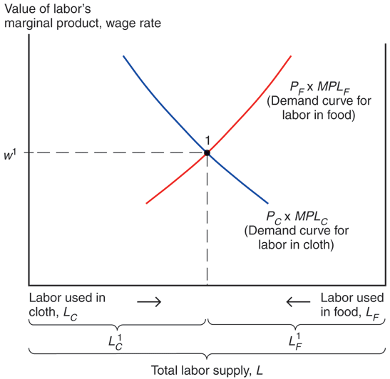
Fig. 4-4: The Allocation of Labor

Slide 22
Prices, Wages, and Labor Allocation (cont.)
At the production point, the production possibility frontier must be tangent to a line whose slope is minus the price of cloth divided by that of food.
Relationship between relative prices and output:
-MPL_{F}/MPL_{C} = -P_{C}/P_{F} (4-6)

Slide 23
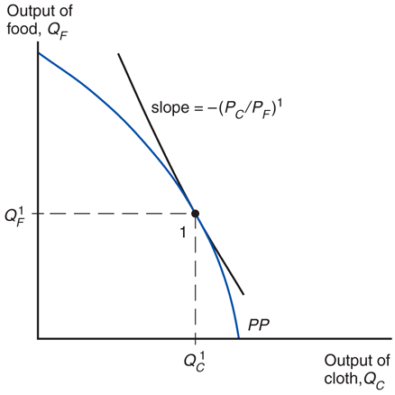
Fig. 4-5: Production in the Specific Factors Model

Slide 24
Prices, Wages, and Labor Allocation (cont.)
What happens to the allocation of labor and the distribution of income when the prices of food and cloth change?
Two cases:
An equal proportional change in prices
A change in relative prices

Slide 25
Prices, Wages, and Labor Allocation (cont.)
When both prices change in the same proportion, no real changes occur.
The wage rate (w) rises in the same proportion as the prices, so real wages (i.e., the ratios of the wage rate to the prices of goods) are unaffected.
The real incomes of capital owners and landowners also remain the same.

Slide 26
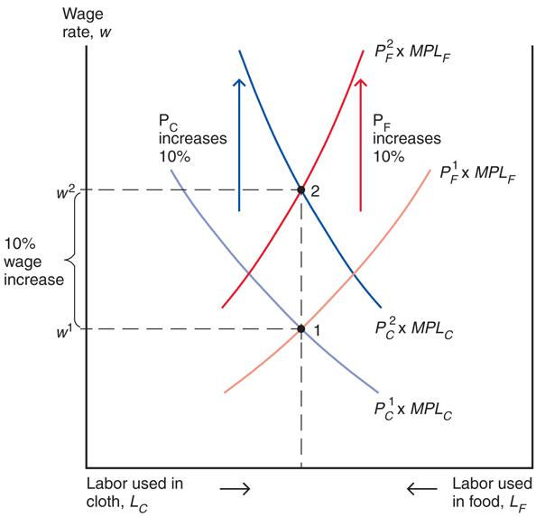
Fig. 4-6: An Equal-Proportional Increase in the Prices of Cloth and Food

Slide 27
Prices, Wages, and Labor Allocation (cont.)
When only P_{C} rises, labor shifts from the food sector to the cloth sector and the output of cloth rises while that of food falls.
The wage rate (w) does not rise as much as P_{C} since cloth employment increases and thus the marginal product of labor in that sector falls.

Slide 28
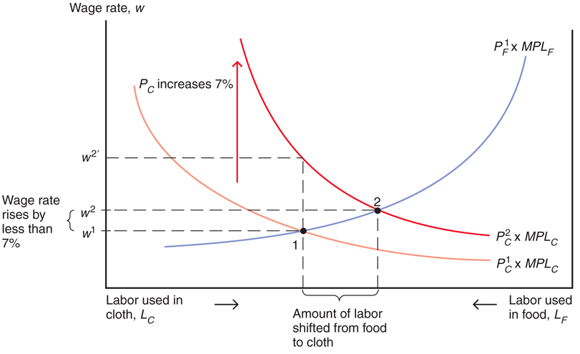
Fig. 4-7: A Rise in the Price of Cloth

Slide 29
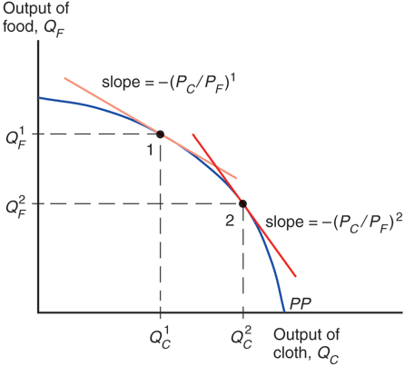
Fig. 4-8: The Response of Output to a Change in the Relative Price of Cloth

Slide 30
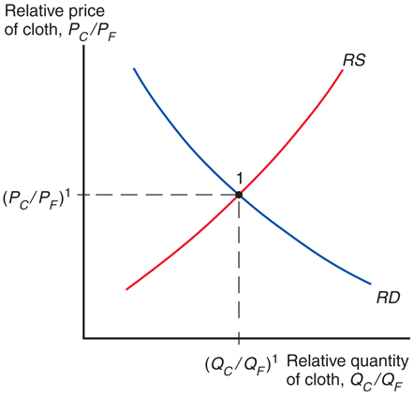
Fig. 4-9: Determination of Relative Prices

Slide 31
Prices, Wages, and Labor Allocation (cont.)
Relative Prices and the Distribution of Income
Suppose that P_{C} increases by 10%. Then, the wage would rise by less than 10%.
What is the economic effect of this price increase on the incomes of the following three groups?
Workers, owners of capital, and owners of land

Slide 32
Prices, Wages, and Labor Allocation (cont.)
Owners of capital are definitely better off.
Landowners are definitely worse off.
Workers: cannot say whether workers are better or worse off:
Depends on the relative importance of cloth and food in workers’ consumption.

Slide 33
International Trade in the Specific Factors Model
Trade and Relative Prices
The relative price of cloth prior to trade is determined by the intersection of the economy’s relative supply of cloth and its relative demand.
Free trade relative price of cloth is determined by the intersection of world relative supply of cloth and world relative demand.
Opening up to trade increases the relative price of cloth in an economy whose relative supply of cloth is larger than for the world as a whole.

Slide 34
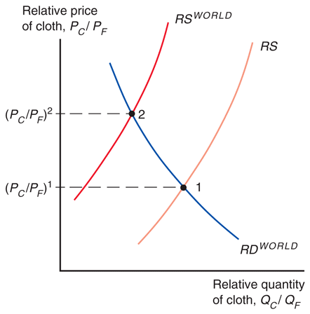
Fig. 4-10: Trade and Relative Prices

Slide 35
International Trade in the Specific Factors Model (cont.)
Gains from trade
Without trade, the economy’s output of a good must equal its consumption.
International trade allows the mix of cloth and food consumed to differ from the mix produced.
The country cannot spend more than it earns:
P_{C} x D_{C} + P_{F} x D_{F} = P_{C} x Q_{C} +P_{F} x Q_{F}

Slide 36
International Trade in the Specific Factors Model (cont.)
The economy as a whole gains from trade.
It imports an amount of food equal to the relative price of cloth times the amount of cloth exported:
D_{F} - Q_{F} = (P_{C} / P_{F}) x (Q_{C} – D_{C} )
It is able to afford amounts of cloth and food that the country is not able to produce itself.
The budget constraint with trade lies above the production possibilities frontier in Figure 4-11.

Slide 37
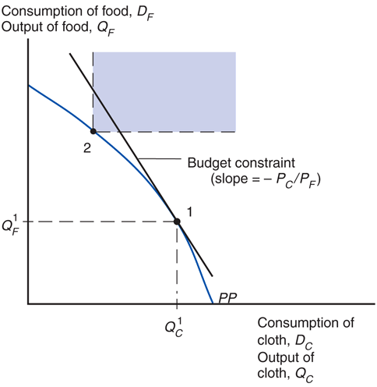
Fig. 4-11: Budget Constraint for a Trading Economy and Gains from Trade

Slide 38
Income Distribution and Trade Politics
International trade shifts the relative price of cloth to food, so factor prices change.
Trade benefits the factor that is specific to the export sector of each country, but hurts the factor that is specific to the import-competing sectors.
Trade has ambiguous effects on mobile factors.

Slide 39
Income Distribution and Trade Politics (cont.)
Trade benefits a country by expanding choices.
Possible to redistribute income so that everyone gains from trade.
Those who gain from trade could compensate those who lose and still be better off themselves.
That everyone could gain from trade does not mean that they actually do – redistribution usually hard to implement.

Slide 40
Income Distribution and Trade Politics (cont.)
Trade often produces losers as well as winners.
Optimal trade policy must weigh one group’s gain against another’s loss.
Some groups may need special treatment because they are already relatively poor (e.g., shoe and garment workers in the United States).
Most economists strongly favor free trade.

Slide 41
Income Distribution and Trade Politics (cont.)
Typically, those who gain from trade are a much less concentrated, informed, and organized group than those who lose.
Example: Consumers and producers in the U.S. sugar industry, respectively
Governments usually provide a “safety net” of income support to cushion the losses to groups hurt by trade (or other changes).

Slide 42
Trade and Unemployment
Trade shifts jobs from import-competing to export sector.
Process not instantaneous – some workers will be unemployed as they look for new jobs.
How much unemployment can be traced back to trade?
From 2001 to 2010, only about 2% of involuntary displacements stemmed from import competition or plants moved overseas.

Slide 43
Trade and Unemployment (cont.)
Figure 4-12 shows that there is no obvious correlation between unemployment rate and imports relative to GDP for the U.S.
Unemployment is primarily a macroeconomic problem that rises during recessions.
The best way to reduce unemployment is by adopting macroeconomic policies to help the economy recover, not by adopting trade protection.

Slide 44
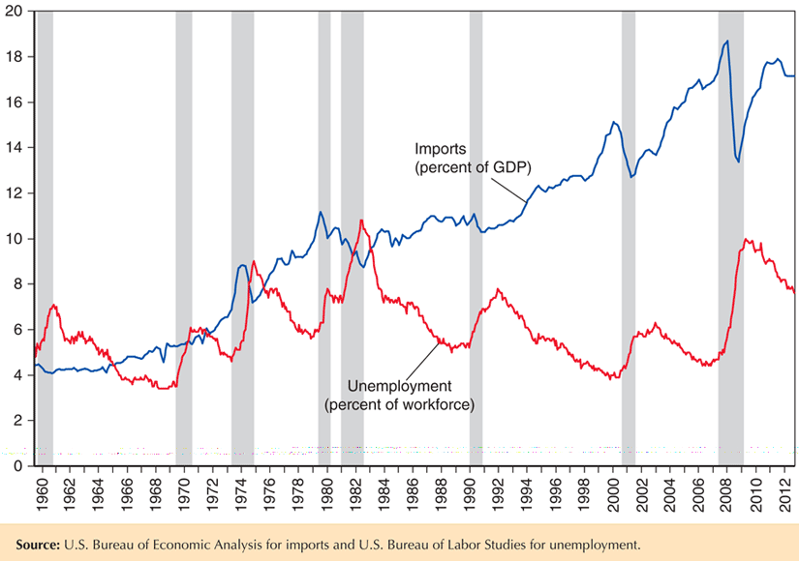
Fig. 4-12: Unemployment and Import Penetration in the United States

Slide 45
International Labor Mobility
Movements in factors of production include
labor migration
the transfer of financial assets through international borrowing and lending
transactions of multinational corporations involving direct ownership of foreign firms
Like movements of goods and services (trade), movements of factors of production are politically sensitive and are often restricted.

Slide 46
International Labor Mobility (cont.)
Why does labor migrate and what effects does labor migration cause?
Workers migrate to wherever wages are highest.
Consider movement of labor across countries instead of across sectors.
Suppose two countries produce one non-traded good (food) using two factors of production:
Land cannot move across countries but labor can.

Slide 47
International Labor Mobility (cont.)
Figure 4-13 finds the equilibrium wage and labor allocation with migration across countries.
Similar to how Figure 4-4 determined the equilibrium allocation of labor between sectors.
Start with OL¹ workers in Home earning a lower real wage (point C) than the L¹O* workers in Foreign (point B).
Lower wage due to less land per worker (lower productivity).
Workers in the home country want to migrate to the foreign country where they can earn more.

Slide 48
International Labor Mobility (cont.)
If no obstacles to labor migration exist, workers move from Home to Foreign until the purchasing power of wages is equal across countries (point A), with OL² workers in Home and L²O* workers in Foreign.
Emigration from Home decreases the supply of labor and raises real wage of the workers who remain there.
Workers who start in the Home country earn more due to emigration regardless if they are among those who leave.
Immigration into Foreign increases the supply of labor and decreases the real wage there.
Wages do not actually equalize, due to barriers to migration such as policies restricting immigration and natural reluctance to move.

Slide 49
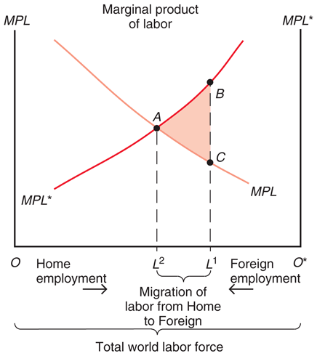
Fig. 4-13: Causes and Effects of International Labor Mobility

Slide 50
International Labor Mobility (cont.)
Labor migration increases world output.
The value of foreign output rises by the area under its MPL* curve from L¹ to L²
The value of domestic output falls by the area under its MPL curve from L² to L¹
World output rises because labor moves to where it is more productive (where wages are higher).
The value of world output is maximized when the marginal productivity of labor is the same across countries.

Slide 51
International Labor Mobility (cont.)
Workers initially in Home benefit while workers in Foreign are hurt by inflows of other workers.
Landowners in Foreign gain from the inflow of workers decreasing real wages and increasing output.
Landowners in Home are hurt by the outflow of workers increasing real wages and decreasing output.

Slide 52
International Labor Mobility (cont.)
Does migration lead to the wage changes predicted?
Table 4-1 shows that real wages in 1870 were much higher in destination countries than in origin countries.
Up until the eve of World War I in 1913, wages rose faster in origin countries than in destination countries (except Canada).
Migration moved the world toward more equalized wages.

Slide 53
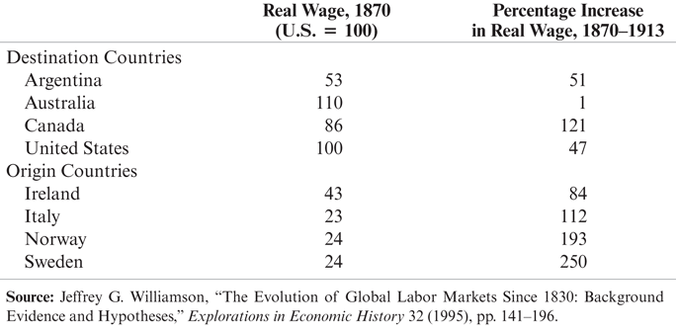
Table 4-1

Slide 54
International Labor Mobility (cont.)
In the early 20th century, share of immigrants in the U.S. increased dramatically.
Vast immigration from Eastern and Southern Europe.
Tight restrictions on immigration imposed in the 1920s.
Immigrants were a minor force in the U.S. by the 1960s.
New wave of immigration began around 1970.
Mostly from Latin America and Asia.
As of 2012, 16.1% of the U.S. labor force is foreign-born.

Slide 55
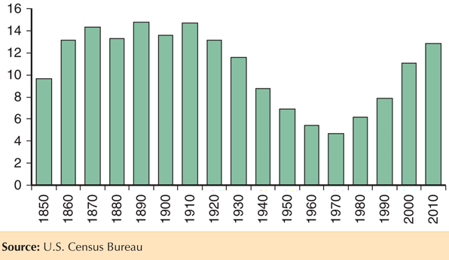
Fig. 4-14: Foreign-Born Population as a Percentage of the U.S. Population

Slide 56
Immigration and the U.S. Economy
The largest increase in recent immigration occurred among workers with the lowest education levels, making less educated workers more abundant.
possibly reduced wages for native-born workers with low education levels while raising wages for the more educated
widening wage gap between less educated workers and highly educated workers.

Slide 57
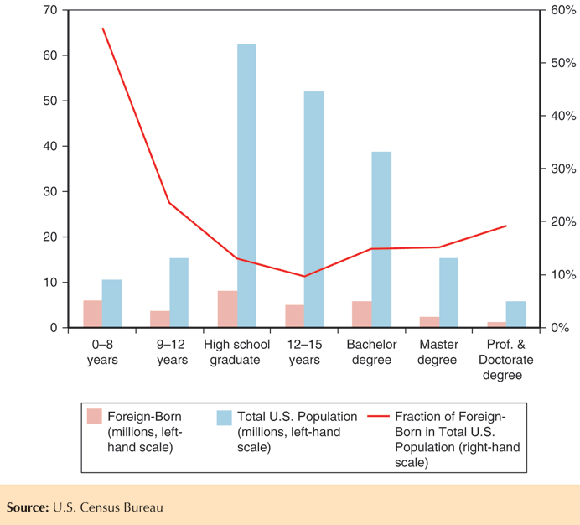
Fig. 4-15: Foreign-Born and Total U.S. Population Over 25 Years Old by Educational Attainment

Slide 58
Summary
International trade often has strong effects on the distribution of income within countries - produces losers as well as winners.
Income distribution effects arise for two reasons:
Factors of production cannot move costlessly and quickly from one industry to another.
Changes in an economy’s output mix have differential effects on the demand for different factors of production.

Slide 59
Summary (cont.)
International trade affects the distribution of income in the specific factors model.
Factors specific to export sectors in each country gain from trade, while factors specific to import-competing sectors lose.
Mobile factors that can work in either sector may either gain or lose.

Slide 60
Summary (cont.)
Trade nonetheless produces overall gains in the sense that those who gain could in principle compensate those who lose while still remaining better off than before.
Most economists would prefer to address the problem of income distribution directly, rather than by restricting trade.
Those hurt by trade are often better organized than those who gain, causing trade restrictions to be adopted.

Slide 61
Summary (cont.)
Labor migrates to countries with higher labor productivity and higher real wages, where labor is scarce.
Real wages fall due to immigration and rise due to emigration.
World output increases.
Real wages across countries are far from equal due to differences in technology and due to immigration barriers.

Slide 62
Chapter 4
Appendix:
Further Details on Specific Factors

Slide 63
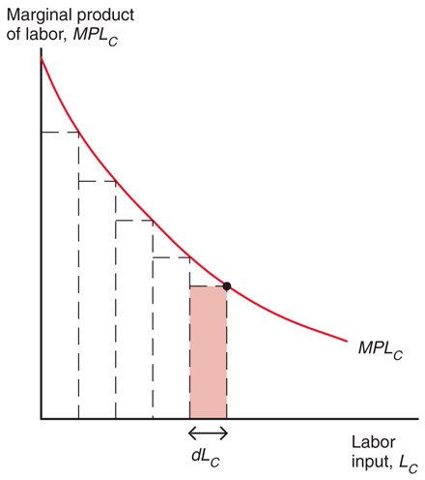
Fig. 4A-1: Showing that Output Is Equal to the Area under the Marginal Product Curve

Slide 64
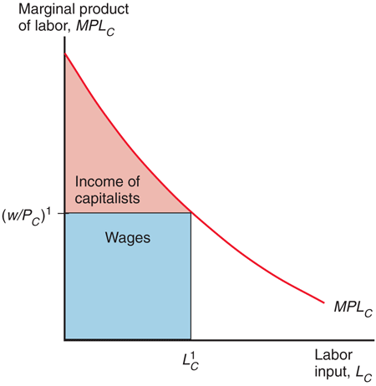
Fig. 4A-2: The Distribution of Income within the Cloth Sector

Slide 65
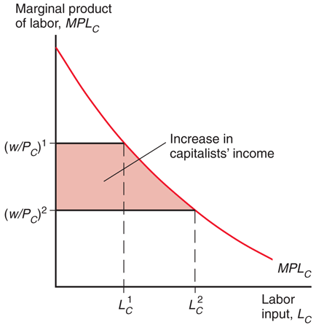
Fig. 4A-3: A Rise in P_{C} Benefits the Owners of Capital

Slide 66
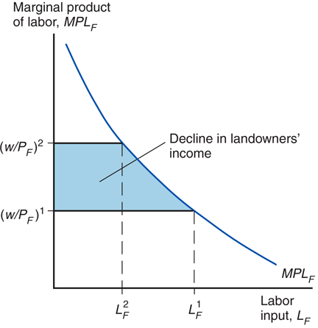
Fig. 4A-4: A Rise in P_{C} Hurts Landowners

