Slide 1
Chapter 5
Resources and Trade: The Heckscher-Ohlin Model

Slide 2
Preview
Production possibilities
Changing the mix of inputs
Relationships among factor prices and goods prices, and resources and output
Trade in the Heckscher-Ohlin model
Factor price equalization
Trade and income distribution
Empirical evidence

Slide 3
Introduction
In addition to differences in labor productivity, trade occurs due to differences in resources across countries.
The Heckscher-Ohlin theory argues that trade occurs due to differences in labor, labor skills, physical capital, capital, or other factors of production across countries.
Countries have different relative abundance of factors of production.
Production processes use factors of production with different relative intensity.

Slide 4
Two-Factor Heckscher-Ohlin Model
Two countries: home and foreign.
Two goods: cloth and food.
Two factors of production: labor and capital.
The mix of labor and capital used varies across goods.
The supply of labor and capital in each country is constant and varies across countries.
In the long run, both labor and capital can move across sectors, equalizing their returns (wage and rental rate) across sectors.

Slide 5
Production Possibilities
With more than one factor of production, the opportunity cost in production is no longer constant and the PPF is no longer a straight line. Why?
Numerical example:
K = 3000, total amount of capital available for production
L = 2000, total amount of labor available for production

Slide 6
Production Possibilities (cont.)
Suppose use a fixed mix of capital and labor in each sector.
a_{KC} = 2, capital used to produce one yard of cloth
a_{LC} = 2, labor used to produce one yard of cloth
a_{KF} = 3, capital used to produce one calorie of food
a_{LF} = 1, labor used to produce one calorie of food

Slide 7
Production Possibilities (cont.)
Production possibilities are influenced by both capital and labor:
a_{KC}Q_{C} + a_{KF}Q_{F} ≤ K
a_{LC}Q_{C} + a_{LF}Q_{F} ≤ L
Total amount of capital resources
Capital used for each yard of cloth production
Capital used for each calorie of food production
Total calories of food production
Total yards of
cloth production
Total amount of
labor resources
Labor used for each yard of cloth production
Labor required for each calorie of food production

Slide 8
Production Possibilities (cont.)
Constraint on capital that capital used cannot exceed supply:
2Q_{C} + 3Q_{F} ≤ 3000
Constraint on labor that labor used cannot exceed labor supply:
2Q_{C} + Q_{F} ≤ 2000

Slide 9
Production Possibilities (cont.)
Economy must produce subject to both constraints – i.e., it must have enough capital and labor.
Without factor substitution, the production possibilities frontier is the interior of the two factor constraints.

Slide 10
Production Possibilities (cont.)
Max food production 1000 (point 1) fully uses capital, with excess labor.
Max cloth 1000 (point 2) fully uses labor, with excess capital.
Intersection of labor and capital constraints occurs at 500 calories of food and 750 yards of cloth (point 3).

Slide 11
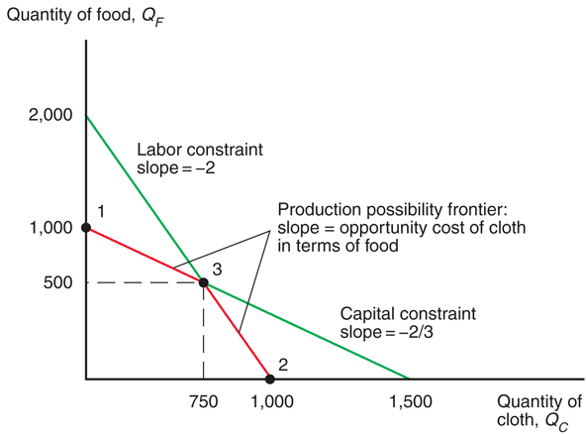
Fig. 5-1: The Production Possibility Frontier without Factor Substitution

Slide 12
Production Possibilities (cont.)
The opportunity cost of producing one more yard of cloth, in terms of food, is not constant:
low (2/3 in example) when the economy produces a low amount of cloth and a high amount of food
high (2 in example) when the economy produces a high amount of cloth and a low amount of food
Why? Because when the economy devotes more resources towards production of one good, the marginal productivity of those resources tends to be low so that the opportunity cost is high.

Slide 13
Production Possibilities (cont.)
The above PPF equations do not allow substitution of capital for labor in production.
Unit factor requirements are constant along each line segment of the PPF.
If producers can substitute one input for another in the production process, then the PPF is curved (bowed).
Opportunity cost of cloth increases as producers make more cloth.

Slide 14
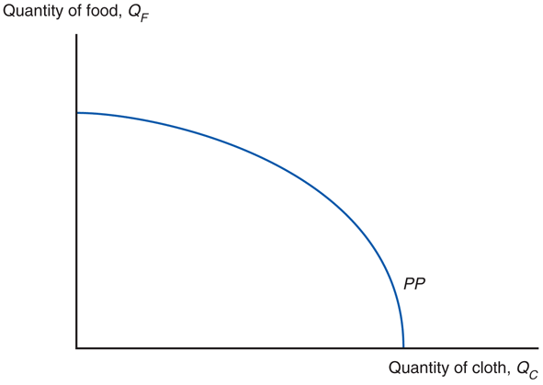
Fig. 5-2: The Production Possibility Frontier with Factor Substitution

Slide 15
Production Possibilities (cont.)
What does the country produce?
The economy produces at the point that maximizes the value of production, V.
An isovalue line is a line representing a constant value of production, V:
V = P_{C} Q_{C} + P_{F} Q_{F}
where P_{C} and P_{F} are the prices of cloth and food.
slope of isovalue line is – (P_{C} /P_{F})

Slide 16
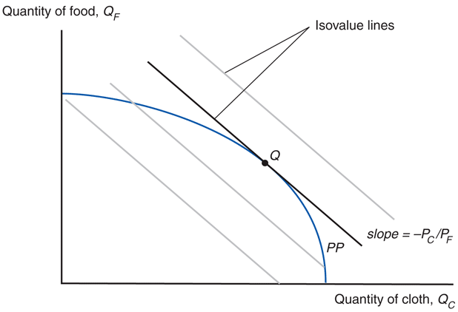
Fig. 5-3: Prices and Production

Slide 17
Production Possibilities (cont.)
Given the relative price of cloth, the economy produces at the point Q that touches the highest possible isovalue line.
At that point, the relative price of cloth equals the slope of the PPF, which equals the opportunity cost of producing cloth.
The trade-off in production equals the trade-off according to market prices.

Slide 18
Choosing the Mix of Inputs
Producers may choose different amounts of factors of production used to make cloth or food.
Their choice depends on the wage, w, paid to labor and the rental rate, r, paid when renting capital.
As the wage w increases relative to the rental rate r, producers use less labor and more capital in the production of both food and cloth.

Slide 19
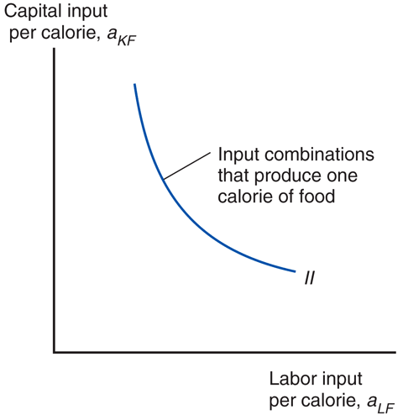
Fig. 5-4: Input Possibilities in Food Production

Slide 20
Choosing the Mix of Inputs (cont.)
Assume that at any given factor prices, cloth production uses more labor relative to capital than food production uses:
a_{LC} /a_{KC} > a_{LF} /a_{KF} or L_{C} /K_{C} > L_{F} /K_{F}
Production of cloth is relatively labor intensive, while production of food is relatively land intensive.
Relative factor demand curve for cloth CC lies outside that for food FF.

Slide 21
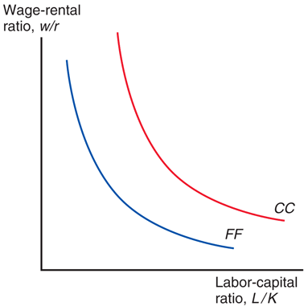
Fig. 5-5: Factor Prices and Input Choices

Slide 22
Factor Prices and Goods Prices
In competitive markets, the price of a good should equal its cost of production, which depends on the factor prices.
How changes in the wage and rent affect the cost of producing a good depends on the mix of factors used.
An increase in the rental rate of capital should affect the price of food more than the price of cloth since food is the capital intensive industry.
Changes in w/r are tied to changes in P_{C} /P_{W}.

Slide 23
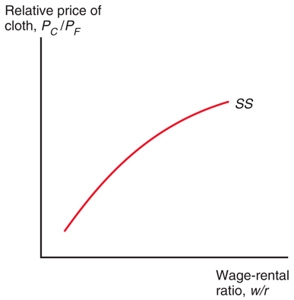
Fig. 5-6: Factor Prices and Goods Prices

Slide 24
Factor Prices and Goods Prices (cont.)
Stolper-Samuelson theorem: If the relative price of a good increases, then the real wage or rental rate of the factor used intensively in the production of that good increases, while the real wage or rental rate of the other factor decreases.
Any change in the relative price of goods alters the distribution of income.

Slide 25
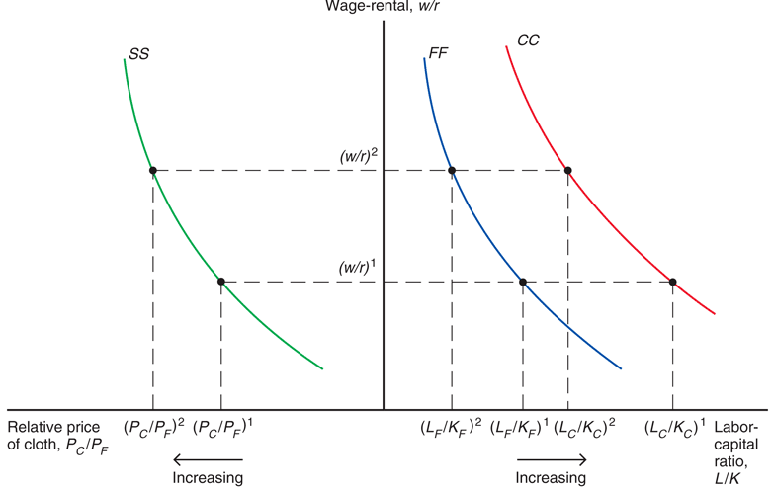
Fig. 5-7: From Goods Prices to Input Choices
Notes:
Suppose the price of cloth relative to the price of food is calculated as (P_{C}/P_{F})₁. If we also know the direct relationship between relative output prices and relative factor prices given by the SS curve, then we can determine relative factor prices--the wage/rental ratio. Once we determine the wage/rental ratio and determine the CC and FF curves, we can determine the capital to labor ratio in both the cloth and food industries.
In sum, given output prices, we can determine not only factor prices, but factor levels in the Heckscher-Ohlin model.

Slide 26
Factor Prices and Goods Prices (cont.)
An increase in the relative price of cloth, P_{C} /P_{F}, is predicted to
raise income of workers relative to that of capital owners, w/r.
raise the ratio of capital to labor services, K/L, used in both industries.
raise the real income (purchasing power) of workers and lower the real income of capital owners.

Slide 27
Resources and Output
How do levels of output change when the economy’s resources change?
Rybczynski theorem: If you hold output prices constant as the amount of a factor of production increases, then the supply of the good that uses this factor intensively increases and the supply of the other good decreases.

Slide 28
Resources and Output (cont.)
Assume an economy’s labor force grows, which implies that its ratio of labor to capital L/K increases.
Expansion of production possibilities is biased toward cloth.
At a given relative price of cloth, the ratio of labor to capital used in both sectors remains constant.
To employ the additional workers, the economy expands production of the relatively labor-intensive good cloth and contracts production of the relatively capital-intensive good food.

Slide 29
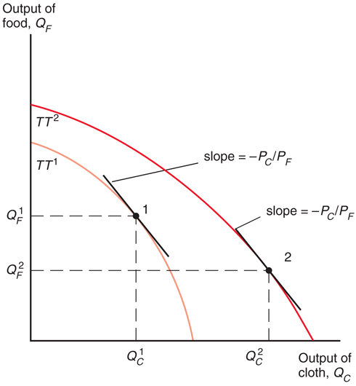
Fig. 5-8: Resources and Production Possibilities

Slide 30
Resources and Output (cont.)
An economy with a high ratio of labor to capital produces a high output of cloth relative to food.
Suppose that Home is relatively abundant in labor and Foreign in capital:
L/K > L*/ K*
Likewise, Home is relatively scarce in capital and Foreign in labor.
Home will be relatively efficient at producing cloth because cloth is relatively labor intensive.

Slide 31
Trade in the Heckscher-Ohlin Model
The countries are assumed to have the same technology and the same tastes.
With the same technology, each economy has a comparative advantage in producing the good that relatively intensively uses the factors of production in which the country is relatively well endowed.
With the same tastes, the two countries will consume cloth to food in the same ratio when faced with the same relative price of cloth under free trade.

Slide 32
Trade in the Heckscher-Ohlin Model (cont.)
Since cloth is relatively labor intensive, at each relative price of cloth to food, Home will produce a higher ratio of cloth to food than Foreign.
Home will have a larger relative supply of cloth to food than Foreign.
Home’s relative supply curve lies to the right of Foreign’s.

Slide 33
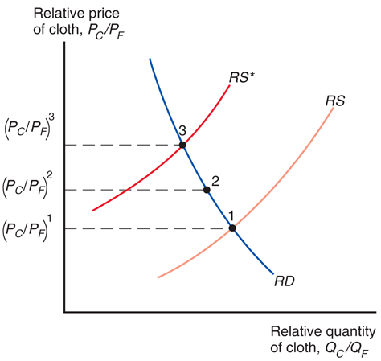
Fig. 5-9: Trade Leads to a Convergence of Relative Prices

Slide 34
Trade in the Heckscher-Ohlin Model (cont.)
Like the Ricardian model, the Heckscher-Ohlin model predicts a convergence of relative prices with trade.
With trade, the relative price of cloth rises in the relatively labor abundant (home) country and falls in the relatively labor scarce (foreign) country.

Slide 35
Trade in the Heckscher-Ohlin Model (cont.)
Relative prices and the pattern of trade: In Home, the rise in the relative price of cloth leads to a rise in the relative production of cloth and a fall in relative consumption of cloth.
Home becomes an exporter of cloth and an importer of food.
The decline in the relative price of cloth in Foreign leads it to become an importer of cloth and an exporter of food.

Slide 36
Trade in the Heckscher-Ohlin Model (cont.)
Heckscher-Ohlin theorem: The country that is abundant in a factor exports the good whose production is intensive in that factor.
This result generalizes to a correlation:
Countries tend to export goods whose production is intensive in factors with which the countries are abundantly endowed.

Slide 37
Trade and the Distribution of Income
Changes in relative prices can affect the earnings of labor and capital.
A rise in the price of cloth raises the purchasing power of labor in terms of both goods while lowering the purchasing power of capital in terms of both goods.
A rise in the price of food has the reverse effect.

Slide 38
Trade and the Distribution of Income (cont.)
Thus, international trade can affect the distribution of income, even in the long run:
Owners of a country’s abundant factors gain from trade, but owners of a country’s scarce factors lose.
Factors of production that are used intensively by the import-competing industry are hurt by the opening of trade – regardless of the industry in which they are employed.

Slide 39
Trade and the Distribution of Income (cont.)
Compared with the rest of the world, the United States is abundantly endowed with highly skilled labor while low-skilled labor is correspondingly scarce.
International trade has the potential to make low-skilled workers in the United States worse off - not just temporarily, but on a sustained basis.

Slide 40
Trade and the Distribution of Income (cont.)
Changes in income distribution occur with every economic change, not only international trade.
Changes in technology, changes in consumer preferences, exhaustion of resources and discovery of new ones all affect income distribution.
Economists put most of the blame on technological change and the resulting premium paid on education as the major cause of increasing income inequality in the US.
It would be better to compensate the losers from trade (or any economic change) than prohibit trade.
The economy as a whole does benefit from trade.

Slide 41
Trade and the Distribution of Income (cont.)
There is a political bias in trade politics: potential losers from trade are better politically organized than the winners from trade.
Losses are usually concentrated among a few, but gains are usually dispersed among many.
Each of you pays about $8/year to restrict imports of sugar, and the total cost of this policy is about $2 billion/year.
The benefits of this program total about $1 billion, but this amount goes to relatively few sugar producers.

Slide 42
North-South Trade and Income Inequality
Over the last 40 years, countries like South Korea, Mexico, and China have exported to the U.S. goods intensive in unskilled labor (ex., clothing, shoes, toys, assembled goods).
At the same time, income inequality has increased in the U.S., as wages of unskilled workers have grown slowly compared to those of skilled workers.
Did the former trend cause the latter trend?

Slide 43
North-South Trade and Income Inequality (cont.)
The Heckscher-Ohlin model predicts that owners of relatively abundant factors will gain from trade and owners of relatively scarce factors will lose from trade.
Little evidence supporting this prediction exists.
According to the model, a change in the distribution of income occurs through changes in output prices, but there is no evidence of a change in the prices of skill-intensive goods relative to prices of unskilled-intensive goods.

Slide 44
North-South Trade and Income Inequality (cont.)
According to the model, wages of unskilled workers should increase in unskilled labor abundant countries relative to wages of skilled labor, but in some cases the reverse has occurred:
Wages of skilled labor have increased more rapidly in Mexico than wages of unskilled labor.
But compared to the U.S. and Canada, Mexico is supposed to be abundant in unskilled workers.

Slide 45
North-South Trade and Income Inequality (cont.)
Even if the model were exactly correct, trade is a small fraction of the U.S. economy, so its effects on U.S. prices and wages prices should be small.
The majority view of trade economists is that the villain is not trade but rather new production technologies that put a greater emphasis on worker skills (such as the widespread introduction of computers and other advanced technologies in the workplace).

Slide 46
Skill-Biased Technological Change and Income Inequality
Even though skilled labor becomes relatively more expensive, in panel (b) producers in both sectors respond to the skill-biased technological change by increasing their employment of skilled workers relative to unskilled workers.
The trade explanation in panel (a) predicts an opposite response for employment in both sectors.
A widespread increase in the skilled labor ratios for most sectors in the U.S. economy points to the skill-biased technological explanation.

Slide 47
Skill-Biased Technological Change and Income Inequality (cont.)
Trade likely has been an indirect contributor to increases in wage inequality, by accelerating the process of technological change.
Firms that begin to export may upgrade to more skill-intensive production technologies.
Trade liberalization can then generate widespread technological change by inducing a large proportion of firms to make such technology-upgrade choices.
Breaking up the production process across countries can increase the relative demand for skilled workers in developed countries similar to skill-biased technological change.

Slide 48
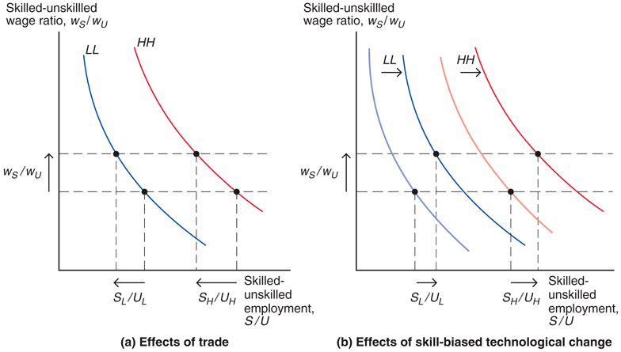
Fig. 5-10: Increased Wage Inequality: Trade or Skill-Biased Technological Change?

Slide 49
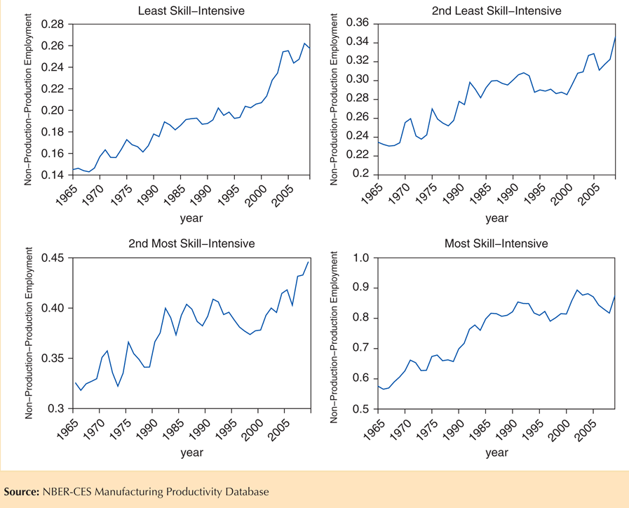
Fig. 5-11: Evolution of U.S. Non-Production–Production Employment Ratios in Four Groups of Sectors

Slide 50
Factor Price Equalization
Unlike the Ricardian model, the Heckscher-Ohlin model predicts that factor prices will be equalized among countries that trade.
Free trade equalizes relative output prices.
Due to the connection between output prices and factor prices, factor prices are also equalized.
Trade increases the demand of goods produced by relatively abundant factors, indirectly increasing the demand of these factors, raising the prices of the relatively abundant factors.

Slide 51
Factor Price Equalization (cont.)
In the real world, factor prices are not equal across countries.
The model assumes that trading countries produce the same goods, but countries may produce different goods if their factor ratios radically differ.
The model also assumes that trading countries have the same technology, but different technologies could affect the productivities of factors and therefore the wages/rates paid to these factors.

Slide 52
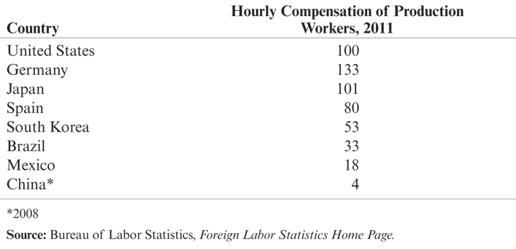
Table 5-1: Comparative International Wage Rates (United States = 100)

Slide 53
Factor Price Equalization (cont.)
The model also ignores trade barriers and transportation costs, which may prevent output prices and thus factor prices from equalizing.
The model predicts outcomes for the long run, but after an economy liberalizes trade, factors of production may not quickly move to the industries that intensively use abundant factors.
In the short run, the productivity of factors will be determined by their use in their current industry, so that their wage/rental rate may vary across countries.

Slide 54
Empirical Evidence on the Heckscher-Ohlin Model
Tests on US data
Leontief found that U.S. exports were less capital-intensive than U.S. imports, even though the U.S. is the most capital-abundant country in the world: Leontief paradox.
Tests on global data
Bowen, Leamer, and Sveikauskas tested the Heckscher-Ohlin model on data from 27 countries and confirmed the Leontief paradox on an international level.

Slide 55
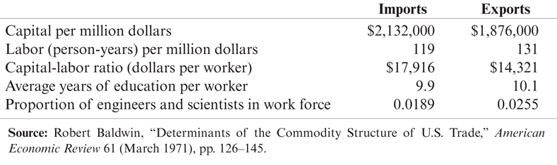
Table 5-2: Factor Content of U.S. Exports and Imports for 1962

Slide 56
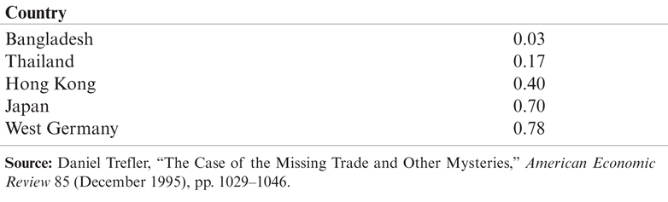
Table 5-3: Estimated Technological Efficiency, 1983 (United States = 1)

Slide 57
Empirical Evidence of the Heckscher-Ohlin Model (cont.)
Because the Heckscher-Ohlin model predicts that factor prices will be equalized across trading countries, it also predicts that factors of production will produce and export a certain quantity goods until factor prices are equalized.
In other words, a predicted value of services from factors of production will be embodied in a predicted volume of trade between countries.

Slide 58
Empirical Evidence of the Heckscher-Ohlin Model (cont.)
But because factor prices are not equalized across countries, the predicted volume of trade is much larger than actually occurs.
A result of “missing trade” discovered by Daniel Trefler.
The reason for this “missing trade” appears to be the assumption of identical technology among countries.
Technology affects the productivity of workers and therefore the value of labor services.
A country with high technology and a high value of labor services would not necessarily import a lot from a country with low technology and a low value of labor services.

Slide 59
Empirical Evidence of the Heckscher-Ohlin Model (cont.)
An important study by Donald Davis and David Weinstein showed that if relax the assumption of common technologies, along with assumptions underlying factor price equalization (countries produce the same goods and costless trade equalizes prices of goods):
then the predictions for the direction and volume of the factor content of trade line-up well with empirical evidence and ultimately generate a good fit.
Difficulty finding support for the predictions of the “pure” Heckscher-Ohlin model can be blamed on some of the assumptions made.

Slide 60
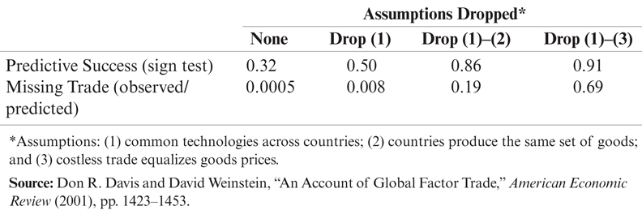
Table 5-4: A Better Empirical Fit for the Factor Content of Trade

Slide 61
Empirical Evidence of the Heckscher-Ohlin Model (cont.)
Contrast the exports of labor-abundant, skill-scarce nations in the developing world with the exports of skill-abundant, labor-scarce (rich) nations.
The exports of the three developing countries to the United States are concentrated in sectors with the lowest skill-intensity.
The exports of the three skill abundant countries to the United States are concentrated in sectors with higher skill intensity.

Slide 62
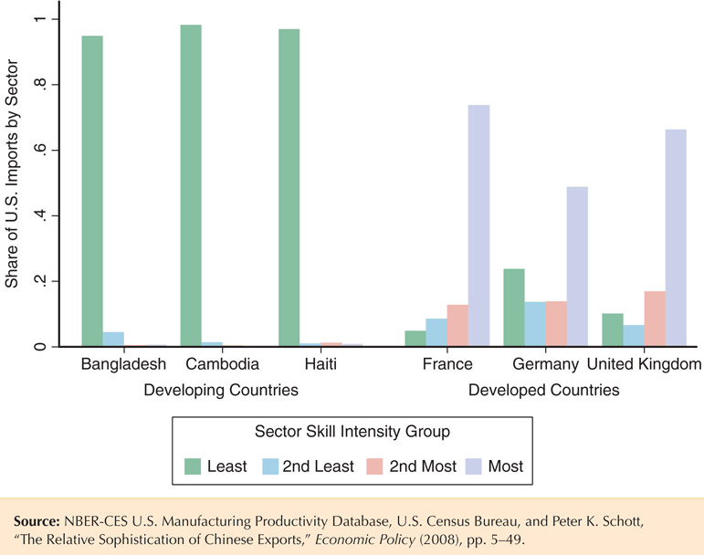
Fig. 5-12: Export Patterns for a Few Developed and Developing Countries, 2008–2012

Slide 63
Empirical Evidence of the Heckscher-Ohlin Model (cont.)
Or compare how exports change when a country such as China grows and becomes relatively more skill-abundant:
The concentration of exports in high-skill sectors steadily increases over time.
In the most recent years, the greatest share of exports is transacted in the highest skill-intensity sectors, whereas exports were concentrated in the lowest skill-intensity sectors in the earlier years.

Slide 64
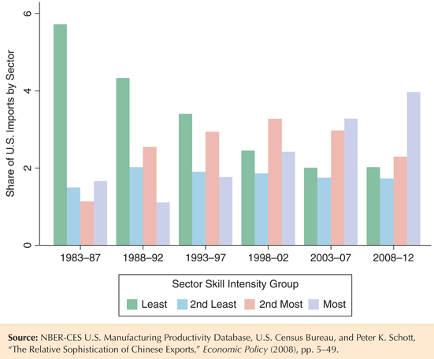
Fig. 5-13: Changing Pattern of Chinese Exports over Time

Slide 65
Summary
Substitution of factors used in the production process generates a curved PPF.
When an economy produces a low quantity of a good, the opportunity cost of producing that good is low.
When an economy produces a high quantity of a good, the opportunity cost of producing that good is high.
When an economy produces the most value it can from its resources, the opportunity cost of producing a good equals the relative price of that good in markets.

Slide 66
Summary (cont.)
An increase in the relative price of a good causes the real wage or real rental rate of the factor used intensively in the production of that good to increase,
while the real wage and real rental rates of other factors of production decrease.
If output prices remain constant as the amount of a factor of production increases, then the supply of the good that uses this factor intensively increases, and the supply of the other good decreases.

Slide 67
Summary (cont.)
An economy exports goods that are relatively intensive in its relatively abundant factors of production and imports goods that are relatively intensive in its relatively scarce factors of production.
Owners of abundant factors gain, while owners of scarce factors lose with trade.
A country as a whole is predicted to be better off with trade, so winners could in theory compensate the losers within each country.

Slide 68
Summary (cont.)
The Heckscher-Ohlin model predicts that relative output prices and factor prices will equalize, neither of which occurs in the real world.
Empirical support of the Heckscher-Ohlin model is weak except for cases involving trade between high-income countries and low/middle- income countries or when technology differences are included.

Slide 69
Chapter 5
Appendix: Factor Prices, Goods Prices, and Production Decisions

Slide 70
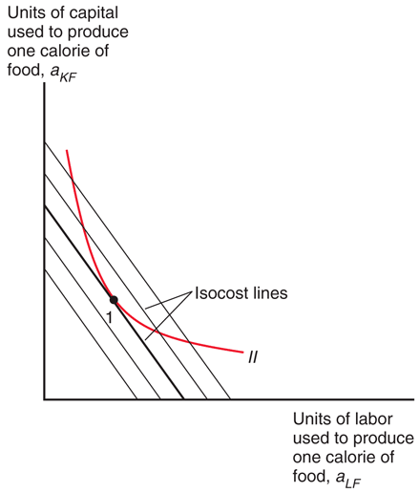
Fig. 5A-1: Choosing the Optimal Labor-Capital Ratio

Slide 71
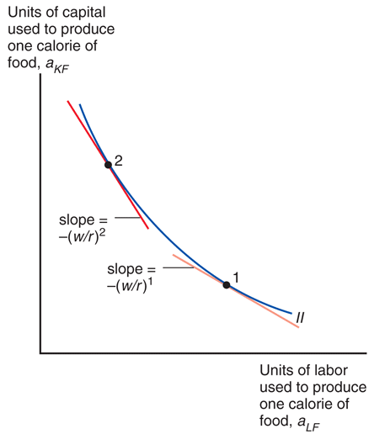
Fig. 5A-2: Changing the Wage-Rental Ratio

Slide 72
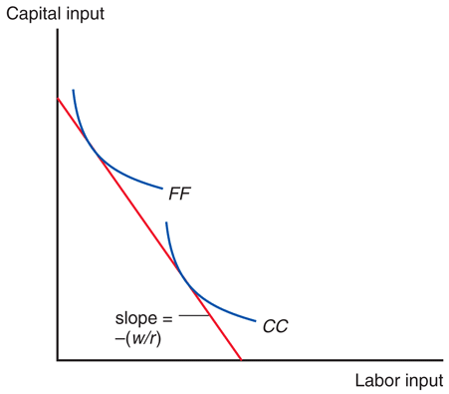
Fig. 5A-3: Determining the Wage-Rental Ratio

Slide 73
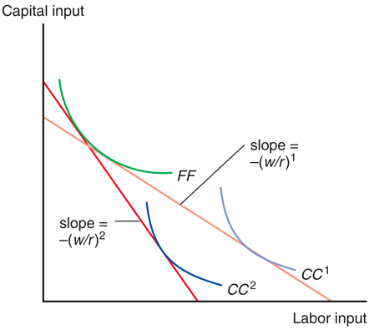
Fig. 5A-4: A Rise in the Price of Cloth

