Slide 1
Chapter 6
The Standard Trade Model

Slide 2
Preview
Relative supply and relative demand
The terms of trade and welfare
Effects of economic growth, import tariffs, and export subsidies
International borrowing and lending

Slide 3
Introduction
Standard trade model is a general model that includes Ricardian, specific factors, and Heckscher-Ohlin models as special cases.
Two goods, food (F) and cloth (C).
Each country’s PPF is a smooth curve.

Slide 4
Introduction (cont.)
Differences in labor services, labor skills, physical capital, land, and technology between countries cause differences in production possibility frontiers.
A country’s PPF determines its relative supply function.
National relative supply functions determine a world relative supply function, which along with world relative demand determines the equilibrium under international trade.

Slide 5
Production Possibilities and Relative Supply
What a country produces depends on the relative price of cloth to food P_{C} /P_{F}.
An economy chooses its production of cloth Q_{C} and food Q_{F} to maximize the value of its output V = P_{C}Q_{C} + P_{F} Q_{F}, given the prices of cloth and food.
The slope of an isovalue line equals –(P_{C} /P_{F}).
Produce at point where PPF is tangent to isovalue line.

Slide 6
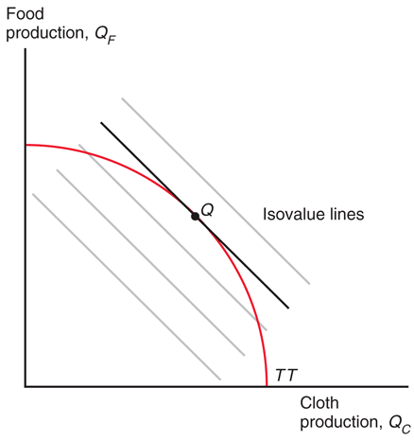
Fig. 6-1: Relative Prices Determine the Economy’s Output

Slide 7
Production Possibilities and Relative Supply (cont.)
Relative prices and relative supply:
An increase in the price of cloth relative to food P_{C} /P_{F} makes the isovalue line steeper.
Production shifts from point Q¹ to point Q².
Supply of cloth relative to food Q_{C} /Q_{F} rises.
Relative supply of cloth to food increases with the relative price of cloth to food.

Slide 8
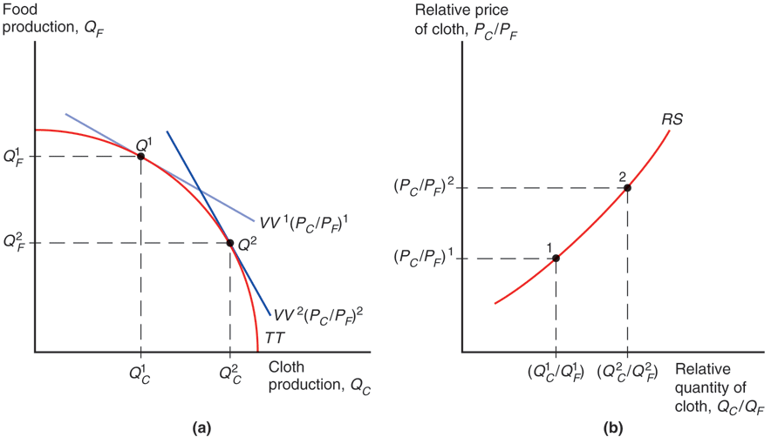
Fig. 6-2: How an Increase in the Relative Price of Cloth Affects Relative Supply

Slide 9
Relative Prices and Demand
The value of the economy’s consumption must equal the value of the economy’s production.
P_{C} D_{C} + P_{F} D_{F} = P_{C} Q_{C} + P_{F} Q_{F} = V
Assume that the economy’s consumption decisions may be represented as if they were based on the tastes of a single representative consumer.
An indifference curve represents combinations of cloth and food that leave the consumer equally well off (indifferent).

Slide 10
Relative Prices and Demand (cont.)
Indifference curves
are downward sloping — if you have less cloth, then you must have more food to be equally satisfied.
that lie farther from the origin make consumers more satisfied — they prefer having more of both goods.
become flatter when they move to the right — with more cloth and less food, an extra yard of cloth becomes less valuable in terms of how many calories of food you are willing to give up for it.

Slide 11
Relative Prices and Demand (cont.)
Consumption choice is based on preferences and relative price of goods:
Consume at point D where the isovalue line is tangent to the indifference curve.
Economy exports cloth — the quantity of cloth produced exceeds the quantity of cloth consumed — and imports food.

Slide 12
Relative Prices and Demand (cont.)
Relative prices and relative demand
An increase in the relative price of cloth P_{C} /P_{F} causes consumption choice to shift from point D¹ to point D².
Demand for cloth relative to food D_{C} /D_{F} falls.
Relative demand for cloth to food falls as the relative price of cloth to food rises.

Slide 13
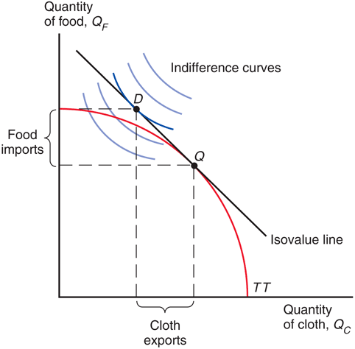
Fig. 6-3: Production, Consumption, and Trade in the Standard Model

Slide 14
Relative Prices and Demand (cont.)
An economy that exports cloth is better off when the price of cloth rises relative to the price of food:
the isovalue line becomes steeper and a higher indifference curve can be reached.
A higher relative price of cloth means that more calories of food can be imported for every yard of cloth exported.

Slide 15
Relative Prices and Demand (cont.)
If the economy cannot trade:
The relative price of cloth to food is determined by the intersection of relative demand and relative supply for that country.
Consume and produce at point D³ where the indifference curve is tangent to the production possibilities frontier.

Slide 16
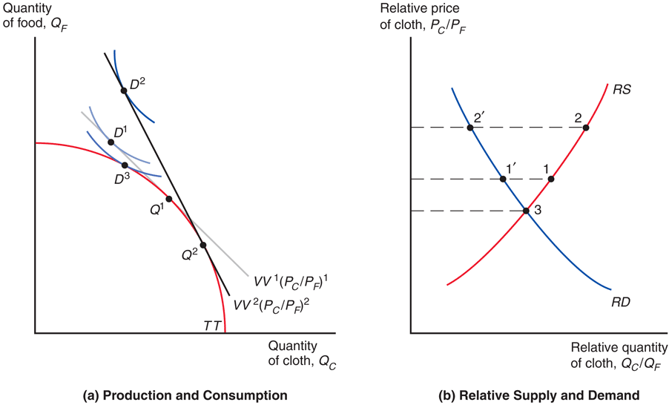
Fig. 6-4: Effects of a Rise in the Relative Price of Cloth and Gains from Trade

Slide 17
The Welfare Effects of Changes in the Terms of Trade
The terms of trade refers to the price of exports relative to the price of imports.
When a country exports cloth and the relative price of cloth increases, the terms of trade rise.
Because a higher relative price for exports means that the country can afford to buy more imports, an increase in the terms of trade increases a country’s welfare.
A decline in the terms of trade decreases a country’s welfare.

Slide 18
Determining Relative Prices
To determine the price of cloth relative to the price food, use relative supply and relative demand.
World supply of cloth relative to food at each relative price.
World demand for cloth relative to food at each relative price.
World quantities are the sum of quantities from the two countries in the world: (Q_{C} + Q_{C}*)/(Q_{F} + Q_{F}*) and (D_{C} + D_{C}*)/(D_{F} + D_{F}*).

Slide 19
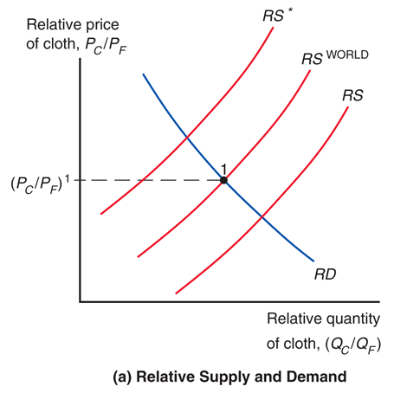
Fig. 6-5a: Equilibrium Relative Price with Trade and Associated Trade Flows
Notes:
Trade produces an equilibrium relative price of cloth, (P_{C}/P_{F})₁, where the relative quantity demanded of cloth equals the relative quantity supplied of cloth. At this relative price, there is no tendency for the relative quantity demanded of cloth nor the relative quantity supplied of cloth to change.

Slide 20
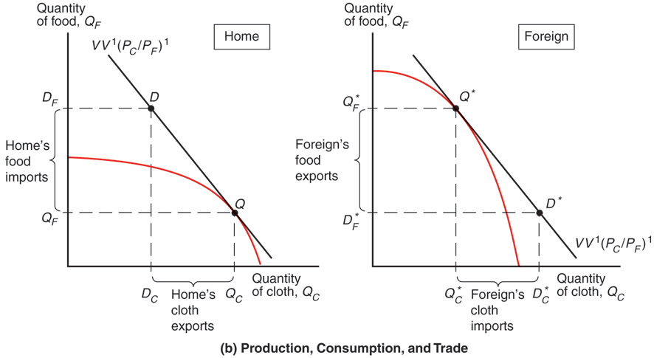
Fig. 6-5b: Equilibrium Relative Price with Trade and Associated Trade Flows
Notes:
Trade produces an equilibrium relative price of cloth, (P_{C}/P_{F})₁, where the relative quantity demanded of cloth equals the relative quantity supplied of cloth. At this relative price, there is no tendency for the relative quantity demanded of cloth nor the relative quantity supplied of cloth to change.

Slide 21
The Effects of Economic Growth
Is economic growth in China good for the standard of living in the U.S.?
Is growth in a country more or less valuable when it is integrated in the world economy?
The standard trade model gives us precise answers to these questions.

Slide 22
The Effects of Economic Growth (cont.)
Growth is usually biased: it occurs in one sector more than others, causing relative supply to change.
Rapid growth has occurred in U.S. computer industries but relatively little growth has occurred in U.S. textile industries.
In the Ricardian model, technological progress in one sector causes biased growth.
In the Heckscher-Ohlin model, an increase in one factor of production causes biased growth.

Slide 23
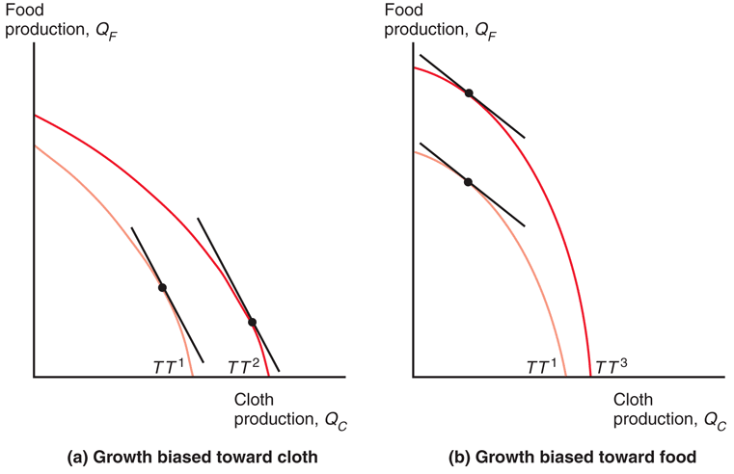
Fig. 6-6: Biased Growth

Slide 24
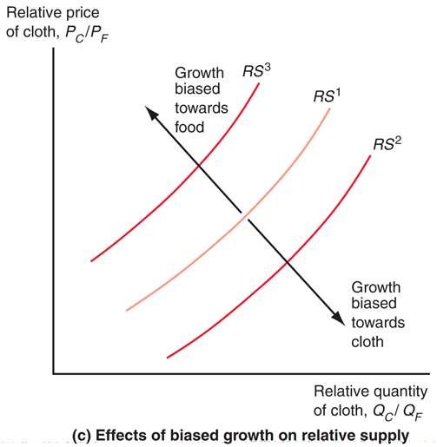
Fig. 6-6: Biased Growth (cont.)

Slide 25
The Effects of Economic Growth (cont.)
Biased growth and the resulting change in relative supply causes a change in the terms of trade.
Biased growth in the cloth industry (in either the home or foreign country) will lower the price of cloth relative to the price of food and lower the terms of trade for cloth exporters.
Biased growth in the food industry (in either the home or foreign country) will raise the price of cloth relative to the price of food and raise the terms of trade for cloth exporters.
Suppose that the home country exports cloth and imports food.

Slide 26
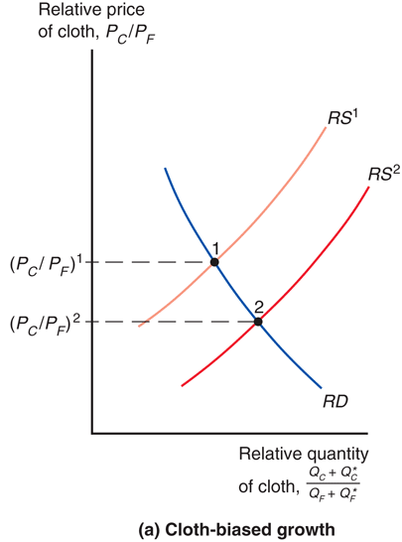
Fig. 6-7a: Growth and World Relative Supply
Notes:
If biased growth occurs in the cloth industry, suppliers are more able and willing to sell cloth relative to food, so that the relative supply curve shifts right to represent an increase in the supply of cloth relative to the supply of food. In the new trade equilibrium, the relative quantity of cloth bought and sold increases and the price of cloth relative to the price of food decreases from (P_{C}/P_{F})₁ to (P_{C}/P_{F})₂. If the home country exports cloth and imports food, the price of exports relative to the price of imports for the domestic country decreases. In other words, the terms of trade for the domestic country decreases.

Slide 27
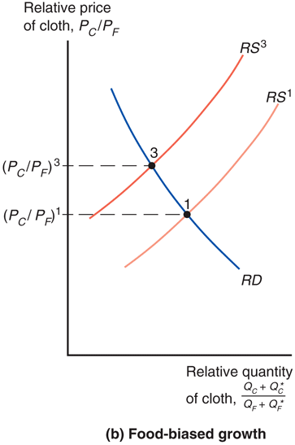
Fig. 6-7b: Growth and World Relative Supply
Notes:
If biased growth occurs in the food industry, suppliers are more able and willing to sell food relative to cloth, so that the relative supply curve shifts left to represent a decrease in the supply of cloth relative to the supply of food. In the new trade equilibrium, the relative quantity of food bought and sold increases (and the relative quantity of cloth bought and sold decreases) and the price of cloth relative to the price of food increases from (P_{C}/P_{F})₁ to (P_{C}/P_{F})₂. If the domestic country exports cloth and imports food, the price of exports relative to the price of imports for the domestic country increases. In other words, the terms of trade for the domestic country increases.

Slide 28
The Effects of Economic Growth (cont.)
Export-biased growth is growth that expands a country’s production possibilities dispro- portionately in that country’s export sector.
Biased growth in the food industry in the foreign country is export-biased growth for the foreign country.
Import-biased growth is growth that expands a country’s production possibilities dispro- portionately in that country’s import sector.
Biased growth in cloth production in the foreign country is import-biased growth for the foreign country.

Slide 29
The Effects of Economic Growth (cont.)
Export-biased growth reduces a country’s terms of trade, reducing its welfare and increasing the welfare of foreign countries.
Import-biased growth increases a country’s terms of trade, increasing its welfare and decreasing the welfare of foreign countries.

Slide 30
Has the Growth of Newly Industrializing Countries Hurt Advanced Nations?
The standard trade model predicts that import-biased growth in China would occur in sectors that compete with U.S. exports and reduce the U.S. terms of trade.
But the data indicates that changes in the U.S. terms of trade have been small with no clear trend over the last few decades.
The terms of trade for China have deteriorated over the past decade, suggesting their recent growth may have been export-biased.

Slide 31
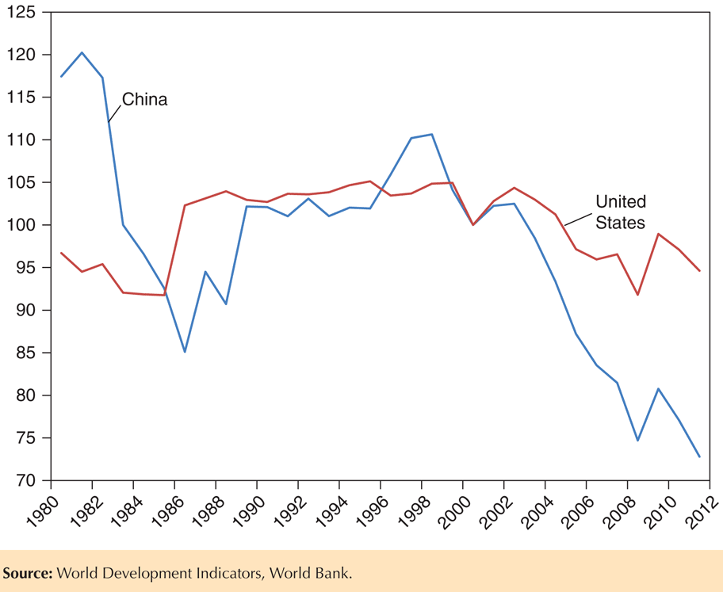
Fig. 6-8: Evolution of the Terms of Trade for the United States and China (1980–2011, 2000 = 100)

Slide 32
Import Tariffs and Export Subsidies: Simultaneous Shifts in RS and RD
Import tariffs are taxes levied on imports.
Export subsidies are payments given to domestic producers that export.
Both policies influence the terms of trade and therefore national welfare.
Import tariffs and export subsidies drive a wedge between prices in world markets and prices in domestic markets.

Slide 33
Relative Price and Supply Effects of a Tariff
If the home country imposes a tariff on food imports, the price of food relative to the price of cloth rises for domestic consumers.
Likewise, the price of cloth relative to the price of food falls for domestic consumers.
Domestic producers will receive a lower relative price of cloth, and therefore will be more willing to switch to food production: relative supply of cloth will decrease.
Domestic consumers will pay a lower relative price for cloth, and therefore will be more willing to switch to cloth consumption: relative demand for cloth will increase.

Slide 34
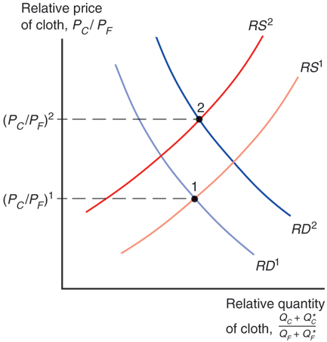
Fig. 6-9: Effects of a Food Tariff on the Terms of Trade

Slide 35
Relative Price and Supply Effects of a Tariff (cont.)
When the home country imposes an import tariff, the terms of trade increase and the welfare of the country may increase.
The magnitude of this effect depends on the size of the home country relative to the world economy.
If the country is a small part of the world economy, its tariff (or subsidy) policies will not have much effect on world relative supply and demand, and thus on the terms of trade.
But for large countries, a tariff may maximize national welfare at the expense of foreign countries.

Slide 36
Effects of an Export Subsidy
If the home country imposes a subsidy on cloth exports, the price of cloth relative to the price of food rises for domestic consumers.
Domestic producers will receive a higher relative price of cloth when they export, and therefore will be more willing to switch to cloth production: relative supply of cloth will increase.
Domestic consumers must pay a higher relative price of cloth to producers, and therefore will be more willing to switch to food consumption: relative demand for cloth will decrease.

Slide 37
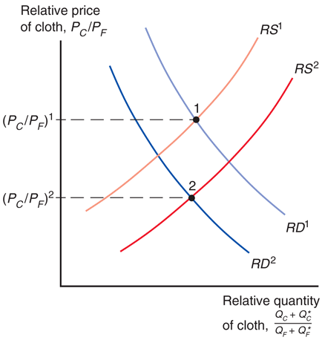
Fig. 6-10: Effects of a Cloth Subsidy on the Terms of Trade

Slide 38
Effects of an Export Subsidy (cont.)
When the home country imposes an export subsidy, the terms of trade decrease and the welfare of the country decreases to the benefit of the foreign country.

Slide 39
Implications of Terms of Trade Effects: Who Gains and Who Loses?
The standard trade model predicts that
an import tariff by the home country can increase domestic welfare at the expense of the foreign country.
an export subsidy by the home country reduces domestic welfare to the benefit of the foreign country.

Slide 40
Implications of Terms of Trade Effects: Who Gains and Who Loses? (cont.)
Additional effects of tariffs and subsidies that can occur in a world with many countries and many goods:
A foreign country may subsidize the export of a good that the U.S. also exports, which will reduce the price for the U.S. in world markets and decrease its terms of trade.
The EU subsidizes agricultural exports, which reduce the price that American farmers receive for their goods in world markets.
A foreign country may put a tariff on an imported good that the U.S. also imports, which will reduce the price for the U.S. in world markets and increase its terms of trade.

Slide 41
Implications of Terms of Trade Effects: Who Gains and Who Loses? (cont.)
Export subsidies by foreign countries on goods that
the U.S. imports reduce the world price of U.S. imports and increase the terms of trade for the U.S.
the U.S. also exports reduce the world price of U.S. exports and decrease the terms of trade for the U.S.
Import tariffs by foreign countries on goods that
the U.S. exports reduce the world price of U.S. exports and decrease the terms of trade for the U.S.
the U.S. also imports reduce the world price of U.S. imports and increase the terms of trade for the U.S.

Slide 42
Implications of Terms of Trade Effects: Who Gains and Who Loses? (cont.)
Export subsidies on a good decrease the relative world price of that good by increasing relative supply of that good and decreasing relative demand of that good.
Import tariffs on a good decrease the relative world price of that good (and increase the relative world price of other goods) by increasing the relative supply of that good and decreasing the relative demand of that good.

Slide 43
International Borrowing and Lending
The standard trade model can be modified to analyze international borrowing and lending.
Two goods are current and future consumption (same good at different times), rather than different goods at the same time.
Countries usually have different opportunities to invest to become able to produce more in the future.
A special kind of production possibility frontier, an intertemporal production possibility frontier, depicts different possible combinations of current output and future output.

Slide 44
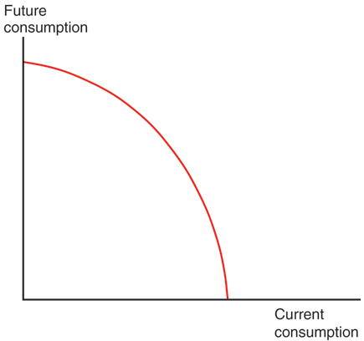
Fig. 6-11: The Intertemporal Production Possibility Frontier

Slide 45
International Borrowing and Lending (cont.)
Suppose that Home has production possibilities biased towards current output, while Foreign has production possibilities biased towards future output.
Foreign has better opportunities to invest now to generate more output in the future.

Slide 46
International Borrowing and Lending (cont.)
If you borrow 1 unit of output, you must repay principal + interest = 1 + r in the future, where r is the real interest rate.
The price of future consumption relative to current consumption is 1/(1+r).
1 unit of current consumption is worth 1 + r of future consumption,
so 1 unit of future consumption is worth 1/(1 + r) units of current consumption.

Slide 47
International Borrowing and Lending (cont.)
Home exports current consumption and imports future consumption.
Home lends to Foreign by consuming less than it produces now.
Foreign pays back the loan by consuming less than it produces in the future.

Slide 48
International Borrowing and Lending (cont.)
When international borrowing and lending are allowed, the relative price of future consumption — and thus the world real interest rate — is determined by the intersection of world relative demand and world relative supply.

Slide 49
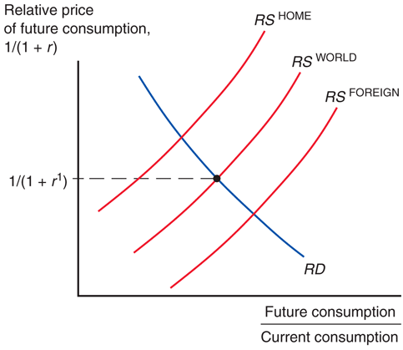
Fig. 6-12: Equilibrium Interest Rate with Borrowing and Lending

Slide 50
Summary
The terms of trade refers to the price of exports relative to the price of imports.
Export-biased growth reduces a country’s terms of trade, reducing its welfare and increasing the welfare of foreign countries.
Import-biased growth increases a country’s terms of trade, increasing its welfare and decreasing the welfare of foreign countries.

Slide 51
Summary (cont.)
When a country imposes an import tariff, its terms of trade increase and its welfare may increase.
When a country imposes an export subsidy, its terms of trade decrease and its welfare decreases.

Slide 52
Summary (cont.)
International borrowing and lending is intertemporal trade, where countries with profitable investment opportunities borrow funds today and repay lenders in the future, benefiting both borrowers and lenders.
The price of future consumption relative to the price of current consumption, 1/(1 + r), is determined like any other relative price.

Slide 53
Chapter 6
Appendix: More on Intertemporal Trade

Slide 54
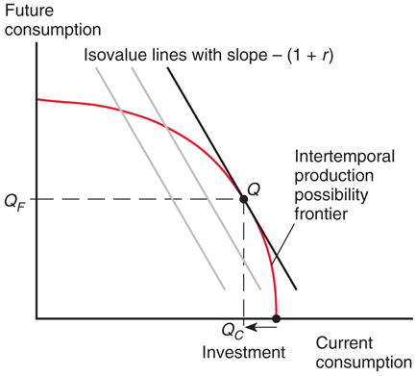
Fig. 6A-1: Determining Home’s Intertemporal Production Pattern

Slide 55
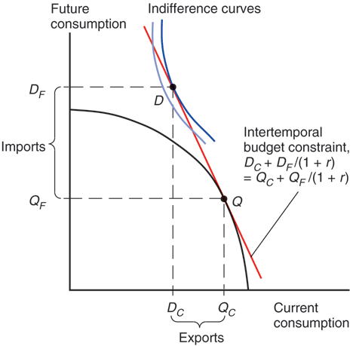
Fig. 6A-2: Determining Home’s Intertemporal Consumption Pattern

Slide 56
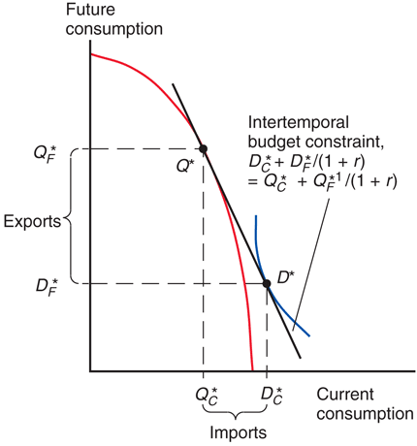
Fig. 6A-3: Determining Foreign’s Intertemporal Production and Consumption Patterns

