Slide 1
Chapter 8
Firms in the Global Economy: Export Decisions, Outsourcing, and Multinational Enterprises

Slide 2
Preview
Monopolistic competition and trade
The significance of intra-industry trade
Firm responses to trade: winners, losers, and industry performance
Dumping
Multinationals and outsourcing

Slide 3
Introduction
Internal economies of scale result when large firms have a cost advantage over small firms, causing the industry to become uncompetitive.
Internal economies of scale imply that a firm’s average cost of production decreases the more output it produces.

Slide 4
Introduction (cont.)
Perfect competition that drives the price of a good down to marginal cost would imply losses for those firms because they would not be able to recover the higher costs incurred from producing the initial units of output.
As a result, perfect competition would force those firms out of the market.
In most sectors, goods are differentiated from each other and there are other differences across firms.

Slide 5
Introduction (cont.)
Integration causes the better-performing firms to thrive and expand, while the worse-performing firms contract.
Additional source of gain from trade: As production is concentrated toward better-performing firms, the overall efficiency of the industry improves.
Study why those better-performing firms have a greater incentive to engage in the global economy.

Slide 6
The Theory of Imperfect Competition
In imperfect competition, firms are aware that they can influence the prices of their products and that they can sell more only by reducing their price.
This situation occurs when there are only a few major producers of a particular good or when each firm produces a good that is differentiated from that of rival firms.
Each firm views itself as a price setter, choosing the price of its product.

Slide 7
Monopoly: A Brief Review
A monopoly is an industry with only one firm.
An oligopoly is an industry with only a few firms.
In these industries, the marginal revenue generated from selling more products is less than the uniform price charged for each product.
To sell more, a firm must lower the price of all units, not just the additional ones.
The marginal revenue function therefore lies below the demand function (which determines the price that customers are willing to pay).

Slide 8
Monopoly: A Brief Review (cont.)
Assume that the demand curve the firm faces is a straight line Q = A – B(P), where Q is the number of units the firm sells, P the price per unit, and A and B are constants.
Marginal revenue equals MR = P – Q/B.
Suppose that total costs are C = F + c(Q), where F is fixed costs, those independent of the level of output, and c is the constant marginal cost.

Slide 9
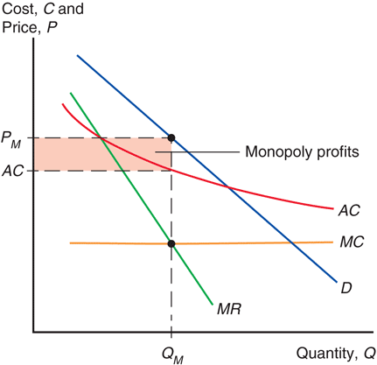
Fig. 8-1: Monopolistic Pricing and Production Decisions

Slide 10
Monopoly: A Brief Review (cont.)
Average cost is the cost of production (C) divided by the total quantity of production (Q).
AC = C/Q = F/Q + c
Marginal cost is the cost of producing an additional unit of output.
A larger firm is more efficient because average cost decreases as output Q increases: internal economies of scale.

Slide 11
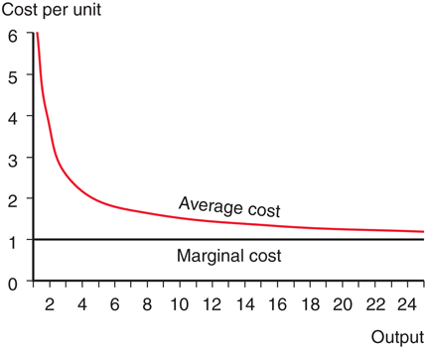
Fig. 8-2: Average Versus Marginal Cost

Slide 12
Monopoly: A Brief Review (cont.)
The profit-maximizing output occurs where marginal revenue equals marginal cost.
At the intersection of the MC and MR curves, the revenue gained from selling an extra unit equals the cost of producing that unit.
The monopolist earns some monopoly profits, as indicated by the shaded box, when P > AC.

Slide 13
Monopolistic Competition
Monopolistic competition is a simple model of an imperfectly competitive industry that assumes that each firm
can differentiate its product from the product of competitors, and
takes the prices charged by its rivals as given.

Slide 14
Monopolistic Competition (cont.)
A firm in a monopolistically competitive industry is expected to sell
more as total sales in the industry increase and as prices charged by rivals increase.
less as the number of firms in the industry increases and as the firm’s price increases.
These concepts are represented by the function:

Slide 15
Monopolistic Competition (cont.)
Q = S[1/n – b(P – P)]
Q is an individual firm’s sales
S is the total sales of the industry
n is the number of firms in the industry
b is a constant term representing the responsiveness of a firm’s sales to its price
P is the price charged by the firm itself
P is the average price charged by its competitors

Slide 16
Monopolistic Competition (cont.)
Assume that firms are symmetric: all firms face the same demand function and have the same cost function.
Thus all firms should charge the same price and have equal share of the market Q = S/n
Average costs should depend on the size of the market and the number of firms:
AC = C/Q = F/Q + c = n F/S + c

Slide 17
Monopolistic Competition (cont.)
AC = n(F/S) + c
As the number of firms n in the industry increases, the average cost increases for each firm because each produces less.
As total sales S of the industry increase, the average cost decreases for each firm because each produces more.

Slide 18
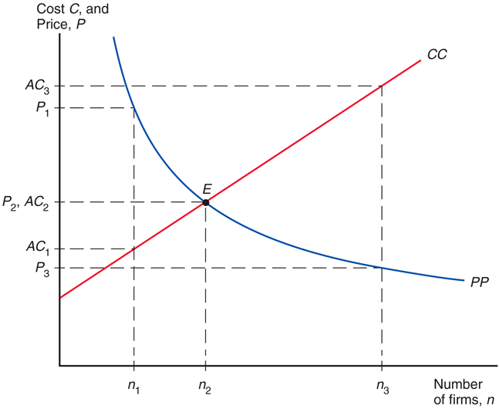
Fig. 8-3: Equilibrium in a Monopolistically Competitive Market

Slide 19
Monopolistic Competition (cont.)
If monopolistic firms face linear demand functions, Q = A – B(P),
where A and B are constants.
When firms maximize profits, they should produce until marginal revenue equals marginal cost:
MR = P – Q/B = c

Slide 20
Monopolistic Competition (cont.)
As the number of firms n in the industry increases, the price that each firm charges decreases due to increased competition.
P = c + 1 > (b*n)
Each firm’s markup over marginal cost
P - c = 1 > (b*n)
decreases with the number of competing firms.

Slide 21
Monopolistic Competition (cont.)
At some number of firms, the price that firms charge (which decreases in n) matches the average cost that firms pay (which increases in n).
At this long-run equilibrium number of firms in the industry, firms have no incentive to enter or exit the industry.

Slide 22
Monopolistic Competition (cont.)
If the number of firms is greater than or less than the equilibrium number, then firms have an incentive to exit or enter the industry.
Firms have an incentive to exit the industry when price < average cost.
Firms have an incentive to enter the industry when price > average cost.

Slide 23
Monopolistic Competition and Trade
Because trade increases market size, trade is predicted to decrease average cost in an industry described by monopolistic competition.
Industry sales increase with trade leading to decreased average costs: AC = n(F/S) + c
Because trade increases the variety of goods that consumers can buy under monopolistic competition, it increases the welfare of consumers.
And because average costs decrease, consumers can also benefit from a decreased price.

Slide 24
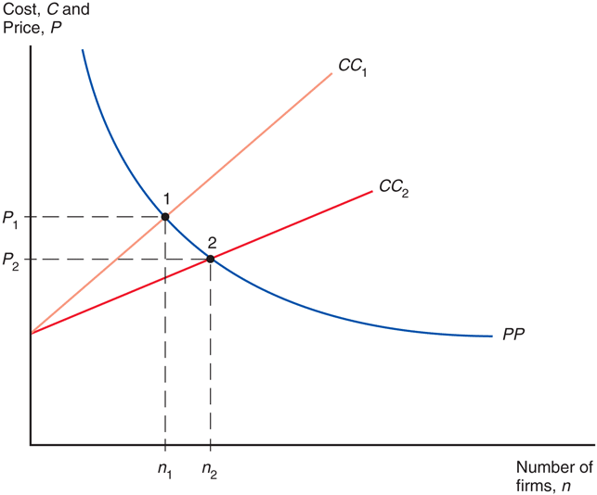
Fig. 8-4: Effects of a Larger Market

Slide 25
Monopolistic Competition and Trade (cont.)
As a result of trade, the number of firms in a new international industry is predicted to increase relative to each national market.
But it is unclear if firms will locate in the domestic country or foreign countries.
Integrating markets through international trade therefore has the same effects as growth of a market within a single country.

Slide 26
Gains from an Integrated Market: A Numerical Example
Suppose that b = 1/30,000, fixed cost F = $750,000,000 and a marginal cost of c = $5,000 per automobile.
The total cost is
C = 750,000,000 + (5,000*Q).
The average cost is therefore
AC = (750,000,000/Q) + 5,000.

Slide 27
Gains from an Integrated Market: A Numerical Example (cont.)
Suppose there are two countries, Home and Foreign.
Home has annual sales of 900,000 automobiles; Foreign has annual sales of 1.6 million.
The two countries are assumed (for now) to have the same costs of production.

Slide 28
Gains from an Integrated Market: A Numerical Example (cont.)
The integrated market supports more firms, each producing at a larger scale and selling at a lower price than either national market does on its own.
Everyone is better off as a result of the larger market with integration:
Consumers have a wider range of choices, and
Each firm produces more and is therefore able to offer its product at a lower price.

Slide 29
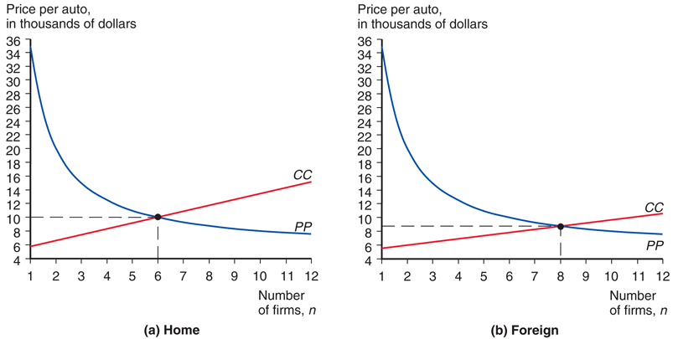
Fig. 8-5: Equilibrium in the Automobile Market

Slide 30
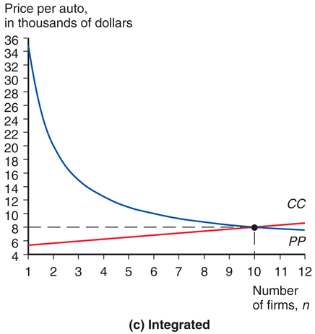
Fig. 8-5: Equilibrium in the Automobile Market (cont.)

Slide 31
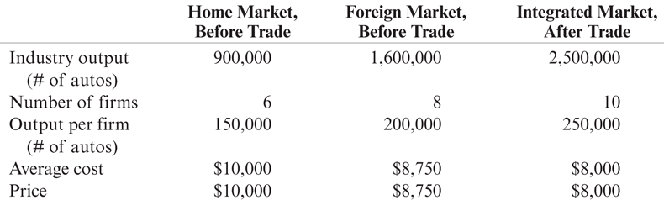
Table 8-1: Hypothetical Example of Gains from Market Integration

Slide 32
Monopolistic Competition and Trade (cont.)
Product differentiation and internal economies of scale lead to trade between similar countries with no comparative advantage differences between them.
This is a very different kind of trade than the one based on comparative advantage, where each country exports its comparative advantage good.

Slide 33
The Significance of Intra-Industry Trade
Intra-industry trade refers to two-way exchanges of similar goods.
Two new channels for welfare benefits from trade:
Benefit from a greater variety at a lower price.
Firms consolidate their production and take advantage of economies of scale.
A smaller country stands to gain more from integration than a larger country.

Slide 34
The Significance of Intra-Industry Trade (cont.)
About 25–50% of world trade is intra-industry.
Most prominent is the trade of manufactured goods among advanced industrial nations, which accounts for the majority of world trade.

Slide 35
The Significance of Intra-Industry Trade (cont.)
For the United States, industries that have the most intra-industry trade—such as pharmaceuticals, chemicals, and specialized machinery—require relatively larger amounts of skilled labor, technology, and physical capital.
Case Study 8.1

Slide 36
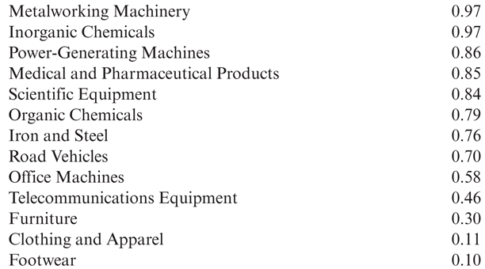
Table 8-2: Indexes of Intra-Industry Trade for U.S. Industries, 2009

Slide 37
Firm Responses to Trade
Increased competition tends to hurt the worst-performing firms — they are forced to exit.
The best-performing firms take the greatest advantage of new sales opportunities and expand the most.
When the better-performing firms expand and the worse-performing ones contract or exit, overall industry performance improves.
Trade and economic integration improve industry performance as much as the discovery of a better technology does.

Slide 38
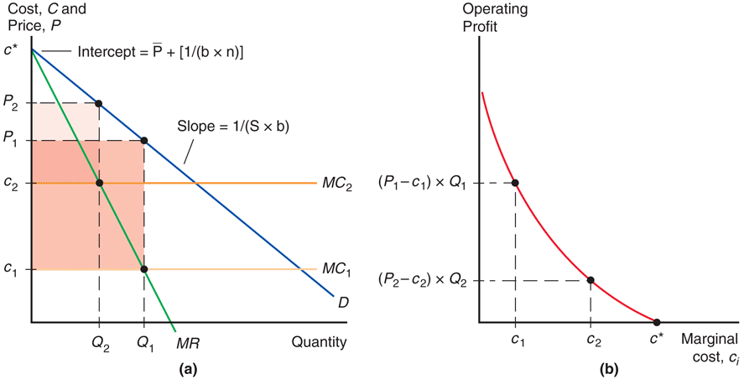
Fig. 8-6: Performance Differences Across Firms

Slide 39
Trade Costs and Export Decisions
Most U.S. firms do not report any exporting activity at all — sell only to U.S. customers.
In 2002, only 18% of U.S. manufacturing firms reported any sales abroad.
Even in industries that export much of what they produce, such as chemicals, machinery, electronics, and transportation, fewer than 40 percent of firms export.
A major reason why trade costs reduce trade so much is that they drastically reduce the number of firms selling to customers across the border.
Trade costs also reduce the volume of export sales of firms selling abroad.

Slide 40
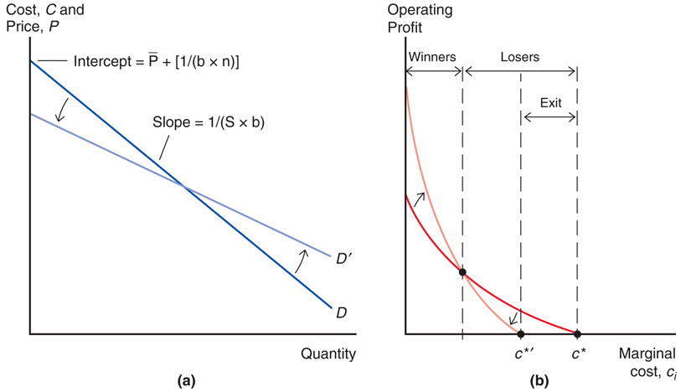
Fig. 8-7: Winners and Losers from Economic Integration

Slide 41
Trade Costs and Export Decisions (cont.)
Trade costs added two important predictions to our model of monopolistic competition and trade:
Why only a subset of firms export, and why exporters are relatively larger and more productive (lower marginal costs).
Overwhelming empirical support for this prediction that exporting firms are bigger and more productive than firms in the same industry that do not export.
In the United States, in a typical manufacturing industry, an exporting firm is on average more than twice as large as a firm that does not export.
Differences between exporters and nonexporters are even larger in many European countries.

Slide 42
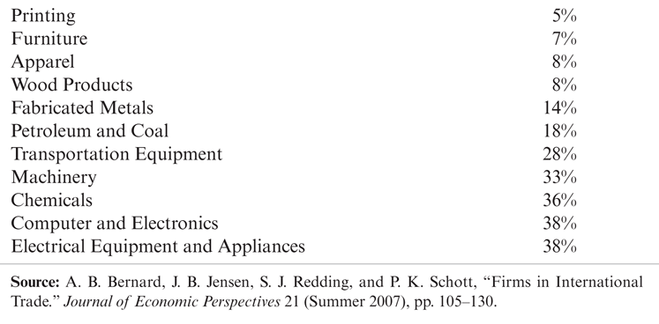
Table 8-3: Proportion of U.S. Firms Reporting Export Sales by Industry, 2002

Slide 43
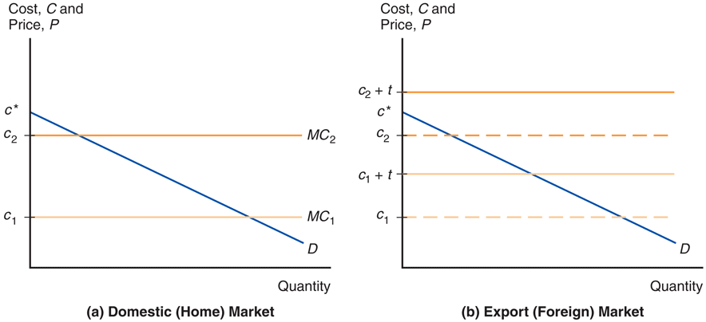
Fig: 8-8: Export Decisions with Trade Costs

Slide 44
Dumping
Dumping is the practice of charging a lower price for exported goods than for goods sold domestically.
Dumping is an example of price discrimination: the practice of charging different customers different prices.
Price discrimination and dumping may occur only if
imperfect competition exists: firms are able to influence market prices.
markets are segmented so that goods are not easily bought in one market and resold in another.

Slide 45
Dumping (cont.)
Dumping can be a profit-maximizing strategy:
A firm with a higher marginal cost chooses to set a lower markup over marginal cost.
Therefore, an exporting firm will respond to the trade cost by lowering its markup for the export market.
This strategy is considered to be dumping, regarded by most countries as an “unfair” trade practice.

Slide 46
Protectionism and Dumping
Case Study 8.2
A U.S. firm may appeal to the Commerce Department to investigate if dumping by foreign firms has injured the U.S. firm.
The Commerce Department may impose an “anti-dumping duty” (tax) to protect the U.S. firm.
Tax equals the difference between the actual and “fair” price of imports, where “fair” means “price the product is normally sold at in the manufacturer's domestic market.”

Slide 47
Protectionism and Dumping (cont.)
Next, the International Trade Commission (ITC) determines if injury to the U.S. firm has occurred or is likely to occur.
If the ITC determines that injury has occurred or is likely to occur, the anti-dumping duty remains in place.
http://www.usitc.gov/trade_remedy/731_ad_ 701_cvd/index.htm

Slide 48
Protectionism and Dumping (cont.)
Most economists believe that the enforcement of dumping claims is misguided.
Trade costs have a natural tendency to induce firms to lower their markups in export markets.
Such enforcement may be used excessively as an excuse for protectionism.

Slide 49
Multinationals and Outsourcing
Foreign direct investment refers to investment in which a firm in one country directly controls or owns a subsidiary in another country.
If a foreign company invests in at least 10% of the stock in a subsidiary, the two firms are typically classified as a multinational corporation.
10% or more of ownership in stock is deemed to be sufficient for direct control of business operations.

Slide 50
Multinationals and Outsourcing (cont.)
Greenfield FDI is when a company builds a new production facility abroad.
Brownfield FDI (or cross-border mergers and acquisitions) is when a domestic firm buys a controlling stake in a foreign firm.
Greenfield FDI has tended to be more stable, while cross-border mergers and acquisitions tend to occur in surges.

Slide 51
Multinationals and Outsourcing (cont.)
Developed countries have been the biggest recipients of inward FDI.
much more volatile than FDI going to developing and transition economies.
Steady expansion in the share of FDI flowing to developing and transition countries.
Accounted for half of worldwide FDI flows since 2009.
Sales of FDI affiliates are often used as a measure of multinational activity.

Slide 52
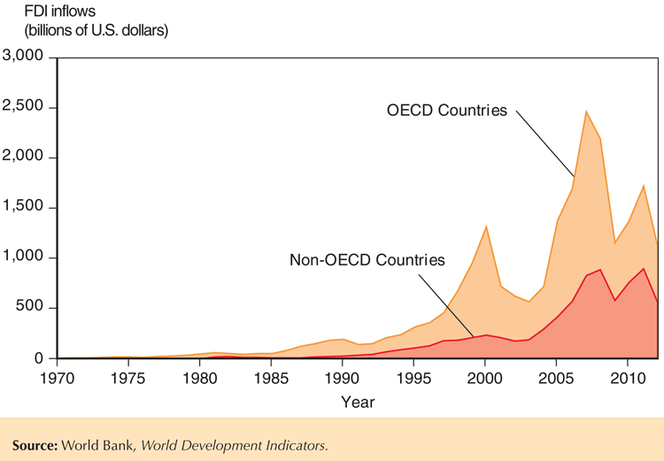
Fig. 8-9: Inflows of Foreign Direct Investment, 1970-2012

Slide 53
Multinationals and Outsourcing (cont.)
Two main types of FDI:
Horizontal FDI when the affiliate replicates the production process (that the parent firm undertakes in its domestic facilities) elsewhere in the world.
Vertical FDI when the production chain is broken up, and parts of the production processes are transferred to the affiliate location.

Slide 54
Multinationals and Outsourcing (cont.)
Vertical FDI is mainly driven by production cost differences between countries (for those parts of the production process that can be performed in another location).
Vertical FDI is growing fast and is behind the large increase in FDI inflows to developing countries.

Slide 55
Multinationals and Outsourcing (cont.)
Horizontal FDI is dominated by flows between developed countries.
Both the multinational parent and the affiliates are usually located in developed countries.
The main reason for this type of FDI is to locate production near a firm’s large customer bases.
Hence, trade and transport costs play a much more important role than production cost differences for these FDI decisions.

Slide 56
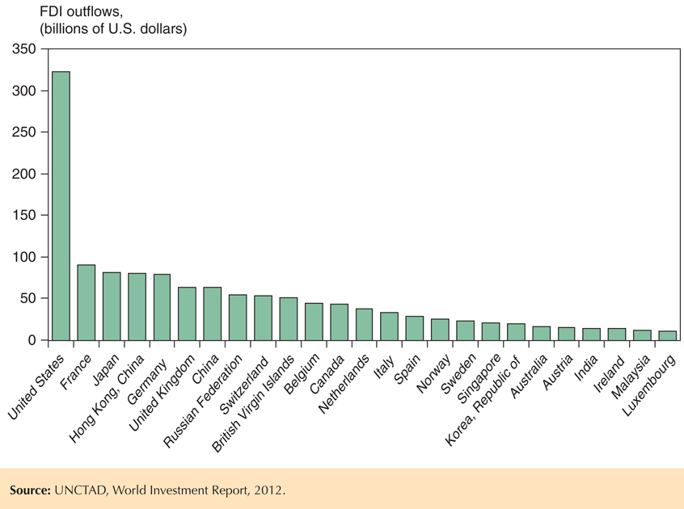
Fig. 8-10: Outward Foreign Direct Investment for Top 25 Countries, 2009-2011

Slide 57
The Firm’s Decision Regarding Foreign Direct Investment
Proximity-concentration trade-off:
High trade costs associated with exporting create an incentive to locate production near customers.
Increasing returns to scale in production create an incentive to concentrate production in fewer locations.

Slide 58
The Firm’s Decision Regarding Foreign Direct Investment (cont.)
FDI activity concentrated in sectors with high trade costs.
When increasing returns to scale are important and average plant sizes are large, we observe higher export volumes relative to FDI.
Multinationals tend to be much larger and more productive than other firms (even exporters) in the same country.

Slide 59
The Firm’s Decision Regarding Foreign Direct Investment (cont.)
The horizontal FDI decision involves a trade-off between the per-unit export cost t and the fixed cost F of setting up an additional production facility.
If t(Q) > F, costs more to pay trade costs t on Q units sold abroad than to pay fixed cost F to build a plant abroad.
When foreign sales large Q > F/t, exporting is more expensive and FDI is the profit-maximizing choice.
Low costs make more apt to choose FDI due to larger sales.

Slide 60
The Firm’s Decision Regarding Foreign Direct Investment (cont.)
The vertical FDI decision also involves a trade-off between cost savings and the fixed cost F of setting up an additional production facility.
Cost savings related to comparative advantage make some stages of production cheaper in other countries.

Slide 61
The Firm’s Decision Regarding Foreign Direct Investment (cont.)
Foreign outsourcing or offshoring occurs when a firm contracts with an independent firm to produce in the foreign location.
In addition to deciding the location of where to produce, firms also face an internalization decision: whether to keep production done by one firm or by separate firms.

Slide 62
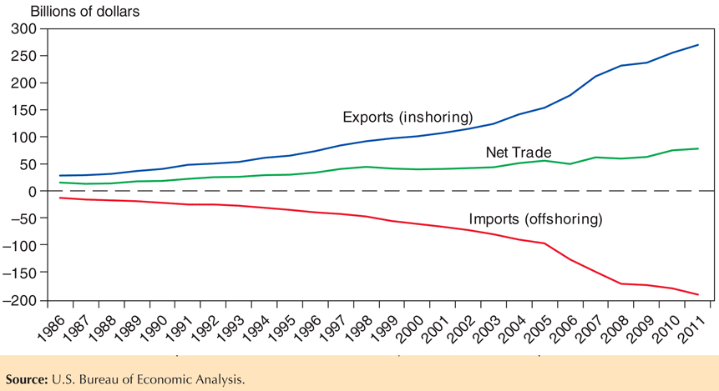
Fig. 8-11: U.S. International Trade in Business Services, 1986–2011

Slide 63
The Firm’s Decision Regarding Foreign Direct Investment (cont.)
Internalization occurs when it is more profitable to conduct transactions and production within a single organization. Reasons for this include:
Technology transfers: transfer of knowledge or another form of technology may be easier within a single organization than through a market transaction between separate organizations.
Patent or property rights may be weak or nonexistent.
Knowledge may not be easily packaged and sold.

Slide 64
The Firm’s Decision Regarding Foreign Direct Investment (cont.)
Vertical integration involves consolidation of different stages of a production process.
Consolidating an input within the firm using it can avoid holdup problems and hassles in writing complete contracts.
But an independent supplier could benefit from economies of scale if it performs the process for many parent firms.

Slide 65
The Firm’s Decision Regarding Foreign Direct Investment (cont.)
Foreign direct investment should benefit the countries involved for reasons similar to why international trade generates gains.
Multinationals and firms that outsource take advantage of cost differentials that favor moving production (or parts thereof) to particular locations.
FDI is very similar to the relocation of production that occurred across sectors when opening to trade.
There are similar welfare consequences for the case of multinationals and outsourcing: Relocating production to take advantage of cost differences leads to overall gains from trade.

Slide 66
Summary
Internal economies of scale imply that more production at the firm level causes average costs to fall.
With monopolistic competition, each firm can raise prices somewhat above those on competing products due to product differentiation but must compete with other firms whose prices are believed to be unaffected by each firm’s actions.
Monopolistic competition allows for gains from trade through lower costs and prices, as well as through wider consumer choice.

Slide 67
Summary (cont.)
Monopolistic competition predicts intra-industry trade, and does not predict changes in income distribution within a country.
Location of firms under monopolistic competition is unpredictable, but countries with similar relative factors are predicted to engage in intra-industry trade.

Slide 68
Summary (cont.)
Dumping may be a profitable strategy when a firm faces little competition in its domestic market and faces heavy competition in foreign markets.
Multinationals are typically larger and more productive than exporters, which in turn are larger and more efficient than firms that sell only to the domestic market.

Slide 69
Summary (cont.)
Multinational corporations undertake foreign direct investment when proximity is more important than concentrating production in one location.
Firms produce where it is most cost-effective — abroad if the scale is large enough. They replicate entire production process abroad or locate stages in different countries.
Firms also decide whether to keep transactions within the firm or contract with another firm.

