Slide 1
Chapter 9
The Instruments of Trade Policy

Slide 2
Preview
Partial equilibrium analysis of tariffs in a single industry: supply, demand, and trade
Costs and benefits of tariffs
Export subsidies
Import quotas
Voluntary export restraints
Local content requirements

Slide 3
Types of Tariffs
A tariff is a tax levied when a good is imported.
A specific tariff is levied as a fixed charge for each unit of imported goods.
For example, $3 per barrel of oil.
An ad valorem tariff is levied as a fraction of the value of imported goods.
For example, 25% tariff on the value of imported trucks.

Slide 4
Supply, Demand, and Trade in a Single Industry
Consider how a tariff affects a single market, say that of wheat.
Suppose that in the absence of trade the price of wheat is higher in Home than it is in Foreign.
With trade, wheat will be shipped from Foreign to Home until the price difference is eliminated.

Slide 5
Supply, Demand, and Trade in a Single Industry (cont.)
An import demand curve is the difference between the quantity that Home consumers demand minus the quantity that Home producers supply, at each price.
The Home import demand curve
MD = D – S
intercepts the price axis at P_{A} and is downward sloping:
As price increases, the quantity of imports demanded declines.

Slide 6
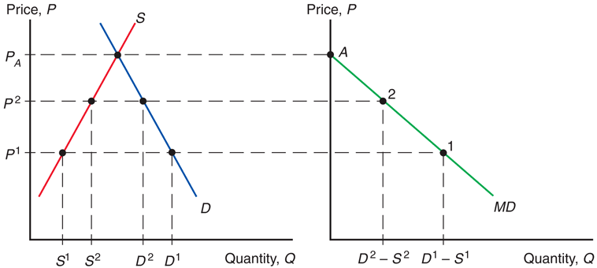
Fig. 9-1: Deriving Home’s Import Demand Curve

Slide 7
Supply, Demand, and Trade in a Single Industry (cont.)
An export supply curve is the difference between the quantity that Foreign producers supply minus the quantity that Foreign consumers demand, at each price.
The Foreign export supply curve
XS* = S* – D*
intersects the price axis at P_{A}* and is upward sloping:
As price increases, the quantity of exports supplied rises.

Slide 8
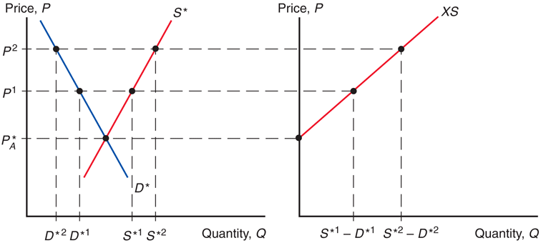
Fig. 9-2: Deriving Foreign’s Export Supply Curve

Slide 9
Supply, Demand, and Trade in a Single Industry (cont.)
In equilibrium,
import demand = export supply,
home demand – home supply
= foreign supply – foreign demand,
home demand + foreign demand
= home supply + foreign supply,
world demand = world supply.

Slide 10
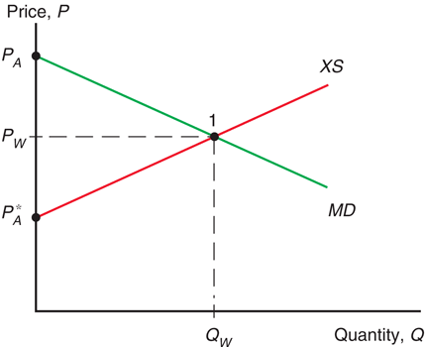
Fig. 9-3: World Equilibrium

Slide 11
Effects of a Tariff
A tariff acts like a transportation cost, making sellers unwilling to ship goods unless the Home price exceeds the Foreign price by the amount of the tariff:
P_{T} – t = P_{T}*
A tariff makes the price rise in the Home market and fall in the Foreign market.

Slide 12
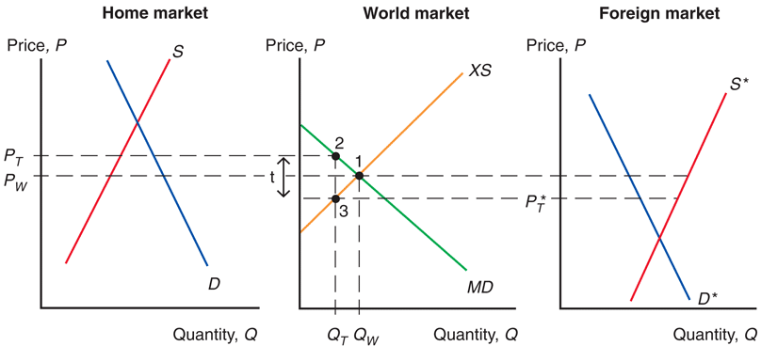
Fig. 9-4: Effects of a Tariff

Slide 13
Effects of a Tariff (cont.)
Because the price in the Home market rises from P_{W} under free trade to P_{T} with the tariff,
Home producers supply more and Home consumers demand less, so
the quantity of imports falls from Q_{W} under free trade to Q_{T} with the tariff.

Slide 14
Effects of a Tariff (cont.)
Because the price in the Foreign market falls from P_{W} under free trade to P_{T}* with the tariff,
Foreign producers supply less, and Foreign consumers demand more, so
the quantity of exports falls from Q_{W} to Q_{T} .

Slide 15
Effects of a Tariff (cont.)
The quantity of Home imports demanded equals the quantity of Foreign exports supplied when
P_{T} – P_{T}* = t
The increase in the price in Home can be less than the amount of the tariff.
Part of the effect of the tariff causes the Foreign export price to decline.
But this effect is sometimes very small.

Slide 16
Effects of a Tariff in a Small Country
When a country is “small,” it has no effect on the foreign (world) price because its demand is an insignificant part of world demand for the good.
The foreign price does not fall, but remains at P_{w} .
The price in the home market rises by the full amount of the tariff, to P_{T} = P_{w} + t .

Slide 17
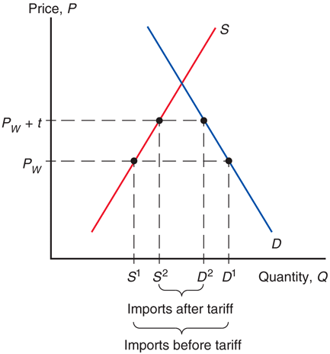
Fig. 9-5: A Tariff in a Small Country

Slide 18
Measuring the Amount of Protection
The effective rate of protection measures how much protection a tariff (or other trade policy) provides.
It represents the change in value that firms in an industry add to the production process when trade policy changes, which depends on the change in prices the trade policy causes.
Effective rates of protection often differ from tariff rates because tariffs affect sectors other than the protected sector, causing indirect effects on the prices and value added for the protected sector.

Slide 19
Measuring the Amount of Protection (cont.)
For example, suppose that automobiles sell in world markets for $8,000, and they are made from factors of production worth $6,000.
The value added of the production process is $8,000 – $6,000.
Suppose that a country puts a 25% tariff on imported autos so that home auto assembly firms can now charge up to $10,000 instead of $8,000.

Slide 20
Measuring the Amount of Protection (cont.)
The effective rate of protection for home auto assembly firms is the change in value added:
($4,000 – $2,000)/$2,000 = 100%
In this case, the effective rate of protection is greater than the tariff rate.

Slide 21
Costs and Benefits of Tariffs
A tariff raises the price of a good in the importing country, so it hurts consumers and benefits producers there.
In addition, the government gains tariff revenue.
How to measure these costs and benefits?
Use the concepts of consumer surplus and producer surplus.

Slide 22
Consumer and Producer Surplus
Consumer surplus measures the amount that consumers gain from purchases by computing the difference in the price actually paid from the maximum price they would be willing to pay for each unit consumed.
When price increases, the quantity demanded decreases as well as the consumer surplus.

Slide 23
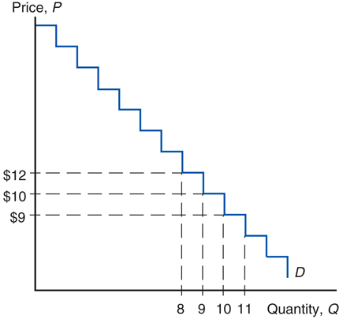
Fig. 9-6: Deriving Consumer Surplus from the Demand Curve

Slide 24
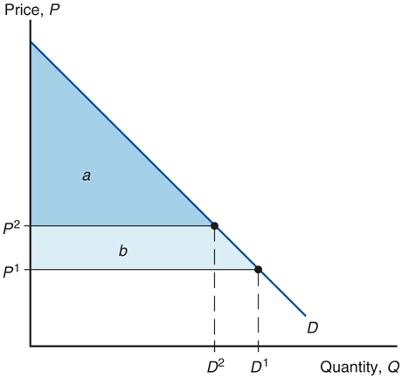
Fig. 9-7: Geometry of Consumer Surplus

Slide 25
Consumer and Producer Surplus (cont.)
Producer surplus measures the amount that producers gain from sales by computing the difference in the price received from the minimum price at which they would be willing to sell.
When price increases, the quantity supplied increases as well as the producer surplus.

Slide 26
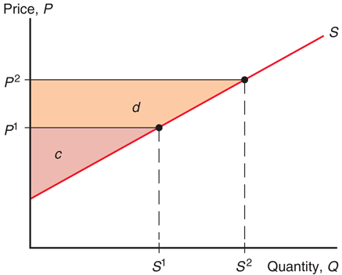
Fig. 9-8: Geometry of Producer Surplus

Slide 27
Measuring the Costs and Benefits of Tariffs
A tariff raises the price in the importing country:
consumer surplus decreases (consumers worse off)
producer surplus increases (producers better off).
the government collects tariff revenue equal to the tariff rate times the quantity of imports with the tariff.
t Q_{T} = (P_{T} –P_{T}* ) (D₂ – S₂)
Change in welfare due to the tariff is e – (b + d).

Slide 28
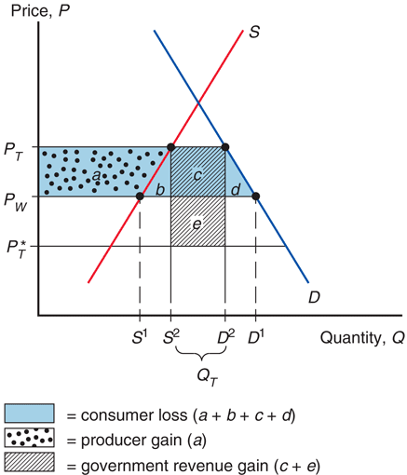
Fig. 9-9: Costs and Benefits of a Tariff for the Importing Country

Slide 29
Measuring the Costs and Benefits of Tariffs (cont.)
For a “large” country, whose imports and exports affect world prices, the welfare effect of a tariff is ambiguous.
The triangles b and d represent the efficiency loss.
The tariff distorts production and consumption decisions: producers produce too much and consumers consume too little.
The rectangle e represents the terms of trade gain.
The tariff lowers the Foreign price, allowing Home to buy its imports cheaper.

Slide 30
Measuring the Costs and Benefits of Tariffs (cont.)
Part of government revenue (rectangle e) represents the terms of trade gain, and part (rectangle c) represents some of the loss in consumer surplus.
The government gains at the expense of consumers and foreigners.
If the terms of trade gain exceed the efficiency loss, then national welfare will increase under a tariff, at the expense of foreign countries.
However, foreign countries are apt to retaliate.

Slide 31
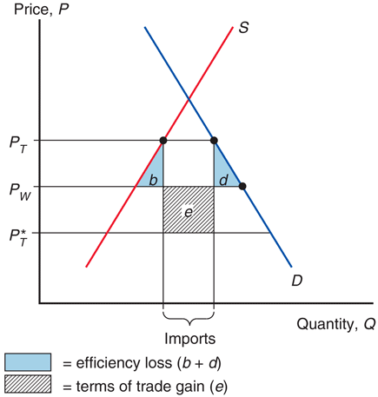
Fig. 9-10: Net Welfare Effects of a Tariff

Slide 32
Measuring the Costs and Benefits of Tariffs (cont.)
Tariffs can lead trading partners to retaliate with their own tariffs, thus hurting exporters in the country that first adopted the tariff.
Tariffs can be hard to remove and large tariffs may induce producers to engage in wasteful activities to avoid paying tariffs.
Ford and Subaru install (then later remove) seats in vans and pickups trucks to avoid U.S. tariff on imports of light commercial trucks.
Case Study 9.1

Slide 33
Export Subsidy
An export subsidy can also be specific or ad valorem:
A specific subsidy is a payment per unit exported.
An ad valorem subsidy is a payment as a proportion of the value exported.
An export subsidy raises the price in the exporting country, decreasing its consumer surplus (consumers worse off) and increasing its producer surplus (producers better off).

Slide 34
Export Subsidy (cont.)
Also, government revenue falls due to paying s X_{S}* for the export subsidy.
An export subsidy lowers the price paid in importing countries P_{S}* = P_{S} – s.
In contrast to a tariff, an export subsidy worsens the terms of trade by lowering the price of exports in world markets.

Slide 35
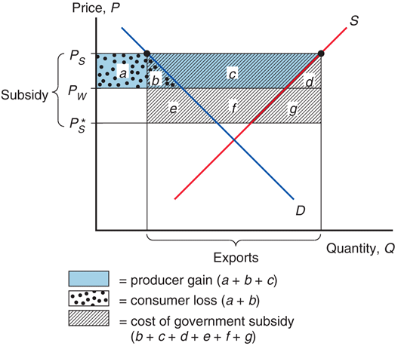
Fig. 9-11: Effects of an Export Subsidy

Slide 36
Export Subsidy (cont.)
An export subsidy damages national welfare.
The triangles b and d represent the efficiency loss.
The export subsidy distorts production and consumption decisions: producers produce too much and consumers consume too little compared to the market outcome.
The area b + c + d + f + g represents the cost of the subsidy paid by the government.
The terms of trade decrease, because the price of exports falls.

Slide 37
Export Subsidy in Europe
The European Union’s Common Agricultural Policy sets high prices for agricultural products and subsidizes exports to dispose of excess output.
Subsidized exports reduce world prices of agricultural products.

Slide 38
Export Subsidy in Europe
The cost of this policy for European taxpayers is almost $30 billion more than its benefits (in 2007). Subsidy payments are about 22% of the value of farm output.
The EU has proposed that farmers receive direct payments independent of the amount of production to help lower EU prices and reduce production.

Slide 39
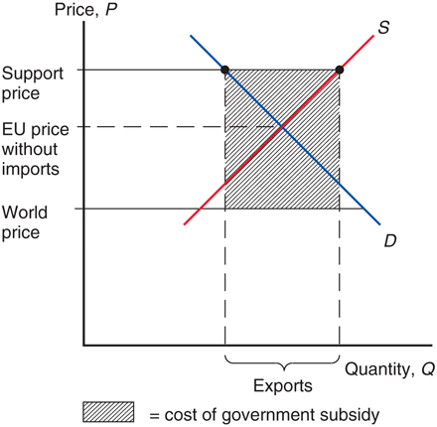
Fig. 9-12: Europe’s Common Agricultural Policy

Slide 40
Import Quota
An import quota is a restriction on the quantity of a good that may be imported.
This restriction is usually enforced by issuing licenses or quota rights.
A binding import quota will push up the price of the import because the quantity demanded will exceed the quantity supplied by Home producers and from imports.

Slide 41
Import Quota (cont.)
When a quota instead of a tariff is used to restrict imports, the government receives no revenue.
Instead, the revenue from selling imports at high prices goes to quota license holders.
These extra revenues are called quota rents.

Slide 42
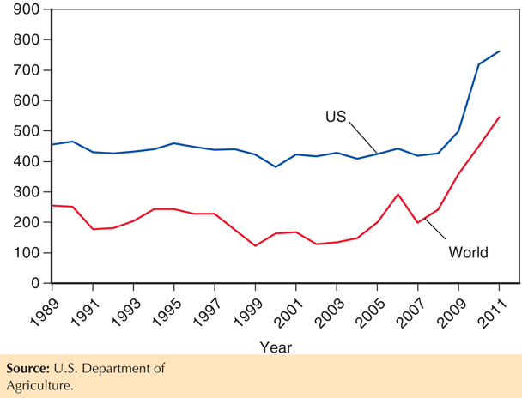
Fig. 9-13: U.S. and World Raw Sugar Prices in $ per ton, 1989–2011

Slide 43
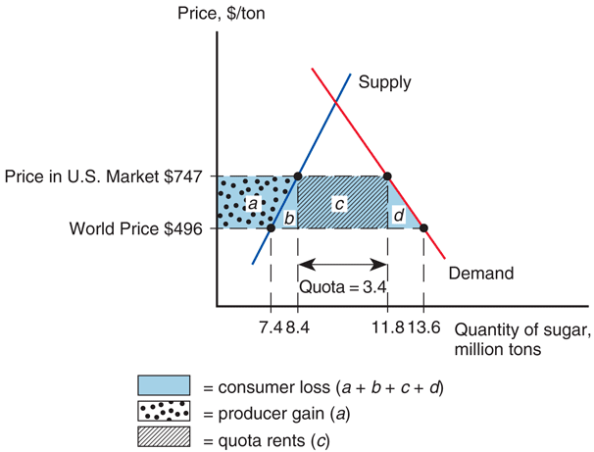
Fig. 9-14: Effects of the U.S. Import Quota on Sugar

Slide 44
Voluntary Export Restraint
A voluntary export restraint works like an import quota, except that the quota is imposed by the exporting country rather than the importing country.
These restraints are usually requested by the importing country.
The profits or rents from this policy are earned by foreign governments or foreign producers.
Foreigners sell a restricted quantity at an increased price.
Case Study 9.2

Slide 45
Local Content Requirement
A local content requirement is a regulation that requires a specified fraction of a final good to be produced domestically.
It may be specified in value terms, by requiring that some minimum share of the value of a good represent home value added, or in physical units.

Slide 46
Local Content Requirement (cont.)
From the viewpoint of domestic producers of inputs, a local content requirement provides protection in the same way that an import quota would.
From the viewpoint of firms that must buy home inputs, however, the requirement does not place a strict limit on imports, but allows firms to import more if they also use more home parts.

Slide 47
Local Content Requirement (cont.)
Local content requirement provides neither government revenue (as a tariff would) nor quota rents.
Instead, the difference between the prices of home goods and imports is averaged into the price of the final good and is passed on to consumers.

Slide 48
Local Content Requirement (cont.)
Any public work project funded by the American Recovery and Re-Investment Act of 2009 (ARRA) must use U.S. iron, steel, and manufactured goods (unless foreign bid more than 25% lower).
The Bay Bridge linking San Francisco and Oakland did not use ARRA funding because some key components would have been 23% ($400 million) more expensive.
Delays due to having to show that some items are unavailable from U.S. sources.
Has triggered protectionist clauses that shut U.S. firms out of opportunities abroad.

Slide 49
Other Trade Policies
Export credit subsidies
A subsidized loan to exporters
U.S. Export-Import Bank subsidizes loans to U.S. exporters.
Government procurement
Government agencies are obligated to purchase from home suppliers, even when they charge higher prices (or have inferior quality) compared to foreign suppliers.
Bureaucratic regulations (red tape)
Safety, health, quality, or customs regulations can act as a form of protection and trade restriction.

Slide 50
The Effects of Trade Policy
For each trade policy, the price rises in the Home country adopting the policy.
Home producers supply more and gain.
Home consumers demand less and lose.
The world price falls when Home is a “large” country that affects world prices.
Tariffs generate government revenue; export subsidies drain it; import quotas do not affect government revenue.
All these trade policies create production and consumption distortions.

Slide 51
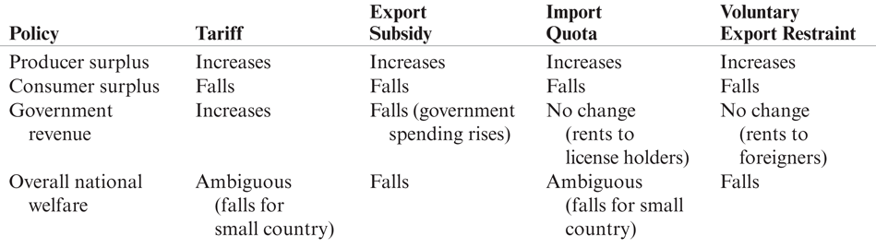
Table 9-1: Effects of Alternative Trade Policies

Slide 52
Summary
A tariff increases the home price and the quantity supplied and reduces the quantity demanded and the quantity traded; also decreases the world price when the country is “large.”
A quota does the same; an export subsidy does the same.
Tariffs generate government revenue; export subsidies drain it; import quotas are revenue neutral.

Slide 53
Summary (cont.)
The welfare effect of a tariff, quota, or export subsidy can be measured by
efficiency loss from consumption and production distortions.
terms of trade gain or loss.
With import quotas, voluntary export restraints, and local content requirements, the government of the importing country receives no revenue.
With voluntary export restraints and occasionally import quotas, quota rents go to foreigners.

Slide 54
Chapter 9
Appendix: Tariffs and Import Quotas in the Presence of Monopoly

Slide 55
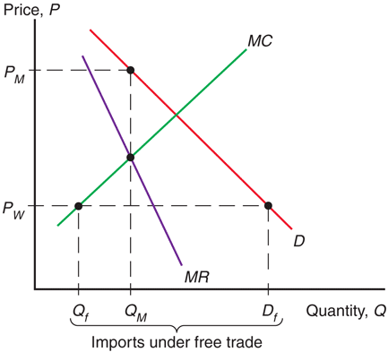
Fig. 9A-1: A Monopolist under Free Trade

Slide 56
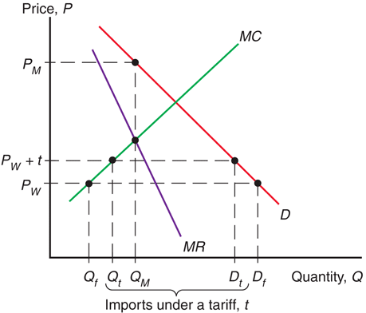
Fig. 9A-2: A Monopolist Protected by a Tariff

Slide 57
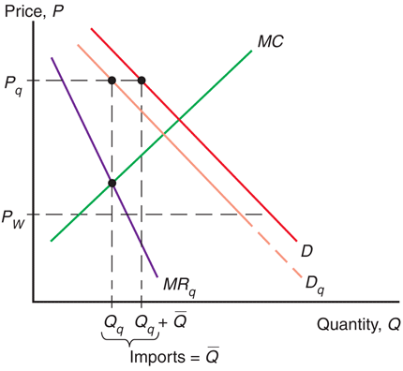
Fig. 9A-3: A Monopolist Protected by an Import Quota

Slide 58
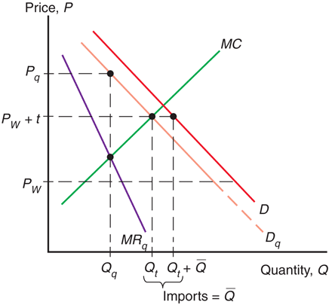
Fig. 9A-4: Comparing a Tariff and a Quota

