Slide 1
Chapter 10
The Political Economy of Trade Policy

Slide 2
Preview
The cases for free trade
The cases against free trade
Political models of trade policy
International negotiations of trade policy and the World Trade Organization

Slide 3
The Cases for Free Trade
The first case for free trade is the argument that producers and consumers allocate resources most efficiently when governments do not distort market prices through trade policy.
National welfare of a small country is highest with free trade.
With restricted trade, consumers pay higher prices and consume too little while firms produce too much.

Slide 4
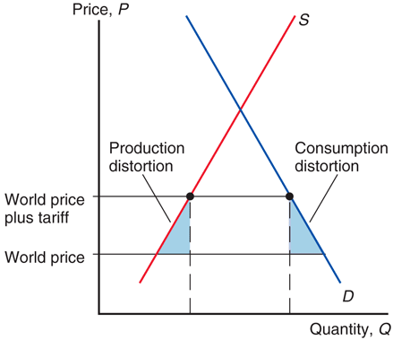
Fig. 10-1: The Efficiency Case for Free Trade

Slide 5
The Cases for Free Trade (cont.)
However, because tariff rates are already low for most countries, the estimated benefits of moving to free trade are only a small fraction of national income for most countries.
For the world as a whole, protection costs less than 1 percent of GDP.
The gains from free trade are somewhat smaller for advanced economies such as the United States and Europe and somewhat larger for poorer developing countries.

Slide 6
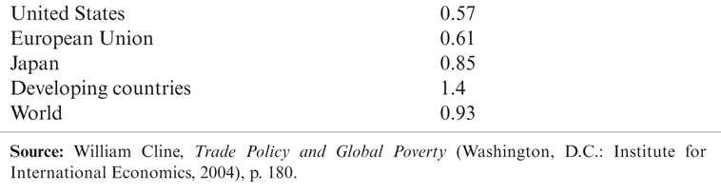
Table 10-1: Benefits of a Move to Worldwide Free Trade (percent of GDP)

Slide 7
The Cases for Free Trade (cont.)
Free trade allows firms or industry to take advantage of economies of scale.
Protected markets limit gains from external economies of scale by inhibiting the concentration of industries:
Too many firms to enter the protected industry.
The scale of production of each firm becomes inefficient.

Slide 8
The Cases for Free Trade (cont.)
Free trade provides competition and opportunities for innovation (dynamic benefits).
By providing entrepreneurs with an incentive to seek new ways to export or compete with imports, free trade offers more opportunities for learning and innovation.

Slide 9
The Cases for Free Trade (cont.)
Free trade avoids the loss of resources through rent seeking.
Spend time and other resources seeking quota rights and the profit that they will earn.

Slide 10
The Cases for Free Trade (cont.)
The political argument for free trade says that free trade is the best feasible political policy, even though there may be better policies in principle.
Any policy that deviates from free trade would be quickly manipulated by political groups, leading to decreased national welfare.
Case Study 10.1

Slide 11
The Cases against Free Trade
For a “large” country, a tariff lowers the price of imports in world markets and generates a terms of trade gain.
This benefit may exceed the losses caused by distortions in production and consumption.
A small tariff will lead to an increase in national welfare for a large country.
But at some tariff rate, the national welfare will begin to decrease as the economic efficiency loss exceeds the terms of trade gain.

Slide 12
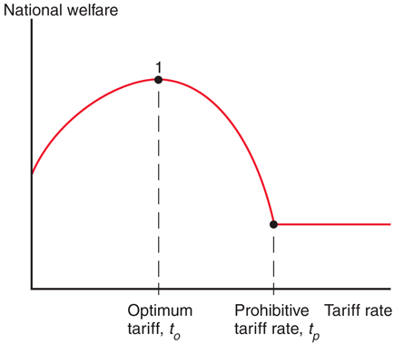
Fig. 10-2: The Optimum Tariff

Slide 13
The Cases against Free Trade (cont.)
A tariff rate that completely prohibits imports leaves a country worse off, but tariff rate t_{O} may exist that maximizes national welfare: an optimum tariff.

Slide 14
The Cases against Free Trade (cont.)
An export tax (a negative export subsidy) that completely prohibits exports leaves a country worse off, but an export tax rate may exist that maximizes national welfare through the terms of trade.
An export subsidy lowers the terms of trade for a large country; an export tax raises the terms of trade for a large country.
An export tax may raise the price of exports in the world market, increasing the terms of trade.

Slide 15
Counter-Argument
For some countries like the U.S., an import tariff and/or export tax could improve national welfare at the expense of other countries.
But this argument ignores the likelihood that other countries may retaliate against large countries by enacting their own trade restrictions.

Slide 16
The Cases against Free Trade (cont.)
A second argument against free trade is that domestic market failures may exist that cause free trade to be a suboptimal policy.
The economic efficiency loss calculations using consumer and producer surplus assume that markets function well.

Slide 17
The Cases against Free Trade (cont.)
Types of market failures include
Persistently high underemployment of workers
surpluses that are not eliminated in the market for labor because wages do not adjust
Persistently high underutilization of structures, equipment, and other forms of capital
surpluses that are not eliminated in the market for capital because prices do not adjust
Property rights not well defined or well enforced

Slide 18
The Cases against Free Trade (cont.)
Types of market failures include
technological benefits for society discovered through private production, but from which private firms cannot fully profit
environmental costs for society caused by private production, but for which private firms do not fully pay
sellers that are not well informed about the (opportunity) cost of production or buyers that are not well informed about value from consumption

Slide 19
The Cases against Free Trade (cont.)
Economists calculate the marginal social benefit to represent the additional benefit to society from private production.
With a market failure, marginal social benefit is not accurately measured by the producer surplus of private firms, so that economic efficiency loss calculations are misleading.
It’s possible that when a tariff increases domestic production, the benefit to domestic society will increase due to a market failure.

Slide 20
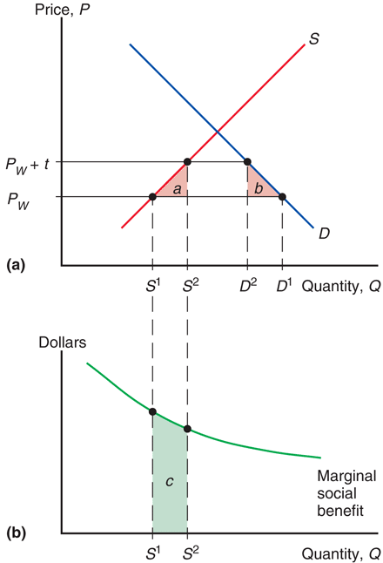
Fig. 10-3: The Domestic Market Failure Argument for a Tariff

Slide 21
The Cases against Free Trade (cont.)
The domestic market failure argument against free trade is an example of a more general argument called the theory of the second best.
Government intervention that distorts market incentives in one market may increase national welfare by offsetting the consequences of market failures elsewhere.
If the best policy, fixing the market failures, is not feasible, then government intervention in another market may be the “second-best” way of fixing the problem.

Slide 22
Counter-Arguments
Economists supporting free trade counter-argue that domestic market failures should be corrected by a “first-best” policy: a domestic policy aimed directly at the source of the problem.
If persistently high underemployment of labor is a problem, then the cost of labor or production of labor-intensive products could be subsidized by the government.
This policy could avoid economic efficiency losses due to a tariff.

Slide 23
Counter-Arguments (cont.)
Unclear when and to what degree a market failure exists in the real world.
Government policies to address market failures are likely to be manipulated by politically powerful groups.
Due to distorting the incentives of producers and consumers, trade policy may have unintended consequences that make a situation worse, not better.

Slide 24
Political Models of Trade Policy
How is trade policy determined?
Models of governments maximizing political success rather than national welfare:
Median voter theorem
Collective action
A model that combines aspects of collective action and the median voter theorem

Slide 25
Median Voter
The median voter theorem predicts that democratic political parties pick their policies to court the voter in the middle of the ideological spectrum (i.e., the median voter).
Suppose the level of a tariff rate is the policy issue.
Line up all the voters according to the tariff rate they prefer, starting with those who favor the lowest rate.

Slide 26
Median Voter (cont.)
Assumptions of the model:
There are two competing political parties.
The objective of each party is to get elected by majority vote.
What policies will the parties promise to follow?
Both parties will offer the same tariff policy to court the median voter (the voter in the middle of the spectrum) in order to capture the most votes.

Slide 27
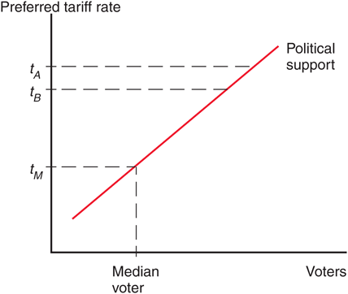
Fig. 10-4: Political Competition

Slide 28
Median Voter (cont.)
Thus, the median voter theorem implies that a two-party democracy should enact trade policy based on how many voters it pleases.
A policy that inflicts large losses on a few people (import-competing producers) but benefits a large number of people (consumers) should be chosen.
But trade policy doesn’t follow this prediction.

Slide 29
Collective Action
Political activity is often described as a collective action problem:
While consumers as a group have an incentive to advocate free trade, each individual consumer has no incentive because his benefit is not large compared to the cost and time required to advocate free trade.
Policies that impose large losses for society as a whole but small losses on each individual may therefore not face strong opposition.

Slide 30
Collective Action (cont.)
However, for groups who suffer large losses from free trade (for example, unemployment), each individual in that group has a strong incentive to advocate the policy he desires.
In this case, the cost and time required to advocate restricted trade is small compared to the cost of unemployment.
Case Study 10.2

Slide 31
A Model of Trade Policy
While politicians may win elections partly because they advocate popular policies as implied by the median voter theorem, they also require funds to run campaigns.
These funds may especially come from groups who do not have a collective action problem and are willing to advocate a special interest policy.
Models of trade restrictions try to measure the trade-off between the reduction in welfare of constituents as a whole and the increase in campaign contributions from special interests.

Slide 32
Which Industries Are Protected?
Agriculture: In the U.S., Europe, and Japan, farmers make up a small fraction of the electorate but receive generous subsidies and trade protection.
Examples: European Union’s Common Agricultural Policy, Japan’s 1000% tariff on imported rice, America’s sugar quota.

Slide 33
Which Industries Are Protected? (cont.)
Clothing: textiles (fabrication of cloth) and apparel (assembly of cloth into clothing).
Until 2005, quota licenses granted to textile and apparel exporters were specified in the Multi-Fiber Agreement between the United States and many other nations.
Phase-out of MFA drastically reduced the costs of U.S. protection, from 14.1b in 2002 (11.8b from textiles and apparel) to 2.6b estimate for 2015 (only 0.5b from textiles and apparel).

Slide 34
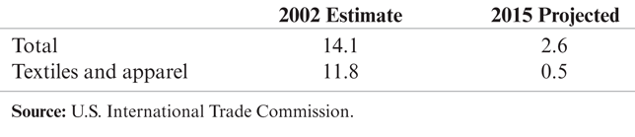
Table 10-2: Welfare Costs of U.S. Protection ($ billion)

Slide 35
International Negotiations of Trade Policy
After rising sharply at the beginning of the 1930s, the average U.S. tariff rate has decreased substantially from the mid-1930s to 1998.
Since 1944, much of the reduction in tariffs and other trade restrictions has come about through international negotiations.
The General Agreement of Tariffs and Trade was begun in 1947 as a provisional international agreement and was replaced by a more formal international institution called the World Trade Organization in 1995.

Slide 36
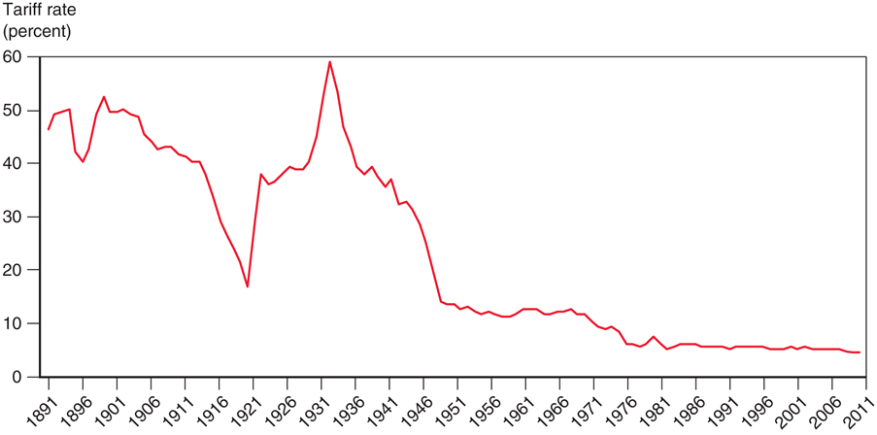
Fig. 10-5: The U.S. Tariff Rate

Slide 37
International Negotiations of Trade Policy (cont.)
Multilateral negotiations mobilize exporters to support free trade if they believe export markets will expand.
This support would be lacking in a unilateral push for free trade. The multilateral approach counteracts the support for restricted trade by import-competing groups.

Slide 38
International Negotiations of Trade Policy (cont.)
Multilateral negotiations also help avoid a trade war between countries, where each country enacts trade restrictions.
A trade war could result if each country has an incentive to adopt protection, regardless of what other countries do.
All countries could enact trade restrictions, even if it is in the interest of all countries to have free trade.
Countries need an agreement that prevents a trade war or eliminates the protection from one.

Slide 39
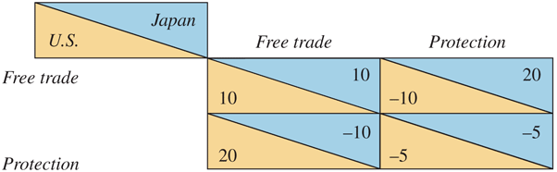
Table 10-3: The Problem of Trade Warfare

Slide 40
International Negotiations of Trade Policy (cont.)
In this example, each country acting individually would be better off with protection (20 > 10), but both would be better off if both chose free trade than if both choose protection (10 > –5).
If Japan and the U.S. can establish a binding agreement to maintain free trade, both can avoid the temptation of protection and both can be made better off.
Or if the damage has already been done, both countries can agree to return to free trade.

Slide 41
International Trade Agreements: A Brief History
In 1930, the United States passed a remarkably irresponsible tariff law, the Smoot-Hawley Act.
Tariff rates rose steeply and U.S. trade fell sharply.
Initial attempts to reduce tariff rates were undertaken through bilateral trade negotiations:
U.S. offered to lower tariffs on some imports if another country would lower its tariffs on some U.S. exports.
Bilateral negotiations, however, do not take full advantage of international coordination.
Benefits can “spill over” to countries that have not made any concessions.

Slide 42
World Trade Organization
In 1947, a group of 23 countries began trade negotiations under a provisional set of rules that became known as the General Agreement on Tariffs and Trade, or GATT.
In 1995, the World Trade Organization, or WTO, was established as a formal organization for implementing multilateral trade negotiations (and policing them).

Slide 43
World Trade Organization (cont.)
WTO negotiations address trade restrictions in at least 3 ways:
Reducing tariff rates through multilateral negotiations.
Binding tariff rates: a tariff is “bound” by having the imposing country agree not to raise it in the future.

Slide 44
World Trade Organization (cont.)
Eliminating nontariff barriers: quotas and export subsidies are changed to tariffs because the costs of tariff protection are more apparent and easier to negotiate.
Subsidies for agricultural exports are an exception.
Exceptions are also allowed for “market disruptions” caused by a surge in imports.

Slide 45
World Trade Organization (cont.)
The World Trade Organization is based on a number of agreements:
General Agreement on Tariffs and Trade: covers trade in goods.
General Agreement on Tariffs and Services: covers trade in services (ex., insurance, consulting, legal services, banking).
Agreement on Trade-Related Aspects of Intellectual Property: covers international property rights (ex., patents and copyrights).

Slide 46
World Trade Organization (cont.)
The dispute settlement procedure: a formal procedure where countries in a trade dispute can bring their case to a panel of WTO experts to rule upon.
The panel decides whether member counties are breaking their agreements.
A country that refuses to adhere to the panel’s decision may be punished by the WTO allowing other countries to impose trade restrictions on its exports.
Case Study 10.3
Case Study 10.4

Slide 47
World Trade Organization (cont.)
The GATT multilateral negotiations in the Uruguay Round, ratified in 1994:
agreed that all quantitative restrictions (ex., quotas) on trade in textiles and clothing as previously specified in the Multi-Fiber Agreement were to be eliminated by 2005.
Quotas on imports from China had to be temporarily reimposed due to surge in Chinese clothing exports when MFA expired.

Slide 48
World Trade Organization (cont.)
In 2001, a new round of negotiations was started in Doha, Qatar, but these negotiations have not yet produced an agreement.
Most of the remaining forms of protection are in agriculture, textiles, and clothing—industries that are politically well organized.

Slide 49
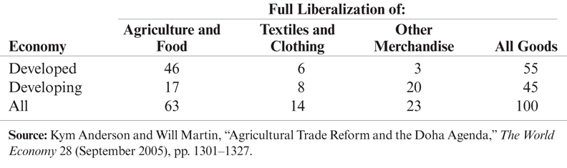
Table 10-4: Percentage Distribution of Potential Gains from Free Trade

Slide 50
Do Agricultural Subsidies in Rich Countries Hurt Poor Countries?
We learned in Chapter 9 that subsidies lower the world price of products.
Since importing countries benefit from cheaper food, why would poor countries want rich countries to remove their agricultural subsidies?
Subsidies harm farmers in poor countries who compete with farmers in rich countries.

Slide 51
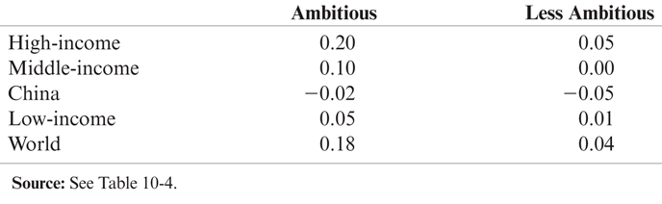
Table 10-5: Percentage Gains in Income under Two Doha Scenarios

Slide 52
Preferential Trading Agreements
Preferential trading agreements are trade agreements between countries in which they lower tariffs for each other but not for the rest of the world.
Under the WTO, such discriminatory trade policies are generally not allowed:
Each country in the WTO promises that all countries will pay tariffs no higher than the nation that pays the lowest: called the “most favored nation” (MFN) principle.
An exception is allowed only if the lowest tariff rate is set at zero.

Slide 53
Preferential Trading Agreements (cont.)
There are two types of preferential trading agreements in which tariff rates are set at or near zero:
A free trade area: an agreement that allows free trade among members, but each member can have its own trade policy towards non-member countries.
An example is the North America Free Trade Agreement (NAFTA).

Slide 54
Preferential Trading Agreements (cont.)
A customs union: an agreement that allows free trade among members and requires a common external trade policy towards non-member countries.
An example is the European Union.

Slide 55
Preferential Trading Agreements (cont.)
Are preferential trading agreements necessarily good for national welfare?
No, it is possible that national welfare decreases under a preferential trading agreement.
How? Rather than gaining tariff revenue from inexpensive imports from world markets, a country may import expensive products from member countries but not gain any tariff revenue.

Slide 56
Preferential Trading Agreements (cont.)
Preferential trading agreements increase national welfare when new trade is created, but not when existing trade from the outside world is diverted to trade with member countries.
Trade creation
occurs when high-cost domestic production is replaced by low-cost imports from other members.
Trade diversion
occurs when low-cost imports from nonmembers are diverted to high-cost imports from member nations.
Case Study 10.5
Case Study 10.6
Case Study 10.7

Slide 57
Summary
The cases for free trade are that freer trade
allows consumers and producers to allocate their resources freely and efficiently, without price distortions.
may allow for economies of scale.
increases competition and innovation.
The cases against free trade are that trade restrictions may allow
terms of trade gains.
a government to address a market failure when better policies are not feasible.

Slide 58
Summary (cont.)
Models of trade policy choice consider the incentives politicians face given their desire to be reelected, and the tendency for groups that gain from protection to be better organized than consumers who lose.
Agricultural and clothing industries are the most protected industries in many countries.

Slide 59
Summary (cont.)
Multilateral negotiations of free trade may mobilize domestic political support for free trade, as well as make countries agree not to engage in a trade war.
The WTO and its predecessor have reduced tariffs substantially in the last 50 years, and the WTO has a dispute settlement procedure for trade disputes.
A preferential trading agreement is beneficial for a country if it creates new trade but is harmful if it diverts existing trade to higher-cost alternatives.

Slide 60
Chapter 10
Appendix: Proving that the Optimum Tariff Is Positive

Slide 61
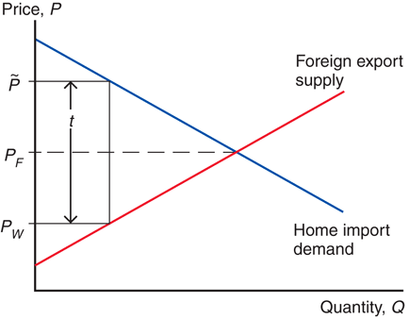
Fig. 10A-1: Effects of a Tariff on Prices

Slide 62
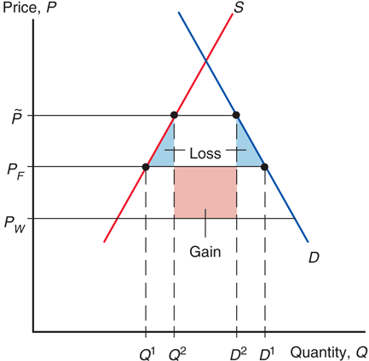
Fig. 10A-2: Welfare Effects of a Tariff

