Slide 1
Chapter 11
Trade Policy in Developing Countries

Slide 2
Preview
Import-substituting industrialization
Trade liberalization since 1985
Trade and growth: takeoff in Asia

Slide 3
Introduction
Which countries are “developing countries”?
The term “developing countries” does not have a precise definition, but it is a name given to many low- and middle-income countries.

Slide 4
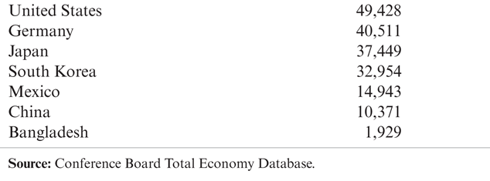
Table 11-1: Gross Domestic Product Per Capita, 2009 (dollars)

Slide 5
Import-Substituting Industrialization
Import-substituting industrialization was a trade policy adopted by many low- and middle-income countries before the 1980s.
The policy aimed to encourage domestic industries by limiting competing imports.
Case Study 11.1

Slide 6
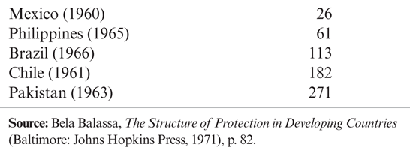
Table 11-2: Effective Protection of Manufacturing in Some Developing Countries (percent)

Slide 7
Import-Substituting Industrialization (cont.)
The principal justification of this policy was/is the infant industry argument:
Countries may have a potential comparative advantage in some industries, but these industries cannot initially compete with well-established industries in other countries.
To allow these industries to establish themselves, governments should temporarily support them until they have grown strong enough to compete internationally.

Slide 8
Problems with the Infant Industry Argument
It may be wasteful to support industries now that will have a comparative advantage in the future.
With protection, infant industries may never “grow up” or become competitive.
There is no justification for government intervention unless there is a market failure that prevents the private sector from investing in the infant industry.

Slide 9
Infant Industries and Market Failures
Two arguments for how market failures prevent infant industries from becoming competitive:
Imperfect financial asset markets
Because of poorly working financial laws and markets (and more generally, a lack of property rights), firms cannot or do not save and borrow to invest sufficiently in their production processes.
If creating better functioning markets and enforcing laws is not feasible, then high tariffs would be a second-best policy to increase profits in new industries, leading to more rapid growth.

Slide 10
Infant Industries and Market Failures (cont.)
The problem of appropriability
Firms may not be able to privately appropriate the benefits of their investment in new industries because those benefits are public goods.
The knowledge created when starting an industry may not be appropriable (may be a public good) because of a lack of property rights.
If establishing a system of property rights is not feasible, then high tariffs would be a second-best policy to encourage growth in new industries.

Slide 11
Import-Substituting Industrialization (cont.)
Import-substituting industrialization in Latin American countries worked to encourage manufacturing industries in the 1950s and 1960s.
But economic development, not encouraging manufacturing, was the ultimate goal of the policy.
Did import-substituting industrialization promote economic development?
No, countries adopting these policies grew more slowly than others.

Slide 12
Import-Substituting Industrialization (cont.)
It appeared that the infant industry argument was not as valid as some had initially believed.
New industries did not become competitive despite or because of trade restrictions.
Import-substitution industrialization involved costs and promoted wasteful use of resources:
It involved complex, time-consuming regulations.
It set high tariff rates for consumers, including firms that needed to buy imported inputs for their products.
It promoted inefficiently small industries.

Slide 13
Trade Liberalization
Some low- and middle-income countries that had relatively free trade had higher average economic growth than those that followed import substitution.
By the mid-1980s, many governments had lost faith in import substitution and began to liberalize trade.
Dramatic fall in tariff rates in India and Brazil, and less drastic reductions in many other developing countries.

Slide 14
Trade Liberalization (cont.)
Trade liberalization in developing countries occurred along with a dramatic increase in the volume of trade.
The share of trade in GDP has tripled over 1970–1998, with most of the growth happening after 1985.
The share of manufactured goods in developing-country exports surged, coming to dominate the exports of the biggest developing economies.
A number of developing countries have achieved extraordinary growth while becoming more, not less, open to trade.

Slide 15
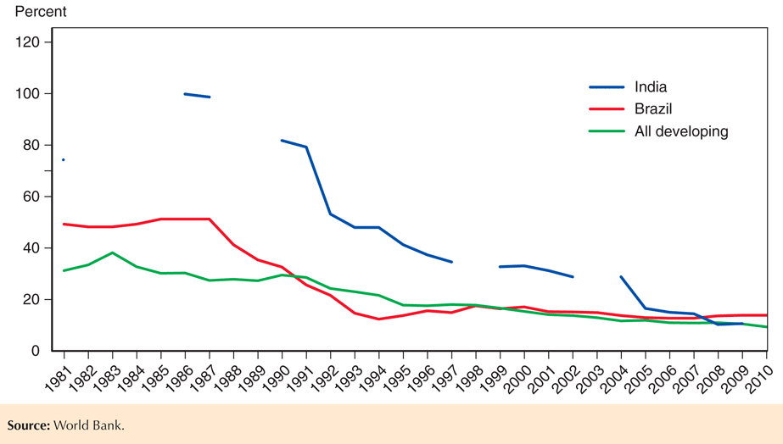
Fig. 11-1: Tariff Rates in Developing Countries

Slide 16
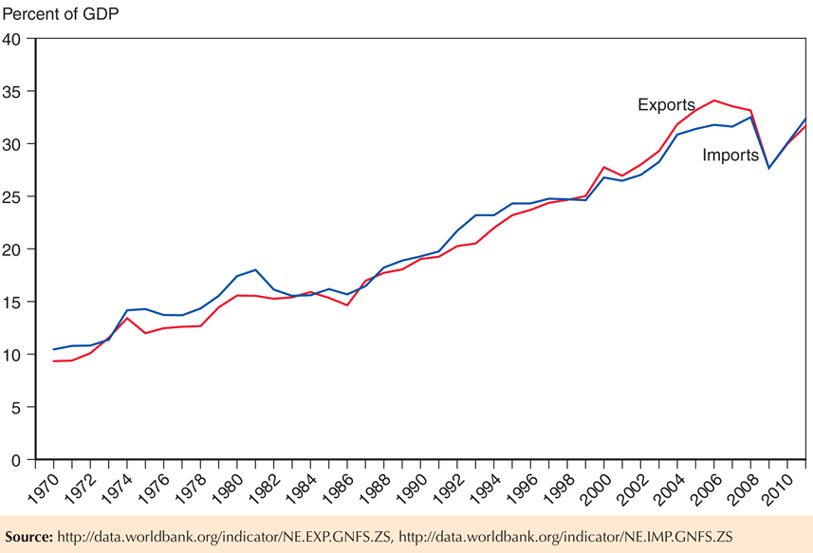
Fig. 11-2: The Growth of Developing-Country Trade

Slide 17
Trade Liberalization (cont.)
Has trade liberalization promoted development? The evidence is mixed.
Growth rates in Brazil and other Latin American countries have been slower since trade liberalization than they were during import-substituting industrialization.
But unstable macroeconomic policies and financial crises contributed to slower growth since the 1980s.

Slide 18
Trade Liberalization (cont.)
Other countries like India have grown rapidly since liberalizing trade in the 1980s, but it is unclear to what degree liberalized trade contributed to growth.
Some economists also argue that trade liberalization has contributed to income inequality, as the Heckscher-Ohlin model predicts.

Slide 19
Trade and Growth: Takeoff in Asia
Instead of import substitution, several countries in East Asia adopted trade policies that promoted exports in targeted industries.
Japan, Hong Kong, Taiwan, South Korea, Singapore, Malaysia, Thailand, Indonesia, and China have experienced rapid growth in various export sectors and rapid economic growth in general.

Slide 20
Trade and Growth: Takeoff in Asia (cont.)
These high-performance Asian economies generated a high volume of exports and imports relative to total production.
Their policy reforms were followed by a large increase in openness, as measured by their share of exports in GDP.
So it is possible to develop through export-oriented growth.
However, Latin American nations such as Mexico and Brazil, which also sharply liberalized trade and shifted toward exports, did not see comparable economic takeoffs.
These Latin American results suggest that other factors must have played a crucial role in the Asian miracle.

Slide 21
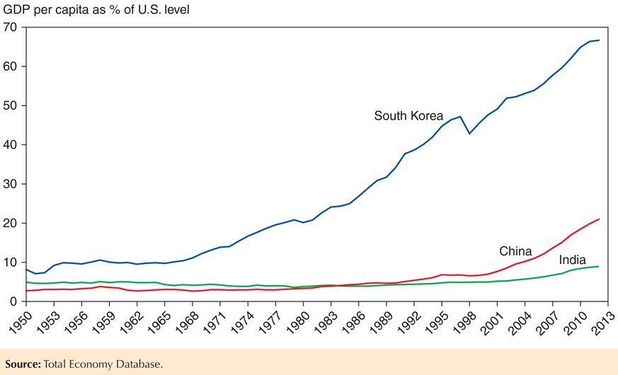
Fig. 11-3: The Asian Takeoff

Slide 22
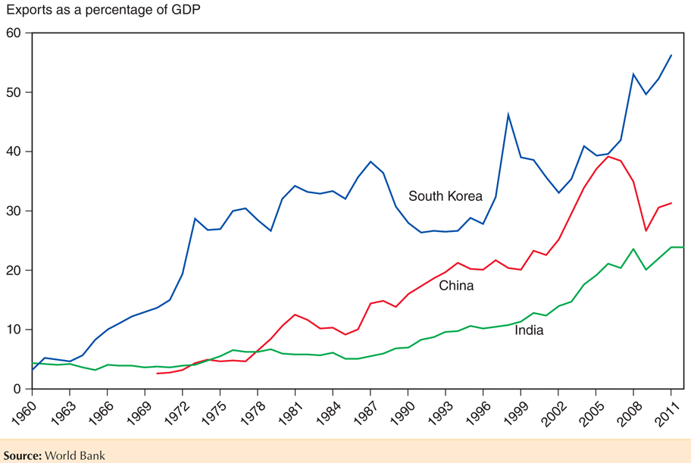
Fig. 11-4: Asia’s Surging Trade

Slide 23
Trade and Growth: Takeoff in Asia (cont.)
It’s unclear if the high volume of exports and imports caused rapid economic growth or was merely correlated with rapid economic growth.
High saving and investment rates could have led to both rapid economic growth in general and rapid economic growth in export sectors.
Rapid growth in education led to high literacy and numeracy rates important for a productive labor force.
These nations also undertook other economic reforms.
Case Study 11.2

Slide 24
Summary
Import-substituting industrialization aimed to promote economic growth by restricting imports that competed with domestic products in low- and middle-income countries.
The infant industry argument says that new industries need temporary trade protection due to market failures:
imperfect asset markets that restrict saving, borrowing, and investment in production processes
problems of appropriating gains from private investment in production processes

Slide 25
Summary (cont.)
Import-substituting industrialization was tried in the 1950s and 1960s but by the mid-1980s it was abandoned for trade liberalization.
The effect of liberalized trade on national welfare is still being debated.
Trade helped growth in some sectors, but saying that trade caused higher overall economic growth has attracted some skepticism.
Some argue that trade has caused increased income inequality.

Slide 26
Summary (cont.)
Several East Asian economies adopted export- oriented instead of import-substituting industrialization.
High export and import volumes and relatively low trade restrictions were characteristics of this policy.
It’s unclear to what degree this policy contributed to overall economic growth, especially since other countries have not had similar successes.

