Slide 1
Chapter 12
Controversies in Trade Policy

Slide 2
Preview
Arguments for “activist” trade policies
Externality or appropriability problem
Strategic trade policy with imperfect competition
Arguments concerning trade and people
Trade and low-wage labor
Trade and the environment
Trade and culture

Slide 3
Arguments for an Activist Trade Policy
An activist trade policy usually means government policies that actively support export industries through subsidies.
Arguments for activist trade policies use an assumption that import-substituting industrialization (Econ/Trade Chapter 11) and the cases against free trade (Econ/Trade Chapter 10) used: market failure.
Externalities or an appropriability problem
Imperfect competition that results in revenues that exceed all (opportunity) costs: “excess” profits.

Slide 4
Technology and Externalities
Firms that invest in new technology generally create knowledge that other firms can use without paying for it: an appropriability problem.
By investing in new technology, firms are creating an extra benefit for society that is easily used by others.
An appropriability problem is an example of an externality: benefits or costs that accrue to parties other than the one that generates it.
An externality implies that the marginal social benefit of investment is not represented by producer surplus.

Slide 5
Technology and Externalities (cont.)
Governments may want to actively encourage investment in technology when externalities in new technologies create a high marginal social benefit.
Should the U.S. government subsidize high- technology industries?

Slide 6
Technology and Externalities (cont.)
When considering whether a government should subsidize high-technology industries, consider:
The ability of governments to subsidize the right activity.
Much activity by high technology firms has nothing to do with generating knowledge: subsidizing equipment purchases or non-technical workers generally does not create new technology.
Knowledge and innovation are created in industries that are not usually classified as high tech.

Slide 7
Technology and Externalities (cont.)
2. Instead of subsidizing specific industries, the U.S. subsidizes research and development through the tax code.
Research and development expenses can be deducted from corporate taxable income.
3. The economic importance of externalities.
It is difficult to determine the quantitative importance that externalities have on the economy.
Therefore, it is difficult to say how much to subsidize activities that create externalities.
4. Externalities may occur across countries as well.
No individual country has an incentive to subsidize industries if all countries could take advantage of the externalities generated in a country.

Slide 8
Technology and Externalities (cont.)
Some argue that the United States should have a deliberate policy of promoting high-technology industries and helping them compete against foreign rivals.
Fear in the 1980s that Japan’s dominance of the semiconductor memory market would translate into a broader dominance of computers and related technologies proved to be unfounded.

Slide 9
Technology and Externalities (cont.)
More recently, the decline in U.S. employment in the information, communication, and technology (ICT) industries, which are at the heart of the information technology revolution, and large U.S. trade deficits in ICT goods have renewed fears.

Slide 10
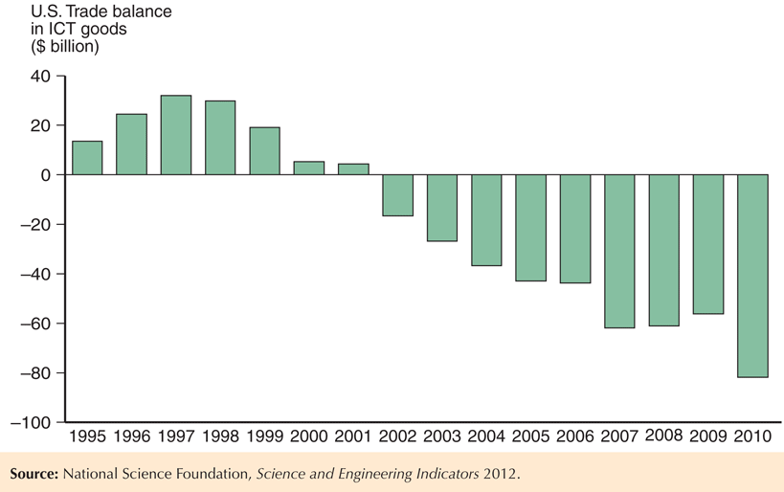
Fig. 12-1: The U.S. Trade Balance in Information Goods

Slide 11
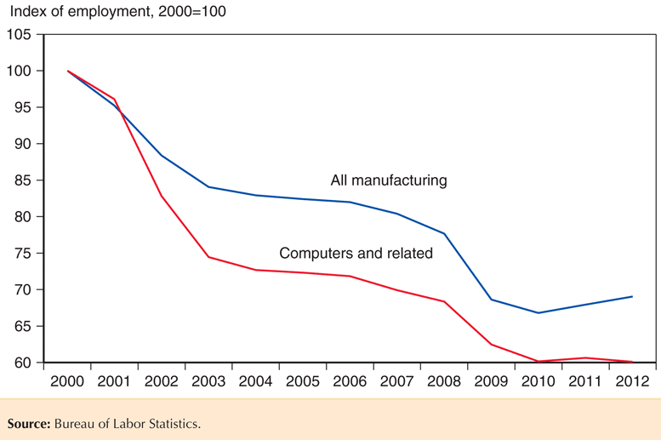
Fig. 12-2: U.S. Manufacturing Employment

Slide 12
Imperfect Competition and Strategic Trade Policy
Imperfectly competitive industries are typically dominated by a few firms that generate monopoly profits or excess profits.
Excess profits are revenues that exceed all opportunity costs: profits higher than what equally risky investments elsewhere in the economy earn.
In an imperfectly competitive industry, government subsidies can shift excess profits from a foreign firm to a domestic firm.

Slide 13
Imperfect Competition and Strategic Trade Policy (cont.)
Example (called the Brander-Spencer analysis):
Two firms (Boeing and Airbus) compete in the international market but are located in two different countries (U.S. and EU).
Both firms manufacture airplanes, but each firm’s profits depends on the actions of the other.
Each firm decides to produce or not depending on profit levels.

Slide 14
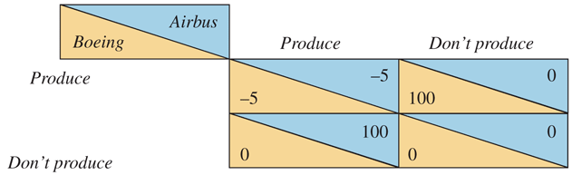
Table 12-1: Two-Firm Competition

Slide 15
Imperfect Competition and Strategic Trade Policy (cont.)
The predicted outcome depends on which firms invest/produce first.
If Boeing produces first, then Airbus will not find it profitable to produce.
If Airbus produces first, then Boeing will not find it profitable to produce.
But a subsidy by the European Union can alter the outcome by making it profitable for Airbus to produce regardless of Boeing’s action.

Slide 16
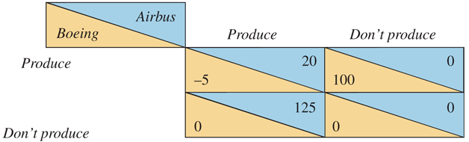
Table 12-2: Effects of a Subsidy to Airbus

Slide 17
Imperfect Competition and Strategic Trade Policy (cont.)
If Boeing expects that the European Union will subsidize Airbus, Boeing will be deterred from entering the industry.
Thus, the subsidy of 25 will generate profits of 125 for Airbus.
The subsidy raises profits more than the amount of the subsidy itself due to its deterrent effect on foreign competition.

Slide 18
Imperfect Competition and Strategic Trade Policy (cont.)
A government policy to give a domestic firm a strategic advantage in production is called a strategic trade policy.

Slide 19
Imperfect Competition and Strategic Trade Policy (cont.)
Criticisms of this analysis include:
Practical use of strategic trade policy requires more information about firms than is likely available.
The predictions from the simple example differ if the numbers are slightly different.
What if governments or economists are not exactly right when predicting the profits of firms?
For example, what if Boeing has a better technology that only it can recognize, so that even if Airbus produces, Boeing still finds it profitable to produce?

Slide 20
Imperfect Competition and Strategic Trade Policy (cont.)
Foreign retaliation also could result:
If the European Union subsidizes Airbus, the U.S. could subsidize Boeing, which would deter neither firm from producing, start a trade war, and waste taxpayer funds.
Strategic trade policy, like any trade policy, could be manipulated by politically powerful groups.
Case Study 12.1
Case Study 12.2

Slide 21
Trade and Low-Wage Labor
Manufactured exports from low- and middle- income countries have been increasing.
Compared to rich-country standards, workers who produce these goods are paid low wages and may work under poor conditions.
Some have opposed free trade for this reason.

Slide 22
Trade and Low-Wage Labor (cont.)
One example of this situation is the maquiladora sector: Mexican firms that produce for export to the U.S.
Opponents of the North American Free Trade Agreement have argued that it is now easier for employers to replace high-wage workers in the U.S. with low-wage workers in Mexico.

Slide 23
Trade and Low-Wage Labor (cont.)
The above claim can be true, but we cannot conclude that trade hurts workers.
A Ricardian model predicts that while wages in Mexico should remain lower than those in the U.S. due to low productivity in Mexico, they will rise relative to their pretrade level.
A Heckscher-Ohlin model does predict that unskilled workers in the U.S. will lose from NAFTA, but it also predicts that unskilled workers in Mexico will gain.

Slide 24
Trade and Low-Wage Labor (cont.)
Despite the low wages earned by workers in Mexico, both theories predict that those workers are better off with trade than they would be if trade had not taken place.
Evidence consistent with these predictions would show that wages in maquiladoras have risen relative to wages in other Mexican sectors.
One could also compare working conditions in maquiladoras with the working conditions in other Mexican sectors, rather than with those in the U.S.

Slide 25
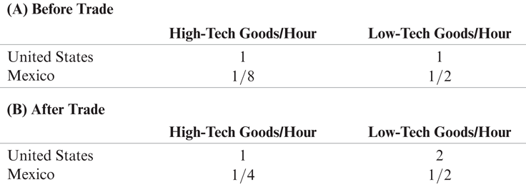
Table 12-3: Real Wages

Slide 26
Trade and Low-Wage Labor (cont.)
Some labor activists want to include labor standards in trade negotiations.
However, labor standards imposed by foreign countries are opposed by governments of low- and middle-income countries.
International standards could be used as a protectionist policy or a basis for lawsuits when domestic producers did not meet them.
Standards set by high-income countries would be expensive for low- and middle-income producers.

Slide 27
Trade and Low-Wage Labor (cont.)
A policy that could be agreeable for governments of low- and middle-income countries is a system that monitors wages and working conditions and makes this information available to consumers.
Products could be certified as made with acceptable wage rates and working conditions.
But this policy would have a limited effect, since a large majority of workers in low- and middle-income countries do not work in the export sector.
Case Study 12.3

Slide 28
Trade and the Environment
Compared to rich-country standards, environmental standards in low- and middle- income countries are lax.
Some have opposed free trade for this reason.
But we cannot conclude that trade hurts the environment, since consumption and production in the absence of trade have degraded the environment.

Slide 29
Trade and the Environment (cont.)
Some environmental activists want to include environmental standards in trade negotiations.
However, environmental standards imposed by foreign countries are opposed by governments of low- and middle-income countries.
International standards could be used as a protectionist policy or a basis for lawsuits when domestic producers did not meet them.
Standards set by high-income countries would be expensive for low- and middle-income producers.

Slide 30
Trade and the Environment (cont.)
As poor countries grow richer, possibly partly due to trade, they produce more and can consume more, leading to more environmental degradation.
But as countries grow richer, they want to pay for more stringent environment protection.
Both of these ideas are represented as an environmental Kuznets curve:
an inverted “U-shaped” relationship between environmental degradation and income per person

Slide 31
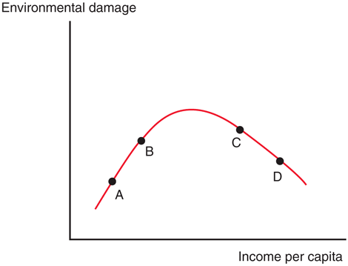
Fig. 12-3: The Environmental Kuznets Curve

Slide 32
Trade and the Environment (cont.)
Because rich countries usually have strict environmental regulations and poor countries do not, environmentally hazardous activities may be moved to poor countries.
A pollution haven is a place where an economic activity that is subject to strict environmental controls in some countries is moved to (sold to) other countries with less strict regulation.
Yet, there is evidence that pollution havens are insignificant relative to the pollution that occurs without international trade.

Slide 33
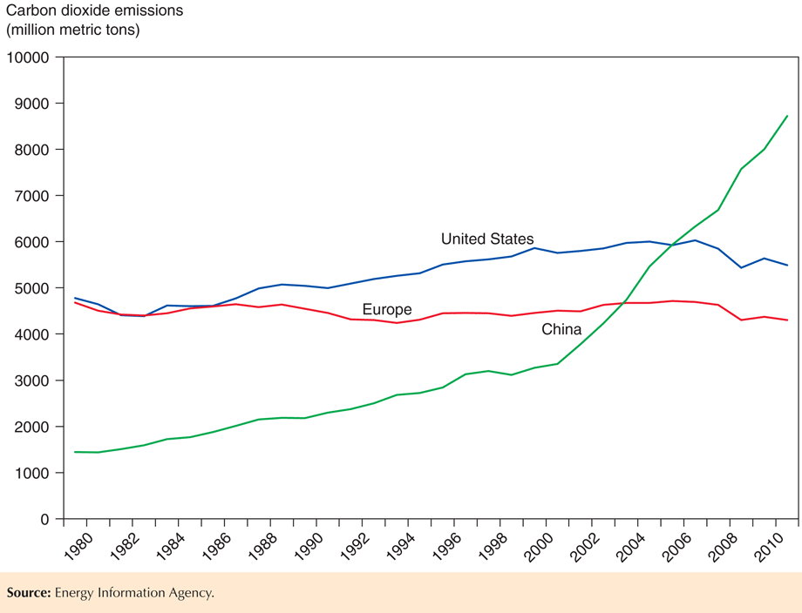
Fig. 12-4: Carbon Dioxide Emissions

Slide 34
Trade and the Environment (cont.)
Pollution in some countries may cause a negative externality for other countries.
For example, production in China could cause air pollution in Korea (or on the West Coast of the U.S.).
To the degree that pollution causes negative externalities for other countries, they should want to include it in international negotiations.
Emissions of carbon dioxide is an example of pollution that causes a negative externality and that has been included in international negotiations.

Slide 35
Trade and Culture
Some activists believe that trade destroys culture in other countries.
This belief neglects the principle that we should allow people to define their culture through the choices that they make, not through standards set by others.
Also, any economic change, not just trade, leads to changes in everyday life.

Slide 36
Summary
One argument for an activist trade policy is that investment in high-technology industries produces externalities for the economy.
But it is hard to identify which activities produce externalities and if so, to what degree they do.
A second argument for an activist trade policy is that governments can give domestic firms a strategic advantage in industries with excess profits.
But it is unclear if such a policy would succeed at giving a firm a strategic advantage or if it would be worthwhile.

Slide 37
Summary (cont.)
Some have opposed free trade because of the fact that workers in low- and middle-income countries earn lower wages and have worse working conditions than workers in high-income countries.
But workers in low- and middle-income countries are predicted to have lower wages due to lower productivity, yet still have higher wages compared to their situation without trade.

Slide 38
Summary (cont.)
Some have proposed that trade negotiations should involve labor, environmental, or “cultural” standards, but these standards are generally opposed by governments of low- and middle- income countries.

