Slide 1
Huazhong University of Science and Technology
International Economics
Fall 2018
Lecture
3-4(M, D9-D316)
3-4(W, D9-D206)

Slide 2
About Me
Instructor: Jing FANG（方晶）
Office: School of Economics 419
Email: jing_fang@hust.edu.cn

Slide 3
About Me
Wuhan University, BA & BS in Econ & Math
Wuhan University, MA in Econ
University of Minnesota, PhD in Econ
Research interests: Industrial Organization, Econometrics and International Trade

Slide 4
What about you?
Name?
Where are you from?
Where have you been to the farthest from home?
Which economic course are you most interested in?
Any hobby?
What’s your plan after graduate?

Slide 5
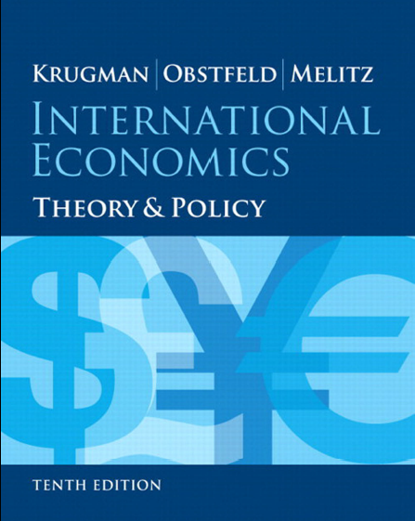
Textbook

Slide 6
Course Description
This will be a full English course.
We will use English everywhere except the conversation.
Homework and exam which is written in Chinese will not be accepted and get no score!

Slide 7
Course Description
You could find the necessary materials in the course website
You need to prepare to learn it by yourself and help each other.

Slide 8
Course Requirements
Homework
2 Problem Sets
All homework should be typed (and stapled)
Work that is not typed (or stapled) gets an automatic discount of 30%
Assignments not turned in by the due date will be penalized 10 points for each day it is late
Students are strongly encouraged to work in groups. However, each student is responsible of writing up his or her own problem set.

Slide 9
Course Requirements
Project
1 Project
You need to collect the data and do some analysis in group.
You will be asked to comment on others work.

Slide 10
Course Requirements
Exams
1 final exam
Final date: 9-11, 12th Dec, 2018

Slide 11
Grading Policy
The weights for the final score will be as follows:
Problem sets: 30%
Projects: 20%
Final exam: 50%
I reserve the right to raise the final score, but I will not lower them.

Slide 12
Course Schedule
The material of the textbook is summarized below.
Part1: International Trade Theory
Part2: International Trade Policy
Part3: Exchange Rates and Open-Economy macroeconomics
Part4: International Macroeconomic Policy
We will definitely cover parts I and part II.

Slide 13
Question?

