Slide 1
Wisconsin Breast Cancer
Report of XAI
G.Aliyev, A.Zafaranchi, I.Tondji
Prof. Fosca Giannotti
Prof. Roberto Pellungrini
4 March 2024

Slide 2
Introduction
What is breast cancer?
Tumors can be benign or malignant
Traditional method of the diagnosis is conducted by radiologists
Radiologists conduct the analysis manually by checking texture and morphological features in image
Recently, AI models are trained to classify tumors. However, black box models do not explain their classification process

Slide 3
Dataset
The dataset is tabular data describing the features of each instance (tumor)
Identified with an ID number, target feature is the diagnosis (M: malignant, B: benign)
Other features are: radius, texture, perimeter, area, smoothness, compactness, concavity, concave points, symmetry and fractal dimension
Mean, standard error and maximum values of each feature are calculated and added (32 features in total)
There are 569 instances (B: 357, M: 212), no missing attribute value

Slide 4
Model
Neural Network build with Pytorch framework
Input layer: 30, hidden layer: 64, output layer: 2
Hyperparameters (batch size:16, epoch: 10, lr:0.001)
Loss function: Cross entropy loss
Optimizer: Adam
Results:
Accuracy: 0.9298
Precision: 0.8431
Recall: 1.0000
F1 Score: 0.9149

Slide 5
Lime(Local Interpretable Model-agnostic Explanations)
Select an individual instance from your dataset that you want to explain
Generate perturbed samples around the selected instance
Use the black box model to predict outcomes for the perturbed samples.
Assign weights to the perturbed samples based on their similarity to the original instance
Select an interpretable model type to serve as the local model and Train this model on the perturbed dataset

Slide 6
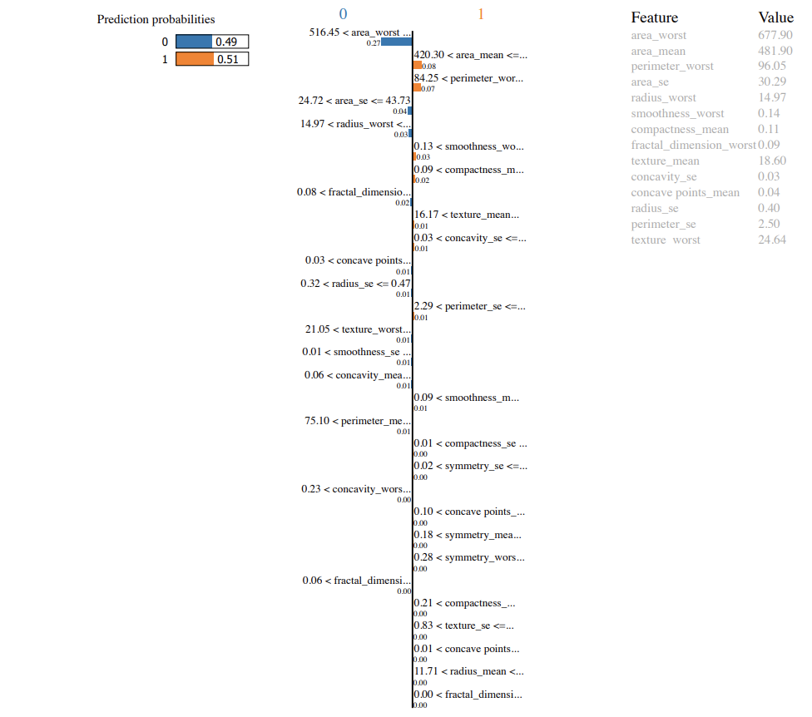
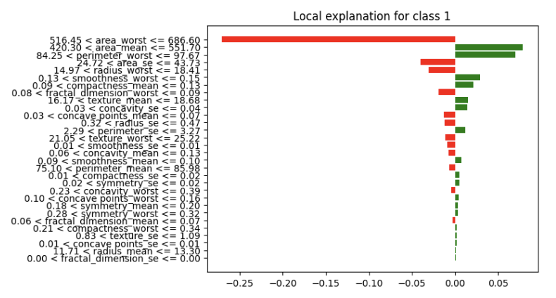
Lime (mispredicted)

Slide 7
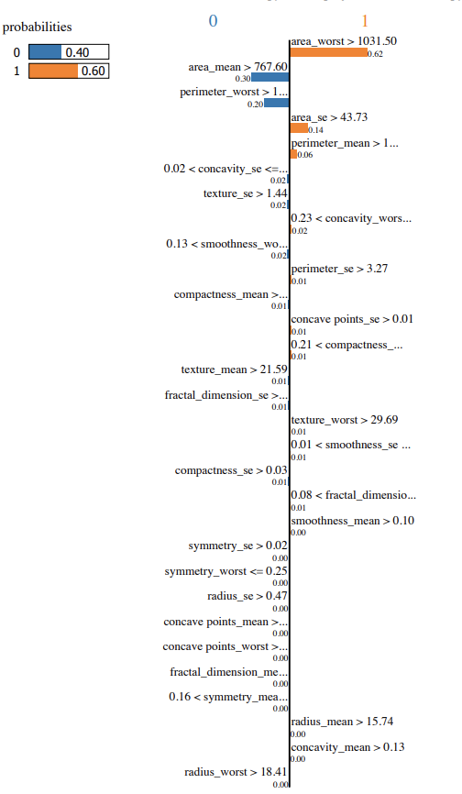
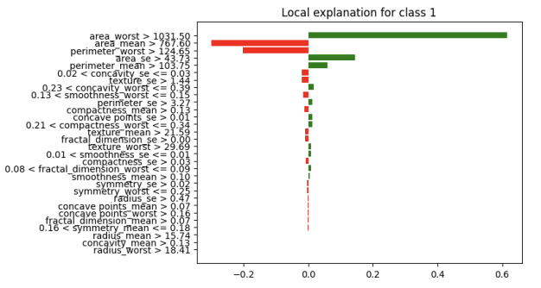
Lime (low confidence)
The prediction here is associated the

Slide 8
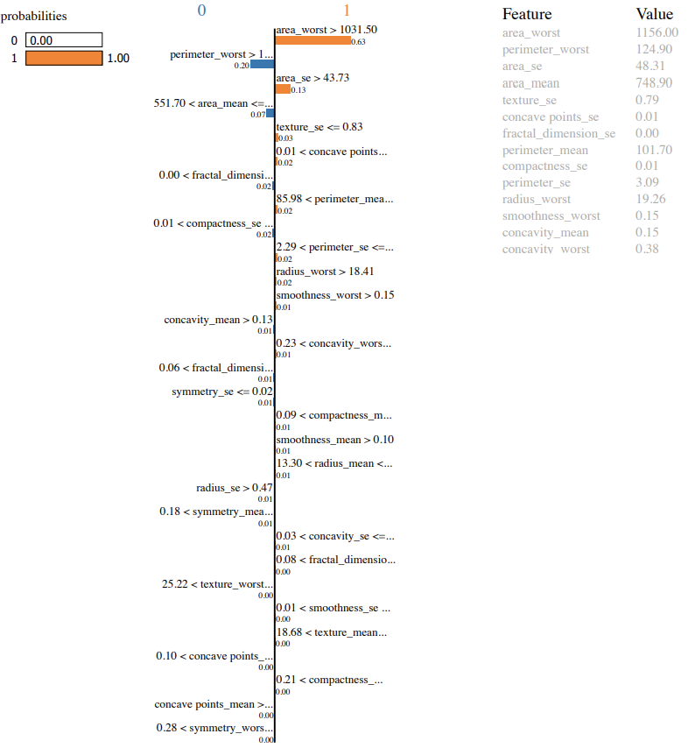
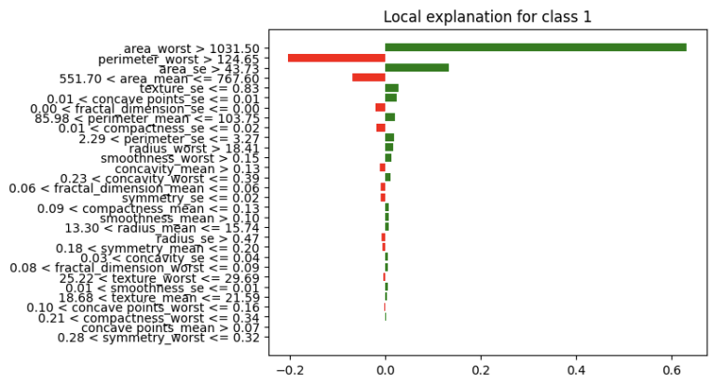
Lime (high confidence)

Slide 9
Lore(Local Rule-Based Explanations of Black Box Decision Systems)
O Agnostic Approach: LORE is model-agnostic, meaning it can explain decisions made by various supervised learning models without knowing their internal workings.
O Local Interpretability: It provides local explanations for individual predictions rather than global model behavior.
O Sampling and Surrogate Dataset
O Creating an Interpretable Model
O A decision rule: Explains the reasons behind the decision.
O A set of counterfactual rules: Suggests feature changes that lead to different outcomes.

Slide 10
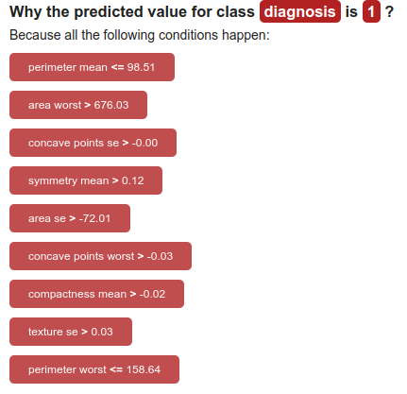
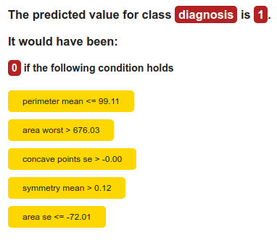
Lore(Local Rule-Based Explanations of Black Box Decision Systems)

Slide 11
SHAP(SHapley Additive exPlanation)
O SHAP deconstructs a prediction into a sum of contributions from each of the model's input variables. For each instance in the data (i.e. row), the contribution from each feature towards the model's prediction will vary depending on the values of the variables for that particular instance.
O A machine learning model's prediction, f(x), can be represented as the sum of its computed SHAP values, plus a fixed base value, such that:
f(x)=basevalue+sum(SHAPvalues)

Slide 12
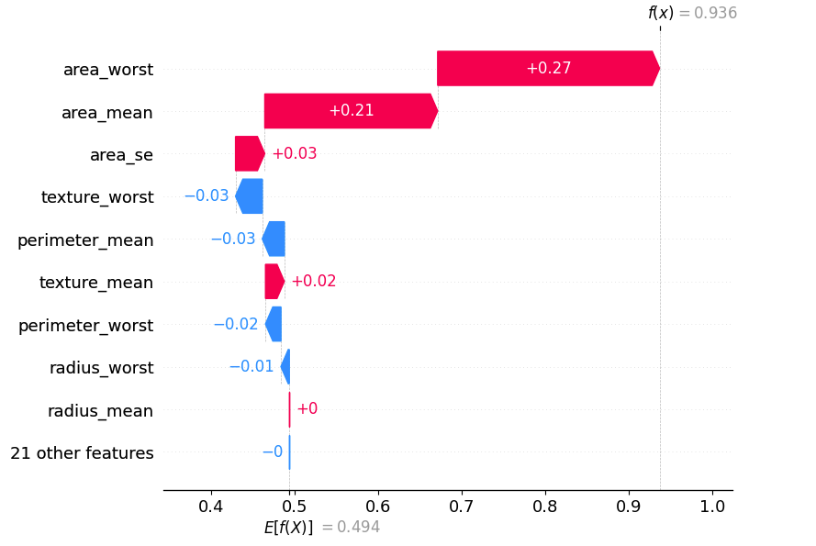
SHAP(SHapley Additive exPlanation)

Slide 13
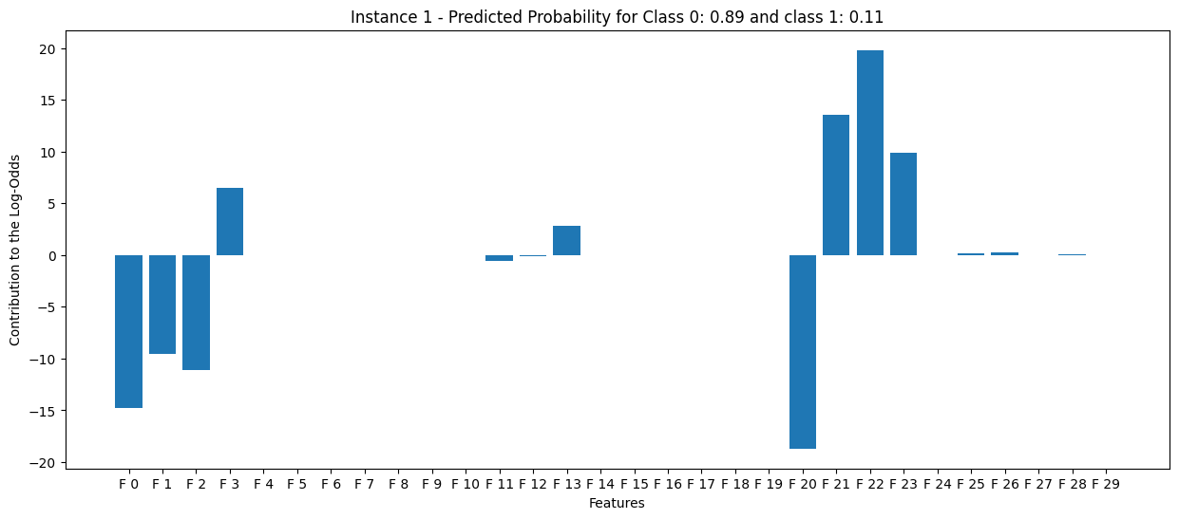
Explainable Model: Linear Regression Model
Features with positive contribution: 3 (area mean), 21 (texture worst), 22 (perimeter worst), 23 (area worst)
Features with negative contribution: 0 (radius mean), 1 (texture mean), 2 (perimeter mean) and 20 (radius worst)

Slide 14
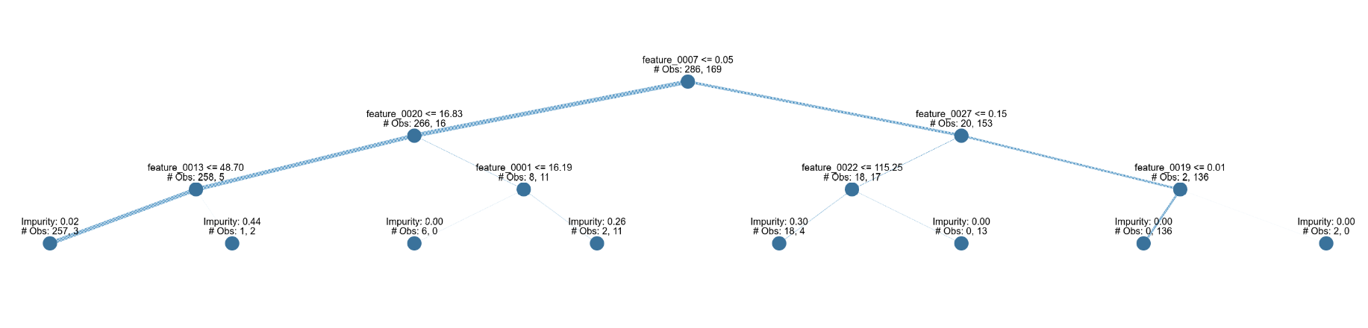
Explainable Model: Decision Tree
Left branch (benign): feature 7 (concave points mean), feature 20 (radius worst) and 13 (area se)
Right branch (malignant): feature 7, 27 (concave points worst) and 19 (fractal dimension se)

Slide 15
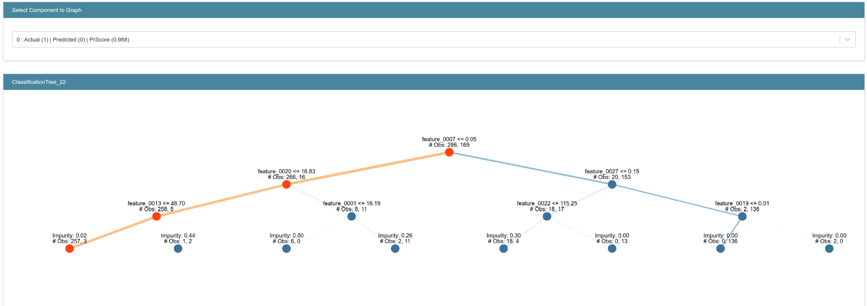
Decision Tree: Instance 5

Slide 16
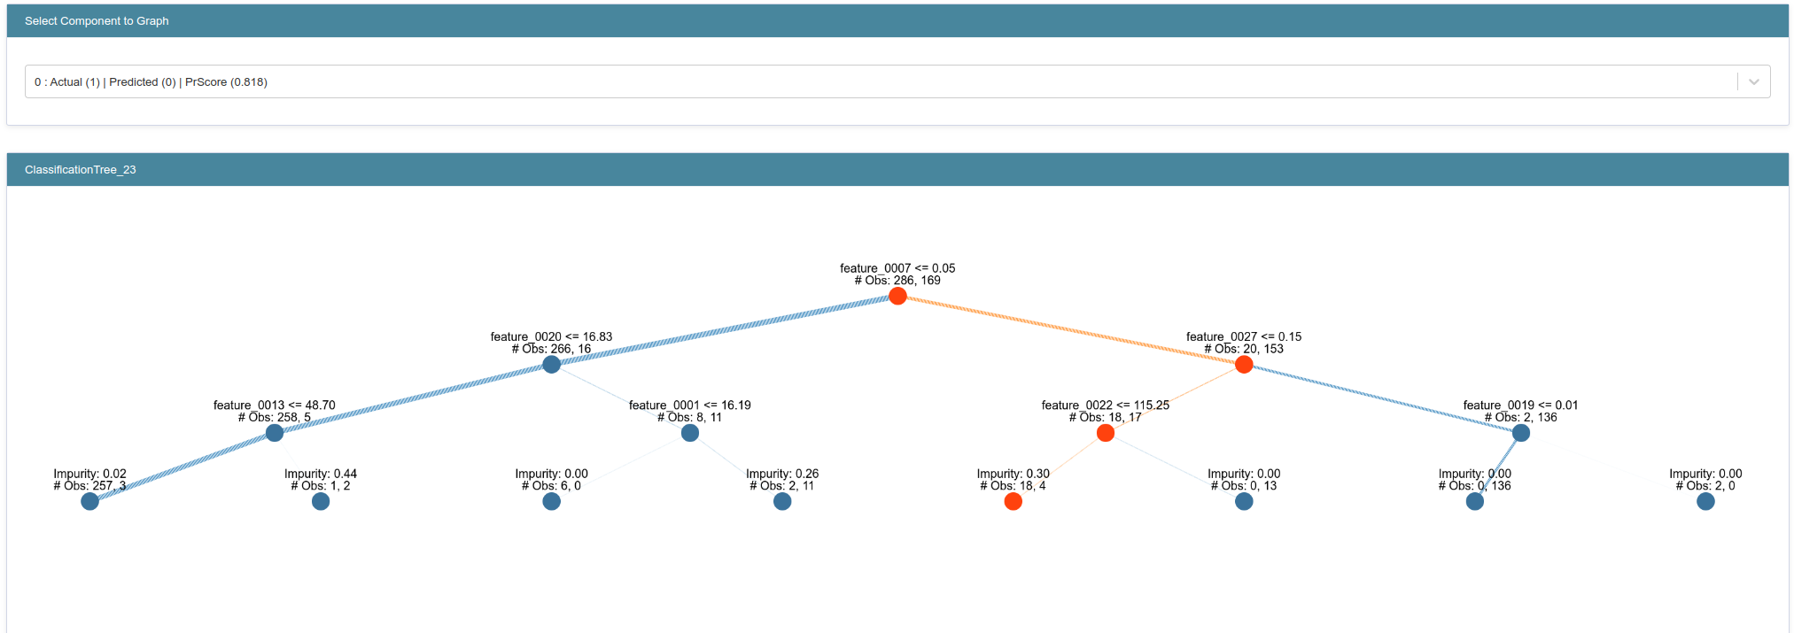
Decision Tree: Instance 6
Feature 22: perimeter_worst
Impurity: Gini Impurity (for a single sample that is taken from the data set, the likelihood of being misclassified if it were given a random class label)

Slide 17
Fidelity
In the end, we also evaluated the fidelity of the LIME explainer, where we compared the prediction of the black box with the explainer on 10 instances.
We used the perturbation testing approach where we systematically perturb (modify) the input data based on the explanations and observe the changes in the model's output.
As metric, we measure the change in output or prediction confidence as a result of the perturbations.

Slide 18
Fidelity
We got no accuracy drop using this technique.
One possibility is that the model's predictions are not heavily reliant on the features identified by LIME explainer as most important, indicating a potential issue with the explainer's fidelity.
Another possibility is that the model is robust to the specific perturbations applied, or it relies on redundant features for its predictions.

Slide 19
Conclusion
Explainable AI can address trust issues in healthcare, providing accurate and reliable explanations for AI-generated decisions, fostering confidence among patients and medical professionals

