Slide 1

HackIT v. 0.2

Slide 2

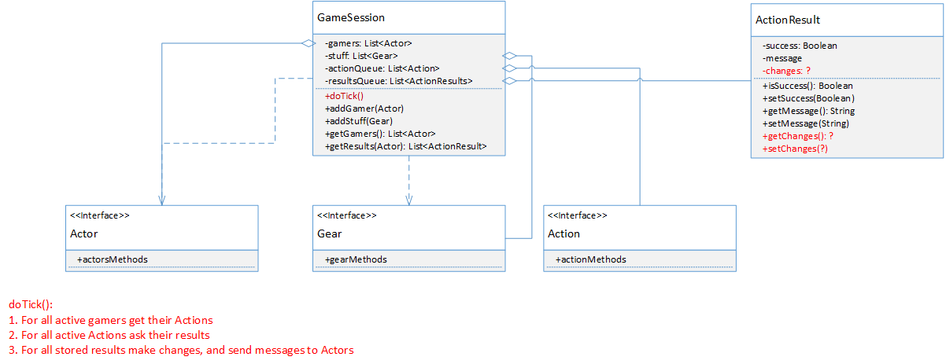

Slide 3
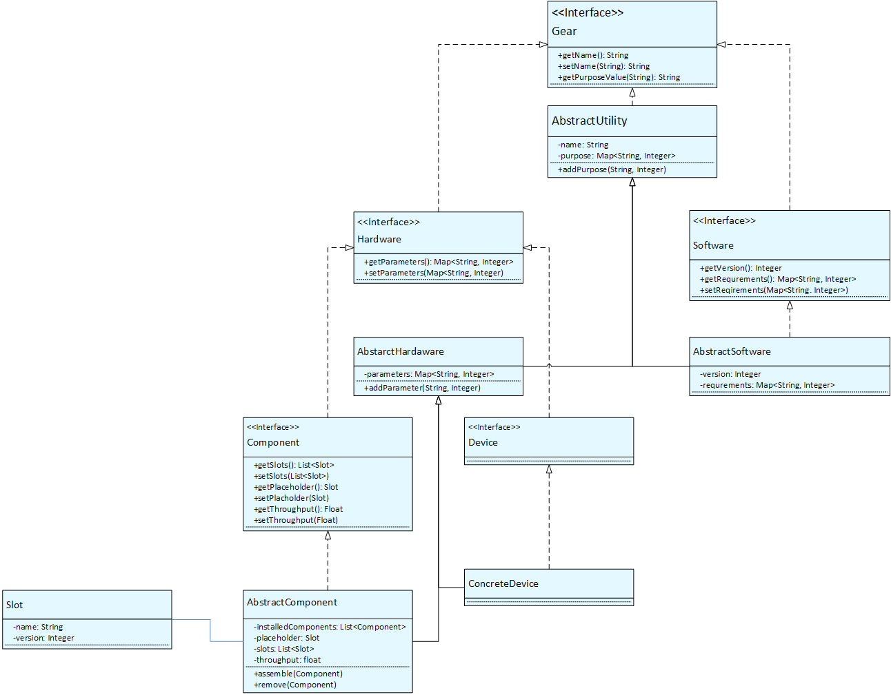

Slide 4



