Slide 1
DIGITAL LOGIC DESIGN
Design of a 4-Bit Binary
to Decimal Conversion and
Display System Using Logic Gates
BCD Decoder • 7-Segment Display • Gate-Level Implementation
7
Presented by:Akhilesh,Yashaswini,Varshita,Dhanush.
Department of Electronics and Communication Engineering | K.L. University

Slide 2
INTRODUCTION
Why Convert Binary to Decimal?
Digital systems (computers, counters, sensors) process and store data in binary form.
Humans read decimal.
1
2
3
Bridge the gap
Build with gates
Drive a display
Convert a 4-bit binary code into its decimal digit equivalent (0–9).
Implement the conversion using only basic logic gates — AND, OR, NOT.
Feed the decoded output to a 7-segment display via a BCD-to-7-segment decoder.
4-Bit Binary to Decimal Converter & Display
2

Slide 3
SYSTEM OVERVIEW
Block Diagram of the System
4-BIT BINARY
INPUT
BCD VALIDITY /
DECODING LOGIC
BCD TO 7-SEG
DECODER (IC 7447)
7-SEGMENT
DISPLAY
B3 B2 B1 B0
AND • OR • NOT
Gate Network
Decimal 0–9
The 4-bit input first passes through decoding logic built from basic gates, which drives the industry-standard BCD-to-7-segment decoder to light the correct display segments.
4-Bit Binary to Decimal Converter & Display
3

Slide 4
CONCEPT
Binary-Coded Decimal (BCD)
A 4-bit binary word B3B2B1B0 can represent 16 combinations (0000 to 1111).
In 8421 BCD, only the first 10 combinations (0–9) are valid decimal digits.
The remaining 6 combinations (1010–1111) are called "don't-care" states — they never occur in a valid BCD number and simplify our logic design.
EXAMPLE
0111
Decimal 7
B3
B2
B1
B0
(0 × 8) + (1 × 4) + (1 × 2) + (1 × 1) = 7
8
4
2
1
Weight (8-4-2-1 code)
4-Bit Binary to Decimal Converter & Display
4

Slide 5
DESIGN STEP 1
Truth Table (Valid BCD Range 0–9)
Dec
B3
B2
B1
B0
⚠ 1010 – 1111 (10–15)
0
0
0
0
0
These 6 combinations never appear in valid BCD data. They are treated as "don't-care" (X) conditions in the K-map, which lets us simplify the Boolean expressions significantly.
1
0
0
0
1
2
0
0
1
0
3
0
0
1
1
4
0
1
0
0
K-map simplification using these don't-cares gives the minimized gate-level expressions on the next slide.
5
0
1
0
1
6
0
1
1
0
7
0
1
1
1
8
1
0
0
0
9
1
0
0
1
4-Bit Binary to Decimal Converter & Display
5

Slide 6
DESIGN STEP 2
Boolean Expressions for 7-Segment Outputs
Each segment (a–g) of the display is a separate Boolean function of B3B2B1B0, derived via K-map from the truth table.
a
B3 + B1 + (B2·B0) + (B2'·B0')
b
B2' + (B1'·B0') + (B1·B0)
c
B1 + B0' + B2
d
(B2'·B1'·B0) + B1·B0' + B2·B1' + B3
e
(B1'·B0) + (B2·B0)
f
B3 + (B2·B1') + (B2·B0') + (B1'·B0')
g
B3 + (B2·B1') + (B1·B0')
' = NOT · · = AND · + = OR
4-Bit Binary to Decimal Converter & Display
6

Slide 7
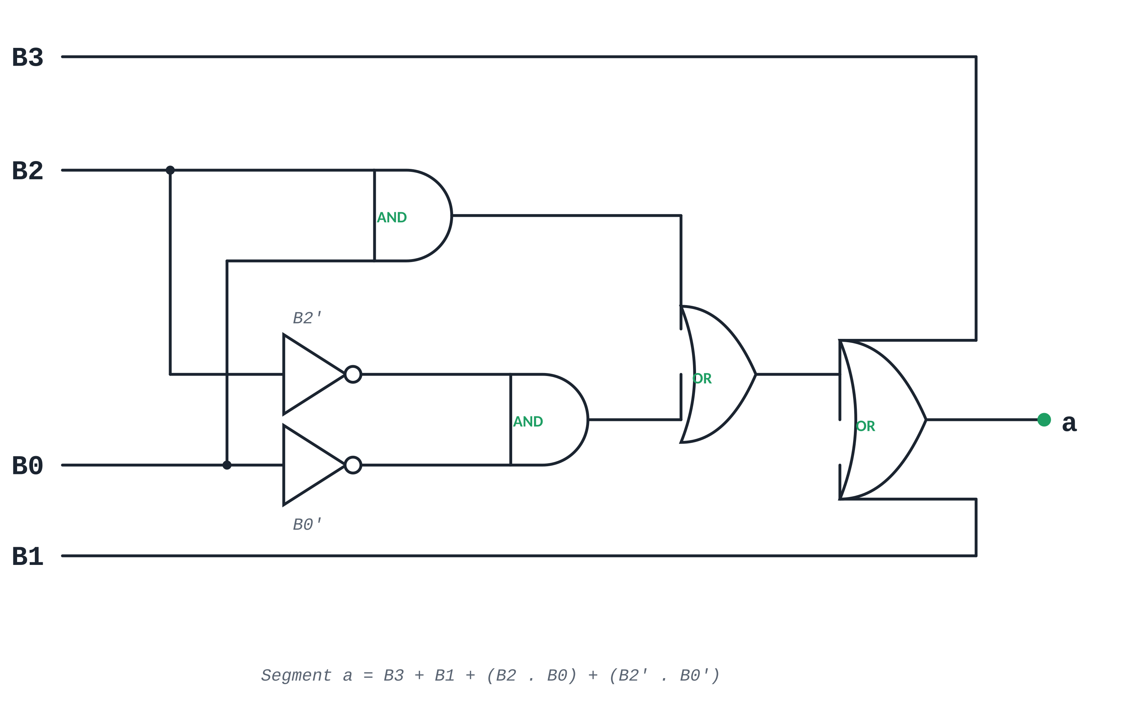
DESIGN STEP 3
Gate-Level Implementation — Segment 'a'
Realizing a = B3 + B1 + (B2 . B0) + (B2' . B0') using AND, OR and NOT gates only:
The same 4-input AND / OR / NOT structure is repeated (with different literal combinations) for each of the remaining six segments (b–g).
4-Bit Binary to Decimal Converter & Display
7

Slide 8

DESIGN STEP 4
Driving the 7-Segment Display
A 7-segment display has 7 LED segments (a–g) arranged to form digits 0–9.
Each Boolean expression derived earlier directly controls one segment:
Output = 1 → segment ON, Output = 0 → segment OFF.
In common-cathode displays this is used directly; common-anode displays need the outputs inverted.
SEGMENT MAP
Digit
a
b
c
d
e
f
g
0
1
1
1
1
1
1
0
1
0
1
1
0
0
0
0
Digit 7
7
1
1
1
0
0
0
0
Segments a, b, c = ON
8
1
1
1
1
1
1
1
Sample segment patterns for selected digits
4-Bit Binary to Decimal Converter & Display
8

Slide 9
APPLICATIONS
Real-World Applications
1
2
3
Digital Clocks & Timers
Calculators
Digital Counters
Converting internal binary counters into human-readable hour/minute/second digits.
Displaying binary computation results as decimal numbers on-screen.
Event counters, token/queue displays, and production line counters in industries.
4
5
6
Measurement Instruments
Elevator / Floor Indicators
Embedded Systems
Digital multimeters and frequency counters showing decimal readouts.
Converting position sensor binary codes into visible floor numbers.
Microcontroller-based systems needing a simple numeric display interface.
4-Bit Binary to Decimal Converter & Display
9

Slide 10
CONCLUSION
A Complete Gate-Level Path
from Binary to Decimal Display
A 4-bit binary input is decoded using only basic AND, OR, and NOT gates.
K-map simplification with don't-care conditions minimizes the gate count for each segment.
The resulting logic drives a 7-segment display, showing decimal digits 0–9.
The design demonstrates core digital logic principles used in real embedded and instrumentation systems.
Thank You
4-Bit Binary to Decimal Converter & Display
10

