Slide 1
Phax

Slide 2


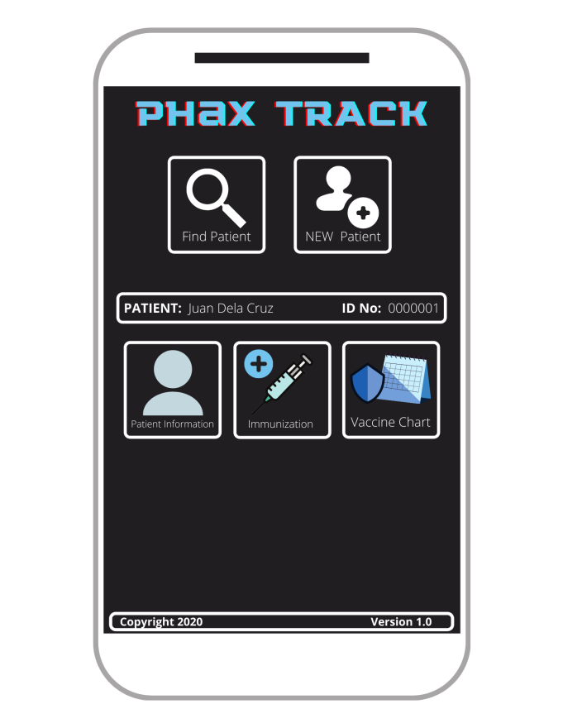


Input vaccine data
Update patient information
Data validation
Healthcare Professional
DBMS
Store data
Read data
Cloud Database
(Firebase)
Manipulate data
Store & retrieve data
Input personal information
Retrieve personal information
Delete data
Patient

