Slide 1
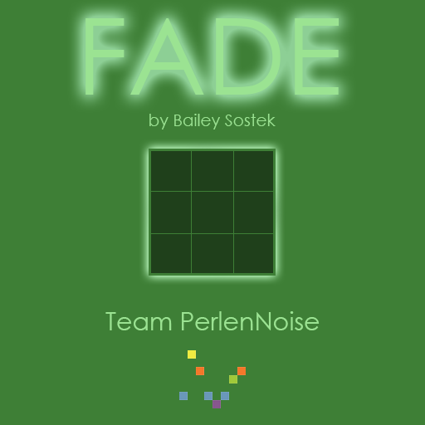
PerlenNoise
By Bailey Sostek

Slide 2
Experience Goals
Get the player to recognize patterns in the game, and sustain a high accuracy until overwhelmed
Keep players playing for longer than two minutes

Slide 3
Tactics used to capture this data
Number of squares are toggled at the start of each level, the number of tiles toggled corresponds to difficulty.
Accuracy = (Number Of Clicks / Difficulty)
If the player is good at pattern recognition, they will notice ways to solve puzzles in fewer steps

Slide 4
Accuracy= 126.502 (closer to 100 is better)

Slide 5
Week 1: Time limit per level

Slide 6
Last week
Gameplay Analytics
This week
Accuracy= 99.74576 (closer to 100 is better)
Average Play Time = 75.5 seconds
Average Level reached on first try 10
Accuracy= 126.502 (closer to 100 is better)
Average Play Time = 157.444 seconds
Average Level reached on first try 8.33

