Slide 1
Boyhood
Growing up in multiple timelines
PerlenNoise
By, Bailey Sostek

Slide 2
Summary Proverb: Like Father, Like Son
Control and make all decisions with the father, then carry out the actions with the son.

Slide 3
Experience Goals
Play the game for at least 5 minutes.
Built in database time function
Become overwhelmed by the puzzle
Design Goal
Subtly suggest determinism.

Slide 4
Target Audience
Anyone who enjoys puzzle games

Slide 5
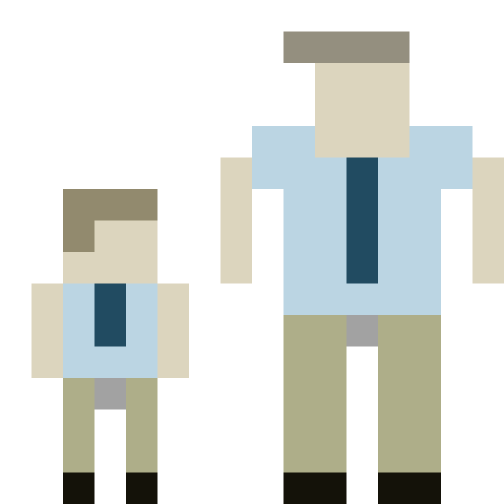
Feature List
5 Receptacles which the player is responsible for directing crates into.
2 controllable game scenarios, controlling the father and controlling the son.
Interactive tutorial which teaches without words.

Slide 6
Play Description
Complete the tutorial by solving puzzles of increasing difficulty.
Control the father and press a sequence of buttons to direct crates into receptacles.
Control the son and move crates into receptacles.

Slide 7
Critique and Surveys
Game was good but hard to learn initially.
Background was too noisy
Fix the debug screen being shown

Slide 8
Anylitics
Time in seconds
Week 1
Week 2

