Slide 1
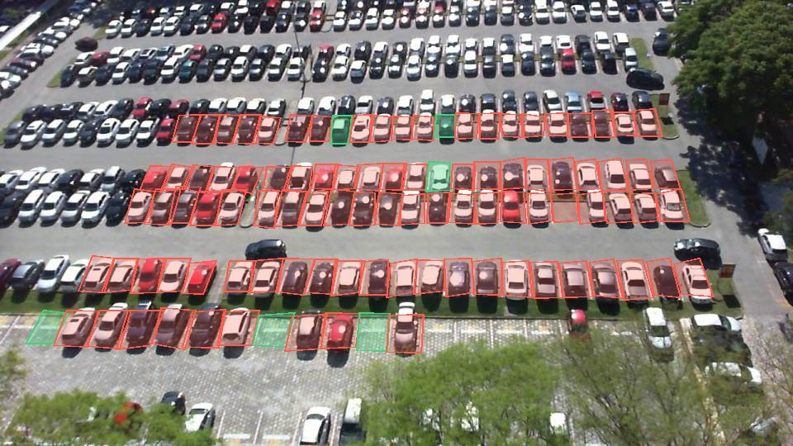
OQIM
WIUT HACKATHON 2026 · COMPUTER VISION FINAL
A parking tracker
from car park cameras
MODE: STARTUP
Team PariVision
Amal Karimov, Komronbek Qodirov, Aziza Adizova
Webster University in Tashkent
The PUCPR car park camera at 09:04 on 17 October 2012 (PKLot dataset). Green: free, red: taken, as our detector read the frame.
PUCPR
09:04
6 free of 100
Live https://oqim-audit.vercel.app/tracker
Code https://github.com/baytoooo/oqim
Notes:
0:10. Good morning. We are team PariVision from Webster University in Tashkent. Our mode is Startup (say it out loud, the rules ask for it). OQIM is a parking tracker. Cameras over a car park count the free spaces, see cars come in and leave, forecast the free spaces for the minute you arrive, and tell each driver which car park to go to. On the right: a real car park at 09:04, 6 free spaces of 100.

Slide 2
Drivers circle because they cannot see free spaces
PROBLEM AND USER
17 h
~5%
13,208
a year a US driver spends searching for parking (INRIX, 2017)
of off-street car parks publish live free spaces (Parkopedia)
paid spaces on 86 streets planned by Poytaxt Parking, Tashkent
SFpark in San Francisco cut cruising for parking by 50% on its pilot blocks. Sources: INRIX, Parkopedia, Spot.uz, ACCESS Magazine
How a driver finds a space today
The user
Picks a car park by distance or habit, and learns it is full at the gate.
Drives on to the next one. While searching, the car is part of the traffic.
A navigator sends every driver to the same nearest car park.
Drivers going to busy places: malls, business centres, hospitals, stations.
Who pays: car park operators, and the city, which wants less searching traffic.
Notes:
0:50. A driver picks a car park by distance or habit and finds out it is full at the gate. Then they drive on to the next one, and while they search, that car is part of the traffic. INRIX found US drivers spend 17 hours a year searching for parking. Parkopedia says only about 5% of off-street car parks publish live free spaces. In Tashkent, Poytaxt Parking plans paid parking on 86 streets with 13,208 spaces, first come, first served. Where cities do show drivers where the space is, it works: SFpark cut cruising by 50% on its pilot blocks. Our user is the driver. Who pays: the car park operator, and the city, which wants less searching traffic.

Slide 3
Free spaces now, and when you arrive
LIVE DEMO · /tracker
98.8%
of space readings right: 112 frames, 6,844 readings
1 / 4
free count off by, median / 90th percentile, spaces per frame
3.0 vs 4.6
forecast error 10 min ahead, in spaces; "same as now" gives 4.6
146 in, 11 out
PUCPR: 100 spaces, 2012-10-17 · UFPR05: 40 spaces, 2013-03-22 · UFPR04: 28 spaces, 2013-01-18
https://oqim-audit.vercel.app/tracker 3 PKLot cameras, 06:55 to 10:35, a frame every 5 min
cars seen coming in and leaving
Notes:
1:40, live. Open https://oqim-audit.vercel.app/tracker. These are 3 real car park cameras from the PKLot dataset: PUCPR with 100 spaces, UFPR05 with 40 spaces, UFPR04 with 28 spaces, one morning each from 06:55 to 10:35. Press play. Every space is marked free or taken from the camera frame; when a space turns taken, a car came in, when it turns free, a car left. Over 112 frames, 98.8% of 6,844 space readings match the dataset's hand labels. The free count is off by a median of 1 spaces, 4 at the 90th percentile. The tracker saw 146 cars come in and 11 leave. The forecast for 10 minutes ahead is off by 3.0 spaces on average, against 4.6 for "same as now", over 101 forecasts. Then pick an arrival time and show which car park the tracker advises.

Slide 4
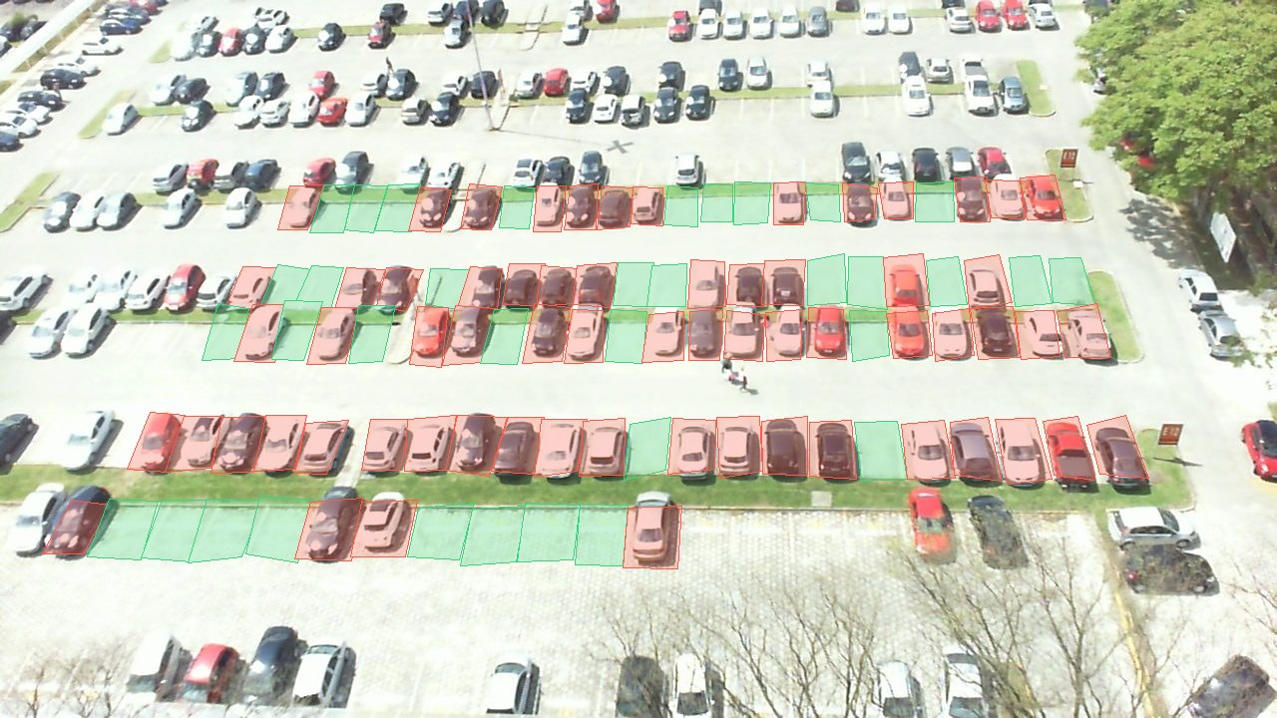
97.4% of spaces right on held-out images
MEASURED · /parking
97.4%
of 13,447 spaces right on 240 held-out images
99.1%
95.3%
precision, taken
recall, taken
By weather: sunny 97.0%, cloudy 99.0%, rainy 96.1%.
Free count: off by a median of 0, 4 at the 90th percentile.
Not measured: night. PKLot has no night frames.
Rule: a space is taken when one car, bus or truck box with confidence above 0.05 covers at least 40% of the space's area; the detector runs on the whole frame and on 3 x 3 overlapping tiles.
Notes:
0:30. The detector itself, measured on images we did not tune on. 240 held-out PKLot images, 13,447 spaces: 97.4% right. When it calls a space taken it is right 99.1% of the time, and it finds 95.3% of the taken spaces. Sunny 97.0%, cloudy 99.0%, rainy 96.1%. The free count per image is off by a median of 0 spaces. Be honest: PKLot has no night frames, so night is not measured. It runs in the browser on /parking; YOLO26n, the same model as the tracker.

Slide 5
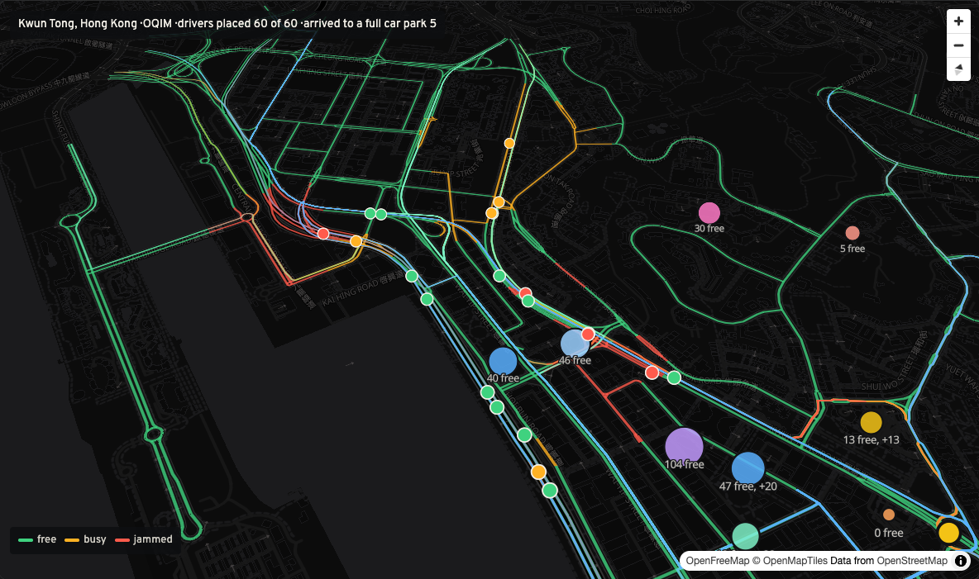
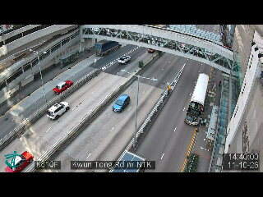
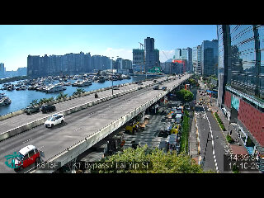
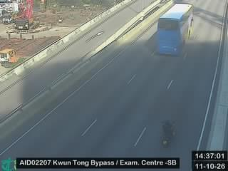
A district: drivers spread over the car parks
LIVE DEMO · /city
60 → 5
drivers arriving to a full car park: nearest car park against OQIM
−18%
−41%
door to door, 15.5 to 12.7 min
vehicle-km with searching, 305 to 181
How: drivers are placed one by one. Each gets the car park and route of least door-to-door time, with the roads and spaces already taken by the drivers placed before.
Snapshot: 13:45 Hong Kong time, 11 October.
Kwun Tong, Hong Kong: 22 open traffic cameras counted by YOLO26m, live vacancy of 28 car parks (DATA.GOV.HK). Drivers simulated.
Notes:
0:40, live. Open https://oqim-audit.vercel.app/city. One car park is not enough to advise a driver, so here is a whole district with live open data: Kwun Tong in Hong Kong, 22 Transport Department traffic cameras counted by YOLO26m, and the live free spaces of the car parks. 60 drivers head to Kwun Tong MTR station. "Nearest" sends every driver to the closest car park, as a navigator does. OQIM places drivers one by one; each gets the car park and route of least door-to-door time, counting the roads and spaces the drivers before them already took. At 13:45 Hong Kong time on 11 October the nearest car park had 0 free spaces: all 60 "nearest" drivers arrived to a full car park; with OQIM 5 did. Door to door 15.5 against 12.7 minutes, minus 18%; vehicle-km with searching 305 against 181, minus 41%. Say it clearly: the drivers are simulated, the free spaces and the camera counts are real. Press "Add drivers one by one" to show each route loading the roads the next driver sees.

Slide 6
From a camera frame to advice
TECHNOLOGY AND ARCHITECTURE
For each car park camera
Frames
Detect
Space state
Forecast
Advise
One frame every 5 min from an ordinary fixed camera. The spaces are outlined once per camera.
YOLO26n (10 MB), whole frame plus 3 x 3 tiles at 960 px. Cars, buses and trucks.
Taken when one box covers 40% of the space. It changes only when two frames in a row agree.
Free spaces, cars in and out. Free spaces 10 min ahead from the last 20 minutes' trend and the usual weekday morning.
Drivers placed one by one on the car park and route of least door-to-door time, counting those already sent.
10 MB
0
No plates
Reused, declared: detector and ONNX worker from our elimination system.
Built for the final: tracker, space rule and its test, district model, signal audit.
detector, YOLO26n in ONNX Runtime Web: WebGPU or WebAssembly
GPU servers. The detector runs in a browser tab.
and no faces are read. Only boxes over spaces.
Notes:
0:40. For each car park camera: one frame every 5 minutes, from an ordinary fixed camera. The spaces are outlined once per camera. YOLO26n, 10 MB, finds cars, buses and trucks on the whole frame and on 3 by 3 tiles at 960 pixels, so small cars at the back are not missed. A space is taken when one box covers 40% of it, and it changes state only when two frames in a row agree, which removes most flicker. From the states we get the free count and every car in and out. The forecast takes the spaces taken now and adds the trend: half from the last 20 minutes, half from the car park's typical weekday morning, from the PKLot labels of its other weekdays. It is checked against the hand labels of the frame that many minutes later. The advice is the district model: drivers placed one by one, counting the ones already sent. The detector runs in ONNX Runtime Web, on WebGPU or WebAssembly; no GPU server, no number plates or faces read. Detector and worker are reused from our elimination system, and we say so.

Slide 7
Budget and ROI
ALL NUMBERS ARE ASSUMPTIONS TO CHECK WITH THE CUSTOMER
Pilot with an operator
Per camera
Value and payback
3
0
Value a month =
extra spaces filled × hours × tariff, plus drivers no longer turned away at the gate
Payback = price ÷ value a month
months, on the operator's own cameras
sensors in the ground. One camera covers the spaces it sees.
People: 3 engineers part time. The main cost.
Hosting: static, free to USD 20 a month. No GPU server.
Data: frames from cameras the operator already has. No licences to buy.
Our cost: outlining the spaces once, and checking a sample of frames by hand.
Price: per camera per month, set in the pilot.
For the city: less searching traffic. The district model counts it in vehicle-km.
We state payback from the pilot inputs, not before.
Notes:
0:45. All numbers here are assumptions to check with the customer. Pilot: 3 months with one car park operator, on cameras it already has. The main cost is people, 3 engineers part time. Hosting is static, free to USD 20 a month, with no GPU server. No sensors in the ground: one camera covers the spaces it sees. Our cost per camera is outlining the spaces once and checking a sample of frames by hand. Price: per camera per month, set in the pilot. Value for the operator: extra spaces filled times hours times the tariff, plus drivers who are no longer turned away at the gate. For the city: less searching traffic, which the district model counts in vehicle-km. Payback: we state it from the pilot inputs; we do not quote a number we have not measured.

Slide 8
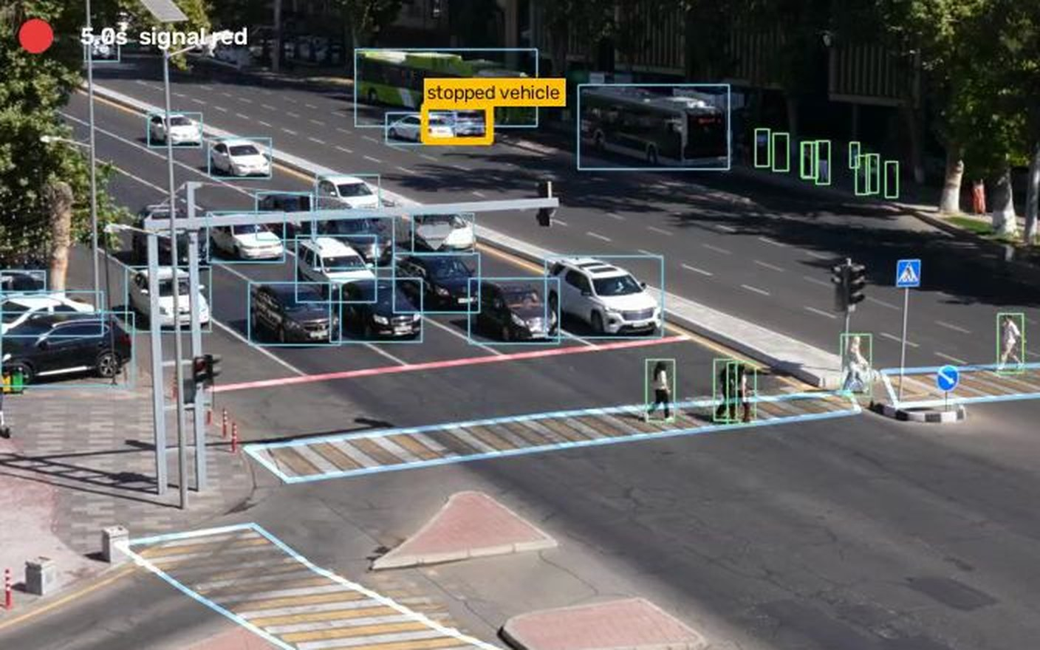
Why it is hard to copy
OUR EDGE
1
A forecast, not only a count
Free spaces for the minute you arrive, checked against "same as now" (3.0 vs 4.6 spaces off, 10 min ahead).
2
Drivers spread, not herded
Each driver counts against the spaces and roads of the next. A navigator sends all of them to the nearest car park.
3
Ordinary cameras
No sensor per space. The detector runs in a browser tab; no plates or faces are read.
Our lamp reader on the organisers' footage, from pixels only.
The same cameras, more products
98.8%
4
Our signal audit reads traffic lights from pixels, with no controller access. That is the next stage.
of frames of C3896: the browser's signal reading agrees with our elimination lamp reader.
Notes:
0:15. Four reasons. One: a forecast for the minute you arrive, not only a count, and it beats "same as now". Two: drivers are spread; each one counts against the spaces and roads of the next, while a navigator sends everyone to the nearest car park. Three: ordinary cameras, no sensor in every space, and the detector runs in a browser tab with no plates or faces read. Four: the same cameras give more products. Our signal audit reads the lights from pixels with no controller access; in the browser it agrees with our elimination lamp reader on 98.8% of frames of C3896.

Slide 9
The same cameras can later time the lights
NEXT STAGE · /audit
Signal audit from one video: the lights read from pixels, every vehicle over the stop line, then signal plans checked on a replay of the junction's own vehicles. Organisers' footage of one Tashkent junction, southbound.
Clip | Length | Cycle read | Vehicles | Replay check: median departure error | Wait now | Webster (1958) | OQIM predictive
C3896 | 5:40 | 75 s | 130 | 0.50 s | 9.3 s | 32.6 s | 9.1 s
C3897 | 5:18 | 75 s | 127 | 0.29 s | 10.0 s | 29.7 s | 8.7 s
C3902 | 5:18 | 80 s | 170 | 0.55 s | 12.3 s | 28.8 s | 10.1 s
C3905 | 2:08 | 80 s | 59 | 4.54 s | 10.3 s | 11.9 s | 7.3 s
29.7 vs 10.0 s
So OQIM never recommends a plan before it replays it. Mean wait per vehicle on the replay, lower is better. Predictive assumes the next 30 s of arrivals are known, which needs a camera upstream. C3905 (2:08, under 2 cycles) fails the replay check, and the page says so.
Tracks: our elimination pipeline (YOLO26m, 1280 px, 10 fps). Night and rain not yet measured on a test set of our own.
C3897: the textbook plan against the timing now. Worse on all 4 clips.
Notes:
0:30. The next stage. Cameras that watch car parks and streets can also watch junctions. Our signal audit already works from one video: it reads the lights from the pixels, counts every vehicle over the stop line, and replays the junction's own vehicles to check signal plans. On 4 clips of one Tashkent junction from the organisers, the replay gives back when each vehicle left within about half a second on three clips; C3905 is too short and fails the check, and the page says so. Webster's textbook plan was worse than the timing now on all 4 clips, for example 29.7 s against 10.0 s on C3897. The predictive mode cut the wait on C3897 to 8.7 s, but it assumes the next 30 s of arrivals are known, which needs a camera upstream.

Slide 10
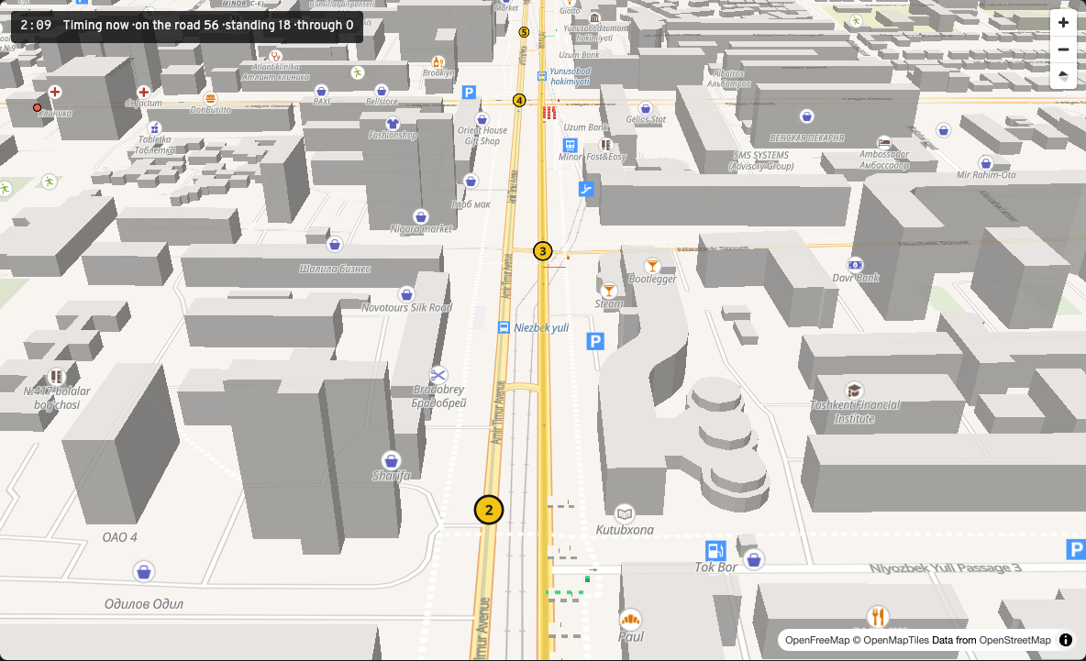
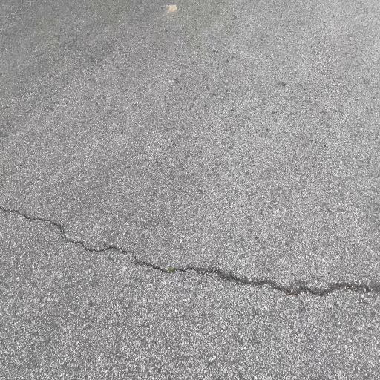
A green wave in 3D, and road damage on a map
NEXT STAGE · /network AND /roads
SIMULATION
MEASURED
Amir Temur Avenue, Tashkent: 1.46 km, 5 signals, 224 vehicles in 10 min, Intelligent Driver Model. Green wave against the timing now; only offsets change.
YOLOv8n fine-tuned on RDD2022 (4 classes), in the browser, on phone photos. Measured on a 300-image sample of the RDD2022 test split.
141 s → 24 s
4.58 → 0.60
0.66
66%
mean delay at the signals
stops per vehicle
mAP50
precision
Elsewhere: Copenhagen's green wave cut travel time by 17% (Centre for Public Impact); Google Project Green Light, up to 30% fewer stops (Seattle DOT).
Notes:
0:20. Two more pieces for later. The green wave: the vehicles from the video drive five real junctions of Amir Temur Avenue in 3D. It is a simulation, one direction, and only the offsets change, so the cross streets keep their time; the real offsets are unknown to us. Mean delay 141 s down to 24 s, stops per vehicle 4.58 down to 0.60. Copenhagen's green wave cut travel time by 17%. And a side tool: road damage from phone photos on a map, YOLOv8n fine-tuned on RDD2022 (4 classes), mAP50 0.66 on a 300-image sample of the RDD2022 test split.

Slide 11
Team PariVision
TEAM AND NEXT STEPS
Amal Karimov
Komronbek Qodirov
Aziza Adizova
Captain. Scene layout and the signal and vehicle rules
Pipeline, live demo and website
Dev set, pedestrian rules and report
1
2
3
4
Pilot
Live feed
Night test
Signals
One car park operator, its own cameras, 3 months.
Frames from a live camera, not a recorded morning.
PKLot has no night frames. A test set of our own, with hand labels.
Then the same cameras time the lights: audit and green wave.
Thank you. Questions?
Try it: https://oqim-audit.vercel.app/tracker Code: https://github.com/baytoooo/oqim
Notes:
0:30. We are Amal Karimov, Komronbek Qodirov, Aziza Adizova. Next: a 3-month pilot with one car park operator on its own cameras; frames from a live camera instead of a recorded morning; a night test set of our own, because PKLot has no night frames; and then the same cameras time the lights, with the signal audit and the green wave. Thank you; we are ready for questions.

