Slide 1

01 / PLACE
A city that connects opportunity
A visual brief for better access to public services.
CONNECTED
COMMUNITIES
Bring essential services closer to where people live, work and learn.
ACCESS
Closer • clearer • more human
CAKRAWALA • 2026
01

Slide 2
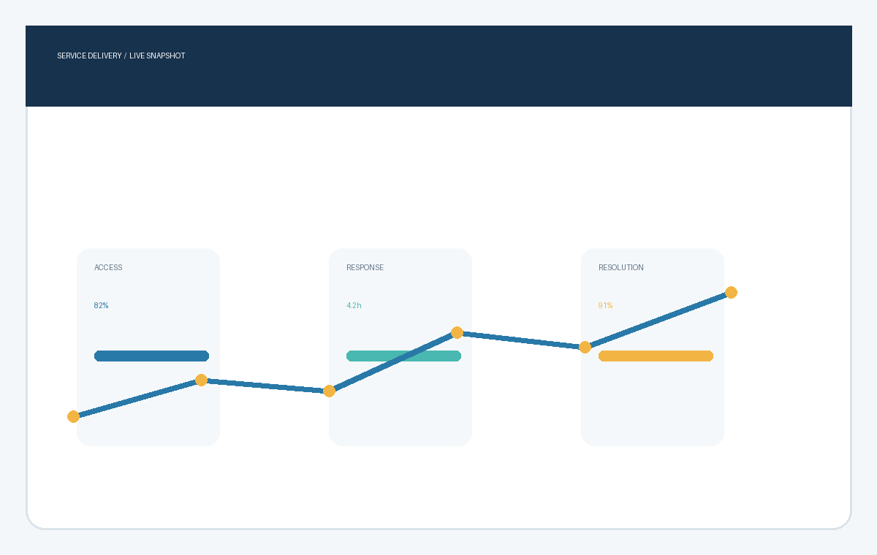
02 / EVIDENCE
See the service, not just the numbers
Illustrative service dashboard image paired with a simple decision.
What the image tells us
Access is improving, while response time remains the clearest opportunity.
NEXT • Reduce repeat visits
CAKRAWALA • 2026
02

