Slide 1
MATH6077 – Discrete Mathematics
Week 02 - Quantifiers

Slide 2
Introduction
Predicates : statements are neither true nor false when the values of the variables are not specified.
Example :
1. x > 3
2. x = y + 3
3. x + y = z
4. Computer x is functioning properly.
The statement “x is greater than 3” has two parts. The first part, the variable x, is the subject of the statement. The second part—the predicate. “is greater than 3”—refers to a property that the subject of the statement can have. Denote by P(x).
P(x) : value of the propositional function P at x. Once a value has been assigned to the variable x, the statement P(x) becomes a proposition and has a truth value.

Slide 3

Predicate

Slide 4
Predicate
Example 01 :
Let Q(x, y) denote the statement “x = y + 3.” What are the truth values of the propositions Q(1, 2) and Q(3, 0)?
Solution :
Q(1, 2) is the statement “1 = 2 + 3,” which is false.
Q(3, 0) is the proposition “3 = 0 + 3,” which is true.
Example 02 :
Let R(x, y, z) denote the statement “x + y = z.” What are the truth values of the propositions R(1, 2, 3) and R(0, 0, 1)?
Solution :
R(1, 2, 3) is the statement “1 + 2 = 3,” which is true.
R(0, 0, 1), which is the statement “0 + 0 = 1,” is false.

Slide 5
Preconditions And Postconditions
Predicates are also used to establish the correctness of computer programs,
The statements that describe valid input are known as preconditions and the conditions that the output should satisfy when the program has run are known as postconditions.
Example :
Consider the following program, designed to interchange the values of two variables x and y.
temp := x
x := y
y := temp
Find predicates that we can use as the precondition and the postcondition to verify the correctness of this program. Then explain how to use them to verify that for all valid input the program does what is intended !

Slide 6
Preconditions And Postconditions
Solution :
For the precondition, we need to express that x and y have particular values before we run the program. So, we can use the predicate P(x, y), that is “x = a and y = b”. Because we want to verify that the program swaps the values of x and y for all input values,
For the postcondition we can use Q(x, y), where Q(x, y) is the statement
“x = b and y = a.”
Suppose that the statement “x = a and y = b” is true. This means that x = a and y = b. The first step of the program, temp := x, assigns the value of x to the variable temp, so after this step we know that x = a, temp = a, and y = b. After the second step of the program, x := y, we know that x = b, temp = a, and y = b. Finally, after the third step, we know that x = b, temp = a, and y = a. Consequently, after this program is run, the postcondition Q(x, y) holds, that is, the statement “x = b and y = a” is true.

Slide 7
Quantifiers

Slide 8
Quantifiers
THE UNIVERSAL QUANTIFIER
The universal quantification of P(x) for a particular domain is the proposition that asserts that P(x) is true for all values of x in this domain.
Definition :
The universal quantification of P(x) is the statement
“P(x) for all values of x in the domain.”
The notation ∀xP(x) denotes the universal quantification of P(x). Here ∀ is called the universal quantifier. We read ∀xP(x) as “for all xP(x)” or “for every xP(x).” An element for which P(x) is false is called a counterexample to ∀xP(x).

Slide 9
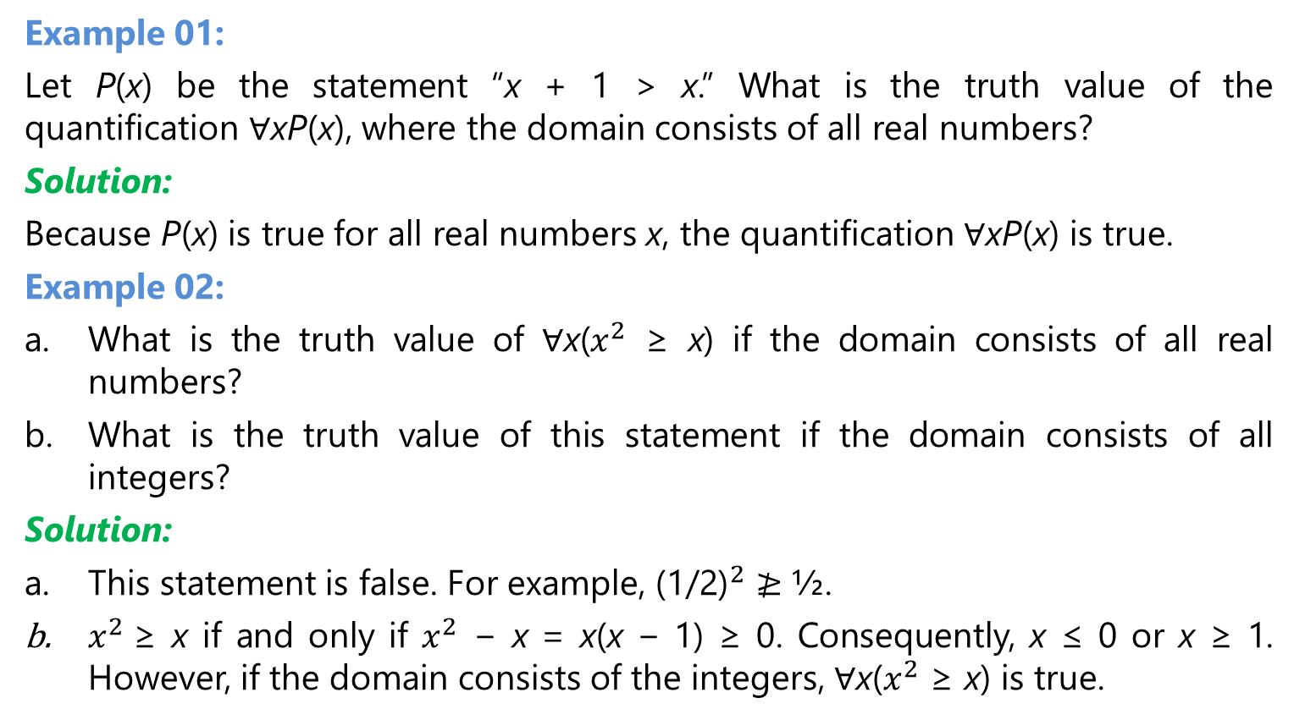
The Universal Quantifier
Example 01:
Let P(x) be the statement “x + 1 > x.” What is the truth value of the quantification ∀xP(x), where the domain consists of all real numbers?
Solution:
Because P(x) is true for all real numbers x, the quantification ∀xP(x) is true.
Example 02:
What is the truth value of ∀x($x^{2}$ ≥ x) if the domain consists of all real numbers?
What is the truth value of this statement if the domain consists of all integers?
Solution:
This statement is false. For example, ${\text{(1/2)}}^{2}$ $≱$ ½.
$x^{2}$≥ x if and only if $x^{2}$ − x = x(x − 1) ≥ 0. Consequently, x ≤ 0 or x ≥ 1. However, if the domain consists of the integers, ∀x($x^{2}$ ≥ x) is true.

Slide 10
The Existential Quantifier
Existential quantification : form a proposition that is true if and only if P(x) is true for at least one value of x in the domain.
Definition :
The existential quantification of P(x) is the proposition
“There exists an element x in the domain such that P(x).”
We use the notation ∃xP(x) for the existential quantification of P(x). Here ∃ is called the existential quantifier.

Slide 11
The Existential Quantifier
Example 01 :
Let P(x) denote the statement “x > 3.” What is the truth value of the quantification ∃xP(x), where the domain consists of all real numbers?
Solution:
Because “x > 3” is sometimes true, for instance, when x = 4, the existential quantification of P(x), which is ∃xP(x), is true.
Example 02 :
Let Q(x) denote the statement “x=x+1.” What is the truth value of the quantification ∃xQ(x), where the domain consists of all real numbers?
Solution: Because Q(x) is false for every real number x, the existential quantification of Q(x), which is ∃xQ(x), is false.

Slide 12
Quantifiers Over Finite Domains

Slide 13
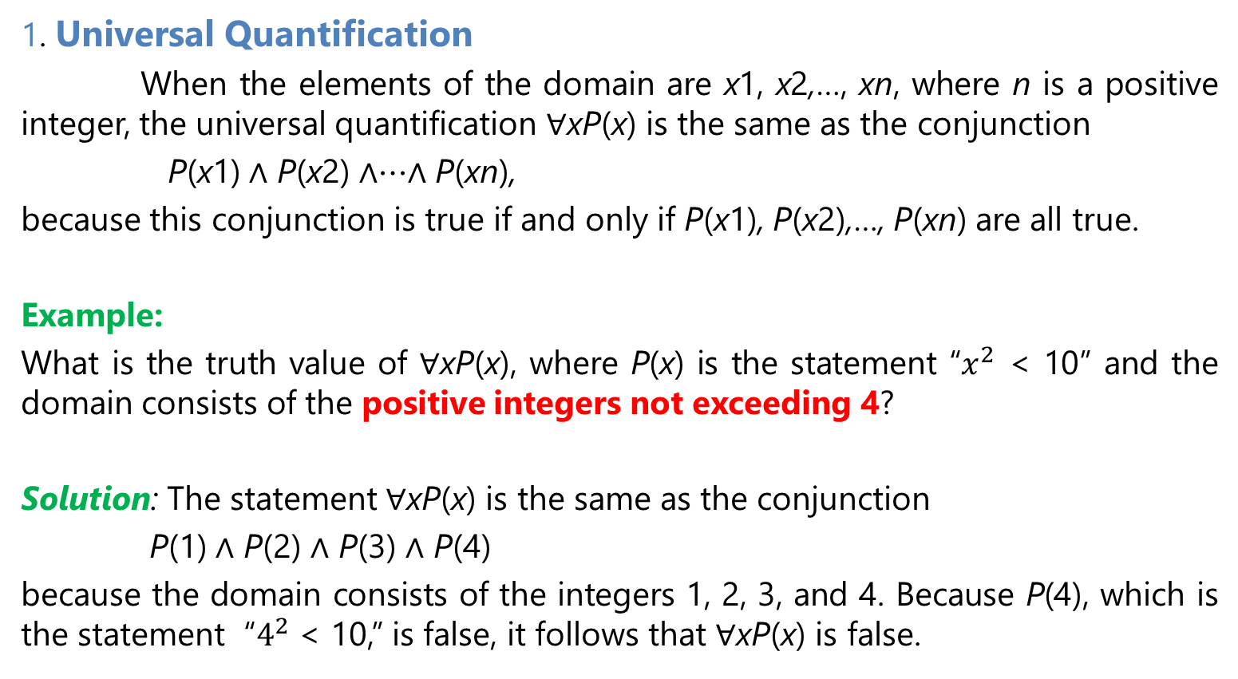
Quantifiers Over Finite Domains
1. Universal Quantification
When the elements of the domain are x1, x2,…, xn, where n is a positive integer, the universal quantification ∀xP(x) is the same as the conjunction
P(x1) ∧ P(x2) ∧⋯∧ P(xn),
because this conjunction is true if and only if P(x1), P(x2),…, P(xn) are all true.
Example:
What is the truth value of ∀xP(x), where P(x) is the statement “$x^{2}$ < 10” and the domain consists of the positive integers not exceeding 4?
Solution: The statement ∀xP(x) is the same as the conjunction
P(1) ∧ P(2) ∧ P(3) ∧ P(4)
because the domain consists of the integers 1, 2, 3, and 4. Because P(4), which is the statement “$4^{2}$ < 10,” is false, it follows that ∀xP(x) is false.

Slide 14
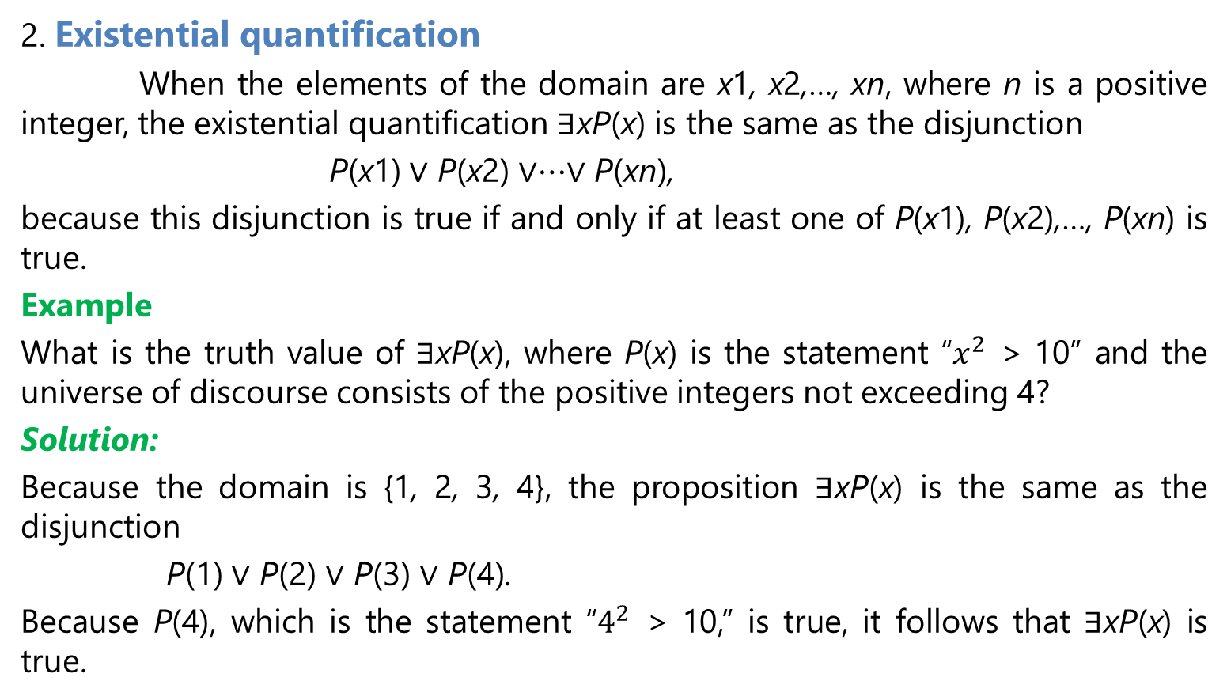
Quantifiers Over Finite Domains
2. Existential quantification
When the elements of the domain are x1, x2,…, xn, where n is a positive integer, the existential quantification ∃xP(x) is the same as the disjunction
P(x1) ∨ P(x2) ∨⋯∨ P(xn),
because this disjunction is true if and only if at least one of P(x1), P(x2),…, P(xn) is true.
Example
What is the truth value of ∃xP(x), where P(x) is the statement “$x^{2}$ > 10” and the universe of discourse consists of the positive integers not exceeding 4?
Solution:
Because the domain is {1, 2, 3, 4}, the proposition ∃xP(x) is the same as the disjunction
P(1) ∨ P(2) ∨ P(3) ∨ P(4).
Because P(4), which is the statement “$4^{2}$ > 10,” is true, it follows that ∃xP(x) is true.

Slide 15
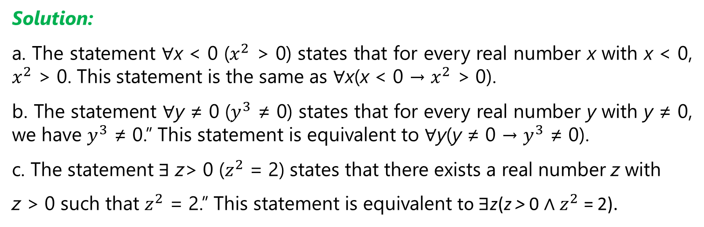
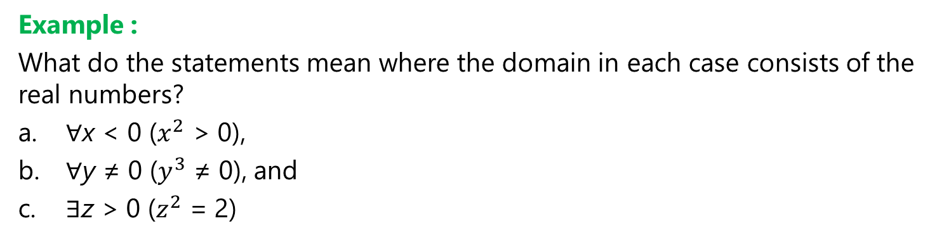
Quantifiers with Restricted Domains
Example :
What do the statements mean where the domain in each case consists of the real numbers?
∀x < 0 ($x^{2}$ > 0),
∀y ≠ 0 ($y^{3}$ ≠ 0), and
∃z > 0 ($z^{2}$ = 2)
Solution:
a. The statement ∀x < 0 ($x^{2}$ > 0) states that for every real number x with x < 0, $x^{2}$ > 0. This statement is the same as ∀x(x < 0 → $x^{2}$ > 0).
b. The statement ∀y ≠ 0 ($y^{3}$ ≠ 0) states that for every real number y with y ≠ 0, we have $y^{3}$ ≠ 0.” This statement is equivalent to ∀y(y ≠ 0 → $y^{3}$ ≠ 0).
c. The statement ∃ z> 0 ($z^{2}$ = 2) states that there exists a real number z with
z > 0 such that $z^{2}$ = 2.” This statement is equivalent to ∃z(z > 0 ∧ $z^{2}$ = 2).

Slide 16
Logical Equivalences Involving Quantifiers
Definition :
Statements involving predicates and quantifiers are logically equivalent if and only if they have the same truth value no matter which predicates are substituted into these statements and which domain of discourse is used for the variables in these propositional functions. We use the notation S ≡ T to indicate that two statements S and T involving predicates and quantifiers are logically equivalent.
Example :
Show that ∀x(P(x) ∧ Q(x)) and ∀xP(x) ∧ ∀xQ(x) are logically equivalent (where the same domain is used throughout).
Solution :
Suppose we have particular predicates P and Q, with a common domain.

Slide 17
Logical Equivalences Involving Quantifiers
Solution :
1. We show that if ∀x(P(x) ∧ Q(x)) is true, then ∀xP(x) ∧ ∀xQ(x) is true.
Suppose that ∀x(P(x) ∧ Q(x)) is true. This means that if a is in the domain, then P(a) ∧ Q(a) is true. Hence, P(a) is true and Q(a) is true. Because P(a) is true and Q(a) is true for every element a in the domain, we can conclude that ∀xP(x) and ∀xQ(x) are both true. This means that ∀xP(x) ∧ ∀xQ(x) is true.
2. We show that if ∀xP(x) ∧ ∀xQ(x) is true, then ∀x(P(x) ∧ Q(x)) is true.
Suppose that ∀xP(x) ∧ ∀xQ(x) is true. It follows that ∀xP(x) is true and ∀xQ(x) is true. Hence, if a is in the domain, then P(a) is true and Q(a) is true [because P(x) and Q(x) are both true for all elements in the domain, there is no conflict using the same value of a here]. It follows that for all a, P(a) ∧ Q(a) is true. It follows that ∀x(P(x) ∧ Q(x)) is true. We can now conclude that
∀x(P(x) ∧ Q(x)) ≡ ∀xP(x) ∧ ∀xQ(x).

Slide 18
Negating Quantified Expressions

Slide 19
Negating Quantified Expressions

Slide 20
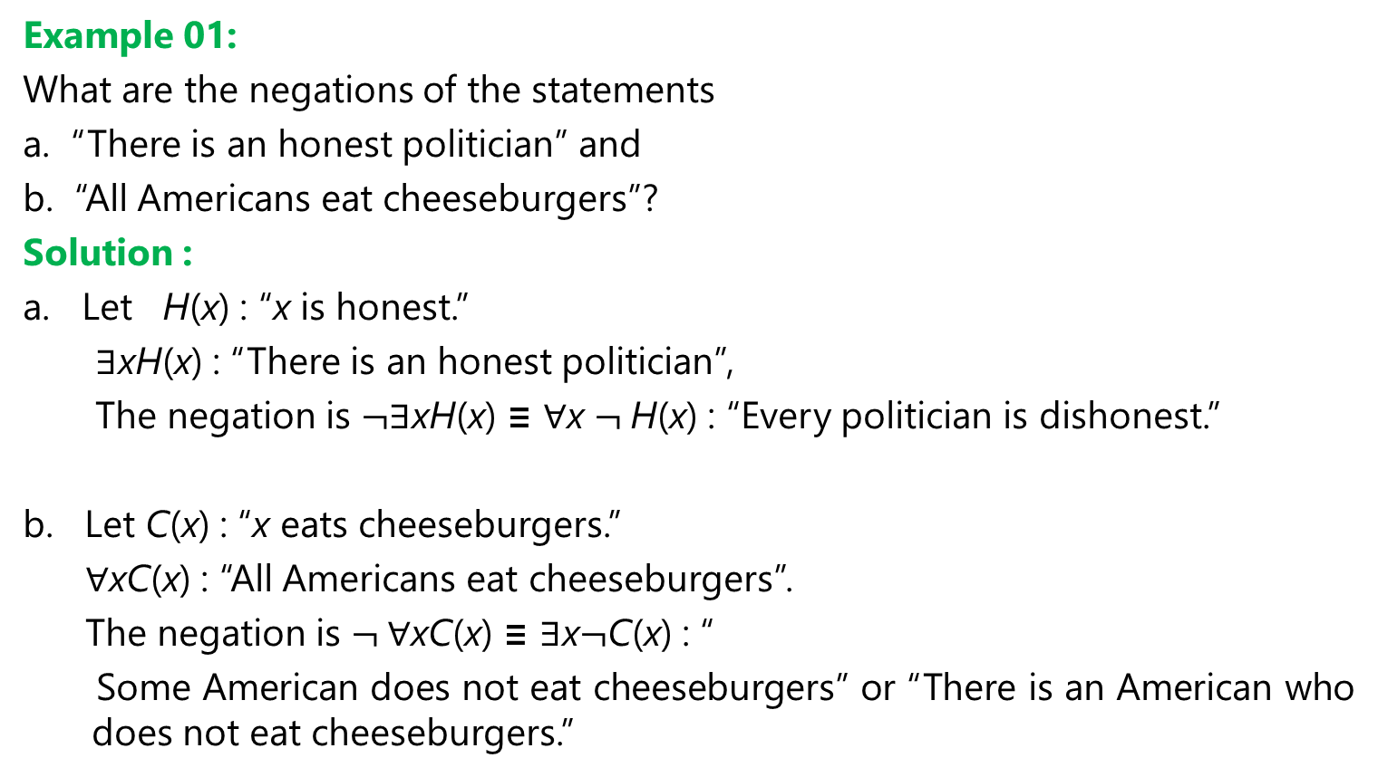
Negating Quantified Expressions
Example 01:
What are the negations of the statements
a. “There is an honest politician” and
b. “All Americans eat cheeseburgers”?
Solution :
a. Let H(x) : “x is honest.”
∃xH(x) : “There is an honest politician”,
The negation is $¬$∃xH(x) ≡ ∀x $¬$H(x) : “Every politician is dishonest.”
b. Let C(x) : “x eats cheeseburgers.”
∀xC(x) : “All Americans eat cheeseburgers”.
The negation is $¬$∀xC(x) ≡ ∃x$¬$C(x) : “
Some American does not eat cheeseburgers” or “There is an American who does not eat cheeseburgers.”

Slide 21
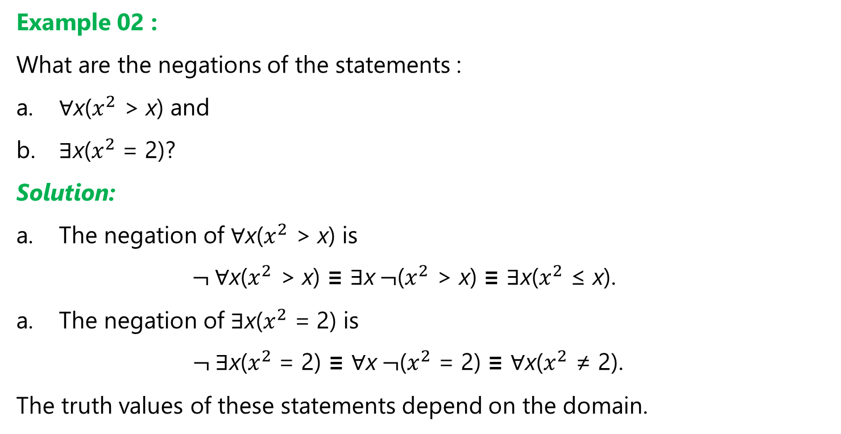
Negating Quantified Expressions
Example 02 :
What are the negations of the statements :
∀x($x^{2}$ > x) and
∃x($x^{2}$ = 2)?
Solution:
The negation of ∀x($x^{2}$ > x) is
$¬$∀x($x^{2}$ > x) ≡ ∃x $¬$($x^{2}$ > x) ≡ ∃x($x^{2}$ ≤ x).
The negation of ∃x($x^{2}$ = 2) is
$¬$∃x($x^{2}$ = 2) ≡ ∀x $¬$($x^{2}$ = 2) ≡ ∀x($x^{2}$ ≠ 2).
The truth values of these statements depend on the domain.

Slide 22
Using Quantifiers in System Specifications
Example 01 :
Use predicates and quantifiers to express the system specifications
“Every mail message larger than one megabyte will be compressed”
“If a user is active, at least one network link will be available.”
Solution :
a. Let S(m, y) : “Mail message m is larger than y megabytes,”
where the variable x has the domain of all mail messages and the variable y is a positive real number,
C(m) : “Mail message m will be compressed.”
Then the specification :
“Every mail message larger than one megabyte will be compressed”
= ∀m(S(m, 1) → C(m)).

Slide 23
Using Quantifiers in System Specifications
Solution :
Let A(u) : “User u is active,”
where the variable u has the domain of all users,
S(n, x) : “Network link n is in state x,”
where n has the domain of all network links and x has the domain of all possible states for a network link.
Then the specification :
“If a user is active, at least one network link will be available”
= ∃uA(u) → ∃nS(n, available).

Slide 24
Using Quantifiers in System Specifications
Example 02:
Consider these statements. The first two are called premises and the third is called the conclusion. The entire set is called an argument.
“All lions are fierce.”
“Some lions do not drink coffee.”
“Some fierce creatures do not drink coffee.”
Solution :
Let P(x) : “x is a lion,”
Q(x) : “x is fierce,”
R(x) : “x drinks coffee”

Slide 25
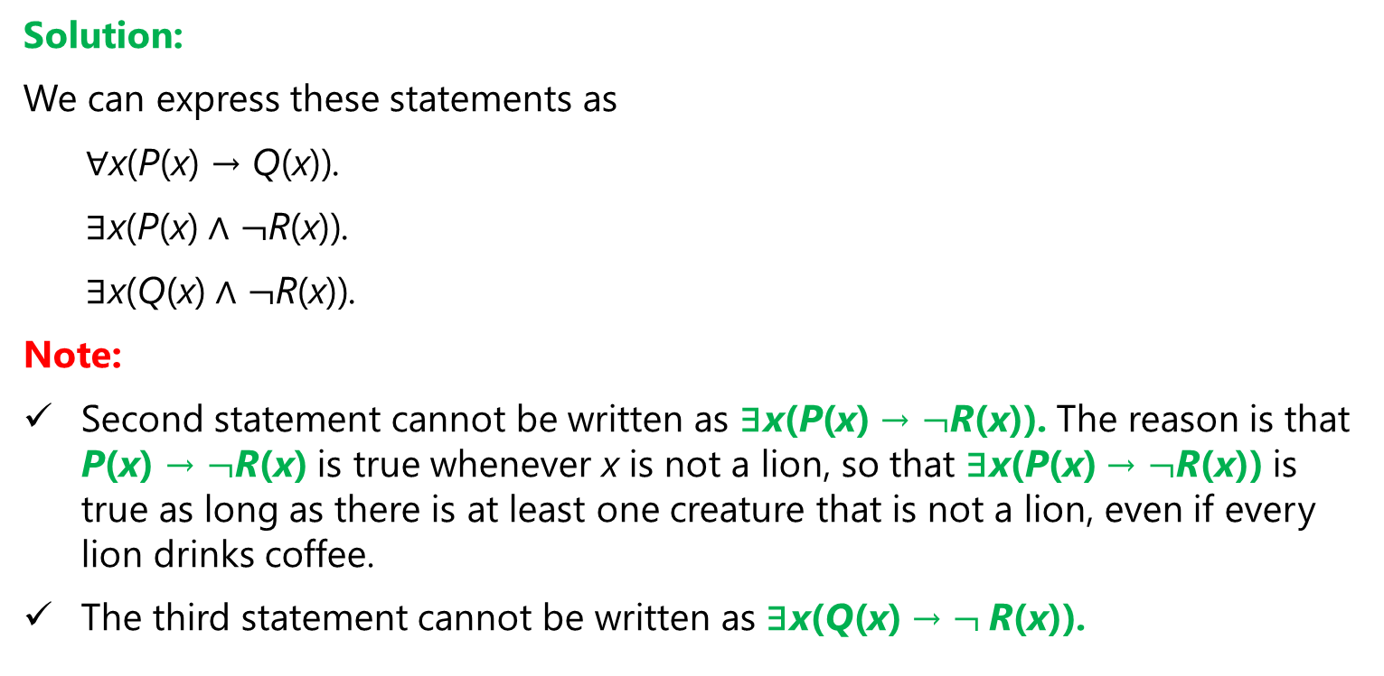
Using Quantifiers in System Specifications
Solution:
We can express these statements as
∀x(P(x) → Q(x)).
∃x(P(x) ∧ $¬$R(x)).
∃x(Q(x) ∧ $¬$R(x)).
Note:
Second statement cannot be written as ∃x(P(x) → $¬$R(x)). The reason is that P(x) → $¬$R(x) is true whenever x is not a lion, so that ∃x(P(x) → $¬$R(x)) is true as long as there is at least one creature that is not a lion, even if every lion drinks coffee.
The third statement cannot be written as ∃x(Q(x) → $¬$R(x)).

Slide 26
Using Quantifiers in System Specifications
Example 03:
Consider these statements, of which the first three are premises and the fourth is a valid conclusion.
“All hummingbirds are richly colored.”
“No large birds live on honey.”
“Birds that do not live on honey are dull in color.”
“Hummingbirds are small.”
Solution :
Let P(x) : “x is a hummingbird,”
Q(x) : “x is large”
R(x) : “x lives on honey”
S(x) : “x is richly colored

Slide 27
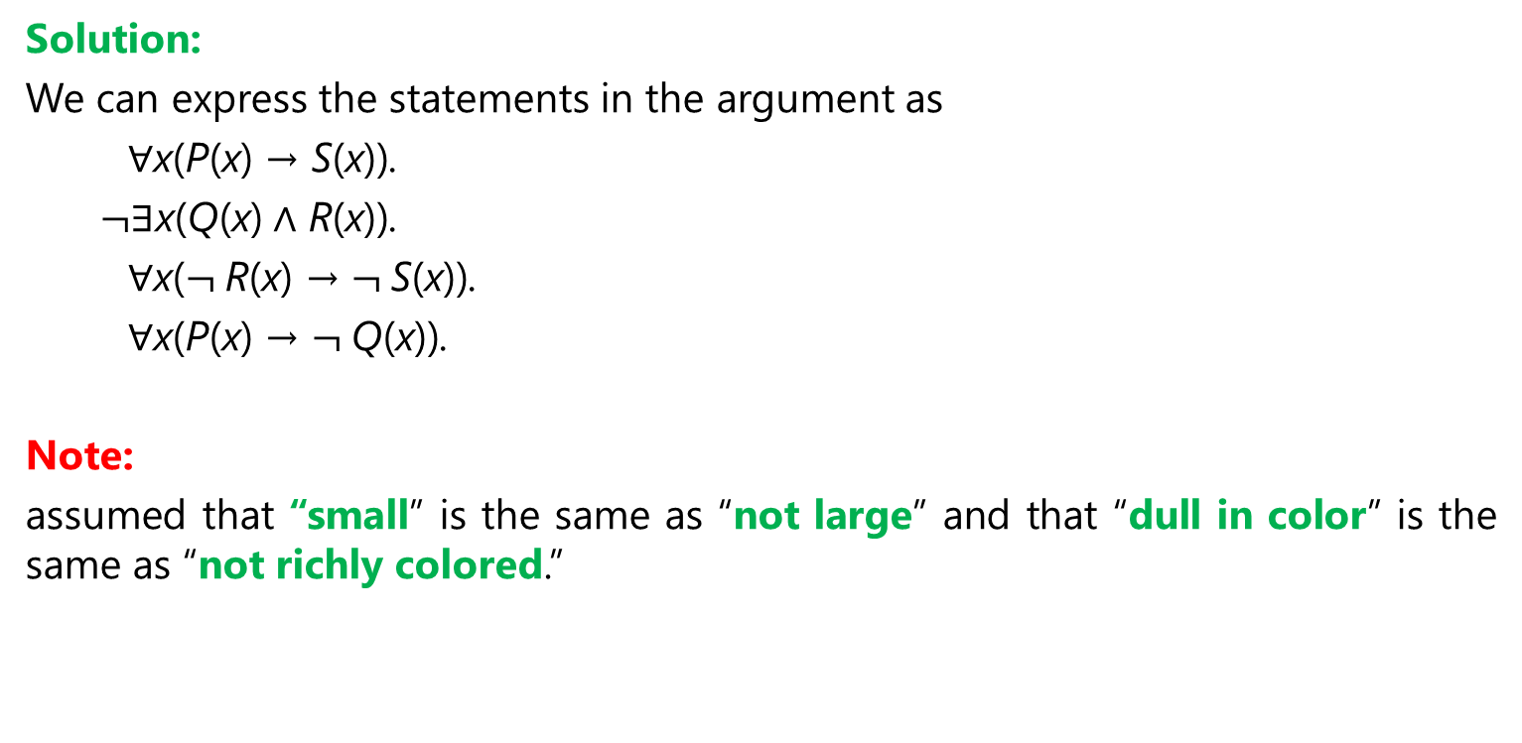
Using Quantifiers in System Specifications
Solution:
We can express the statements in the argument as
∀x(P(x) → S(x)).
$¬$∃x(Q(x) ∧ R(x)).
∀x($¬$R(x) → $¬$S(x)).
∀x(P(x) → $¬$Q(x)).
Note:
assumed that “small” is the same as “not large” and that “dull in color” is the same as “not richly colored.”

Slide 28
Nested Quantifiers

Slide 29
Understanding Statements Involving Nested Quantifiers
Assume that the domain for the variables x and y consists of all real numbers. The statement
∀x∀y (x + y = y + x)
says that x + y = y + x for all real numbers x and y. This is the commutative law for addition of real numbers.
The statement
∀x∃y (x + y = 0)
says that for every real number x there is a real number y such that x + y = 0.
This states that every real number has an additive inverse.
Similarly, the statement
∀x∀y∀z (x + (y + z) = (x + y) + z)
is the associative law for addition of real numbers

Slide 30
Understanding Statements Involving Nested Quantifiers
Example :
Translate into English the statement :
∀x∀y ((x > 0) ∧ (y < 0) → (xy < 0))
where the domain for both variables consists of all real numbers.
Solution:
This statement says that for every real number x and for every real number y, if x > 0 and y < 0, then xy < 0.
That is, this statement says that for real numbers x and y, if x is positive and y is negative, then xy is negative.
This can be stated more succinctly as
“The product of a positive real number and a negative real number is always a negative real number.”

Slide 31
The Order of Quantifiers
Example 01 :
Let Q(x, y) denote “x + y = 0.” What are the truth values of the quantifications a. ∃y∀x Q(x, y)
b. ∀x∃y Q(x, y)
where the domain for all variables consists of all real numbers?
Solution:
a. The quantification ∃y∀x Q(x, y) denotes the proposition :
“There is a real number y such that for every real number x, Q(x, y)”
No matter what value of y is chosen, there is only one value of x for which
x + y = 0. Because there is no real number y such that x + y = 0 for all real numbers x, the statement ∃y∀xQ(x, y) is false.

Slide 32
The Order of Quantifiers
Solution :
b. The quantification ∀x∃y Q(x, y)
denotes the proposition
“For every real number x there is a real number y such that Q(x, y).”
Given a real number x, there is a real number y such that x + y = 0;
namely, y = −x.
Hence, the statement ∀x∃yQ(x, y) is true.

Slide 33
The Order of Quantifiers
Example 02 :
Let Q(x, y, z) be the statement “x+y=z.” What are the truth values of the statements
a. ∀x∀y∃z Q(x, y, z)
b. ∃z∀x∀y Q(x, y, z),
where the domain of all variables consists of all real numbers?
Solution:
a. Suppose that x and y are assigned values. Then, there exists a real number z such that
x + y = z
Consequently, the quantification ∀x∀y∃z Q(x, y, z), which is the statement
“For all real numbers x and for all real numbers y there is a real number z such that x + y = z,” is true.

Slide 34
The Order of Quantifiers
Solution:
b. The order of the quantification here is important, because the quantification
∃z∀x∀y Q(x, y, z)
which is the statement
“There is a real number z such that for all real numbers x and for all real numbers y it is true that x + y = z,”
is false, because there is no value of z that satisfies the equation x + y = z for all values of x and y.

Slide 35
Quantifications of Two Variables

Slide 36
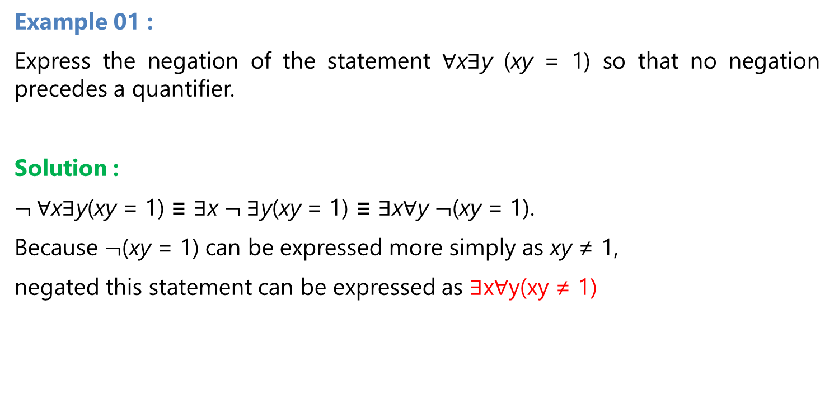
Negating Nested Quantifiers
Example 01 :
Express the negation of the statement ∀x∃y (xy = 1) so that no negation precedes a quantifier.
Solution :
$¬$∀x∃y(xy = 1) ≡ ∃x $¬$∃y(xy = 1) ≡ ∃x∀y $¬$(xy = 1).
Because $¬$(xy = 1) can be expressed more simply as xy ≠ 1,
negated this statement can be expressed as ∃x∀y(xy ≠ 1)

Slide 37
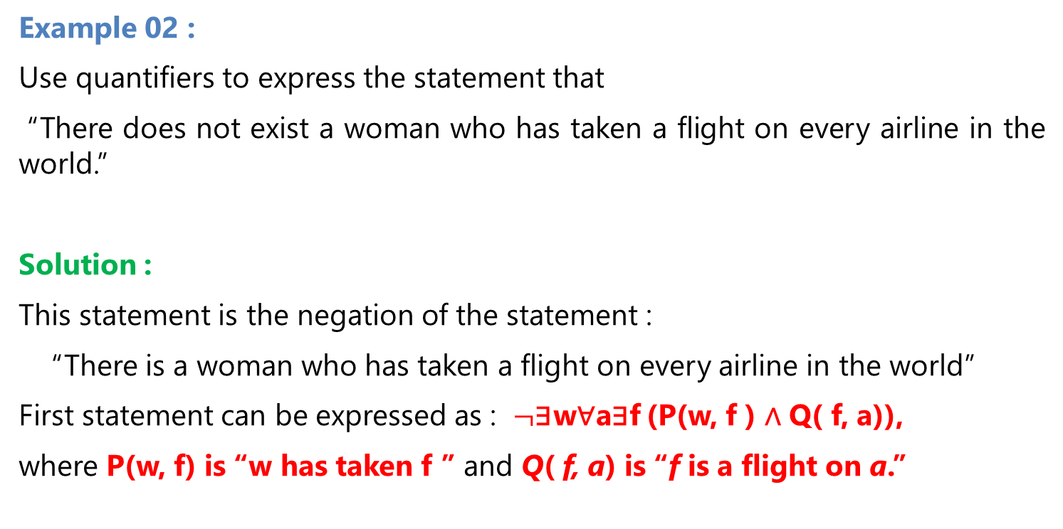
Negating Nested Quantifiers
Example 02 :
Use quantifiers to express the statement that
“There does not exist a woman who has taken a flight on every airline in the world.”
Solution :
This statement is the negation of the statement :
“There is a woman who has taken a flight on every airline in the world”
First statement can be expressed as : $¬$∃w∀a∃f (P(w, f ) ∧ Q( f, a)),
where P(w, f) is “w has taken f ” and Q( f, a) is “f is a flight on a.”

Slide 38
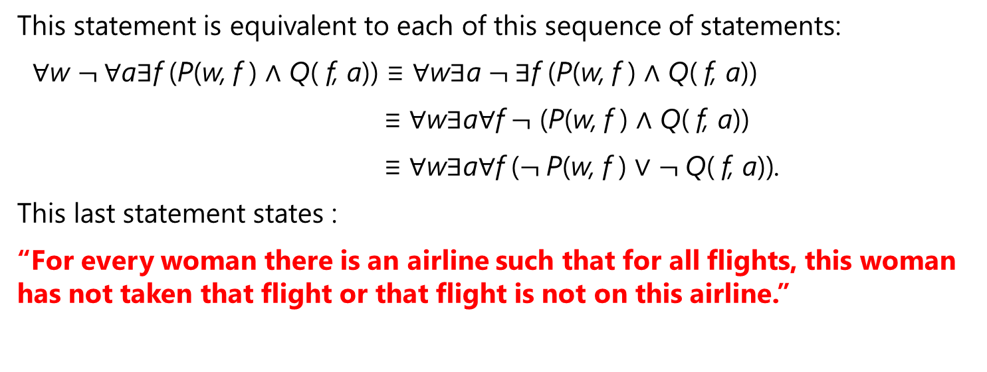
Negating Nested Quantifiers
This statement is equivalent to each of this sequence of statements:
∀w $¬$∀a∃f (P(w, f ) ∧ Q( f, a)) ≡ ∀w∃a $¬$∃f (P(w, f ) ∧ Q( f, a))
≡ ∀w∃a∀f $¬$ (P(w, f ) ∧ Q( f, a))
≡ ∀w∃a∀f ($¬$P(w, f ) ∨ $¬$Q( f, a)).
This last statement states :
“For every woman there is an airline such that for all flights, this woman has not taken that flight or that flight is not on this airline.”

Slide 39
Reference
Kenneth H. Rosen, “ Discrete Mathematics and its Applications”, 8th edition,2019, McGraw-Hill Education, New York, ISBN 978-1-259-67651-2

