Slide 1
COMP6599 – Algorithm and Programming
Week 7
Session 11
Structure & Union

Slide 2
Sub Topics
Structures & Union
Structure
Typedef
Union
Enumeration

Slide 3
Structure

Slide 4
Structure Definition
Structure is a data type to store group of data with various of data type
Structure component called member/field/element.
Heterogeneous (various element data type)
Structure in other programming language also called record

Slide 5
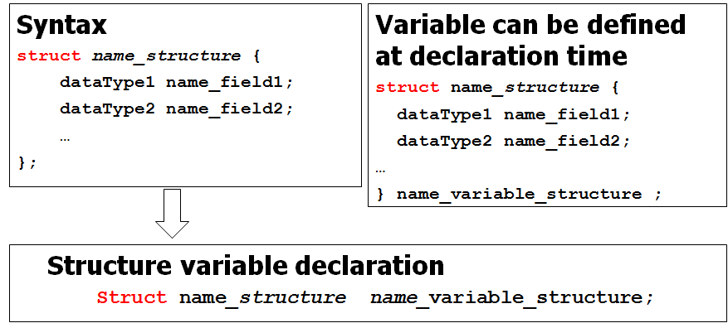
Structure Definition

Slide 6
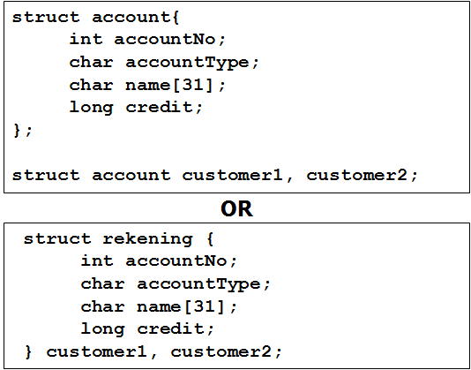
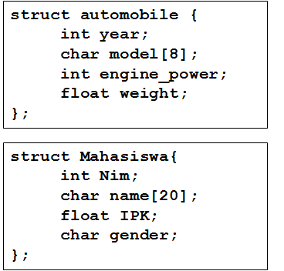
Structure Declaration Example
Example 1
Example 2

Slide 7
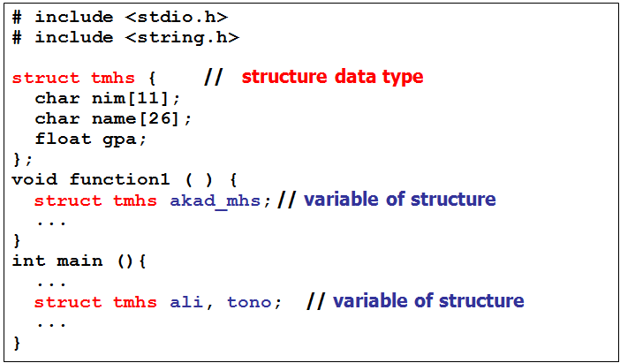
Program Example using Structure Declaration 1
Example

Slide 8
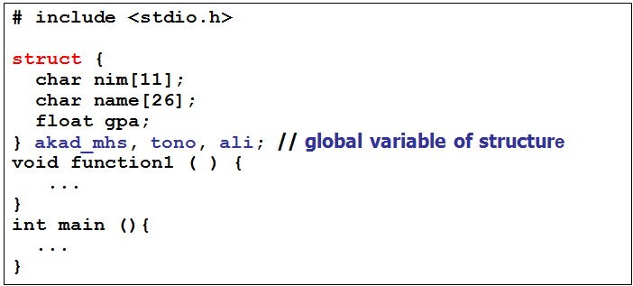
Program Example using Structure Declaration 2
Example
Structure can be used without naming, structure variable can be directly declared along with structure declaration.

Slide 9
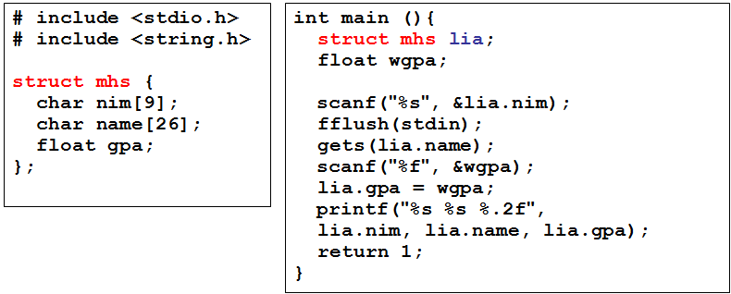
Accessing Structure
Element (field) of a structure can be accessed using dot operator from structure variable

Slide 10
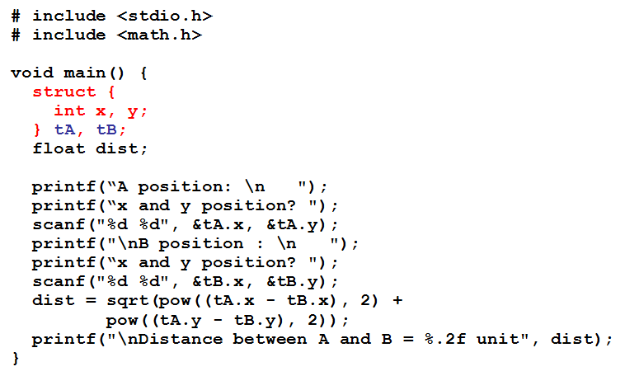
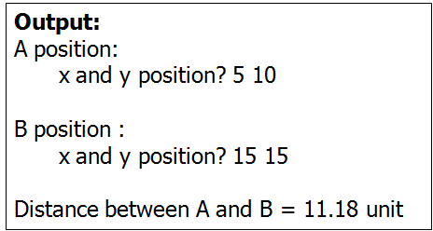
Local Structure

Slide 11
Nested Structure
Nested Structure is a structure with one of its element is another structure.
Structure as a member should be declared in advance.
Example:
struct mhs consists of nim, name, address, dob
address is a structure consists of name street, number, city, and province.
dob is a structure consists of date, month and year.

Slide 12
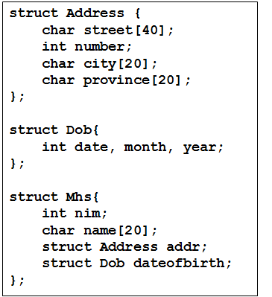
Nested Structure Example

Slide 13
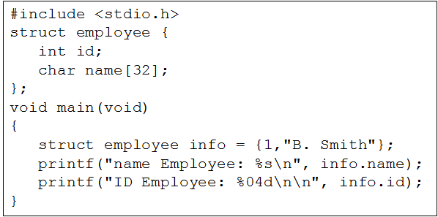
Structure Initialization
Syntax:
struct struct_name variable = {value_1, …, value_m};
Example:
struct account customer1 = {1984, ‘a’, “frenzy”, 200000, 19};

Slide 14
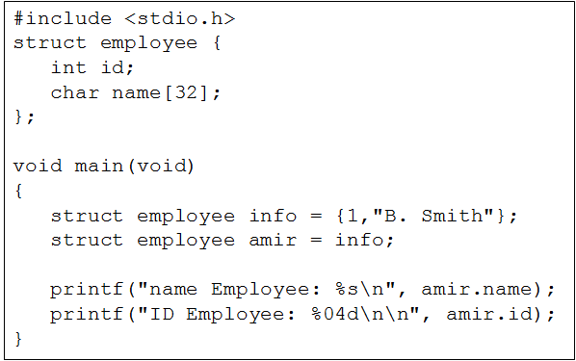
Structure Initialization
Structure variable can be assigned with other structure variable with similar structure name

Slide 15
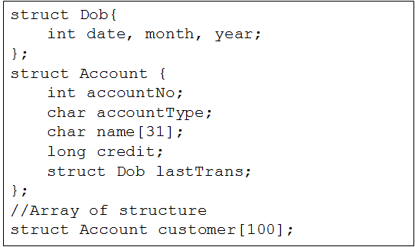
Array of Structure
Structure data type can only contain one record. Real world problem needs group of records.
In practice, structure usually used in conjunction with array.

Slide 16
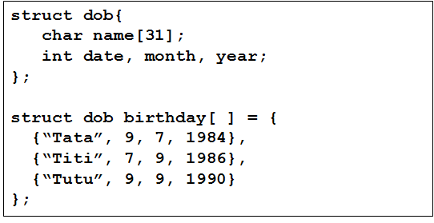
Array of Structure
Init Array of Structure

Slide 17
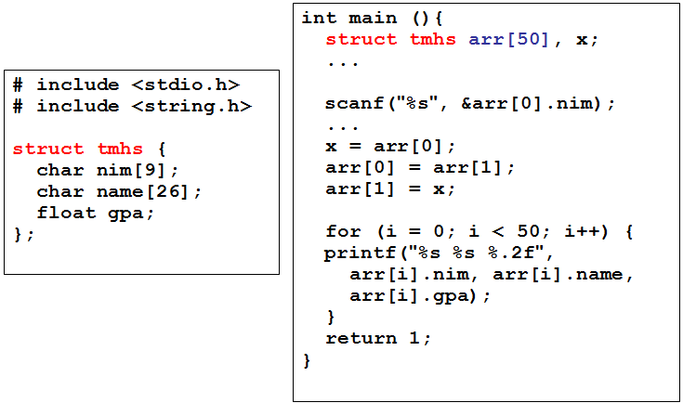
Array of Structure Example

Slide 18
Typedef

Slide 19
Typedef
typedef is an alias (other name)
Used for short naming – especially for long identifier
typedef commonly used in a structure
Example:
typedef struct BinusStudent{
char name[20];
int nim;
float gpa;
}Mhs;
Mhs is an alias name of struct BinusStudent, and its function as a new data type.
To define a structure variable, using:
Mhs ali, tono;

Slide 20
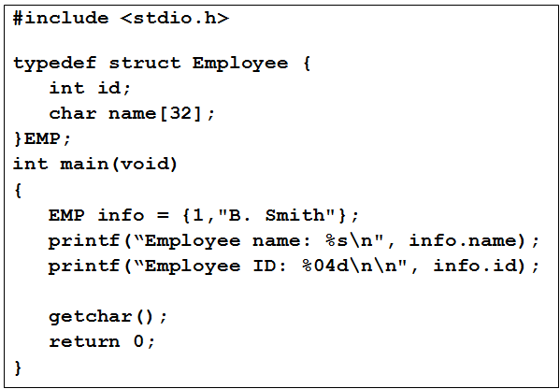
Program Example Uisng Typedef

Slide 21
Bit Field
A struct with each element assign with certain number of bit.
Syntax:
struct name{
type field1: numberof_bit;
…...
};
Type : can only use unsigned int, signed int, or int.

Slide 22
Bit Field Example
Example :
struct {
unsigned short icon : 8;
unsigned short color : 4;
unsigned short underline : 1;
unsigned short blink : 1;
}screen[25][80];
The screen array filled with 2000 elements, where each element using 2 byte (14 bit needs at least two bytes)

Slide 23
Union

Slide 24
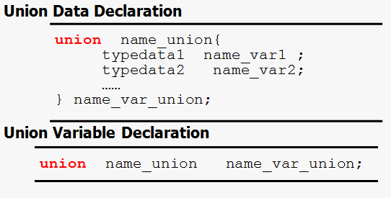
Union Definition
Union is used for memory join. By using union, a memory location can be assigned for two or more variable with different data types
Memory capacity used by union is the largest capacity used by any element of the union

Slide 25
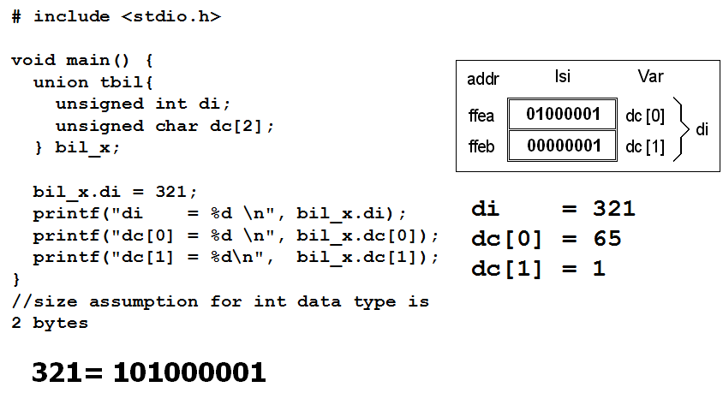
Union Definition

Slide 26
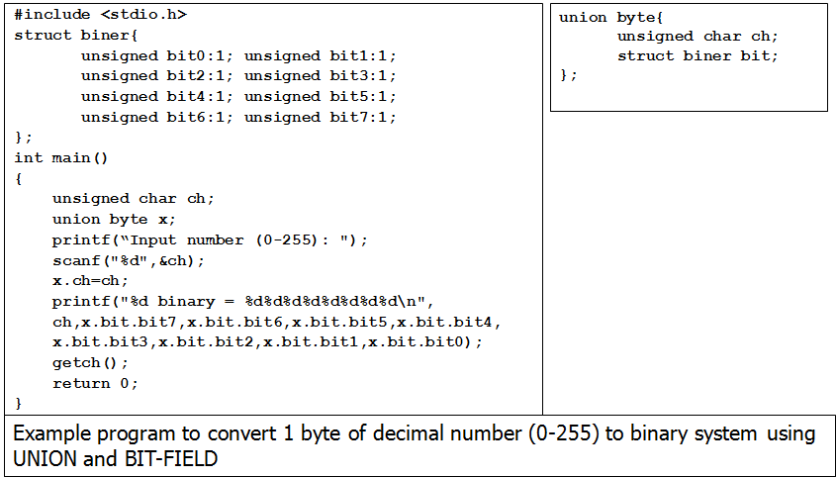
Union Definition

Slide 27
Enumeration

Slide 28
Enumeration
Enumeration is a data type with predefined number of data. This limited number of data is named for program readability.
Data type enumeration declaration
enum name_type {
const1, const2,… const_n
}name_var;
Enumeration variable
enum name_type name_var;

Slide 29
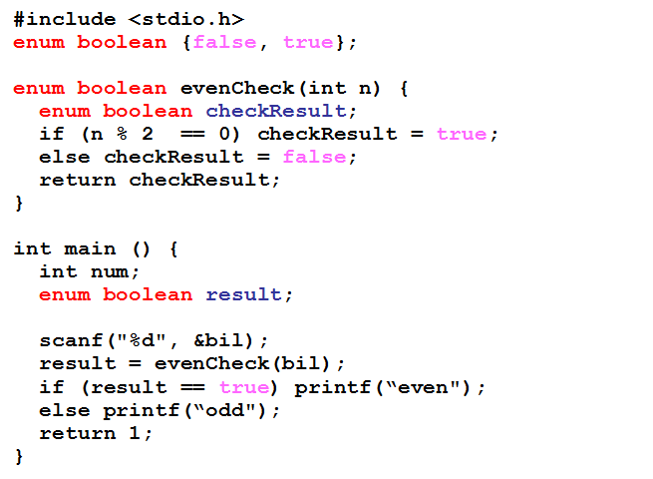
Enumeration Example 1
100
even
37
odd

Slide 30
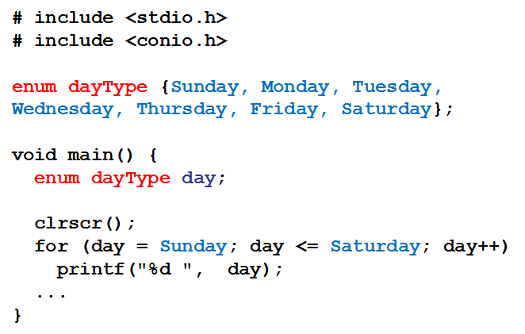
Enumeration Example 2
Output :
0 1 2 3 4 5 6

Slide 31
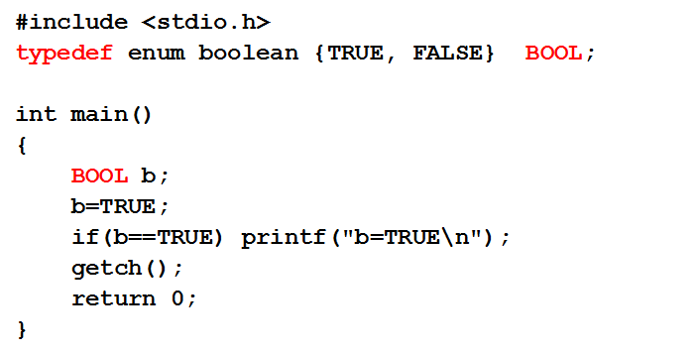
Enumeration Example 3
Use typedef to cut enumeration declaration

Slide 32
Summary

Slide 33
Summary
Structure is a data type to store group of data with various of data type
Structure in other programming language also called record
Nested Structure is a structure with one of its element is another structure.
Union is used for memory join. By using union, a memory location can be assigned for two or more variable with different data types

Slide 34
References
Paul J. Dietel,Harvey M. Deitel,. 2010. C : how to program. PEAPH. New Jersey. ISBN:978-0-13-705966-9 Chapter 10
Collecting Data Items of Different Types: http://aelinik.free.fr/c/ch19.htm
Structs, Enums, and Unions: http://www.lysator.liu.se/c/c-faq/c-9.html

