Slide 1
MATH6077 – Discrete Mathematics
Week 06 - Counting

Slide 2

The Basics of Counting

Slide 3
Introduction
Counting problems arise throughout mathematics and computer science.
For example, we must count the successful outcomes of experiments and all the possible outcomes of these experiments to determine probabilities of discrete events.
We need to count the number of operations used by an algorithm to study its time complexity.
We will introduce the basic techniques of counting, these methods serve as the foundation for almost all counting techniques.

Slide 4
Basic Counting Principles
THE PRODUCT RULE
Suppose that a procedure can be broken down into a sequence of two tasks. If there are n1 ways to do the first task and for each of these ways of doing the first task, there are n2 ways to do the second task, then there are n1n2 ways to do the procedure
Example 1 :
A new company with just two employees, Sanchez and Patel, rents a floor of a building with 12 offices. How many ways are there to assign different offices to these two employees?
Example 2:
How many different license plates can be made if each plate contains a sequence of three uppercase English letters followed by three digits (and no sequences of letters are prohibited, even if they are obscene)?

Slide 5
The Product Rule
Solution :
1. The procedure of assigning offices to these two employees consists of assigning an office to Sanchez, which can be done in 12 ways, then assigning an office to Patel different from the office assigned to Sanchez, which can be done in 11 ways. By the product rule, there are
12 ⋅ 11 = 132 ways to assign offices to these two employees.
2. There are 26 choices for each of the three uppercase English letters and 10 choices for each of the three digits. Hence, by the product rule there are a total of
26 ⋅ 26 ⋅ 26 ⋅ 10 ⋅ 10 ⋅ 10
= 17,576,000 possible license plates

Slide 6
The Product Rule
Example 3 :
What is the value of k after the following code, where n1, n2,…, nm are positive integers, has been executed?
Solution :
The initial value of k is zero. Each time the nested loop is traversed, 1 is added to k.
Let Ti be the task of traversing the ith loop.
Then the number of times the loop is traversed is the number of ways to do the tasks T1, T2,…, Tm.
The number of ways to carry out the task Tj, j = 1, 2,…, m, is nj, because the jth loop is traversed once for each integer ij with 1 ≤ ij ≤ nj.
By the product rule, it follows that the nested loop is traversed n1n2⋯nm times.
Hence, the final value of k is n1n2⋯nm.

Slide 7
2. The Sum Rule
The Sum Rule
If a task can be done either in one of n1 ways or in one of n2 ways, where none of the set of n1 ways is the same as any of the set of n2 ways, then there are n1 + n2 ways to do the task.
Example 1:
A student can choose a computer project from one of three lists. The three lists contain 23, 15, and 19 possible projects, respectively. No project is on more than one list. How many possible projects are there to choose from?
Solution:
The student can choose a project by selecting a project from the first list, the second list, or the third list. Because no project is on more than one list, by the sum rule there are 23 + 15 + 19 = 57 ways to choose a project.

Slide 8
2. The Sum Rule
Example 2
What is the value of k after the following code, where n1, n2,…, nm are positive integers, has been executed?
Solution :
The initial value of k is zero. This block of code is made up of m different loops. Each time a loop is traversed, 1 is added to k,
We need to determine how many times we traverse a loop. Note that there are ni ways to traverse the ith loop. Because we only traverse one loop at a time, the sum rule shows that the final value of k, which is the number of ways to traverse one of the m loops is
n1 + n2 +⋯+ nm.

Slide 9
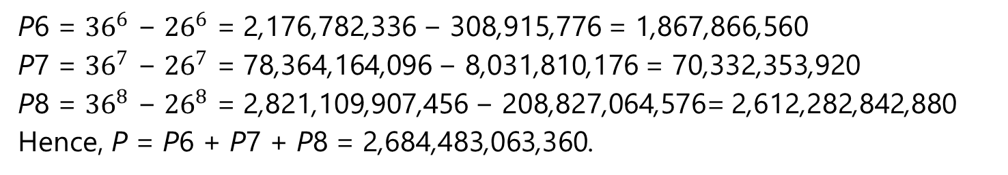
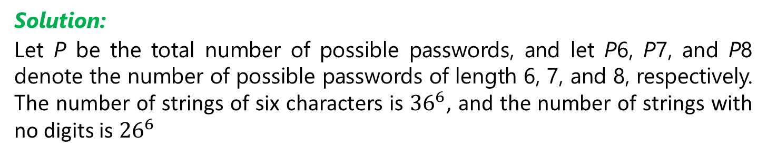
2. The Sum Rule
Example 3 :
Each user on a computer system has a password, which is six to eight characters long, where each character is an uppercase letter or a digit. Each password must contain at least one digit. How many possible passwords are there?
Solution:
Let P be the total number of possible passwords, and let P6, P7, and P8 denote the number of possible passwords of length 6, 7, and 8, respectively. The number of strings of six characters is ${36}^{6}$, and the number of strings with no digits is ${26}^{6}$
P6 = ${36}^{6}$ − ${26}^{6}$ = 2,176,782,336 − 308,915,776 = 1,867,866,560
P7 = ${36}^{7}$ − ${26}^{7}$ = 78,364,164,096 − 8,031,810,176 = 70,332,353,920
P8 = ${36}^{8}$ − ${26}^{8}$ = 2,821,109,907,456 − 208,827,064,576= 2,612,282,842,880
Hence, P = P6 + P7 + P8 = 2,684,483,063,360.

Slide 10
3. The Subtraction Rule
THE SUBTRACTION RULE
If a task can be done in either n1 ways or n2 ways, then the number of ways to do the task is n1 + n2 minus the number of ways to do the task that are common to the two different ways.
The subtraction rule is also known as the principle of inclusion exclusion, especially when it is used to count the number of elements in the union of two sets.
Suppose that A1 and A2 are sets. Then
|A1| ways to select an element from A1
|A2| ways to select an element from A2.
|A1 ∩ A2| ways to select an element common to both sets
| A1 ∪ A2 | ways to select an element in either A1 or in A2
|A1 ∪ A2| = |A1| + |A2| − |A1 ∩ A2|.

Slide 11
3. The Subtraction Rule
Example :
A computer company receives 350 applications from college graduates for a job planning a line of new web servers. Suppose that 220 of these applicants majored in computer science, 147 majored in business, and 51 majored both in computer science and in business. How many of these applicants majored neither in computer science nor in business?
Solution :
Let A1 : the set of students who majored in computer science
A2 : the set of students who majored in business.
A1 ∪ A2 : the set of students who majored in computer science or business A1 ∩ A2 : the set of students who majored both in computer science and in business.
|A1 ∪ A2| = |A1| + |A2| − |A1 ∩ A2| = 220 + 147 − 51 = 316.
We conclude that 350 − 316 = 34 of the applicants majored neither in computer science nor in business.

Slide 12
Venn Diagram
Solution :

Slide 13
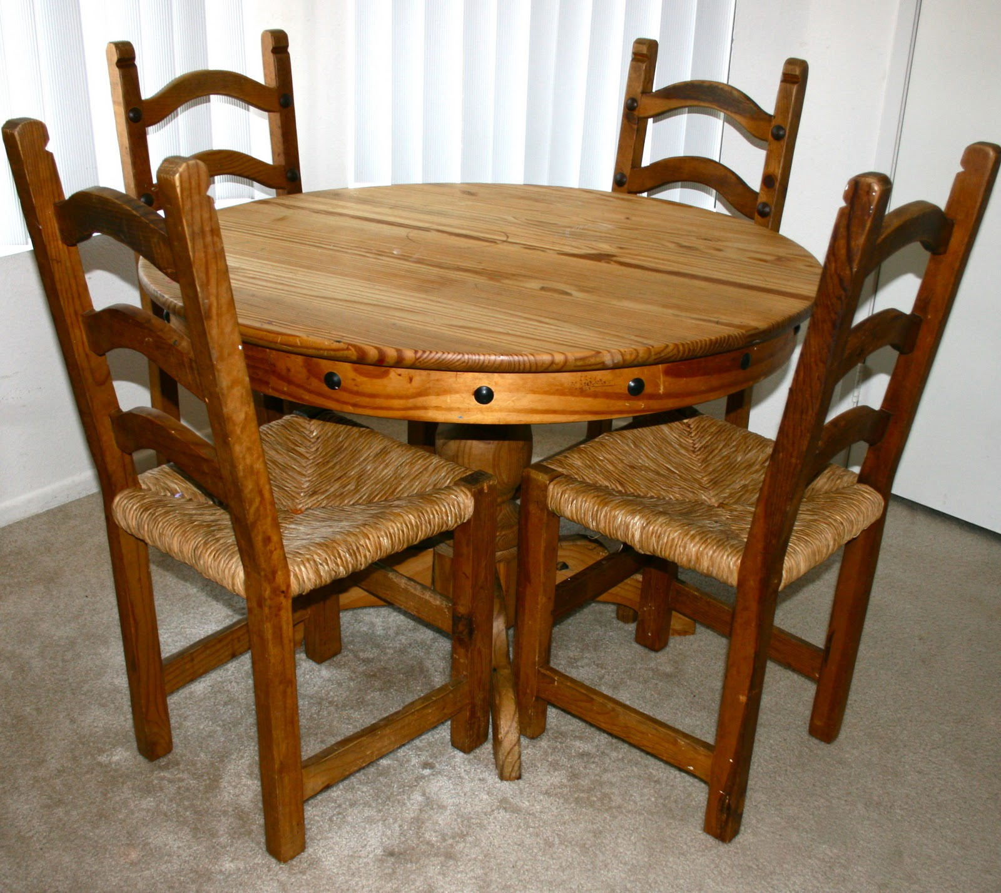
4. The Division Rule
The Division Rule
There are n∕d ways to do a task if it can be done using a procedure that can be carried out in n ways, and for every way w, exactly d of the n ways correspond to way w.
Example :
How many different ways are there to seat four people around a circular table, where two seatings are considered the same when each person has the same left neighbor and the same right neighbor?
This Photo by Unknown Author is licensed under CC BY

Slide 14
The Division Rule
Solution:
We arbitrarily select a seat at the table and label it seat 1. We number the rest of the seats in numerical order, proceeding clockwise around the table. Note that are four ways to select the person for seat 1, three ways to select the person for seat 2, two ways to select the person for seat 3, and one way to select the person for seat 4.
Thus, there are 4! = 24 ways to order the given four people for these seats.
However, each of the four choices for seat 1 leads to the same arrangement, as we distinguish two arrangements only when one of the people has a different immediate left or immediate right neighbor.
Because there are four ways to choose the person for seat 1, by the division rule there are 24∕4 = 6 different seating arrangements of four people around the circular table.

Slide 15
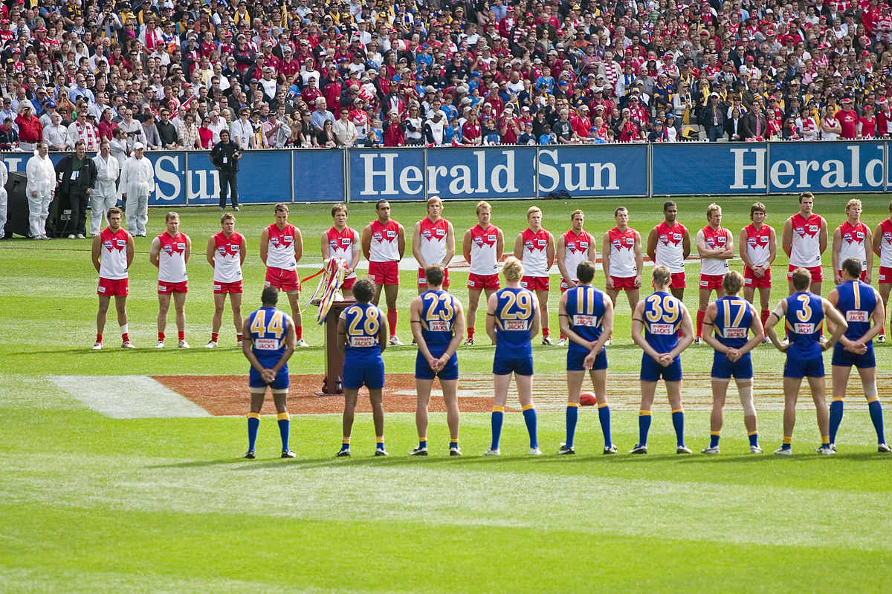
5. Tree Diagrams
A tree consists of a root, a number of branches leaving the root, and possible additional branches leaving the endpoints of other branches.
To use trees in counting, we use a branch to represent each possible choice. We represent the possible outcomes by the leaves, which are the endpoints of branches not having other branches starting at them
Example :
A playoff between two teams consists of at most five games. The first team that wins three games wins the playoff. In how many different ways can the playoff occur?
This Photo by Unknown Author is licensed under CC BY-SA

Slide 16
5. Tree Diagrams
Solution:
The tree diagram in Figure below displays all the ways the playoff can proceed, with the winner of each game shown. We see that there are 20 different ways for the playoff to occur.

Slide 17
The Pigeonhole Principle

Slide 18
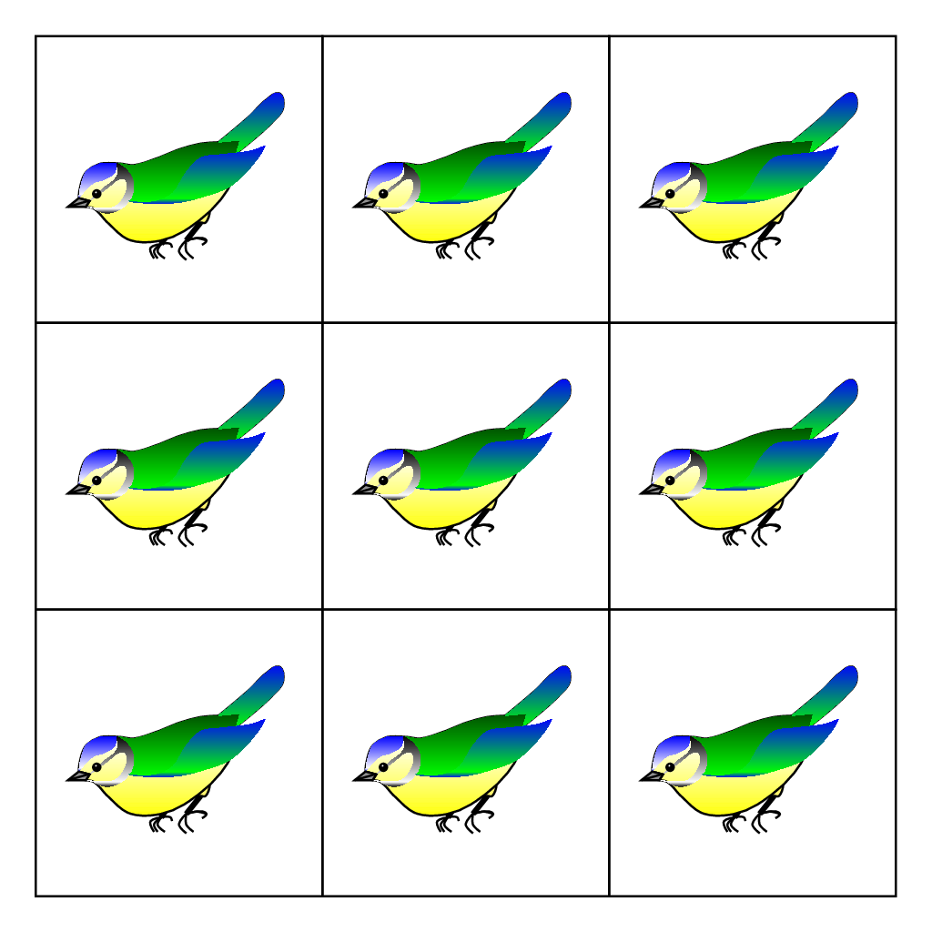
The Pigeonhole Principle
Theorem 1
If k is a positive integer and k + 1 or more objects are placed into k boxes, then there is at least one box containing two or more of the objects.
Proof:
We prove the pigeonhole principle using a proof by contraposition. Suppose that none of the k boxes contains more than one object. Then the total number of objects would be at most k.
This is a contradiction, because there are at least k + 1 objects
This Photo by Unknown Author is licensed under CC BY-SA

Slide 19
The Pigeonhole Principle
Corollary 1
A function f from a set with k + 1 or more elements to a set with k elements is not one-to-one.
Proof:
Suppose that for each element y in the codomain of f we have a box that contains all elements x of the domain of f such that f (x) = y. Because the domain contains k + 1 or more elements and the codomain contains only k elements, the pigeonhole principle tells us that one of these boxes contains two or more elements x of the domain. This means that f cannot be one-to-one.

Slide 20
The Pigeonhole Principle
Example 1 :
Among any group of 367 people, there must be at least two with the same birthday, because there are only 366 possible birthdays.
Example 2 :
How many students must be in a class to guarantee that at least two students receive the same score on the final exam, if the exam is graded on a scale from 0 to 100 points?
Solution :
There are 101 possible scores on the final. The pigeonhole principle shows that among any 102 students there must be at least 2 students with the same score.

Slide 21
Applications of the Pigeonhole Principle
Example :
During a month with 30 days, a baseball team plays at least one game a day, but no more than 45 games. Show that there must be a period of some number of consecutive days during which the team must play exactly 14 games.
Solution:
Let aj be the number of games played on or before the jth day of the month. Then a1, a2,…, a30 is an increasing sequence of distinct positive integers, with
1 ≤ aj ≤ 45. Moreover, a1 + 14, a2 + 14,…, a30 + 14 is also an increasing sequence of distinct positive integers, with 15 ≤ aj + 14 ≤ 59.
The 60 positive integers a1, a2,…, a30, a1 + 14, a2 + 14,…, a30 + 14 are all less than or equal to 59.
Hence, by the pigeonhole principle two of these integers are equal. Because the integers aj, j = 1, 2,…, 30 are all distinct and the integers aj + 14, j = 1, 2,…, 30 are all distinct, there must be indices i and j with ai = aj + 14. This means that exactly 14 games were played from day j + 1 to day i.

Slide 22
Permutations and Combinations

Slide 23
Permutations
A permutation of a set of distinct objects is an ordered arrangement of these objects.
An ordered arrangement of r elements of a set is called an r-permutation.
The number of r-permutations of a set with n elements is denoted by
P(n, r).
We can find P(n, r) using the product rule.
Theorem 1
If n is a positive integer and r is an integer with 1 ≤ r ≤ n, then there are
P(n, r) = n(n − 1)(n − 2)⋯(n − r + 1)
r-permutations of a set with n distinct elements.

Slide 24
Permutations
Corollary 1
If n and r are integers with 0 ≤ r ≤ n, then P(n, r) = n!(n − r)! .
Proof:
When n and r are integers with 1 ≤ r ≤ n, by Theorem 1 we have
P(n, r) = n(n − 1)(n − 2)⋯(n − r + 1) = n!(n − r)!
Because
n!(n − 0)! = n! n! = 1
whenever n is a nonnegative integer, we see that the formula
P(n, r) = n!(n − r)! also holds when r = 0.
By Theorem 1 we know that if n is a positive integer, then P(n, n) = n!.

Slide 25
Permutations
Example 1 :
How many ways are there to select a first-prize winner, a second prize winner, and a third-prize winner from 100 different people who have entered a contest?
Solution:
Because it matters which person wins which prize, the number of ways to pick the three prize winners is the number of ordered selections of three elements from a set of 100 elements, that is, the number of 3-permutations of a set of 100 elements.
Consequently, the answer is
P(100, 3) = 100 ⋅ 99 ⋅ 98 = 970,200.

Slide 26
Permutations
Example 2 :
Suppose that a saleswoman has to visit eight different cities. She must begin her trip in a specified city, but she can visit the other seven cities in any order she wishes. How many possible orders can the saleswoman use when visiting these cities?
Solution:
The number of possible paths between the cities is the number of permutations of seven elements, because the first city is determined, but the remaining seven can be ordered arbitrarily.
Consequently, there are 7! = 7 ⋅ 6 ⋅ 5 ⋅ 4 ⋅ 3 ⋅ 2 ⋅ 1 = 5040 ways for the saleswoman to choose her tour.

Slide 27
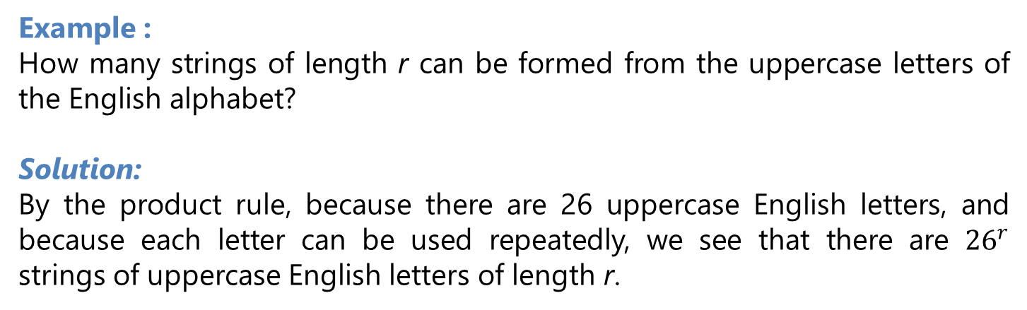
Permutations with Repetition
Counting permutations when repetition of elements is allowed can easily be done using the product rule.
Example :
How many strings of length r can be formed from the uppercase letters of the English alphabet?
Solution:
By the product rule, because there are 26 uppercase English letters, and because each letter can be used repeatedly, we see that there are ${26}^{r}$ strings of uppercase English letters of length r.
Theorem
The number of r-permutations of a set of n objects with repetition allowed is $n^{r}$

Slide 28
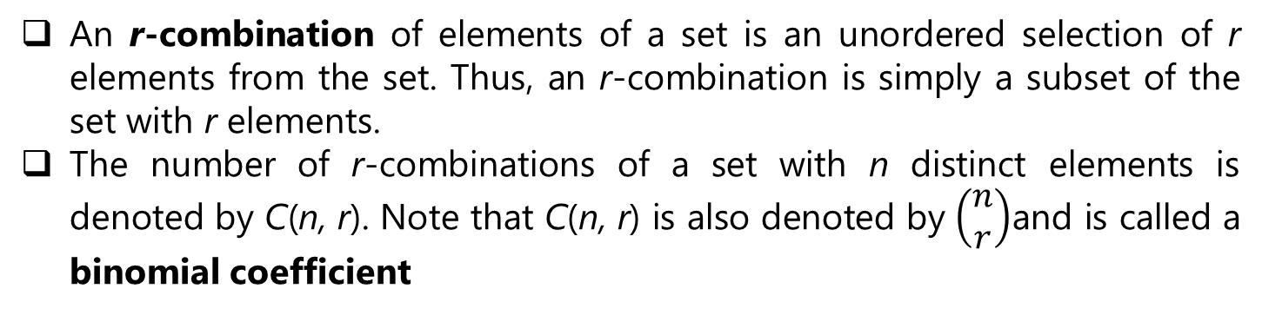
Combinations
An r-combination of elements of a set is an unordered selection of r elements from the set. Thus, an r-combination is simply a subset of the set with r elements.
The number of r-combinations of a set with n distinct elements is denoted by C(n, r). Note that C(n, r) is also denoted by $\left(\begin{aligned}n \\ r\end{aligned}\right)$and is called a binomial coefficient
Theorem 2
The number of r-combinations of a set with n elements, where n is a nonnegative integer and r is an integer with 0 ≤ r ≤ n, equals
C(n, r) = n!
r! (n − r)! .

Slide 29
Combinations
Corollary 2
Let n and r be nonnegative integers with r ≤ n. Then C(n, r) = C(n, n − r).
Proof:
From Theorem 2 it follows that
C(n, r) = n!
r! (n − r)!
and
C(n, n − r) = n!
(n − r)! [n − (n − r)]!
= n!
(n − r)! r!.
Hence, C(n, r) = C(n, n − r).

Slide 30
Combinations
Example 1 :
A group of 30 people have been trained as astronauts to go on the first mission to Mars. How many ways are there to select a crew of six people to go on this mission (assuming that all crew members have the same job)?
Solution:
The number of ways to select a crew of six from the pool of 30 people is the number of 6-combinations of a set with 30 elements, The number of such combinations is
C(30, 6) = 30!
6! 24!
= 30 ⋅ 29 ⋅ 28 ⋅ 27 ⋅ 26 ⋅ 25 . 6 ⋅ 5 ⋅ 4 ⋅ 3 ⋅ 2 ⋅ 1
= 593,775.

Slide 31
Combinations
Example Suppose that there are 9 faculty members in the mathematics department and 11 in the computer science department. How many ways are there to select a committee to develop a discrete mathematics course at a school if the committee is to consist of three faculty members from the mathematics department and four from the computer science department?
Solution:
The answer is the product of the number of 3-combinations of a set with nine elements and the number of 4-combinations of a set with 11 elements, the number of ways to select the committee is
C(9, 3) ⋅ C(11, 4) = 9! ⋅ 11!
3!6! 4!7!
= 84 ⋅ 330 = 27,720.

Slide 32
Combinations with Repetition
Example combinations with repetition of elements allowed.
How many ways are there to select four pieces of fruit from a bowl containing apples, oranges, and pears if the order in which the pieces are selected does not matter, only the type of fruit and not the individual piece matters, and there are at least four pieces of each type of fruit in the bowl?
Solution:
To solve this problem we list all the ways possible to select the fruit. There are 15 ways:
4 apples 4 oranges 4 pears
3 apples, 1 orange 3 apples, 1 pear 3 oranges, 1 apple
3 oranges, 1 pear 3 pears, 1 apple 3 pears, 1 orange
2 apples, 2 oranges 2 apples, 2 pears 2 oranges, 2 pears
2 apples, 1orange, 1pear 2 oranges, 1 apple, 1 pear 2 pears, 1 apple, 1 orange
The solution is the number of 4-combinations with repetition allowed from a three-element set, {apple, orange, pear}.

Slide 33
Combinations with Repetition
Theorem 2
There are C(n + r − 1, r) = C(n + r − 1, n − 1) r-combinations from a set with n elements when repetition of elements is allowed.
Example :
Suppose that a cookie shop has four different kinds of cookies. How many different ways can six cookies be chosen? Assume that only the type of cookie, and not the individual cookies or the order in which they are chosen, matters.
Solution:
C(4 + 6 − 1, 6) = C(9, 6). Because
C(9, 6) = C(9, 3) = 9 ⋅ 8 ⋅ 7
1 ⋅ 2 ⋅ 3
= 84,
there are 84 different ways to choose the six cookies.

Slide 34
Combinations and Permutations With and Without Repetition.

Slide 35
Permutations with Indistinguishable Objects
Example :
How many different strings can be made by reordering the letters of the word SUCCESS?
Solution:
Because some of the letters of SUCCESS are the same, the answer is not given by the number of permutations of seven letters. This word contains three Ss, two Cs, one U, and one E.
Consequently, from the product rule, the number of different strings that can be made is
C(7, 3)C(4, 2)C(2, 1)C(1, 1) = 7! ⋅ 4! . 2! ⋅ 1!
3! 4! 2! 2! 1! 1! 1! 0!
= 7!
3! 2! 1! 1!
= 420.

Slide 36
Permutations with Indistinguishable Objects
THEOREM
The number of different permutations of n objects, where there are n1 indistinguishable objects of type 1, n2 indistinguishable objects of type 2,…, and nk indistinguishable objects of type k, is
n!
n1! n2!⋯nk!

Slide 37
Distributing Objects Into Boxes

Slide 38
Distinguishable Objects And Distinguishable Boxes
Example :
How many ways are there to distribute hands of 5 cards to each of four players from the standard deck of 52 cards?
Solution:
The first player can be dealt 5 cards in C(52, 5) ways.
The second player can be dealt 5 cards in C(47, 5) ways, because only 47 cards are left.
The third player can be dealt 5 cards in C(42, 5) ways.
Finally, the fourth player can be dealt 5 cards in C(37, 5) ways.
Hence, the total number of ways to deal four players 5 cards each is
C(52, 5)C(47, 5)C(42, 5)C(37, 5) = 52! ⋅ 47! ⋅ 42! 37!
47! 5! 42! 5! 37! 5! ⋅ 32! 5!
= 52!
5! 5! 5! 5! 32! .

Slide 39
Indistinguishable Objects And Distinguishable Boxes
Example :
How many ways are there to place 10 indistinguishable balls into eight distinguishable bins?
Solution:
The number of ways to place 10 indistinguishable balls into eight bins equals the number of 10-combinations from a set with eight elements when repetition is allowed.
Consequently, there are
C(8 + 10 − 1, 10) = C(17, 10) = 17!
10!7!
= 19,448.

Slide 40
Indistinguishable Objects And Indistinguishable Boxes
Example :
How many ways are there to pack six copies of the same book into four identical boxes, where a box can contain as many as six books?
Solution:
For each way to pack the books, we will list the number of books in the box with the largest number of books, followed by the numbers of books in each box containing at least one book, in order of decreasing number of books in a box. The ways we can pack the books are
6
5, 1
4, 2
4, 1, 1
3, 3
We conclude that there are nine allowable ways to pack the books
3, 2, 1
3, 1, 1, 1
2, 2, 2
2, 2, 1, 1.

Slide 41
Binomial Coefficients and Identities

Slide 42
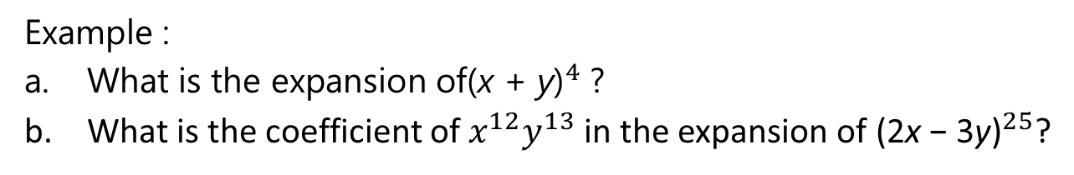
The Binomial Theorem
THEOREM 1
The binomial theorem . Let x and y be variables, and let n be a nonnegative integer. Then
Example :
What is the expansion of${\text{(}\text{x} \text{+ }\text{y}\text{)}}^{4}$ ?
What is the coefficient of $x^{12}y^{13}$ in the expansion of ${\text{(2}\text{x} \text{− 3}\text{y}\text{)}}^{25}$?

Slide 43
The Binomial Theorem
Solution:
a. From the binomial theorem it follows that

Slide 44

The Binomial Theorem
Solution :
b. By the binomial theorem, we Have
Consequently, the coefficient of $x^{12}y^{13}$ in the expansion is obtained when j = 13, namely,

Slide 45
The Binomial Theorem
Corollary 1
Let n be a nonnegative integer. Then
Corollary 2
Let n be a positive integer. Then
Corollary 3
Let n be a nonnegative integer. Then

Slide 46
Pascal’s Identity and Triangle
Theorem 2
Pascal’s Identity . Let n and k be positive integers with n ≥ k. Then
Pascal’s identity is the basis for a geometric arrangement of the binomial coefficients in a triangle. The nth row in the triangle consists of the binomial coefficients
This triangle is known as Pascal’s triangle, named after the French mathematician Blaise Pascal

Slide 47
Pascal’s triangle

Slide 48
Reference
Kenneth H. Rosen, “ Discrete Mathematics and its Applications”, 8th edition,219, McGraw-Hill Education, New York, ISBN 978-1-259-67651-2

