Slide 1
MATH6077 – Discrete Mathematics
Week 04 - Set Theory and Function

Slide 2
Sets
Sets are used to group objects together
Often, but not always, the objects in a set have similar properties
It is common for sets to be denoted using uppercase letters. Lowercase letters are usually used to denote elements of sets.
Definition 1
A set is an unordered collection of distinct objects, called elements or members of the set. A set is said to contain its elements. We write a ∈ A to denote that a is an element of the set A. The notation a ∉ A denotes that a is not an element of the set A.

Slide 3
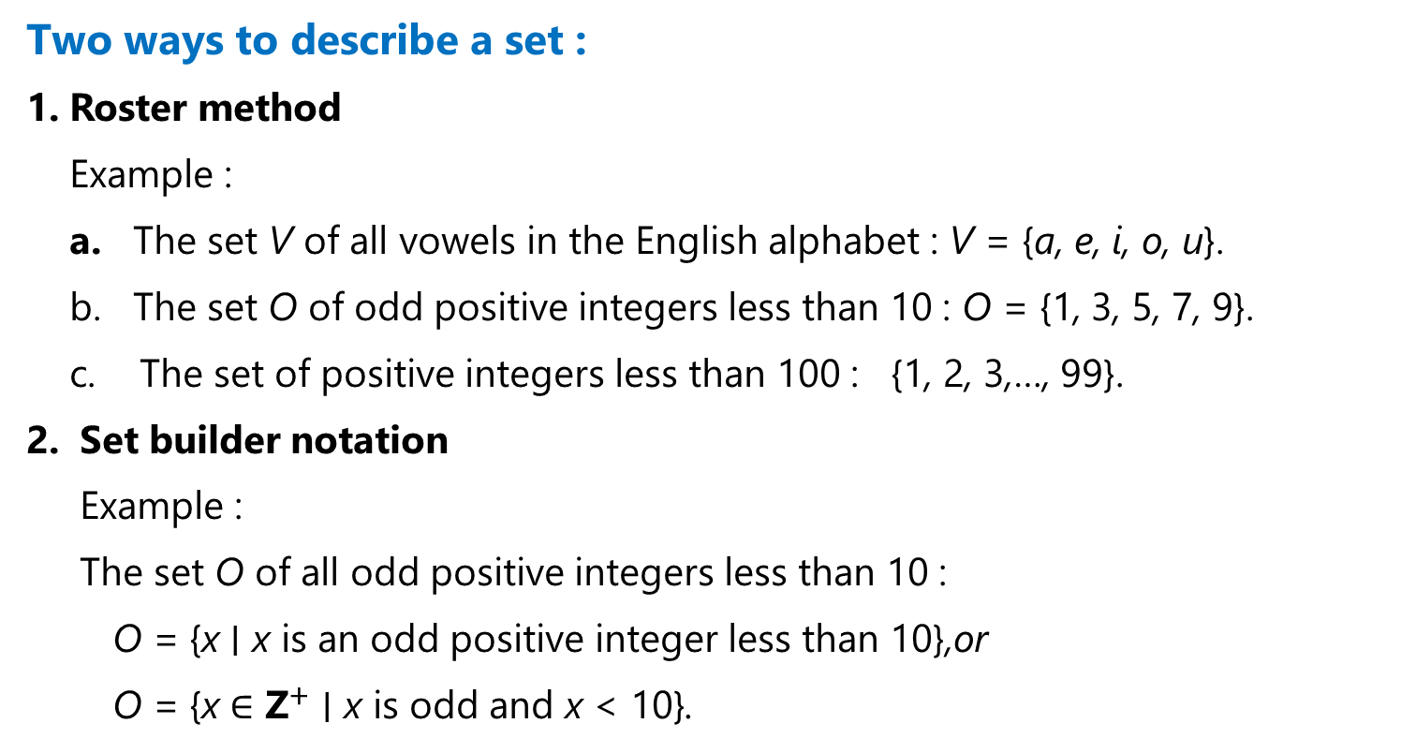
Sets
Two ways to describe a set :
Roster method
Example :
The set V of all vowels in the English alphabet : V = {a, e, i, o, u}.
b. The set O of odd positive integers less than 10 : O = {1, 3, 5, 7, 9}.
The set of positive integers less than 100 : {1, 2, 3,…, 99}.
Set builder notation
Example :
The set O of all odd positive integers less than 10 :
O = {x ∣ x is an odd positive integer less than 10},or
O = {x ∈ ${\text{Z}}^{+}$ ∣ x is odd and x < 10}.

Slide 4
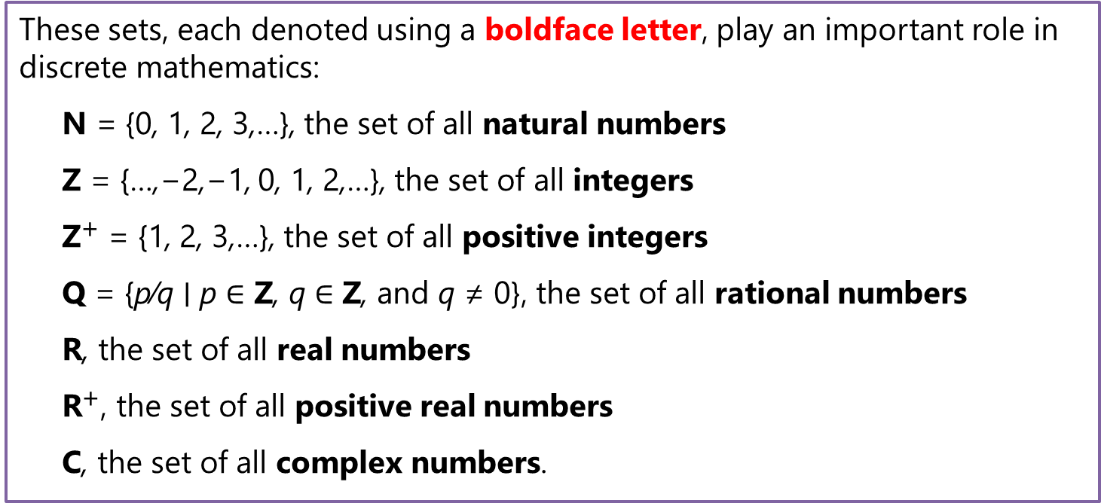
Sets
These sets, each denoted using a boldface letter, play an important role in discrete mathematics:
N = {0, 1, 2, 3,…}, the set of all natural numbers
Z = {…,−2,−1, 0, 1, 2,…}, the set of all integers
${\text{Z}}^{+}$ = {1, 2, 3,…}, the set of all positive integers
Q = {p∕q ∣ p ∈ Z, q ∈ Z, and q ≠ 0}, the set of all rational numbers
R, the set of all real numbers
${\text{R}}^{+}$, the set of all positive real numbers
C, the set of all complex numbers.

Slide 5
Equality of 2 Sets
Definition :
Two sets are equal if and only if they have the same elements. Therefore, if A and B are sets, then A and B are equal if and only if ∀x(x ∈ A ↔ x ∈ B). We write A = B if A and B are equal sets.
Example :
The sets {1, 3, 5} = {3, 5, 1} = {1, 3, 3, 3, 5, 5, 5, 5}

Slide 6
The Empty Set
Empty Set or null set : a special set that has no elements and is denoted by ∅ or by { }
A set with one element is called a singleton set.
Example :
A= {∅} has one more element than ∅.
In a computer file system, the empty set can be thought of as an empty folder and the set consisting of just the empty set can be thought of as a folder with exactly one folder inside, namely, the empty folder.

Slide 7

Venn Diagrams

Slide 8
Subsets
Definition :
The set A is a subset of B, and B is a superset of A, if and only if every element of A is also an element of B.We use the notation A ⊆ B to indicate that A is a subset of the set B. If, instead, we want to stress that B is a superset of A, we use the equivalent notation B ⊇ A. (So, A ⊆ B and B ⊇ A are equivalent statements.)
A ⊆ B if and only if the quantification
∀x(x ∈ A → x ∈ B) is true.
To show that A is not a subset of B we need only find one element x ∈ A with x ∉ B. Such an x is a counterexample to the claim that x ∈ A implies x ∈ B.

Slide 9
Subsets
Venn Diagram A is a subset of B.
Theorem
For every set S,
(i ) ∅ ⊆ S and
(ii ) S ⊆ S.
A is a proper subset of B if a set A is a subset of a set B but that A ≠ B, we write A ⊂ B.
For A ⊂ B to be true, it must be the case that A ⊆ B and there must exist an element x of B that is not an element of A

Slide 10
Subsets
Definition :
Showing Two Sets are Equal To show that two sets A and B are equal, show that A ⊆ B and B ⊆ A.
Example :
A = {∅, {a}, {b}, {a, b}} and
B = {x ∣ x is a subset of the set {a, b}}.
These two sets are equal, that is, A = B.
Note that {a} ∈ A, but a ∉ A.

Slide 11
The Size of a Set
Definition
Let S be a set. If there are exactly n distinct elements in S where n is a nonnegative integer, we say that S is a finite set and that n is the cardinality of S. The cardinality of S is denoted by |S|.
Example :
1. Let A be the set of odd positive integers less than 10. Then |A| = 5.
2. Let S be the set of letters in the English alphabet. Then |S| = 26.
3. The null set has no elements, it follows that |∅| = 0.
4. B ={1, 3, 3, 3, 5, 5, 5, 5} , then |B| = 3
5. The set of positive integers is infinite

Slide 12
Power Sets
Definition
Given a set S, the power set of S is the set of all subsets of the set S. The power set of S is denoted by P(S).
If a set has n elements, then its power set has $2^{n}$ elements
Example :
What is the power set of the :
a. Set {0, 1, 2}
b. Empty set?
c. Set {∅}?

Slide 13
Power Sets
Solution:
a. The power set P{0,1,2} = {∅, {0}, {1}, {2}, {0, 1}, {0, 2}, {1, 2}, {0, 1, 2}}.
(The empty set and the set itself are members of this set of subsets)
b. The empty set has exactly one subset, namely, itself. Consequently,
P(∅) = {∅}.
c. The set {∅} has exactly two subsets, namely, ∅ and the set {∅} itself.
Therefore, ({∅}) = {∅, {∅}}.

Slide 14
Cartesian Products
Definition
The ordered n-tuple (a1, a2,…, an) is the ordered collection that has a1 as its first element, a2 as its second element,…, and an as its nth element.
Let A and B be sets. The Cartesian product of A and B, denoted by A × B, is the set of all ordered pairs (a, b), where a ∈ A and b ∈ B. Hence,
A × B = {(a, b) ∣ a ∈ A ∧ b ∈ B}.
Example :
What is the Cartesian product of A = {1, 2} and B = {a, b, c}?
Solution:
A × B = {(1, a), (1, b), (1, c), (2, a), (2, b), (2, c)}.
B × A = {(a, 1), (a, 2), (b, 1), (b, 2), (c, 1), (c, 2)}.

Slide 15
Cartesian Products
Definition:
The Cartesian product of the sets A1, A2,…, An, denoted by
A1 × A2 ×⋯× An, is the set of ordered n-tuples (a1, a2,…, an),
where ai belongs to Ai for i = 1, 2,…, n. In other words,
A1 × A2 ×⋯× An = {(a1, a2,…, an) ∣ ai ∈ Ai for i = 1, 2,…, n}.
Example :
What is the Cartesian product A ×B ×C, where A = {0, 1}, B = {1, 2}, and
C = {0, 1, 2}?
Solution:
The Cartesian product A × B × C consists of all ordered triples (a, b, c), where a ∈ A,b ∈ B, and c ∈ C. Hence,
A×B ×C = {(0, 1, 0), (0, 1, 1), (0, 1, 2), (0, 2, 0), (0, 2, 1), (0, 2, 2),
(1, 1, 0), (1, 1, 1), (1, 1, 2), (1, 2, 0), (1, 2, 1), (1, 2, 2)}.

Slide 16
Set Operations

Slide 17
Set Operations
Union
Definition :
Let A and B be sets. The union of the sets A and B, denoted by A ∪ B, is the set that contains those elements that are either in A or in B, or in both.
Venn diagram of the union of A and B.
A ∪ B = {x ∣ x ∈ A ∨ x ∈ B}.
Example :
A = {1, 3, 5} and B = {1, 2, 3} A ∪ B= {1, 2, 3, 5}.

Slide 18
Set Operations
2. Intersection
Definition :
Let A and B be sets. The intersection of the sets A and B, denoted by A ∩ B, is the set containing those elements in both A and B.
Venn diagram of the intersection of A and B.
A ∩ B = {x ∣ x ∈ A ∧ x ∈ B}.
Example :
A = {1, 3, 5} and B = {1, 2, 3} A ∪ B= {1, 3,}.

Slide 19
Set Operations
3. Disjoint
Definition :
Two sets are called disjoint if their intersection is the empty set
Example :
Let A = {1, 3, 5, 7, 9} and B = {2, 4, 6, 8, 10}. Because A ∩ B = ∅,
A and B are disjoint
B
A

Slide 20
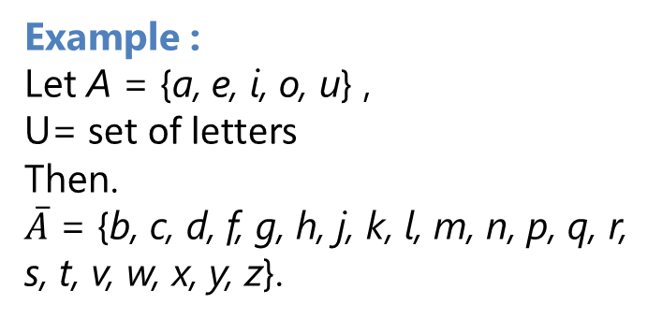
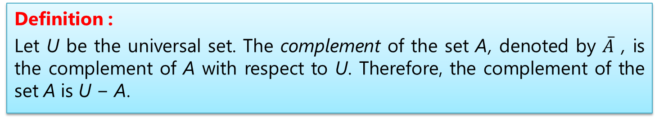
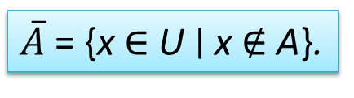
Set Operations
4. Complement
Definition :
Let U be the universal set. The complement of the set A, denoted by $\overline{A}$ , is the complement of A with respect to U. Therefore, the complement of the set A is U − A.
Venn diagram for the complement of the set A
$\overline{A}$ = {x ∈ U ∣ x ∉ A}.
Example :
Let A = {a, e, i, o, u} ,
U= set of letters
Then.
$\overline{A}$ = {b, c, d, f, g, h, j, k, l, m, n, p, q, r, s, t, v, w, x, y, z}.

Slide 21
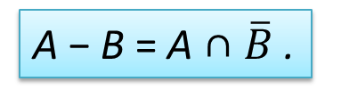
Set Operations
5. Difference
Definition :
Let A and B be sets. The difference of A and B, denoted by A − B, is the set containing those elements that are in A but not in B. The difference of A and B is also called the complement of B with respect to A.
Venn diagram for the difference of A and B.
A − B = {x ∣ x ∈ A ∧ x ∉ B}.
A − B = A ∩ $\overline{B}$ .
Example :
A = {1, 3, 5} and B = {1, 2, 3} A - B= {5}.
B - A ={ 2}

Slide 22
Set Identities.

Slide 23
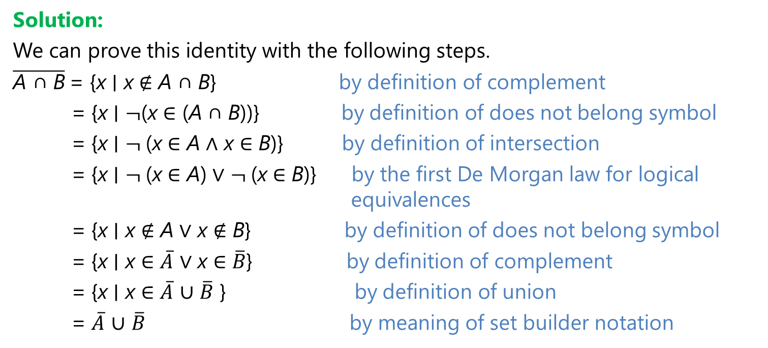
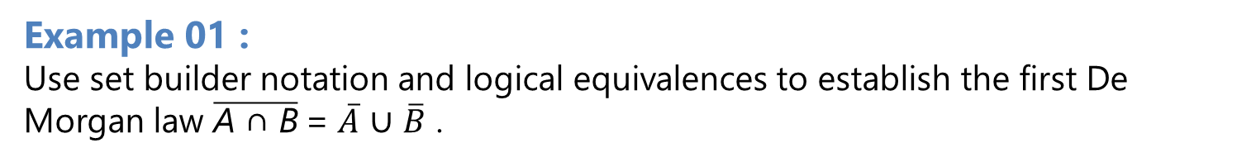
Set Identities
Example 01 :
Use set builder notation and logical equivalences to establish the first De Morgan law $\overline{\text{A} \text{∩ }\text{B}}$= $\overline{A}$ ∪ $\overline{B}$ .
Solution:
We can prove this identity with the following steps.
$\overline{\text{A} \text{∩ }\text{B}}$= {x ∣ x ∉ A ∩ B} by definition of complement
= {x ∣ $¬$(x ∈ (A ∩ B))} by definition of does not belong symbol
= {x ∣ $¬$(x ∈ A ∧ x ∈ B)} by definition of intersection
= {x ∣ $¬$(x ∈ A) ∨ $¬$(x ∈ B)} by the first De Morgan law for logical equivalences
= {x ∣ x ∉ A ∨ x ∉ B} by definition of does not belong symbol
= {x ∣ x ∈ $\overline{A}$ ∨ x ∈ $\overline{B}$} by definition of complement
= {x ∣ x ∈ $\overline{A}$ ∪ $\overline{B}$ } by definition of union
= $\overline{A}$ ∪ $\overline{B}$ by meaning of set builder notation

Slide 24
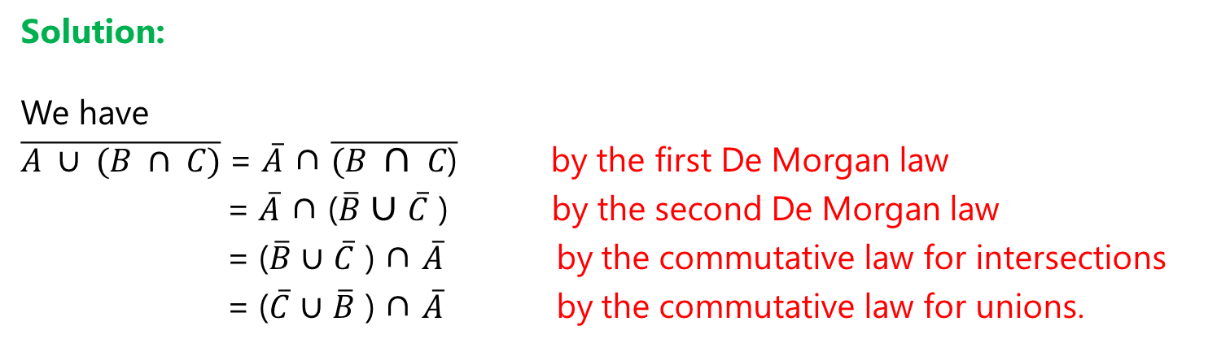
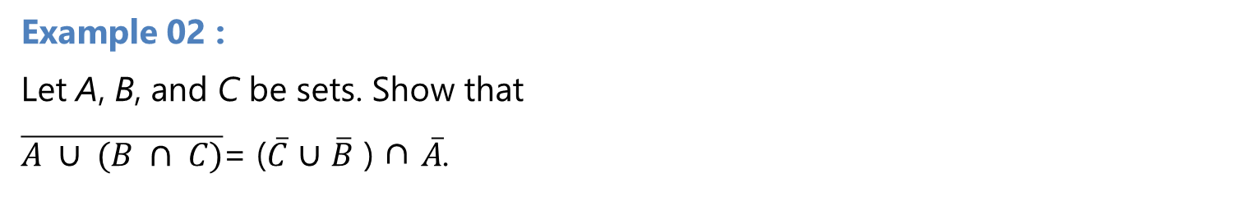
Set Identities
Example 02 :
Let A, B, and C be sets. Show that
$\overline{A ∪ (B ∩ C)}$= ($\overline{C}$ ∪ $\overline{B}$ ) ∩ $\overline{A}$.
Solution:
We have
$\overline{A ∪ (B ∩ C)}$= $\overline{A}$ ∩ $\overline{(B ∩ C\text{)}}$ by the first De Morgan law
= $\overline{A}$ ∩ ($\overline{B}$ ∪ $\overline{C}$ ) by the second De Morgan law
= ($\overline{B}$ ∪ $\overline{C}$ ) ∩ $\overline{A}$ by the commutative law for intersections
= ($\overline{C}$ ∪ $\overline{B}$ ) ∩ $\overline{A}$ by the commutative law for unions.

Slide 25
Computer Representation of Sets
Specify an arbitrary ordering of the elements of U, for instance a1, a2,…, an. Represent a subset A of U with the bit string of length n, where the ith bit in this string is 1 if ai belongs to A and is 0 if ai does not belong to A.
Example 01:
Let U = {1, 2, 3, 4, 5, 6, 7, 8, 9, 10}, and the ordering of elements of U has the elements in increasing order; that is, ai = i.
What bit strings represent the subset of all odd integers in U,
What the subset of all even integers in U, and
What the subset of integers not exceeding 5 in U?

Slide 26
Computer Representation of Sets
Solution:
The bit string that represents the set of odd integers in U, namely,
{1, 3, 5, 7, 9}, has a one bit in the first, third, fifth, seventh, and ninth positions, and a zero elsewhere. It is
10 1010 1010.
b. The subset of all even integers in U, namely, {2, 4, 6, 8, 10}, by the string 01 0101 0101.
The set of all integers in U that do not exceed 5, namely, {1, 2, 3, 4, 5}, is represented by the string
11 1110 0000.

Slide 27
Computer Representation of Sets
Example 02 :
The bit strings for the sets {1, 2, 3, 4, 5} and {1, 3, 5, 7, 9} are 11 1110 0000 and 10 1010 1010, respectively. Use bit strings to find the union and intersection of these sets.
Solution:
The bit string for the union of these sets is
11 1110 0000 ∨ 10 1010 1010 = 11 1110 1010,
which corresponds to the set {1, 2, 3, 4, 5, 7, 9}.
The bit string for the intersection of these sets is
11 1110 0000 ∧ 10 1010 1010 = 10 1010 0000,
which corresponds to the set {1, 3, 5}.

Slide 28
Functions

Slide 29
Function
Definition 1 :
Let A and B be nonempty sets. A function f from A to B is an assignment of exactly one element of B to each element of A. We write f (a) = b if b is the unique element of B assigned by the function f to the element a of A. If f is a function from A to B, we write f : A → B.
Definition 2
If f is a function from A to B, we say that A is the domain of f and B is the codomain of f. If f (a) = b, we say that b is the image of a and a is a preimage of b. The range, or image, of f is the set of all images of elements of A. Also, if f is a function from A to B, we say that f maps A to B.

Slide 30
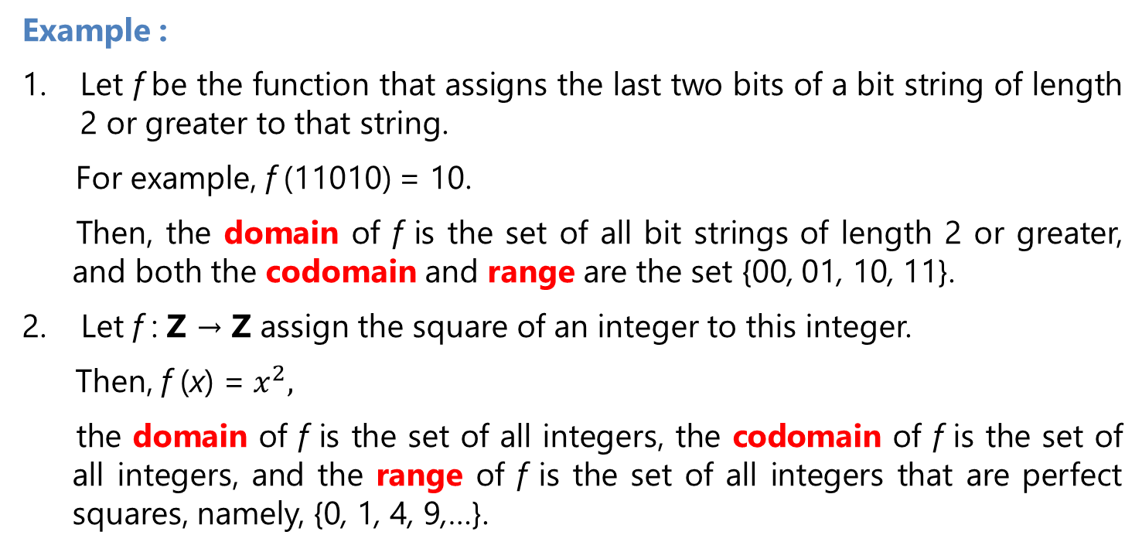
Function
Example :
Let f be the function that assigns the last two bits of a bit string of length 2 or greater to that string.
For example, f (11010) = 10.
Then, the domain of f is the set of all bit strings of length 2 or greater, and both the codomain and range are the set {00, 01, 10, 11}.
Let f : Z → Z assign the square of an integer to this integer.
Then, f (x) = $x^{2},$
the domain of f is the set of all integers, the codomain of f is the set of all integers, and the range of f is the set of all integers that are perfect squares, namely, {0, 1, 4, 9,…}.

Slide 31
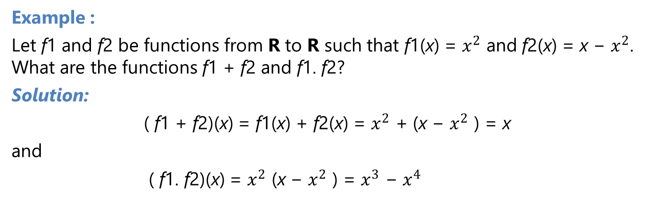
Function
Definition :
Let f1 and f2 be functions from A to R. Then f1+f2 and f1.f2 are also functions from A to R defined for all x ∈ A by
( f1 + f2)(x) = f1(x) + f2(x)
( f1f2)(x) = f1(x)f2(x).
Example :
Let f1 and f2 be functions from R to R such that f1(x) = $x^{2}$ and f2(x) = x − $x^{2}$. What are the functions f1 + f2 and f1. f2?
Solution:
( f1 + f2)(x) = f1(x) + f2(x) = $x^{2}$ + (x − $x^{2}$ ) = x
and
( f1. f2)(x) = $x^{2}$ (x − $x^{2}$ ) = $x^{3}$ − $x^{4}$

Slide 32
One-to-One and Onto Functions

Slide 33
One-to-One Functions
Definition
A function f is said to be one-to-one, or an injection, if and only if f(a) = f(b) implies that a = b for all a and b in the domain of f. A function is said to be injective if it is one-to-one.
Example 01 :
Determine whether the function f from {a, b, c, d} to {1, 2, 3, 4, 5} with f (a) = 4, f (b) = 5,
f (c) = 1, and f (d) = 3 is one-to-one.
Solution:
The function f is one-to-one because f takes on different values at the four elements
of its domain.

Slide 34
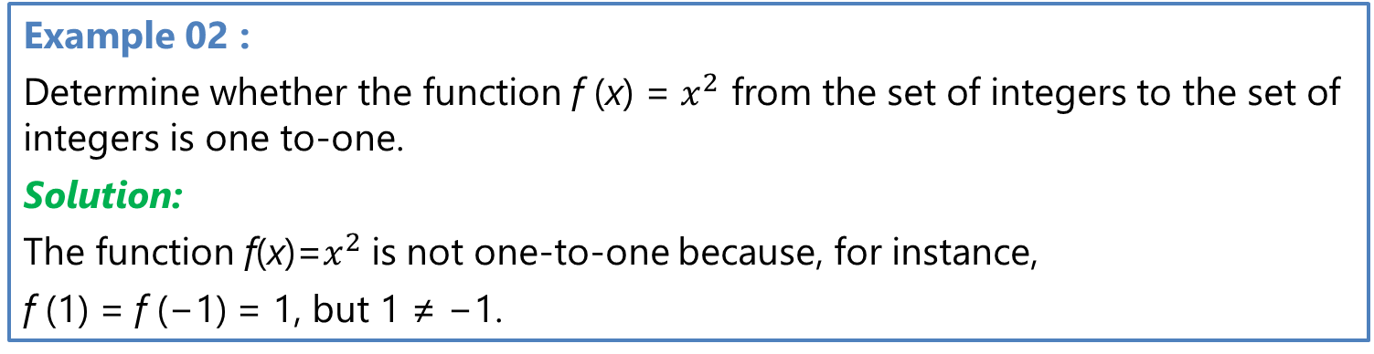
One-to-One Functions
Example 02 :
Determine whether the function f (x) = $x^{2}$ from the set of integers to the set of integers is one to-one.
Solution:
The function f(x)=$x^{2}$is not one-to-one because, for instance,
f (1) = f (−1) = 1, but 1 ≠ −1.
Example 03 :
Determine whether the function f (x) = x+1 from the set of real numbers to it self is one-to-one.
Solution:
Suppose that x and y are real numbers with
f(x) = f(y),
so that x + 1 = y + 1.
This means that x = y.
Hence, f (x) = x + 1 is a one-to-one function from R to R.

Slide 35
Onto Functions
Definition :
A function f from A to B is called onto, or a surjection, if and only if for every element b ∈ B there is an element a ∈ A with f (a) = b. A function f is called surjective if it is onto.
Example :
Let f be the function from {a, b, c, d} to {1, 2, 3} defined by f (a) = 3, f (b) = 2, f (c) = 1, and f (d) = 3. Is f an onto function?
Solution:
Because all three elements of the codomain are images of elements in the domain, we see that f is onto.

Slide 36
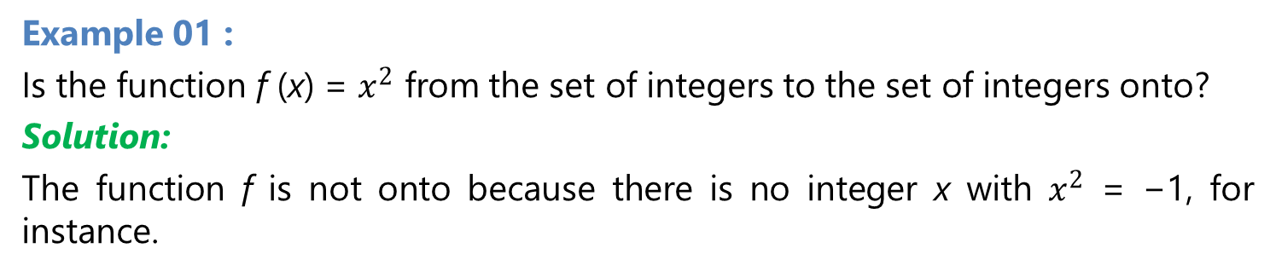
Onto Functions
Example 01 :
Is the function f (x) = $x^{2}$ from the set of integers to the set of integers onto?
Solution:
The function f is not onto because there is no integer x with $x^{2}$ = −1, for instance.
Example 02 :
Is the function f (x) = x + 1 from the set of integers to the set of integers onto?
Solution:
This function is onto, because for every integer y there is an integer x such that f(x) = y
if and only if x + 1 = y,
x = y − 1.
(Note that y − 1 is also an integer, and so, is in the domain of f .)

Slide 37
Onto Functions
Example 03 :
Is the function f (x) = x + 1 from the set of integers to the set of integers onto?
Solution:
This function is onto, because for every integer y there is an integer x such that f (x) = y.
if and only if x + 1 = y,
which holds if and only if x = y − 1.
(Note that y − 1 is also an integer, and so, is in the domain of f .)

Slide 38
One-to-one correspondence
Definition 8
The function f is a one-to-one correspondence, or a bijection, if it is both one-to-one and onto. We also say that such a function is bijective
Example :
Let f be the function from {a, b, c, d} to {1, 2, 3, 4} with f (a) = 4, f (b) = 2, f (c) = 1, and f (d) =3. Is f a bijection?
Solution:
f is one-to-one because no two values in the domain are assigned the same function value.
f is onto because all four elements of the codomain are images of elements in the domain.
Hence, f is a bijection.

Slide 39
Examples of different types of correspondences

Slide 40
Inverse Functions and Compositions of Functions
Floor and ceiling functions

Slide 41
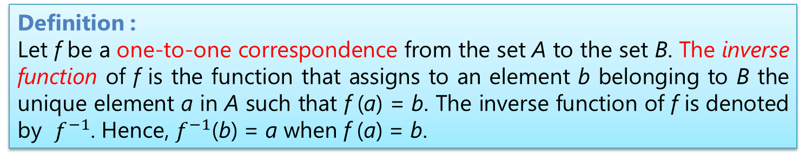
Inverse Functions and Compositions of Functions
Definition :
Let f be a one-to-one correspondence from the set A to the set B. The inverse function of f is the function that assigns to an element b belonging to B the unique element a in A such that f (a) = b. The inverse function of f is denoted by $f^{−1}$. Hence, $f^{−1}$(b) = a when f (a) = b.

Slide 42
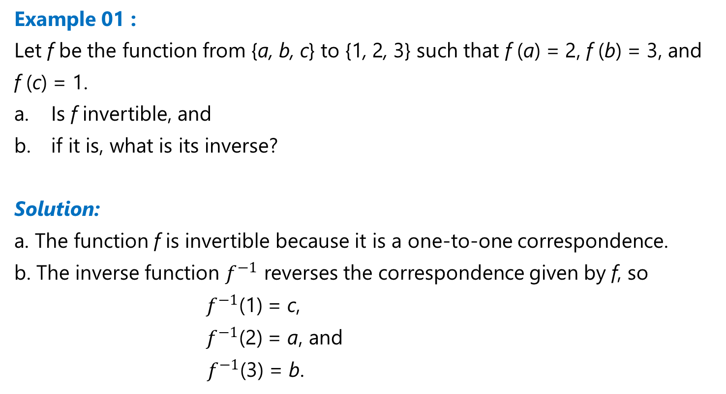
Inverse Functions and Compositions of Functions
Example 01 :
Let f be the function from {a, b, c} to {1, 2, 3} such that f (a) = 2, f (b) = 3, and
f (c) = 1.
Is f invertible, and
if it is, what is its inverse?
Solution:
a. The function f is invertible because it is a one-to-one correspondence.
b. The inverse function $f^{−1}$ reverses the correspondence given by f, so
$f^{−1}$(1) = c,
$f^{−1}$(2) = a, and
${ f}^{−1}$(3) = b.

Slide 43
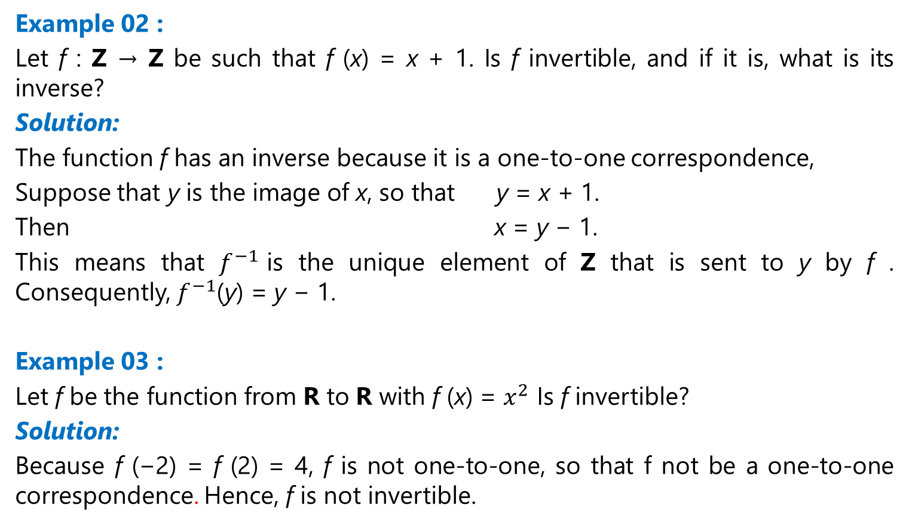
Inverse Functions and Compositions of Functions
Example 02 :
Let f : Z → Z be such that f (x) = x + 1. Is f invertible, and if it is, what is its inverse?
Solution:
The function f has an inverse because it is a one-to-one correspondence,
Suppose that y is the image of x, so that y = x + 1.
Then x = y − 1.
This means that $f^{−1}$is the unique element of Z that is sent to y by f . Consequently, $f^{−1}$(y) = y − 1.
Example 03 :
Let f be the function from R to R with f (x) = $x^{2}$ Is f invertible?
Solution:
Because f (−2) = f (2) = 4, f is not one-to-one, so that f not be a one-to-one correspondence. Hence, f is not invertible.

Slide 44
Composition of Function
Definition :
Let g be a function from the set A to the set B and let f be a function from the set B to the set C. The composition of the functions f and g, denoted for all a ∈ A by f o g, is the function from A to C defined by
( f og)(a) = f (g(a)).

Slide 45
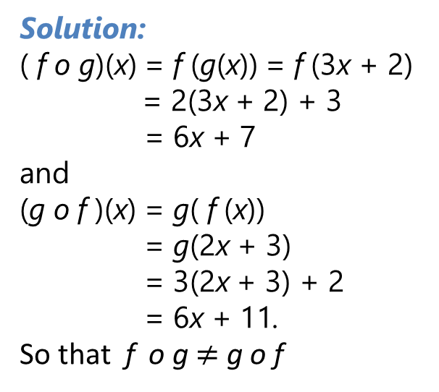
Composition of Function
Example 01 :
Let f and g be the functions from the set of integers to the set of integers defined by f (x) = 2x + 3 and g(x) = 3x + 2. What is the composition of f and g? What is the composition of g and f ?
Solution:
( f o g)(x) = f (g(x)) = f (3x + 2) = 2(3x + 2) + 3
= 6x + 7
and
(g o f )(x) = g( f (x))
= g(2x + 3)
= 3(2x + 3) + 2
= 6x + 11.
So that f o g $≠$ g o f

Slide 46
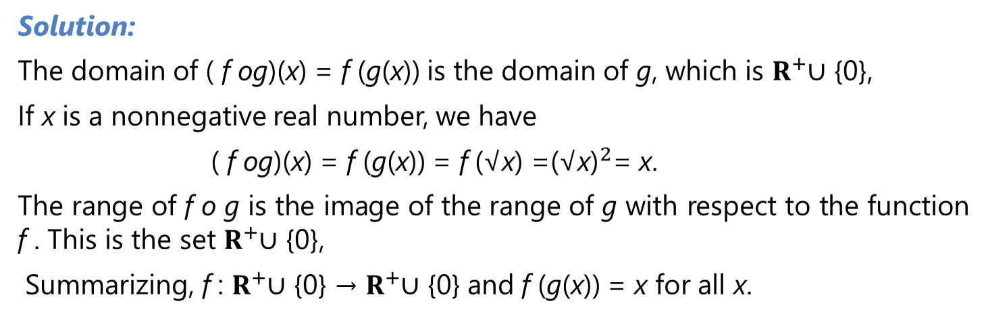
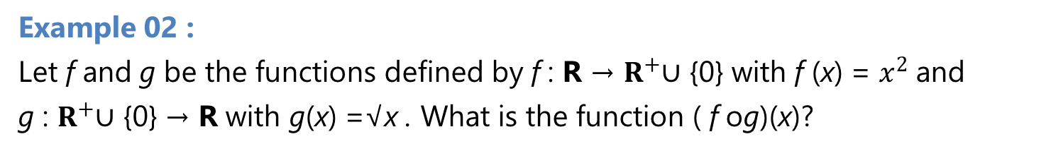
Composition of Function
Example 02 :
Let f and g be the functions defined by f : R → $R^{+}$∪ {0} with f (x) = $x^{2}$and
g : $R^{+}$∪ {0} → R with g(x) =√x . What is the function ( f og)(x)?
Solution:
The domain of ( f og)(x) = f (g(x)) is the domain of g, which is $R^{+}$∪ {0},
If x is a nonnegative real number, we have
( f og)(x) = f (g(x)) = f (√x) =${\text{(√}\text{x}\text{)}}^{2}$= x.
The range of f o g is the image of the range of g with respect to the function f . This is the set $R^{+}$∪ {0},
Summarizing, f : $R^{+}$∪ {0} → $R^{+}$∪ {0} and f (g(x)) = x for all x.

Slide 47
Floor and Ceiling Functions
Definition :
The floor function assigns to the real number x the largest integer that is less than or equal to x. The value of the floor function at x is denoted by ⌊x⌋. The ceiling function assigns to the real number x the smallest integer that is greater than or equal to x. The value of the ceiling function at x is denoted by ⌈x⌉.
Floor Function
Ceiling Function

Slide 48
Floor and Ceiling Functions
Example 01:
These are some values of the floor and ceiling functions:
⌊1/2⌋ = 0, ⌈1/2⌉ = 1, ⌊−1/2⌋ = −1, ⌈−1/2⌉ = 0, ⌊3.1⌋ = 3, ⌈3.1⌉ = 4, ⌊7⌋ = 7, ⌈7⌉ = 7.
Example 02:
Data stored on a computer disk or transmitted over a data network are usually represented as a string of bytes. Each byte is made up of 8 bits. How many bytes are required to encode 100 bits of data?
Solution:
To determine the number of bytes needed, we determine the smallest integer that is at least as large as the quotient when 100 is divided by 8, the number of bits in a byte.
Consequently, ⌈100 ∕8⌉ = ⌈12.5⌉ = 13 bytes are required

Slide 49
Definition of fuzzy set

Slide 50
Fuzzy Set
Fuzzy Set Theory was formalized by Professor Lofti Zadeh at the University of California in 1965.
What Zadeh proposed is very much a paradigm shift that first gained acceptance in the Far East and its successful application has ensured its adoption around the world.

Slide 51
Fuzzy Sets
Formal definition:
A fuzzy set A in X is expressed as a set of ordered pairs:
1.0
1.0
.9
.5
5’10’’
5’10’’
6’2’’
Crisp set A
Heights
Fuzzy set A
Heights
Notes:
A fuzzy set is a set with fuzzy boundary. Suppose that A is the set of tall people. In a conventional set, or crisp set, an element is either belong to not belong to a set; there nothing in between. Therefore to define a crisp set A, we need to find a number, say, 5??, such that for a person taller than this number, he or she is in the set of tall people. For a fuzzy version of set A, we allow the degree of belonging to vary between 0 and 1. Therefore for a person with height 5??, we can say that he or she is tall to the degree of 0.5. And for a 6-foot-high person, he or she is tall to the degree of .9. So everything is a matter of degree in fuzzy sets. If we plot the degree of belonging w.r.t. heights, the curve is called a membership function. Because of its smooth transition, a fuzzy set is a better representation of our mental model of all? Moreover, if a fuzzy set has a step-function-like membership function, it reduces to the common crisp set.

Slide 52
Alternative Notation
A fuzzy set A can be alternatively denoted as follows:
X is discrete
X is continuous
Note that S and integral signs stand for the union of membership grades; “/” stands for a marker and does not imply division.

Slide 53
PROPERTIES fuzzy set

Slide 54
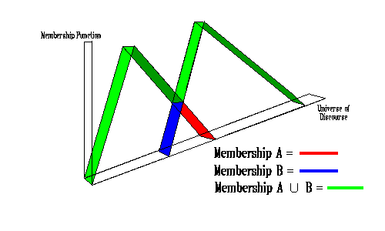
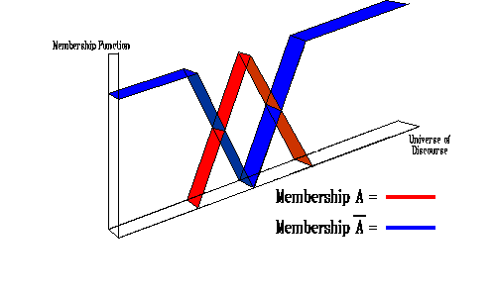
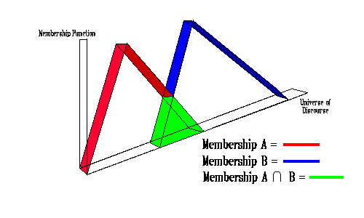
Operations of Fuzzy Set (1/2)
Union :
μ_{A∪B}(x) = max(μ_{A}(x),μ_{B}(x))
Intersection:
μ_{A∩B}(x) = min(μ_{A}(x),μ_{B}(x))
Complement:
μ_{not A}(x) = 1-μ_{A}(x))

Slide 55
Operations of Fuzzy Set (2/2)
Fuzzy set A is equal to fuzzy set B if
Fuzzy set A is subset of fuzzy set B

Slide 56

Support
The support of a fuzzy set A in the universe of discourse U is a crisp set that contains all the elements of U that have nonzero membership values in A
If the support of a fuzzy set is empty it is called and empty fuzzy set

Slide 57

Alpha - Cut
An α-cut of a fuzzy set A is a crisp set Aα that contains all the elements in U that have membership values in A greater than or equal to α

Slide 58
Cardinality
A fuzzy set A in X has cardinality

Slide 59
Example: Discrete Fuzzy Set (1/2)
(usia)
x
(x)
(x)
(x)
(x)
5
0
0
1
0
10
0
0
1
0
20
0
0,8
0,8
0,1
30
0
1
0,5
0,2
40
0
1
0,2
0,4
50
0
1
0,1
0,6
60
0
1
0
0,8
70
0
1
0
1
80
0
1
0
1

Slide 60
Example: Discrete Fuzzy Set (2/2)
supp Tua = {20,30,40,50,60,70,80}
Muda _{0,2} = {5,10,20,30,40}
Muda _{0,8} = {5,10,20}
Muda₁ = {5,10}
|Bayi| = 0
Muda U Tua = 1/5+1/10+0,8/20+0,5/30+0,4/40
+0,6/50+0,8/60+1/70+1/80.
Muda ∩ Tua = 0,1/20+0,2/30+0,2/40+0,1/50

Slide 61
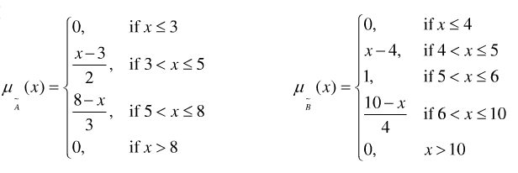
Example: Continuous Fuzzy Set (1/4)
Giving two fuzzy utilities expressed in
Draw their figures
Draw A∩B, A∪B, A^{c}, B^{c}, A^{c}∪B^{c},A^{c}∩B^{c} and support of them

Slide 62
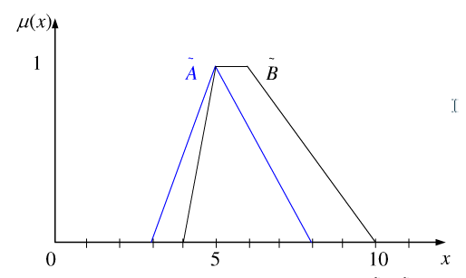
Example: Continuous
Fuzzy Set (2/4)
Supp (A∩B) = 4 < x < 8
A∩B
Supp (A) = 3 < x < 8
Supp (B) = 4 < x < 10

Slide 63
Example: Continuous
Fuzzy Set (3/4)
Supp (A∪B) = 3 < x < 10
A^{c}
B^{c}
A∪B
Supp (A^{c}) = x ≠ 5
Supp (B^{c}) = x < 5, x > 6

Slide 64
Example: Continuous
Fuzzy Set (4/4)
Supp (A^{c}∪B^{c}) = x ≠ 5
1
A^{c}∩B^{c}
A^{c}
B^{c}
1
A^{c}∪B^{c}
0
5
10
A^{c}
B^{c}
Supp (A^{c}∩B^{c}) = x < 5, x > 6
0
5
10

Slide 65
Reference
Kenneth H. Rosen, “ Discrete Mathematics and its Applications”, 8th edition,2019, McGraw-Hill Education, New York, ISBN 978-1-259-67651-2

