Slide 1
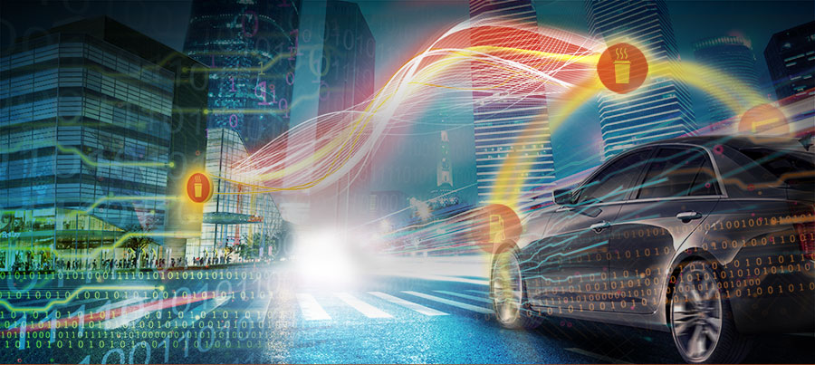
PROPOSAL KOMPETISI DIMMA 2017
INDICAR
Notes:
NOTE:
To change the image on this slide, select the picture and delete it. Then click the Pictures icon in the placeholder to insert your own image.

Slide 2
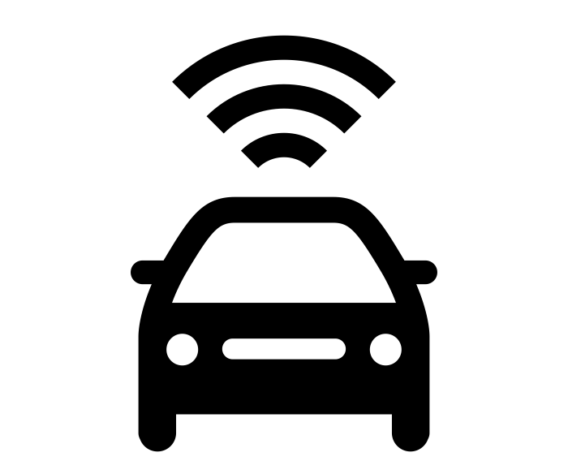

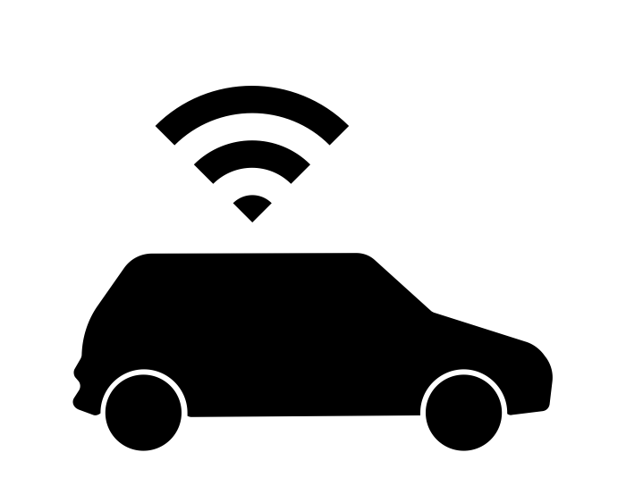
INDICAR
IndiCar is a connected car service to provide digital service platform in the car to create safety, secure, and comfort traveling experience to driver, passenger and owner.
IndiCar service is a packet data and content bundling service to fulfill the needs of application and content in the vehicle both for driver and passenger
SERVICE FEATURES
Driving
Infotainment
Connection
Diagnostic
Emergency & Security
Commerce
indiCar

Slide 3
LEAN CANVAS
Lean Canvas: IndiCar
PROBLEM | SOLUTION | UNIQUE VALUE PROPOSITION |  | UNFAIR ADVANTAGE | CUSTOMER
Driver & passenger:: Kemacetan lalu lintas Emergency Kenyamanan perjalanan Car owner: Security Komunikasi | IndiCAR service design Mobile broadband (4G) Koneksi Device joint development In car apps Partnership | Continuously maintenanced service as a data mobile broadband services from Telkomsel. Customized to customer demand, auto brand and requirement. Integrated with many Telkom’s existing service (useetv, moovigo, melon, langit musik, dll). Partnership with all stakeholder (carmaker, device manufacturer, mobile operator, content provider). |  | Huge TSel subscriber: 130M TSel subs, 30M smartphone user, Rp 100rb ARPU 4G infrastructure: Existing Media content: UseeTV, Melon, Langit Musik, Moovigo | General: • family car owner, more than private car owner. Early adopter: • car hobbies, with medium income up
 | KEY METRICS |  |  | CHANNELS
 | Prototipe IndiCAR utk kendaraan keluarga. |  |  | 3G/4G TSel
COST STRUCTURE |  |  | REVENUE STREAMS
Service design Device development Apps development Joint innovation |  |  | Monthly subscribtion 4G IndiCAR packet Feature services (useetv premium, T-Drive, MooviGo, Melon, Langit Musik) Integrated services: workshop, smart parking, toll payment. Emergency, insurance, public transport facility.

Slide 4

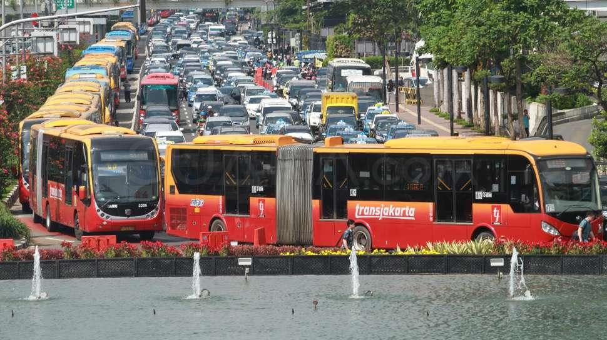
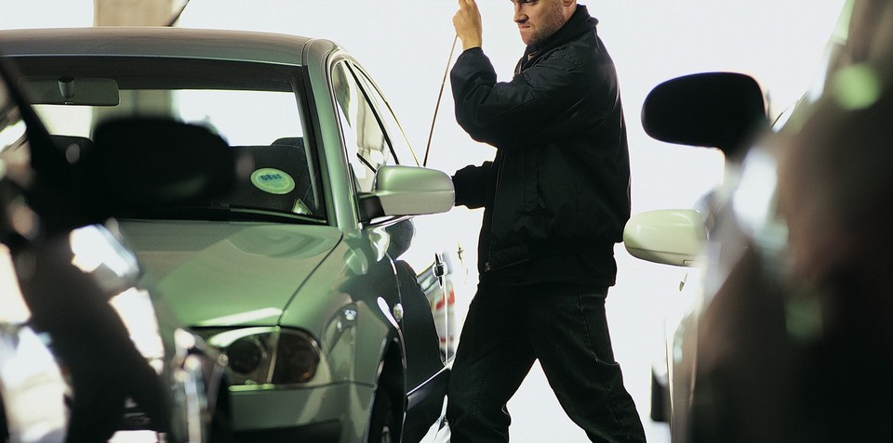
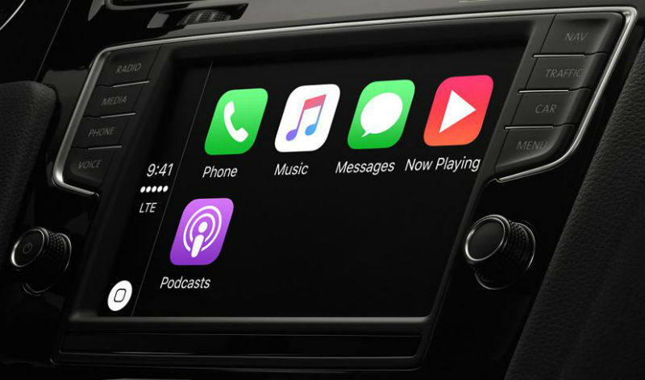
PROBLEM SOLVING
DRIVER & PASSENGER
CAR OWNER
Traffic Jam
Emergency
Comfort on the go
Security
Communication

Slide 5
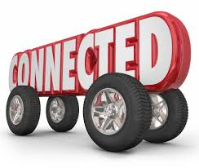

UNIQUENESS
Continuously maintenanced service as a data mobile broadband services from Telkomsel.
Customized to customer demand, auto brand and requirement.
Integrated with many Telkom’s existing service (useetv, moovigo, melon, langit musik, dll).
Partnership with all stakeholder (carmaker, device manufacturer, mobile operator, content provider).

Slide 6



DDS Impact
Peningkatan Revenue
Penambahan Portfolio Product Digital melalui IoT
Peningkatan kapabilitas personal

Slide 7
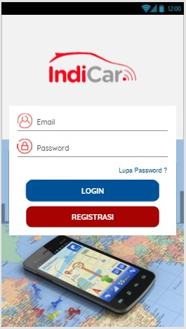
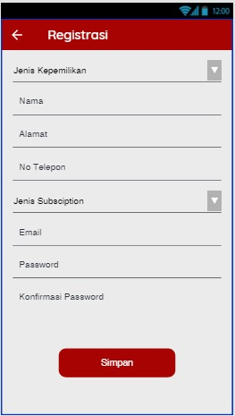
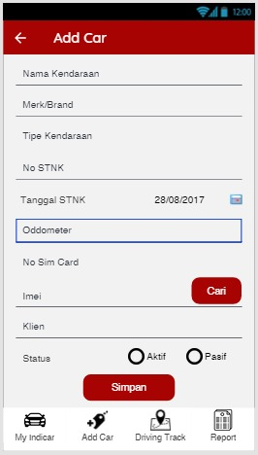
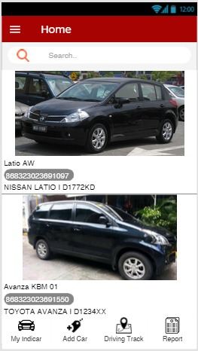
SCREEN CAPTURE

Slide 8
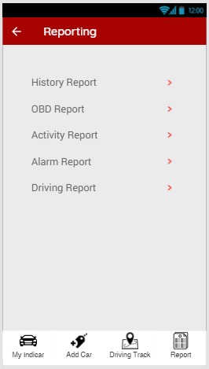
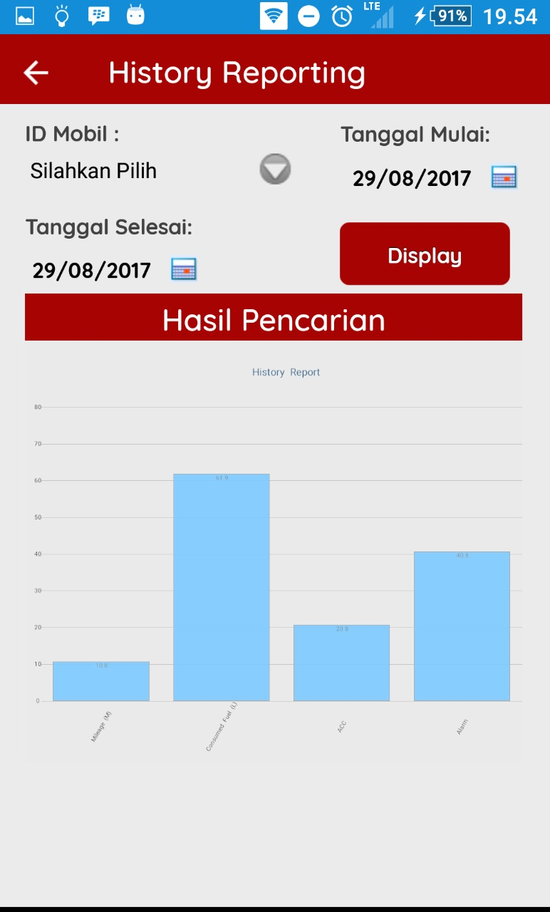
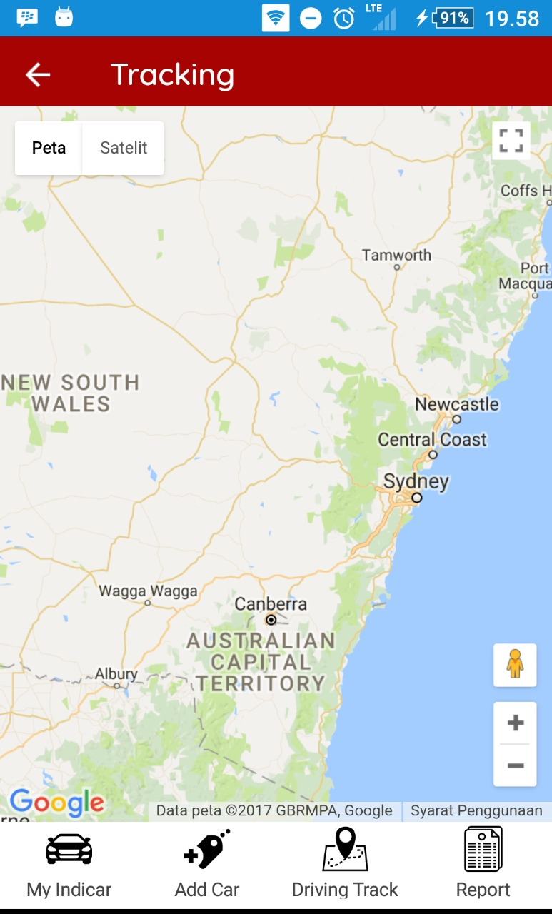
SCREEN CAPTURE

Slide 9


Team MEMBER
JADEQUELINE MARSHA PRICILA
Mobile & Wholesale Ecosystem
Programmer
SAM NURSANTO
Mobile & Wholesale Ecosystem
Programmer
AJI WIDODO - 690604
Mobile & Wholesale Ecosystem
Experience & Product Development

Slide 10
Terima kasih

