Slide 1
Group Quiz

Slide 2
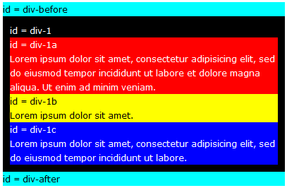
Initial
Div-1 is parent of div-1a, div-1b, div-1c.
Width: 380px. Padding: 10px. Position: Relative.

Slide 3
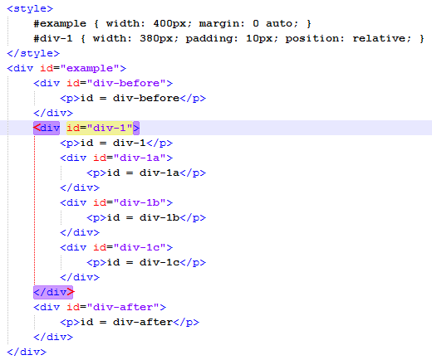
Initial
Code

Slide 4
Initial
What position of div1-a/b/c ?
Position/Float: ?
Top/Bottom: ? (Optional)
Left/Right: ? (Optional)

Slide 5
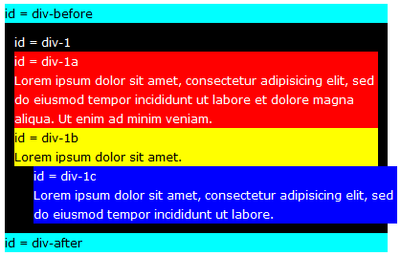
Question 1
What is position of div1-c?

Slide 6
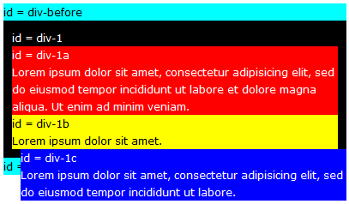
Question 2
What is position of div1-c?

Slide 7
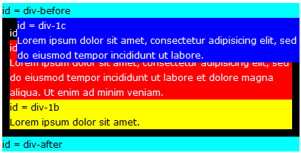
Question 3
What is position of div1-c?

Slide 8
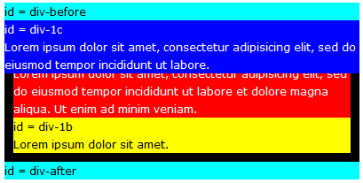
Question 4
What is position of div1-c?

Slide 9
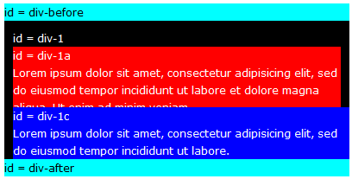
Question 5
What is position of div1-c?

Slide 10
Question 6
What is position of div1-c?

Slide 11
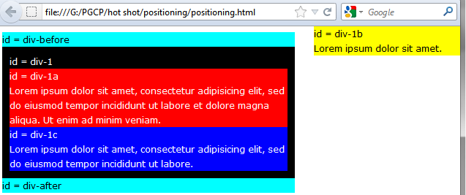
Question 7
What is position of div1-b?
Width of div1-b is 200px

Slide 12
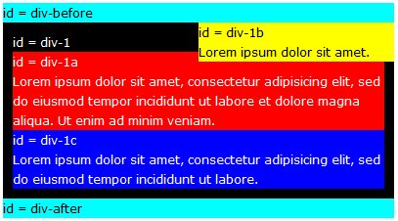
Question 8
What is position of div1-b?
Width of div1-b is 200px

Slide 13
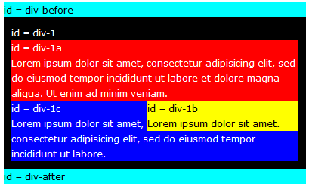
Question 9
What is position of div1-b?
Width of div1-b is 200px

Slide 14
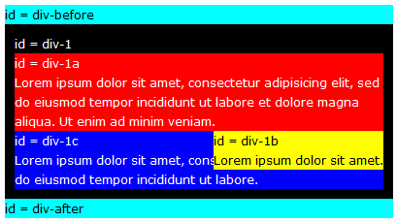
Question 10
What is position of div1-b?
Width of div1-b is 200px

Slide 15
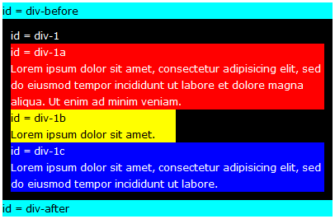
Question 11
What is position of div1-b?
Width of div1-b is 200px

