Slide 1
AVOIDING INTRUDER & SECURE DATA COMMUNICATION USING SDR
by
V.SAI SANTHOSH(1041240143)
B.S.V.D.PRAKASH(1041240190)
B.VISHNU (1041240129)

Slide 2
ABSTRACT
In today's world, radios exist in a multitude of items such as cell phones, computers, car door openers, vehicles, and televisions.
Modifying radio devices easily and cost effectively has become business critical.
Software defined radio technology brings the flexibility, cost efficiency and power to drive communications forward, with wide-reaching benefits realized by service providers and product developers through to end users.
Traditional hardware based radio devices limit cross-functionality and can only be modified through physical intervention. This results in higher production costs and minimal flexibility in supporting multiple waveform standards.
By contrast, software defined radio technology provides an efficient and comparatively inexpensive solution to this problem, allowing multimode, multi-band and/or multi-functional wireless devices that can be enhanced using software upgrades.

Slide 3
EXISTING SYSTEM
Existing System is an hardware alone for the radio frequency transmission where the transmission must be in fixed frequency, modulation and parameters.
The Operators are supported by adapted software components such as reminders for cyclic update intervals.
Normal gsm technology is used and the intruders tuning to our frequency
cannot be determined.
It involves normal signal converters, modulators and demodulators.

Slide 4
DISADVANTAGES
Cannot be used for multi frequency transmission
Transmitter and receiver need separate antenna
Because of using the hardware alone, impedance matching must be considered

Slide 5
PROPOSED SYSTEM
Proposed System is an Software defined radio is a radio which can tune to any frequency band.
It can able to transmit and receive different modulations and different physical parameters.
An SDR performs significant amount of signal processing in a general purpose computer a reconfigurable pulse of digital electronics on the combination of both.

Slide 6
ADVANTAGES OF PROPOSED SYSTEM
It reduces the cost of hardware and up-gradation
By using program itself we can change the modulation, frequency parameters.
Reduce costs in providing end-users
Intruder can be detected and data is secured by encryption/decryption and transmitted.

Slide 7
APPLICATIONS
It is used in military applications
Can be used for one to end/many devices by Secure Transmission

Slide 8
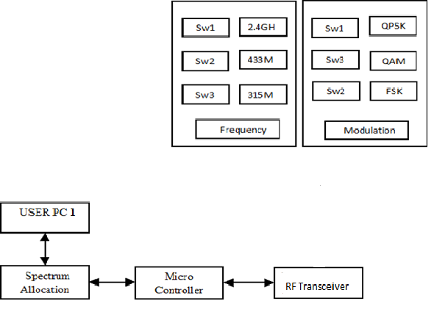
BLOCK DIAGRAM
TRANSMITTER SECTION
PC1

Slide 9
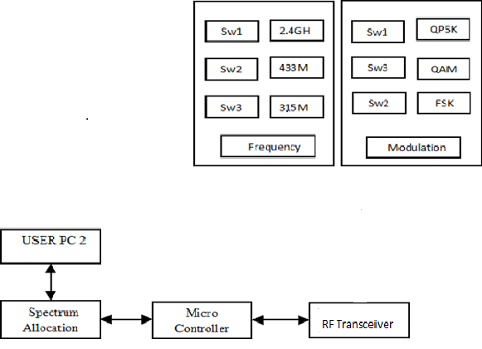
BLOCK DIAGRAM
RECIEVER SECTION
PC2

Slide 10
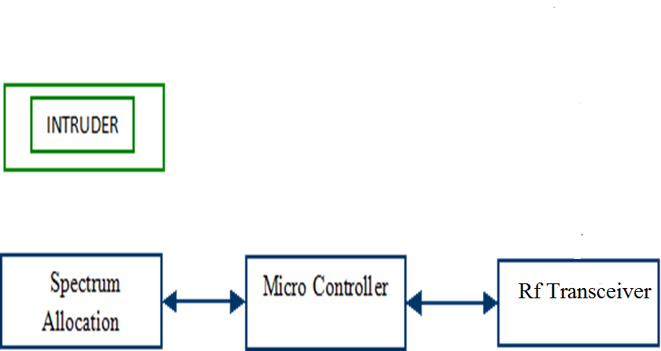
INTRUDER SECTION

Slide 11
WORKING
Coding is developed in Visual basic 6.0 and is installed in Pc’s. We require two pc’s to show the transmitted and received data.
Hardware components are fabricated by connecting the Microcontroller and Rf transceiver.
Max 232 probe is used to connect the pc’s and Rf transceiver for serial communication of the data
Spectrum Allocation is done in software. In this we will select license free frequencies as our carrier frequency and we can choose the type of modulation and frequency for transmitting the data or message
For prototype purpose we will be using only 3 frequencies and 3 modulation. In general purpose we can select N number of frequencies and modulations.
.

Slide 12
User 1 and User 2 should select the same frequency and modulation for the communication has to be happened.
Now the communication will be established and data is sent through Rf transceiver.
If any intruder comes into our frequency range whether he doesn’t want to know what is happening in that frequency range we will be getting an alert message in both the pc’s.
When the alert message is shown in both pc’s we can change the frequency or modulation for sending the data. Text sending now will be sent by adding X to the data which is transmitted.

Slide 13
HARDWARE REQUIREMENTS
MICROCONTROLLER (AT89S52)
WSN TRANSMITTER - TX
WSN RECEIVER - RX
UART
PC

Slide 14
SOFTWARE REQUIREMENTS
EMBEDDED C
KEIL COMPILER
VISUAL BASIC

Slide 15
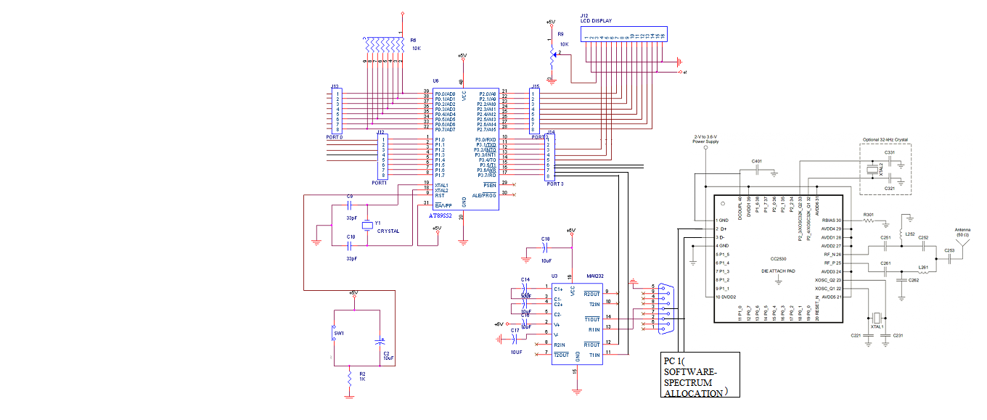
CIRCUIT DIAGRAM

Slide 16
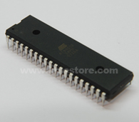
AT89s52 Microcontroller
The AT89S52 is a low-power, high-performance CMOS 8-bit microcontroller with 8K bytes of in-system programmable Flash memory.
The device is manufactured using Atmel’s high-density nonvolatile memory technology and is compatible with the Indus-try-standard 80C51 instruction set and pin out.

Slide 17
FEATURES
Compatible with MCS®-51 Products.
8K Bytes of In-System Programmable (ISP) Flash Memory – Endurance: 1000 Write/Erase Cycles.
4.0V to 5.5V Operating Range.
Fully Static Operation: 0 Hz to 33 MHz.
Three-level Program Memory Lock.
256 x 8-bit Internal RAM.
32 Programmable I/O Lines.]
Three 16-bit Timer/Counters.
Eight Interrupt Sources.

Slide 18
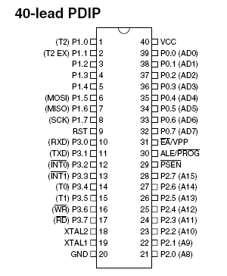
ATMEL PIN DIAGRAM

Slide 19
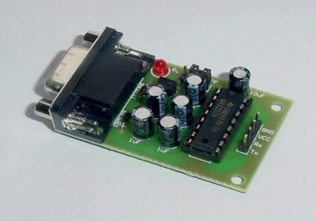
UART
An UART, universal asynchronous receiver / transmitter is responsible for performing the main task in serial communications with computers.
The device changes incoming parallel information to serial data which can be sent on a communication line.
A second UART can be used to receive the information. The UART performs all the tasks, timing, parity checking, etc. needed for the communication.
The only extra devices attached are line driver chips capable of transforming the TTL level signals to line voltages and vice versa.
Basically uart contributes of two components viz
    Max232 ic.
    Rs232 serial cable.

Slide 20
Features
9-bit address mode with hardware address detection
BAUD rates from 110 – 921600 bps or arbitrary up to 3 Mbps
RX and TX buffers = 1 – 65535
Detection of Framing, Parity and Overrun errors
Full Duplex, Half Duplex, TX only and RX only optimized hardware
2 out of 3 voting per bit
Break signal generation and detection
8x or 16x oversampling

Slide 21
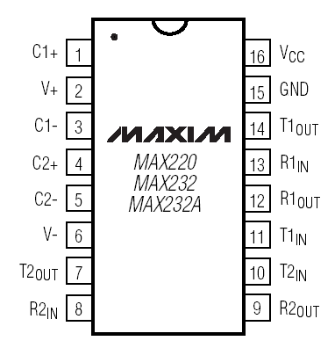
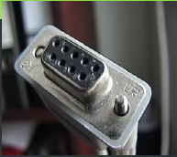

Diagram

Slide 22
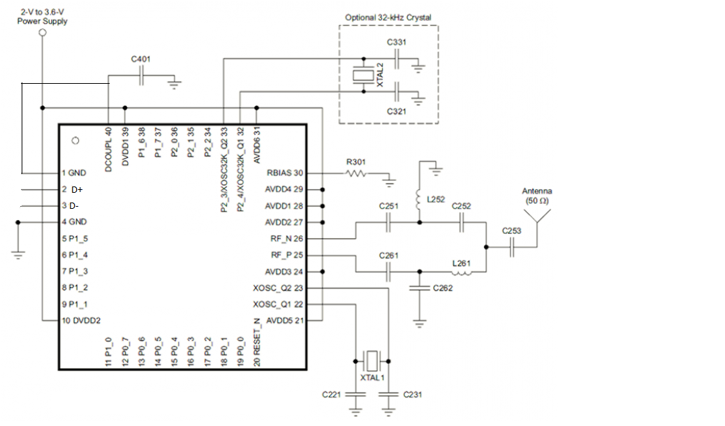
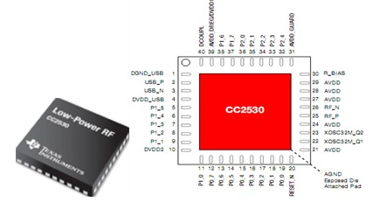
RF TRANSCEIVER

Slide 23
Features
FEATURES
RF/Layout
2.4-GHz IEEE 802.15.4 Compliant RF Transceiver
Excellent Receiver Sensitivity and Robustness to Interference
Programmable Output Power Up to 4.5 dBm
Very Few External Components
Suitable for Systems Targeting Compliance With Worldwide Radio
32-, 64-, 128-, or 256-KB In-System-Programmable Flash
8-KB RAM With Retention in All Power Modes
Hardware Debug Support
Powerful Five-Channel DMA

Slide 24
APPLICATIONS
2.4 GHZ IEEE 802.15.4 systems
ZIGBEE systems (256 KB flash)
Home/Building Automation
Lighting systems
Industrial control and monitoring
Low power wireless sensor networks
Consumer electronics
Health care

Slide 25
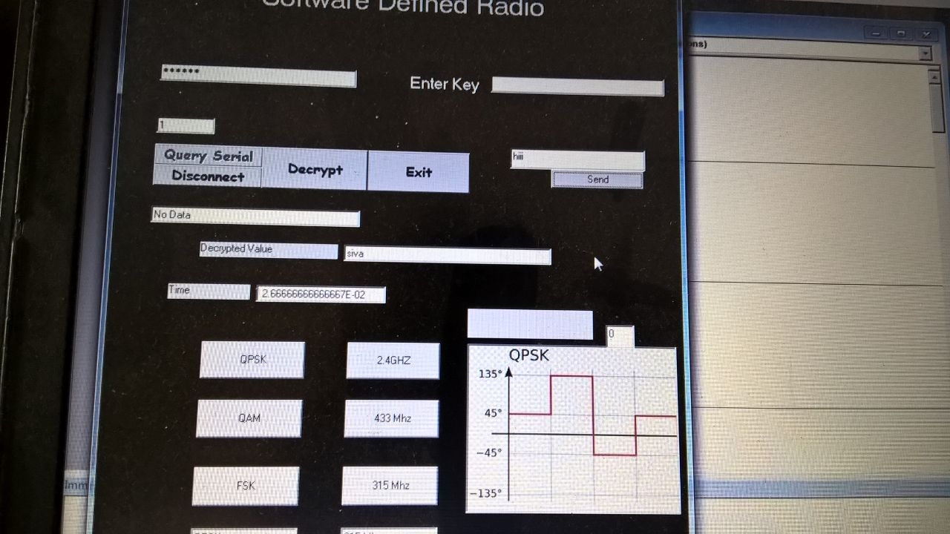
Simulation
Transceiver window 1

Slide 26
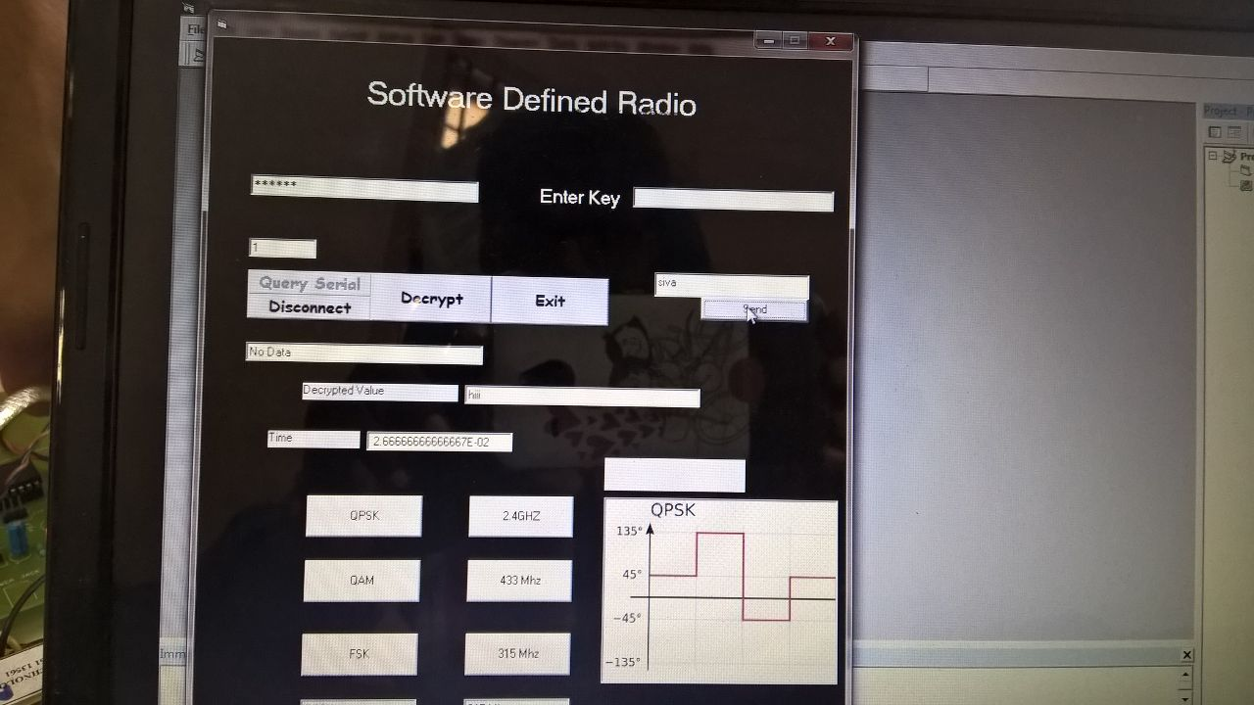
Transceiver window 2

Slide 27
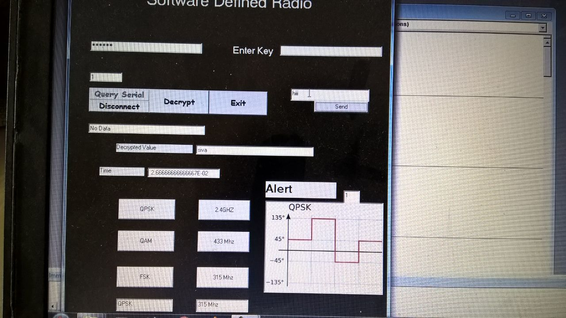
Transceiver window 1 with intruder acting

Slide 28
Transceiver window 2 with intruder acting

Slide 29
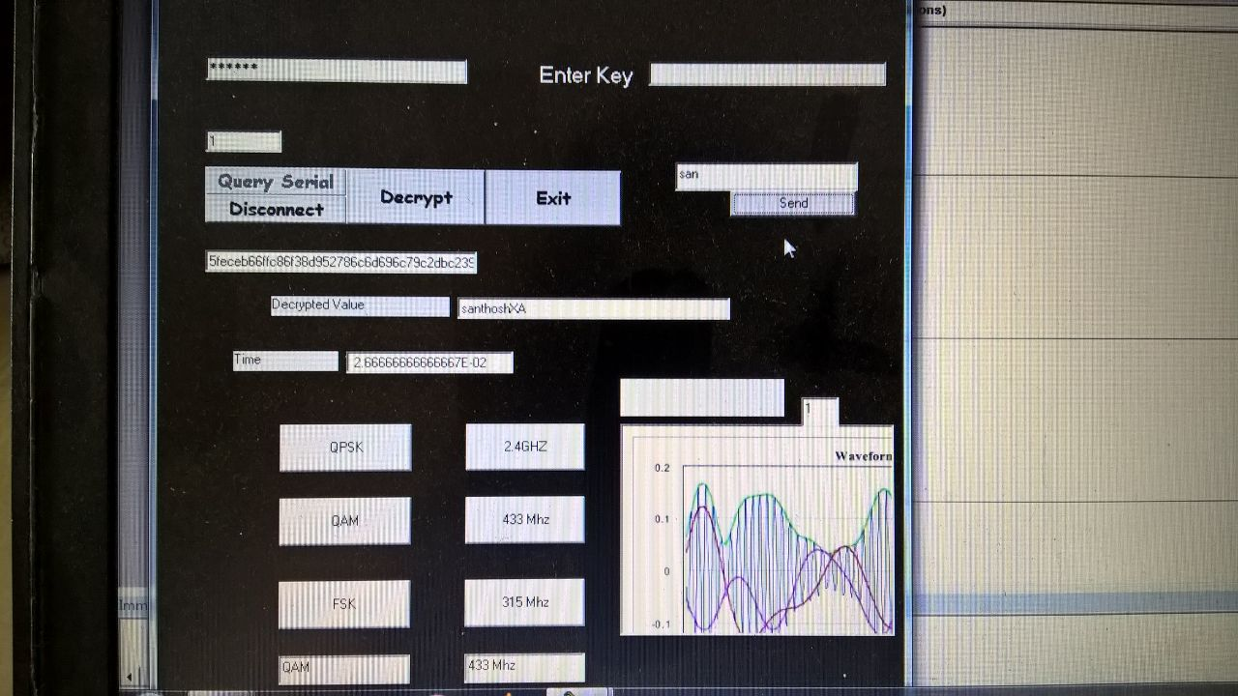
Transceiver window 1 after changing frequency and amplitude

Slide 30
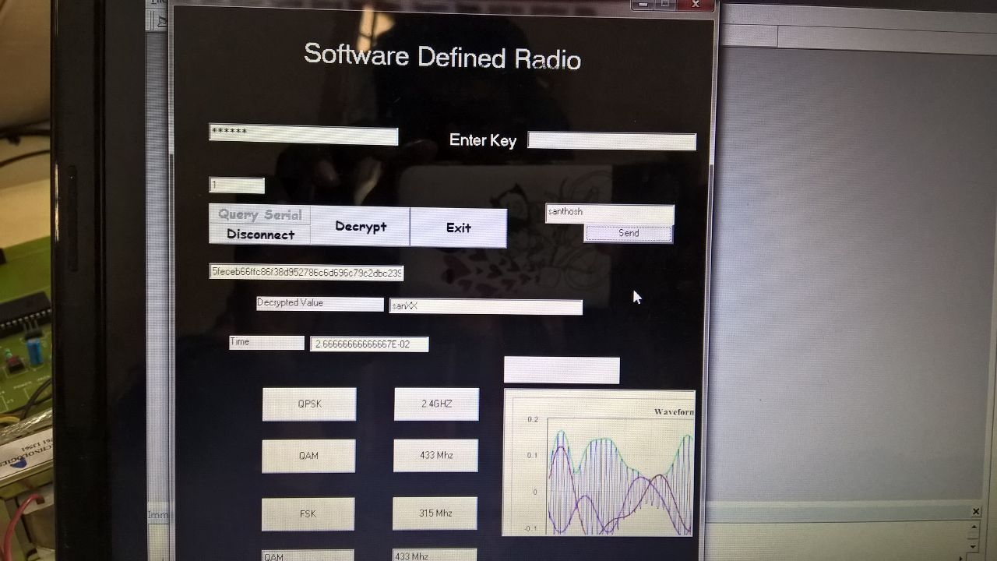
Transceiver window 2 after changing frequency and amplitude

Slide 31
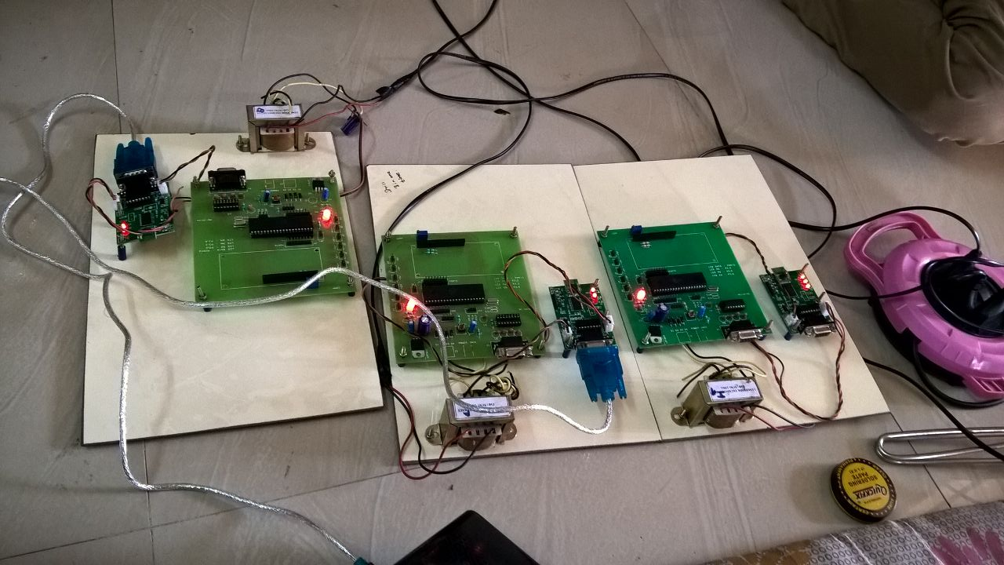
Hardware Kit

Slide 32
FUTURE SCOPE
In the proposed system we are changing the frequencies and modulation in sdr manually but in future there is a scope to change it automatically
In future it can be used for cellphones,wi-fi,entertainment section and public safety by radio sensing and broadcasting

Slide 33
References
[1] A. L. Reis, A. F. Selva, K. G. Lenzi, S. E. Barbin, and L. G. Meloni, “Software deﬁned radio on digital communications: A new teaching tool,” in Wireless and Microwave Technology Conference (WAMICON), 2012 IEEE 13th Annual. IEEE, 2012, pp. 1–8
[2] Defense File: Eurofighter Typhoon gains next generation encryption technology. http://www.defensefile.com/News_Detail_Eurofighter_typhoon_gains_next_generation_encryption_technology_6267.asp, 2013
[3] Hanigk,Sebastian; Kretzschmar, Michael; Eyermann, Frank: Towards a management system for SDR-based ad-hoc networks in military environments; MILCIS, 2010
[4] http://www.atmel.com/dyn/resources/prod_documents/doc1919.pdfc
[5] M. Sruthi, M. Abirami, A. Manikkoth, R. Gandhiraj, and K. Soman, “Low cost digital transceiver design for software deﬁned radio using rtl-sdr,” in Automation, Computing, Communication, Control and Compressed Sensing (iMac4s), 2013 International Multi-Conference on. IEEE, 2014, pp. 852–855.
[6] Mitola J,“Software Radio Architecture–Object Oriented Approaches to Wireless Systems Engineering”, Wiley-Interscience, ISBN 0-471-38492-5, 2000
[7] Rao Arvind Mallari,Khyati Vachhani,“Experimental study on Wide Band FM Receiver using GNURadio and RTL-SDR” 978-1-4799-8792-4/15/$31.00 ©2015 IEEE.
[8] "Support Statement for Visual Basic 6.0 on Windows Vista, Windows Server 2008, Windows 7, Windows 8 and Windows 8.1, Windows Server 2012, and Windows 10". Microsoft. Retrieved 2015-10-15.
[9] Spliter. "Visual Basic 6.0: A giant more powerful than ever". CodeProject.com. Retrieved 3 April 2014
[10] T.Ulversoy, “Software deﬁned radio: Challenges and opportunities,” Communications Surveys & Tutorials, IEEE, vol. 12, no. 4, pp. 531– 550, 2010.

Slide 34



