Slide 1
FINAL PROJECT PRESENTATION
Financial Risk
Analysis
Infosys Data Visualization Internship • Team 5
Praharsha • Sindhura • Madeeha • Santhosh

Slide 2
CONTEXT
CHALLENGE
PROJECT OBJECTIVES
Financial datasets contain many customer, credit and repayment attributes. Without preprocessing and visualization,
important risk patterns can be difficult to interpret quickly.
• Assess customer risk clearly across Low, Medium and
High segments.
• Discover patterns using credit, income, loans,
payment history and DTI.
• Build an executive-level view of key financial indicators.
• Support proactive monitoring through risk-focused
dashboard views.
TEAM 5 • INFOSYS DATA VISUALIZATION INTERNSHIP
3

Slide 3
Dataset overview
RAW RECORDS
ORIGINAL COLUMNS
DUPLICATES IDENTIFIED
RETAINED RECORDS
16,500
20
1,500
15,000
Core financial and customer attributes
What the dataset supports
Age & demographics
Income & credit score
• Customer-level financial profiling
• Risk segmentation and comparison
• Loan and repayment analysis
• Preparation for further modeling
Loan amount & purpose
Employment & job tenure
Payment history
Debt-to-income ratio
Assets & dependents
Previous defaults
Location
Risk rating
TEAM 5 • INFOSYS DATA VISUALIZATION INTERNSHIP
4

Slide 4
DATA QUALITY
Data Cleaning
01
02
03
04
Inspect
Clean
Prepare
Retain
Reviewed rows, columns, missing values and data types.
Addressed duplicate records and data-quality issues.
Improved consistency for numerical and categorical fields.
15,000 records were retained for further analysis.
CLEANING OUTCOME
• The cleaned dataset provided a consistent base for preprocessing and dashboard development.
• Duplicate records were removed before the final analysis dataset was used.

Slide 5
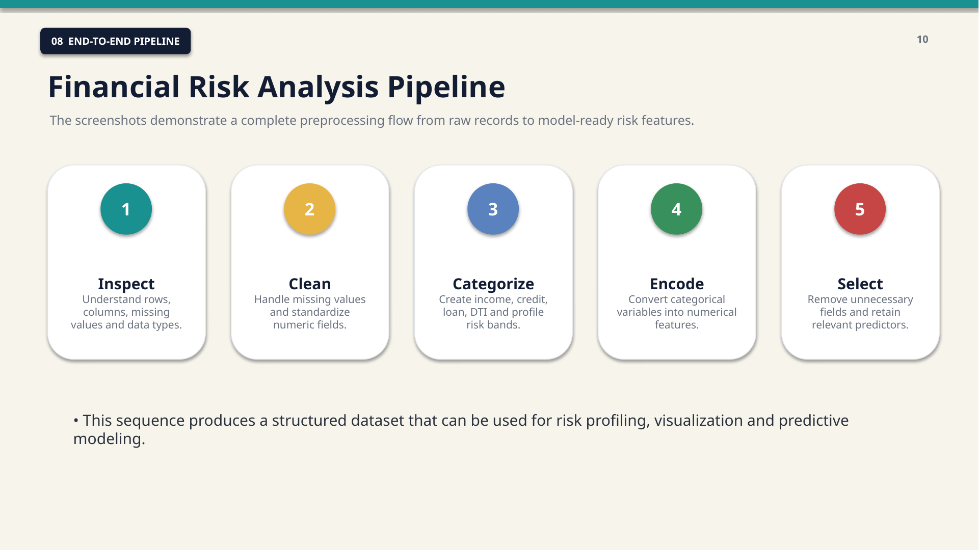
MILESTONE 2 • DATA PREPARATION
Preprocessing pipeline
01
Inspect
Rows, columns, missing values and types
02
Clean
Missing values & numeric consistency
03
Categorize
Income, credit, loan and DTI bands
04
Encode
Convert categories into 0/1 features
05
Select
Retain relevant predictors
Outcome: a structured, model-ready feature set for risk profiling and visualization.
TEAM 5 • INFOSYS DATA VISUALIZATION INTERNSHIP
6

Slide 6
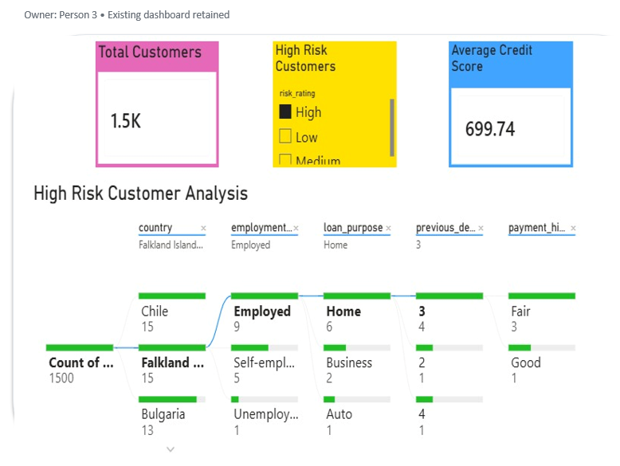
High Risk Customer Analysis
PURPOSE / OBJECTIVE
Drill into the characteristics of customers classified as high risk.
IMPORTANT VISUALIZATIONS
• Risk by employment status
• Risk by loan purpose
• Average credit score by risk
• Overall risk distribution
KEY INSIGHTS / FINDINGS
• High-risk customers can be isolated for review
• Employment and loan purpose add context
• Credit score supports risk comparison
• Overall distribution shows the wider risk structure
APPLICATION / VALUE
Provides a focused drill-down view for higher-risk customer segments.
Infosys Internship | Data Visualization | Team 5
9/16

Slide 7
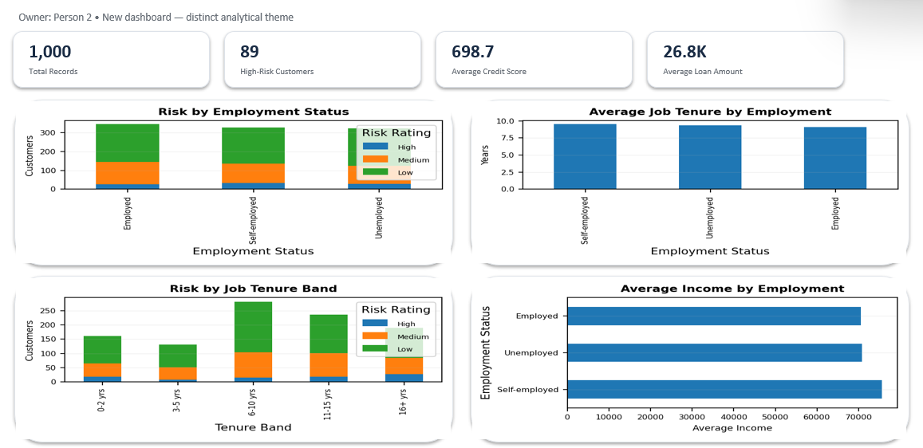
Employment Stability
PURPOSE / OBJECTIVE
Study employment status and job stability as part of financial risk profiling.
IMPORTANT VISUALIZATIONS
• Risk by employment status
• Average credit score by employment
• Risk by years at current job
• Employment-segment analysis
KEY INSIGHTS / FINDINGS
• Employment status can be compared across risk groups
• Credit quality adds financial context
• Job tenure provides stability context
• Employment filters support focused analysis
APPLICATION / VALUE
Adds employment stability as a contextual risk dimension.
Infosys Internship | Data Visualization | Team 5
10/16

Slide 8
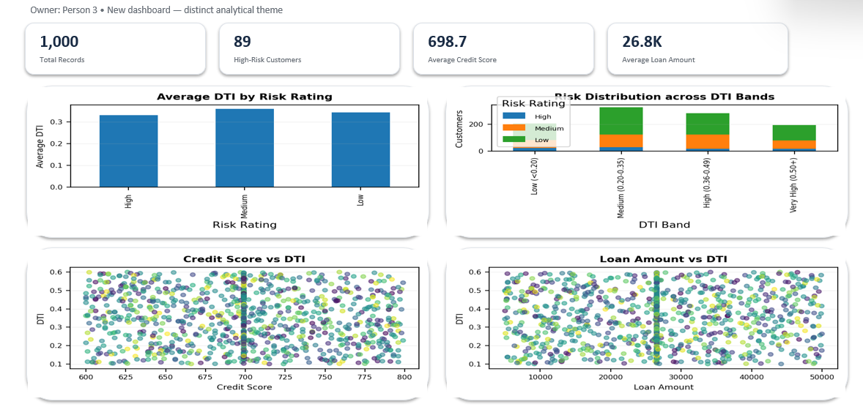
Debt-to-Income & Financial Stress
PURPOSE / OBJECTIVE
Analyze debt burden and its relationship with financial risk.
IMPORTANT VISUALIZATIONS
• Average DTI by risk group
• DTI distribution
• Credit score vs DTI
• Loan amount vs financial stress
KEY INSIGHTS / FINDINGS
• DTI provides a direct view of debt burden
• Risk groups can be compared using DTI
• Credit score adds a complementary signal
• Loan exposure can be viewed with financial stress
APPLICATION / VALUE
Makes debt burden easier to compare across segments.
Infosys Internship | Data Visualization | Team 5
11/16

Slide 9
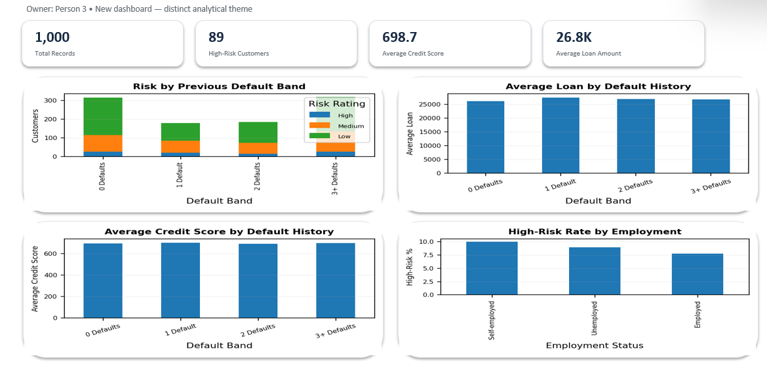
Default Risk & Repayment Exposure
PURPOSE / OBJECTIVE
Examine previous defaults and repayment-related exposure.
IMPORTANT VISUALIZATIONS
• Risk by previous defaults
• Average loan by default history
• Average credit score by default history
• Risk by employment
KEY INSIGHTS / FINDINGS
• Previous defaults provide historical risk context
• Loan exposure can be compared by default history
• Credit score adds credit-quality context
• Employment supports customer segmentation
APPLICATION / VALUE
Supports default-focused risk and repayment analysis.
Infosys Internship | Data Visualization | Team 5
12/16

Slide 10
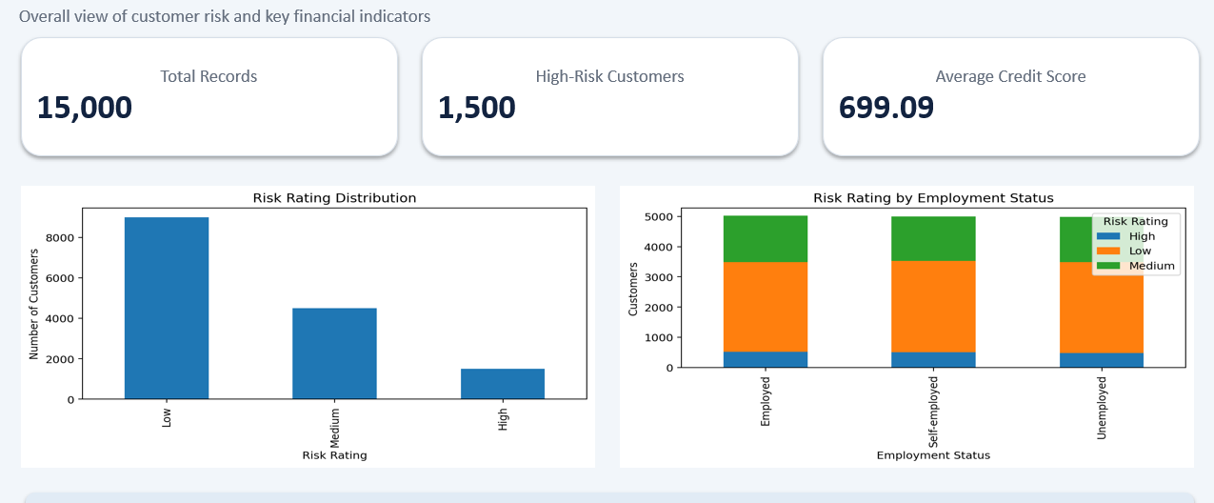
MILESTONE 4 • INTERACTIVE ANALYTICS
Core risk assessment dashboard
Reported KPIs
TOTAL RECORDS
15,000
HIGH-RISK CUSTOMERS
1,500
AVERAGE CREDIT SCORE
699.09
Use: quick assessment of overall risk
distribution and customer risk patterns.
TEAM 5 • INFOSYS DATA VISUALIZATION INTERNSHIP
11

Slide 11
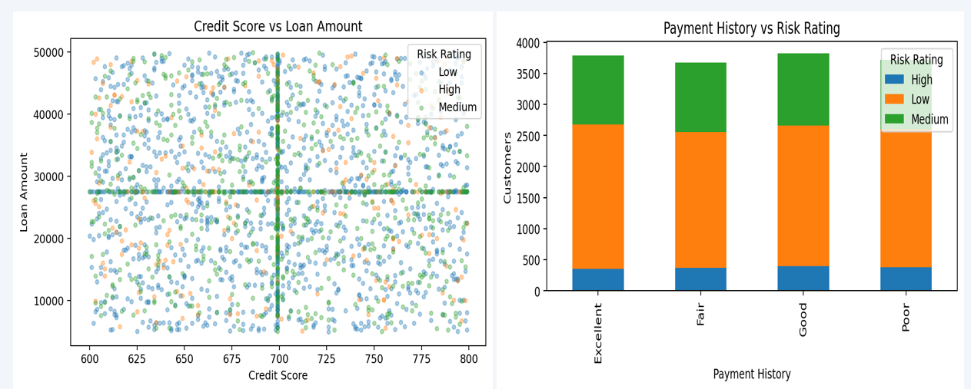
MILESTONE 4 • RISK INDICATORS
Predictive pattern analytics
AVERAGE INCOME
69,909
AVERAGE LOAN AMOUNT
27,464
AVERAGE DTI
0.35
Indicators used for pattern analysis
Previous defaults
Payment history
Credit score
Debt-to-income ratio
TEAM 5 • INFOSYS DATA VISUALIZATION INTERNSHIP
12

Slide 12
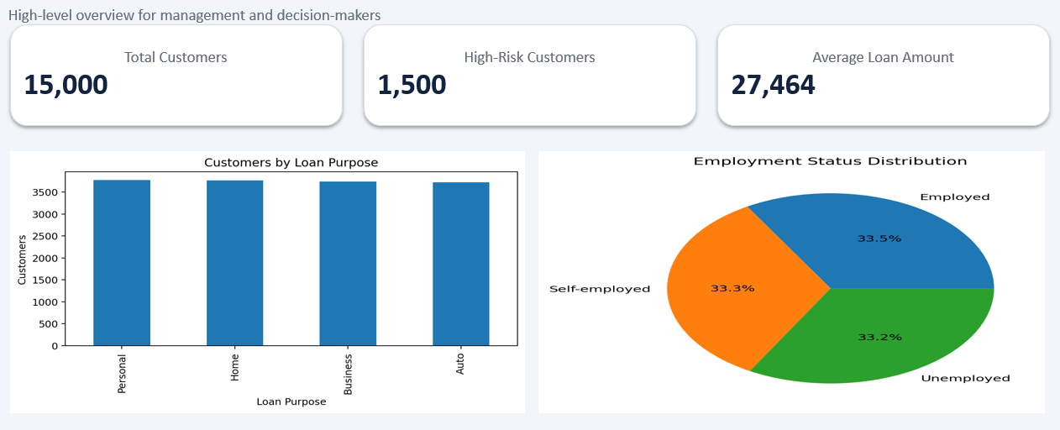
MILESTONE 4 • MANAGEMENT MONITORING
Executive command-center view
What management can see
• Overall risk exposure
• Loan amount by risk category
• Customer composition
• Employment distribution
• Priority segments for monitoring
Value
Key indicators are centralized in one analytical view.
TEAM 5 • INFOSYS DATA VISUALIZATION INTERNSHIP
13

Slide 13
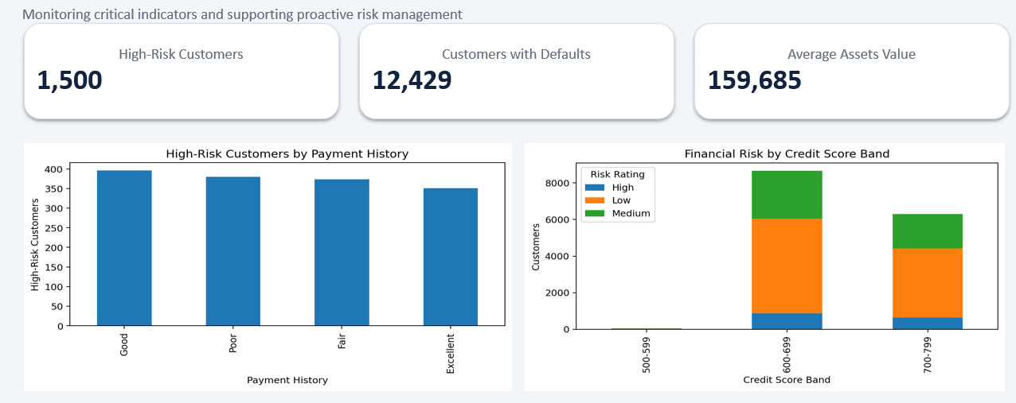
MILESTONE 4 • PROACTIVE RISK MANAGEMENT
Monitoring, alerting & performance optimization
HIGH-RISK CUSTOMERS
1,500
CUSTOMERS WITH DEFAULTS
12,429
AVERAGE ASSETS VALUE
159,685
Monitoring focus
Payment behavior • credit-score bands • customer segments • income/assets relationships
TEAM 5 • INFOSYS DATA VISUALIZATION INTERNSHIP
14

Slide 14
CONCLUSION
From raw records to risk intelligence.
Across four milestones, the project moved through data understanding, preprocessing, dashboard development and interactive analytics.
RAW DATA
→
CLEAN DATA
→
DASHBOARDS
→
ANALYTICS
16,500
15,000
16 views
Risk monitoring
Team 5 • Praharsha • Sindhura • Madeeha • Santhosh

Slide 15
THANK YOU
Financial Risk Analysis

