Slide 1
FINAL PROJECT PRESENTATION
Financial Risk
Analysis
Infosys Data Visualization Internship • Team 5
Praharsha • Sindhura • Madeeha • Santhosh

Slide 2
About the Project
A clear progression from understanding the data to decision-ready dashboards.
01
02
03
04
FOUNDATION
PREPROCESSING
DASHBOARD DEVELOPMENT
INTERACTIVE ANALYTICS
Project abstract, dataset understanding and cleaning
Data quality, type conversion, risk bands and feature selection
16 dashboard views across four team members
Risk assessment, pattern analysis, executive monitoring
16,500 raw records • 20 columns
1,500 duplicates removed • 15,000 retained
Risk, income, loans, credit, DTI, geography & more
15,000 records • 1,500 high-risk customers
TEAM 5 • INFOSYS DATA VISUALIZATION INTERNSHIP
2

Slide 3
CONTEXT
CHALLENGE
PROJECT OBJECTIVES
Financial datasets contain many customer, credit and repayment attributes. Without preprocessing and visualization,
important risk patterns can be difficult to interpret quickly.
• Assess customer risk clearly across Low, Medium and
High segments.
• Discover patterns using credit, income, loans,
payment history and DTI.
• Build an executive-level view of key financial indicators.
• Support proactive monitoring through risk-focused
dashboard views.
TEAM 5 • INFOSYS DATA VISUALIZATION INTERNSHIP
3

Slide 4
MILESTONE 1 • FOUNDATION
Dataset overview
RAW RECORDS
ORIGINAL COLUMNS
DUPLICATES IDENTIFIED
RETAINED RECORDS
16,500
20
1,500
15,000
Core financial and customer attributes
What the dataset supports
Age & demographics
Income & credit score
• Customer-level financial profiling
• Risk segmentation and comparison
• Loan and repayment analysis
• Preparation for further modeling
Loan amount & purpose
Employment & job tenure
Payment history
Debt-to-income ratio
Assets & dependents
Previous defaults
Location
Risk rating
TEAM 5 • INFOSYS DATA VISUALIZATION INTERNSHIP
4

Slide 5
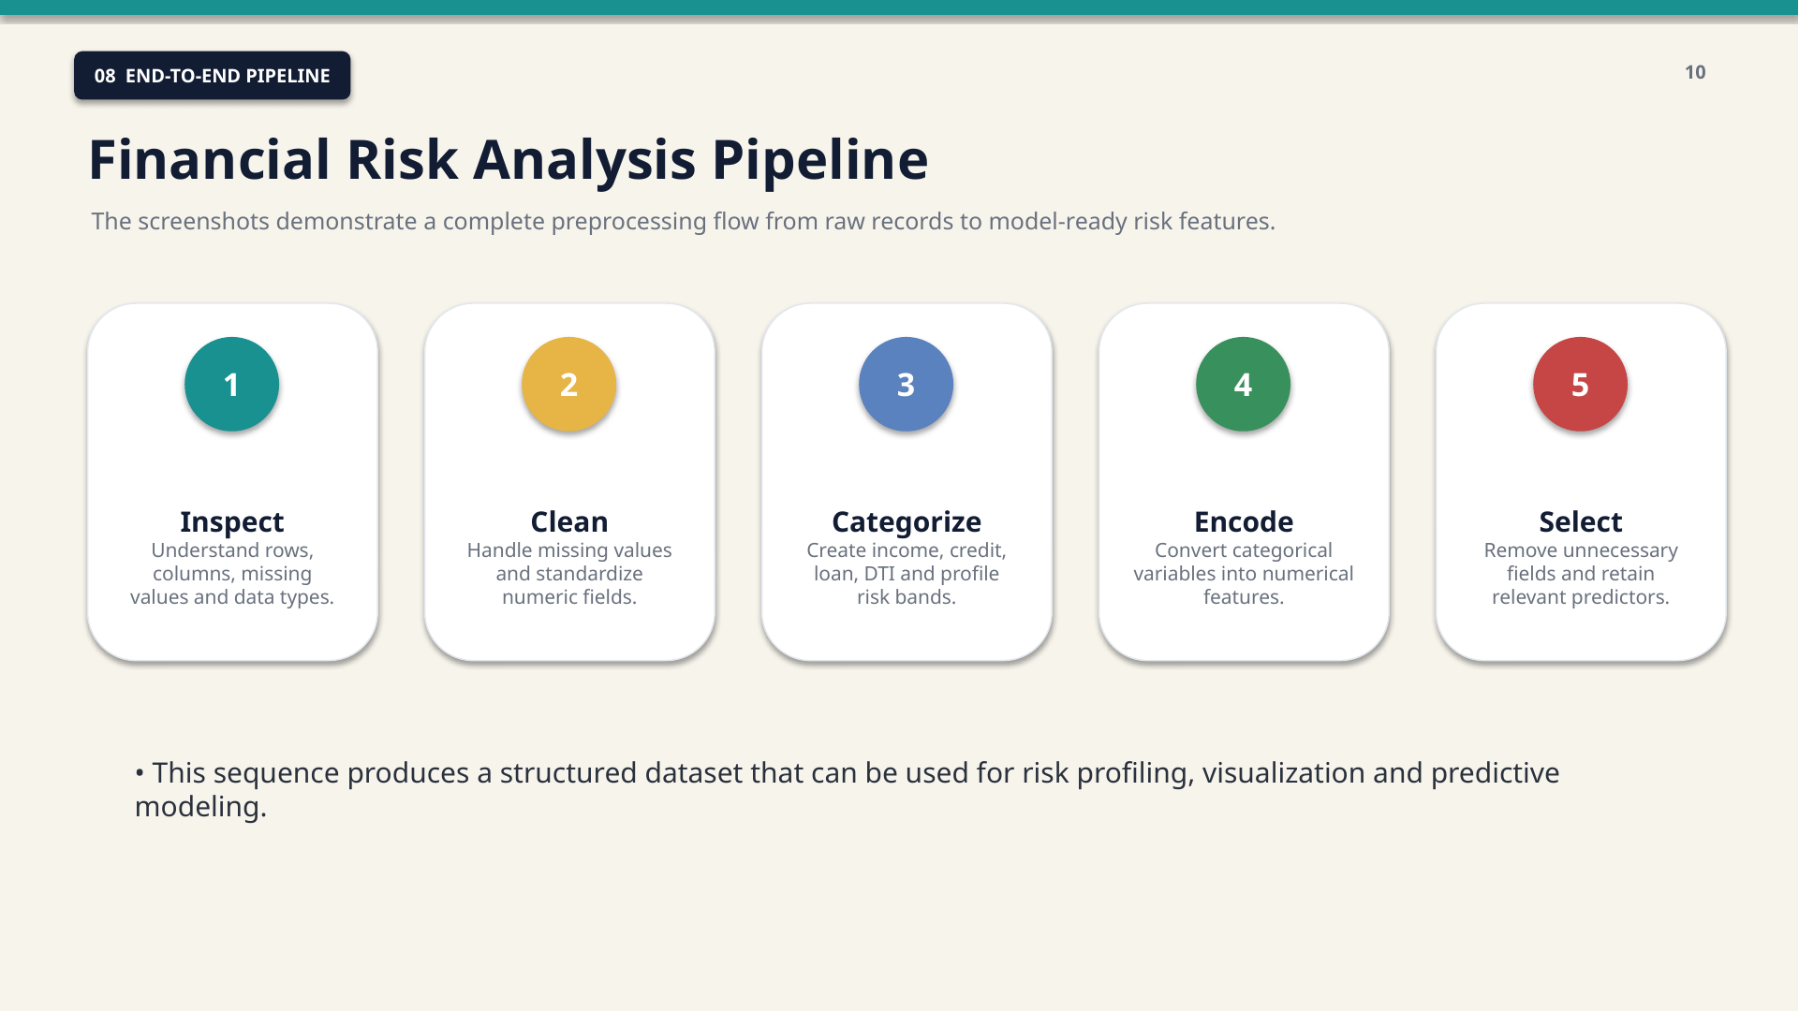
MILESTONE 2 • DATA PREPARATION
Preprocessing pipeline
01
Inspect
Rows, columns, missing values and types
02
Clean
Missing values & numeric consistency
03
Categorize
Income, credit, loan and DTI bands
04
Encode
Convert categories into 0/1 features
05
Select
Retain relevant predictors
Outcome: a structured, model-ready feature set for risk profiling and visualization.
TEAM 5 • INFOSYS DATA VISUALIZATION INTERNSHIP
6

Slide 6
MILESTONE 3
Dashboard development
16 dashboard views were designed to turn the prepared data into interactive risk stories.
FINANCIAL RISK ANALYSIS
9

Slide 7
MILESTONE 3 • DASHBOARD COVERAGE
Dashboards
Financial Risk Analysis
Financial Risk Surface
Credit Quality & Exposure
Risk Assessment & Customer
Coverage
Income & Financial Capacity
Loan Portfolio & Purpose
High Risk Customer Analysis
Geographic Risk Profile
Assets & Financial Strength
Payment Behavior & Credit History
Debt-to-Income & Financial Stress
Education & Financial Risk
Customer Demographics & Risk
Employment Stability
Default Risk & Repayment Exposure
Customer Affordability & Lending Capacity
TEAM 5 • INFOSYS DATA VISUALIZATION INTERNSHIP
10

Slide 8
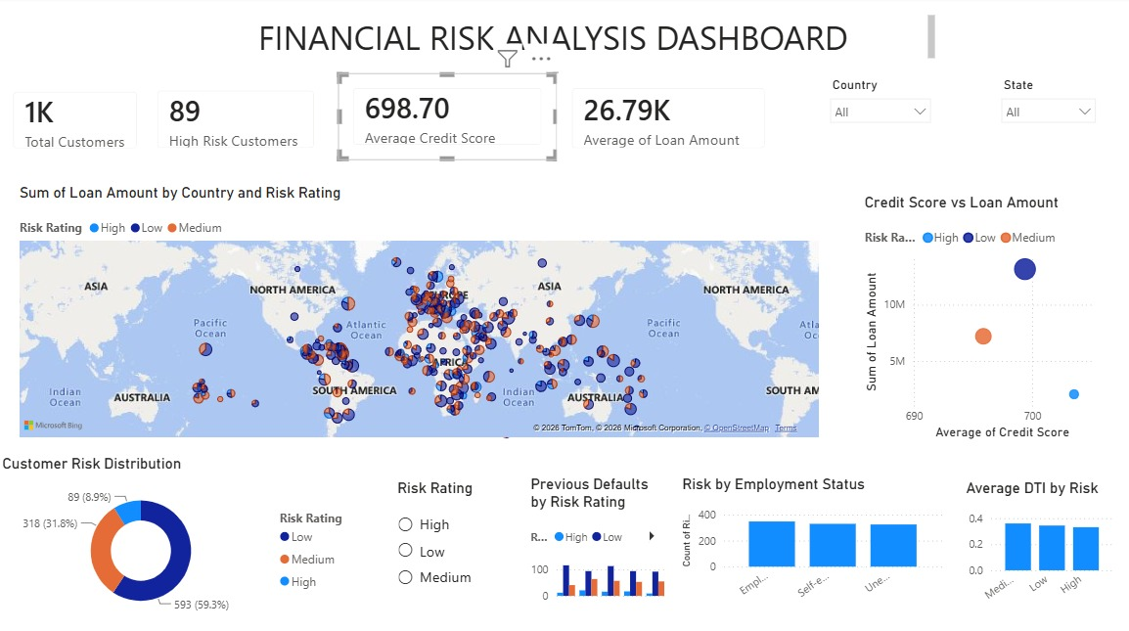
DASHBOARD 1
Financial Risk Analysis Dashboard
PURPOSE / OBJECTIVE
Provide an overall view of customer financial risk and exposure.
IMPORTANT VISUALIZATIONS
• Customer KPI summary and risk distribution
• Geographic loan exposure
• Credit score vs loan amount
• Employment and DTI context
KEY INSIGHTS / FINDINGS
• Total records: 1,000
• High-risk customers: 89
• Average credit score: 698.7
• Average loan amount: 26.8K
APPLICATION / VALUE
Supports quick customer-risk screening and comparison of major financial indicators.
Infosys Internship | Data Visualization | Team 5
1/16

Slide 9
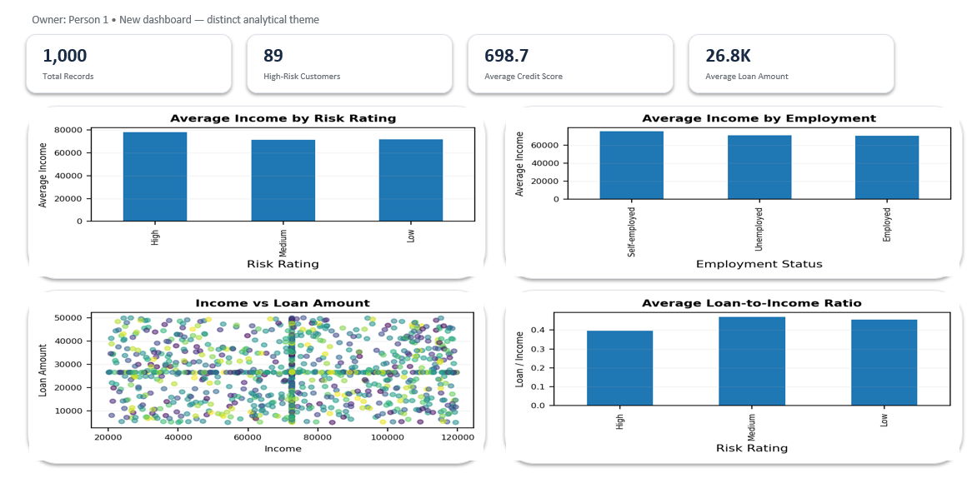
DASHBOARD 2
Income & Financial Capacity
PURPOSE / OBJECTIVE
Examine income levels and lending capacity
across customer risk segments.
IMPORTANT VISUALIZATIONS
• Average income by risk rating
• Income comparison across employment groups
• Income vs loan amount
• Loan exposure by risk
KEY INSIGHTS / FINDINGS
• Income is compared across risk categories
• Employment adds income context
• Loan exposure can be viewed alongside income
• KPI cards summarize the selected population
APPLICATION / VALUE
Helps assess affordability and financial capacity.
Infosys Internship | Data Visualization | Team 5
2/16

Slide 10
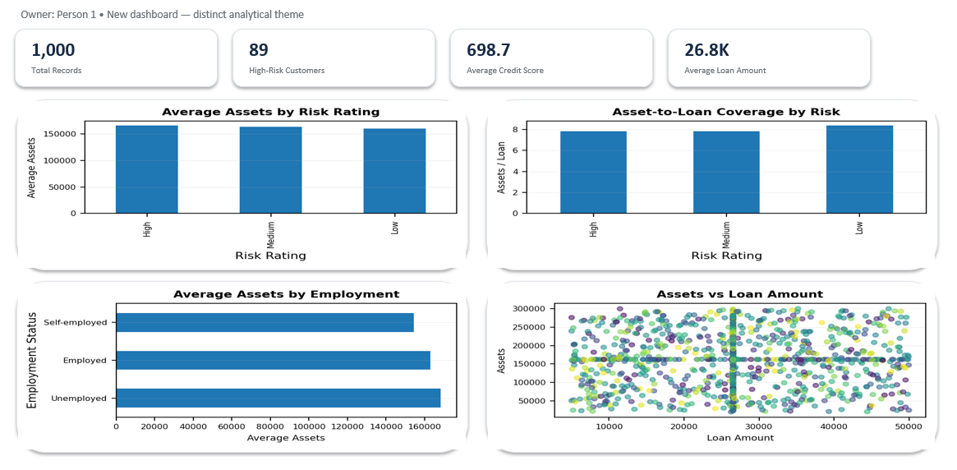
DASHBOARD 3
Assets & Financial Strength
PURPOSE / OBJECTIVE
Relate customer assets to risk and lending exposure.
IMPORTANT VISUALIZATIONS
• Average assets by risk rating
• Assets by loan exposure
• Assets by employment
• Geographic asset distribution
KEY INSIGHTS / FINDINGS
• Asset levels are compared across risk groups
• Loan exposure is viewed alongside financial strength
• Employment adds customer-profile context
• Geographic distribution supports exploration
APPLICATION / VALUE
Provides an additional financial-strength perspective.
Infosys Internship | Data Visualization | Team 5
3/16

Slide 11
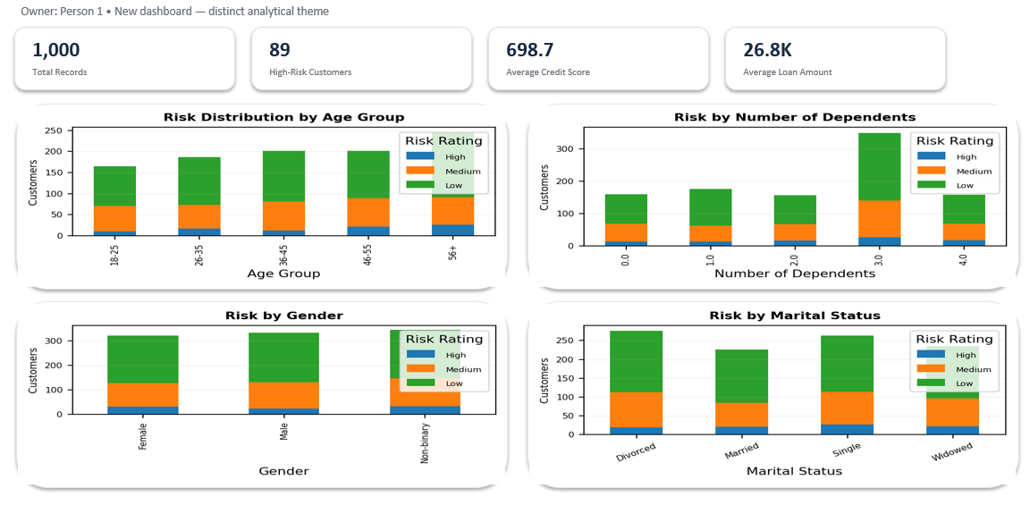
DASHBOARD 4
Customer Demographics & Risk
PURPOSE / OBJECTIVE
Explore customer demographics and their relationship with financial risk.
IMPORTANT VISUALIZATIONS
• Risk by education level
• Risk by gender
• Risk by marital status
• Dependents and customer profile
KEY INSIGHTS / FINDINGS
• Demographic segments can be compared by risk
• Gender-based risk distribution is visible
• Marital-status groups can be explored
• Customer profile adds context to financial risk
APPLICATION / VALUE
Supports demographic segmentation of customer risk.
Infosys Internship | Data Visualization | Team 5
4/16

Slide 12
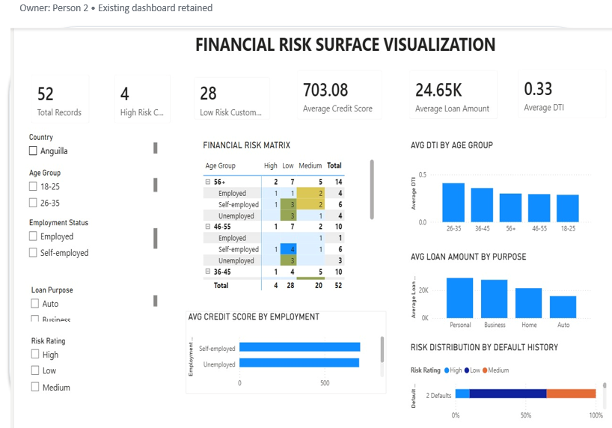
DASHBOARD 5
Financial Risk Surface Visualization
PURPOSE / OBJECTIVE
Explore how age, employment, DTI, loan purpose and repayment history interact with risk.
IMPORTANT VISUALIZATIONS
• Risk matrix by age and employment
• Average DTI by age group
• Loan amount by purpose
• Default history and credit score
KEY INSIGHTS / FINDINGS
• Risk can be examined across age and employment
• DTI highlights debt burden
• Loan purpose shows exposure concentration
• Defaults and credit score add repayment context
APPLICATION / VALUE
Enables multi-dimensional risk exploration.
Infosys Internship | Data Visualization | Team 5
5/16

Slide 13
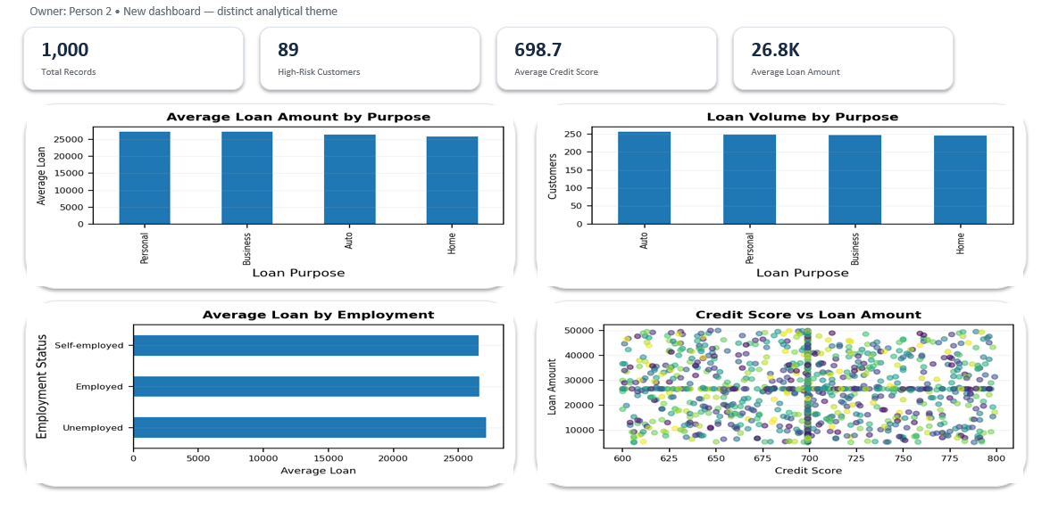
DASHBOARD 6
Loan Portfolio & Purpose
PURPOSE / OBJECTIVE
Understand lending exposure across loan purposes and customer segments.
IMPORTANT VISUALIZATIONS
• Average loan amount by purpose
• Loan volume comparisons
• Loan exposure by employment
• Geographic loan distribution
KEY INSIGHTS / FINDINGS
• Loan amounts differ across purposes
• Portfolio composition can be compared
• Employment adds exposure context
• Geographic views support location analysis
APPLICATION / VALUE
Helps organize loan exposure into interpretable segments.
Infosys Internship | Data Visualization | Team 5
6/16

Slide 14
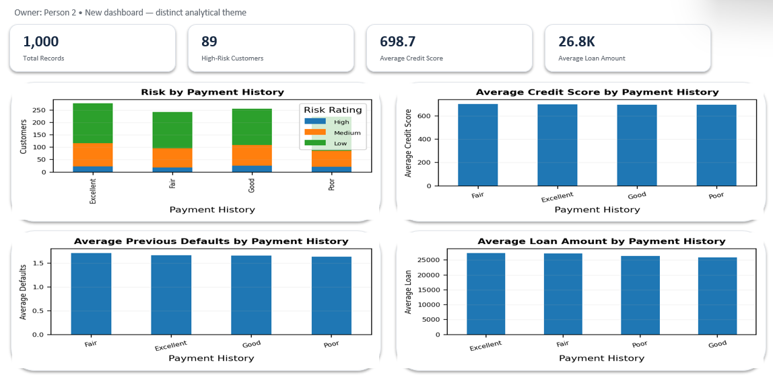
DASHBOARD 7
Payment Behavior & Credit History
PURPOSE / OBJECTIVE
Connect payment behavior and credit history with customer risk.
IMPORTANT VISUALIZATIONS
• Risk by payment history
• Average credit score by payment history
• Average previous defaults
• Loan exposure by repayment history
KEY INSIGHTS / FINDINGS
• Payment history differentiates customer segments
• Credit score provides credit-quality context
• Previous defaults add historical risk context
• Loan exposure can be interpreted alongside repayment behavior
APPLICATION / VALUE
Supports repayment-focused customer profiling.
Infosys Internship | Data Visualization | Team 5
7/16

Slide 15
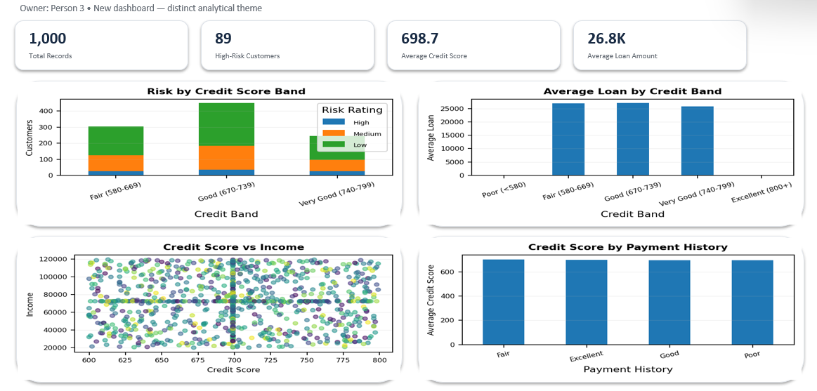
DASHBOARD 8
Credit Quality & Exposure
PURPOSE / OBJECTIVE
Analyze credit quality and lending exposure across customer risk segments.
IMPORTANT VISUALIZATIONS
• Risk by credit-score band
• Average loan by credit score
• Credit score distribution
• Payment history comparison
KEY INSIGHTS / FINDINGS
• Credit-quality bands reveal customer segments
• Loan exposure can be compared by credit quality
• Distribution shows the spread of scores
• Payment history complements credit analysis
APPLICATION / VALUE
Provides a credit-focused view of financial risk.
Infosys Internship | Data Visualization | Team 5
8/16

Slide 16
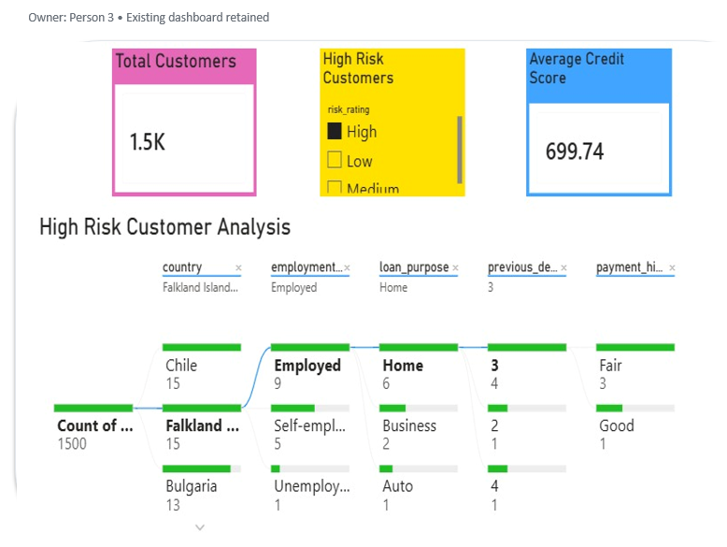
DASHBOARD 9
High Risk Customer Analysis
PURPOSE / OBJECTIVE
Drill into the characteristics of customers classified as high risk.
IMPORTANT VISUALIZATIONS
• Risk by employment status
• Risk by loan purpose
• Average credit score by risk
• Overall risk distribution
KEY INSIGHTS / FINDINGS
• High-risk customers can be isolated for review
• Employment and loan purpose add context
• Credit score supports risk comparison
• Overall distribution shows the wider risk structure
APPLICATION / VALUE
Provides a focused drill-down view for higher-risk customer segments.
Infosys Internship | Data Visualization | Team 5
9/16

Slide 17
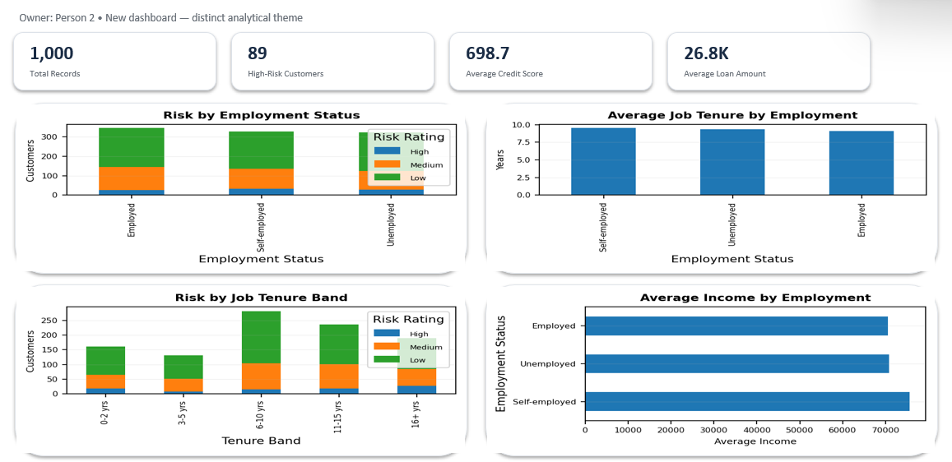
DASHBOARD 10
Employment Stability
PURPOSE / OBJECTIVE
Study employment status and job stability as part of financial risk profiling.
IMPORTANT VISUALIZATIONS
• Risk by employment status
• Average credit score by employment
• Risk by years at current job
• Employment-segment analysis
KEY INSIGHTS / FINDINGS
• Employment status can be compared across risk groups
• Credit quality adds financial context
• Job tenure provides stability context
• Employment filters support focused analysis
APPLICATION / VALUE
Adds employment stability as a contextual risk dimension.
Infosys Internship | Data Visualization | Team 5
10/16

Slide 18
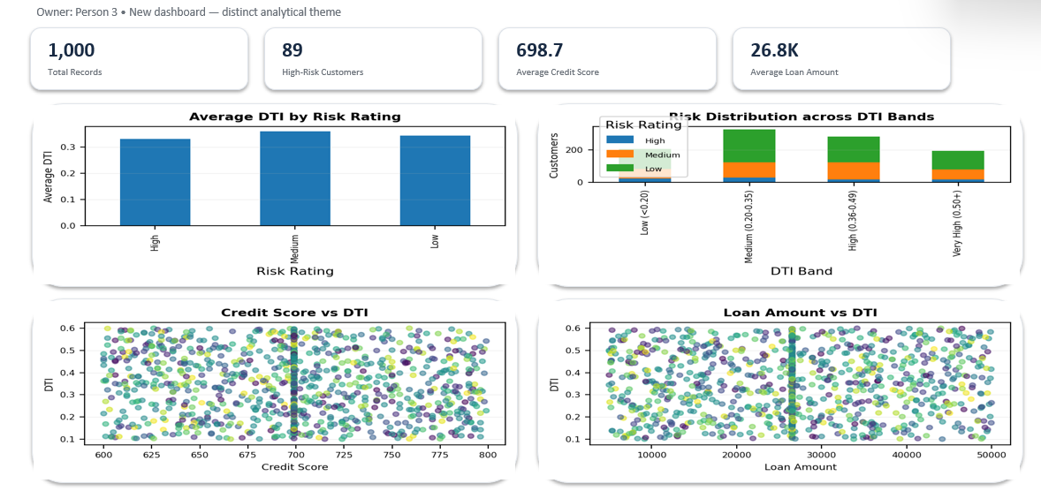
DASHBOARD 11
Debt-to-Income & Financial Stress
PURPOSE / OBJECTIVE
Analyze debt burden and its relationship with financial risk.
IMPORTANT VISUALIZATIONS
• Average DTI by risk group
• DTI distribution
• Credit score vs DTI
• Loan amount vs financial stress
KEY INSIGHTS / FINDINGS
• DTI provides a direct view of debt burden
• Risk groups can be compared using DTI
• Credit score adds a complementary signal
• Loan exposure can be viewed with financial stress
APPLICATION / VALUE
Makes debt burden easier to compare across segments.
Infosys Internship | Data Visualization | Team 5
11/16

Slide 19
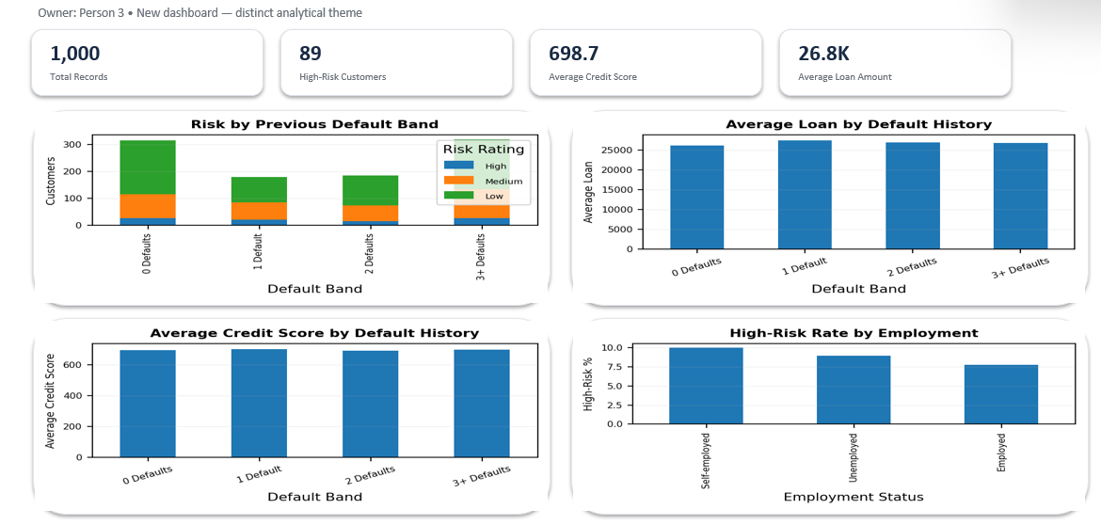
DASHBOARD 12
Default Risk & Repayment Exposure
PURPOSE / OBJECTIVE
Examine previous defaults and repayment-related exposure.
IMPORTANT VISUALIZATIONS
• Risk by previous defaults
• Average loan by default history
• Average credit score by default history
• Risk by employment
KEY INSIGHTS / FINDINGS
• Previous defaults provide historical risk context
• Loan exposure can be compared by default history
• Credit score adds credit-quality context
• Employment supports customer segmentation
APPLICATION / VALUE
Supports default-focused risk and repayment analysis.
Infosys Internship | Data Visualization | Team 5
12/16

Slide 20
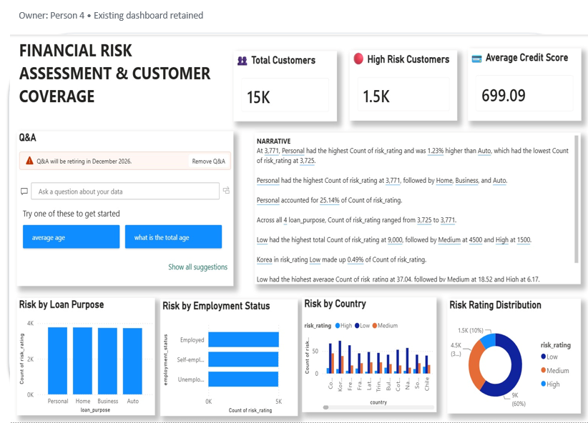
DASHBOARD 13
Financial Risk Assessment & Customer Coverage
PURPOSE / OBJECTIVE
Bring core risk indicators and customer coverage into one analytical view.
IMPORTANT VISUALIZATIONS
• KPI summary and customer coverage
• Risk by loan purpose and employment
• Country-level risk distribution
• Interactive narrative and Q&A view
KEY INSIGHTS / FINDINGS
• Customer coverage is summarized through KPIs
• Loan purpose and employment reveal segment differences
• Country-level analysis supports comparison
• Multiple views form a connected risk story
APPLICATION / VALUE
Creates a consolidated starting point for risk assessment.
Infosys Internship | Data Visualization | Team 5
13/16

Slide 21
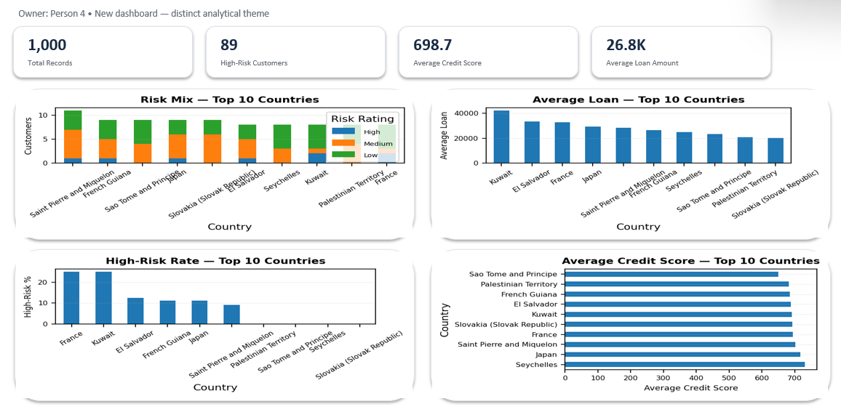
DASHBOARD 14
Geographic Risk Profile
PURPOSE / OBJECTIVE
Identify how financial risk and exposure vary across geographic segments.
IMPORTANT VISUALIZATIONS
• Risk distribution by location
• Average loan amount by geography
• High-risk customer comparisons
• Geographic drill-down
KEY INSIGHTS / FINDINGS
• Risk can be compared across locations
• Loan exposure differs by geography
• High-risk concentration can be explored
• Geographic filtering supports targeted analysis
APPLICATION / VALUE
Adds location as a practical risk dimension.
Infosys Internship | Data Visualization | Team 5
14/16

Slide 22
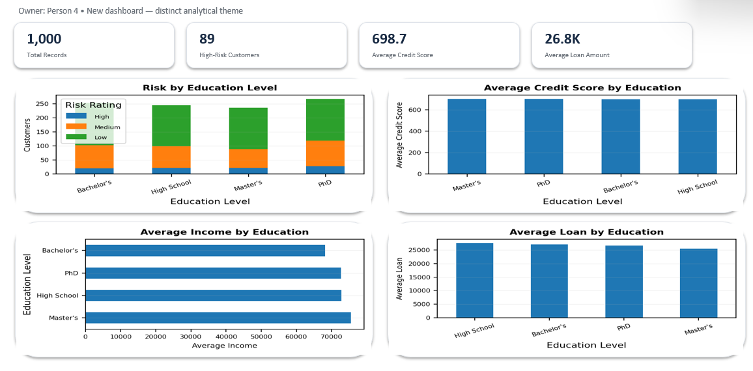
DASHBOARD 15
Education & Financial Risk
PURPOSE / OBJECTIVE
Examine education-related customer segments alongside financial risk indicators.
IMPORTANT VISUALIZATIONS
• Risk by education level
• Average credit score by education
• Average loan amount by education
• Education-level comparisons
KEY INSIGHTS / FINDINGS
• Risk patterns can be compared across education groups
• Credit score adds credit-quality context
• Loan exposure differs across segments
• Education adds demographic context
APPLICATION / VALUE
Supports demographic segmentation with financial indicators.
Infosys Internship | Data Visualization | Team 5
15/16

Slide 23
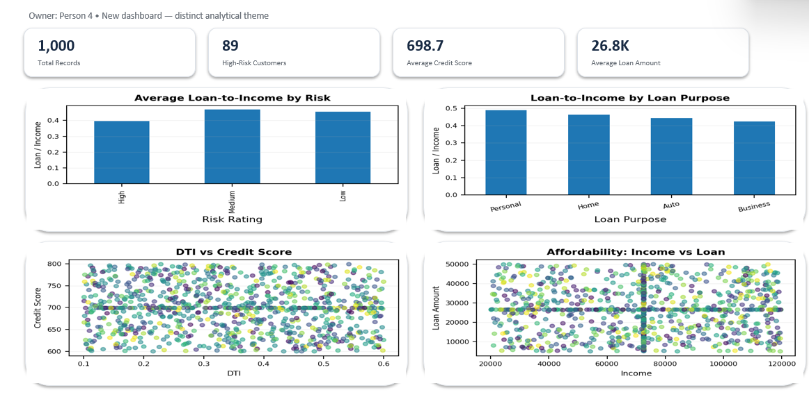
DASHBOARD 16
Customer Affordability & Lending Capacity
PURPOSE / OBJECTIVE
Assess customer affordability by relating income, credit and lending exposure.
IMPORTANT VISUALIZATIONS
• Average loan by risk
• Loan amount by loan purpose
• DTI vs credit score
• Affordability and loan exposure
KEY INSIGHTS / FINDINGS
• Loan exposure can be compared across risk groups
• Purpose shows where lending is concentrated
• DTI and credit score provide affordability context
• Customer segments can be explored interactively
APPLICATION / VALUE
Supports affordability and lending-capacity analysis.
Infosys Internship | Data Visualization | Team 5
16/16

Slide 24
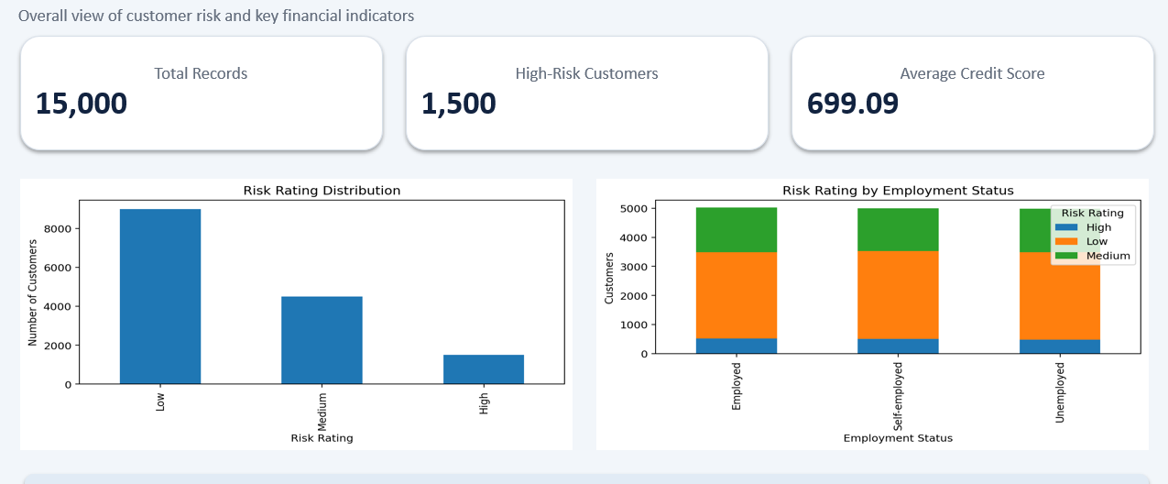
MILESTONE 4 • INTERACTIVE ANALYTICS
Core risk assessment dashboard
Reported KPIs
TOTAL RECORDS
15,000
HIGH-RISK CUSTOMERS
1,500
AVERAGE CREDIT SCORE
699.09
Use: quick assessment of overall risk
distribution and customer risk patterns.
TEAM 5 • INFOSYS DATA VISUALIZATION INTERNSHIP
11

Slide 25
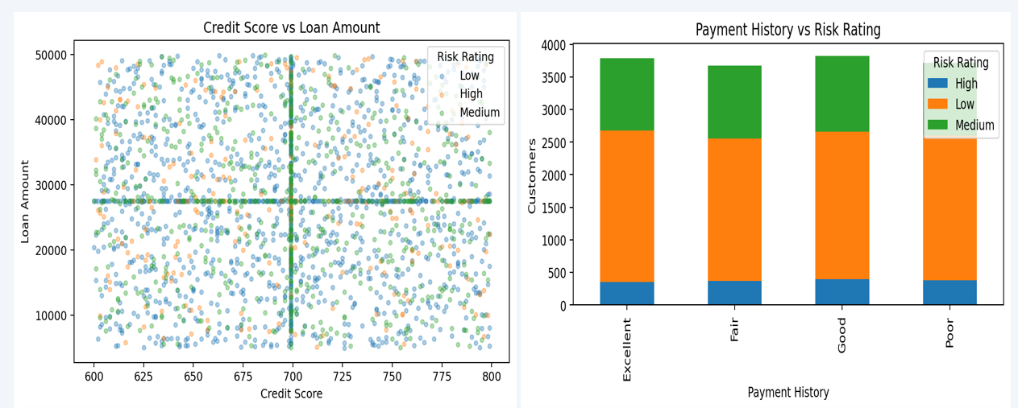
MILESTONE 4 • RISK INDICATORS
Predictive pattern analytics
AVERAGE INCOME
69,909
AVERAGE LOAN AMOUNT
27,464
AVERAGE DTI
0.35
Indicators used for pattern analysis
Previous defaults
Payment history
Credit score
Debt-to-income ratio
TEAM 5 • INFOSYS DATA VISUALIZATION INTERNSHIP
12

Slide 26
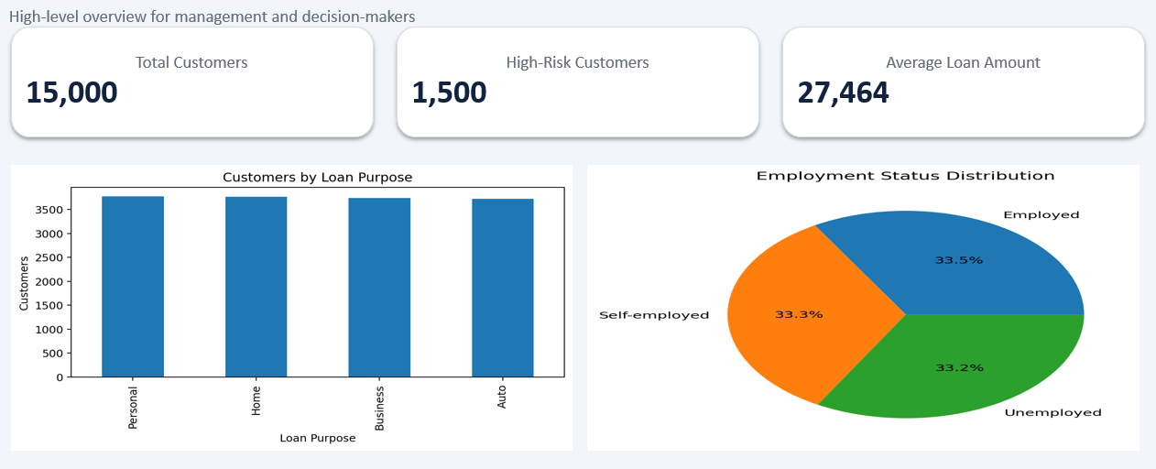
MILESTONE 4 • MANAGEMENT MONITORING
Executive command-center view
What management can see
• Overall risk exposure
• Loan amount by risk category
• Customer composition
• Employment distribution
• Priority segments for monitoring
Value
Key indicators are centralized in one analytical view.
TEAM 5 • INFOSYS DATA VISUALIZATION INTERNSHIP
13

Slide 27
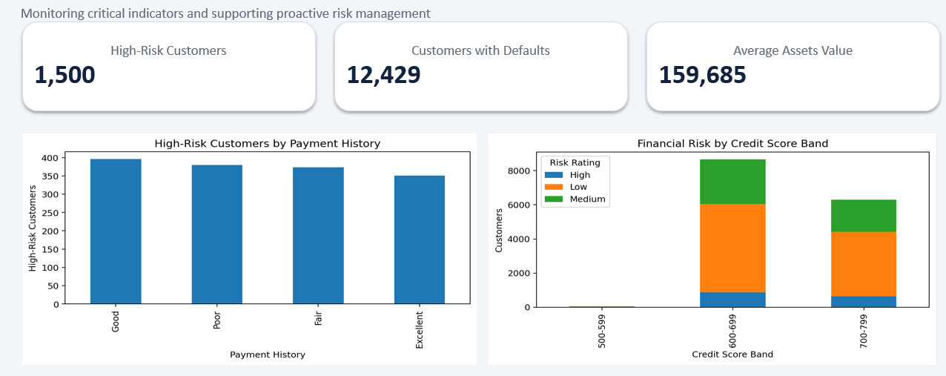
MILESTONE 4 • PROACTIVE RISK MANAGEMENT
Monitoring, alerting & performance optimization
HIGH-RISK CUSTOMERS
1,500
CUSTOMERS WITH DEFAULTS
12,429
AVERAGE ASSETS VALUE
159,685
Monitoring focus
Payment behavior • credit-score bands • customer segments • income/assets relationships
TEAM 5 • INFOSYS DATA VISUALIZATION INTERNSHIP
14

Slide 28
PROJECT OUTCOME
Key insights from the completed workflow
01
DATA QUALITY
02
RISK STRUCTURE
Duplicates and missing values were addressed before analysis.
Income, credit, loan size and DTI were transformed into interpretable bands.
03
RISK SIGNALS
04
DECISION SUPPORT
Previous defaults, payment history, credit score and DTI support risk-pattern analysis.
Interactive dashboards consolidate customer risk, exposure and segment-level views.
TEAM 5 • INFOSYS DATA VISUALIZATION INTERNSHIP
15

Slide 29
NEXT STEP
Value & Future scope
VALUE DELIVERED
FUTURE SCOPE
• Turns complex financial records into visual risk stories.
• Enables faster comparison across customer and loan segments.
• Provides drill-down views for high-risk analysis.
• Creates a reusable structure for ongoing monitoring.
• Train and validate a dedicated risk-prediction model.
• Add automated alerts for threshold-based risk indicators.
• Introduce time-based forecasting as new data becomes available.
• Expand dashboard drill-through and scenario analysis.
Current work prepares the foundation for these next-stage capabilities.
TEAM 5 • INFOSYS DATA VISUALIZATION INTERNSHIP
16

Slide 30
CONCLUSION
From raw records to risk intelligence.
Across four milestones, the project moved through data understanding, preprocessing, dashboard development and interactive analytics.
RAW DATA
→
CLEAN DATA
→
DASHBOARDS
→
ANALYTICS
16,500
15,000
16 views
Risk monitoring
Team 5 • Praharsha • Sindhura • Madeeha • Santhosh

Slide 31
THANK YOU
Financial Risk Analysis

