Slide 1

SMART INDIA HACKATHON 2026
Problem Statement ID – SIH26085
Problem Statement Title- Urban Flood Nowcasting System (Drainage and Rainfall Coupling)
Theme-
PS Category- Software
Team ID-
Team Name - Hexaura

Slide 2

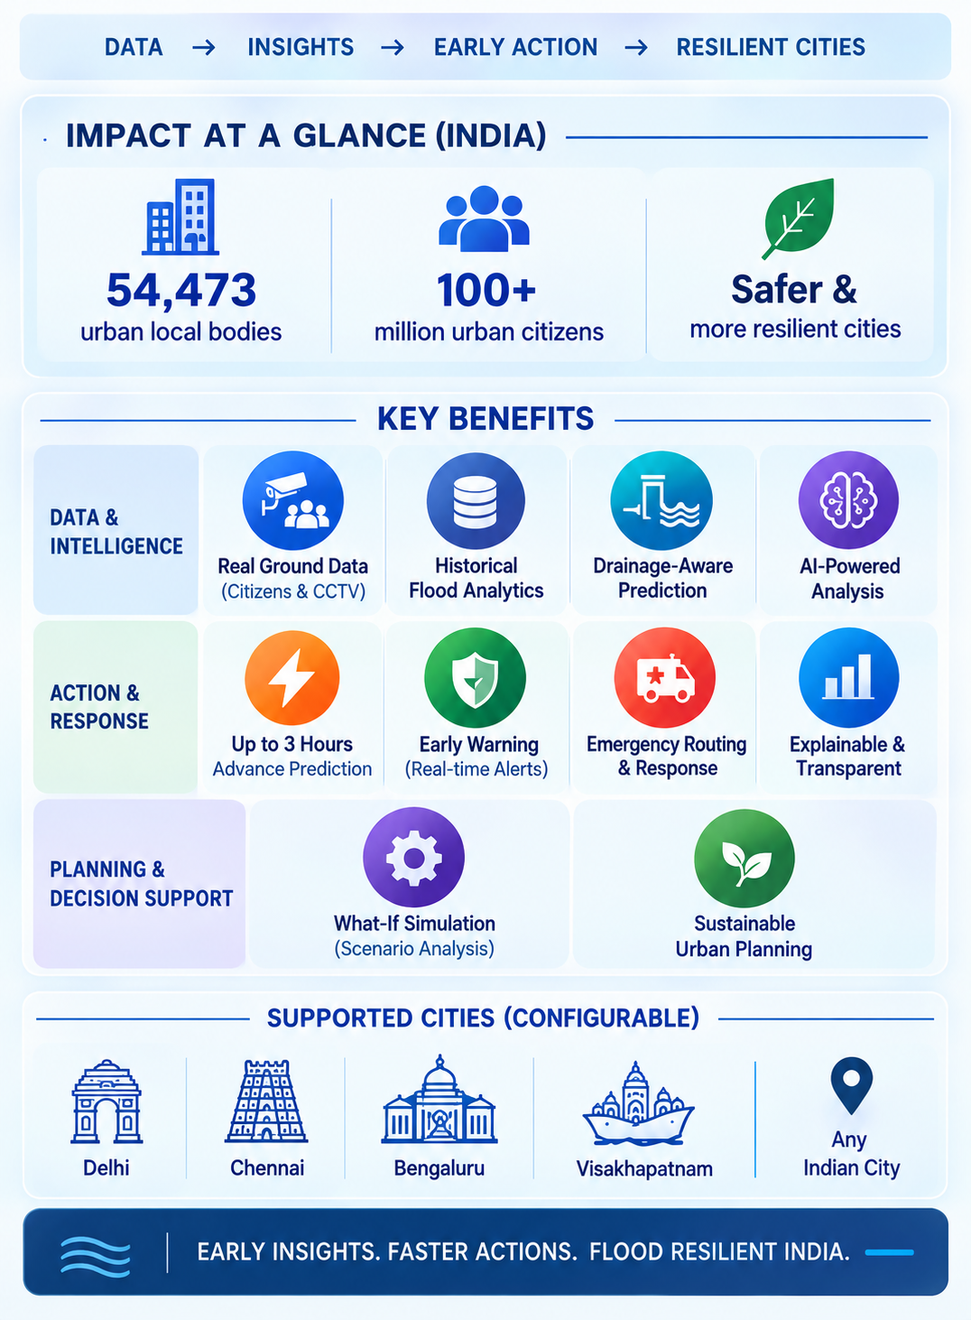
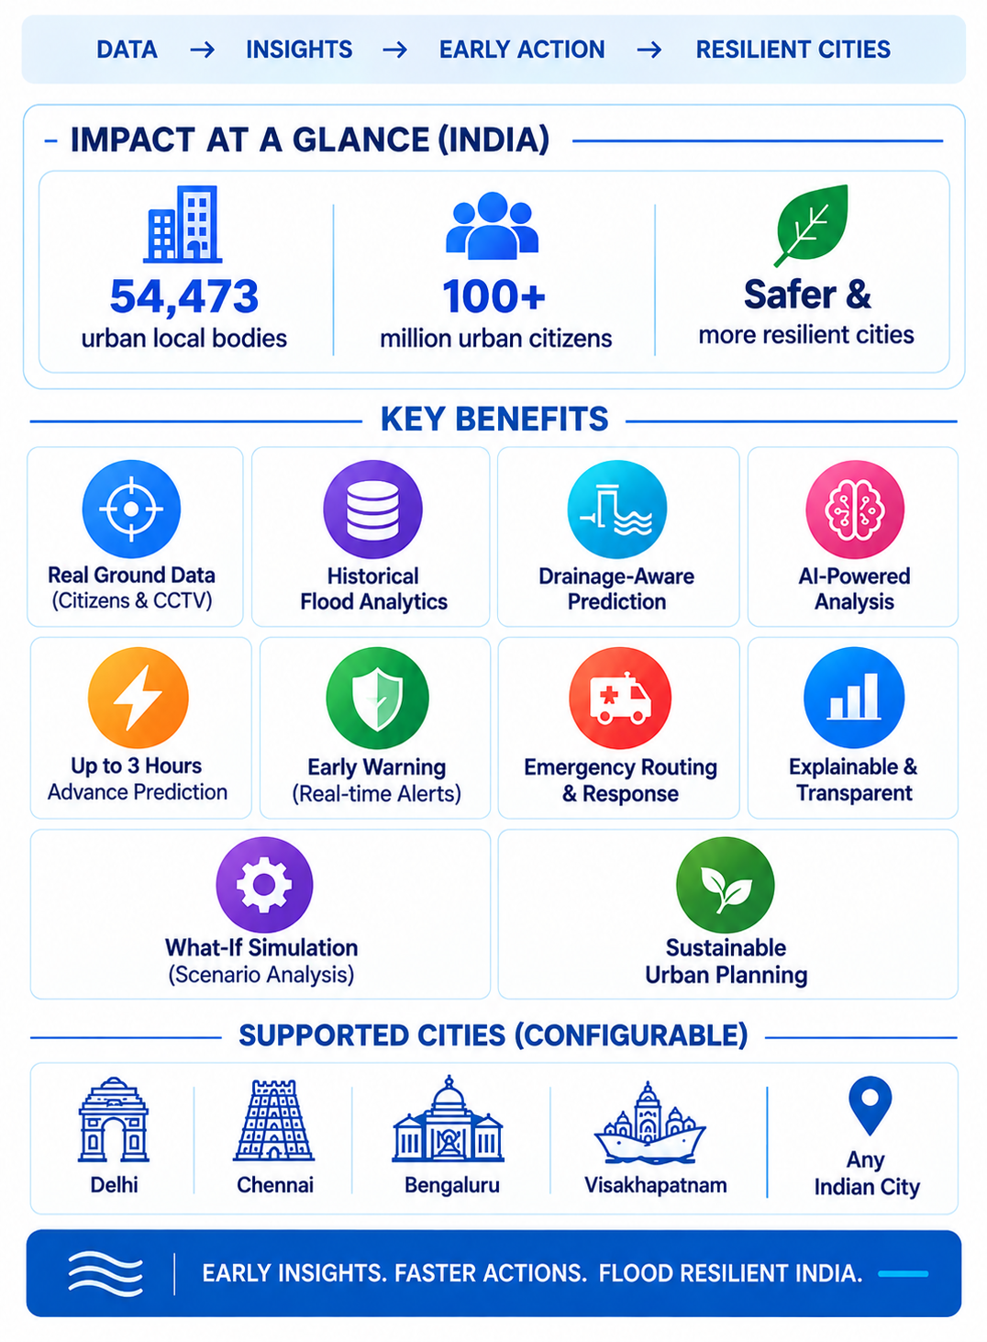
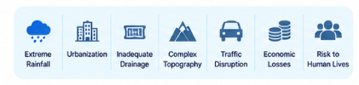
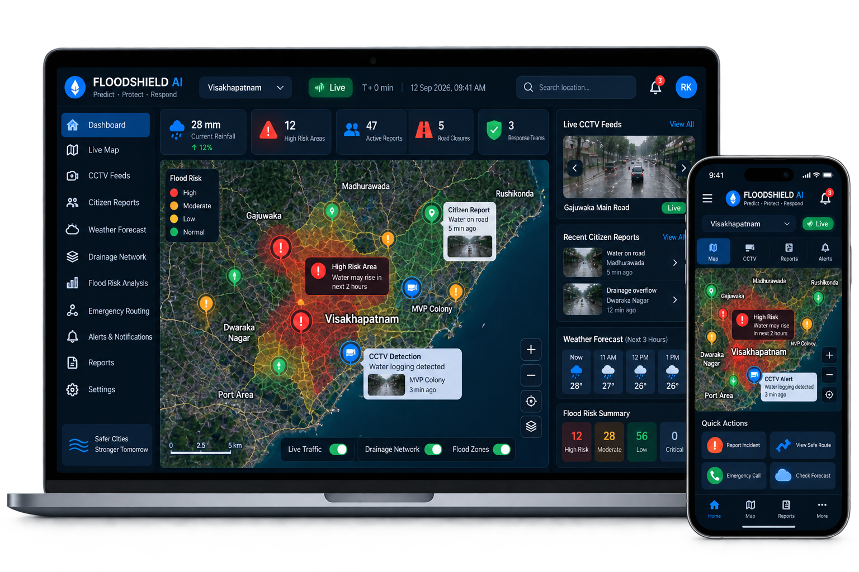

Flood Shield AI
The Challenge
Urban flooding is an annual crisis in Indian cities. Weather forecasts alone cannot predict where streets will flood. Fragmented citizen reports, CCTV, drainage, and historical data make it difficult to identify flood locations, severity, and vulnerable areas—delaying emergency response.
Proposed Solution
FLOODSHIELD AI combines citizen reports, CCTV, drainage data, historical floods and weather data to analyze flood hotspots and vulnerable streets, delivering street-level predictions, early warnings and safe routes for faster response.

Slide 3
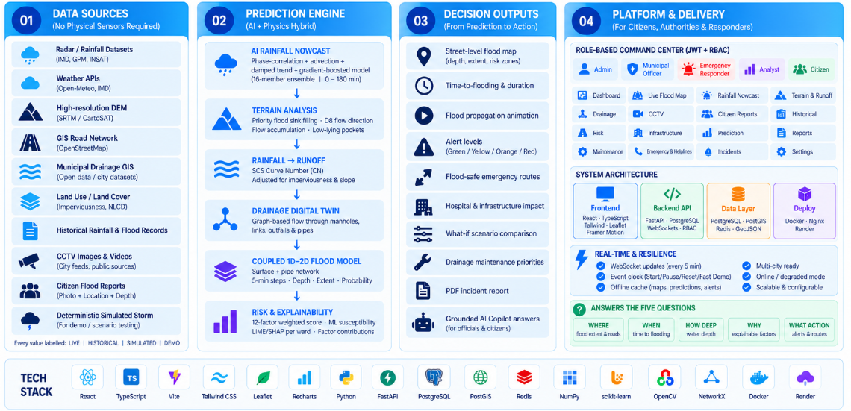
TECHNICAL APPROACH

Slide 4
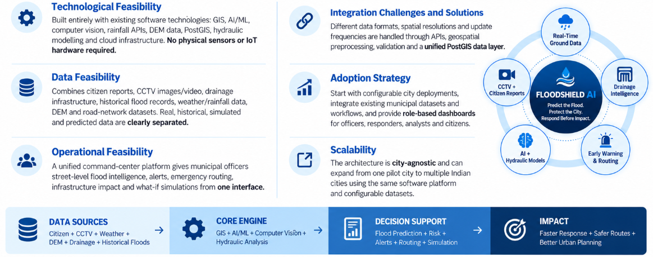
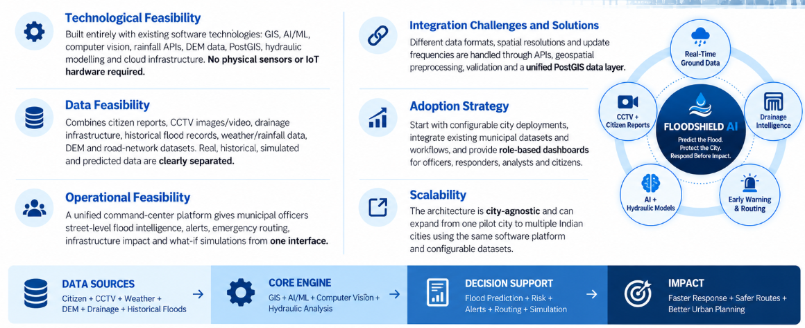
FEASIBILITY AND VIABILITY
Analysis of the feasibility of the idea
Potential challenges and risks
Strategies for overcoming these challenges

Slide 5
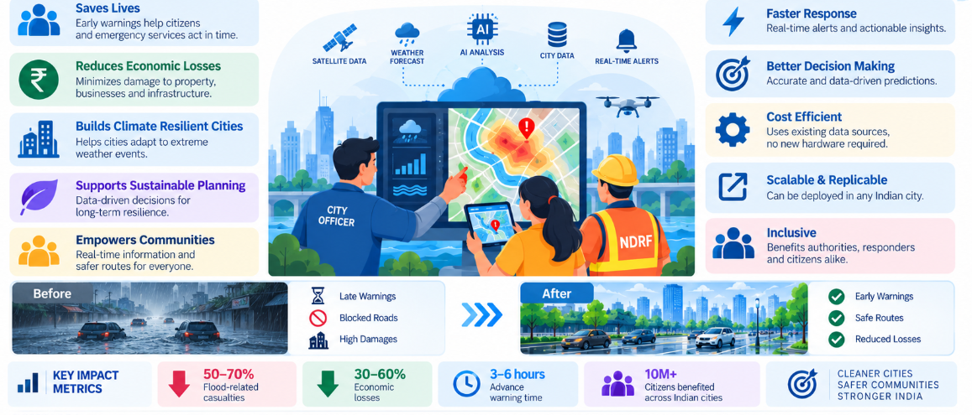
IMPACT AND BENEFITS

Slide 6
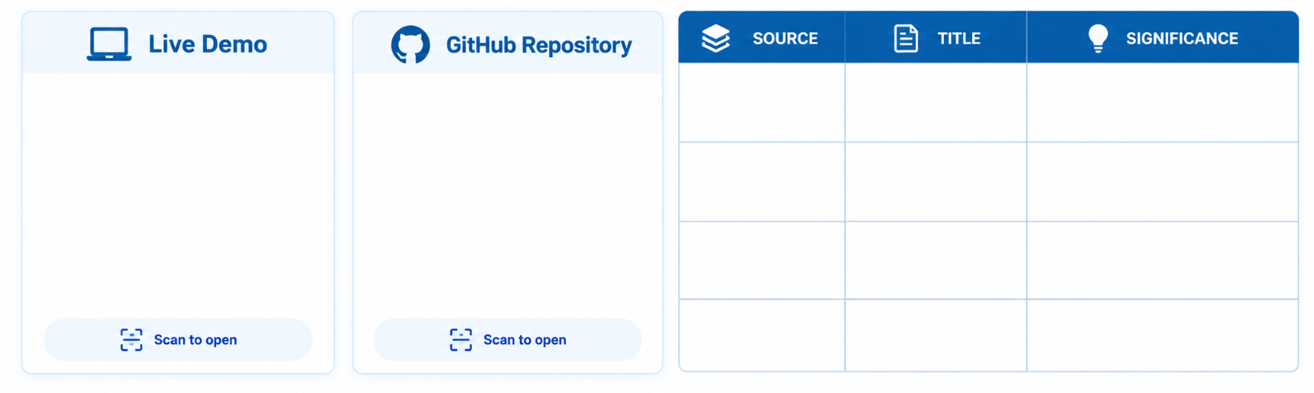


RESEARCH AND REFERENCES
Environmental Modelling & Software | Vol 143, September 2021 | ScienceDirect.com by Elsevier
Environmental Modelling & Software
Supports using webcams, social media and citizen-science data for fine-scale urban flood monitoring.
Details / Links of the reference and research work
Sustainable Cities and Society | Vol 137, 1 February 2026 | ScienceDirect.com by Elsevier
Sustainable Cities and Society
Supports combining ML and geospatial/SAR data for urban flood-risk mapping and infrastructure planning.
Urban Flooding During Monsoon Season
Provides the Indian government context on urban drainage, flood mitigation and the role of Urban Local Bodies
SOP-Urban-flooding.pdf
hhnfnnfnlflff
https://floodshield-web.onrender.com/login
https://github.com/bayyavarapubhanuteja/floodshield-ai.git
Directly supports your citizen/crowdsourced flood-data approach and its combination with rainfall and elevation information.
Urban Climate | Vol 53, January 2024 | ScienceDirect.com by Elsevier
Floods recent years with crowdsourced data

