Slide 1
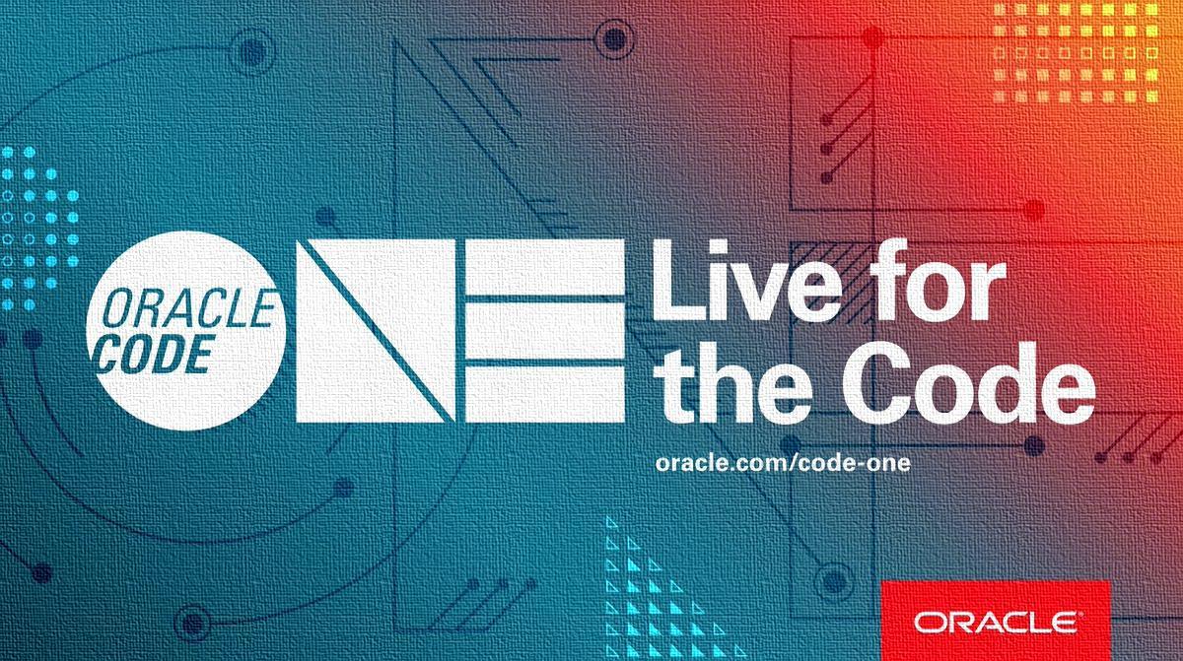
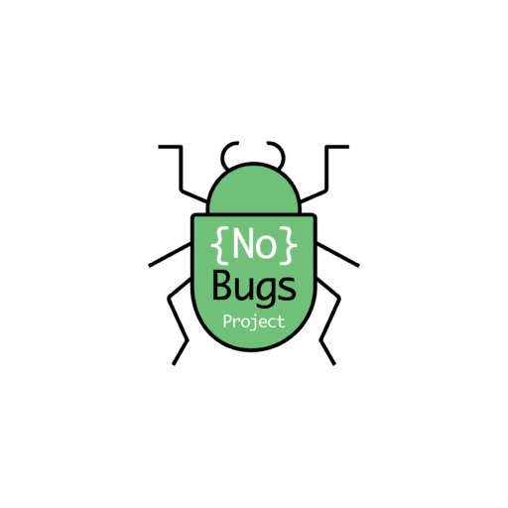

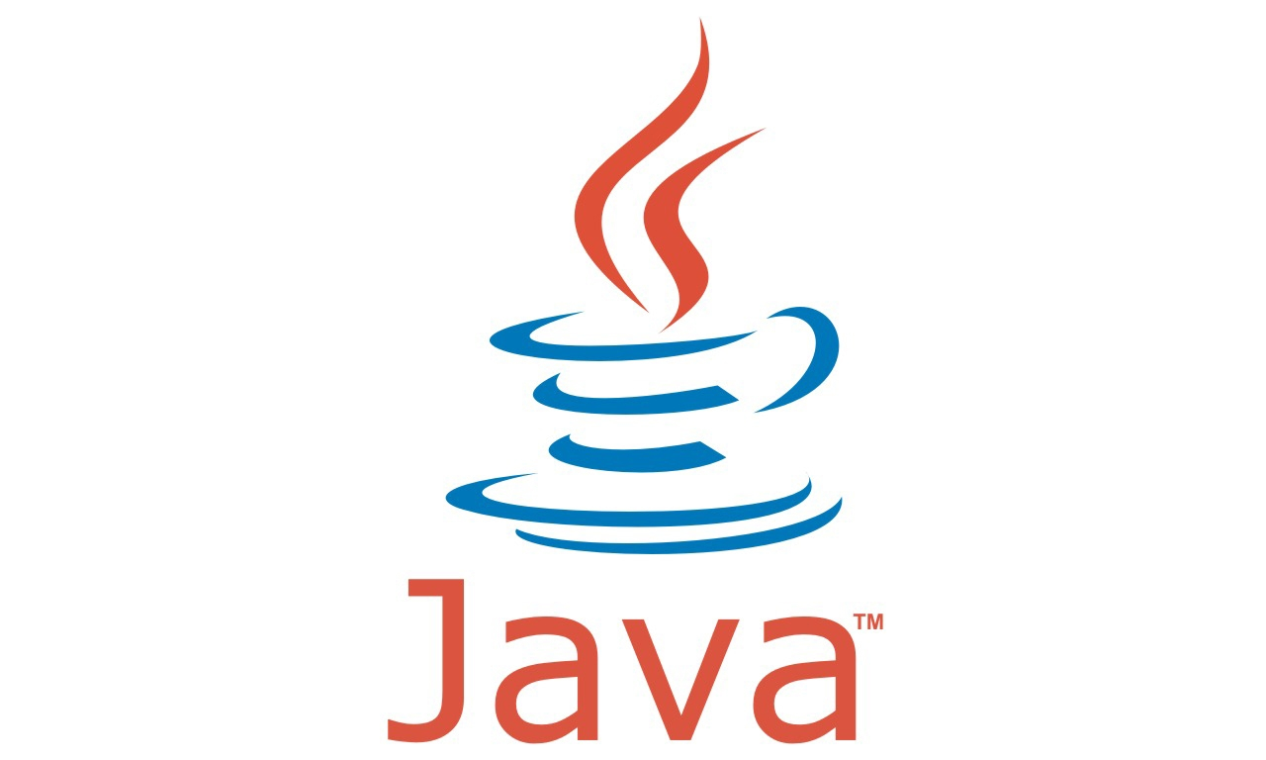

Master the Concepts Behind the Java 10 Challenges and Eliminate Stressful Bugs

Slide 2
What we will do together...
Learn 10 recently released Java core concepts
by solving fun challenges

Slide 3


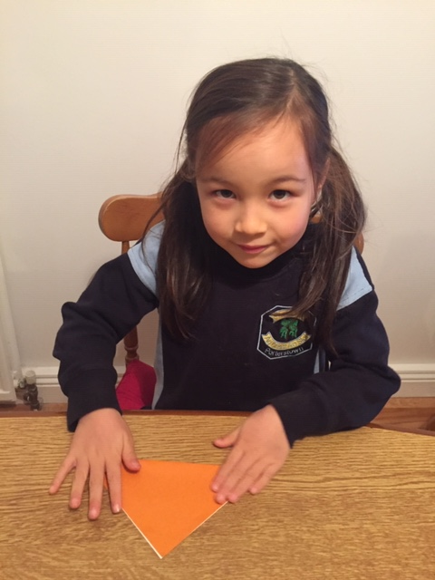

Lets learn together…
9
10

Slide 4
Topics we will cover
1. Interface
2. Optional
3. Reactive Streams
4. Try with resources
5. Take and drop while
6. CompletableFuture
7. Type Inference (var!)
8. Collection Factories
9. Functional Interfaces
10. ProcessHandle API

Slide 5

Get to know me...
Rafael Del Nero
Made in Brazil
Java Champion
Quiz master in Oracle Dev Gym
Creator of the Java Challengers series in Java World
Creator of nobugsproject.com
Author of "No Bugs, No Stress - Create a Life Changing Software Without Destroying Your Life” book.

Slide 6
Topics we will cover – Part I
1. Interface
2. Optional
3. Reactive Streams
4. Try with resources
5. Take and drop while

Slide 7
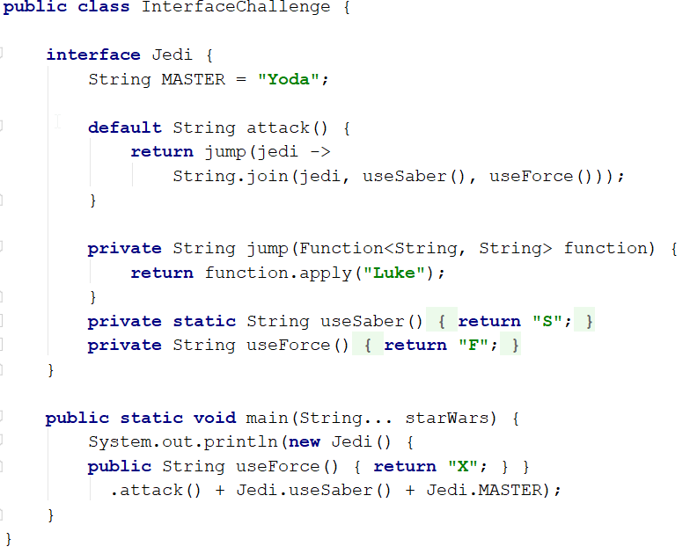
Interface #1
A) LukeSFSYoda
B) LukeXYoda
C) It won’t compile
D) SLukeFSYoda

Slide 8
Interface #1
Class != interface
A) LukeSFSYoda
B) LukeXYoda
C) It won’t compile
D) SLukeFSYoda
private methods on interfaces
Default methods

Slide 9
Interface #1
Class != interface
A) LukeSFSYoda
B) LukeXYoda
C) It won’t compile
D) SLukeFSYoda
private methods on interfaces
Default methods

Slide 10
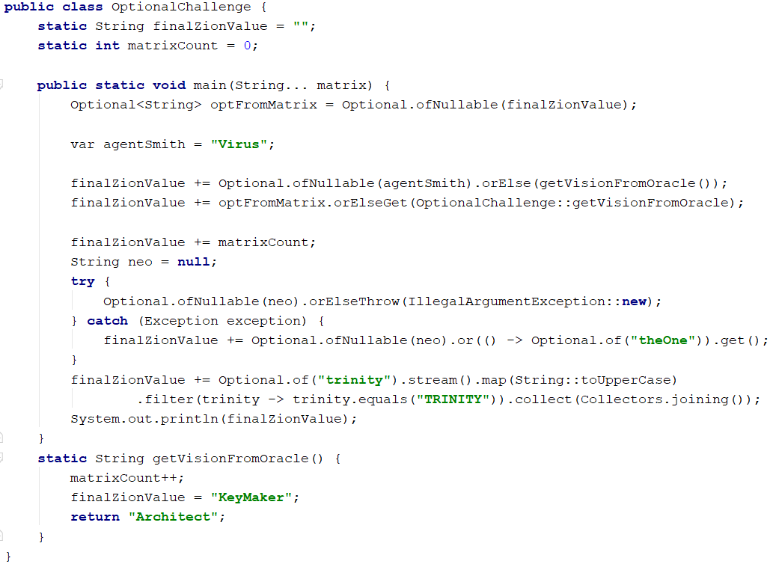
Optional #2
A) keyMakerVirus2theOneTRINITY
B) keyMakerVirusArchitect2theOneTRINITY
C) Virus1theOneTRINITY
D) keyMakerVirus1theOne

Slide 11
Optional #2
orElse
A) keyMakerVirus2theOneTRINITY
B) keyMakerVirusArchitect2theOneTRINITY
C) Virus1theOneTRINITY
D) keyMakerVirus1theOne
orElseGet
or

Slide 12
Optional #2
A) keyMakerVirus2theOneTRINITY
B) keyMakerVirusArchitect2theOneTRINITY
C) Virus1theOneTRINITY
D) keyMakerVirus1theOne

Slide 13
Optional #2
orElse
A) keyMakerVirus2theOneTRINITY
B) keyMakerVirusArchitect2theOneTRINITY
C) Virus1theOneTRINITY
D) keyMakerVirus1theOne
orElseGet
or

Slide 14
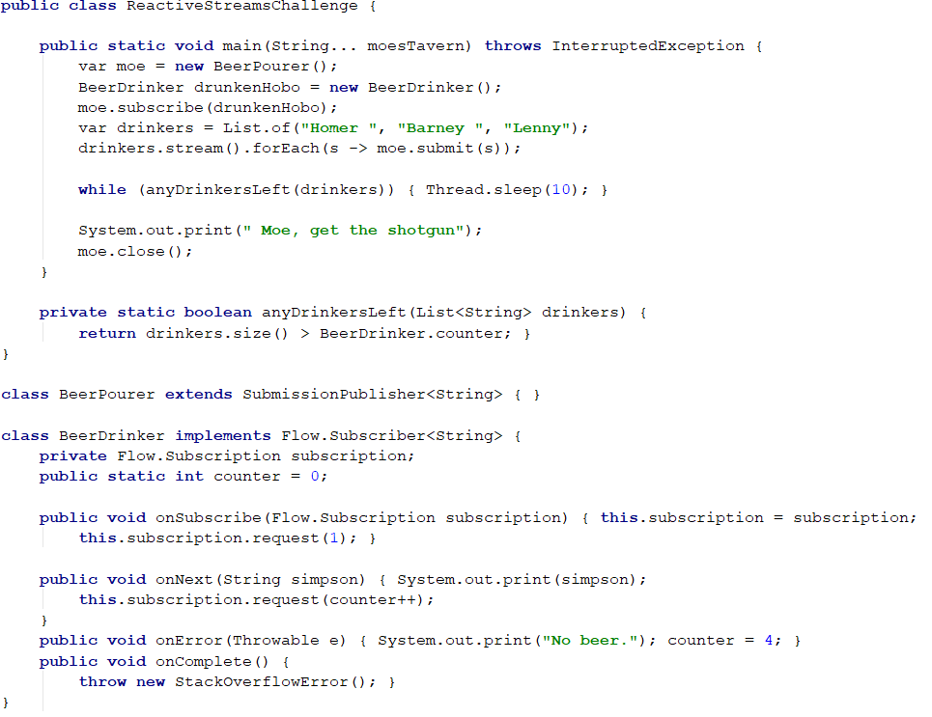
Reactive Streams #3
Asynchronous process
Homer Barney Lenny
Moe, get the shotgun
B) Homer No beer.
Moe, get the shotgun
C) It will be a random result
D) Homer Barney Lenny
and StackOverflowError will be thrown

Slide 15
Reactive Streams #3
Asynchronous process
Homer Barney Lenny
Moe, get the shotgun
B) Homer No beer.
Moe, get the shotgun
C) It will be a random result
D) Homer Barney Lenny
and StackOverflowError will be thrown
++ operator
Daemon and non-daemon Thread

Slide 16
Reactive Streams #3
Homer Barney Lenny
Moe, get the shotgun
B) Homer No beer.
Moe, get the shotgun
C) It will be a random result
D) Homer Barney Lenny
and StackOverflowError will be thrown

Slide 17
Reactive Streams #3
Asynchronous process
Homer Barney Lenny
Moe, get the shotgun
B) Homer No beer.
Moe, get the shotgun
C) It will be a random result
D) Homer Barney Lenny
and StackOverflowError will be thrown
++ operator
Daemon and non-daemon Thread

Slide 18
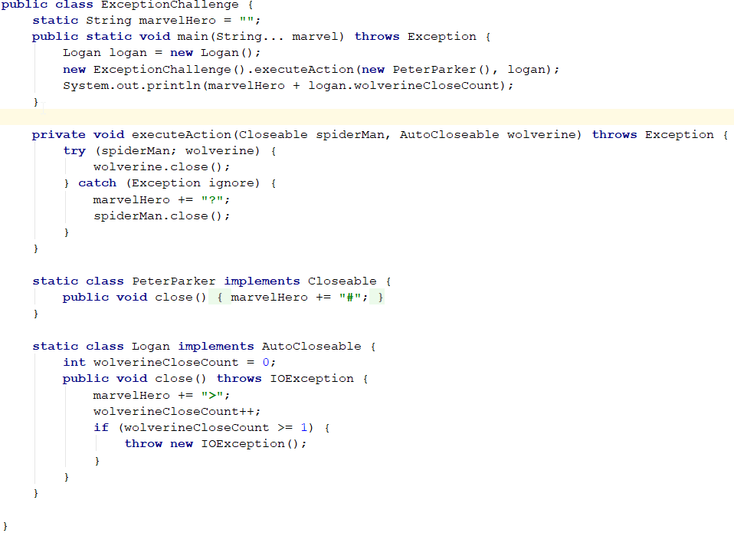
Try with resources #4
A) IOException will be thrown
B) >#?#1
C) >>#?#2
D) >#? then IOException will be thrown

Slide 19
Try with resources #4
Closable can be passed from outside since Java 9
A) IOException will be thrown
B) >#?#1
C) >>#?#2
D) >#? then IOException will be thrown
Close method is invoked after try block is executed
No need to use finally to close resources

Slide 20
Try with resources #4
Closable can be passed from outside since Java 9
A) IOException will be thrown
B) >#?#1
C) >>#?#2
D) >#? then IOException will be thrown
Close method is invoked after try block is executed
No need to use finally to close resources

Slide 21
Try with resources #4
A) IOException will be thrown
B) >#?#1
C) >>#?#2
D) >#? then IOException will be thrown

Slide 22
Try with resources #4
Closable can be passed from outside since Java 9
A) IOException will be thrown
B) >#?#1
C) >>#?#2
D) >#? then IOException will be thrown
Close method is invoked after try block is executed
No need to use finally to close resources

Slide 23
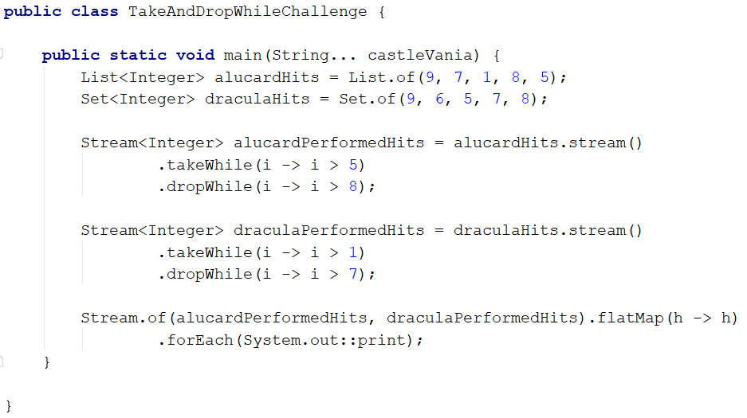
Take and drop while #5
A) 76578
B) 78657
C) 786578
D) 7 and random values

Slide 24
Take and drop while #5
Take and Drop while will break when the condition is false
A) 76578
B) 78657
C) 786578
D) 7 and random values
Set interface has unordered elements
Stream.flatMap()

Slide 25
Take and drop while #5
A) 76578
B) 78657
C) 786578
D) 7 and random values

Slide 26
Take and drop while #5
Take and Drop while will break when the condition is false
A) 76578
B) 78657
C) 786578
D) 7 and random values
Set interface has unordered elements
Stream.flatMap()

Slide 27
Topics we will cover – Part II
6. CompletableFuture
7. Type Inference (var!)
8. Collection Factories
9. Functional Interfaces
10. ProcessHandle API

Slide 28



Get to know me...
Barry Evans
Made in (N) Ireland
Live in Dublin
Java == ☺ since 2007
Consultant @ Version 1
💚 Clean Code & TDD
Dublin Java User Group Co-lead
http://DubJUG.org
💔 Bugs & Untested Code

Slide 29
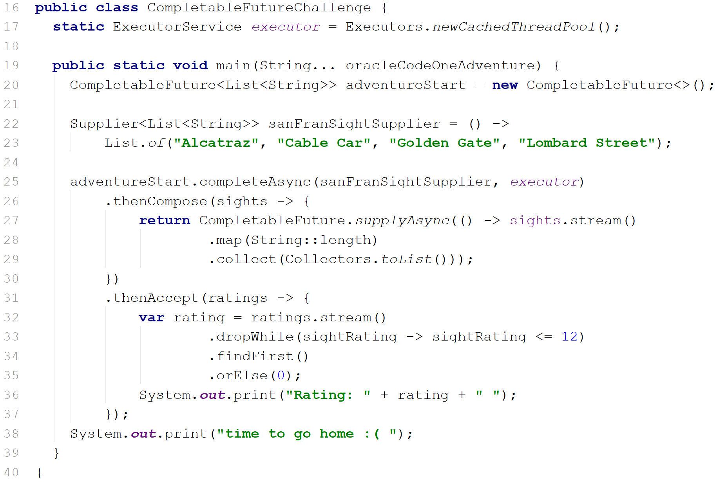
Completable Future #6
A)
time to go home :( Rating: 0 & the jvm terminates
B)
time to go home :( Rating: 14 & the jvm terminates
C)
time to go home :( Rating: 14 & the jvm does not terminate
D)
Rating: 14 time to go home :( & the jvm does not terminate

Slide 30
Completable Future #6
CF’s – Declarative task pipelines Good use of Threads
A)
time to go home :( Rating: 0 & the jvm terminates
completeAsync() – Java 9
B)
Rating: 14 time to go home :( & the jvm terminates
ExecutorService.shutdown()
C)
time to go home :( Rating: 14 & the jvm does not terminate
D)
Rating: 14 time to go home :( & the jvm does not terminate

Slide 31
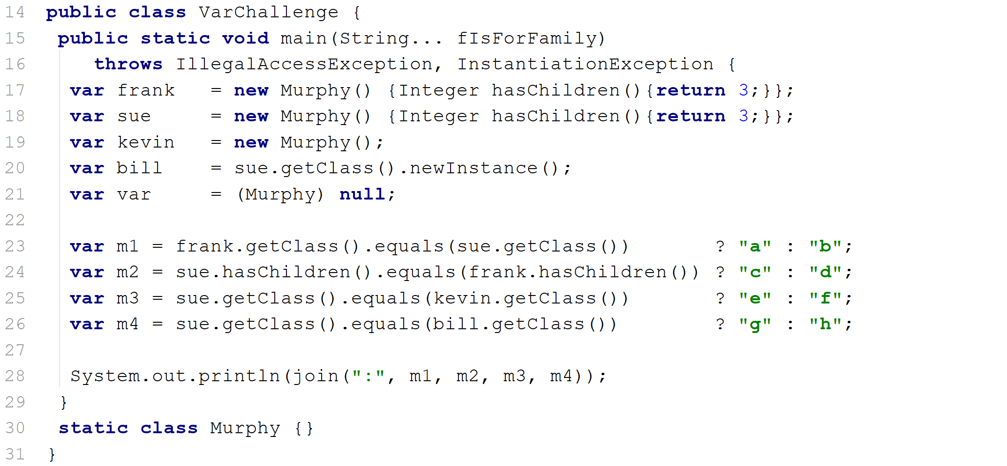
Type Inference #7
A) a:c:e:g
B) b:c:f:g
C) b:c:e:g
D) Throws java.lang.
ClassCastException
at line 21
Notes:
Non-Denotable types (like Anonymous Classes) can be inferred by var. assigning null to var var is not a keyword cons of using var why did Java use var? - show generics example Gen/1/2/3

Slide 32
Type Inference #7
Non-Denotable types
A) a:c:e:g
B) b:c:f:g
Assigning null to var
C) b:c:e:g
var is not a keyword
D) Throws java.lang.
ClassCastException
at line 21
Notes:
Non-Denotable types (like Anonymous Classes) can be inferred by var. assigning null to var var is not a keyword cons of using var why did Java use var? - show generics example Gen/1/2/3

Slide 33
Type Inference #7
A) a:c:e:g
B) b:c:f:g
C) b:c:e:g
D) Throws java.lang.
ClassCastException
at line 21
Notes:
Non-Denotable types (like Anonymous Classes) can be inferred by var. assigning null to var var is not a keyword cons of using var why did Java use var? - show generics example Gen/1/2/3

Slide 34
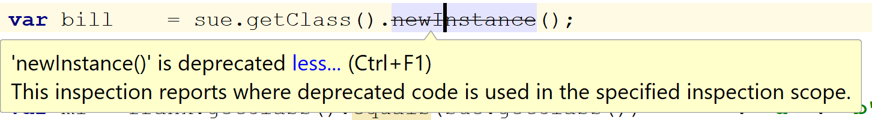

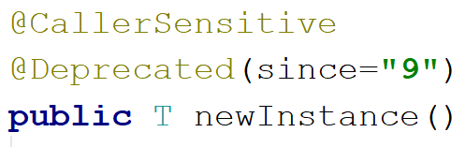
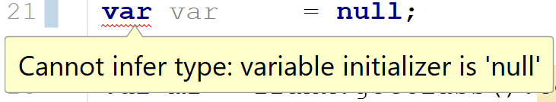
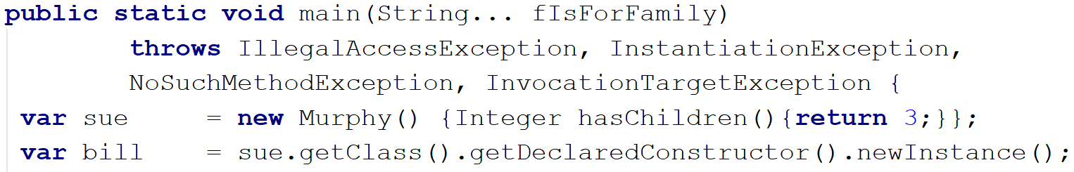
Type Inference #7
A) a:c:e:g
B) b:c:f:g
No compile-time exception checking
C) b:c:e:g
D) Throws java.lang.
ClassCastException
at line 21
Notes:
newInstance() effectively bypasses the compile-time exception checking

Slide 35
Type Inference #7
Non-Denotable types
A) a:c:e:g
B) b:c:f:g
Assigning null to var
C) b:c:e:g
var is not a keyword
D) Throws java.lang.
ClassCastException
at line 21
Notes:
Non-Denotable types (like Anonymous Classes) can be inferred by var. assigning null to var var is not a keyword cons of using var why did Java use var? - show generics example Gen/1/2/3

Slide 36
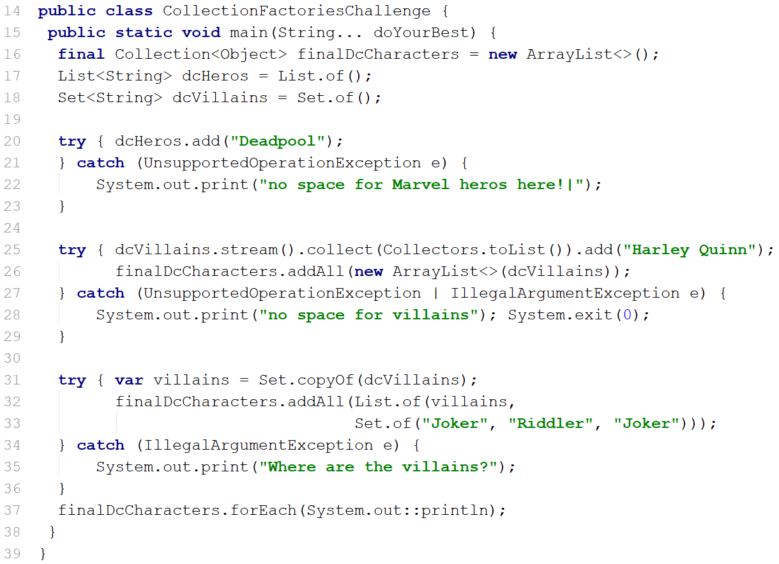
Collection Factories #8
A) no space for Marvel heros here!|Where are the villains?
B) no space for villains and exits
C) Harley Quinn, Joker, Riddler
D) Joker, Riddler, Joker

Slide 37
Collection Factories #8
of() provides Immutable collections
A) no space for Marvel heros here!|Where are the villains?
Set.copyOf() & duplicates ☺
B) no space for villains and exits
Set.of() & duplicates ☹
C) Harley Quinn, Joker, Riddler
D) Joker, Riddler, Joker

Slide 38
Collection Factories #8
Immutable Collections
A) no space for Marvel heros here!|Where are the villains?
Not assigned
B) no space for villains and exits
Java 10
C) Harley Quinn, Joker, Riddler
Duplicates not allowed
D) Joker, Riddler, Joker

Slide 39
Collection Factories #8
of() provides Immutable collections
A) no space for Marvel heros here!|Where are the villains?
Set.copyOf() & duplicates ☺
B) no space for villains and exits
Set.of() & duplicates ☹
C) Harley Quinn, Joker, Riddler
D) Joker, Riddler, Joker

Slide 40
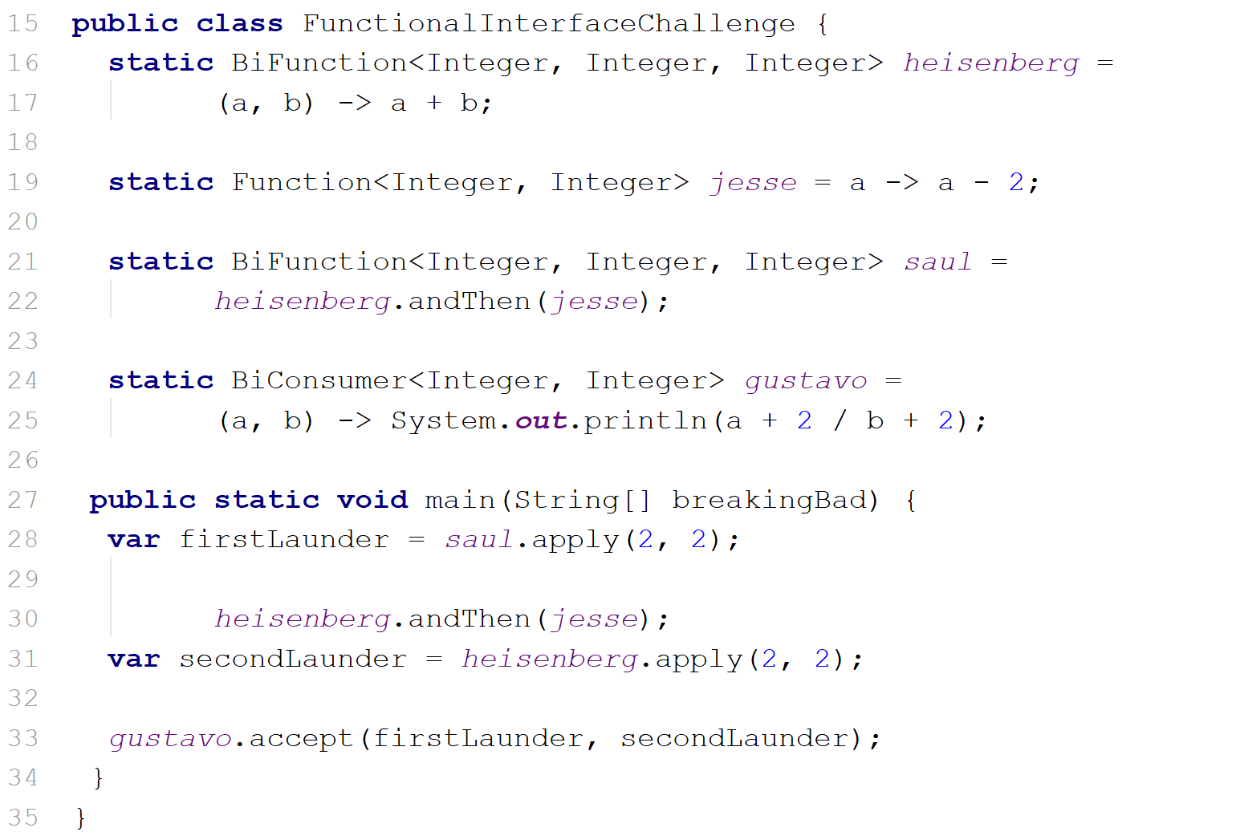
Functional Interfaces #9
A) -2
B) 1
C) 4
D) Throws
java.lang.ArithmeticException: / by zero

Slide 41
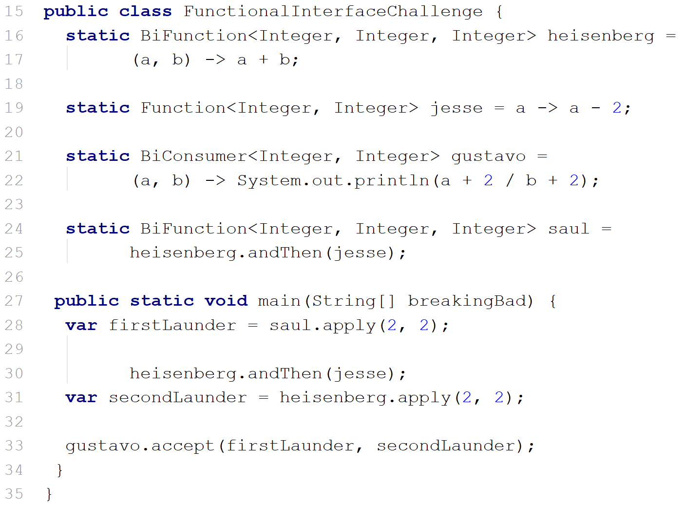
Functional Interfaces #9
Assign functional interfaces to fields
A) -2
A) -2
andThen() chaining is like a pipe |
B) 1
B) 1
C) 4
Function | BiFunction | BiConsmer
C) 4
D) Throws
java.lang.ArithmeticException: / by zero
D) Throws
java.lang.ArithmeticException: / by zero

Slide 42
Functional Interfaces #9
3
4
A) -2
A) -2
2
4
B) 1
6
B) 1
2/4 == 0.5 == 0
1
= 2
C) 4
C) 4
Does nothing
5
= 4
D) Throws
java.lang.ArithmeticException: / by zero
D) Throws
java.lang.ArithmeticException: / by zero
= 4

Slide 43
Functional Interfaces #9
Assign functional interfaces to fields
A) -2
andThen() chaining is like a pipe |
B) 1
Function | BiFunction | BiConsmer
C) 4
D) Throws
java.lang.ArithmeticException: / by zero

Slide 44
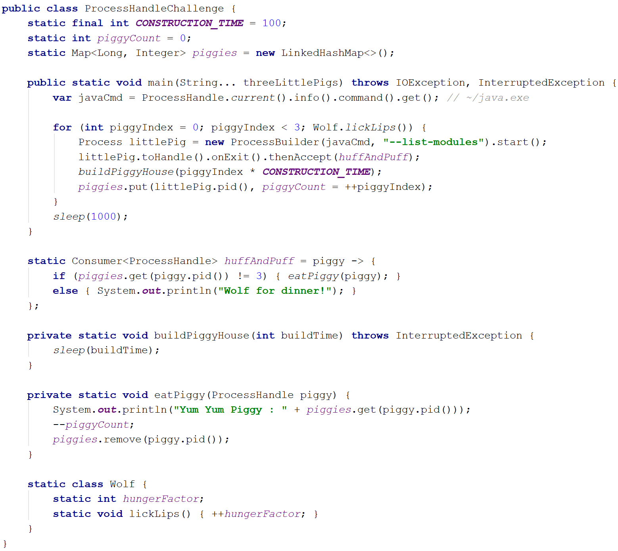
ProcessHandle API #10
A) Yum Yum Piggy : 0 Yum Yum Piggy : 1 Yum Yum Piggy : 2
B) Error: Could not create the Java Virtual Machine. Error: A fatal exception has occurred. Program will exit. Unrecognized option: --list-modules
C) Wolf for dinner! Wolf for dinner! Yum Yum Piggy : 3
D) Yum Yum Piggy : 1 Yum Yum Piggy : 2 Wolf for dinner!

Slide 45
ProcessHandle API #10
ProcessHandle | ProcessHandle.Info Java 9
A) Yum Yum Piggy : 0 Yum Yum Piggy : 1 Yum Yum Piggy : 2
liveness, children, pid, destroy
B) Error: Could not create the Java Virtual Machine. Error: A fatal exception has occurred. Program will exit. Unrecognized option: --list-modules
C) Wolf for dinner! Wolf for dinner! Yum Yum Piggy : 3
ProcessHandle.onExit() → CompletableFuture
D) Yum Yum Piggy : 1 Yum Yum Piggy : 2 Wolf for dinner!

Slide 46
Topics we covered
1. Interface
2. Optional
3. Reactive Streams
4. Try with resources
5. Take and drop while
6. CompletableFuture
7. Type Inference (var!)
8. Collection Factories
9. Functional Interfaces
10. ProcessHandle API

Slide 47

Have a wonderful @OracleCodeOne! Master the Concepts Behind the Java 10 Challenges and Eliminate Stressful Bugs
@rafaDelNero
@bazza_ni

