Slide 1
Recommendations Travel

Slide 2
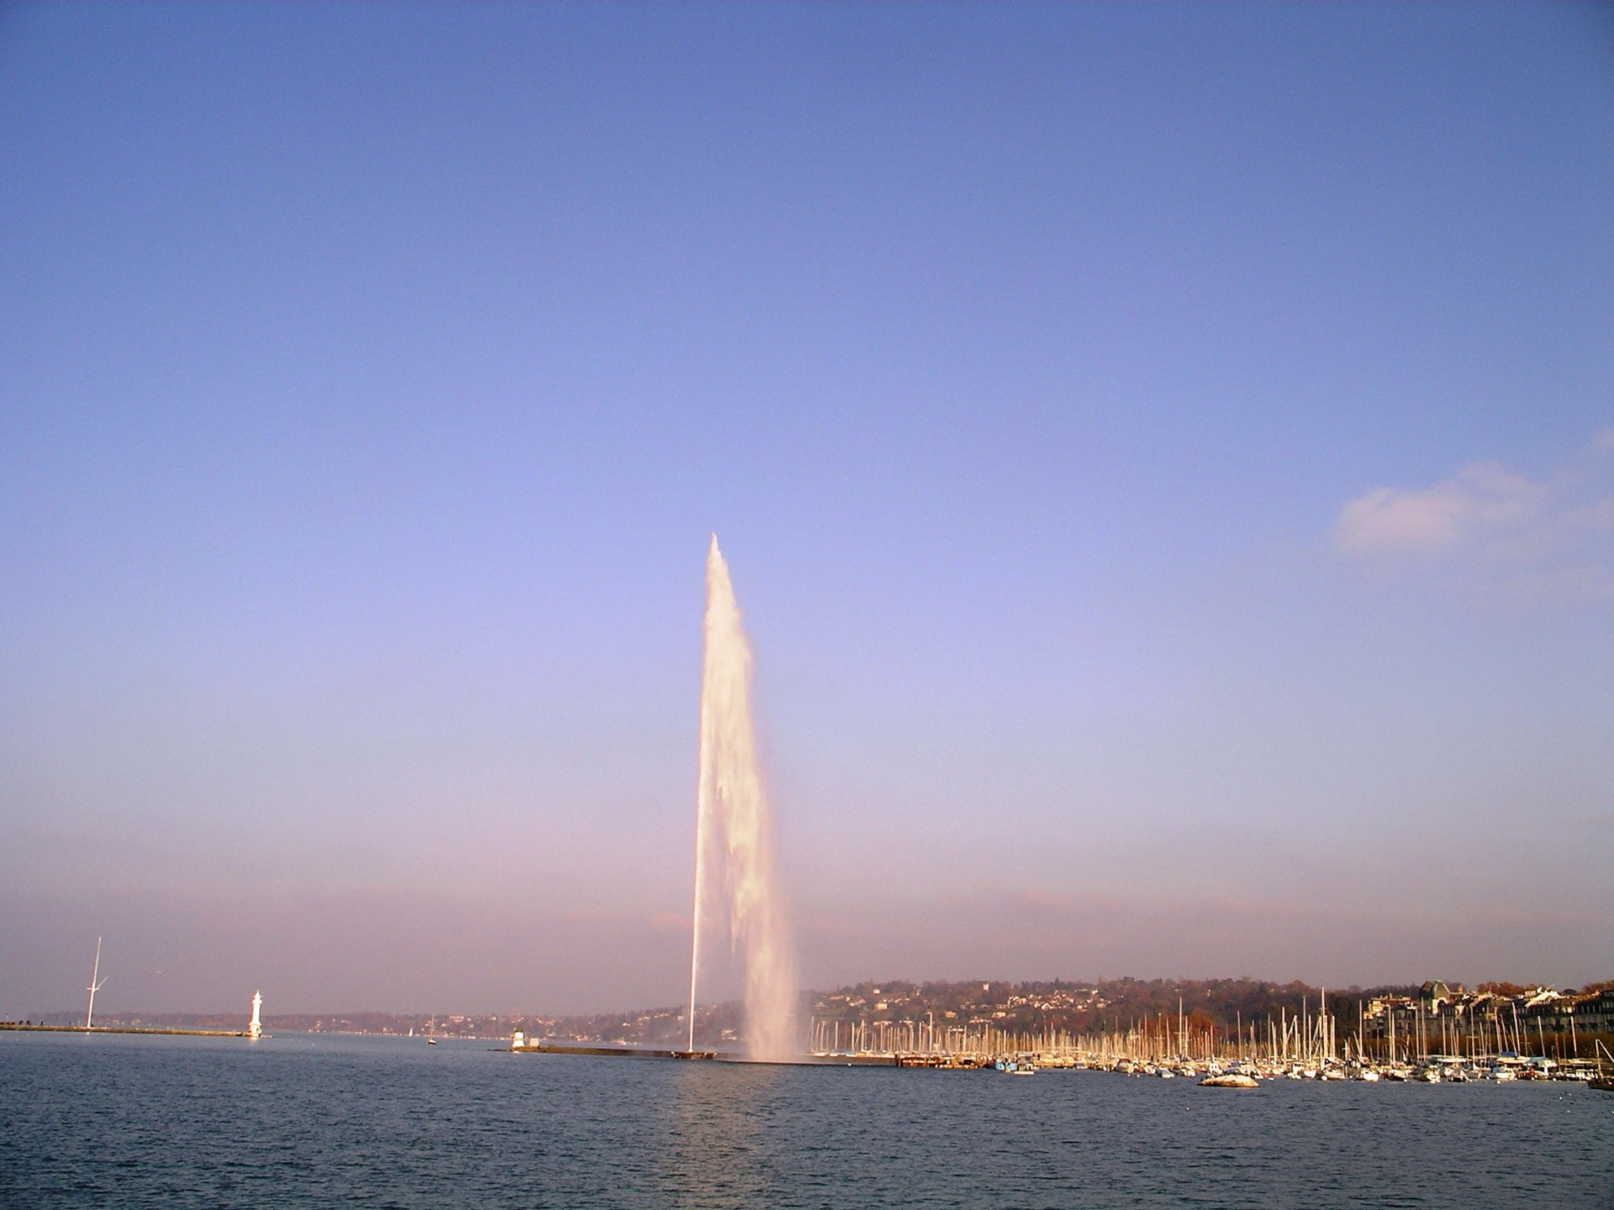
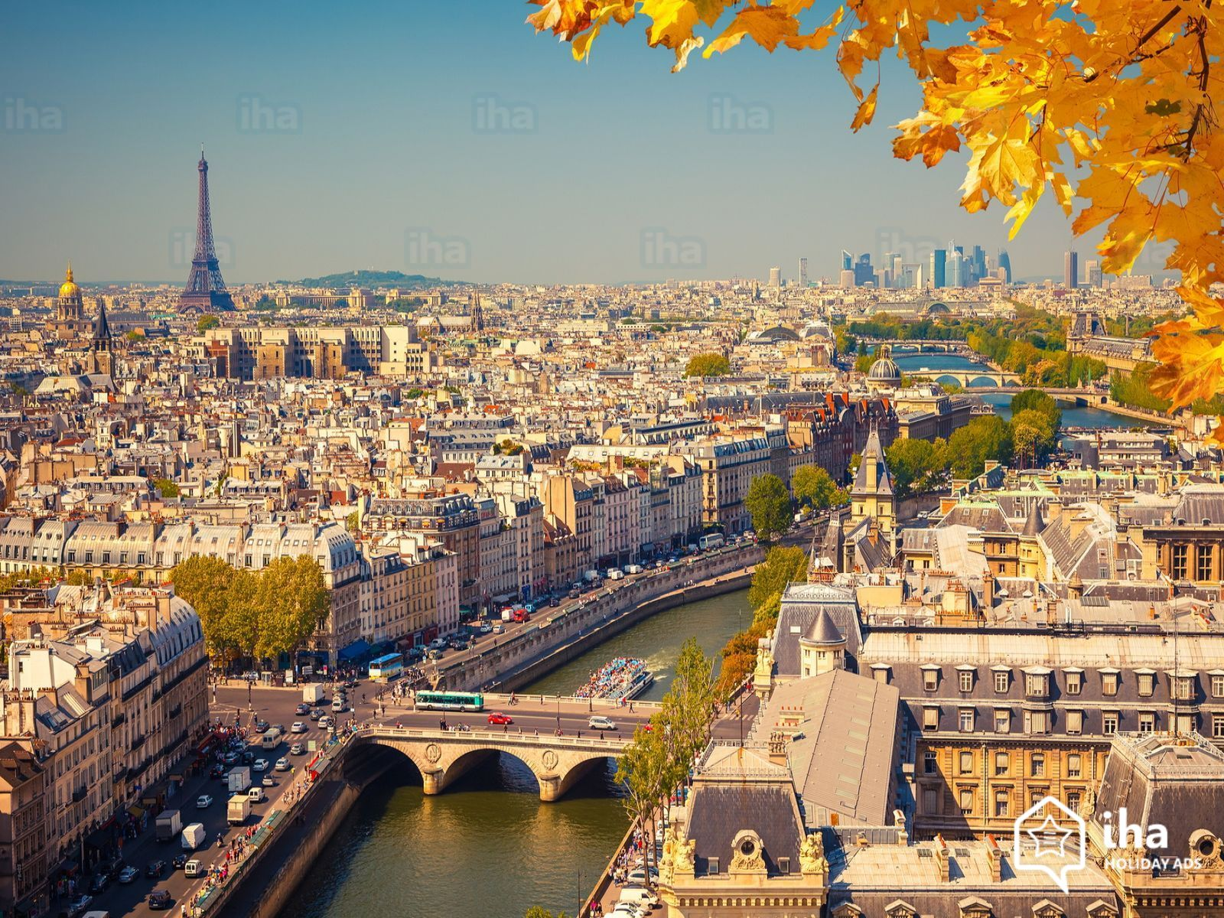
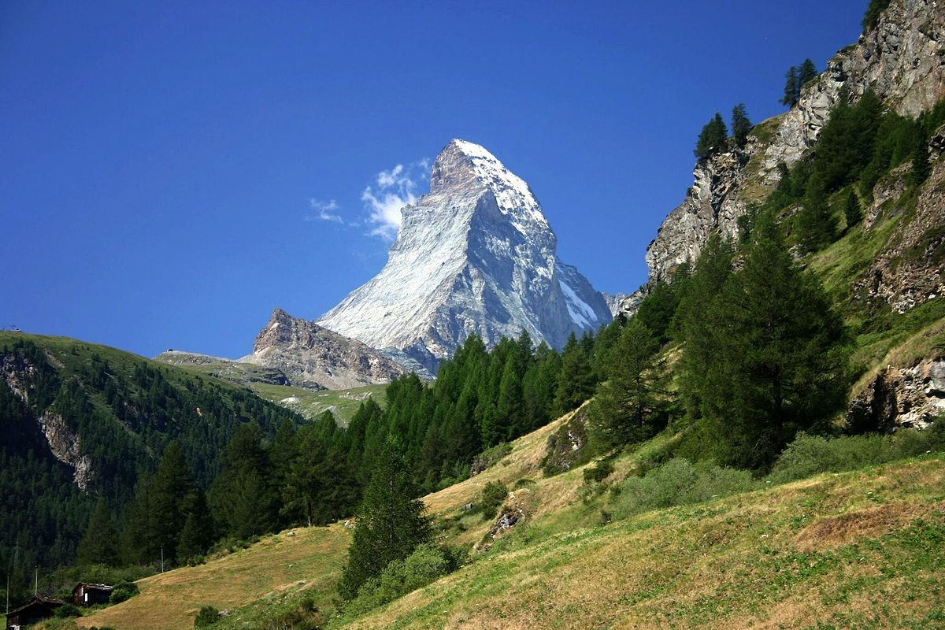
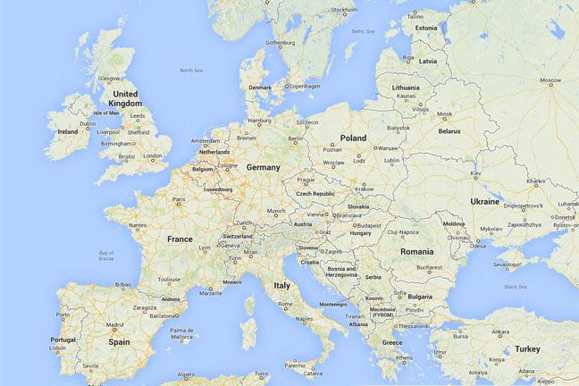
COSSCHAT
TRAVEL
GENEVA
France
Other regions in
Switzerland
Other European Countries

Slide 3
COSSCHAT
TRAVEL
GENEVA
France
Other regions in
Switzerland
Other European Countries

Slide 4
📸Attraction
🎒Excursion
🍽Restaurant
🛒Shopping
🚋Transport

Slide 5
Attraction
・Cathedrale Saint-Pierre/Cathédrale St. Pierre(link: https://www.cathedrale-geneve.ch)
・International Monument to the Reformation/Monument international de la Réformation(link: https://www.myswitzerland.com/en/experiences/monument-de-la-reformation-reformation-monument/)
・Ariana Museum/Musée Ariana(link: http://institutions.ville-geneve.ch/fr/ariana/)
・Natural History Museum/Musée d’Histoire Naturelle(link: http://www.ville-geneve.ch/plan-ville/musees/museum-histoire-naturelle/)
・Patek Philippe Museum(link: https://www.geneve.com/en/attractions/patek-philippe-museum/)
・ Museum of Far Eastern Art /Fondation Baur,Musée des Arts d’Extreme-Orient(link: https://www.fondation-baur.ch)
・Fondation Martin Bodmer /Fondation Martin Bodmer Bibliotheque et Musée (link:https://fondationbodmer.ch)

Slide 6
Excursion
・Saleve Mountain(link:https://www.myswitzerland.com/en/experiences/mont-saleve-genevas-home-mountain/)
・Jura Mountains(link:https://www.lonelyplanet.com/switzerland/the-jura-mountains)
・Baby-Plage(link:http://www.ville-geneve.ch/plan-ville/parcs-jardins-plages-bains-publics/baby-plage/)
・Club de la Plage de l'ONU / UN Port & Beach Club(link:https://unport.org/the-beach)

Slide 7
Restaurant
・ Traditional swiss food
Auberge de Savièse (https://en.yelp.ch/biz/auberge-de-savièse-genève)
Le Boël (https://en.yelp.ch/biz/le-boël-genève)
Restaurant Edelweiss(https://en.yelp.ch/biz/restaurant-edelweiss-genève)
・ Pizzeria
Restaurant Espresso Club (https://en.yelp.ch/biz/restaurant-espresso-club-genève-2?osq=pizza)
Luigia (https://en.yelp.ch/biz/luigia-genève?osq=pizza)
Restaurant Age d’Or (https://en.yelp.ch/biz/restaurant-age-d-or-genève-2?osq=pizza)
・Asian food
Hungky (https://en.yelp.ch/biz/hungky-genève)
La maison d’asie (https://en.yelp.ch/biz/la-maison-d-asie-genève-4)
Izumi(https://en.yelp.ch/biz/izumi-genève)
Chandigarh Tandoori (https://en.yelp.ch/biz/chandigarh-tandoori-genève?osq=Indian)
・For Vegetarians and Vegans
Qibi (https://en.yelp.ch/biz/qibi-genève?osq=Vegetarian)

Slide 8
shopping
Denner (link: https://www.denner.ch/de/)
Price★★★ Location ★★ ☆
Migros(link: https://www.migros.ch/de.html)
Price ★ ☆ ☆Location ★★★
COOP
Carrefour(link: https://www.carrefour.fr)
Price ★★ ☆Location ★★★
LIDRE

