Slide 1

Boris Babenko¹, Ming-Hsuan Yang², Serge Belongie¹
1. University of California, San Diego
2. University of California, Merced
OLCV, Kyoto, Japan

Slide 2

Extending online boosting beyond supervised learning
Some algorithms exist (i.e. MIL, Semi-Supervised), but would like a single framework
[Oza ‘01, Grabner et al. ‘06, Grabner et al. ‘08, Babenko et al. ‘09]

Slide 3

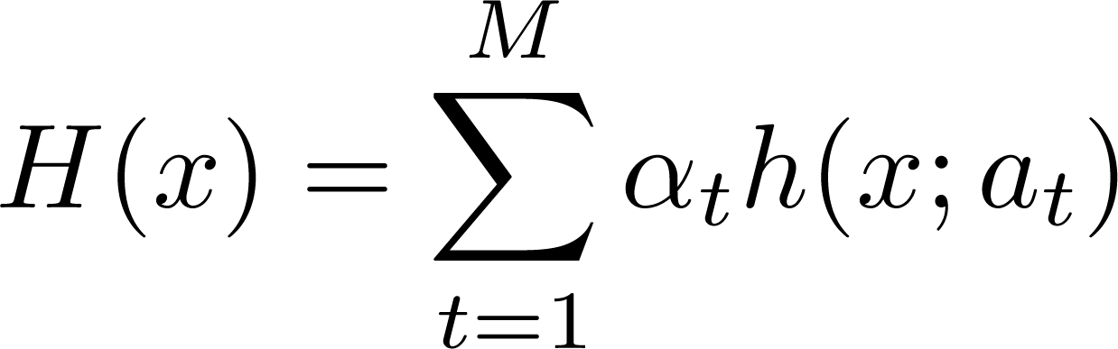


Goal: learn a strong classifier
where is a weak classifier, and is the learned parameter vector

Slide 4


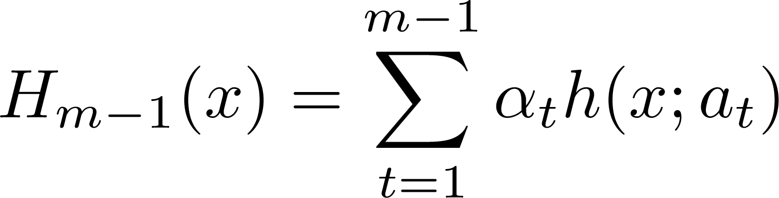
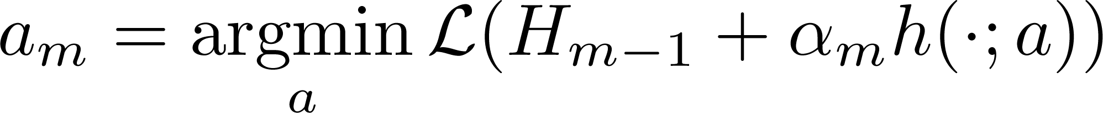
Have some loss function
Have
Find next weak classifier:

Slide 5


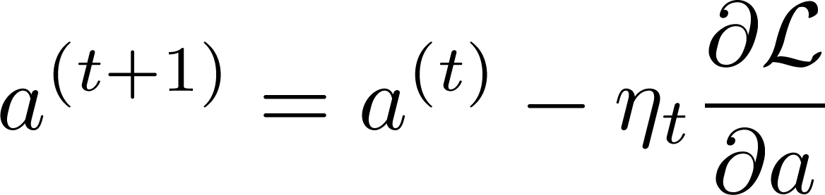
Find some parameter vector that optimizes loss

Slide 6

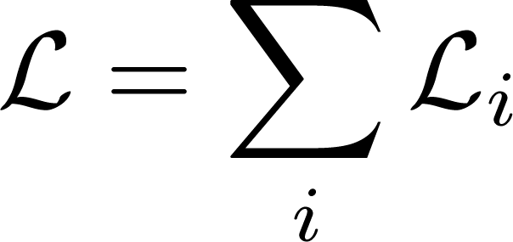
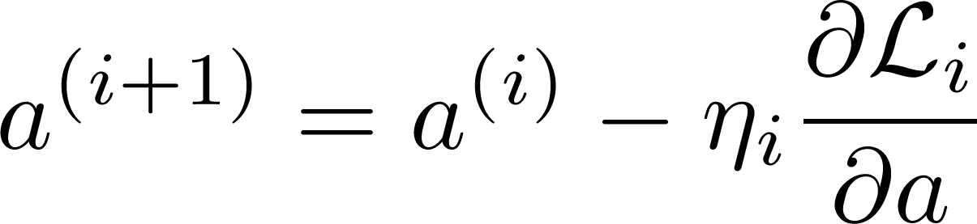
If loss over entire training data can be split into sum of loss per training example
can use the following update:

Slide 7
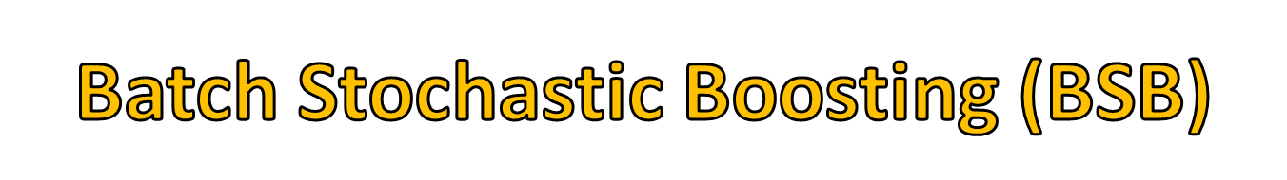
Recall, we want to solve
What if we use stochastic gradient descent to find ?

Slide 8
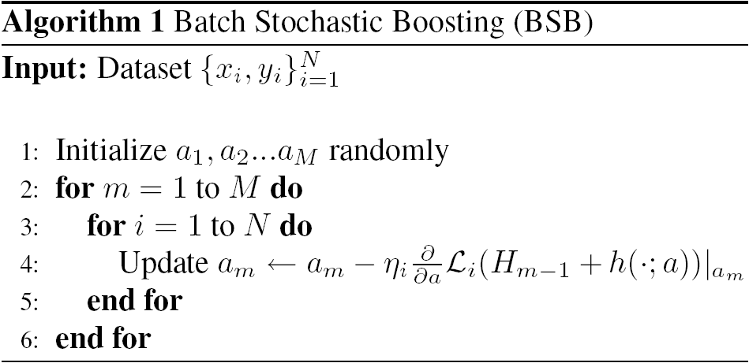

Slide 10

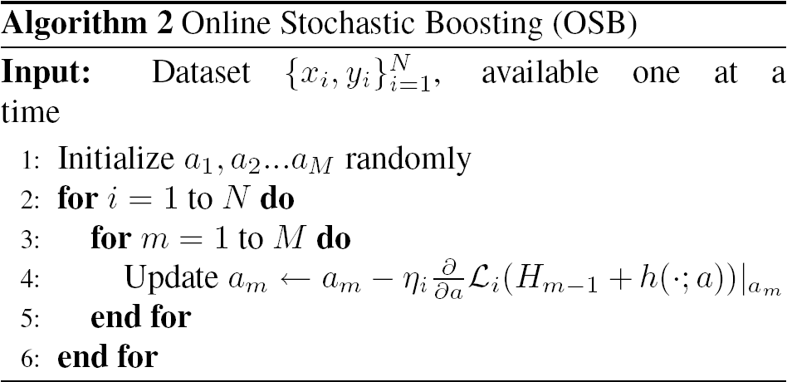

Slide 11

For any differentiable loss function, can derive boosting algorithm…

Slide 13

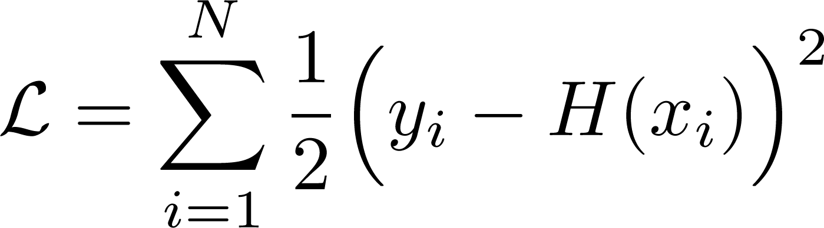
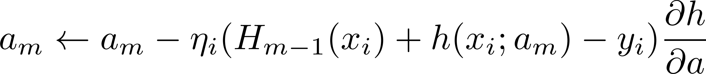
Loss:
Update rule:

Slide 14
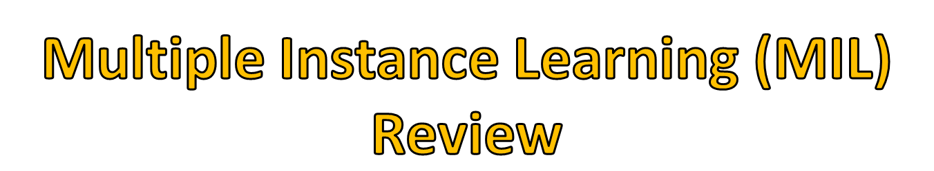
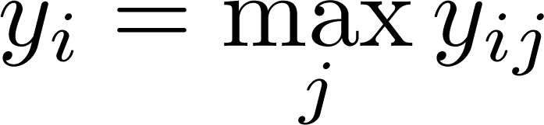
Training data: bags of instances and bag labels
Bag is positive if at least one member is positive

Slide 15

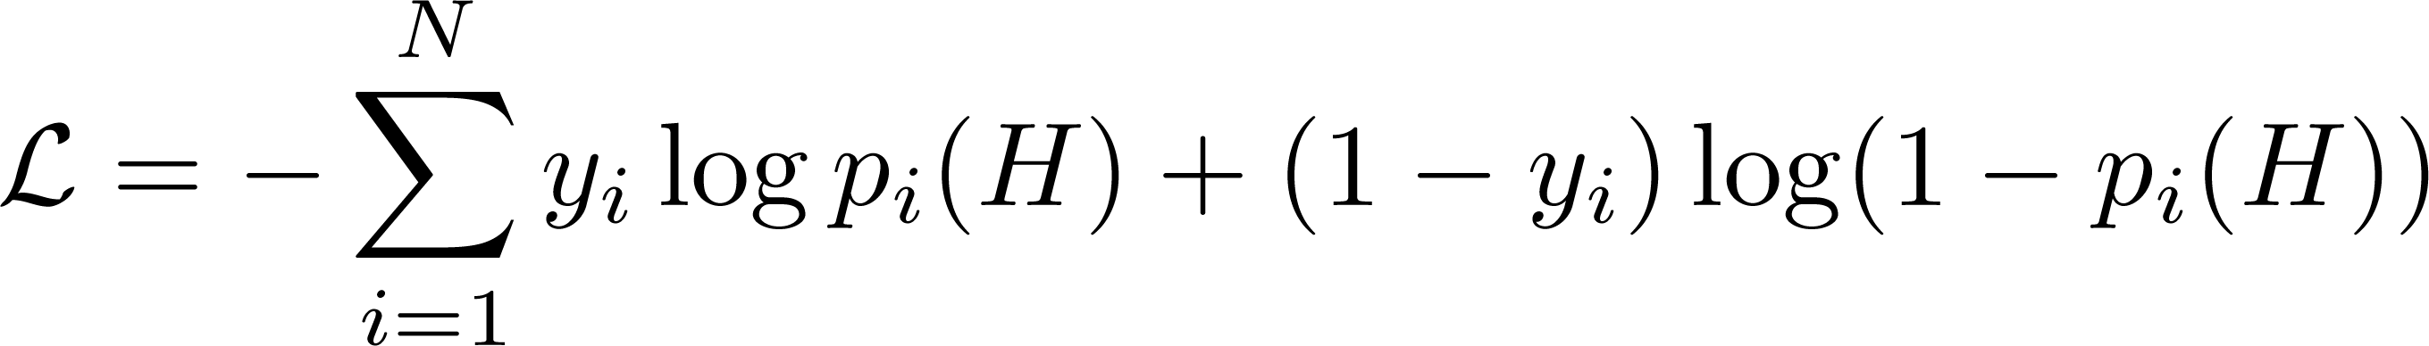
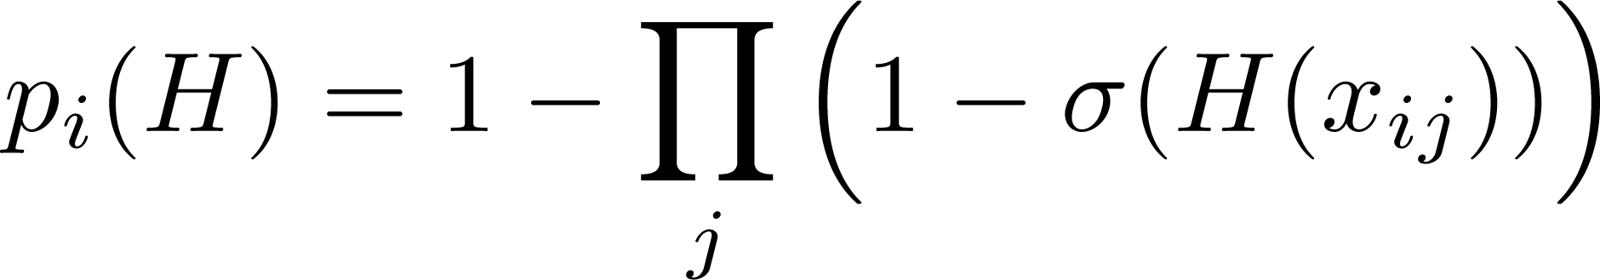
Loss:
where
[Viola et al. ‘05]

Slide 16
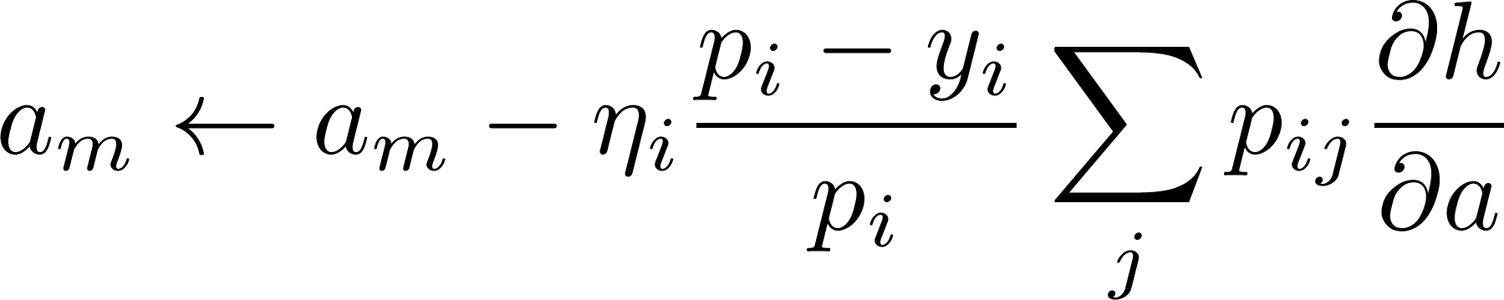
Update rule:

Slide 17

So far, only empirical results
Compare
  OSB
  BSB
  standard batch boosting algorithm
  Linear & non-linear model trained with stochastic gradient descent (BSB with M=1)

Slide 18

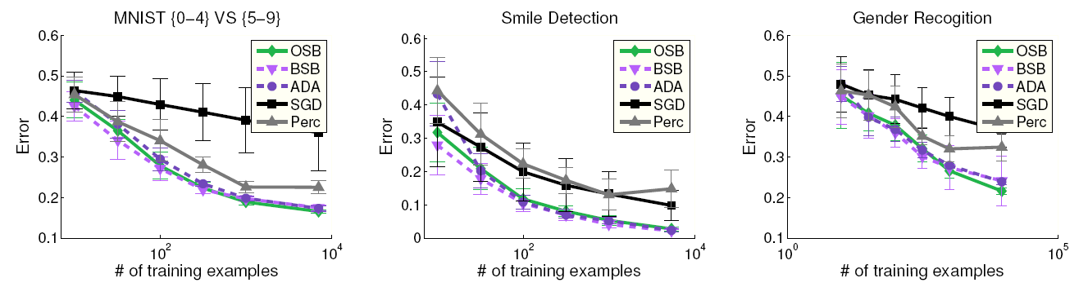
[LeCun et al. 98, Kanade et al. ‘00, Huang et al. ‘07

Slide 19

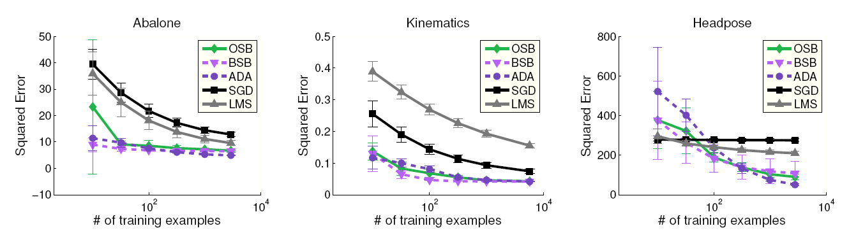
[UCI Repository, Ranganathan et al. ‘08]

Slide 20

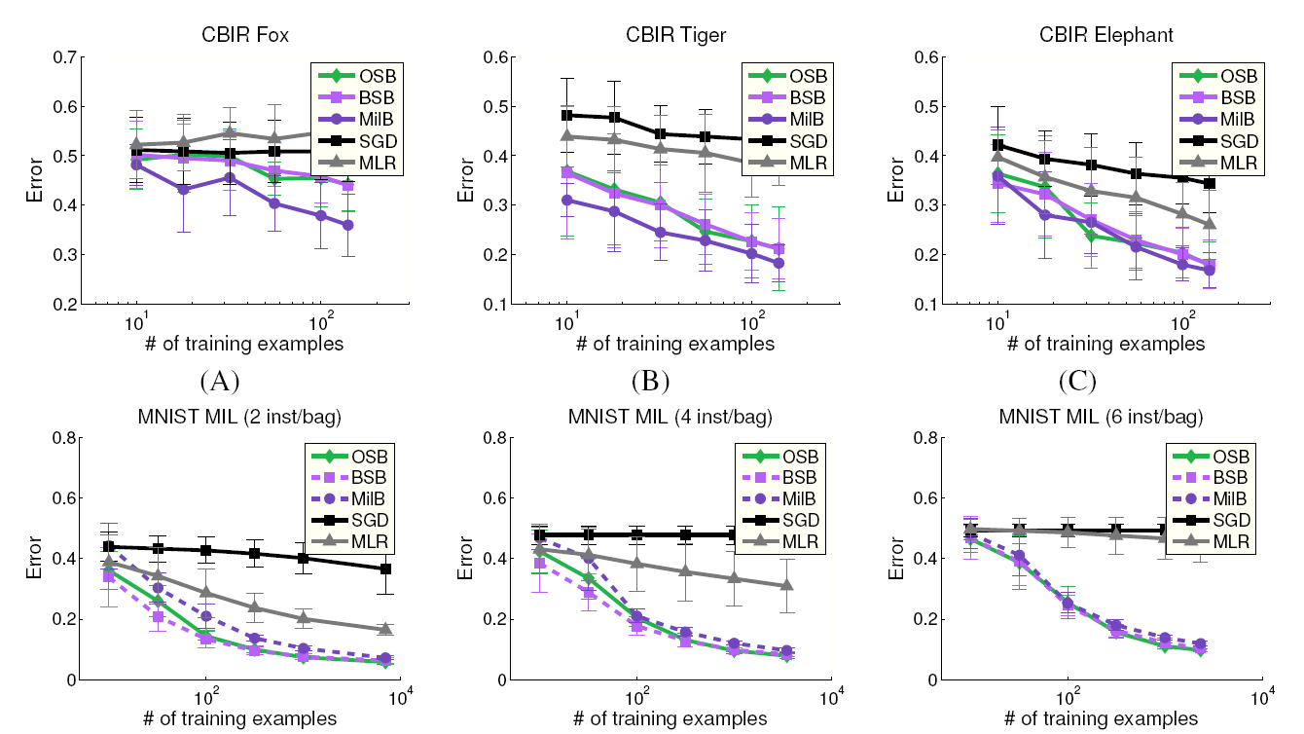
LeCun et al. ‘97, Andrews et al ‘02

Slide 21

Friedman’s “Gradient Boosting” framework = gradient descent in function space
  OSB = gradient descent in parameter space
Similar to Neural Net methods (i.e. Ash et al. ‘89)

Slide 22

Advantages:
  Easy to derive new Online Boosting algorithms for various problems / loss functions
  Easy to implement
Disadvantages:
  No theoretic guarantees yet
  Restricted class of weak learners

Slide 23

Research supported by:
  NSF CAREER Grant #0448615
  NSF IGERT Grant DGE- 0333451
  ONR MURI Grant #N00014-08-1-0638

