Slide 1
Prions
Or
Why You Don’t Feed Cows to Other Cows

Slide 2
Proteins
Linear strand of molecules
“String”
Function == 3D Structure (and a bunch of other factors we won’t discuss)
Among the most structurally complex objects in existence
No proteins = no you

Slide 3
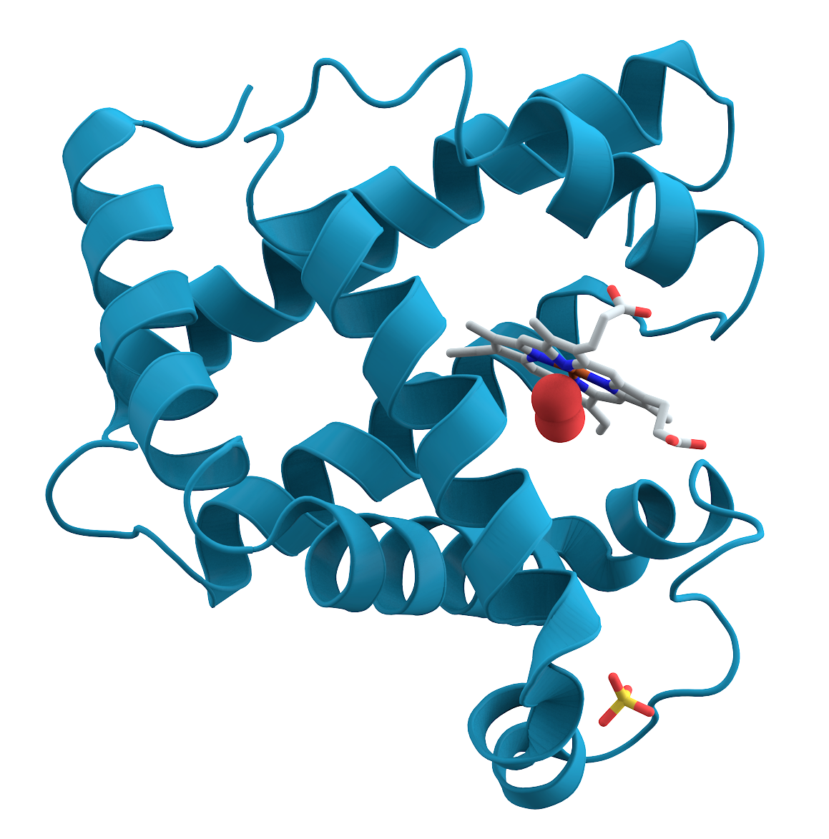
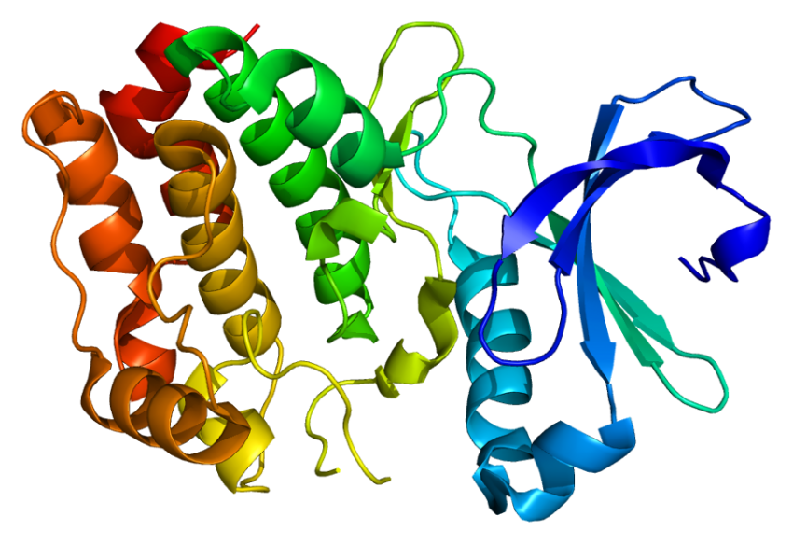
Tiny Machines

Slide 4
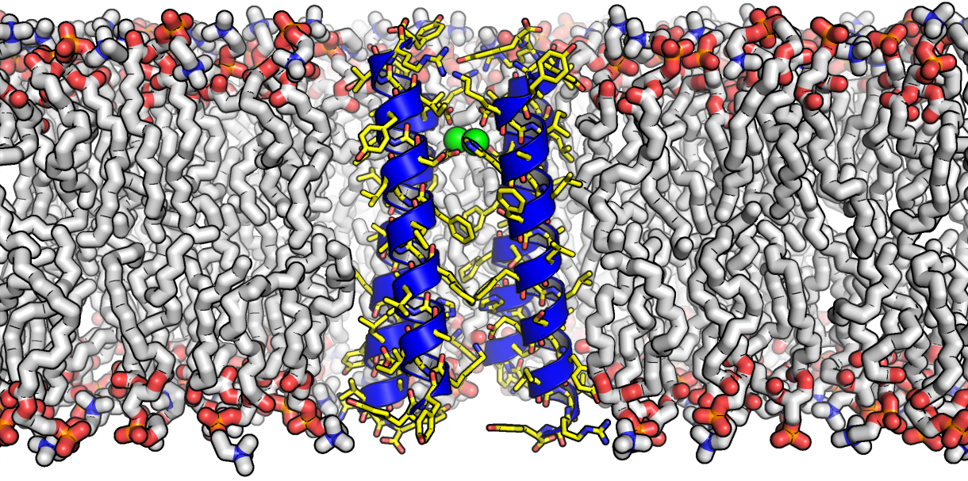
Tiny Machines Built Into Things

Slide 5
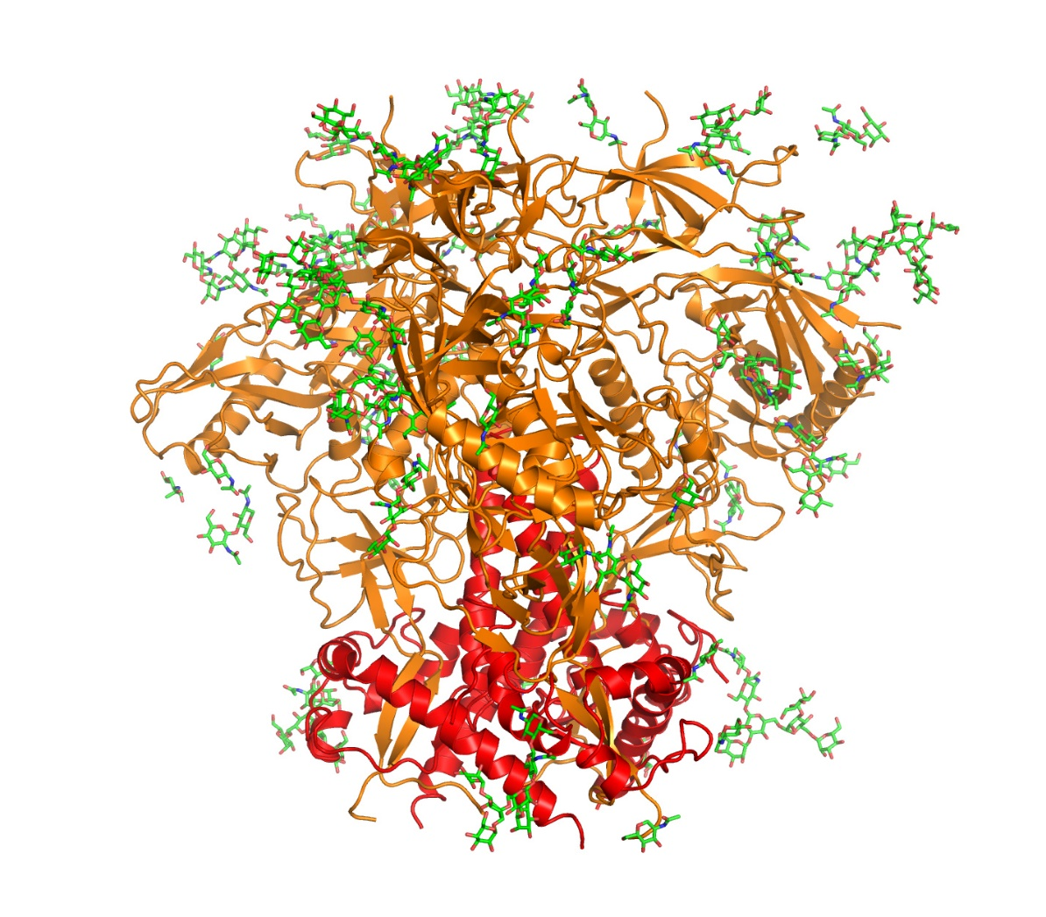
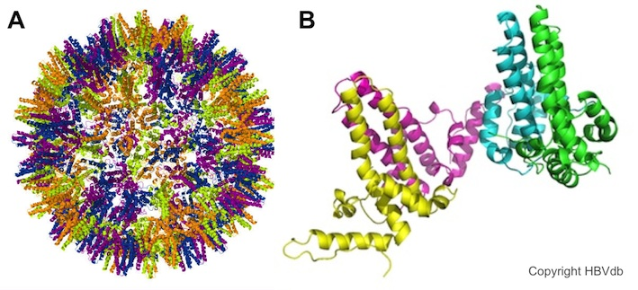
Making You Sick
Hepatitis B Virus structure
HIV membrane-fusing protein

Slide 6
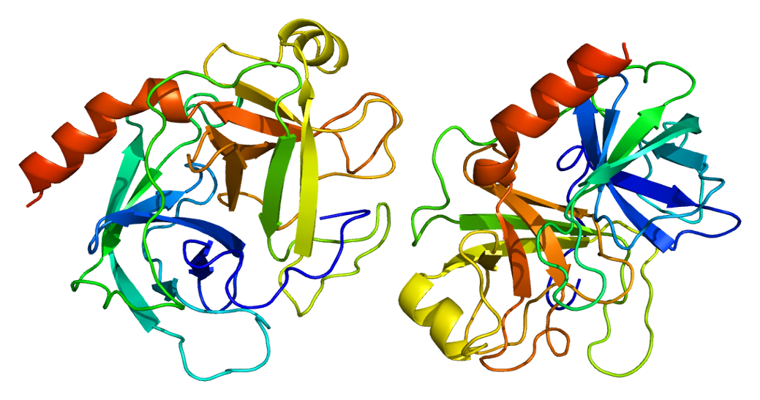
Keeping You Healthy

Slide 7
Prions
Refers to both healthy and diseased form
Non-living disease particle
PRotenaceous infectION
“Short-circuit”
Functional invincibility

Slide 8
Healthy Prion Protein
Diseased Prion

Slide 9
Prion and Prion-type Diseases
Known:
Bovine Spongiform Encephalopathy (Mad Cow Disease)
Creutzfeldt-Jakob Disease
Amyotrophic Lateral Sclerosis (Lou Gehrig’s Disease)
Alzheimer’s Disease
Huntington’s Disease
Suspected:
Tuberculosis
Crohn’s Disease
Rheumatoid Arthritis

Slide 10
Our Simulation
Epidemiology Model
System of ODEs
Modelling intercellular and extracellular spread
Exosome-based transport

Slide 24
The Runge-Kutta Method
A robust method for numerically solving ordinary differential equations

Slide 25
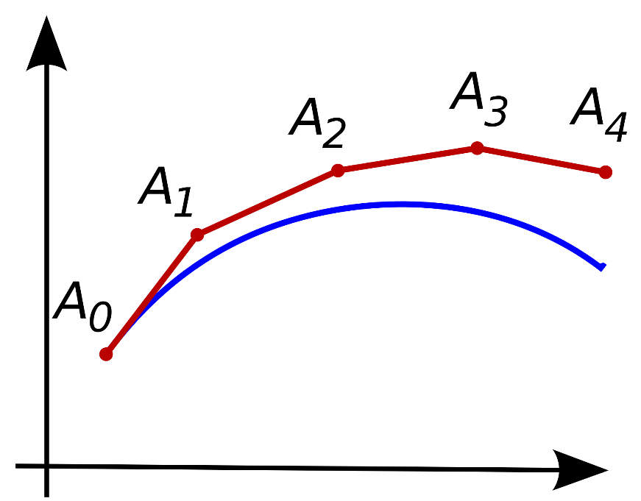
What it improves upon: the Euler’s Method
Euler’s method:
Calculate function’s derivative
Use this derivative as slope and advance time step
Calculate new derivative at this point, ect, ect.
For very small timesteps this can be a valid method, but error is still O(h³)

Slide 26
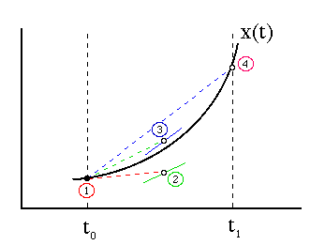
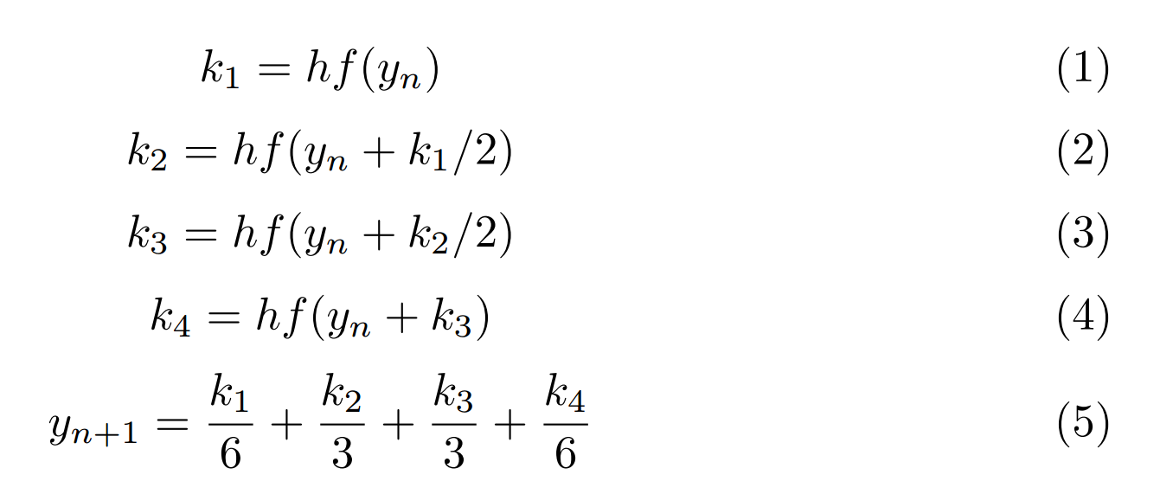
Why Runge-Kutta is better and how it works
Runge-Kutta uses a weighted average of recursively calculated derivatives
to get maximum accuracy. We use the 4th order version, which gives the best
accuracy to computation time ratio. This gives us O(h⁴), so our h can be much larger.
Terms: y_{n} = initial conditions, h = timestep, k1-4: recursively calculated derivatives

Slide 27
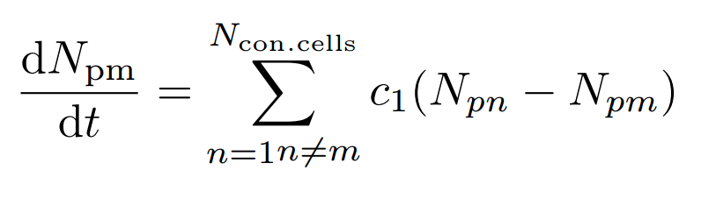
Our implementation
for (int i = 0; i < numCells; i++) {
for (int j = 0; j < numCells; j++) {
switch (cycle) {
case 1:
if (h[i][j] && (i != j)) {
k1[i] += (constant*cellVector.at(j).prionCount - constant*cellVector.at(i).prionCount);
}
case 2:
if (h[i][j] && (i != j)) {
k2[i] += (constant*(cellVector.at(j).prionCount + .5*k1[j]) - constant*(cellVector.at(i).prionCount + .5*k1[i]));
}
case 3:
if (h[i][j] && (i != j)) {
k3[i] += (constant*(cellVector.at(j).prionCount + .5*k2[j]) - constant*(cellVector.at(i).prionCount + .5*k2[i]));
}
case 4:
if (h[i][j] && (i != j)) {
k4[i] += (constant*(cellVector.at(j).prionCount + k3[j]) - constant*(cellVector.at(i).prionCount + k3[i]));
}
}
}
}
cellVector.at(i).prionCount = cellVector.at(i).prionCount + (k1[i] + 2 * k2[i] + 2 * k3[i] + k4[i]) / 6

Slide 28
Future Work
Parameterization to experimental data
Do science
Acquire knowledge
That’s it. It’s actually nearly research-grade at this point

