Slide 1
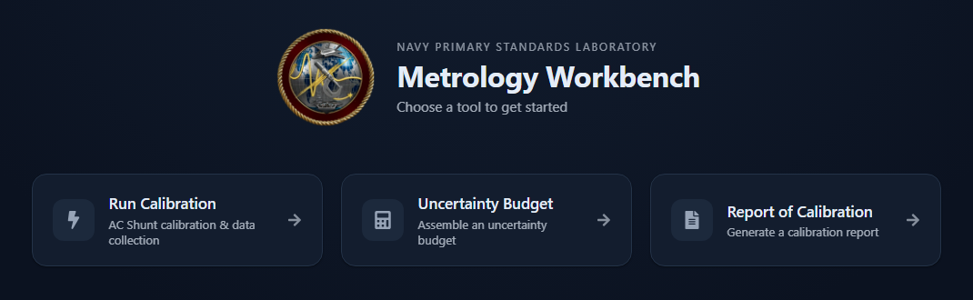
NAVY PRIMARY STANDARDS LABORATORY
Actual software home page
Calibration. Uncertainty. Reporting.
Three connected modules. One starting point for the measurement workflow.
RUN CALIBRATION
UNCERTAINTY BUDGET
REPORT OF CALIBRATION
Automate Y5020 and A40B shunt workflows. Capture measurements and Type A uncertainty.
Combine uncertainty contributors. Evaluate decision risk and guardband options.
Bring saved results into a consistent report. Review, format and export PDF or Excel.
Notes:
The center of this slide is a real screenshot of the running Metrology Workbench home page, cropped to emphasize the emblem, title and three module launchers. The descriptions beneath the screenshot are presentation annotations. The screenshot has not been redrawn. Introduce the suite from left to right: acquire measurements, analyze uncertainty and decision risk, then prepare a report.
1. Metrology Workbench
Metrology Workbench brings three complementary tools into one home screen. Run Calibration handles supported Y5020 and A40B calibration workflows. Uncertainty Budget carries saved Type A results into a wider analysis of measurement uncertainty and decision risk. Report of Calibration imports saved calibration results into an editable report. Users review instrument definitions, analysis assumptions and report metadata as part of their work. The architecture supports additional modules and calibration capabilities in the future.
Sources: user-supplied Tasking.docx; Frontend/workbench/src/app/HomeLauncher.jsx; Frontend/workbench/src/app/moduleRegistry.jsx. Home layout follows the image in Tasking.docx. Calibration artwork is an AI illustration based on user-supplied Photo 1.jpg. Other visual elements are illustrative. The distribution is conceptual; the simplified sum of variances assumes uncorrelated contributions expressed in common output units.

Slide 2
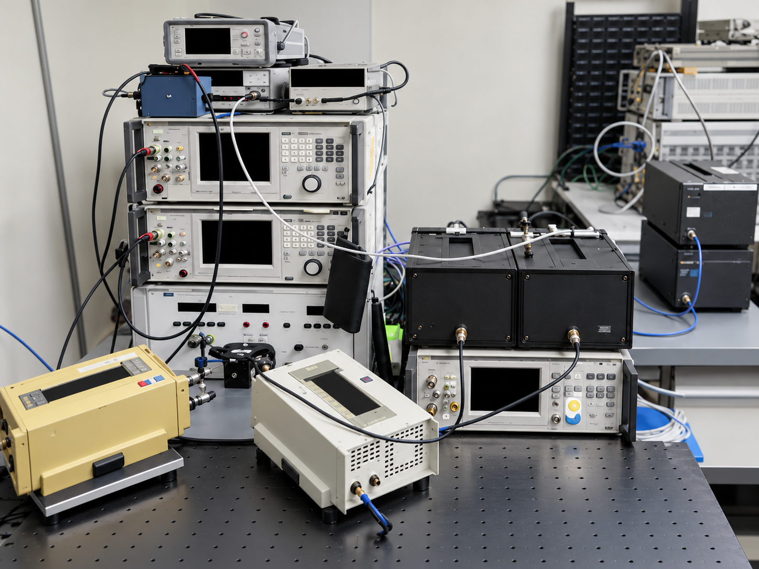
METROLOGY WORKBENCH
Run Calibration
Automated shunt calibration and data collection
Y5020 and A40B workflows
Run supported shunt calibrations within
a consistent measurement setup.
Configure the session
Set test points, instrument settings
and measurement cycles.
Monitor the measurement
Follow instrument status, stability
and calibration results.
Reuse the results
Save measurements and Type A uncertainty
for analysis and reporting.
Reference-based equipment illustration; displays intentionally black.
Notes:
This slide supports editable PowerPoint text and layout shapes. The equipment remains a separate replaceable raster image. All instrument display windows are black as requested. The reference-based illustration was generated from the user-supplied laboratory photo and the prior artwork; it is not an exact wiring diagram or an unmodified photograph. The module supports Y5020 and A40B measurement sessions, instrument settings, stability monitoring, saved results and Type A uncertainty. Type A is one contribution to a complete uncertainty budget.
Sources: Tasking.docx; Photo 1.jpg; Frontend/workbench/src/modules/ac-shunt/components/session/SessionSetup.jsx; components/calibration/Calibration.jsx, LiveStabilityTracker.jsx, CycleStatisticsTracker.jsx and CalibrationResults.jsx.

Slide 3
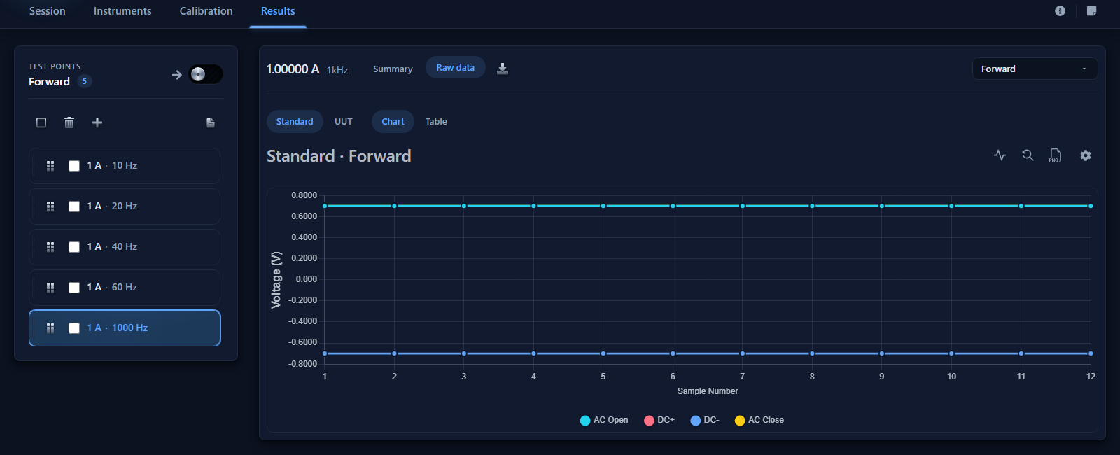
METROLOGY WORKBENCH / IN THE SOFTWARE
Inspect the measurements behind a result
Select a saved session and test point, then compare readings in chart or table form.
Actual software using demonstration data | Companion video: 01-calibration-walkthrough.webm
Notes:
Actual browser screenshot from Run Calibration. The sample is the isolated [MOCK] UI Development session. The walkthrough selects a saved 1 A, 1 kHz point, opens Results and switches between chart and table. No physical instruments were operated. The sample values demonstrate interface behavior, not an instrument performance claim. Video: videos/01-calibration-walkthrough.webm.

Slide 4
METROLOGY WORKBENCH
Uncertainty Budget
Measurement uncertainty and decision risk in one workspace
Import calibration data
FROM CONTRIBUTORS TO A RESULT
Bring saved Type A results and measurement
points into a new budget.
Type A
Type B
Model
Repeatability from
measurements
Specifications
and certificates
Sensitivity and
correlations
Build the complete budget
Combine Type A results, instrument
specifications and Type B contributors.
Evaluate decision risk
Combined standard uncertainty
Review test uncertainty ratio and the
probabilities of false acceptance or rejection.
Contributions in common output units
Explore guardband options
Expanded uncertainty
Compare acceptance limits against
configured risk requirements.
Apply the selected coverage factor
Review TUR, false acceptance and false rejection risk.
Notes:
All text, diagram boxes and arrows on this slide are native editable PowerPoint objects. The diagram is conceptual, not a numerical result or a plot of measured data. Contributions are expressed in common output units through the measurement model, including sensitivity coefficients and correlations where applicable. Expanded uncertainty applies a coverage factor to combined standard uncertainty. The module can import saved Type A results, use shared instrument definitions, assess test uncertainty ratio and decision risk, and explore guardband options.
Sources: Tasking.docx; Frontend/workbench/src/modules/uncertainty/components/tools/AcShuntImportTool.jsx; src/modules/uncertainty/App.jsx; src/modules/uncertainty/constants/constants.js. The adjacent actual-software slide and video use a separate synthetic voltage session.

Slide 5
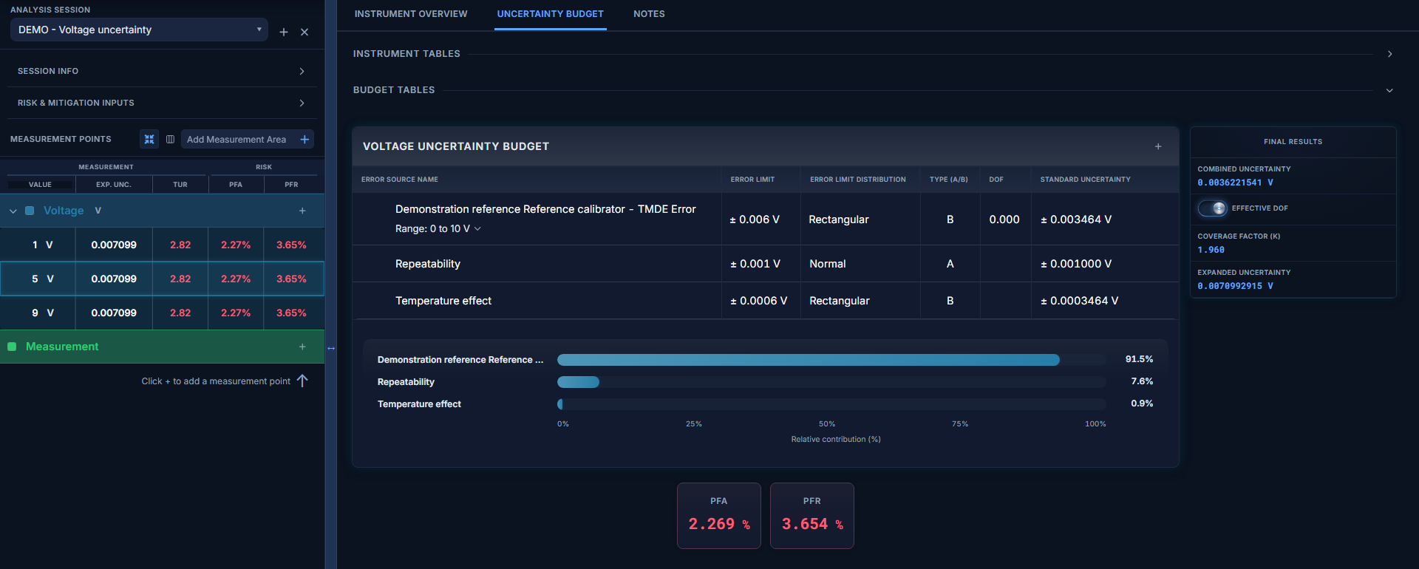
METROLOGY WORKBENCH / IN THE SOFTWARE
See what contributes to uncertainty
Review contributors, expanded uncertainty and decision risk at each measurement point.
Actual software using demonstration data | Companion video: 02-uncertainty-walkthrough.webm
Notes:
Actual browser screenshot from the Uncertainty Budget module (Uncertalytics). This separate synthetic voltage session contains three points and illustrative reference, repeatability and temperature contributions. Calculations shown are produced by the application. It is not the same dataset as the calibration recording and does not claim that an end-to-end shunt import was demonstrated. The contribution chart identifies the dominant term. PFA and PFR represent probability of false acceptance and false rejection under the configured assumptions. Video: videos/02-uncertainty-walkthrough.webm.

Slide 6
METROLOGY WORKBENCH
Report of Calibration
A consistent report built from saved calibration results
Populate from saved data
REPORT OF CALIBRATION
Import calibration results and stored
uncertainty values.
Instrument and serial number
Complete the report details
Customer / Procedure / Dates / Personnel
Review customer, instrument, procedure,
dates and personnel information.
Measurement | Result | Uncertainty
Test point | Saved value | Stored value
Organize report content
Arrange report sections, measurement
tables and supporting statements.
Supporting statements and measurement conditions
Preview and export
Inspect the report, then export
a PDF or Excel workbook.
Technical review and approval
PDF
Excel
Illustrative report structure
Notes:
All text, document shapes and the three-column table on this slide are native editable PowerPoint elements. The white document is a schematic report structure, not a screenshot or a valid certificate. The module imports saved calibration results and stored uncertainty values; users complete and review metadata, sections and statements before export. Current report import maps stored expanded uncertainty and coverage factor. Technical review remains part of the reporting workflow.
Sources: Tasking.docx; Backend/ac_shunt/reports/services.py; Frontend/workbench/src/modules/reports/components/AcShuntImport.jsx, ReportBuilder.jsx and PDFPreview.jsx.

Slide 7
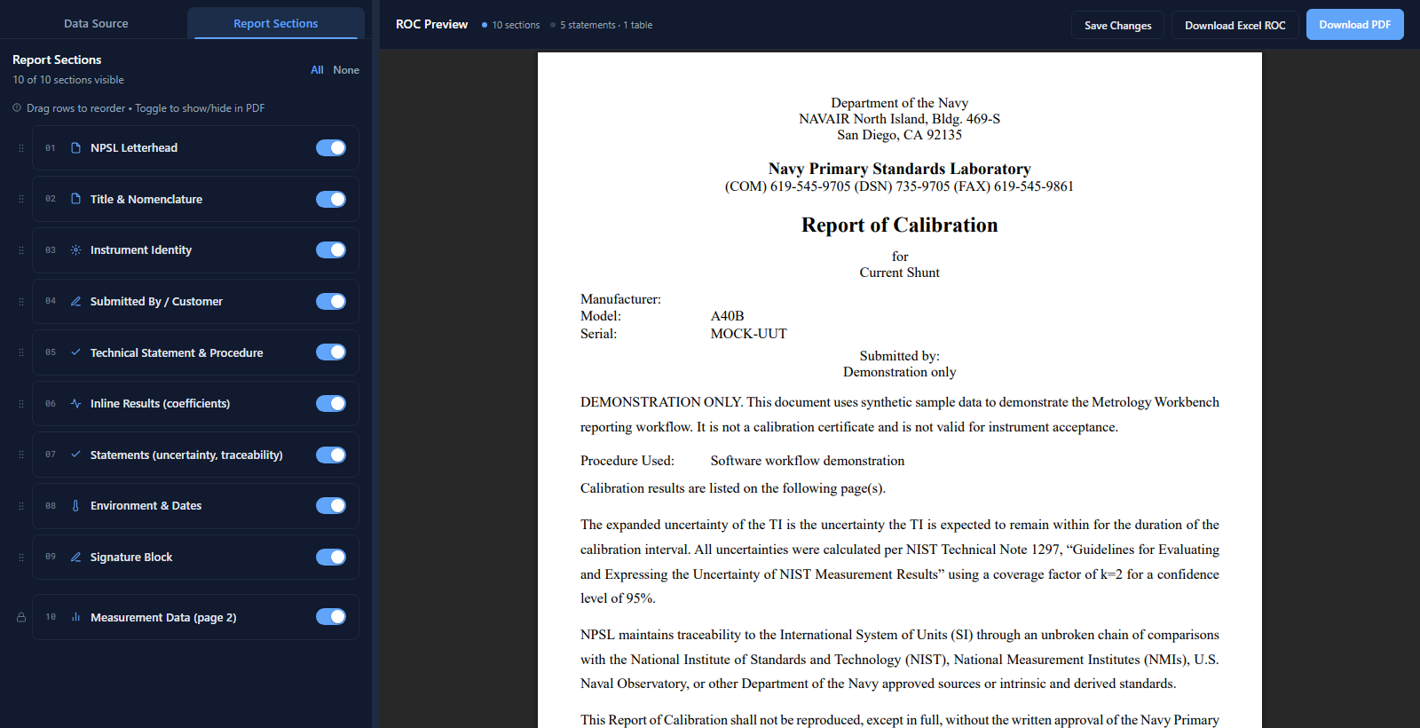
METROLOGY WORKBENCH / IN THE SOFTWARE
Review the report before export
Organize report sections, inspect the PDF preview and export the completed document.
Actual software using demonstration data | Companion video: 03-report-walkthrough.webm
Notes:
Actual browser screenshot from Report of Calibration. The demonstration report was populated from the saved mock AC-shunt session and labeled DEMONSTRATION ONLY. Metadata and procedure text were entered for the demonstration. The clip selects the saved record, opens Report Sections and scrolls the PDF preview. Export controls provide Excel and PDF. This sample is not a valid calibration certificate. Video: videos/03-report-walkthrough.webm.

