Slide 1
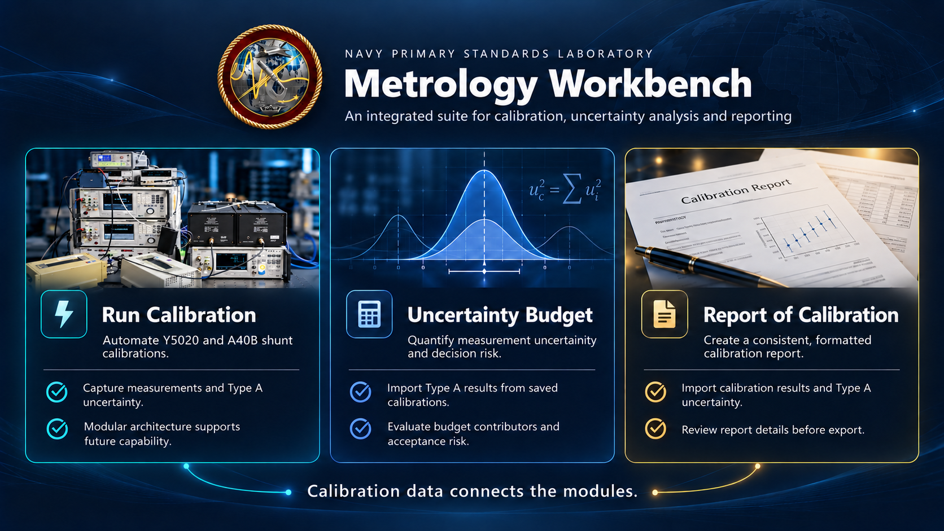
Notes:
Metrology Workbench brings three complementary tools into one home screen. Run Calibration handles supported Y5020 and A40B calibration workflows. Uncertainty Budget carries saved Type A results into a wider analysis of measurement uncertainty and decision risk. Report of Calibration imports saved calibration results into an editable report. Users review instrument definitions, analysis assumptions and report metadata as part of their work. The architecture supports additional modules and calibration capabilities in the future.
Sources: user-supplied Tasking.docx; Frontend/workbench/src/app/HomeLauncher.jsx; Frontend/workbench/src/app/moduleRegistry.jsx. Home layout follows the image in Tasking.docx. Calibration artwork is an AI illustration based on user-supplied Photo 1.jpg. Other visual elements are illustrative. The distribution is conceptual; the simplified sum of variances assumes uncorrelated contributions expressed in common output units.

Slide 2
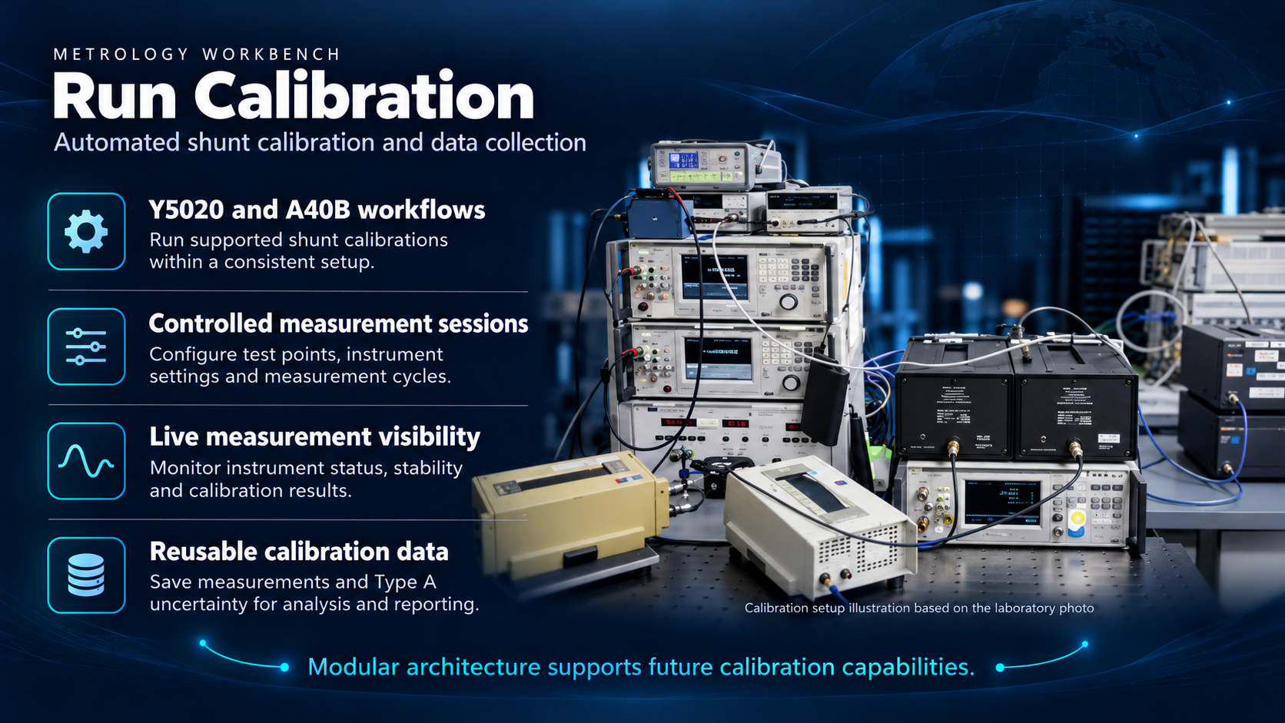
Notes:
The calibration workflow supports Y5020 and A40B shunts. A measurement session holds test points, instrument settings and cycle configuration. During a run, instrument status, stability and results provide visibility into measurement progress. Saved measurements and their statistical Type A uncertainty can support subsequent uncertainty analysis and reporting. Type A uncertainty is one contribution to an uncertainty budget, rather than the whole budget.
Suggested demonstration: open Run Calibration, show session setup, then show a saved result with its Type A uncertainty.
Sources: user-supplied Tasking.docx; Frontend/workbench/src/modules/ac-shunt/components/session/SessionSetup.jsx; components/calibration/Calibration.jsx, LiveStabilityTracker.jsx, CycleStatisticsTracker.jsx and CalibrationResults.jsx; Backend/ac_shunt/api/migrations/0021_calibrationresults_type_a_uncertainty_ppm_and_more.py. Artwork uses the arrangement in user-supplied Photo 1.jpg as a reference. It is a generated illustration, not a wiring diagram or an exact equipment photograph.

Slide 3
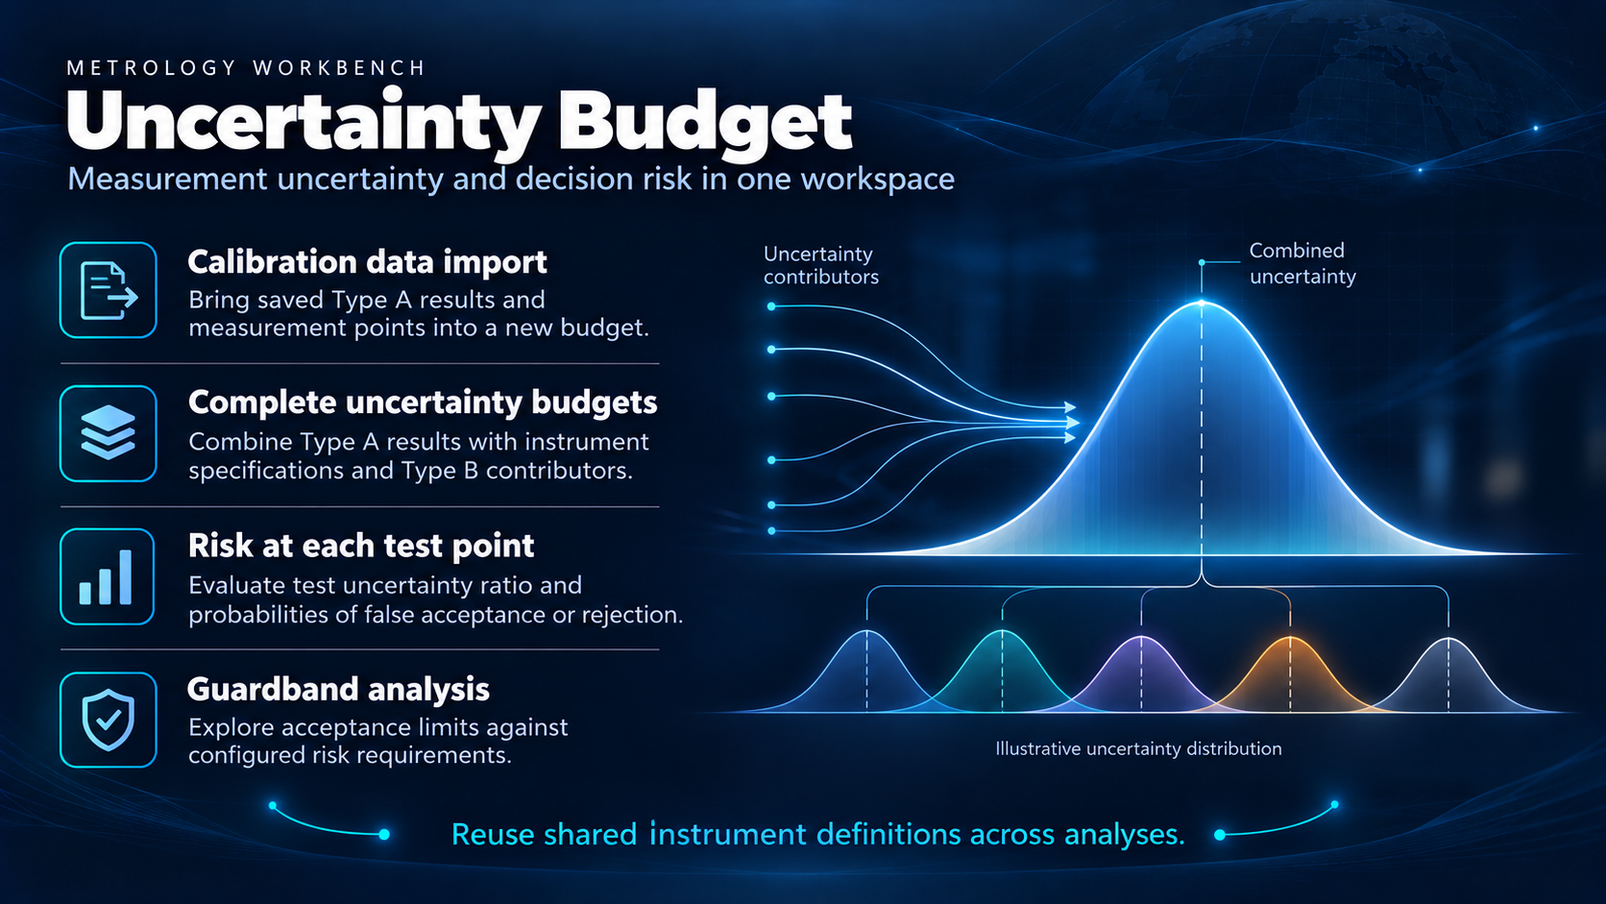
Notes:
Import a saved shunt session to create a new Electrical budget with its measurement points and Type A results. Match instruments to shared definitions so specifications and ranges can be reused. Review Type B contributions and the resulting uncertainty budget. Risk calculations include test uncertainty ratio, probability of false acceptance and probability of false rejection where the required input data are available. Guardband analysis explores acceptance limits against configured risk requirements. Review import warnings and instrument definitions before relying on results.
Suggested demonstration: import a completed calibration, inspect contributors at one test point, then compare risk and guardband results.
Sources: user-supplied Tasking.docx; Frontend/workbench/src/modules/uncertainty/components/tools/AcShuntImportTool.jsx; src/modules/uncertainty/App.jsx; src/modules/uncertainty/constants/constants.js; src/modules/uncertainty/features/analysis/utils/budgetUtils.manual.test.js. Distribution artwork is illustrative and does not depict measured results or imply that every input distribution is normal.

Slide 4
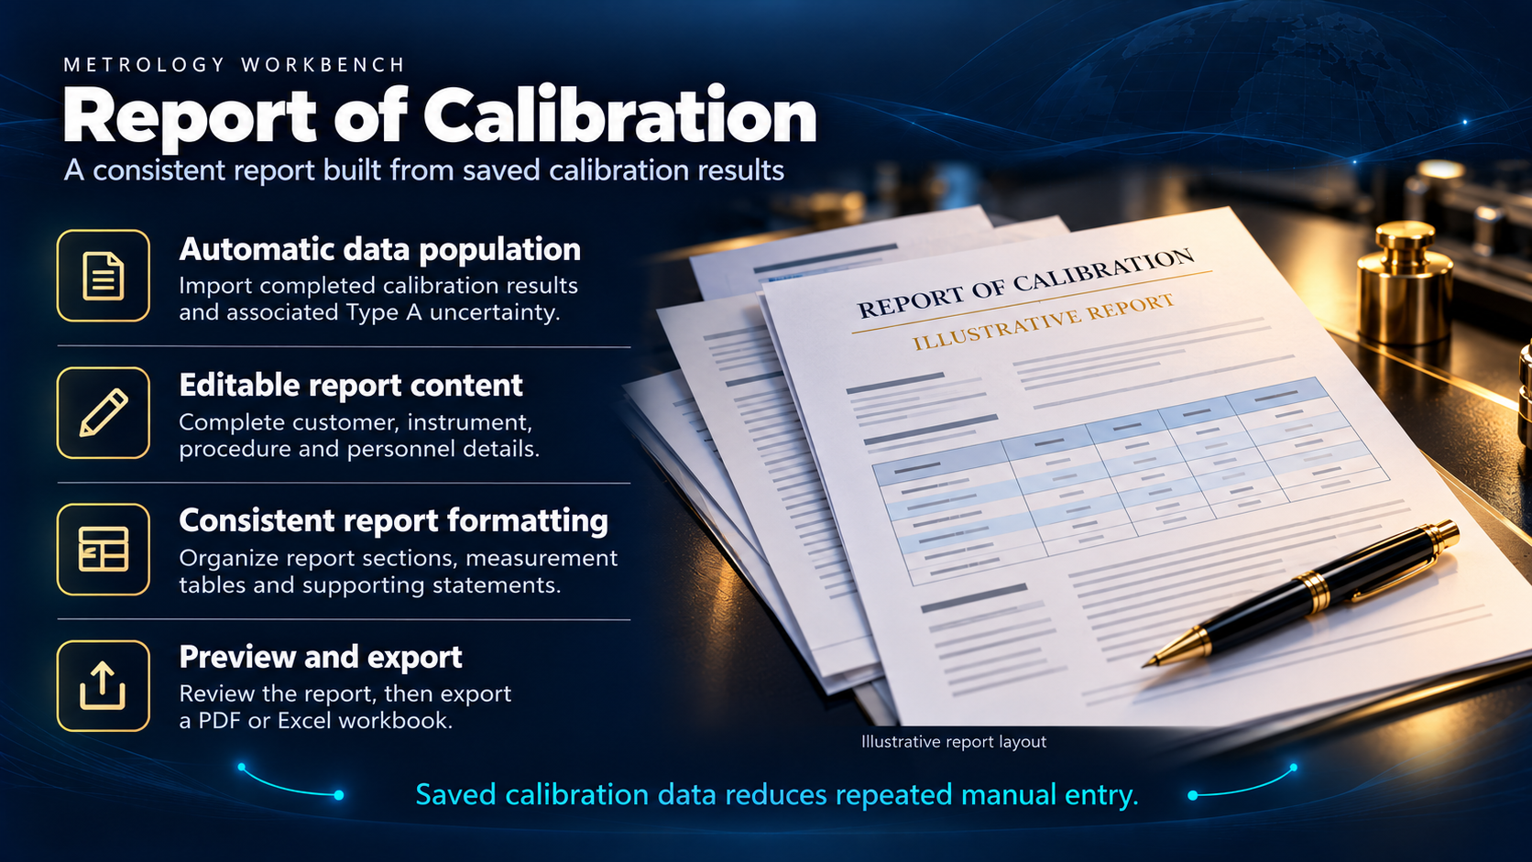
Notes:
Pull a completed calibration into an editable Report of Calibration. The current import maps instrument identity, environmental data and measurement results, including the stored expanded uncertainty and coverage factor, into the report. Review the uncertainty basis and complete customer, procedure, dates and personnel details as needed. Organize report sections and supporting statements, inspect the preview, then export a PDF or Excel workbook. Generation supports the reporting workflow; it does not replace technical review or approval.
Suggested demonstration: select a saved session, show the imported measurement table, complete metadata, and open the report preview.
Sources: user-supplied Tasking.docx; Backend/ac_shunt/reports/services.py; Frontend/workbench/src/modules/reports/components/AcShuntImport.jsx, ReportBuilder.jsx and PDFPreview.jsx. Report artwork is illustrative and is not an actual certificate.

