Slide 1
IoT Network Simulator - python
Contact:
BBAK Technologies, Ph: +91-9353205447, Email: bbaktech@gmail.com
Parameters tracked:
1. Response time
2. Power usage
3. Fog Resource utilization
4.network usage,
5.cloud used Time
Implemented
Cloud only,
Brute force Algorithm
strategies for resource management/task offloading/task scheduling
Easily any one could modify strategies based on genetic/PSO or any algorithms for resource management to optimise parameters
Python code at:
https://github.com/bbaktech/Fog_Edge_Resource_Mgt.git

Slide 2
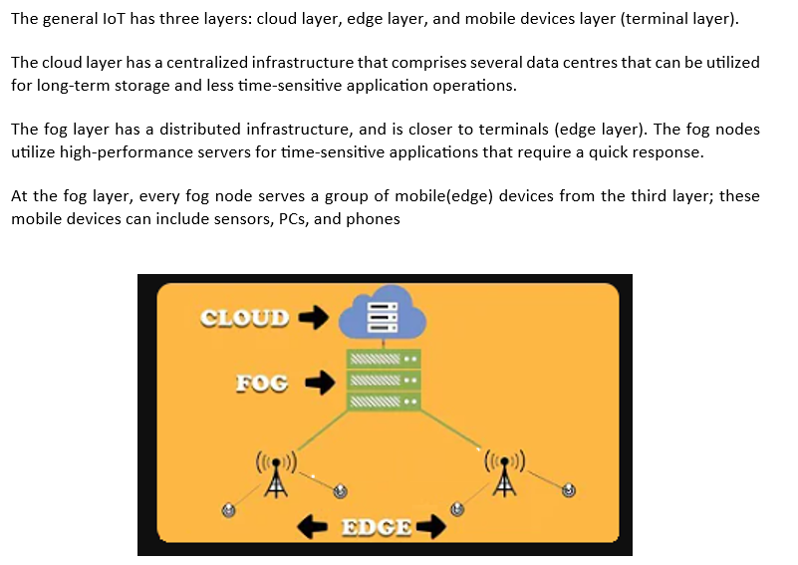

Slide 3
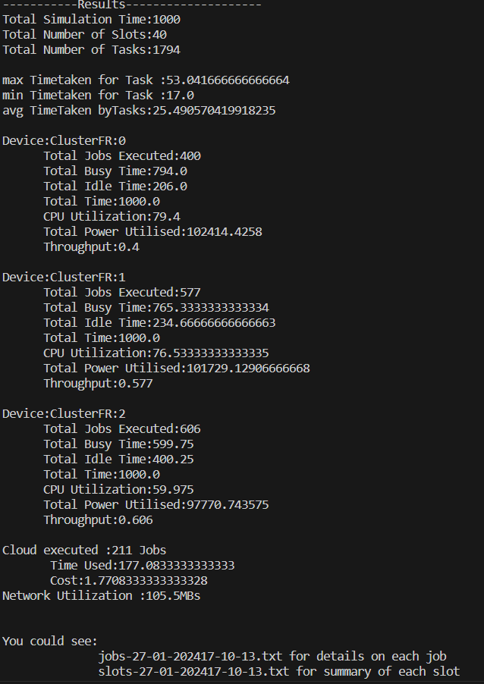
Result
IoT network settings:
Cloud parameters:
CPU speed, cores, up/down latency
Number of clusters:
Fog Node Capabilities:
Edge Node Capabilities:
Task parameters:
instructions size, data size, priority etc
Python code at:
https://github.com/bbaktech/Fog_Edge_Resource_Mgt.git
Contact:
BBAK Technologies, Ph: +91-9353205447, Email: bbaktech@gmail.com

