Slide 1

Employee Attrition
DDS Case Study 2
By: Kito Patterson

Slide 2
What is Attrition?
Attrition is the reduction in staff through a normal lifecycle of employment.
Not to be confused with Turnover
Attrition factors can be either of the following…
Relocation
Retire
Death

Slide 3
Problem Statement
DDS Analytics would like to use Data Science to predict employee attrition in hopes of retaining high performing employees from leaving. DDS Analytics would also like to reduce the cost and resources of having to search and hire new employees due to attrition and a reduction in work force.

Slide 4
Questions of Interest
Are there any trend specific to the Job Role or function
Build a classification model to predict attrition with a minimum accuracy of 60%
What are the top 3 factors that lead to turnover

Slide 5
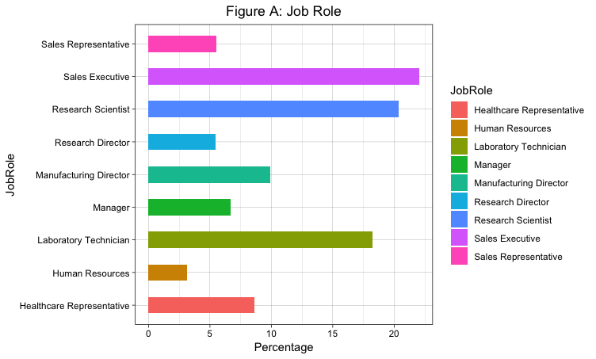

Exploring
Sales Executives make up 22% of the total labor force followed by Research Scientist 20% and Lab Tech at 18%

Slide 6
The only Job Roles with employees less than completely satisfied

Slide 7
Job Role by Attrition
Attrition proportions seem unusually high as compared to others

Slide 8
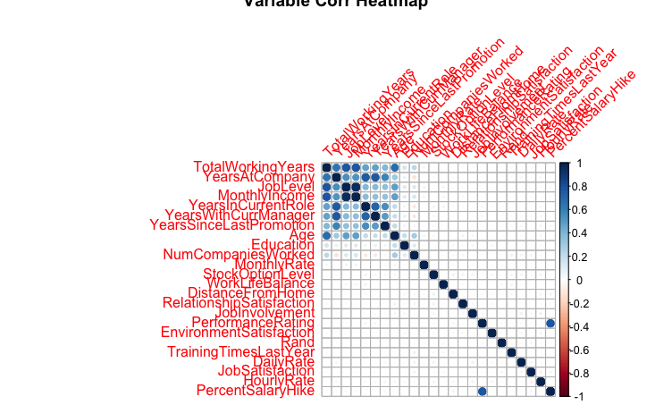
Multi-Collinearity
Variable A | Variable B
Monthly Income | Job Level
Percent Salary Hike | Performance Rating
Total Working Years | Job Level
Total Working Years | Age
Years In Current Role | Total Working Years

Slide 9
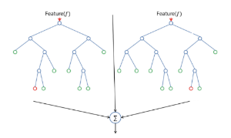
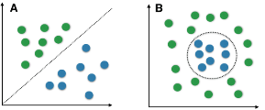
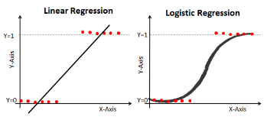
Models

Slide 10
Models
Random Forest
Logistic Regression
Naïve Bayes
85% Accuracy
85% Accuracy
81% Accuracy

Slide 11

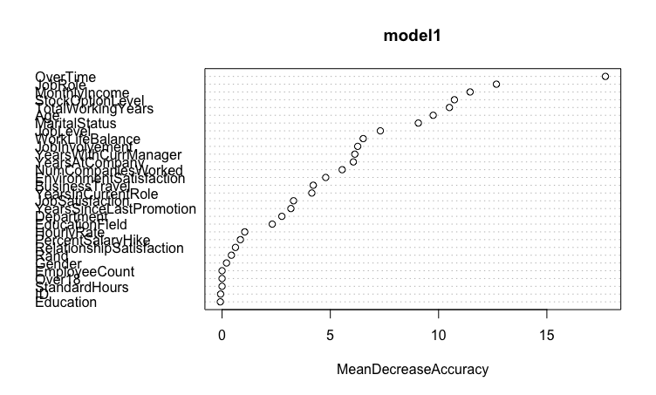
Top Variables by Importance

Slide 12
Conclusion
There seems to be some areas of dissatisfaction as it relates to specific Job Roles that could potentially contribute to attrition. Further analysis is required to uncover deeper stories and insights.
However, we were able to distinguish the most important factors that lead to attrition with a prediction accuracy of 85%.

