Slide 1


ANALYTICAL PREDICTION OF OBSTETRIC DELIVERY METHODS USING MACHINE LEARNING ALGORITHMS.
BCS786 – Project Phase-II
Team Members:
B Matheen 1HK22CS024
Channakeshava D L 1HK22CS034
Balasubramani 1HK22CS026
Chethan Kumar K B 1HK22CS035
Under the Guidance of:
Prof.Khallikkunaisa
Associate Professor
Department of Computer Science & Engineering, HKBKCE-VTU
Notes:
1

Slide 2
Content
Abstract
Problem Statement
Objectives
Scope
Dataset Details
Literature Survey
System Architecture
Methodology
Module Description
Implementation
Results / Output
Conclusion
Future Enhancements
References
Acknowledgment
Department of Computer Science & Engineering, HKBKCE-VTU
Notes:
2

Slide 3
Abstract
Childbirth mode prediction is a critical aspect of obstetric care, aiding healthcare professionals in making informed decisions to ensure maternal safety. Traditional approaches rely on clinical expertise and heuristic-based risk assessment methods, which may not always generalize well across diverse populations. Recent advances in Machine Learning (ML) provide an opportunity to develop data driven predictive models that improve accuracy and support evidence-based decision-making.
This study explores the application of machine learning (ML) algorithms for predicting the mode of childbirth based on patient data. We utilize datasets containing demographic, clinical, and obstetric history features, including maternal age, gestational age, body mass index (BMI), medical conditions. Various ML models, including logistic regression, decision trees, random forests are evaluated for accuracy, precision, and recall.
Department of Computer Science & Engineering, HKBKCE-VTU
Notes:
3

Slide 4
Problem Statement
Traditional, expertise-based methods for predicting childbirth modes are unreliable and contribute to a high rate of unnecessary cesarean deliveries. The problem is urgent, as C-section rates have exceeded the World Health Organization's recommendation by 35.5%. The project aims to solve this by creating a machine learning-based decision support system to improve the safety and accuracy of childbirth management.
Department of Computer Science & Engineering, HKBKCE-VTU
Notes:
4

Slide 5
Objectives
To apply machine learning (ML) algorithms to predict the mode of childbirth using various datasets.
To utilize datasets containing demographic, clinical, and obstetric history features such as maternal age, gestational age, BMI, medical conditions, and previous delivery history.
To evaluate and compare machine learning models, including Random Forest and to assist physicians in choosing the most effective delivery method.
To develop a computerized, intelligent approach to support informed decision-making about the most suitable mode of childbirth, thereby reducing avoidable surgeries and improving maternal and infant health outcomes.
Department of Computer Science & Engineering, HKBKCE-VTU
Notes:
5

Slide 6
Scope of the Project
The scope of this project is to develop a predictive model using machine learning to determine the most suitable mode of childbirth.
It will compare various machine learning algorithms, including Random Forest to assist healthcare professionals in data-driven decision-making.
The ultimate goal is to reduce unnecessary cesarean deliveries and improve maternal and neonatal health outcomes.
Department of Computer Science & Engineering, HKBKCE-VTU
Notes:
6

Slide 7
Dataset Details
Source: The project uses data from a study published in Kaggle, which includes a comprehensive dataset from four different hospitals.
Total Records: The dataset from the kaggle contains a total of 5843 records in which are giving training for the model with specific records.
Key Features: The dataset includes crucial features for predicting childbirth mode such as maternal age, BMI, gestational age, previous delivery history, and other clinical and health indicators.
Objective: This robust dataset serves as the foundation for training and testing the machine learning models to ensure accurate and reliable predictions.
Department of Computer Science & Engineering, HKBKCE-VTU
Notes:
7

Slide 8

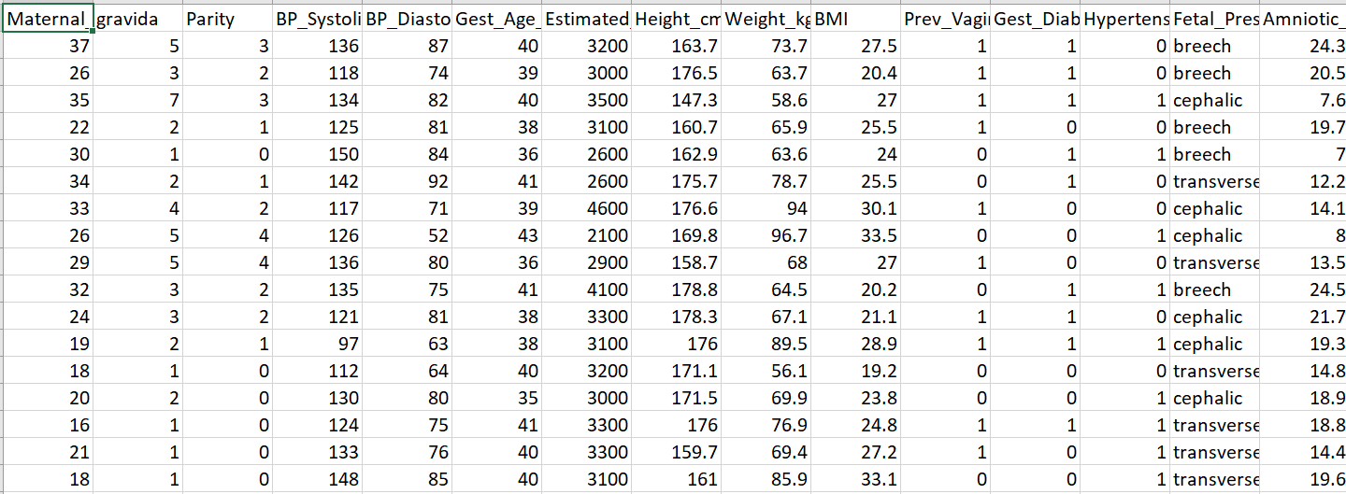
Snapshot of Dataset

Slide 9
Literature Survey
1. Michael Owusu-Adjei et al., 2024
Methods: This study uses an AI-based approach to predict delivery outcomes based on measurable maternal features, including real-time data from partographs. They evaluated three supervised learning techniques: Gradient Boosting, Logistic Regression, and Random Forest. The Logistic Regression model achieved the highest accuracy, at 91%. The research also focused on identifying the most relevant features using effective feature selection techniques.
Limitations: The study's main limitation is its small sample size of 842 participants, which may affect the generalizability of its results. Additionally, the research did not explore the potential influence of socio-economic factors, which can provide a more comprehensive understanding of maternal health outcomes.
Department of Computer Science & Engineering, HKBKCE-VTU
Notes:
9

Slide 10
Literature Survey
2. Sakshi Govind Ahire et al., 2023
Methods: This research focuses on predicting delivery outcomes by analyzing measurable maternal features from a large dataset of over 4,000 birth records. The team pinpointed 32 key features that affect delivery outcomes and used various models, with the stacking classifier performing the best.
Limitations: The study is limited by its dataset, which is drawn from Spanish public hospitals only. This means the performance may vary with more diverse or updated datasets. Additionally, there's limited discussion on real-time deployment in clinical settings.

Slide 11
Literature Survey
3. Vasiliki E. Georgakopoulou et al., 2024
Methods: This systematic review evaluated the application of AI algorithms, specifically SVM, Multilayer Perceptron (MLP), and Random Forest, to predict the mode of delivery. The research used a comprehensive clinical database of over 3,000 records from a hospital in Spain. All three algorithms achieved an impressive accuracy of 86% or higher.
Limitations: The study highlights significant heterogeneity in study design, populations, and outcome measures across the reviewed papers. There is also a lack of standardized data collection and reporting practices. The ethical concerns and the interpretability of AI predictions remain under-addressed.

Slide 12
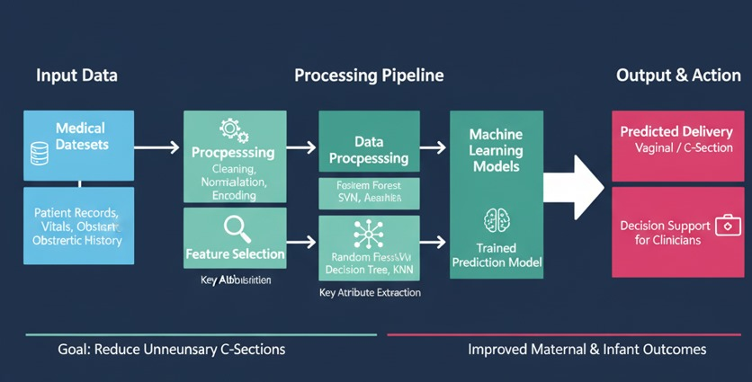
System Architecture
Department of Computer Science & Engineering, HKBKCE-VTU
Notes:
12

Slide 13
Methodology
Technologies Used:
Frontend: HTML, CSS, JavaScript.
Backend: Node.js with Express.js.
Database: MongoDB.
Machine Learning: Python (Scikit-learn, Pandas, NumPy).
Algorithms & Techniques:
Algorithm: Random Forest for classification, chosen for its accuracy and robustness.
Techniques: Data Preprocessing (cleaning, normalization), Feature Selection, Model Training & Evaluation (using metrics like accuracy, precision, recall).
Department of Computer Science & Engineering, HKBKCE-VTU
Notes:
13

Slide 14
Process Flow:
Data Acquisition: Collect patient data.
Data Preprocessing (Python): Clean and prepare data.
Feature Selection (Python): Identify key predictive features.
Model Training (Python): Train Random Forest model.
Model Deployment (Node.js/Express.js): Integrate model into backend API.
User Interaction (Frontend): Input data via web interface.
Prediction (Backend): Model predicts delivery mode.
Result Display (Frontend): Show prediction to user.

Slide 15
Module Description
Data Collection Module: Gathers raw patient data, including demographic, clinical, and obstetric history, from various sources.
Data Preprocessing Module: Cleans, transforms, and standardizes the raw data, handling missing values and preparing it for model training.
Feature Selection Module: Identifies and selects the most relevant features from the preprocessed data to optimize model performance and reduce noise.
Machine Learning Model Training Module: Trains the Random Forest algorithm on the prepared dataset to learn patterns for predicting childbirth modes.
Prediction Engine Module: Utilizes the trained Random Forest model to generate real-time predictions for the mode of delivery based on new patient input.
API (Application Programming Interface) Module: Facilitates communication between the frontend and the backend, exposing endpoints for data submission and prediction retrieval.
User Interface (UI) Module: Provides an intuitive web-based interface (HTML, CSS, JavaScript) for healthcare professionals to input data and view predictions.
Database Management Module: Manages the storage and retrieval of patient data and potentially model-related information using MongoDB.
Department of Computer Science & Engineering, HKBKCE-VTU
Notes:
15

Slide 16
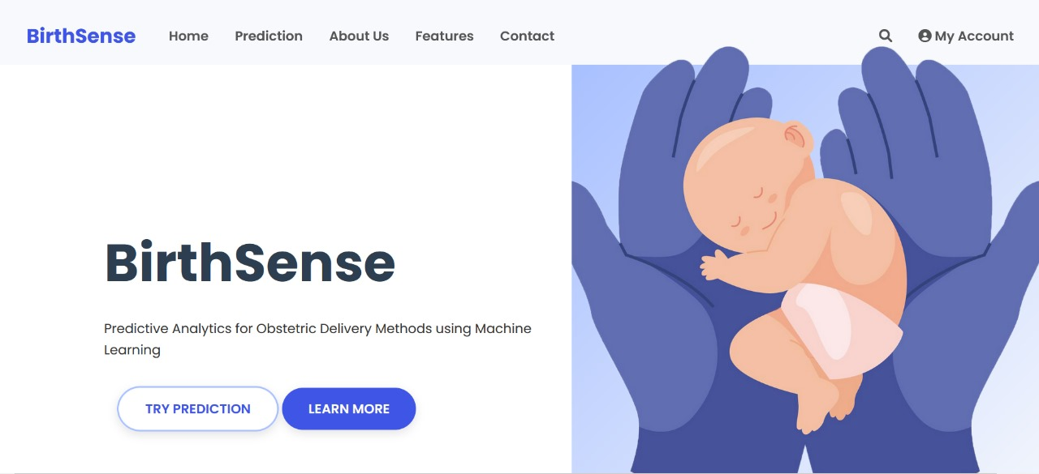
Implementation
UI Screens
Department of Computer Science & Engineering, HKBKCE-VTU

Slide 17
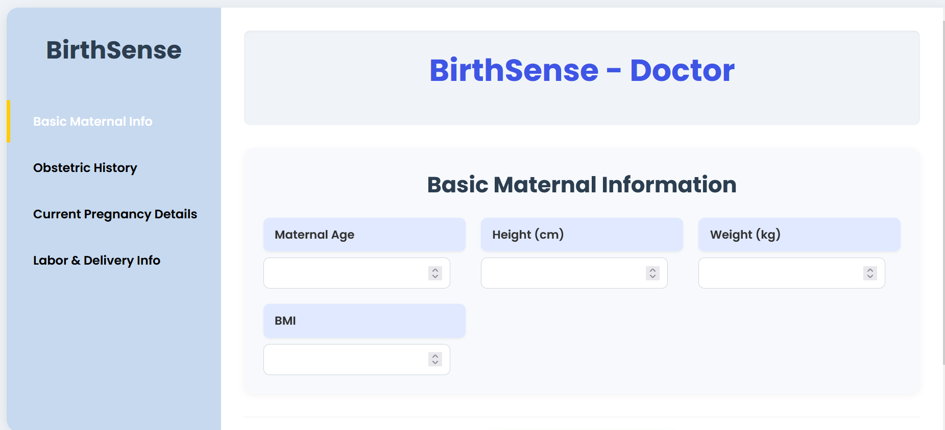
Department of Computer Science & Engineering, HKBKCE-VTU

Slide 18
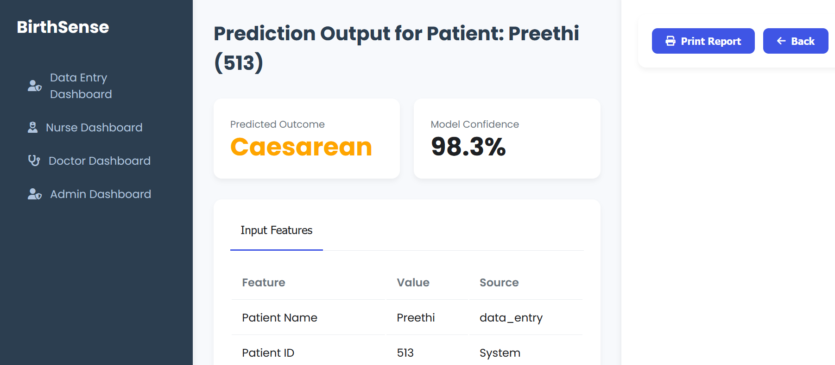
Results/Output
Department of Computer Science & Engineering, HKBKCE-VTU

Slide 19

Demo
19

Slide 20
Conclusion
This project successfully developed a machine learning-based system using Random Forest to predict obstetric delivery methods, demonstrating high accuracy with diverse patient data. The well-structured data preprocessing and feature selection, alongside a robust web-based deployment, were key to its effectiveness in providing data-driven decision support. However, limitations include the dataset's generalizability across broader populations and the current model's inability to account for real-time, dynamic external factors during labor.
Department of Computer Science & Engineering, HKBKCE-VTU

Slide 21
Future Enhancements
Future enhancements will prioritize integrating real-time physiological data for dynamic predictions during labor and expanding the dataset to include diverse local populations within Bengaluru, Karnataka, India, to significantly improve generalizability and relevance.
We also plan to optimize the system's scalability and performance for faster responses within clinical environments and enhance the User Interface (UI) for intuitive use by local healthcare professionals. Additionally, we will focus on seamless integration with existing Hospital Information Systems (HIS) prevalent in the region to ensure practical applicability and streamlined workflows.
Department of Computer Science & Engineering, HKBKCE-VTU

Slide 22
References
[1] An AI-based approach to predict delivery outcome based on measurable factors of pregnant mothers Michael Owusu- Adjei et al., 2024.
[2] Predicting Modes of Child Birth Using Machine Learning– Sakshi Govind Ahire et al., 2023.
[3] Artificial Intelligence in Predicting the Mode of Delivery: A Systematic Review– Vasiliki E. Georgakopoulou., 2024.
[4] Prediction of the Mode of Delivery Using Artificial Intelligence Algorithms– Alberto De Ramón Fernández et al., 2022.
[5] PREDICTING THE MODE OF CHILDBIRTH USING MACHINE LEARNING Mrs. M.Soumya , N.Sasi Priya, V.Namratha , S.Sonika, J.Venu,2023.
[6] Exploring Machine Learning Algorithms to Find the Best Features for Predicting Modes of Childbirth Mrs. B. Vijaya, MCA, M.Tech , Bogini Naveen Kumar ,2022.
[7] An AI-based approach to predict delivery outcome based on measurable factors of pregnant Mothers Michael Owusu- AdjeiID*, James Ben Hayfron-Acquah, Twum Frimpong, AbdulSalaam Gaddafi, 2025.
Department of Computer Science & Engineering, HKBKCE-VTU

Slide 23
[8] Predicting Maternal Health Risk Using Machine Learning Models And Comparing The Performance Of Percentage Split And K-Fold Cross Validation ,Aman Sharma,2024.
[9] Prediction of modes of child birth using SVC P. Devika, S. Bhuvaneswari, R. Rithika, S. Swarna & N. Vijitha,2025.
[10] Predicting the Childbirth Mode using Exhaustive Feature Selection and Machine Learning Techniques ,Arul Natarajan , 2023.
[11] Predicting Childbirth Modes: A Comparative Analysis of Machine Learning Algorithm Vizhiyarasi S , Mathews S, Meaga J, Nishani S, 2025.
[12] Quantitative prediction of postpartum hemorrhage in cesarean section on machine learning Meng Wang, Gao Yi, Yunjia Zhang, Mei Li, Jin Zhang, 2024.
[13] Development and External Validation of Machine Learning Models to Predict Caesarean Section Following Induction of Labor Using Real-World, Population-Based Administrative Datasets in Australia, Yanan Hu, Xin Zhang, Valerie Slavin, Joanne Enticott, Emily Callander, 2024.
[14] Machine learning to predict pregnancy outcomes: a systematic review, synthesizing framework and future research agenda, Muhammad Nazrul Islam, Sumaiya Nuha Mustafina, Tahasin Mahmud, Nafiz Imtiaz Khan, 2022.
[15] Predicting preterm birth using machine learning methods, Anna Kloska, Alicja Harmoza, Sylwester M. Kloska, Tomasz Marciniak, Iwona Sadowska Krawczenko, 2025
Department of Computer Science & Engineering, HKBKCE-VTU

Slide 24
THANK YOU
Department of Computer Science & Engineering, HKBKCE-VTU

