Slide 1
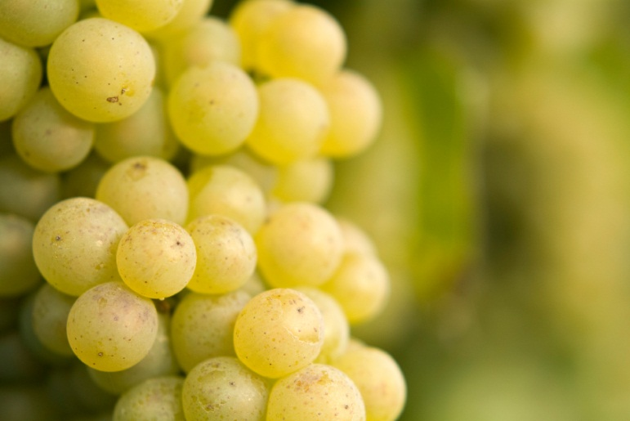
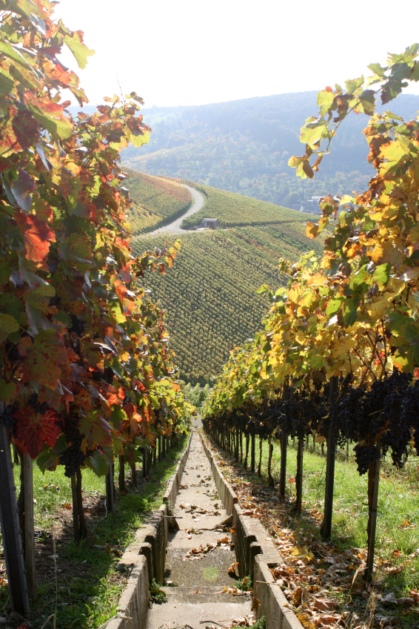
Predicting Vinho Verde Quality using Random Forests
Megan McGoldrick
GA Data Science
April 2015

Slide 2
Objective
In 2009, a research team in Portugal showed that SVM outperformed NN and MLR methods in “predict[ing] human wine taste preferences based on easily available analytical tests.” ª
My goal is to achieve comparable or better classification performance with less effort on data transformation, parameter tuning and/or feature selection.
ª P. Cortez, A. Cerdeira, F. Almeida, T. Matos and J. Reis. Modeling wine preferences by data mining from physicochemical properties. In Decision Support Systems, Elsevier, 47(4):547-553, 2009.

Slide 3
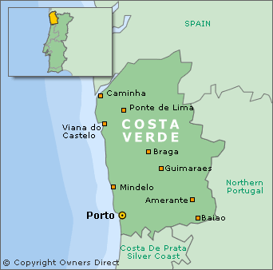
Data Source
Samples of Vinho Verde (“young wine”) from northwest Portugal
1,599 red, 4,898 white
Features
1 response: sensory-based measure of quality
11 explanatory (physiochemical properties): Fixed acidity, volatile acidity, citric acid, pH, alcohol, residual sugar, chlorides, density, sulphates, free sulfur dioxide and total sulfur dioxide
No missing values
Collected by Portugal’s official certification body (CVRVV) between May 2004 and February 2007
Available in UCI MLR http://archive.ics.uci.edu/ml/datasets/Wine+Quality

Slide 4
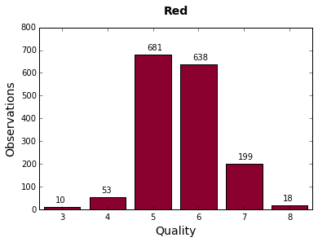
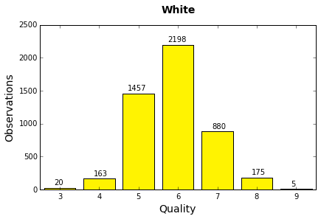
Multiple, imbalanced classes
Most samples perceived as “average;” few high/low quality
Distribution of Quality Median of 3+ expert ratings on 0-10 scale from blind tastings
Mean 5.6 Median 6
Mean 5.9 Median 6
Notes:
Expert preferences may not be reflective of consumer preferences

Slide 5
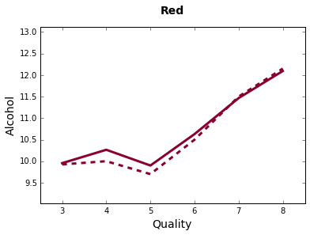
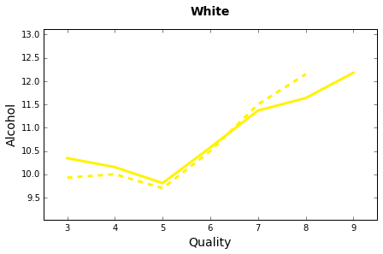
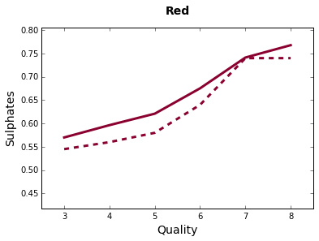
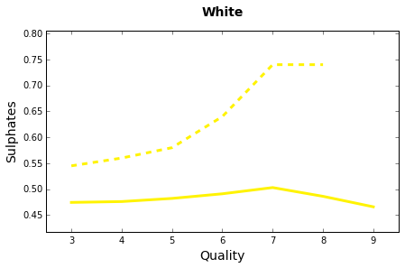
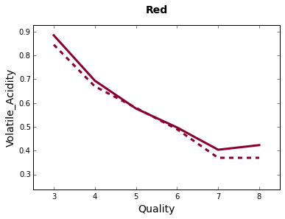
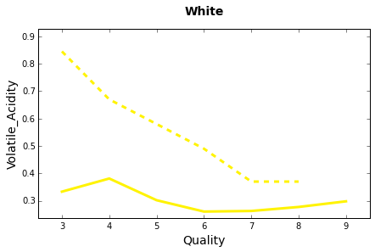
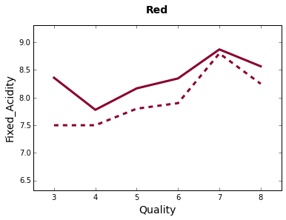
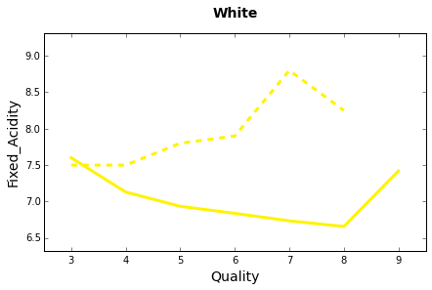
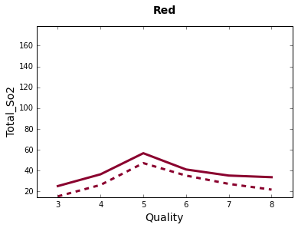
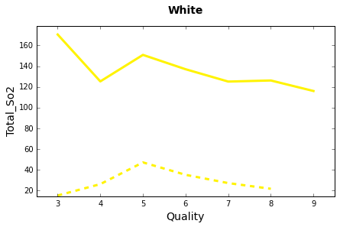
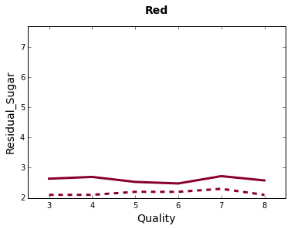
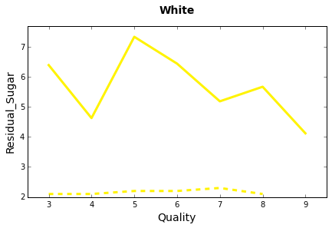
Skewed/noisy data, non-linear relationships
Mean
Median

Slide 6
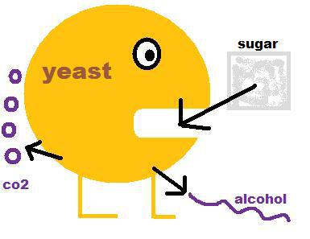
Dependent/correlated features
Selected Spearman Rank Correlation Coefficients
(p-value < .0001)
 | Red | White
Density - Alcohol | -0.5 | -0.8
Density - Residual Sugar | 0.4 | 0.8
Density - Chlorides | 0.4 | 0.5
pH - Fixed Acidity | -0.7 | -0.4
pH - Citric Acid | -0.5
Free S02 - Total S02 | 0.8 | 0.6
Citric Acid - Fixed Acidity | 0.7
Citric Acid - Volatile Acidity | -0.6

Slide 7
Modeling Approach
Separate for red and white
20 iterations of Scikit-Learn’s Random Forest Classifier with 500 trees and stratified 5-fold cross validation
Grid search with F1 scoring to tune parameters for number of trees, max features per tree and measure of tree split quality (gini vs entropy)
20 additional iterations of Random Forest Classifier with “best” model parameters and stratified 5-fold CV
Comparison of RF overall accuracy, kappa, sensitivity by class and precision by class to published SVM T_{0.5} results
Notes:
F1 to deal with imbalanced classes
No need to scale features with RF
5-fold due to small class sizes
20 iterations same as published research/calculate confidence intervals

Slide 8
Red: RF shows some gains over SVM
Particularly for higher classes
ª
^{b}
0.5
+5.9pp
+9.2pp
N/A
ª 20 iterations of Scikit-Learn’s Random Forest Classifier with stratified 5-fold cross validation with 500 estimators
^{b} Cortez et. al. Note, Sensitivity by Class calculated from published confusion matrix.
n = 1,599

Slide 9
White: RF slightly better
No lift for highest (9), lowest (3) classes
ª
^{b}
0.5
+4.4pp
+0.0pp
N/A
N/A
ª 20 iterations of Scikit-Learn’s Random Forest Classifier with stratified 5-fold cross validation with 500 estimators
^{b} Cortez et. al. Note, Sensitivity by Class calculated from published confusion matrix.
n = 4,898

Slide 10
Alcohol top feature in RF
But differences across wine types, methods
RF Importance | RF Rank | SVM Rank
 | 1 | 4
 | 2 | 1
 | 3 | 3
 | 4 | 5
 | 5 | 10
 | 6 | 9
 | 7 | 7
 | 8 | 2
 | 9 | 11
 | 10 | 8
 | 11 | 6
RF Importance | RF Rank | SVM Rank
 | 1 | 2
 | 2 | 8
 | 3 | 7
 | 4 | 6
 | 5 | 5
 | 6 | 3
 | 7 | 9
 | 8 | 10
 | 9 | 4
 | 10 | 1
 | 11 | 11

Slide 11
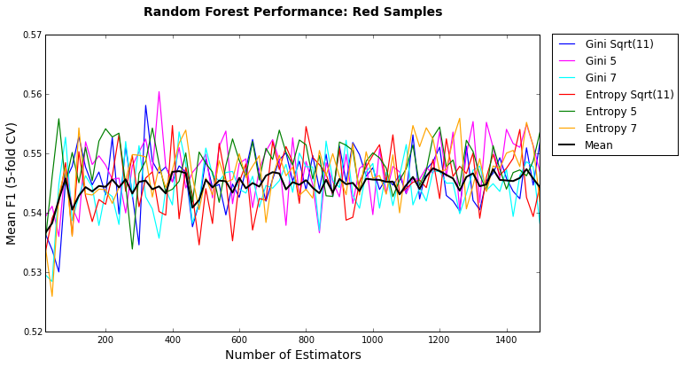
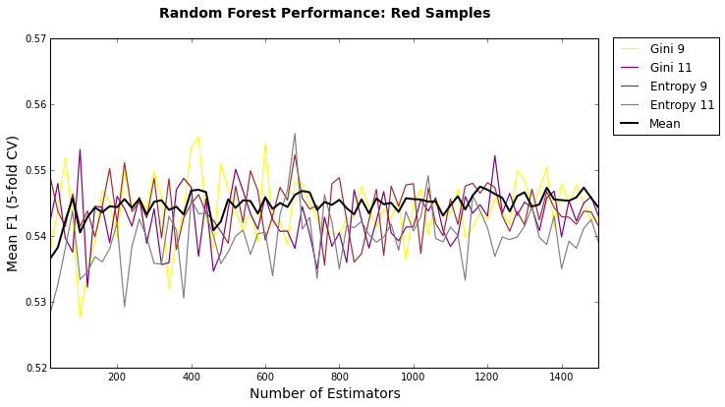
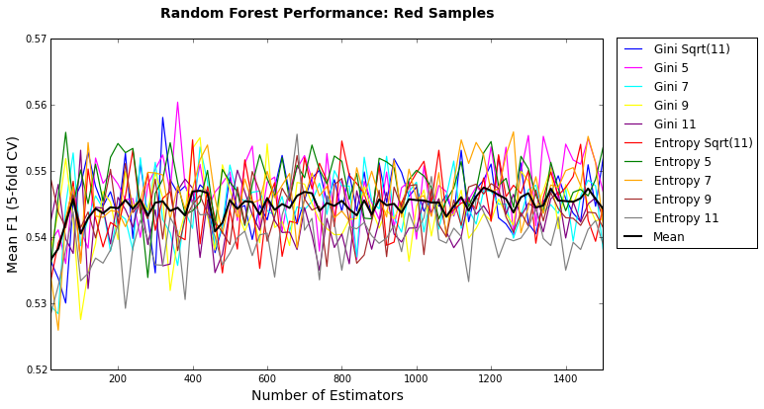
Red: Tuning suggests 5 features, fewer trees
Improvement likely to be small, if any
Best Score
360 trees, 5 max features, Gini coefficient
n = 1,599

Slide 12
Red: Only hi/lo precision improves with tuning
ª
^{b}
^{c}
0.5
+5.4pp
+5.9pp
+8.3pp
+9.2pp
N/A
ª 20 iterations of Scikit-Learn’s Random Forest Classifier with stratified 5-fold cross validation, 360 estimators and 5 max features
^{b} 20 iterations of Scikit-Learn’s Random Forest Classifier with stratified 5-fold cross validation and 500 estimators
n = 1,599
^{c} Cortez et. al. Note, Sensitivity by Class calculated from published confusion matrix.

Slide 13
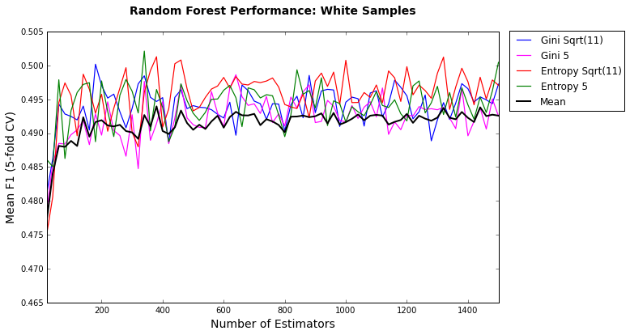
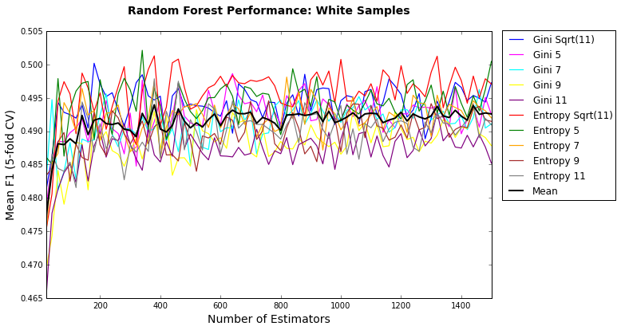
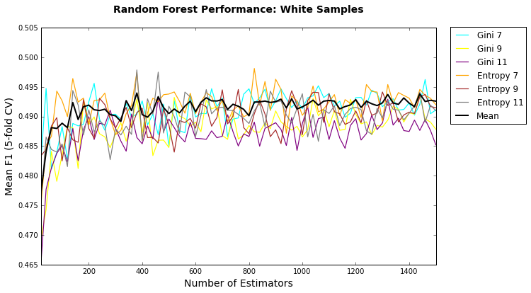
White: Similar changes + entropy split criterion
Toss up between sqrt(d) and 5 max features
Best Score
360 trees, 5 max features, Entropy
n = 4,898

Slide 14
White: No notable change with tuning
ª
^{b}
^{c}
0.5
+4.3pp
+4.4pp
-0.2pp
+0.0pp
N/A
N/A
ª 20 iterations of Scikit-Learn’s Random Forest Classifier with stratified 5-fold cross validation, 360 estimators, 5 max features and entropy
^{b} 20 iterations of Scikit-Learn’s Random Forest Classifier with stratified 5-fold cross validation and 500 estimators
n = 4,898
^{c} Cortez et. al. Note, Sensitivity by Class calculated from published confusion matrix.

Slide 15
Conclusions
Random Forest appears to beat SVM, especially for red, but still room for improvement
Variable transformations? e.g., log
Other methods? e.g., Sklearn Multiclass
Results potentially useful for wine production and marketing decisions
Key challenge will be expanding dataset to cover other varietals, regions, metrics and/or audiences

