Slide 1
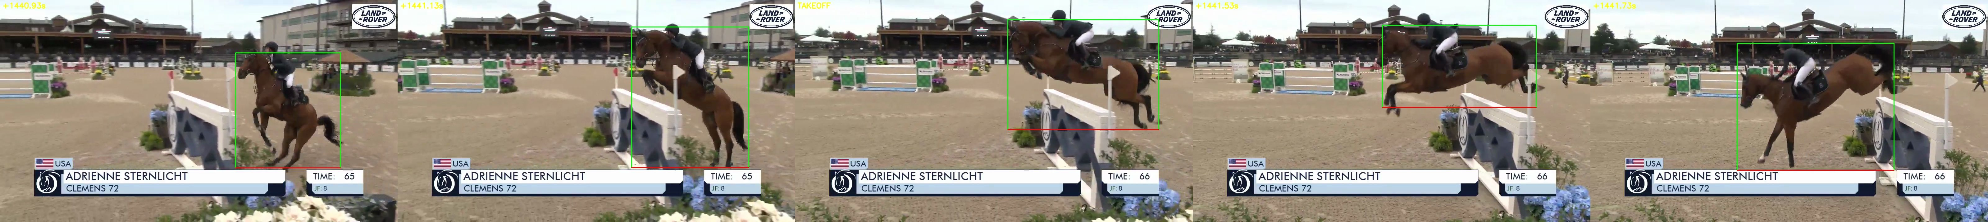
CS 131 · STANFORD UNIVERSITY · SPRING 2026 · FINAL PROJECT
Predicting Showjumping Outcomes
with Self-Supervised Video Representations
Type-conditioned estimation of approach quality from unlabeled broadcast footage
Brooke Ballhaus ballhaus@stanford.edu
Figure 1. YOLOv8 horse track (green) · detected takeoff across a 1.50 m fence.

Slide 2
1 · PROBLEM STATEMENT
Outcome prediction
Type-dependence of the optimal takeoff distance
Approach quality: stride rhythm, approach velocity, takeoff distance.
Outcome is a factor of approach quality and obstacle difficulty.
Outcomes: clean / knockdown / refusal.
Type | Geometry | Ideal d
Vertical | single plane of rails | ~2.6 m
Oxer | two spread rails | ~2.1 m
PROBLEM FORMULATION
OBJECTIVE
Fence height fixed at 1.50 m, conditioned on type (vertical / oxer).
Estimate takeoff distance d.
Ideal value is type-dependent.
Measure how much SSL pretraining on unlabeled clips reduces the labels needed for approach quality prediction.
Benchmarking against from-scratch supervised and ImageNet features across label budgets.
Predicting Showjumping Outcomes with Self-Supervised Video Representations
Ballhaus · CS 131 · 2

Slide 3
2 · DATA
Diverse corpus of unlabeled clips
6
18.5 h
2,223
1,121
182
Grand Prix broadcasts
raw 1.50 m footage
2-sec clips @ 16 fps
retained by horse filter
hand annotations
ACQUISITION
WHY SELF-SUPERVISION
6 Grand Prix broadcasts: Wellington, Tryon, Madrid
YOLOv8 horse filter keeps 1,121 (drops crowd, course-walk, replay).
Hand labels: 39 fence boxes, 110 outcomes, 33 takeoff frames.
Plenty of footage, labels expensive (frame-by-frame).
Pretrain encoder on all 1,121 unlabeled clips.
Fine-tune compact heads on a small labeled subset.
Predicting Showjumping Outcomes with Self-Supervised Video Representations
Ballhaus · CS 131 · 3

Slide 4
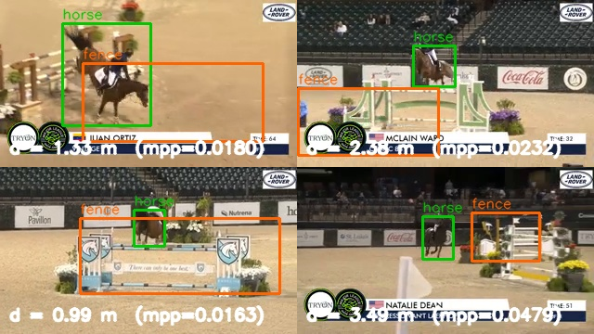
3 · METHODOLOGY
Pipeline architecture
1 · DATA
→
2 · GEOMETRY · M1
→
3 · SSL · M2
→
4 · HEADS · M3
→
5 · EVALUATION
scrape · GP video
2-sec clips @ 16 fps
horse filter → 1,121
venue + hand labels
horse YOLOv8
fence YOLO + type
takeoff frame
d = ‖hoof − base‖·mpp
R(2+1)D-18 +Kinetics
InfoNCE (τ = 0.1)
6-way temporal order
DANN + venue sampler
frozen / fine-tuned
outcome head
distance head → d
type-conditioned
sample eff · n = 25–200
cross-venue A / B
venue probe
macro f1 / accuracy
HORSE + FENCE DETECTION
TAKEOFF-FRAME DETECTION · BOX-EDGE REVERSAL
approach → suspension → landing · MAE ≈ 1.75 frames (83 % within ± 2)
mpp = 3.5 / w_fence · d = ‖ hoof − base ‖ · mpp
Predicting Showjumping Outcomes with Self-Supervised Video Representations
Ballhaus · CS 131 · 4

Slide 5
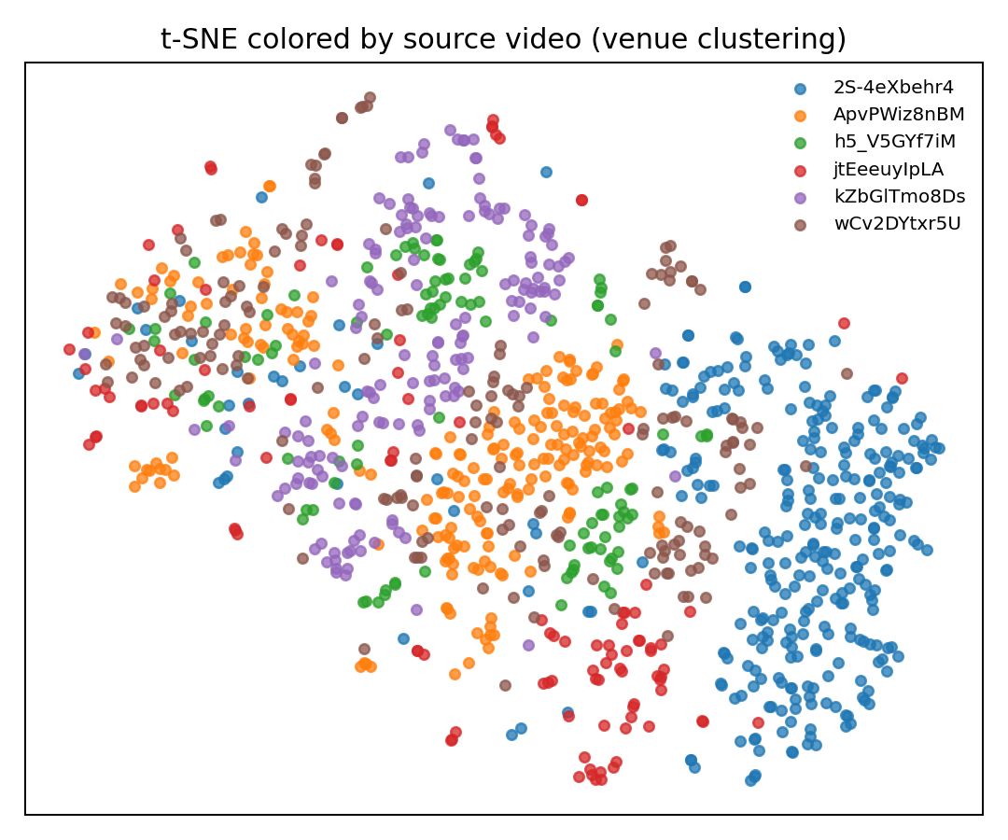
4 · SELF-SUPERVISED PRETRAINING
Pretraining an R(2+1)D-18 encoder and the venue confound
Pretext objectives
InfoNCE: two augmented views (τ = 0.1)
6-way temporal-order: three 4-frame sub-clips (λ = 0.3).
R(2+1)D-18 + MLP projector · AdamW · cosine · batch 16 · 10 epochs.
REPRESENTATIONAL COLLAPSE
From-scratch: losses fall, but close mappings (NN cosine ≈ 0.97).
Use Kinetics-400 pretrained weights.
KEY FINDING
Dominant axis of variation = venue (arena, lighting, footing, crowd)
Must hold out entire source broadcasts.
Figure 3. t-SNE pre-fix colored by source broadcast
Predicting Showjumping Outcomes with Self-Supervised Video Representations
Ballhaus · CS 131 · 5

Slide 6
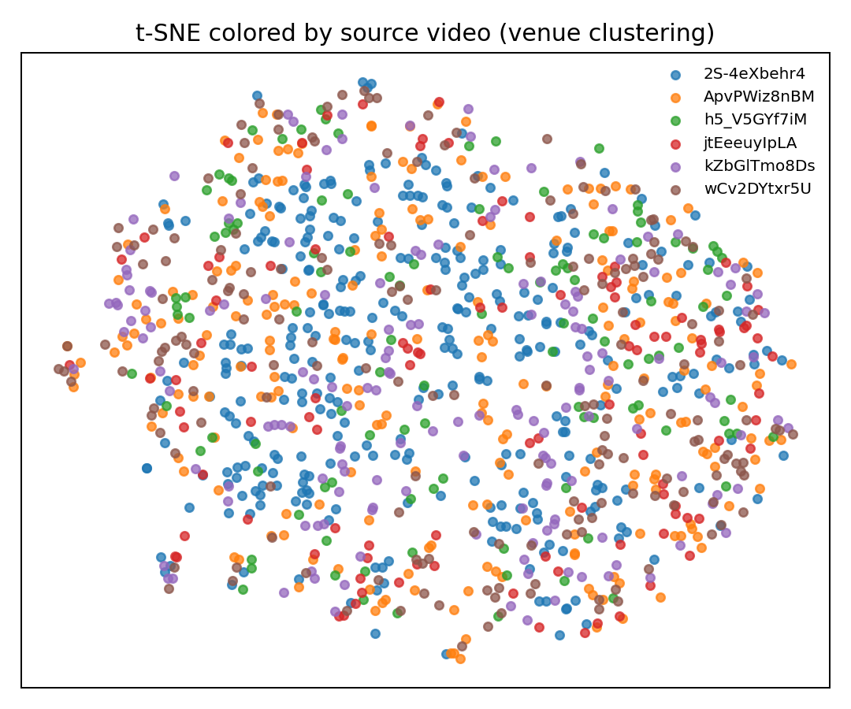
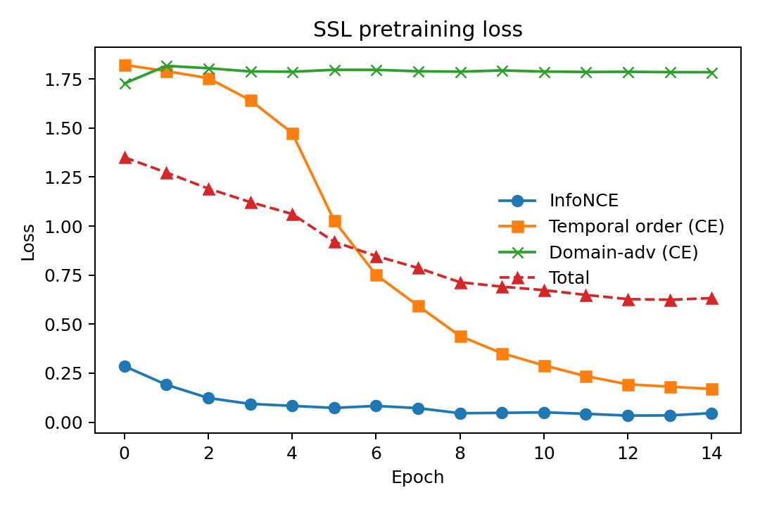
5 · RESULTS — REPRESENTATION LEARNING
Pretraining converges and confound suppression
Figure 4. Final encoder colored by source broadcast
Figure 5. SSL loss
READING THE RESULT
Kinetics-init, no collapse (InfoNCE 0.28→0.05, temporal-order 1.8→0.17). Held-out-broadcast eval: confound lessened, t-SNE de-clusters by venue but linear probe still 0.78 (majority 0.61, chance 0.33).
Predicting Showjumping Outcomes with Self-Supervised Video Representations
Ballhaus · CS 131 · 6

Slide 7
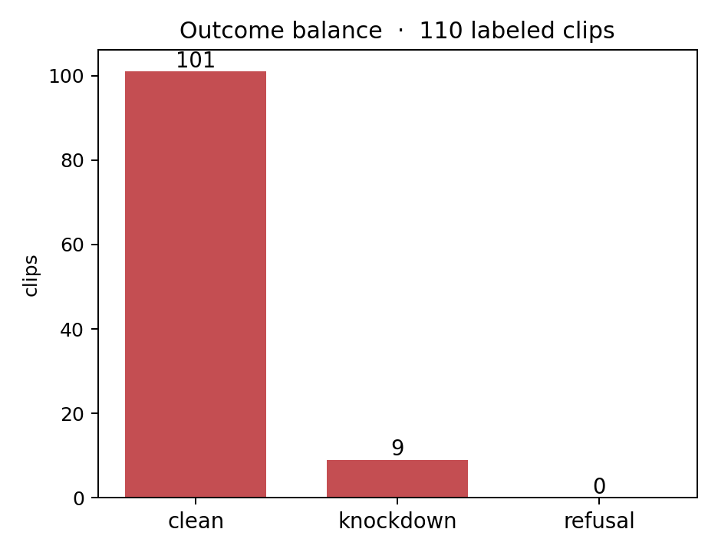
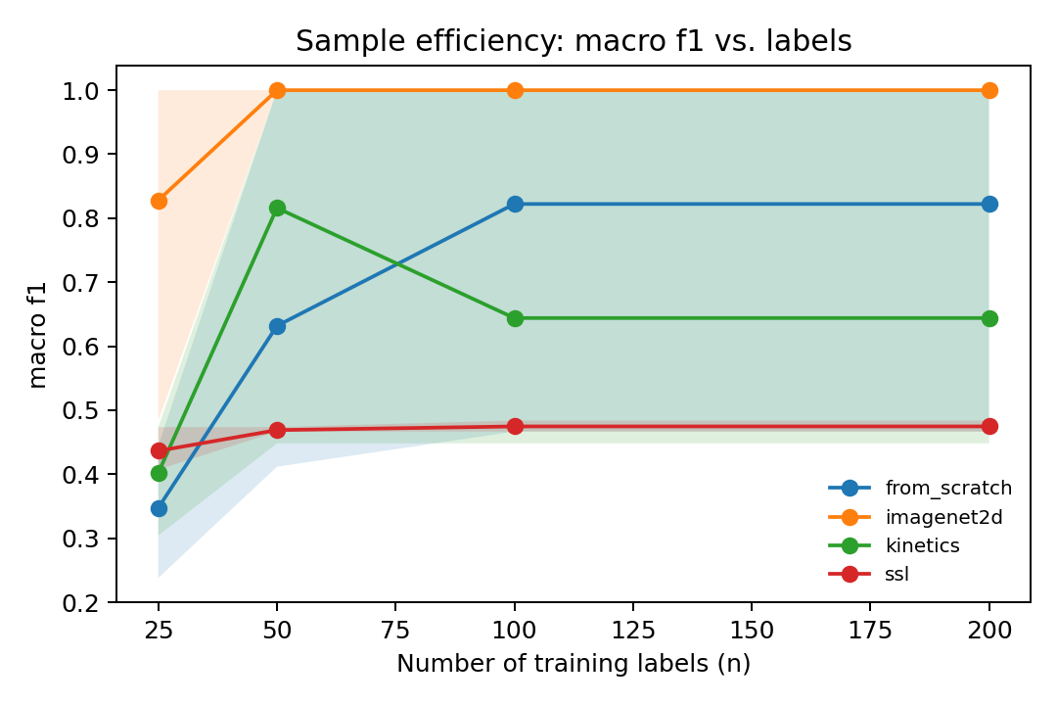
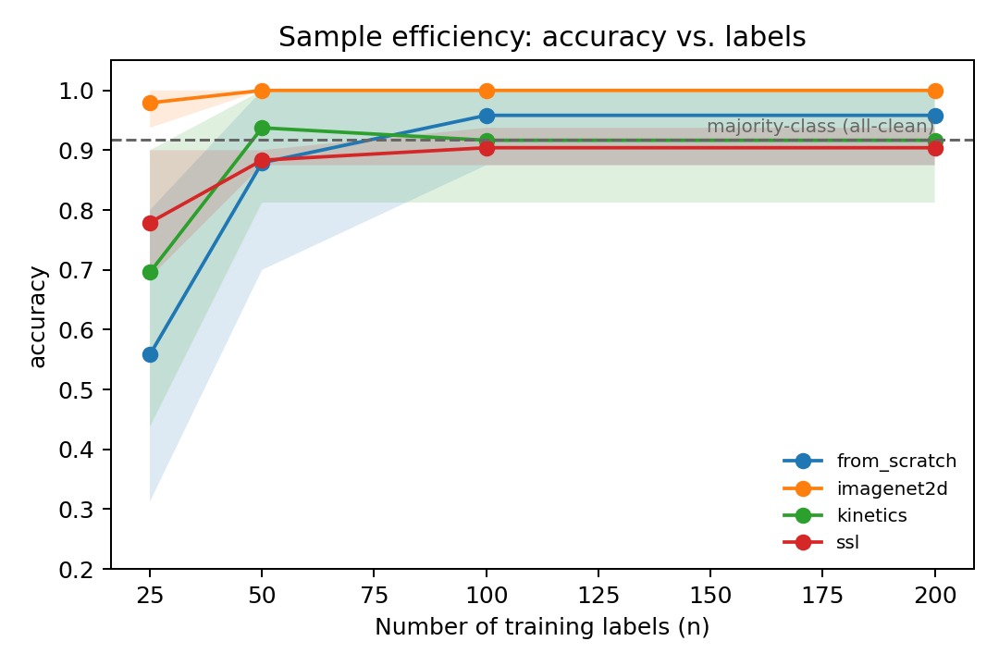
6 · RESULTS — DOWNSTREAM OUTCOME PREDICTION (PRELIMINARY)
Label limitations
Figure 6. 110 labeled outcomes
Figure 7. Macro-F1 vs. number of labels
Figure 8. Accuracy vs. number of labels
Interpretation
Accuracy ≈ 0.90 = majority-class rate. Macro-F1: 0.47 single-class baseline. SSL learned to always predict clean, requires more diverse outcome labels.
Baseline means are raised by a few degenerate 1.0 folds while mostly stabilizing at 0.47, so the methods can't be reliably ordered.
Predicting Showjumping Outcomes with Self-Supervised Video Representations
Ballhaus · CS 131 · 7

Slide 8
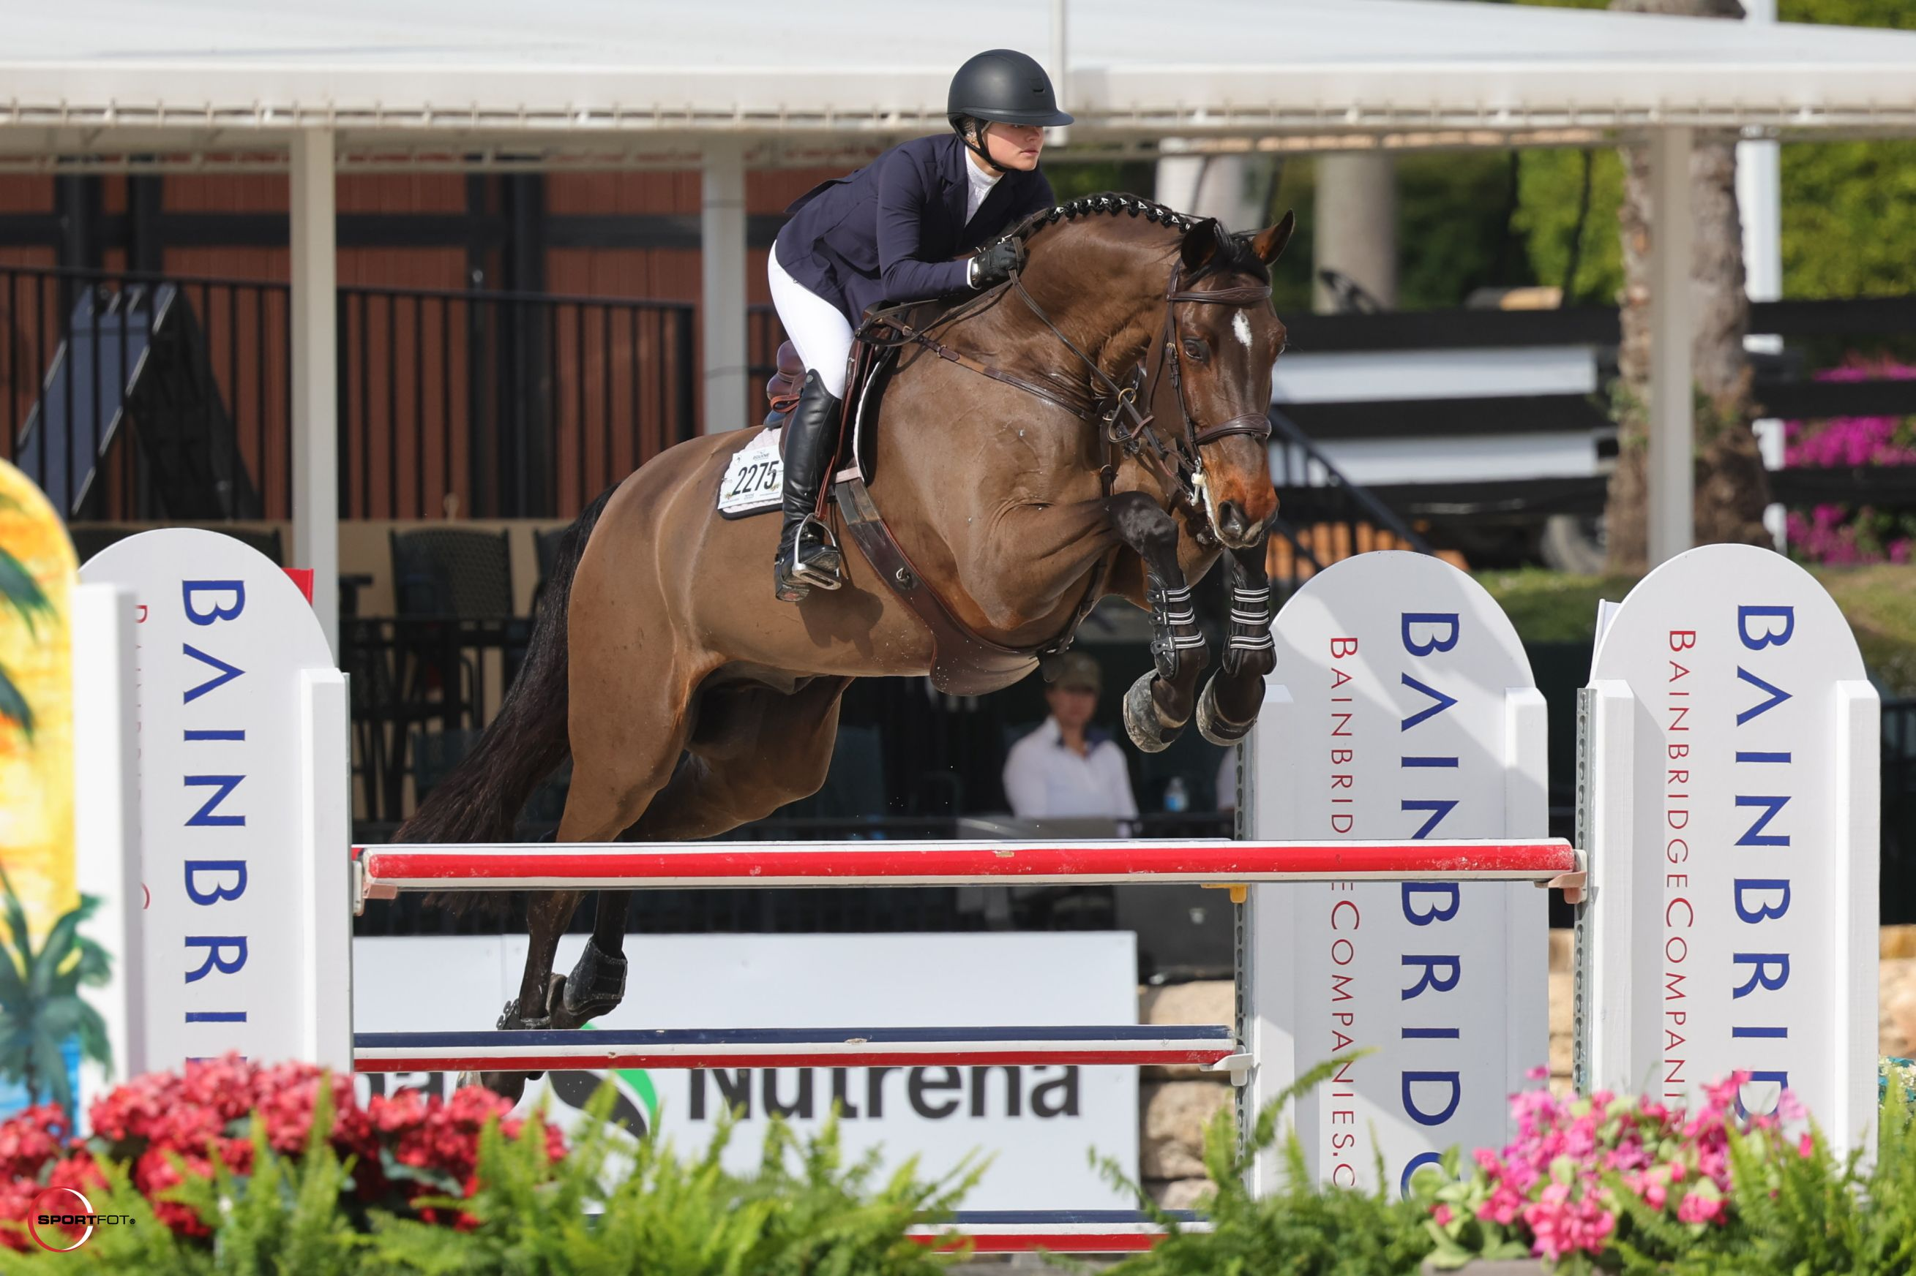
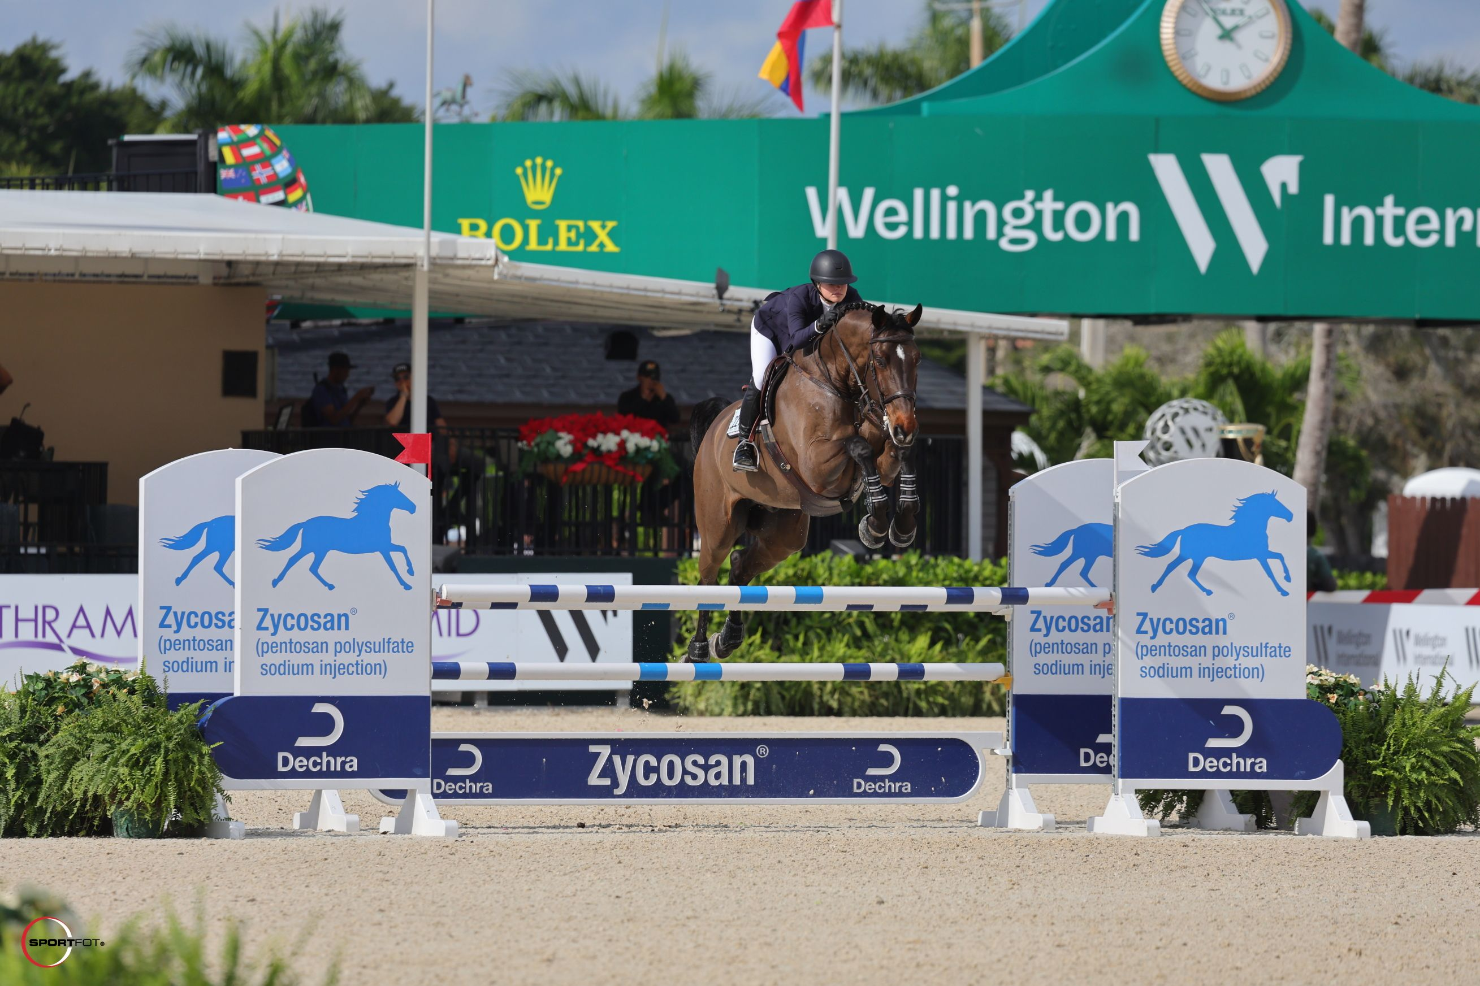
7 · SUMMARY & OUTLOOK
Summary, limitations, and next steps
1
2
3
Complete unlabeled-to-task pipeline
Venue confound lessened but not absent
Accuracy is data-limited
Scale to >300 fully labled data entries.
Aim for greater outcome balance.
Run cross-venue sweep.
NEXT STEPS
Pose-based motion features.
Predictive SSL.
Stronger venue invariance.
FUTURE RESEARCH
Brooke Ballhaus · ballhaus@stanford.edu · github.com/bballhaus/showjumping-ssl

