Slide 1

The power of chromosome-scale, haplotype-resolved genomes
Patrick P. Edger
Molecular Plant
Volume 15 Issue 3 Pages 393-395 (March 2022)
DOI: 10.1016/j.molp.2022.02.010
Copyright © 2022 The Author Terms and Conditions

Slide 2
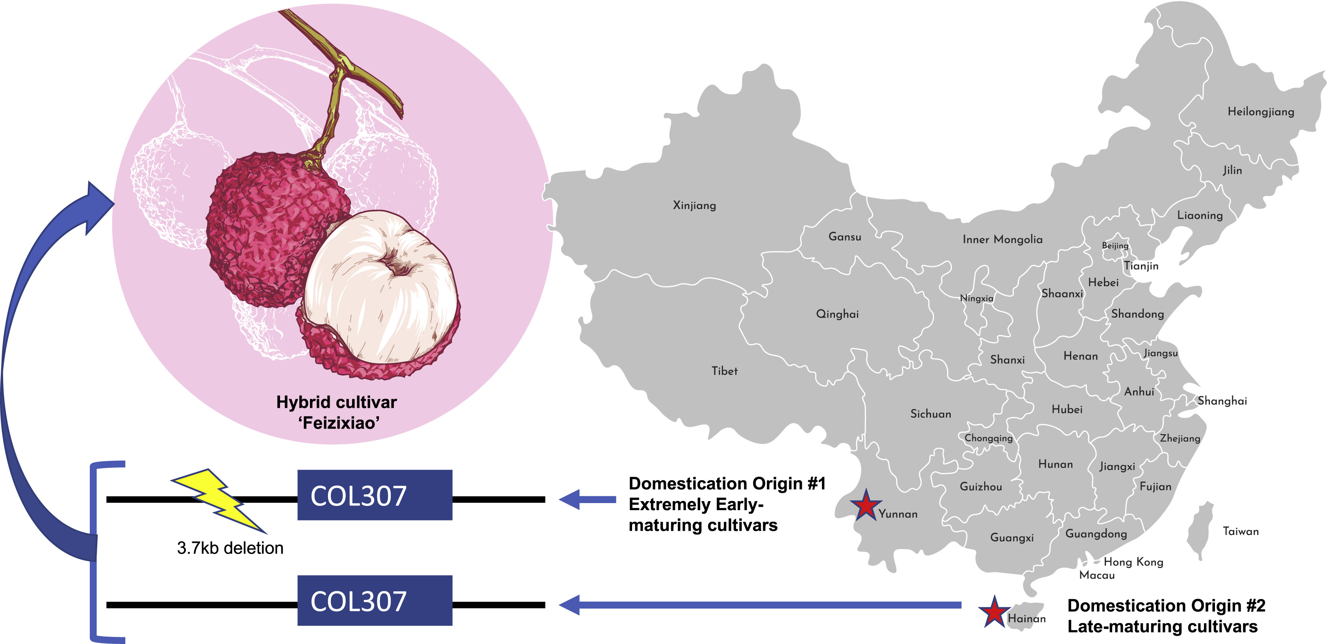
Figure 1
Molecular Plant 2022 15393-395DOI: (10.1016/j.molp.2022.02.010)
Copyright © 2022 The Author Terms and Conditions
Notes:
Origin and domestication history of lychee.
Red stars denote the approximate locations of the two independent domestication origins in China; Yunnan for extremely early-maturing cultivars and Hainan for late-maturing cultivars. A 3.7-kb deletion close to a homolog of CONSTANS (COL307), possibly caused by a transposable element, may in large part contribute to the observed differences in flowering-time and fruit maturity dates. The reference genome of the hybrid cultivar Feizixiao contains both variants of this gene and exhibits an intermediate phenotype.

