Slide 1
The Intel new mexico Family & Friends amazing Car experience
April 23rd 8:30am – 3:00pm
Intel Maker Nation
presents
Brought to you by NM Makers: Brian Baltz, Allison Barnes, David Manzanares, Todd Marsh, Dan Mcculley, Russ McInnis, Noel Paz, Janet Sholar, Alex Fei Event sponsored by Intel Global Brand & Reputation Marketing, Melissa Beers

Slide 2
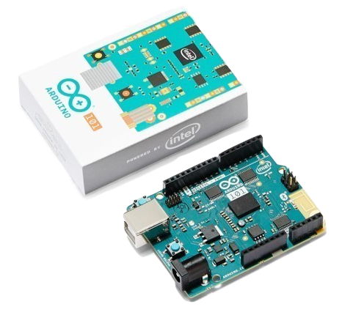
The Intel new mexico Family & Friends amazing Car experience
Inside Blue soco.intel.com/events/21970
Event introduces Intel® Arduino 101 to Intel employees, families & friends
build a car with coding & hardware experts available to answer questions
15 Teams will be randomly selected from the Inside Blue signup list
https://soco.intel.com/events/21970 An email notification will be sent if your Team is selected or placed on a waiting list
Saturday April 23rd from 8:30am to 3:00pm in RR7 TR1 & TR2
Bring 2 family members/friends (3 people total per team 8yrs and older)
~4 hours for creating the Basic Car, ~2 hours for the smart and connected Intermediate and Advanced level cars
Bring a laptop with a mouse and power cord
Beverages, Breakfast Snacks and Lunch will be provided
Thank you, if you have any questions please contact Allison Barnes or Todd Marsh

