Slide 1

CMPE/SE 257 Machine Learning April 30
Department of Computer engineering
San José state University
Spring 2018
Instructor :Bhavana Bhasker

Slide 2
Seq to Seq modelling : Importance
DNNs work well with large labelled datasets, they cannot be used to map sequences to sequences
DNNs can only be applied to problems whose inputs and targets can be sensibly encoded with vectors of fixed dimensionality
Many important problems are best expressed with sequences whose lengths are not known a-priori

Slide 3
Seq to seq : Basics
Use one LSTM to read the input sequence, one timestep at a time, to obtain large fixed dimensional vector representation
then use another LSTM to extract the output sequence from that vector
The second LSTM is essentially a recurrent neural network language model except that it is conditioned on the input sequence

Slide 4
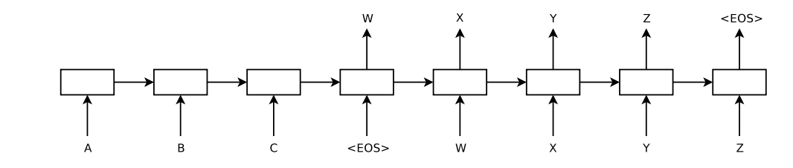
Seq to Seq : Basics

Slide 5
Seq to Seq : Basics
Why LSTM?
LSTM learns to map an input sentence of variable length into a fixed-dimensional vector representation
Temporal dependencies

Slide 6
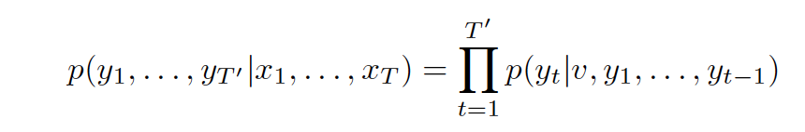
Seq to Seq model
map the input sequence to a fixed-sized vector using one RNN
map the vector to the target sequence with another RNN
the LSTM is to estimate the conditional probability p(y1, . . . , yT′ |x1, . . . , xT )
where(x1, . . . , xT ) is an input sequence
and y1, . . . , yT′ is its corresponding output sequence whose lengthT′ may differ from T.

Slide 7
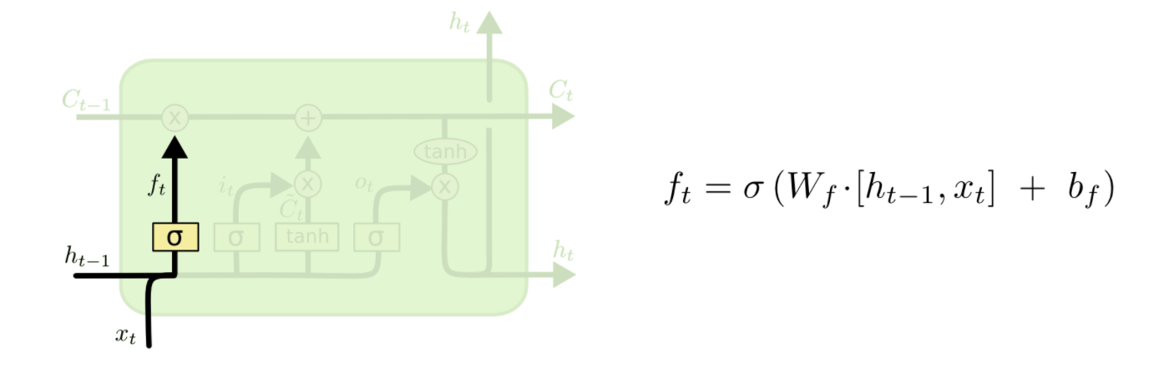
Seq to Seq : LSTM basics
Forget Layer

Slide 8
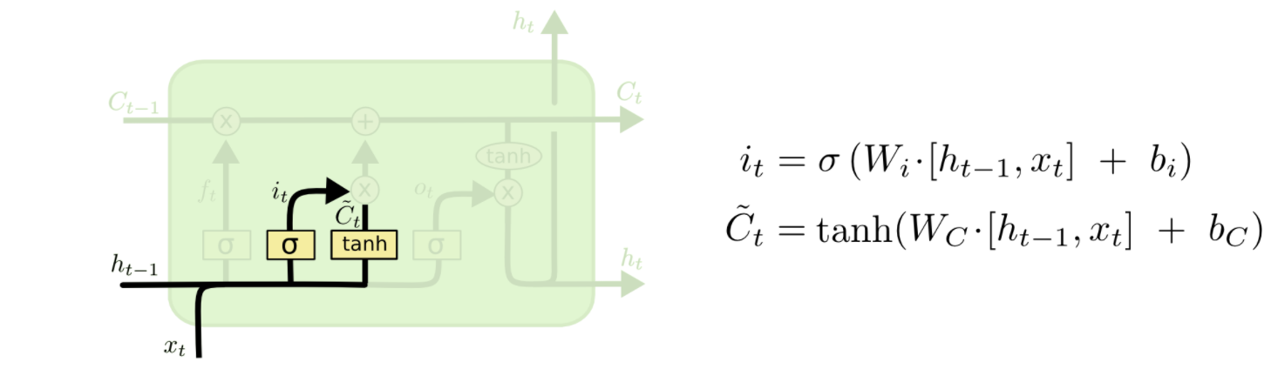
Seq to Seq : LSTM basics
Input Gate Layer

Slide 9
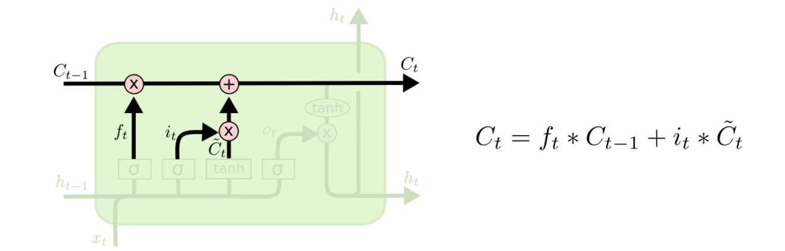
Seq to Seq : LSTM basics
New Layer Update

Slide 10
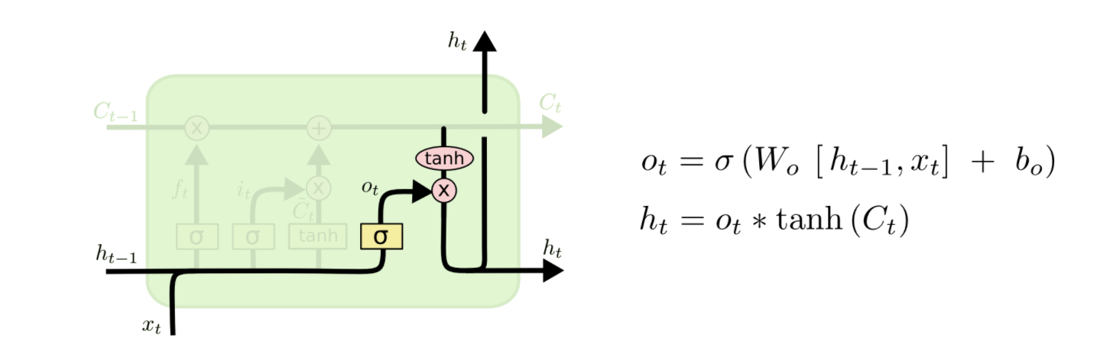
Seq to Seq : LSTM basics
Output Layer

Slide 11
Seq to Seq : Encoder- Decoder model
The encoder is an RNN that reads each symbol of an input sequence x sequentially. As it reads each symbol, the hidden state of the RNN changes. After reading the end of the sequence (marked by an end-of-sequence symbol),the hidden state of the RNN is a summary c of the whole input sequence.
The decoder of the proposed model is another RNN which is trained to generate the output sequence by predicting the next symbol y_{t} given the hidden state ht, both yt and ht are also conditioned on yt−1 and on the summary c of the input sequence.

Slide 12
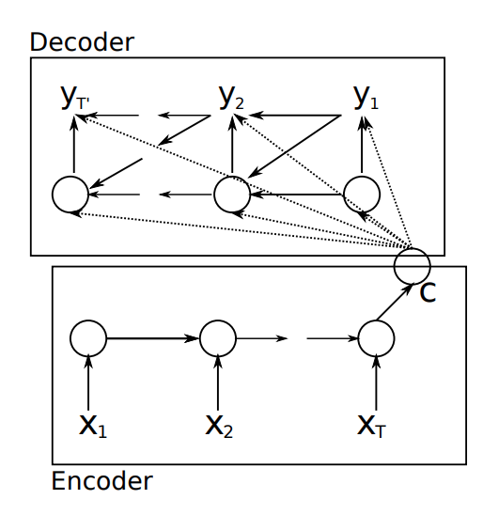
Seq to Seq : Encoder- Decoder model

Slide 13
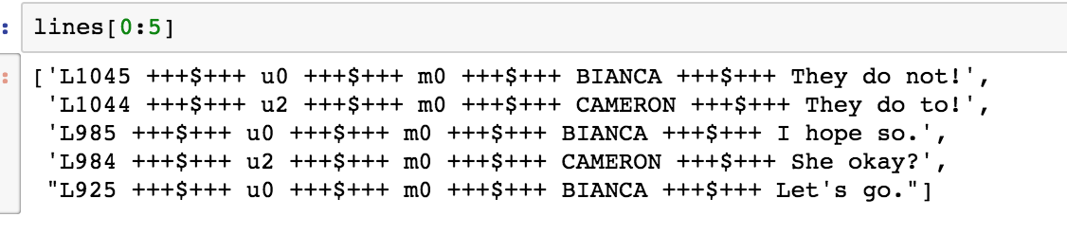
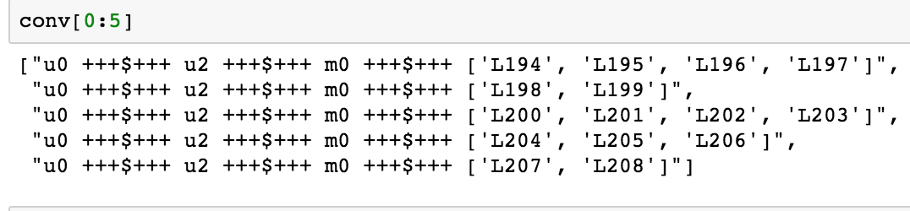
Implementation of seq2seq
Data Ingestion : Cornell movie data

Slide 14
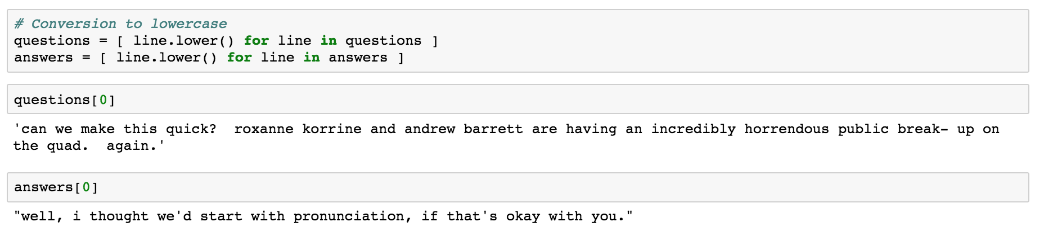
Implementation of seq2seq
Data preprocessing :
1. Conversion to lowercase

Slide 15
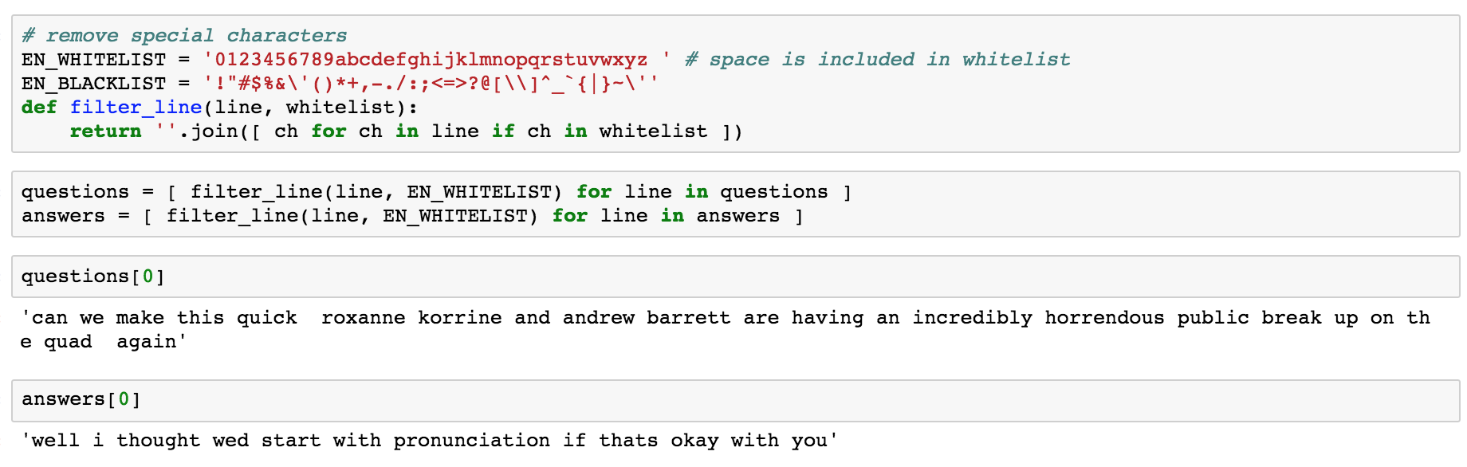
Implementation of seq2seq
Data preprocessing :
2. Remove special characters

Slide 16
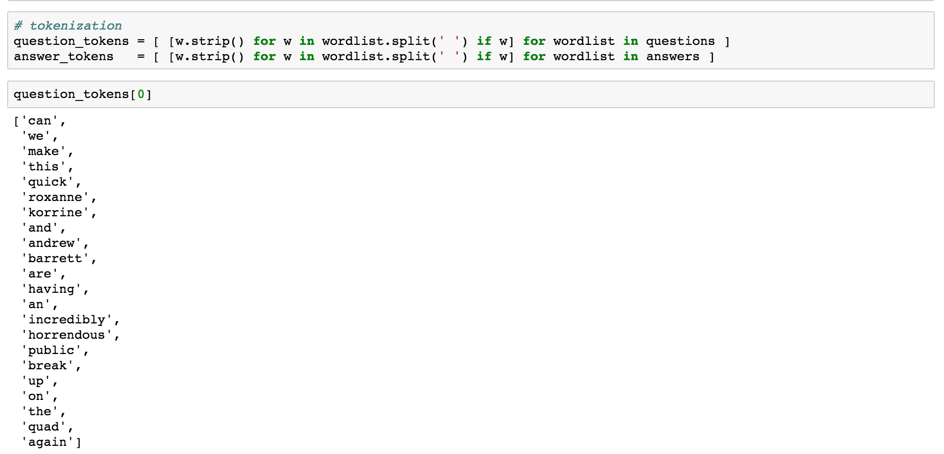
Implementation of seq2seq
Data preprocessing :
3. Tokenization

Slide 17
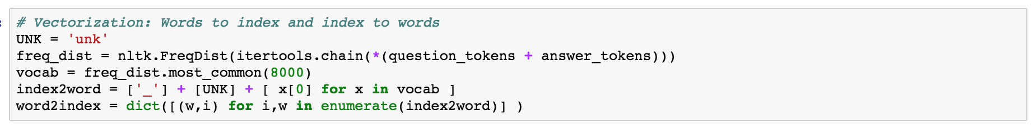
Implementation of seq2seq
Data preprocessing :
4. Vectorization

Slide 18
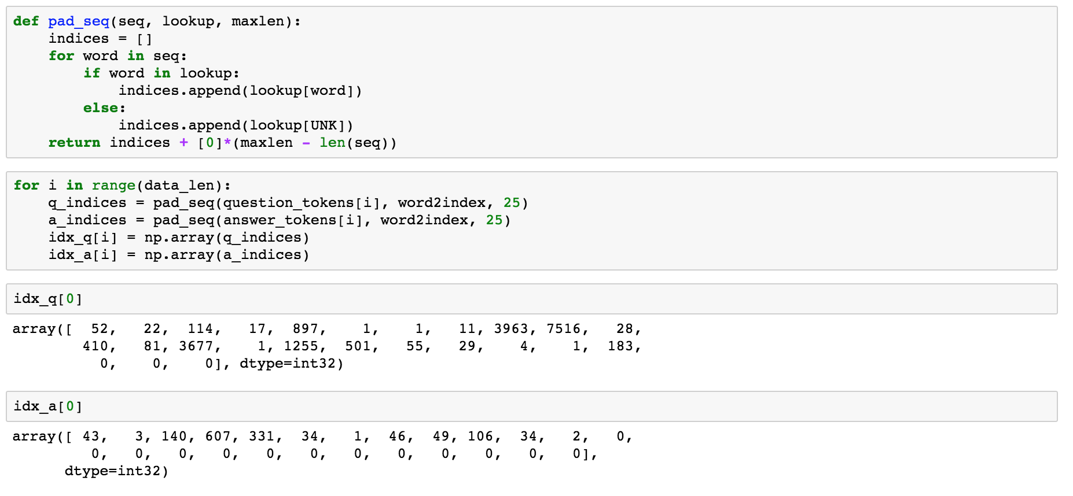
Implementation of seq2seq
Data preprocessing :
5. Pad sequences

Slide 19
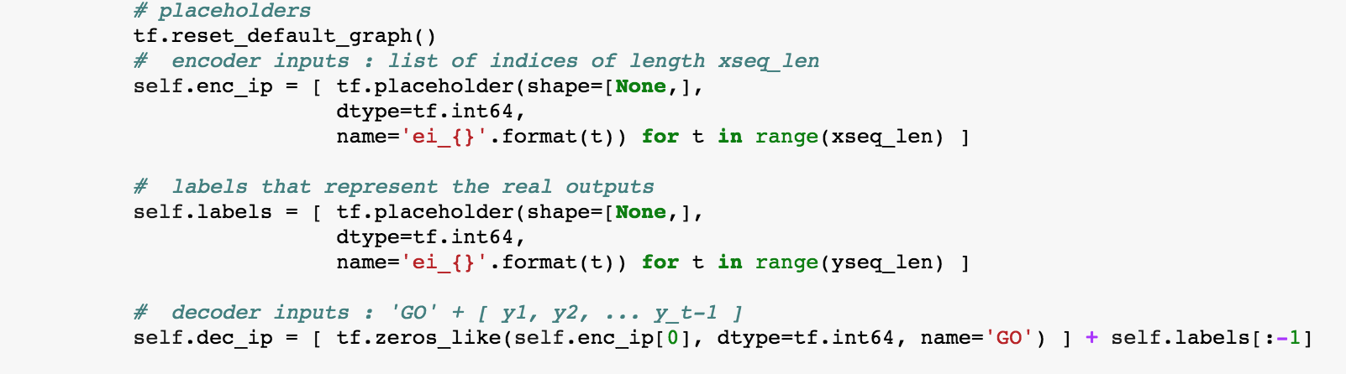
Implementation of seq2seq
Creating the place holders

Slide 20
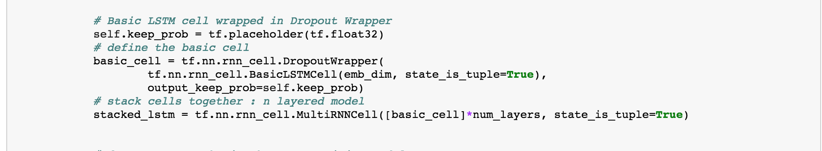
Implementation of seq2seq
Creating the LSTM cell

Slide 21
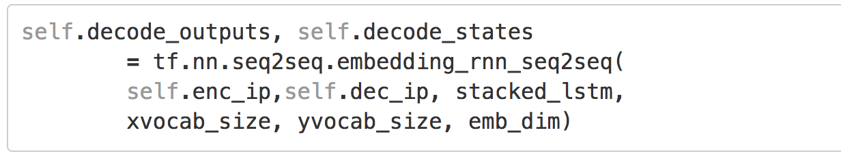
Implementation of seq2seq
Creating Decoder :

Slide 22
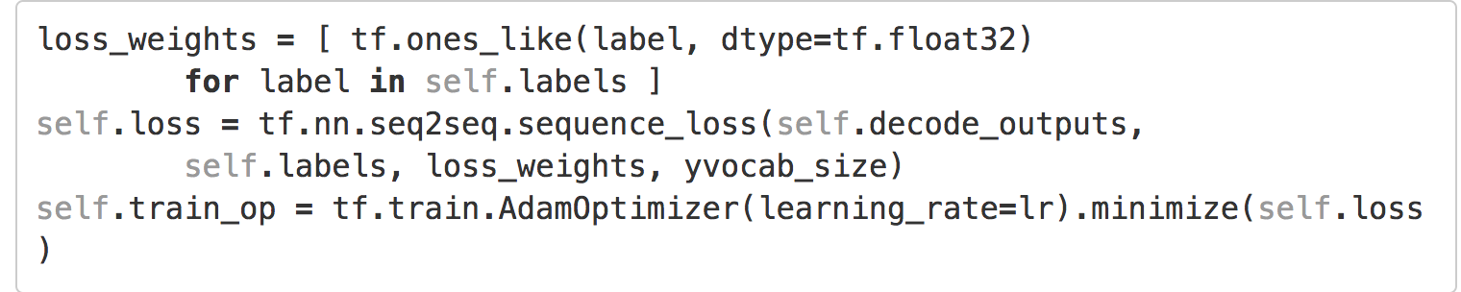
Implementation of seq2seq
Loss function

Slide 23
Implementation of seq2seq
Training

Slide 24
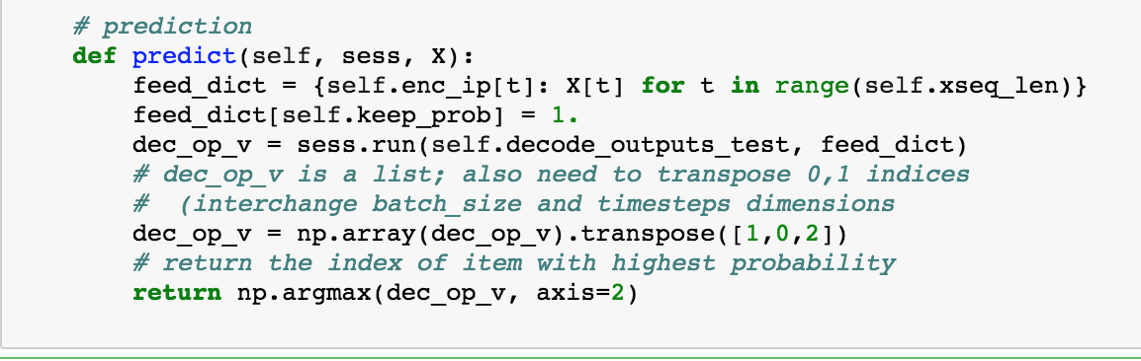
Implementation of seq2seq
Predict Function

Slide 25
Computer vision Fundamentals
Reading an image :
Cv2.imread(image path)
Copy the image :
np.copy(image)
Selecting the color threshold:
red_threshold = 0
green_threshold = 0
blue_threshold = 0
rgb_threshold = [red_threshold, green_threshold, blue_threshold]

Slide 26
Computer vision Fundamentals
# Identify pixels below the threshold
thresholds = (image[:,:,0] < rgb_threshold[0]) \
| (image[:,:,1] < rgb_threshold[1]) \
| (image[:,:,2] < rgb_threshold[2])
color_select[thresholds] = [0,0,0]
# Display the image
plt.imshow(color_select)
plt.show()

Slide 27
Computer Vision Fundamentals
Canny Edge Detection
cv2.canny() -> First argument is input image
Second argument –and third argument are : minVal and maxVal
edges = cv2.Canny(img,100,200)

Slide 28
In-class Assignment
Write canny edge detection program
Read an image
Apply canny algorithm
Plot the canny image

