Slide 1
ALIAS Generator

Slide 2
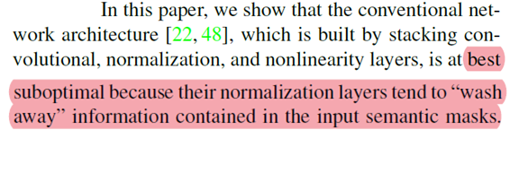
Related work: SPADE
Previous semantic image synthesis
conv
normalize
RELU
……
conv
normalize
RELU
Semantic
Segmentation
Synthesis
Image

Slide 3
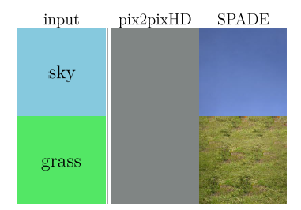
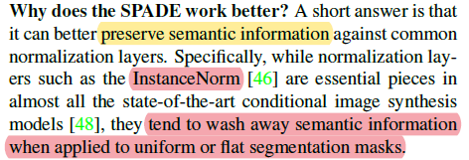
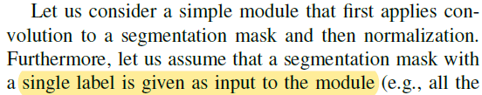
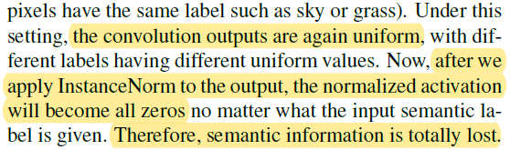
Related work: SPADE
단순 single label map을 conv + norm layer에 넣으면 0값이 나온다.
Semantic segmentation은 uniform value들을 가지고 있으므로 정보가 손실된다
=> Semantic은 정규화 하지 말아야.

Slide 4
Related work: SPADE
Unconditional normalization layers: activation
Conditional normalization layers: activation + external data
Local Response Normalization
Batch normalization
Instance normalization
Layer normalization
Group normalization
Weight normalization
Conditional batch normalization
Adaptive instance normalization

Slide 5
Related work: SPADE
Conditional normalization layers
normalize
denormalize
activation
activation
affine param
External data(condition) = segment map
style transform(instance normalization)에서는 이미지 전체의 style을 변경하는 것이기 때문에 affine parameter가 channel별로 일정함(affine parameter가 크기가 C(channel 수)인 vector).
SPADE에서는 이미지의 디테일을 위해 affine parameter로 이미지를 조정한다.(affine parameter가 tensor) (spatially-varying affine parameter)

Slide 6
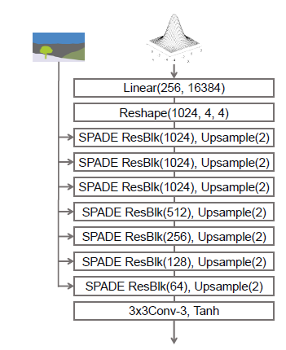
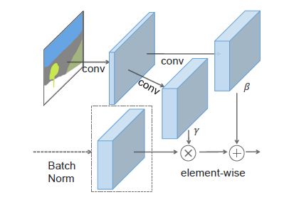
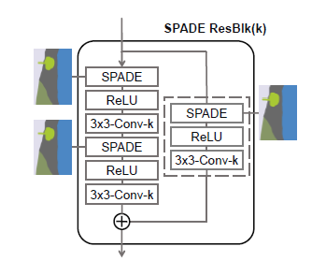
Related work: SPADE
Random noise + (encoded style)
SPatially Adaptive (DE)normalization

Slide 7
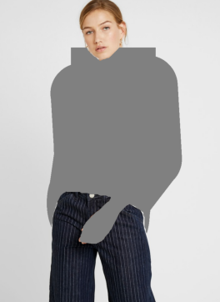
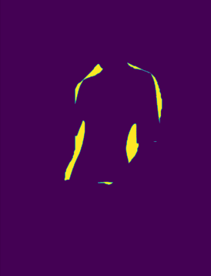
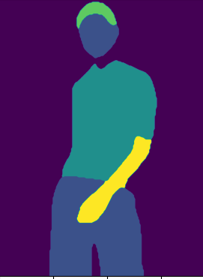
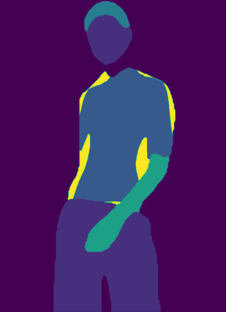
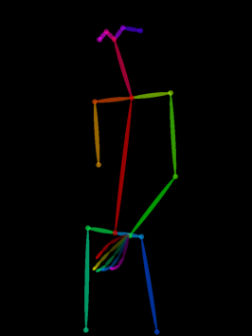
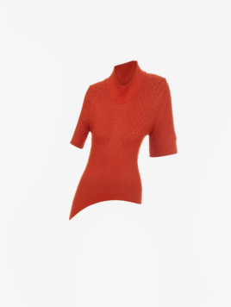
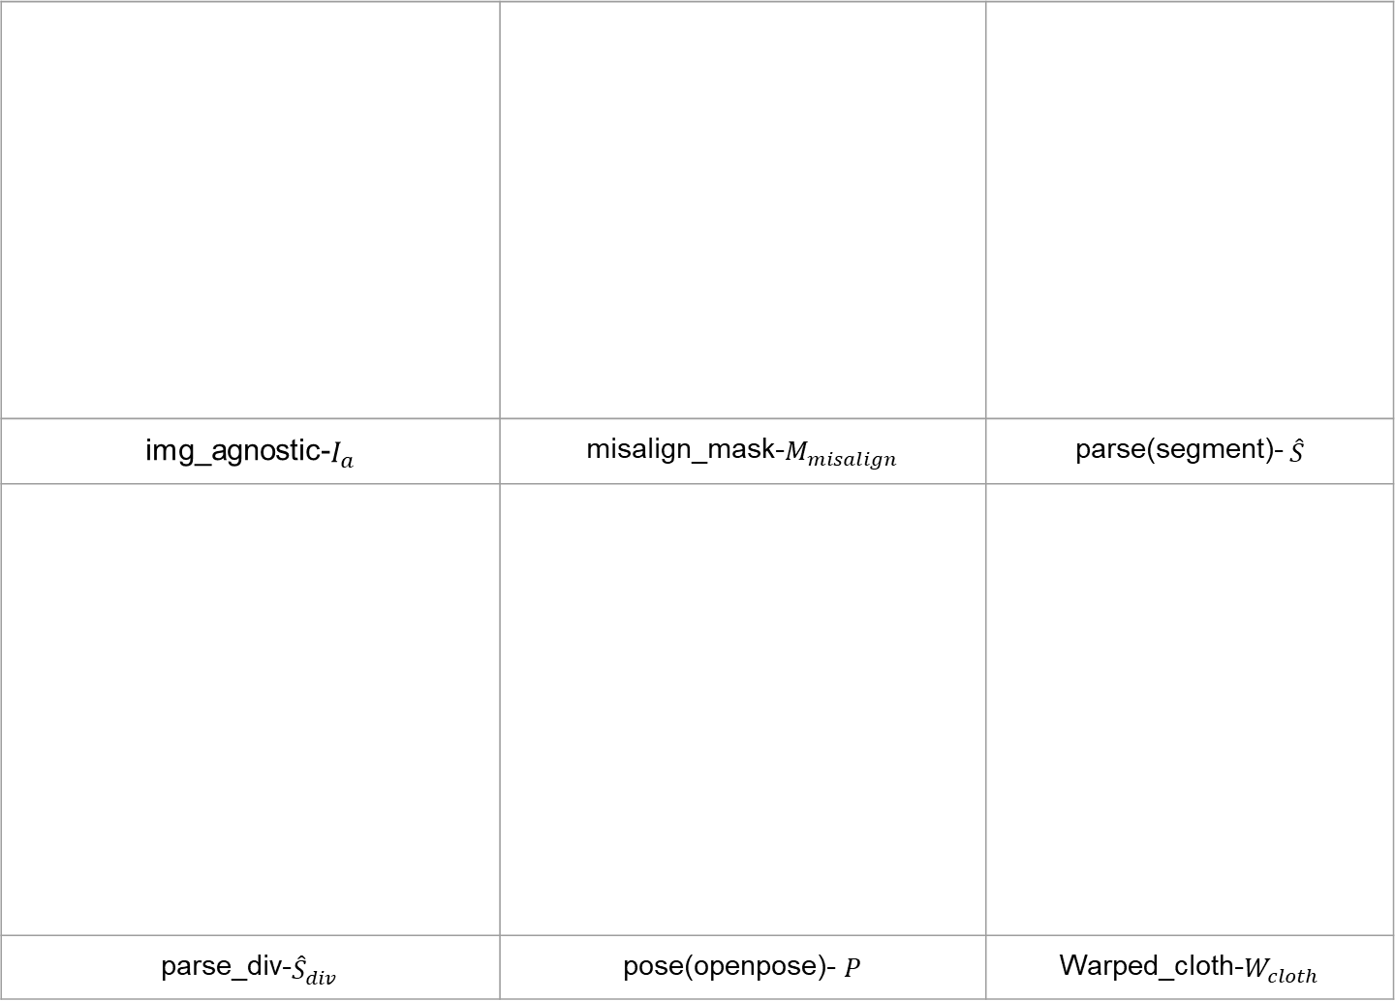
ALIAS Input
img_agnostic-$I_{a}$ | misalign_mask-$M_{misalign}$ | parse(segment)- $\hat{S}$
parse_div-${\hat{S}}_{div}$ | pose(openpose)- $P$ | Warped_cloth-$W_{cloth}$

Slide 8
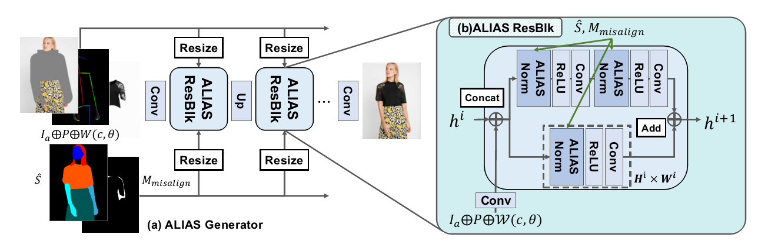
ALIAS Generator
Ia
P
W(c)
M_{misalign} = S’_{c}-W(M_{c}) =\= S_{c} -W(M_{c})
Loss = w1 * L_{feature} + w2 * L_{cgan} + w3 * L _{perc}
S’ ~ S
So, we need real or simulated W(Mc) and W(c) for training
Even though we can use Sc for S’c and S for S’
Not pixel level L1 l oss
Multiscale D
VGG
S’ : 타영역 + 옷 영역에서 Mc 영역 제외. => 가져다 쓸 수 있는 영역을 알려 줌?
Mmisalign은 따로줌 => 그 영역을 채워 넣으라고 다시 한번 강조?
Code 에서는 S가 다시 들어감. WHY?

Slide 9
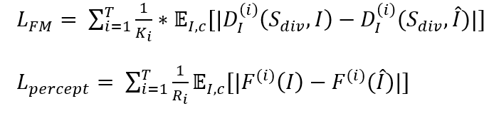

ALIAS Generator Loss
$λ_{FM}$, $λ_{percept}$=10
D: multi scale discriminator
I: given reference(GT)
c: target cloth image
F: VGG network layer

Slide 10
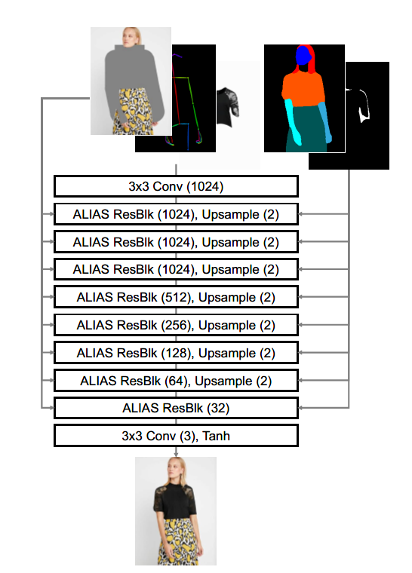
Ia, P, W(C)
Sdiv
S
ALIAS Generator
Mdiv
Default:most
Coarse(global)
conv0(1,6,8,1024)
Sdiv, Mdiv
head0(1,6,8,1024)
F[0]
middle0(1,12,16,1024)
F[1]
Sdiv, Mdiv
If more or most: add upsample layer
middle1(1,24,32,1024)
F[2]
Sdiv, Mdiv
up0(1,48,64,512)
F[3]
Sdiv, Mdiv
up1(1,96,128,256)
F[4]
Sdiv, Mdiv
up2(1,192,256,128)
F[5]
S
up3(1,384,512,64)
F[6]
S
up4(1,768,1024,32)
If most: add upsample layer and resblock
F[7]
S
conv_img(1,768,1024,3)
Refine(detail)
Multiscale refinement at feature level => preserve cloth detail

Slide 11
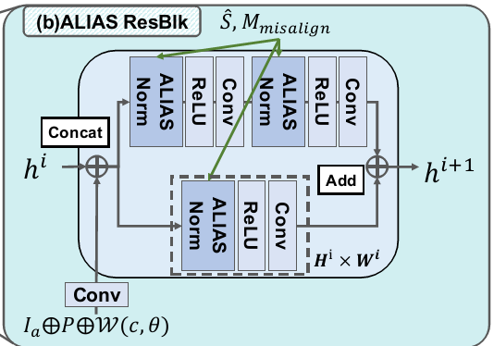
ALIAS ResBlk
seg
Spectral normalize된 conv
d_x
x
x_s
Learned_shortcut (if input_nc != output_nc) => skip connection(dim 맞춰줘야)

Slide 12
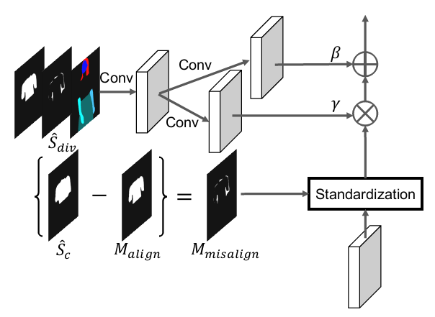
ALIAS normalization
(B,C,H,W)
(B,128,H,W)
normalized * (1 + gamma) + beta
(B,7 or 8,H,W)
Conv_shared
(B,C,H,W)
actv
Conv_beta
Conv_gamma
(B,C,H,W)
(B,C,H,W)
normalized
Mask norm
or
Instance norm
Param_free_norm
(B,1,H,W)
X

Slide 13
ALIAS ResBlk
class ALIASResBlock(nn.Module):
def __init__(self, opt, input_nc, output_nc, use_mask_norm=True):
super(ALIASResBlock, self).__init__()
self.learned_shortcut = (input_nc != output_nc)#False이면 하나 더
middle_nc = min(input_nc, output_nc)#작은걸 골랐을 때 성능이 더 좋았나?
self.conv_0 = nn.Conv2d(input_nc, middle_nc, kernel_size=3, padding=1)
self.conv_1 = nn.Conv2d(middle_nc, output_nc, kernel_size=3, padding=1)
if self.learned_shortcut:#2+1개의 ALIAS Norm중 1개
self.conv_s = nn.Conv2d(input_nc, output_nc, kernel_size=1, bias=False)
subnorm_type = opt.norm_G#spectralaliasinstance
if subnorm_type.startswith('spectral'):#True
subnorm_type = subnorm_type[len('spectral'):]#aliasinstance
self.conv_0 = spectral_norm(self.conv_0)#2개의 ALIAS Norm중 하나
self.conv_1 = spectral_norm(self.conv_1)#sectral norm이 뭐지
if self.learned_shortcut:#input_nc!=output_nc임
self.conv_s = spectral_norm(self.conv_s)#2+1개의 ALIAS Norm중 1개
semantic_nc = opt.semantic_nc#13
if use_mask_norm:
subnorm_type = 'aliasmask'
semantic_nc = semantic_nc + 1
self.norm_0 = ALIASNorm(subnorm_type, input_nc, semantic_nc)
self.norm_1 = ALIASNorm(subnorm_type, middle_nc, semantic_nc)
if self.learned_shortcut:
self.norm_s = ALIASNorm(subnorm_type, input_nc, semantic_nc)
self.relu = nn.LeakyReLU(0.2)
def shortcut(self, x, seg, misalign_mask):
if self.learned_shortcut:
return self.conv_s(self.norm_s(x, seg, misalign_mask))
else:
return x
def forward(self, x, seg, misalign_mask=None):#그림과 동일
#seg:concat(S_hat,M_misaligned)
seg = F.interpolate(seg, size=x.size()[2:], mode='nearest')
if misalign_mask is not None:
misalign_mask = F.interpolate(misalign_mask, size=x.size()[2:], mode='nearest')
x_s = self.shortcut(x, seg, misalign_mask)
dx = self.conv_0(self.relu(self.norm_0(x, seg, misalign_mask)))
dx = self.conv_1(self.relu(self.norm_1(dx, seg, misalign_mask)))
output = x_s + dx
return output

Slide 14
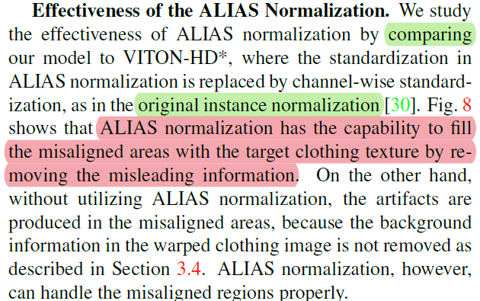
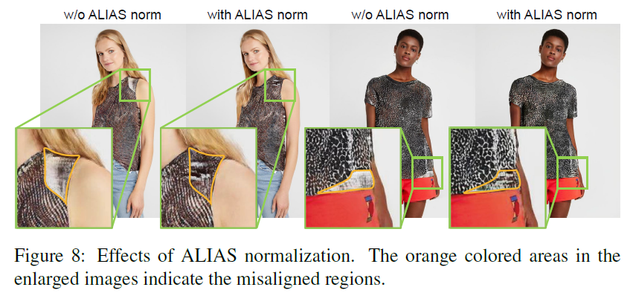
ALIAS normalization
ALIAS normalization은 target cloth의 texture를 보존하면서 misalign 영역에 있는 artifacts들을 제거할 수 있다.
Misleading information=artifacts Artifacts: warped cloth의 제거되지 않은 background (근데 이게 misalign 영역에 있나?)

Slide 15
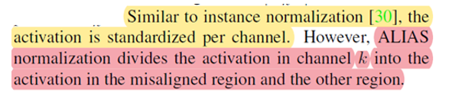
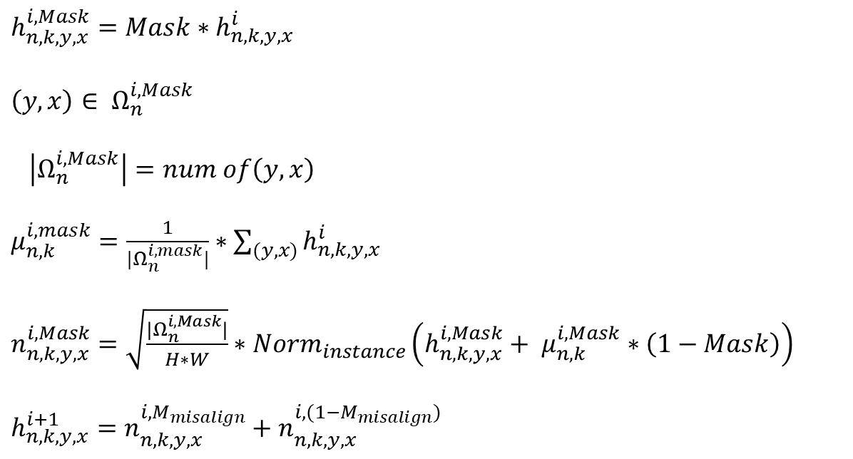
mask normalization
$h_{n,k,y,x}^{i,Mask}=Mask∗h_{n,k,y,x}^{i}$
${\left(y,x\right)∈ Ω}_{n}^{i,Mask}$
$\left|Ω_{n}^{i,Mask}\right|=num of\left(y,x\right)$
$μ_{n,k}^{i,mask}=\frac{1}{|Ω_{n}^{i,mask}|}∗\sum_{(y,x)}{h_{n,k,y,x}^{i}}$
$n_{n,k,y,x}^{i,Mask}=\sqrt{\frac{|Ω_{n}^{i,Mask}|}{H∗W}}∗Norm_{instance}\left(h_{n,k,y,x}^{i,Mask}+ μ_{n,k}^{i,Mask}∗\left(1−Mask\right)\right)$
$h_{n,k,y,x}^{i+1}=n_{n,k,y,x}^{i,M_{misalign}}+n_{n,k,y,x}^{i,{(1−M}_{misalign})}$
Misalign 영역과 아닌 영역을 나눠서 normalize
Misalign 영역이 작을 수록 표준편차가 작음, 따라서 normalize된 값이 커짐.
1-Misalign 과 범위를 어느정도 맞추기 위해 계수를 곱하는 것 같음

Slide 16


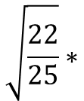


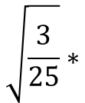





mask normalization example
$$n_{1,1,y,x}^{i,M_{misalign}}$$
$$h_{1,1,y,x}^{i,M_{misalign}}$$
$$h_{n,k,y,x}^{i}$$
0 | 0 | 0 | 0 | 0
0 | 0 | 0 | 0 | 0
0 | -3.5 | 3.5 | 0 | 0
0 | 0 | 0 | 0 | 0
0 | 0 | 0 | 0 | 0
$$h_{1,1,y,x}^{i}$$
0 | 0 | 0 | 0 | 0
0 | 0 | 0 | 0 | 0
0 | 1 | 3 | 2 | 0
0 | 0 | 0 | 0 | 0
0 | 0 | 0 | 0 | 0
2 | 2 | 2 | 2 | 2
2 | 2 | 2 | 2 | 2
2 | 1 | 3 | 2 | 2
2 | 2 | 2 | 2 | 2
2 | 2 | 2 | 2 | 2
$$\sqrt{\frac{3}{25}}∗$$
1 | 2 | 3 | 2 | 2
2 | 2 | 2 | 2 | 2
1 | 1 | 3 | 2 | 3
2 | 2 | 1 | 2 | 3
3 | 1 | 2 | 2 | 2
$$h_{1,1,y,x}^{i,M_{misalign}}+\left(1−M_{misalign}\right)∗μ_{1,1,y,x}^{i,M_{misalign}}$$
$$⊕$$
$$M_{misalign}$$
$$M_{misalign}$$
$$h_{1,1,y,x}^{i,(1−M_{misalign})}$$
0 | 0 | 0 | 0 | 0
0 | 0 | 0 | 0 | 0
0 | 1 | 1 | 1 | 0
0 | 0 | 0 | 0 | 0
0 | 0 | 0 | 0 | 0
-1.7 | 0 | 1.7 | 0 | 0
0 | 0 | 0 | 0 | 0
-1.7 | 0 | 0 | 0 | 1.7
0 | 0 | -1.7 | 0 | 1.7
1.7 | -1.7 | 0 | 0 | 0
1 | 2 | 3 | 2 | 2
2 | 2 | 2 | 2 | 2
1 | 0 | 0 | 0 | 3
2 | 2 | 1 | 2 | 3
3 | 1 | 2 | 2 | 2
1 | 2 | 3 | 2 | 2
2 | 2 | 2 | 2 | 2
1 | 2 | 2 | 2 | 3
2 | 2 | 1 | 2 | 3
3 | 1 | 2 | 2 | 2
$$\sqrt{\frac{22}{25}}∗$$
$$h_{1,1,y,x}^{i,(1−M_{misalign})}+M_{misalign}∗μ_{1,1,y,x}^{i,{(1−M}_{misalign})}$$
$$n_{1,1,y,x}^{i,{(1−M}_{misalign})}$$

Slide 17
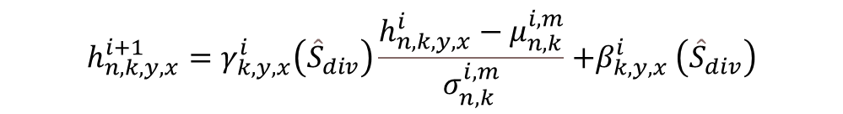
ALIAS norm
class ALIASNorm(nn.Module):
def __init__(self, norm_type, norm_nc, label_nc):
super(ALIASNorm, self).__init__()
self.noise_scale = nn.Parameter(torch.zeros(norm_nc))
assert norm_type.startswith('alias')
param_free_norm_type = norm_type[len('alias’):]
#ALIAS_resblock에서 use_mask_norm를 쓰면 mask norm 안 쓰면 instance norm
#3 case 모두 다 affine false
if param_free_norm_type == 'batch’:#안 쓰임
self.param_free_norm = nn.BatchNorm2d(norm_nc, affine=False)
elif param_free_norm_type == 'instance':
self.param_free_norm = nn.InstanceNorm2d(norm_nc, affine=False)
elif param_free_norm_type == 'mask':
self.param_free_norm = MaskNorm(norm_nc)
else:
raise ValueError(
"'{}' is not a recognized parameter-free normalization type in ALIASNorm".format(param_free_norm_type)
)
nhidden = 128
ks = 3
pw = ks // 2
self.conv_shared = nn.Sequential(nn.Conv2d(label_nc, nhidden, kernel_size=ks, padding=pw), nn.ReLU())#gamma와 beta의 input으로 가는 layer
self.conv_gamma = nn.Conv2d(nhidden, norm_nc, kernel_size=ks, padding=pw)
self.conv_beta = nn.Conv2d(nhidden, norm_nc, kernel_size=ks, padding=pw)
#normalized를 affine transform했을 때 장점?
#convolution layer로 affine parameter 추정?
def forward(self, x, seg, misalign_mask=None):
# Part 1. Generate parameter-free normalized activations.
b, c, h, w = x.size()
noise = (torch.randn(b, w, h, 1).cuda() * self.noise_scale).transpose(1, 3)#noise 더하는 이유가? gan에서 noise 더하는거랑 같은 이유? normalize할 #때 noise를 더하는게 유리한가? Convolution할 때 강건해지긴 함, 0이므로 실제 안 씀
#standardization == normalization(instance or mask)
if misalign_mask is None:
normalized = self.param_free_norm(x + noise)
else:
normalized = self.param_free_norm(x + noise, misalign_mask)
# Part 2. Produce affine parameters conditioned on the segmentation map.
actv = self.conv_shared(seg) # size: (b,nhidden,h,w)
gamma = self.conv_gamma(actv) # size: (b,norm_nc,h,w)
beta = self.conv_beta(actv) # size: (b,norm_nc,h,w)
# Apply the affine parameters. 뭔 역할 하는지 모르겠음 일종의 선형 변환인데 번거롭게 이런 방식을 사용한 이유가? 어떻게 artifact를 지울 수 있었나
output = normalized * (1 + gamma) + beta #식만 봐서는 모르겠음
return output
#gamma,beta는 normalized된 값을 조정
$${h_{n,k,y,x}^{i+1}=γ}_{k,y,x}^{i}\left({\hat{S}}_{div}\right)\frac{h_{n,k,y,x}^{i}−μ_{n,k}^{i,m}}{σ_{n,k}^{i,m}}{+β}_{k,y,x}^{i}\left({\hat{S}}_{div}\right)$$

Slide 18






Mask norm
X[b,c,:,:] *mask=region $=$
num_pixels$=$
class MaskNorm(nn.Module):
def __init__(self, norm_nc):#semantic_nc = semantic_nc(13) + 1 = 14
super(MaskNorm, self).__init__()
self.norm_layer = nn.InstanceNorm2d(norm_nc, affine=False)
def normalize_region(self, region, mask):#이게 정확히 뭘 하는지 모르겠음
b, c, h, w = region.size()
num_pixels = mask.sum((2, 3), keepdim=True) # size: (b, 1, 1, 1) , mask 영역의 크기
num_pixels[num_pixels == 0] = 1 #0으로 나누는걸 방지
mu = region.sum((2, 3), keepdim=True) / num_pixels # size: (b, c, 1, 1) #mask영역에 있는 값의 channel당 평균 결국 region은 x에 mask를 곱함
normalized_region = self.norm_layer(region + (1 - mask) * mu) # size: (b,c,h,w), 해당 mask가 아닌 부분을 channel의 평균(mu)으로 채우고 instance normalization
return normalized_region * torch.sqrt(num_pixels / (h * w))
def forward(self, x, mask):#x:input, mask: misaligned mask
mask = mask.detach() #size (b, 1, h, w)
normalized_foreground = self.normalize_region(x * mask, mask)#misalign부분
normalized_background = self.normalize_region(x * (1 - mask), 1 - mask)#misalign이 아닌 부분
return normalized_foreground + normalized_background
$$mu=$$

Slide 19

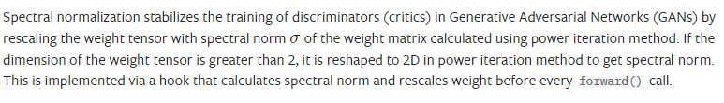
Spectral norm
필터 정규화 -> loss function의 gradient normalize
Discriminators를 학습을 안정화된다고 알려짐, 근데 왜 generator에 사용했는지 모르겠음
학습할 때 도움은 될 듯

Slide 20
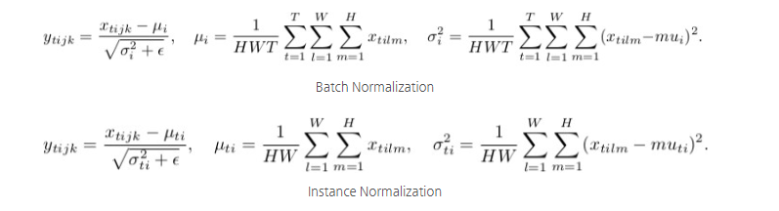



Instance normalization
Batch가 1인 batch normalization
Network가 contrast에 의존적이지 않게 한다.(style transfer등에서)
Affine=True
Torch.nn.instanceNorm2d:
Affine=False
Affine이 false이므로 적용 affine 파라미터는 무시
Style transfer에서 사용된 방식이므로 affine parameter는 dim=C인 vector

Slide 21

$${\hat{S}}_{div} , M_{misalign}$$
$$\hat{S}$$
ALIAS
Generator
ALIAS ResBlk
ALIAS ResBlk
ALIAS ResBlk
ALIAS ResBlk
ALIAS ResBlk
ALIAS ResBlk
ALIAS ResBlk
ALIAS ResBlk
resize
Conv
up
up
up
up
up
up
up
Conv
tanh
Conv
Conv
Conv
Conv
Conv
Conv
Conv
resize
resize
resize
resize
resize
resize
resize
$I_{agnostic} ⨁{ P}_{ }⨁$ $W_{cloth}$
Notes:
I_a w_c resize하지 말고
Seq(conv pool conv poll)

Slide 22




ALIAS ResBlk
$$\hat{S} or {\hat{S}}_{div}$$
$$M_{misalign} or None$$
resize
Spectral norm
Spectral norm
ALIAS norm
ALIAS norm
$h_{i}⨁{\begin{aligned} \\ I_{agnostic}⨁{P⨁{W_{cloth}}}\end{aligned}}$
elementwise sum
$$h_{i+1}$$
ReLU
Conv
ReLU
Conv
Spectral norm
shortcut
ALIAS norm
ReLU
Conv

Slide 23





ALIAS normalization
$$\hat{S} or {\hat{S}}_{div}$$
denormalize
$h_{i}⨁{\begin{aligned} \\ I_{agnostic}⨁{P⨁{W_{cloth}}}\end{aligned}}$
Conv shared
normalize
Conv gamma
Conv beta
Mask norm
or
Instance norm
$$⊗$$
$$⊕$$
element wise
ALIAS normalization
$$M_{misalign} or None$$
None이면 SPADE와 같음

