Slide 1
TypeScript

Slide 2
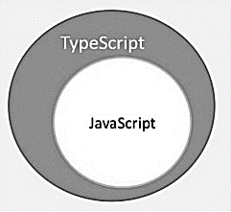
What is TypeScript?
By definition, “TypeScript is JavaScript for application-scale development.”
Open-source programming language from Microsoft.
Typed Superset of JavaScript compiled/transpiled to JavaScript.

Slide 3
Why TypeScript?
Compilation: Hence lesser syntax errors.
Strong static typing: Optional static typing and type inference system through the TLS (TypeScript Language Service).
OOP: Object Oriented Programming concepts like classes, interfaces, inheritance, etc.
TypeScript is portable. TypeScript is portable across browsers, devices, and operating systems.

Slide 4
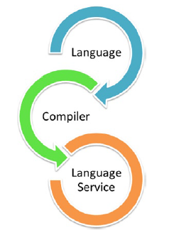
Components
Language: Syntax, keywords, and type annotations.
The TypeScript Compiler: TypeScript to its JavaScript equivalent
The TypeScript Language Service: Editor operations like statement completions, signature help, code formatting and outlining, colorization, etc.

Slide 5
First TypeScript Program
“Hello SharePoint Team”

Slide 6
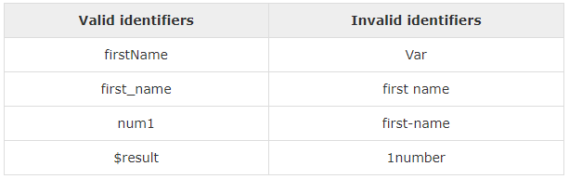
Identifiers
Include Characters and digit.
Cannot start with digit.
‘$’ and ‘_’ only allowed.
Cannot be keywords.
Unique.
Case sensitive.
Cannot contain spaces/tabs.

Slide 7
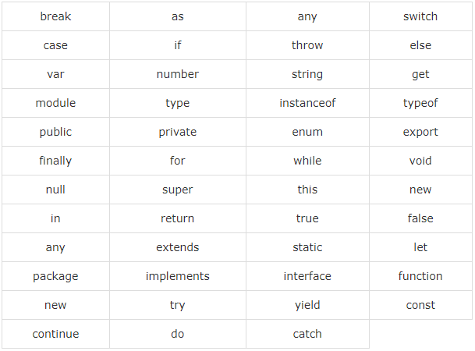
Keywords

Slide 8
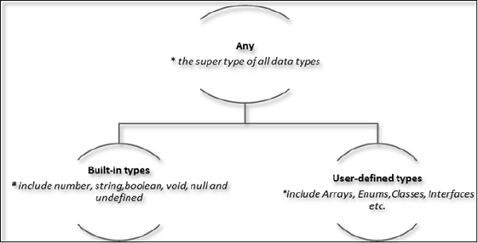
Data Types & Variable
let/ var [identifier] : [type-annotation] = value ;

Slide 9
Operators
Arithmetic: +, -, *, /, %, ++, --
Logical: >, <, >=, <=, ==, !=
Relational: &&, ||, !
Bitwise: &, |, ^, ~, <<, >>, >>>
Assignment: =, +=, -=, *=, /=
Ternary: ?:
Type: typeof <variable name>

Slide 10
Conditional Statement
if… Statement
If…else Statement
Else…if and nested if… statement
Switch statement

Slide 11
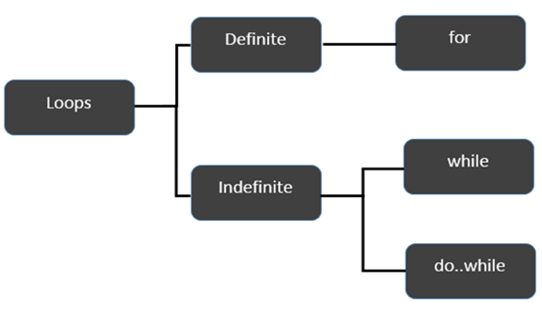
Loops

Slide 12
Functions
Optional Parameters
Rest Parameters
Default Parameters
Anonymous functions – no identifier associated
Function constructor
Lambda function
Function overloads

Slide 13
Interface, Classes & Objects

Slide 14
Questions and Queries

Slide 15
Thank you !!
To be Continued…

