Slide 1
Input 1 :
Reference model
SPTG tool
Output :
Test case
Input 2 :
Test purpose

Slide 2

Input 1 :
Reference model
Input 2 :
Test purpose
q0
q2
tr1
tr2
q0
q0
q1
tr2
tr1
q1
SPTG tool
Output : Test case
INC
INC
PASS
FAIL
FAIL

Slide 3

Input 1 :
Reference model
Input 2 :
Test purpose
q0
q2
tr1
tr2
q0
q0
q1
tr2
tr1
q1
SPTG tool
tguard (cl < TM);
guard (exists< #2 : urational , $1 : urational >(((#2 + x1) == 42) && ($1 == 0)) && (0 <= (x1 + -1)) && (x1 <= 5) && (x1 <= 10));
output In(x1);
cl := 0;
1
Output :
Test case
In! 5 @ 0 time
System Under Test
(SUT)
1
tguard ((#2 == cl) && (cl < TM));
input Out($1);
guard (((#2 + x1) == 42) &&
($1 == 0));
2
Out? 0 @ 41 time
2
Out? 0 @ 42 time
3
TM = 60 time
PASS
SMT-solver (e.g. Z3)
4
Quiescence? @ 60 time
tguard ((#2 == cl) && (cl < TM));
input Out($1);
guard (((#2 + x1) != 42) ||
($1 != 0));
tguard ((#2 == cl) && (cl >= TM));
input Quiescence;
guard forall< # : urational , $1 : urational >(((# + x1) != 42) ||
($1 != 0) || (#2 >= #));
Test instrumentation
3
4
Verdict
PASS / INC / FAIL
FAILdur
FAILout
Stimulation
Observation

Slide 4
Input 1 :
Reference model
Input 2 :
Test purpose
SPTG tool
Output 1 :
Test case
tguard (cl < TM);
guard (exists< #2 : urational , $1 : urational >(((#2 + x1) == 42) && ($1 == 0)) && (0 <= (x1 + -1)) && (x1 <= 5) && (x1 <= 10));
output In(x1);
cl := 0;
tguard ((#2 == cl) && (cl < TM));
input Out($1);
guard (((#2 + x1) == 42) &&
($1 == 0));
In! 5 @ 0 time
SUT
Output 1 :
Test case
Out? 0 @ 41 time
PASS
Out? 0 @ 42 time
TM = 60 time
tguard ((#2 == cl) && (cl < TM));
input Out($1);
guard (((#2 + x1) != 42) ||
($1 != 0));
SMT-solver (e.g. Z3)
Quiescence @ 60 time
tguard ((#2 == cl) && (cl >= TM));
input Quiescence;
guard forall< # : urational , $1 : urational >(((# + x1) != 42) ||
($1 != 0) || (#2 >= #));
Test instrumentation
FAILout
Verdict
PASS / INC / FAIL
FAILdur

Slide 5
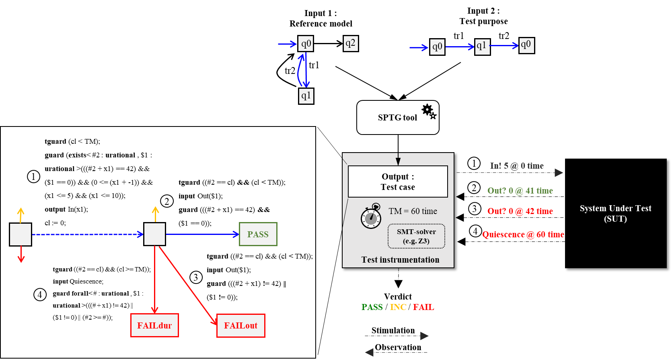

Slide 6
