Slide 1
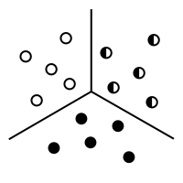
“Kluster It! - Integrating K-Means Clustering and Club Convergence Analysis with Shiny”
Bernard Banyuls

Slide 2
Kluster It! – Shiny App
PROBLEM
Technical complexity limits access to advanced data techniques
Need for tools that are accessible to non-technical users
SOLUTION
Develop a Shiny application for K-Means clustering and Club Convergence analysis for non-technical users and researchers

Slide 3



Methodologies
01
KMEANS
02
CLUB CONVERGENCE
03
KLUB INDEX

Slide 4
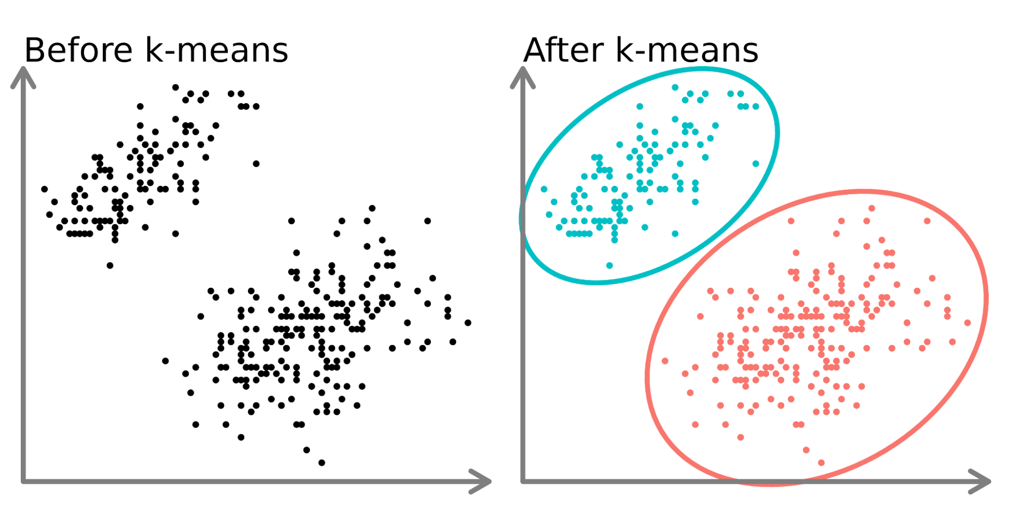
KMEANS
Partitioning data into clusters based on characteristics

Slide 5
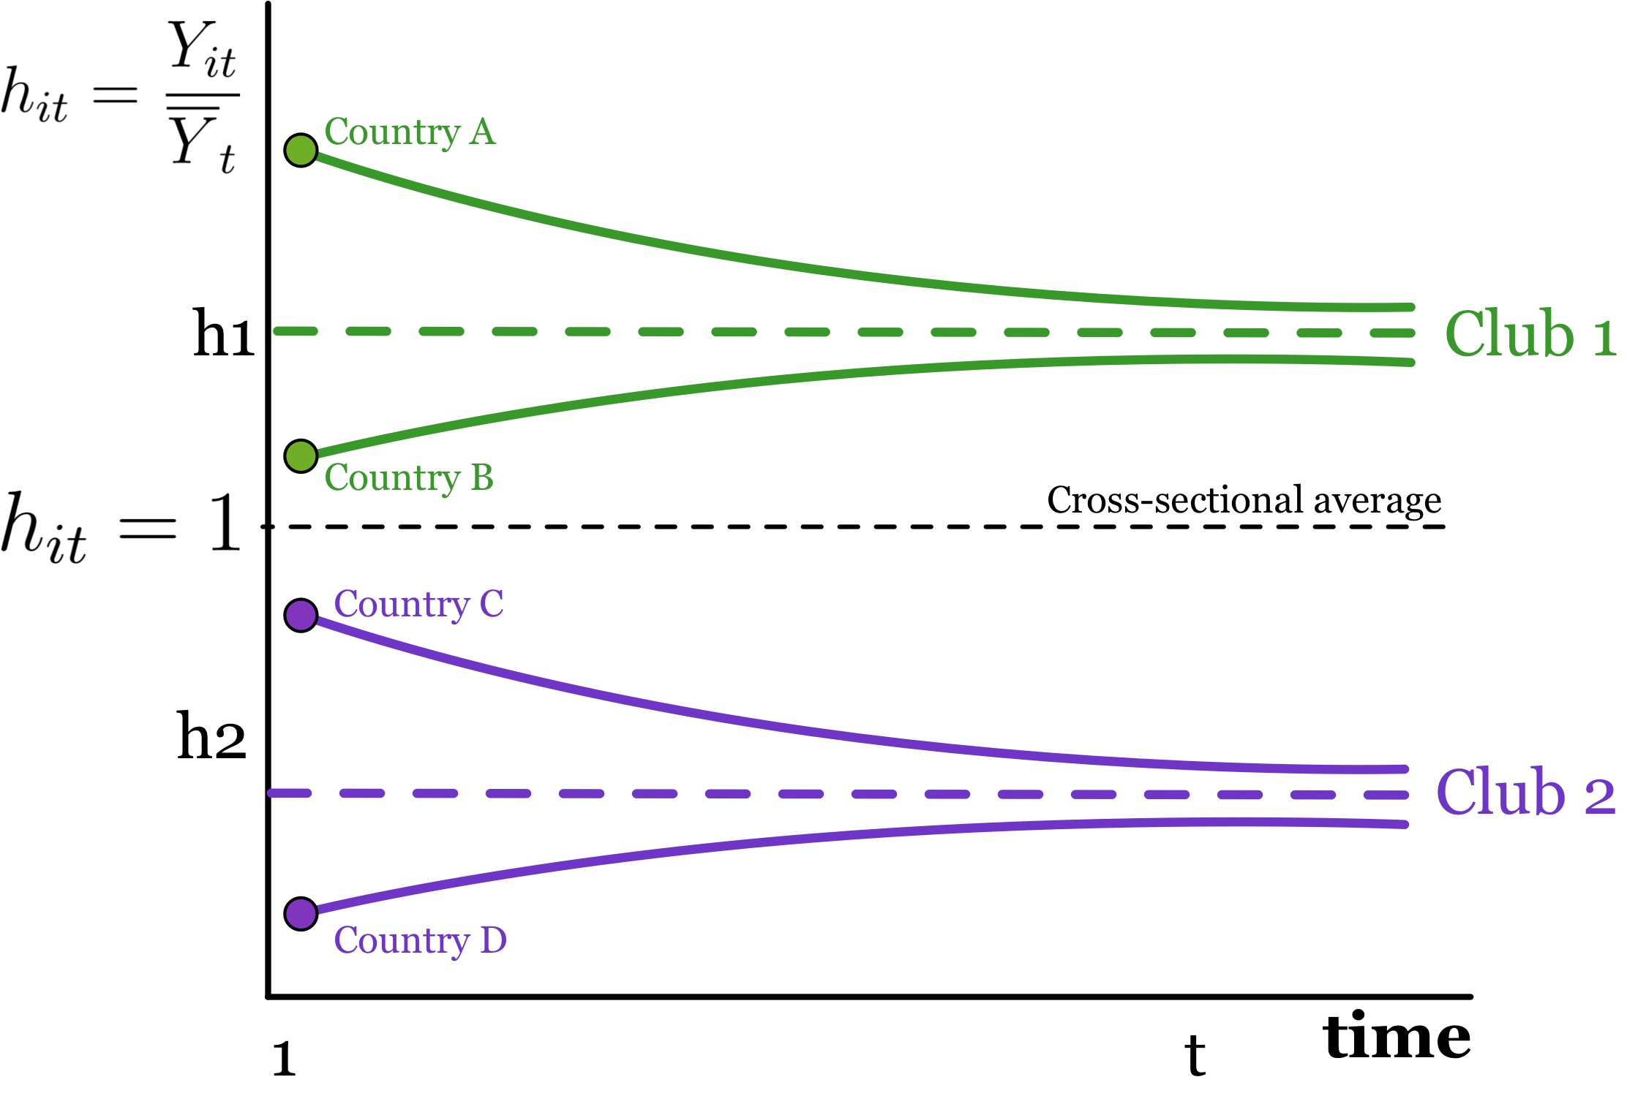

CLUB CONVERGENCE
Identifying groups with similar long-term behavior

Slide 6


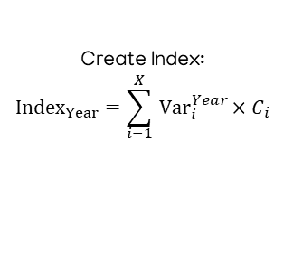
KLUB INDEX
STEP 1
STEP 2
STEP 3
STEP 4
Perform kmeans on entire data to obtain cluster tags.
Use a classification model (XGBoost) to obtain importance coefficients.
Create Index:
$${Index}_{Year}=\sum_{i=1}^{X}{ }{Var}_{i}^{Year}×C_{i}$$
Perform club convergence with the index data.

Slide 7
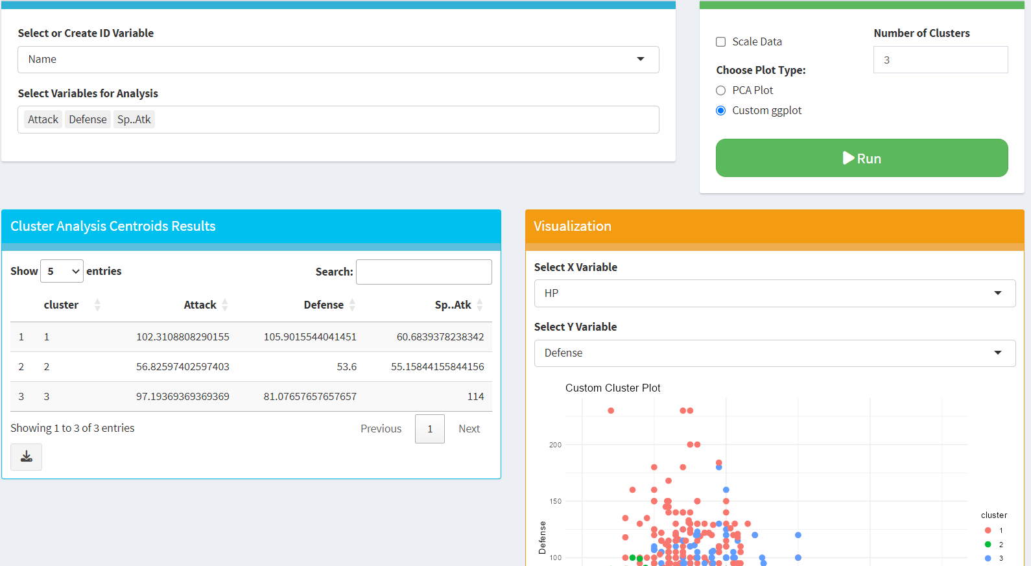

Slide 9
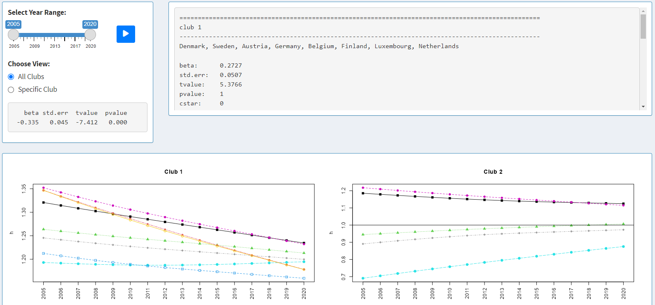

Slide 10
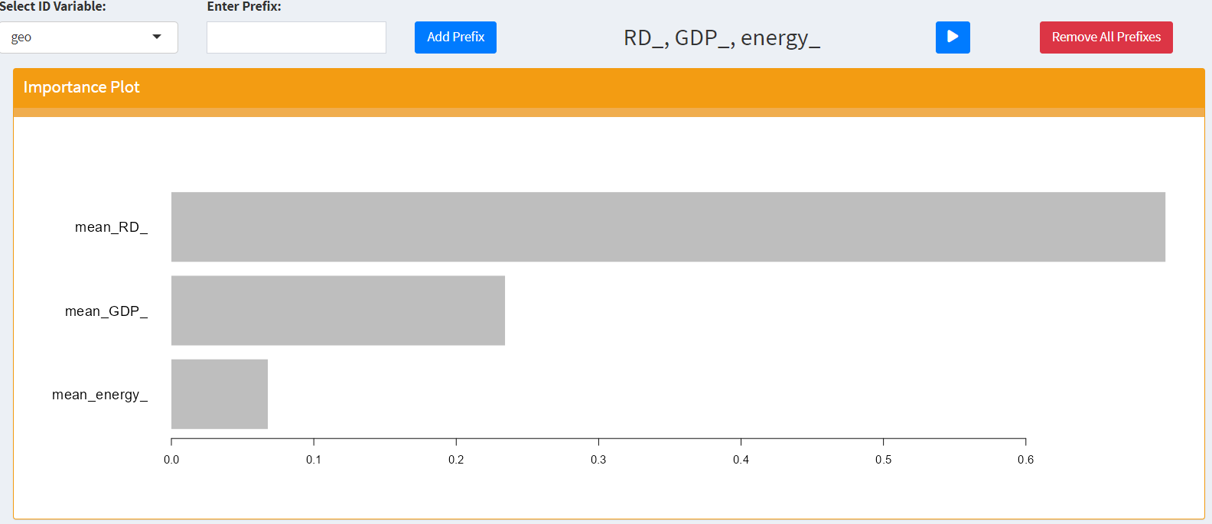

Slide 11
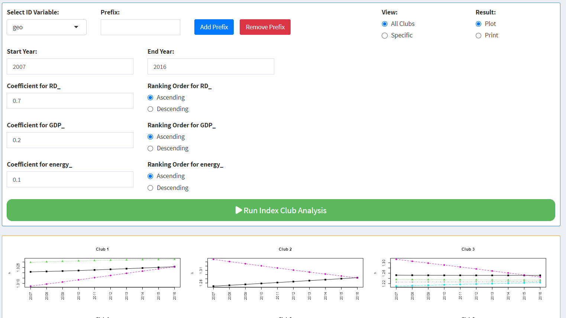

Slide 12
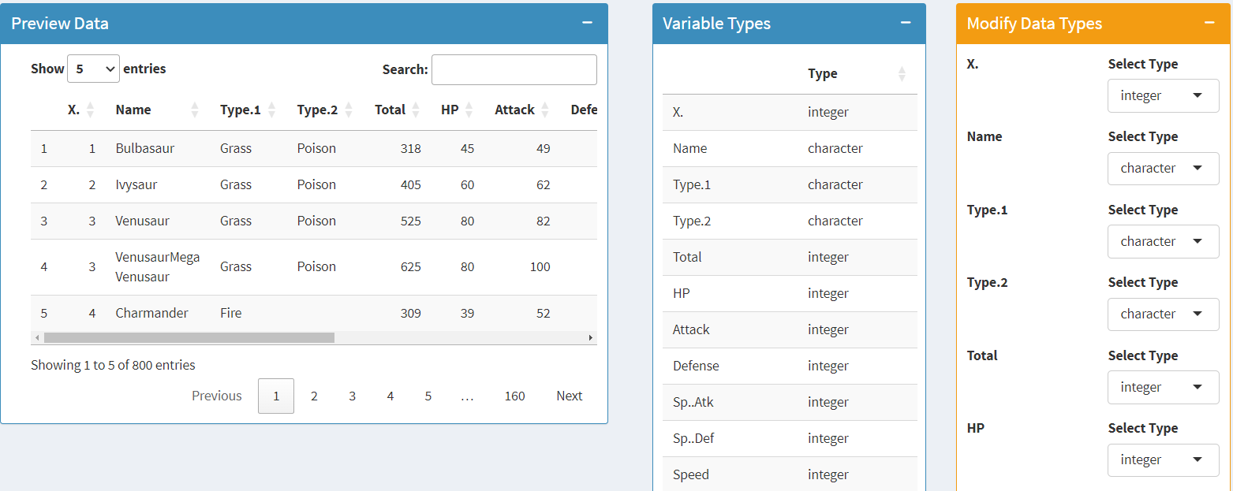

Slide 13
