Slide 1

Analyzing Bitcoin Price Trends and Volatility
Brian Bao, Diondre Wright, Nancy Lam
Department of Information Systems, California State University
CIS 5200-01 Systems Analysis and Design

Slide 2

Introduction
Bitcoin is a highly volatile cryptocurrency
Frequent rapid price changes
Understanding patterns help analyze market behavior
Tableau is used for data visualization

Slide 3
Project Objective
Analyze Bitcoin Price Trends
Measure Market Volatility
Study relationship between volume and prices changes
Data visualization for insights

Slide 4

Dataset Specifications
Historical Bitcoin Data (from Kaggle): btcusd_1-min_data.csv -> bitcoin_price_clean.csv
Rows: ~7.5M, Columns: 6
Data Types: STRING, DOUBLE
URL: https://www.kaggle.com/datasets/mczielinski/bitcoin-historical-data

Slide 5
Hardware Specifications
H/W Specifications:
OS and Architecture: Linux, x86_64
CPU: AMD EPYC 7J13 64-Core Processor
Available CPUs: 6 virtual cores
CPU Speed: 2445.354 MHz / 2.45 GHz
Memory: 31 GiB / 33.3 GB
Storage: ~172 GB available, ~388 GB total
Nodes: 5 nodes (2 Master, 3 Worker [bigdaiwn0, bigdaiwn1, bigdaiwn2])
Hadoop Cluster Version: 3.4.1
SSH Connection: 132.226.148.236

Slide 6
Data Cleaning
Process:
Download dataset as raw .csv file from Kaggle and upload to Linux file systems with scp.
Create BitcoinPrice directory in HDFS to store .csv file.
Move .csv file from Linux file system to HDFS.
Use beeline client and personal database.
Commands:
scp btcusd_1-min_data.csv [your_user]@132.226.148.236:~
hdfs dfs –mkdir BitcoinPrice
hdfs dfs –put btcusd_1-min_data.csv BitcoinPrice
beeline
use your_user;

Slide 7
Data Cleaning (cont.)
Process:
Create table from .csv file.
Convert unixtime column to ISO time column.
Export to HDFS and move to Linux file system.
Download to local system for data visualization.
Commands:
CREATE EXTERNAL TABLE bitcoin_price...
CREATE TABLE bitcoin_price_clean AS SELECT from_unixtime(ts) as ts... FROM bitcoin_price;
INSERT OVERWRITE DIRECTORY '/user/your_user/BitcoinPriceClean'…
scp your_user@IP...

Slide 8
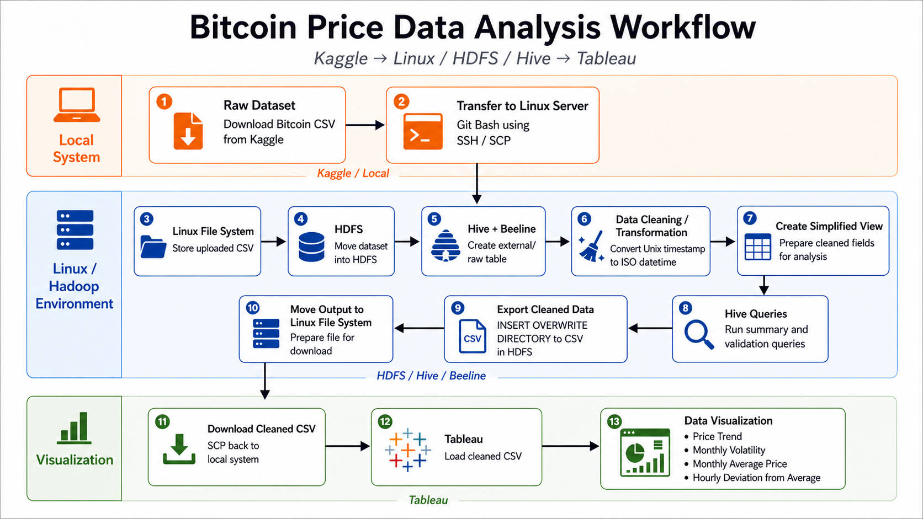
Data Analysis Flowchart

Slide 9
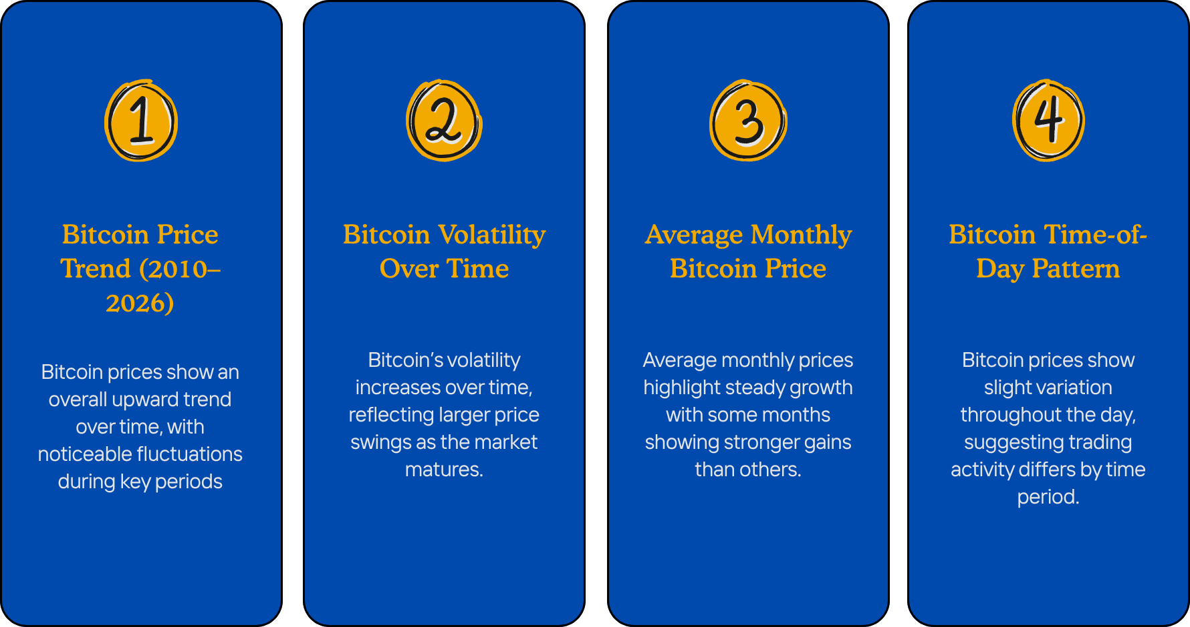
Analysis Overview

Slide 10
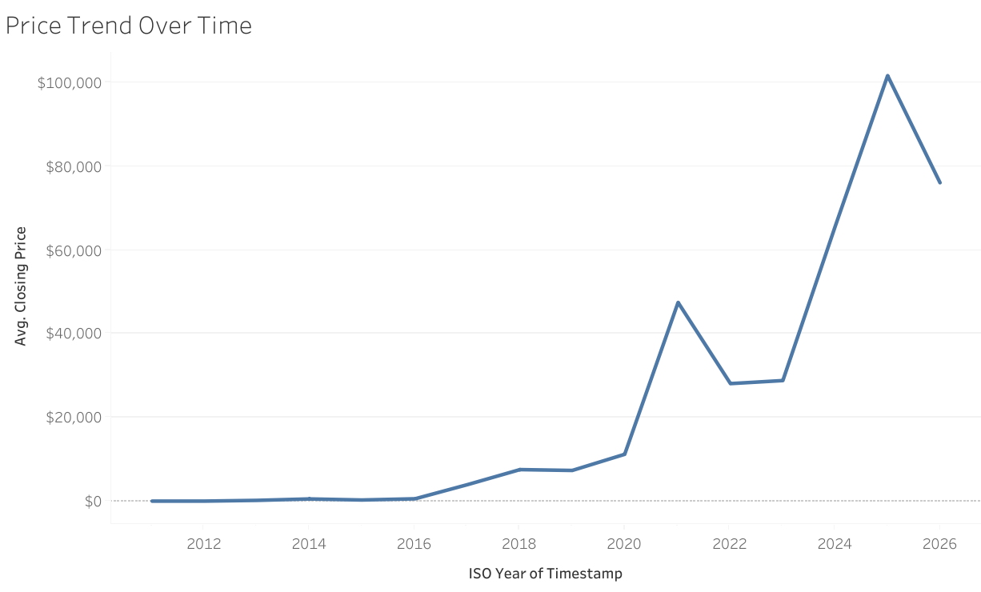
Bitcoin Price Growth
This chart illustrates Bitcoin's strong growth from 2011 to 2025, highlighting a significant surge post-2020, confirming rising market adoption and investor interest.

Slide 11
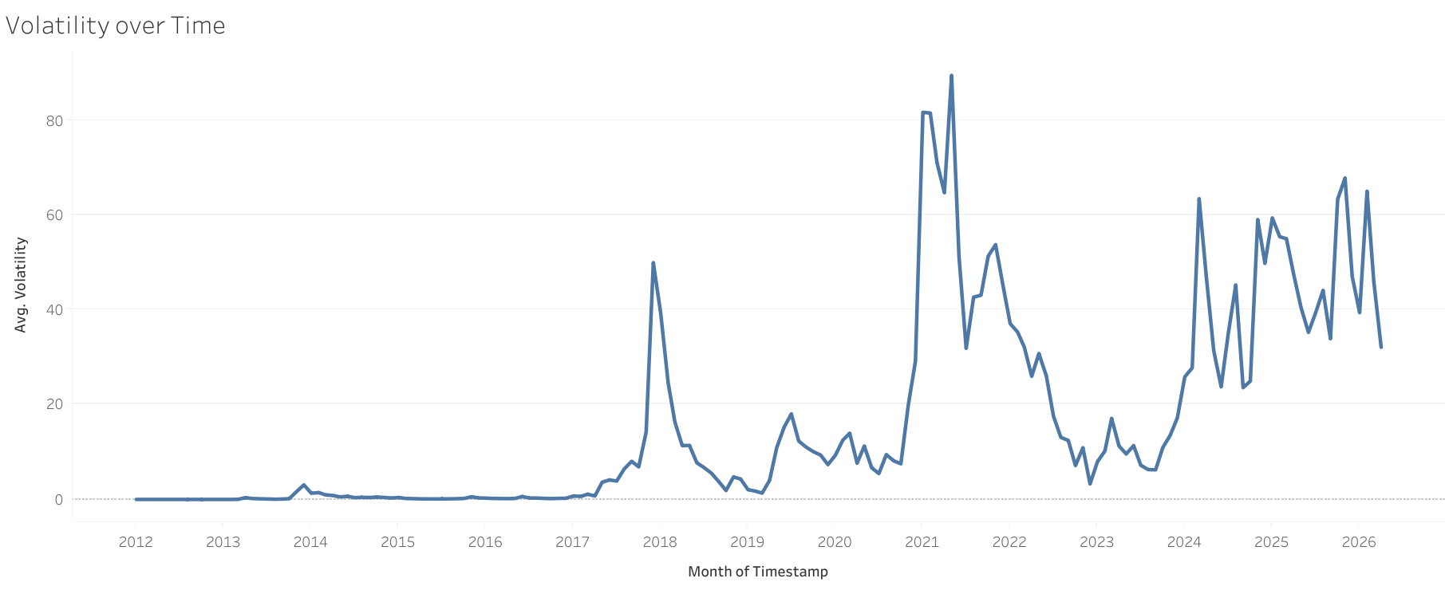
Volatility
Volatility increases over time
Spikes align with major price changes
Reflects higher market risk

Slide 12
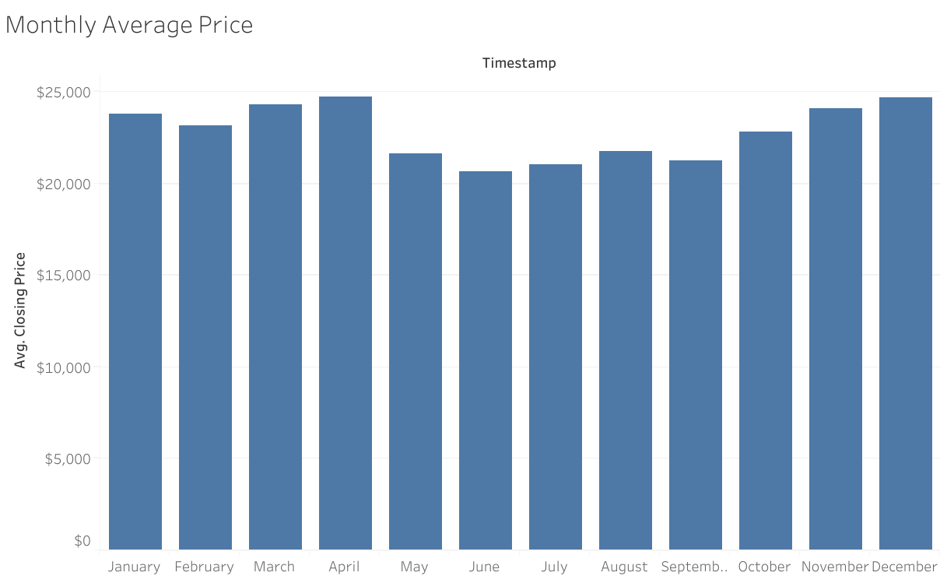
Monthly Price
Monthly prices show moderate variation without a fixed pattern
No consistent seasonal behavior is evident
Price movement is primarily driven by long-term trends

Slide 13
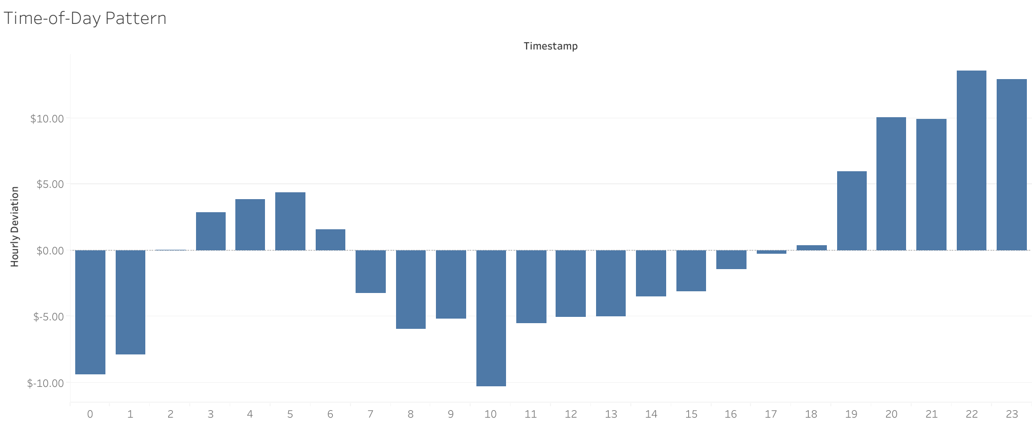
Time of Day
Price varies by time of day
Certain hours show higher activity
Influenced by global trading

Slide 14

Conclusion
Bitcoin market is unstable but active
Volatility increases during major price changes
Trading activity is influenced by price
Visualization helps us understand the patterns

Slide 15
Resources
GitHub Repository:
https://github.com/bbao3-csula/CIS-5200-Bitcoin-Price

Slide 16

Questions?

