Slide 1
Version control with git and GitHub
Kim Dill-McFarland
R-ladies Seattle · Jan 14, 2021
kadm@uw.edu @kdillmcfarland Slides https://tinyurl.com/yxz9llyu

Slide 2
An introduction to git tools to help you collaborate across space and time
Why version control?
Collaborate with yourself
Collaborate with others
Share with the world!
kadm@uw.edu @kdillmcfarland Slides https://tinyurl.com/yxz9llyu

Slide 3
Version control
Date files
Short and long time scale issues
Version numbers (v1.0.0)
Distributed (git)
kadm@uw.edu @kdillmcfarland Slides https://tinyurl.com/yxz9llyu

Slide 4
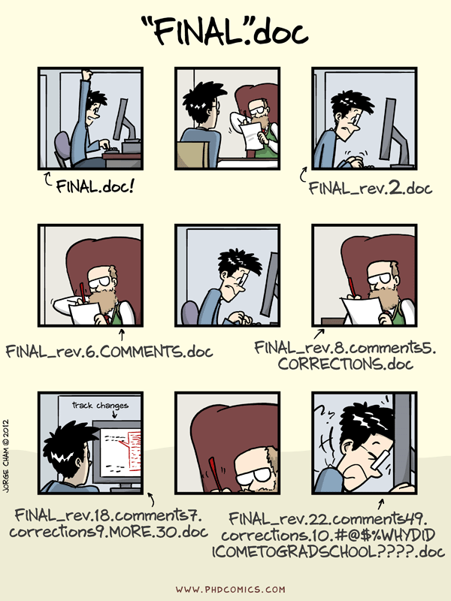
kadm@uw.edu @kdillmcfarland Slides https://tinyurl.com/yxz9llyu

Slide 5
Distributed version control
Time-stamp
Comment
Author
kadm@uw.edu @kdillmcfarland Slides https://tinyurl.com/yxz9llyu

Slide 6
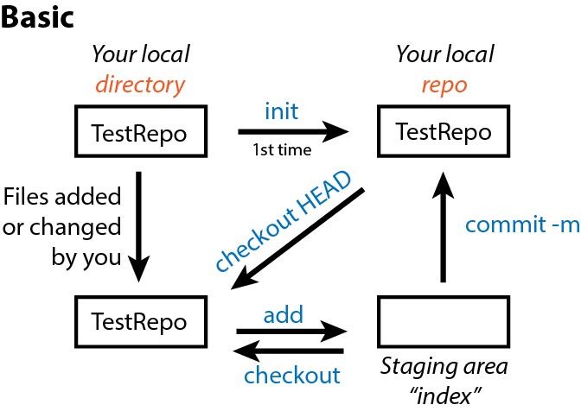
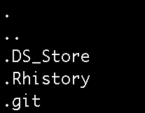
Collaborate with yourself in git
git command line
key terms
kadm@uw.edu @kdillmcfarland Slides https://tinyurl.com/yxz9llyu

Slide 7
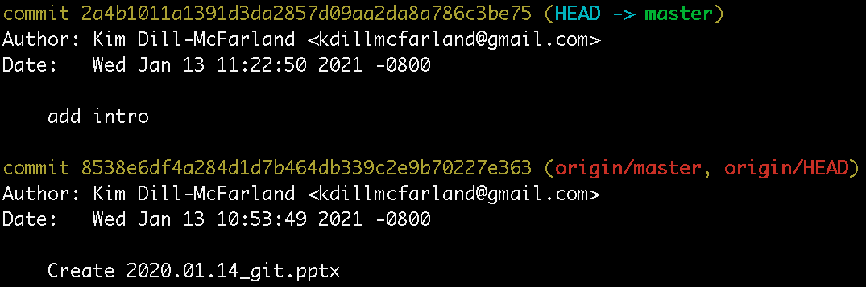
Collaborate over time
kadm@uw.edu @kdillmcfarland Slides https://tinyurl.com/yxz9llyu

Slide 8
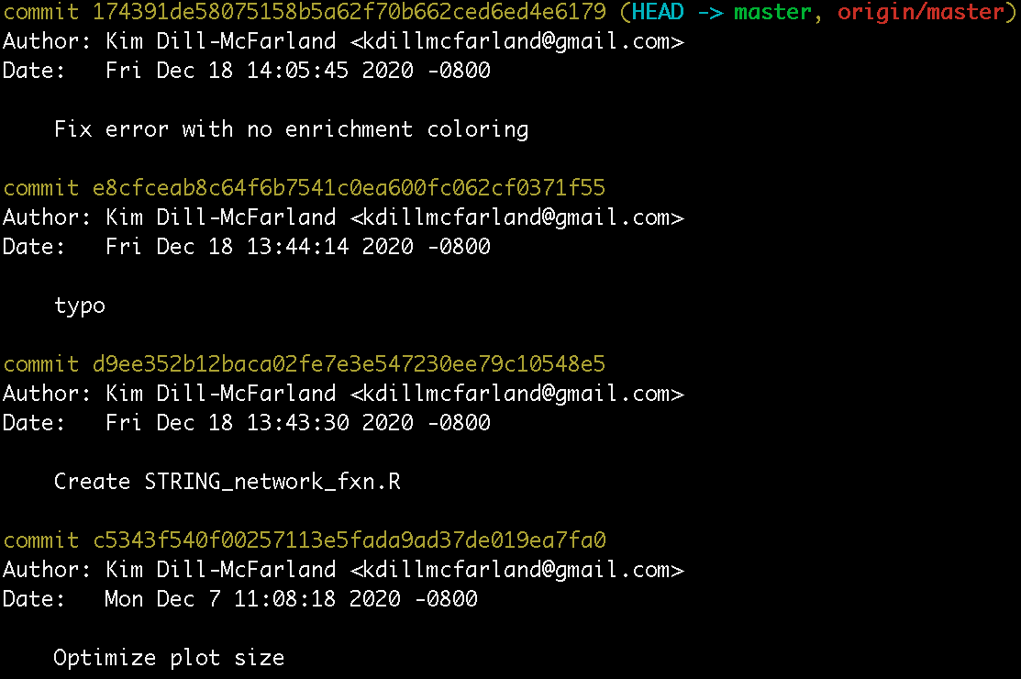
Collaborate over time
kadm@uw.edu @kdillmcfarland Slides https://tinyurl.com/yxz9llyu

Slide 9
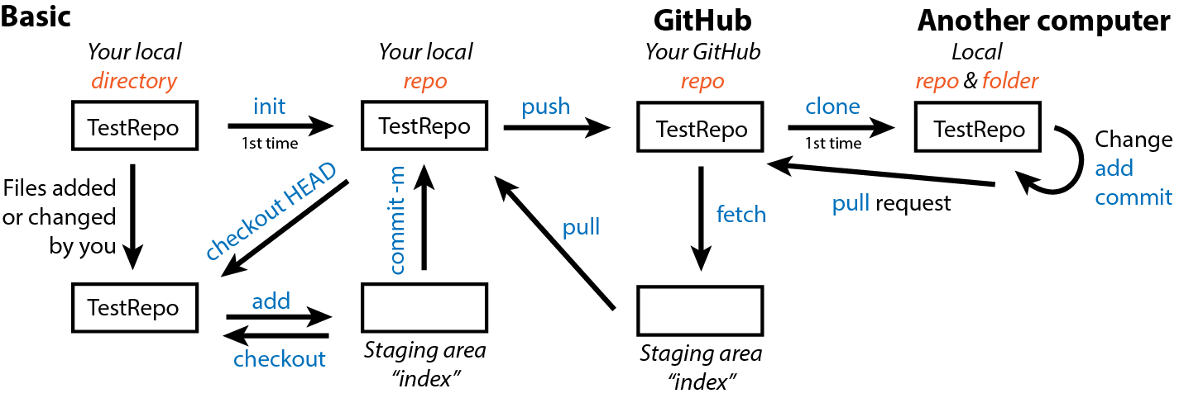
Collaborate over space
git command line
key terms
kadm@uw.edu @kdillmcfarland Slides https://tinyurl.com/yxz9llyu

Slide 10
Collaborate with others
git command line
key terms
Someone else!
kadm@uw.edu @kdillmcfarland Slides https://tinyurl.com/yxz9llyu

Slide 11
Collaborate with others
https://github.com/EDUCE-UBC/workshops/pulls
Closed: Merge introduction to R learnr tutorial
kadm@uw.edu @kdillmcfarland Slides https://tinyurl.com/yxz9llyu

Slide 12
kadm@uw.edu @kdillmcfarland Slides https://tinyurl.com/yxz9llyu

Slide 13
kadm@uw.edu @kdillmcfarland Slides https://tinyurl.com/yxz9llyu

