Slide 1

Finding our next home
Brian B.

Slide 2
The Business Problem
We currently love our community but hate our commute, as such
This project will identify several neighborhoods that have the same distribution of amenities and are closer to our respective workplaces.
No one likes a long commute and we have decided that we no longer need to spend hours in the car to support our lifestyle.
With the power of Foursquare, Pandas and Folium I will create a set of concise images that will guide our apartment hunt!

Slide 3
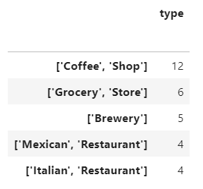
Data
Fist I found the most frequent venues of our current neighborhood from Foursquare
This is the output of grouped and sorted venues

Slide 4
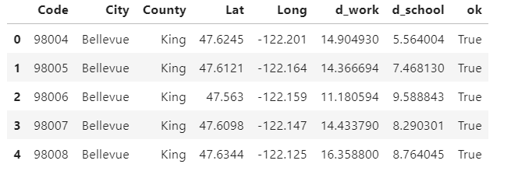
Data
Second, I will need to find similar neighborhoods and the Bing.com/maps api
I started with a list of 134 neighborhoods within one hour of drive time of both school and home

Slide 5
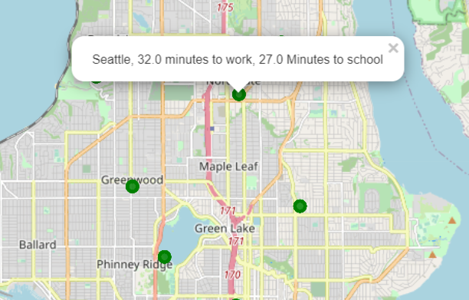
Data
Lastly, I will display the data in a folium map
Key information will be available as a popup summary
Here I highlight the drive times for both my partner and I.

Slide 6
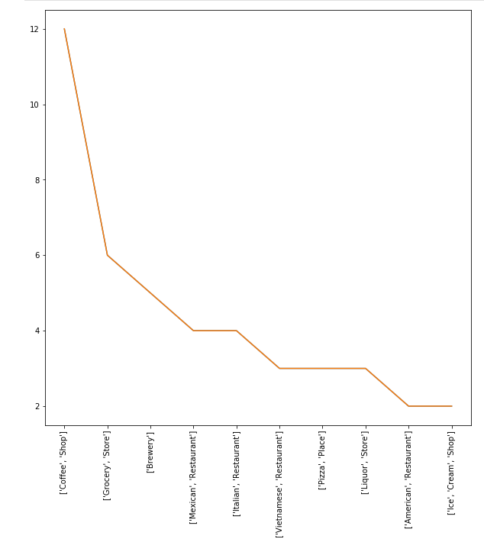
Methodology
After processing we determined that we don’t need to have 12 coffee shops in our neighborhood (for example).
I abandoned the r^2 test and selected only close zip codes that have at least one of our top categories

Slide 7
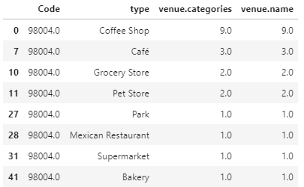
Methodology
By looking for only neighborhoods that contained at least one of each preferred venues we limited the choices to 25 of 134 possibilities.

Slide 8
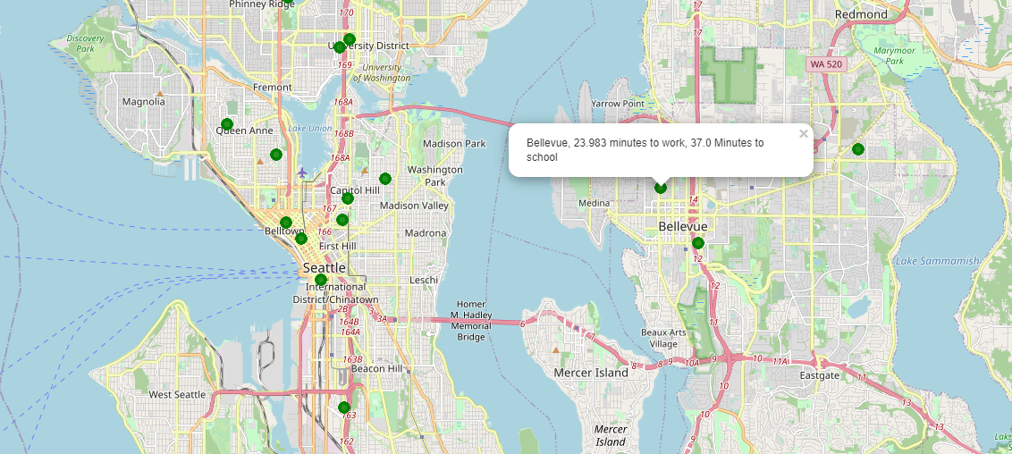
Results : Bellevue

