Slide 1

Birmingham : Part-by-part overview Bram Van Cauwenberghe 26.03.2021
Notes:
(photo is of a tensile test at Industeel, Le Creusot, France)
Good afternoon and good morning everyone and welcome to the Q1 results presentation.
Today I am joined by…

Slide 2
B’ham orderbook – UWBs die cut
Customer | T-Reference | Steel grade | Thickness | Coil width (ccalc) | Parts/stroke | Side evacuation
Tallent Automotive Limited | T-GES6003BLK-Z | BH260+Z | 1,5 | 1105 | 2 | YES (LEFT)
JAGUAR LAND ROVER LIMITED | T-JLR6120V2BLK-Z | BH220+Z100 MBO | 0,8 | 1774 | 1 | NO
JAGUAR LAND ROVER LIMITED | T-JLR6253V2BLK-Z | DP450+Z100 | 1,6 | 1710 | 1 | NO
JAGUAR LAND ROVER LIMITED | T-JLR6266V!BLK-Z | BH180+Z100 | 1 | 967 | 1 | NO
Liberty Pressing Solutions (Coventry) | T-LIB6001BLK-Z | DC06 | 1,2 | 1480 | 1 | NO
SNOP | T-NIS6114V1BLK-Z | XE360B | 1 | 904 | 1 | NO
SNOP | T-NIS6115V1BLK-Z | XE360B | 1 | 904 | 1 | NO
SNOP | T-NIS6118/9V1BLK-Z | XE360B | 1 | 1029 | 1 | NO
SNOP | T-NIS6120/1V1BLK-Z | XE360B | 1,2 | 947 | 1 | NO
SNOP | T-NIS6122/3V1BLK-Z | XE360B | 1,6 | 995 | 2 | YES (RIGHT)
SNOP | T-NIS6124/5V1BLK-Z | XE360B | 1,6 | 1311 | 2 | YES (RIGHT)
New Nissan Qashqai business will represent +/- 70% of UWB die cut orderbook in 2022

Slide 3
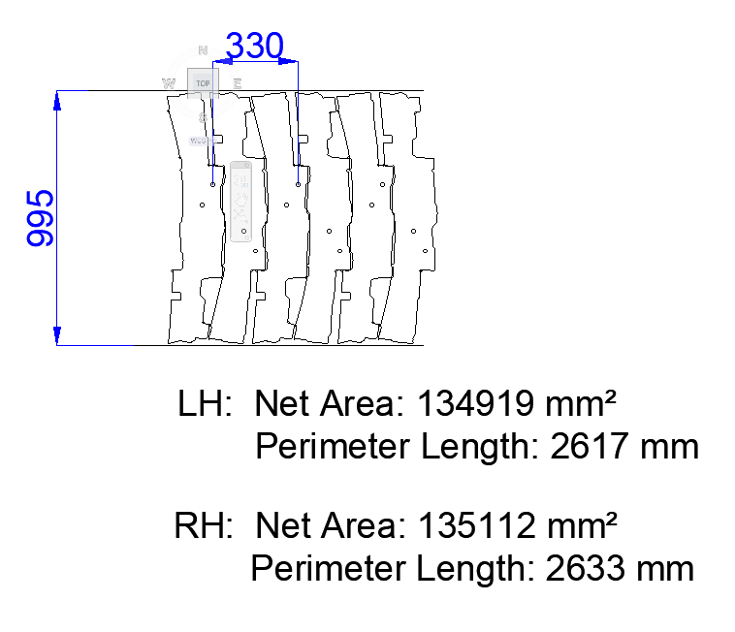
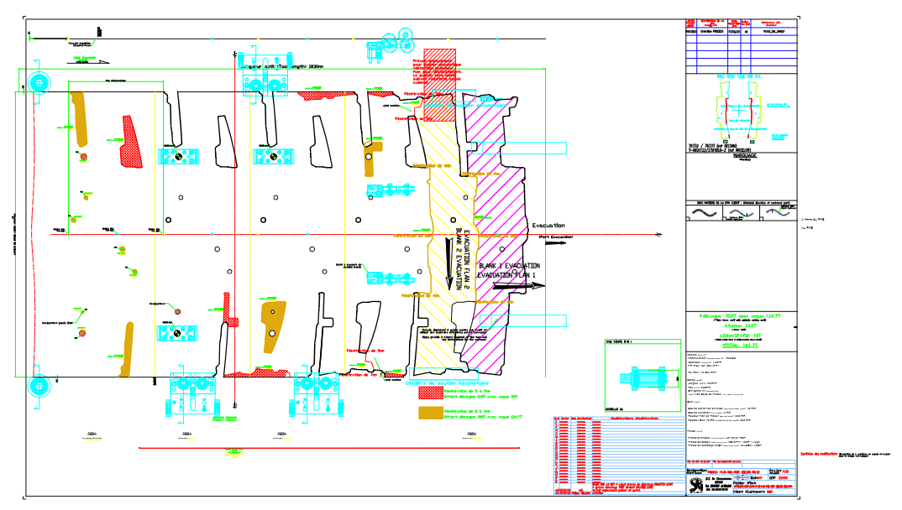

B’ham orderbook – UWBs die cut – new Nissan Qashqai UWBs
T-NIS6122/23
→ Evacuation to the right side : LIEGE Liège considered as contingency press.

Slide 4
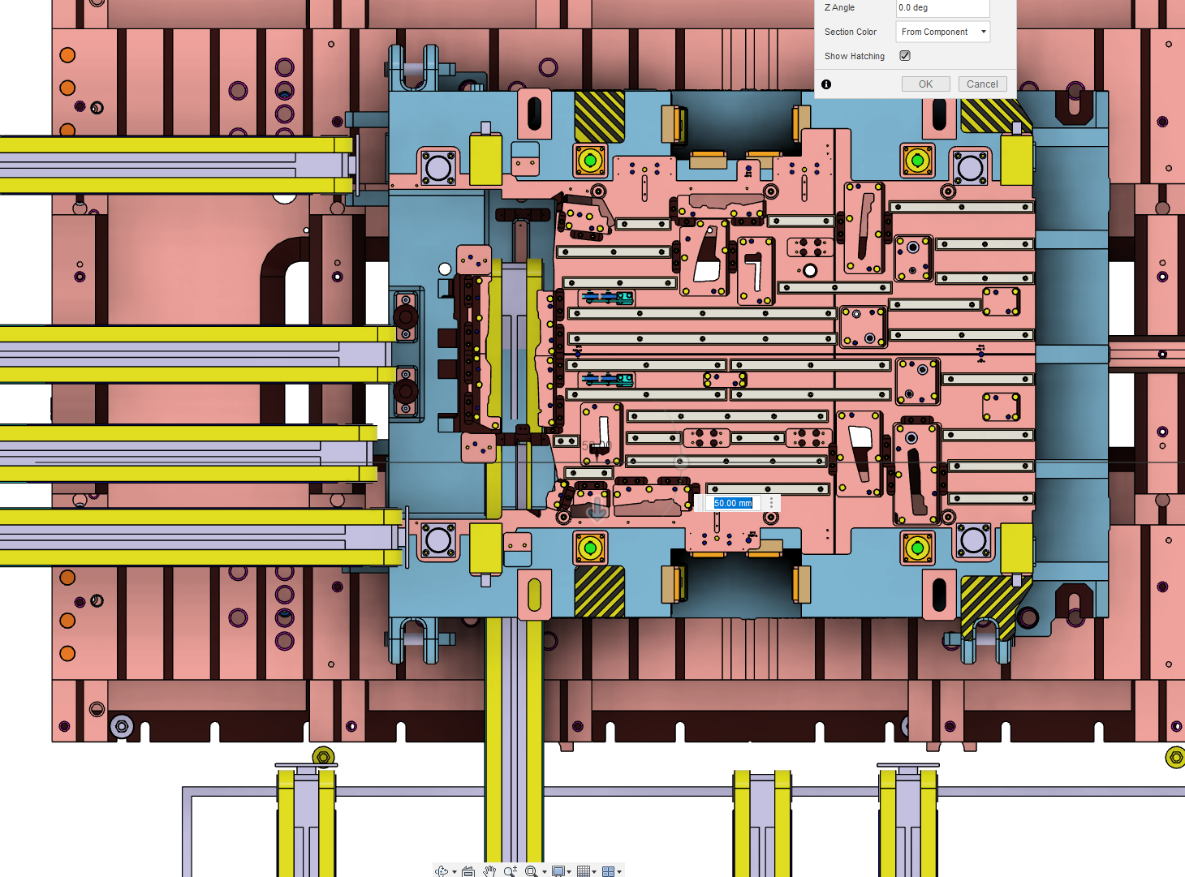
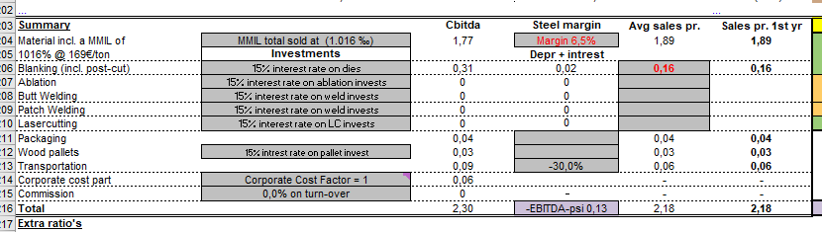
Option 1: extract 2nd blank on the left side (feseability to be verified)
Milling of the casting: 15k€
« taquage » on the side stacker : 5k€
Cadence 30 strokes/min

Slide 5
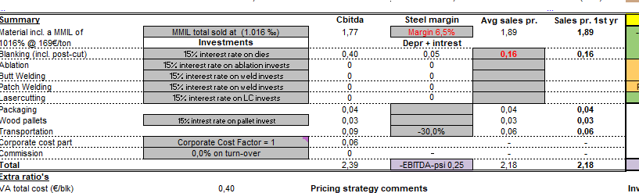
Option 2: extract 2nd blank on the rigth side
Invest for the stacking area: 70k€
Die adaptation : 5k€
Cadence 25 strokes/min
Die change over 45 min

